Slide 1
Introduction to Realm
Silviu Odobescu
March 29, 2016

Slide 2
What is Realm?
Realm is a Mobile Database aimed to be a replacement for Core Data or SQLite
It’s not an ORM, It’s not based on SQLite
Full database (columns/rows/queries), not a Key-Value store
In development since 2011, in production since 2012, public since 2014.
Available for Objective-C, Java, Swift & React Native

Slide 3
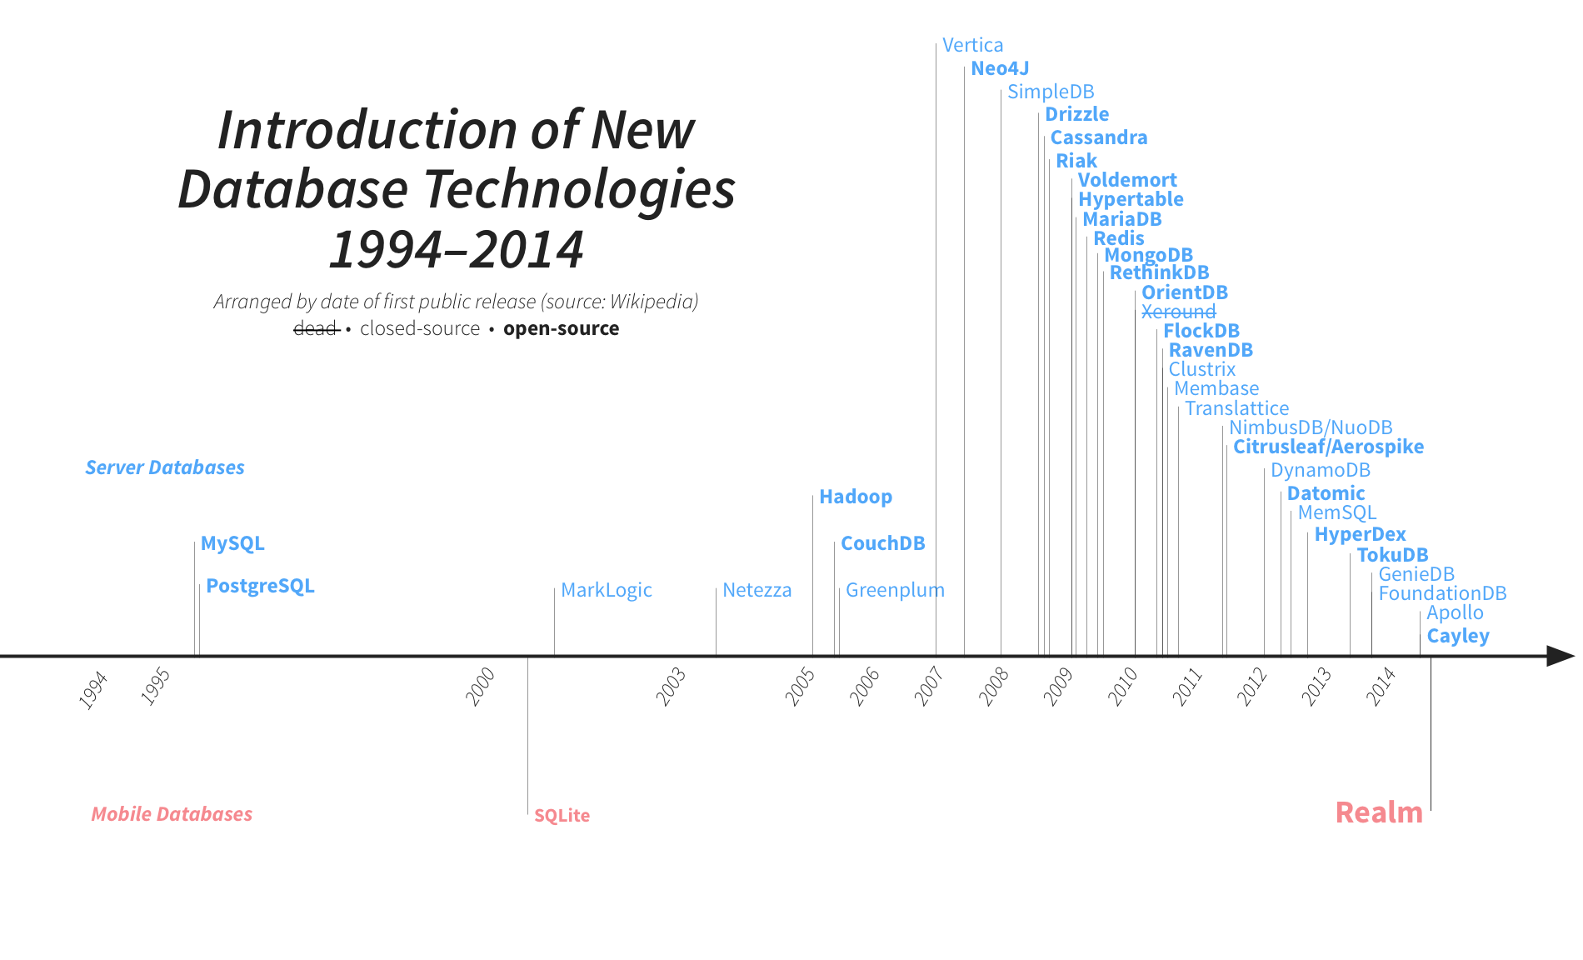
Mobile DB timeline

Slide 4
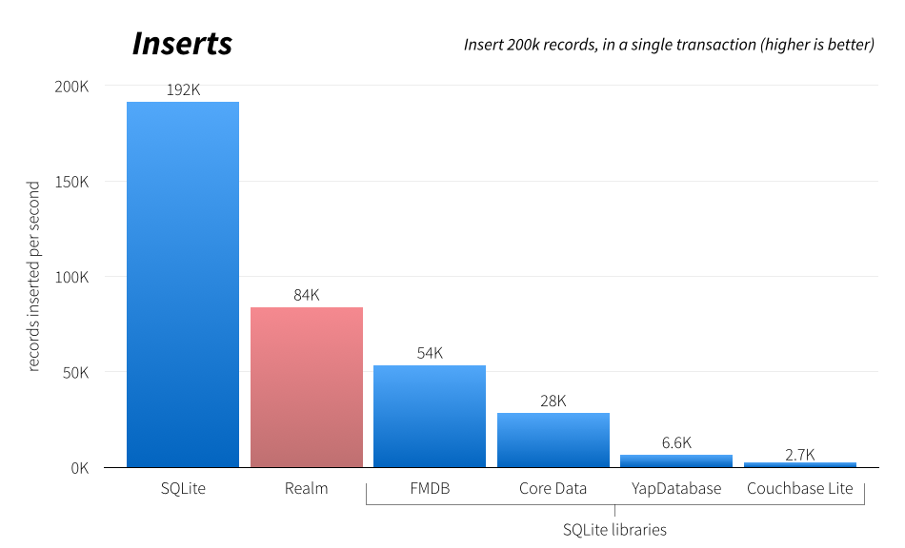
Benchmarks

Slide 5
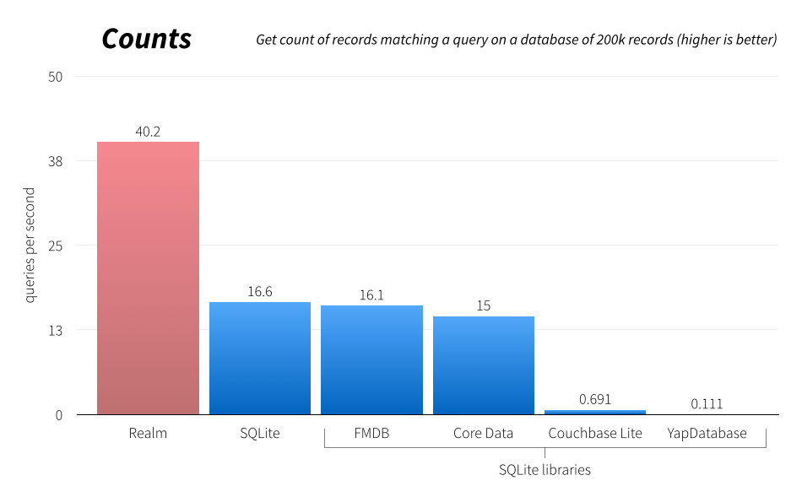
Benchmarks

Slide 6
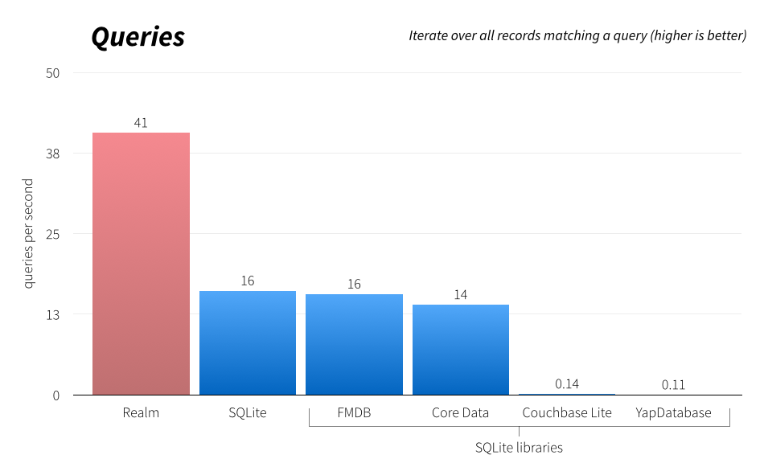
Benchmarks

Slide 7

Who uses Realm?

Slide 8
General info
Current Realm version: 0.98.6
Prerequisites (Realm – Objective C):
iOS 7 or later, OS X 10.9 or later & WatchKit
Xcode 6.4 or later
Objective-C, Swift 1.2 & Swift 2.x
Prerequisites (Realm – Swift):
iOS 8 and later, OS X 10.9 or later & WatchKit
Xcode 7 or later
Swift 2.x

Slide 9
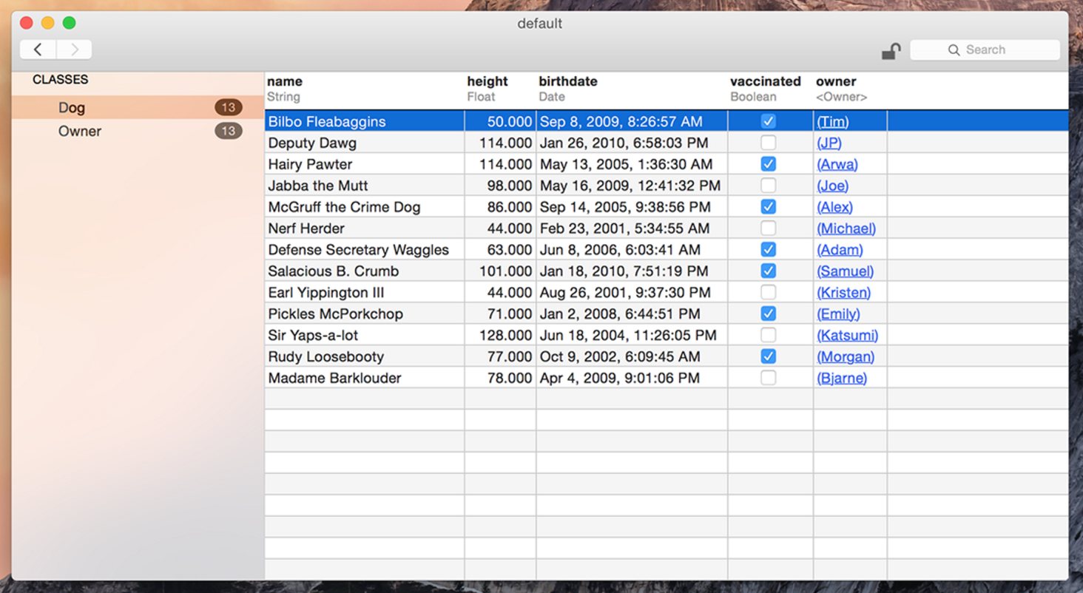
Realm Browser

Slide 10
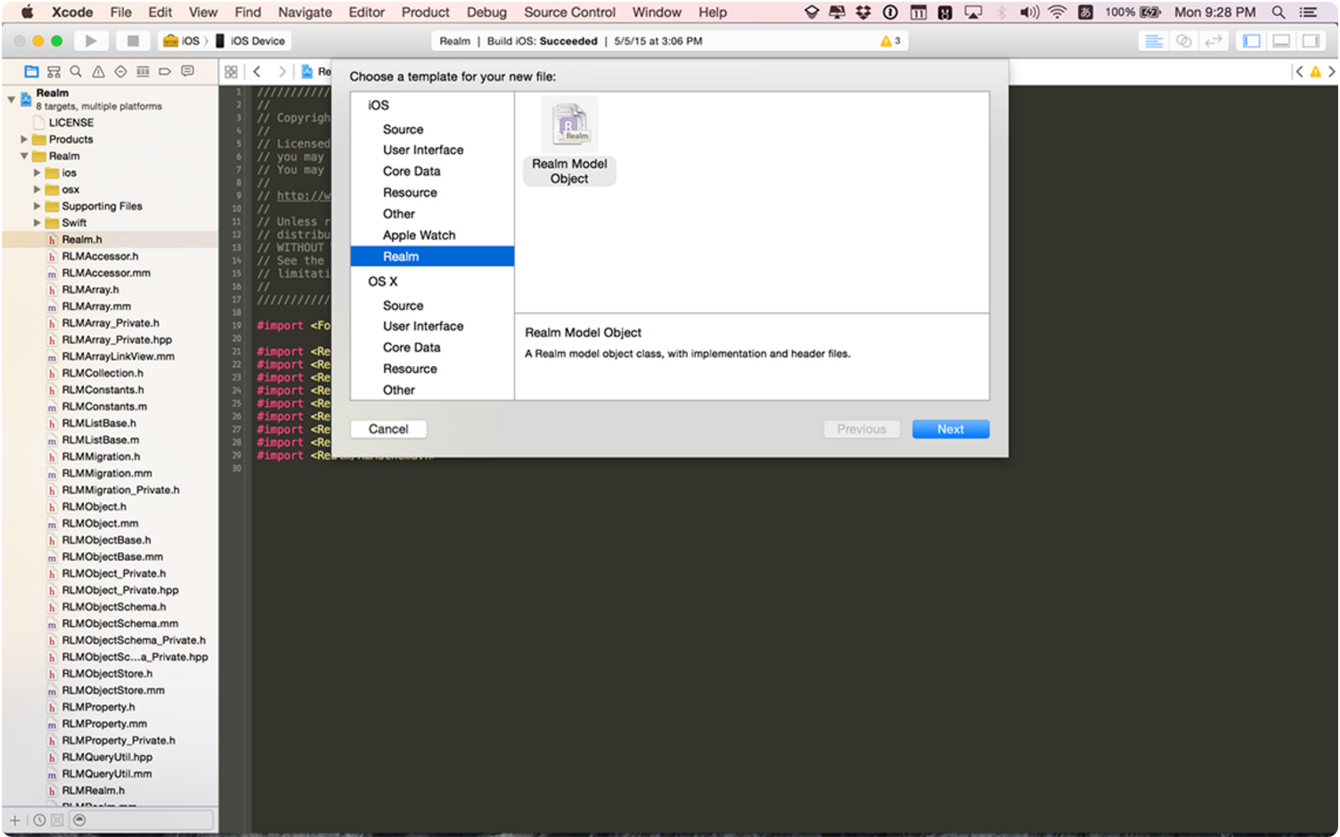
Realm Xcode Plugin

Slide 11
Models
Object
bool
Int8, Int16, Int32, Int64, Double, Float
String
NSDate (truncated to the second)
NSData
Object and List<Object> used to model relationships
List<Object> has a similar interface to mutable Array
Relationships are unidirectional
Inverse computed by using Object().linkingObjects(_:forProperty:)

Slide 12
Models
String, NSDate, and NSData properties - the standard Swift syntax
Int, Float, Double, Bool properties – RealmOptional<T>
Realm properties need dynamic var
Exception: List and RealmOptional – these need let

Slide 13
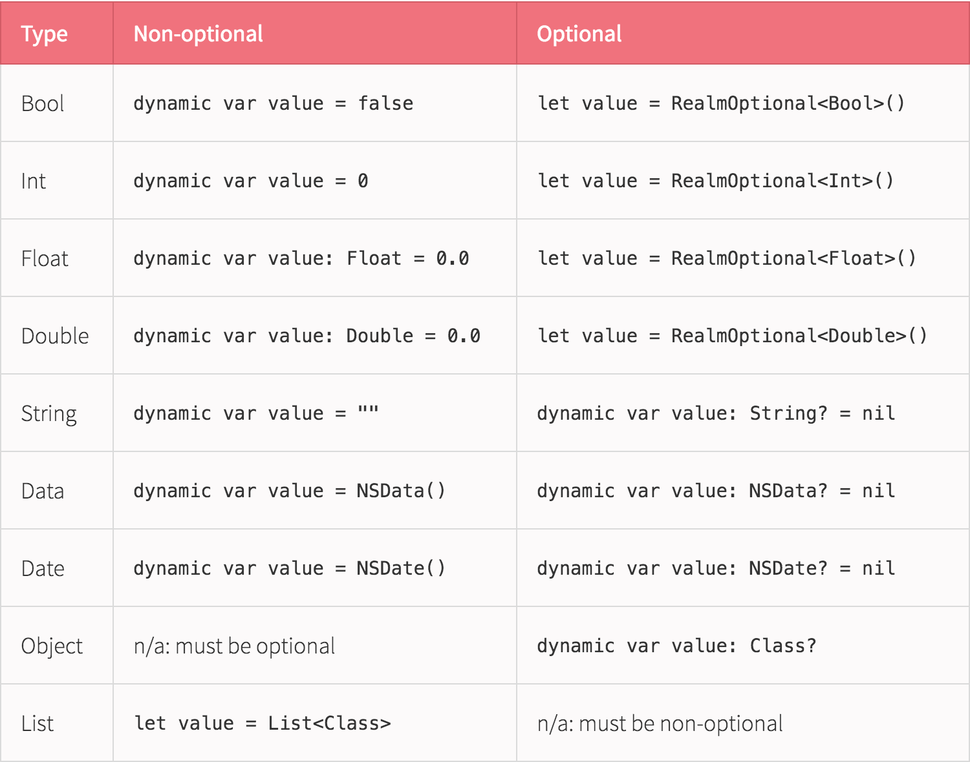
Model – Optional properties

Slide 14
Model inheritance
What is possible:
Class methods, instance methods and properties on parent classes are inherited in their child classes
Methods and functions that take parent classes as arguments can operate on subclasses
What is NOT possible:
Casting between polymorphic classes (ie, subclass to subclass, subclass to parent, parent to subclass, etc.)
Querying on multiple classes simultaneously
Multi-class containers (List and Results)

Slide 15
Limitations
Realm is currently in beta
Class names and property names must be between 0 and 63 bytes in length
NSData cannot hold data exceeding 16MB in size
NSDate can only persist date info down to one second
Any single Realm file cannot be larger than the amount of memory the app would be allowed to map in iOS (thus depends per device)
Realm Object Setters & Getters cannot be overridden
Realm doesn’t have auto-incrementing properties(ex: for keys)

Slide 16
Writes
All changes must be done within a write transaction
Realm objects act as regular objects until they are persisted
Writes block each other and will block the thread if multiple writes are in progress -> solution: offloading writes to a separate thread
Reads are not blocked while a write transaction is open

Slide 17
Queries
Returns a Results object which has an interface similar to Array
All queries (and property access) are lazy
Results are not copies of the data
Modifying the results within a write operation would change data on disk
Results can be kept up to date with the changes made in Realm (with query execution performed on a background thread when possible)
Filtering is done with the help of NSPredicate
Sorting can be done based on a single or multiple properties

Slide 18
Realm
A default realm is available (which maps to default.realm file on the disk)
Customization is available via Realm.Configuration
Allows to have multiple realm files on disk
Switching between different realm files on disk
Allows to have in-memory realms
Can restrict which classes are stored into a specific Realm (two teams working with Realm on different components)

Slide 19
Threading
Within individual threads everything works as regular objects
Reads can happen any time (even if writes are happening simultaneously on other threads)
Cannot have multiple threads sharing the same instances of Realm objects (each should have its own instances)
On any thread with a runloop objects will automatically update
Background threads can call Realm.refresh() to see changes
Unpersisted instances of Objects are safe to pass across threads

Slide 20
Threading
Persisted instances can only be used on the thread on which they were created; some properties and methods can be accessed from any thread:
Realm: all properties, class methods and initializers
Object: invalidated, objectSchema, realm, class methods, initializers
Results: objectClassName and realm
List: invalidated, objectClassName, realm
To access the same Realm file from different threads, a new Realm must be initialized with the same configuration for each thread

Slide 21
Notifications
It is possible to be notified when a Realm, Results or List is updated via addNotificationBlock
A notification token is returned
As long as the token is retained the notifications will stay active

Slide 22
Demo

Slide 23
Vin sarbatorile, vin sarbatorile, vin … ROM si TUICA

