Slide 1
Analiza și Dimensionarea unui Etaj de Alimentare
Nume: Șișca Silviu-Claudiu
An IV, gr. 2142

Slide 2
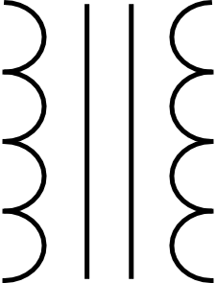
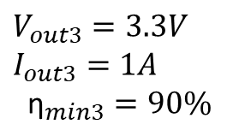
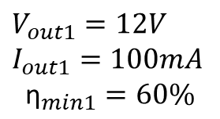
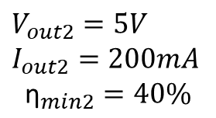


$I_{in}$=?
Stabilizator Liniar
230V
AC
$V_{out1}=12V$ $I_{out1}=100mA$
$${\text{η}}_{min1}=60\%$$
$V_{in}$=?
Stabilizator Liniar Integrat
$V_{out2}=5V$ $I_{out2}=200mA$
$${\text{η}}_{min2}=40\%$$
Buck Converter
$V_{out3}=3.3V$ $I_{out3}=1A$
$${\text{η}}_{min3}=90\%$$

Slide 3

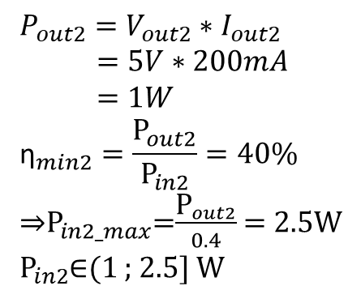
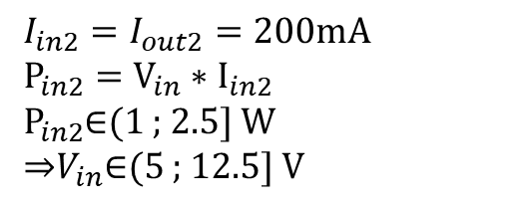
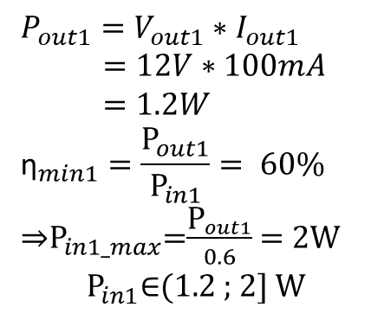
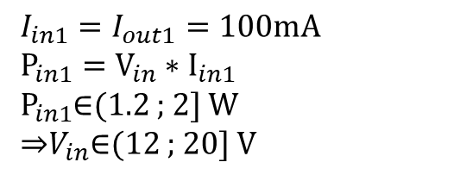
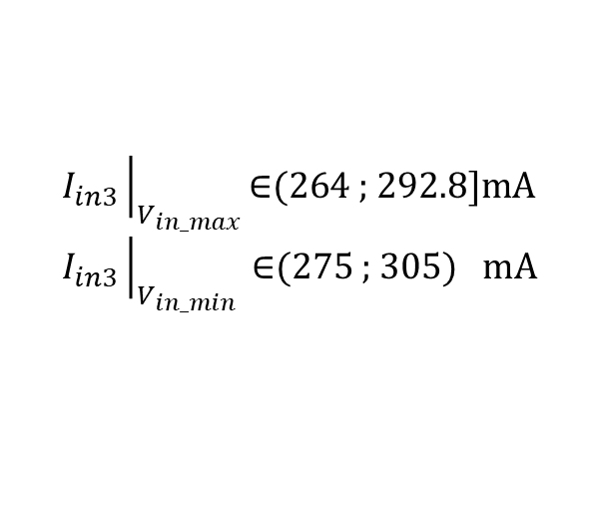
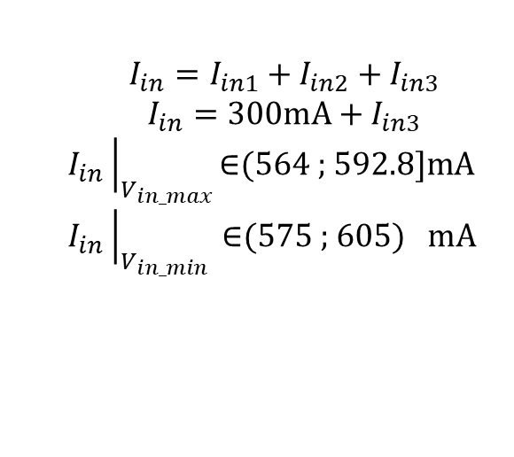
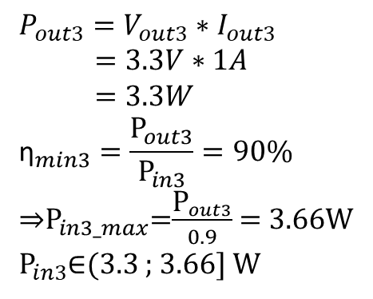
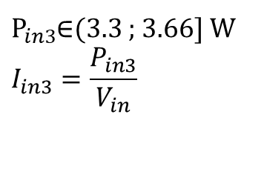
$$P_{out1}=V_{out1}∗I_{out1}$$
$=12V∗100mA$
$=1.2W$
$${\text{η}}_{min1}=\frac{{\text{P}}_{out1}}{{\text{P}}_{in1}}= 60\%$$
⇒${\text{P}}_{in1_max}$=$\frac{{\text{P}}_{out1}}{0.6}$ = 2W
$${\text{P}}_{in1}\text{∈}\text{(}\text{1.2 ; 2] }\text{W}$$
$$P_{out2}=V_{out2}∗I_{out2}$$
$=5V∗200mA$
$=1W$
$${\text{η}}_{min2}=\frac{{\text{P}}_{out2}}{{\text{P}}_{in2}}=40\%$$
⇒${\text{P}}_{in2_max}$=$\frac{{\text{P}}_{out2}}{0.4}$ = 2.5W
${\text{P}}_{in2}$∈(1 ; 2.5] W
$$P_{out3}=V_{out3}∗I_{out3}$$
$=3.3V∗1A$
$=3.3W$
$${\text{η}}_{min3}=\frac{{\text{P}}_{out3}}{{\text{P}}_{in3}}=90\%$$
⇒${\text{P}}_{in3_max}$=$\frac{{\text{P}}_{out3}}{0.9}$ = 3.66W
${\text{P}}_{in3}$∈(3.3 ; 3.66] W
${\text{I}}_{in_stabilizator_liniar}=$ ${\text{I}}_{out_stabilizator_liniar}$
$$I_{in1}=I_{out1}=100mA$$
$${\text{P}}_{in1}={\text{V}}_{in}∗{\text{I}}_{in1}$$
${\text{P}}_{in1}$∈(1.2 ; 2] W
⇒$V_{in}$∈(12 ; 20] V
⇒$V_{in}$∈(12 ; 12.5] V
$$I_{in}=I_{in1}+I_{in2}+I_{in3}$$
$$I_{in}=300mA+I_{in3}$$
$$I_{in}{\left.​\right|}_{V_{in_max}}\text{∈}\text{(}\text{5}\text{64 ; }\text{592.8]}\text{mA}$$
$$I_{in}{\left.​\right|}_{V_{in_min}} \text{∈}\text{(}\text{575}\text{ ; }\text{605) }\text{mA}$$
${\text{P}}_{in3}$∈(3.3 ; 3.66] W
$$I_{in3}=\frac{P_{in3}}{V_{in}}$$
$$I_{in2}=I_{out2}=200mA$$
$${\text{P}}_{in2}={\text{V}}_{in}∗{\text{I}}_{in2}$$
${\text{P}}_{in2}$∈(1 ; 2.5] W
⇒$V_{in}$∈(5 ; 12.5] V
$$I_{in3}{\left.​\right|}_{V_{in_max}}\text{∈}\text{(264 ; }\text{292.8]}\text{mA}$$
$$I_{in3}{\left.​\right|}_{V_{in_min}} \text{∈}\text{(2}\text{75}\text{ ; }\text{305) }\text{mA}$$

Slide 4

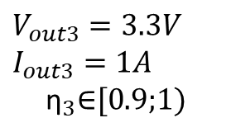
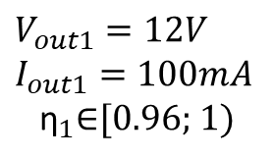
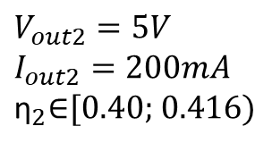
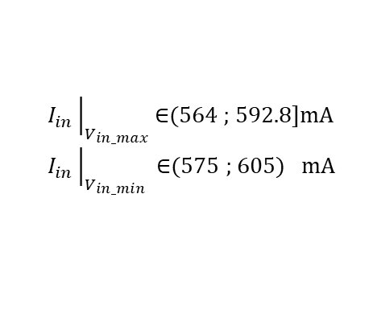
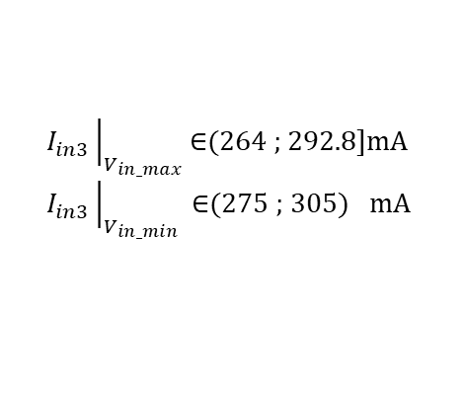


$$I_{in}{\left.​\right|}_{V_{in_max}}\text{∈}\text{(}\text{5}\text{64 ; }\text{592.8]}\text{mA}$$
$$I_{in}{\left.​\right|}_{V_{in_min}} \text{∈}\text{(}\text{575}\text{ ; }\text{605) }\text{mA}$$
$$I_{in1}=100mA$$
Stabilizator Liniar
230V
AC
$V_{out1}=12V$ $I_{out1}=100mA$
$${\text{η}}_{1}\text{∈}\text{[0.96}\text{; }\text{1}\text{)}$$
$V_{in}$∈(12 ; 12.5] V
$$I_{in2}=200mA$$
Stabilizator Liniar Integrat
$V_{out2}=5V$ $I_{out2}=200mA$
$${\text{η}}_{2}\text{∈}\text{[0.40}\text{; }\text{0.416}\text{)}$$
Buck Converter
$V_{out3}=3.3V$ $I_{out3}=1A$
$${\text{η}}_{3}\text{∈}\text{[0.9;1}\text{)}$$
$$I_{in3}{\left.​\right|}_{V_{in_max}}\text{∈}\text{(264 ; }\text{292.8]}\text{mA}$$
$$I_{in3}{\left.​\right|}_{V_{in_min}} \text{∈}\text{(2}\text{75}\text{ ; }\text{305) }\text{mA}$$

Slide 5
Vă mulțumesc pentru atenție!

