Slide 1

ACE Engineering College
Ankushapur (v), Ghatkesar(M), Medchal Dist-501301
FAKE PRODUCT REVIEWS DETECTION SYSTEM USING MACHINE LEARNING TECHNIQUES
Presented by:
1. P. Sriya Reddy (23AG1A6747)
2.Ahmed Ali (23AG1A6739)
3. Simran Kumari (23AG1A6753)
4. B. Indraj (23AG1A6709)
Internal Guide
Dr. P. Chiranjeevi
Head of the Department

Slide 2
Contents
Abstract
Introduction
Existing System And Its Limitations
Proposed System And Its Advantages
Hardware Requirement
Software Requirements
System Architecture
Design (UML Diagrams)
Output Screens
Conclusion
References

Slide 3
Abstract
Online product reviews help people decide which products to buy, but sometimes these reviews are fake. Fake reviews either make a product look better than it is or try to damage its reputation. This makes it hard for customers to trust online shopping. Our project, Fake Product Reviews Detection System, uses Machine Learning (ML) to find out if a review is real or fake.
In this project, we collect product reviews and clean the data by removing unwanted details. We use simple methods to understand the text and train the system to recognize patterns in the reviews. After training, the system can easily check new reviews and predict if they are real or fake.
This project helps make online shopping more trustworthy. It also gives us a basic understanding of machine learning and how it can be used to solve real-life problems.

Slide 4

Introduction
Online product reviews play a crucial role in influencing customer buying decisions. However, the presence of fake reviews on e-commerce platforms misleads customers and undermines their trust. Detecting fake reviews manually is difficult due to their volume. This project uses Machine Learning to automatically identify fake product reviews, helping customers make better purchasing choices.
Key Features:
Collects and cleans product review data
Extracts meaningful features from review texts
Trains a machine learning model to classify reviews
Provides a credibility score for products based on reviews
Objectives:
Detect fake product reviews with high accuracy
Enhance trust in online shopping platforms
Provide useful feedback to customers for informed decisions

Slide 5
Existing System and Its Limitations
System Name | Technology Used | Limitation | Developed By
Amazon Review Filter | Heuristics, Verified Purchase Tag | Cannot detect sophisticated fake reviews, no ML-based system | Amazon
Yelp Review Filter | Proprietary Algorithm | Limited transparency, false positives | Yelp Inc.
Fakespot | Natural Language Processing (NLP) | Limited access to internal data, external analysis only | Fakespot Inc.
ReviewMeta | Statistical Pattern Analysis | Works only on Amazon, lacks adaptive learning | ReviewMeta Team
Manual Flagging System | User-based Reporting | Time-consuming, low detection rate | Most e-commerce platforms

Slide 6
Proposed System
Our project introduces an intelligent, ML-powered system to detect fake product reviews from e-commerce platforms.
Accepts a product URL to extract review data.
Performs data preprocessing
Trains a machine learning model to classify reviews as genuine or fake.
Calculates a credibility score for each product based on review quality.
Presents the results in a simple, interactive web interface.

Slide 7
Advantages
🌟 Automated Detection: No manual effort required — fast and scalable.
🌟 Improved Accuracy: ML models can detect complex fake patterns in text.
🌟 Real-Time Analysis: Instantly checks reviews on user request.
🌟 Enhanced User Trust: Helps customers make informed buying decisions.
🌟 Platform Independent: Can work with data from various e-commerce sites.
🌟 Practical ML Application: Real-world use case for text classification.

Slide 8
Hardware Specifications:
Processor: Intel Core i5 or equivalent (2.5 GHz or higher)
RAM: Minimum 8 GB
Storage: At least 100 GB free space
Graphics Card: Not required (CPU-based ML training)
Display: Standard HD monitor (1366×768 or higher)
Internet Connection: Required for scraping data and API access

Slide 9
Software Requirements
🧑‍💻 Development Environment
Programming Language: Python 3.x
IDE/Editor: VS Code / Jupyter Notebook / PyCharm
Framework: Flask
Deployment/Execution Environment
Operating System: Windows / Ubuntu / macOS
Browser: Chrome / Firefox (for running the web app)
Local Server: Flask Development Server
Optional:
GitHub (for version control)
Heroku / Render (for deployment)

Slide 10
System Architecture
User Interface (Frontend):
Web interface where users input product URLs and view analysis results.
Displays review credibility scores and highlights fake/genuine reviews.
Backend API Server:
Handles requests from frontend.
Fetches product details and reviews from e-commerce sites.
Passes review data to the ML module.
Returns prediction results to frontend.
Machine Learning Module:
Preprocesses review text.
Extracts features.
Classifies reviews as fake or genuine using trained ML models.
Generates credibility scores.

Slide 11
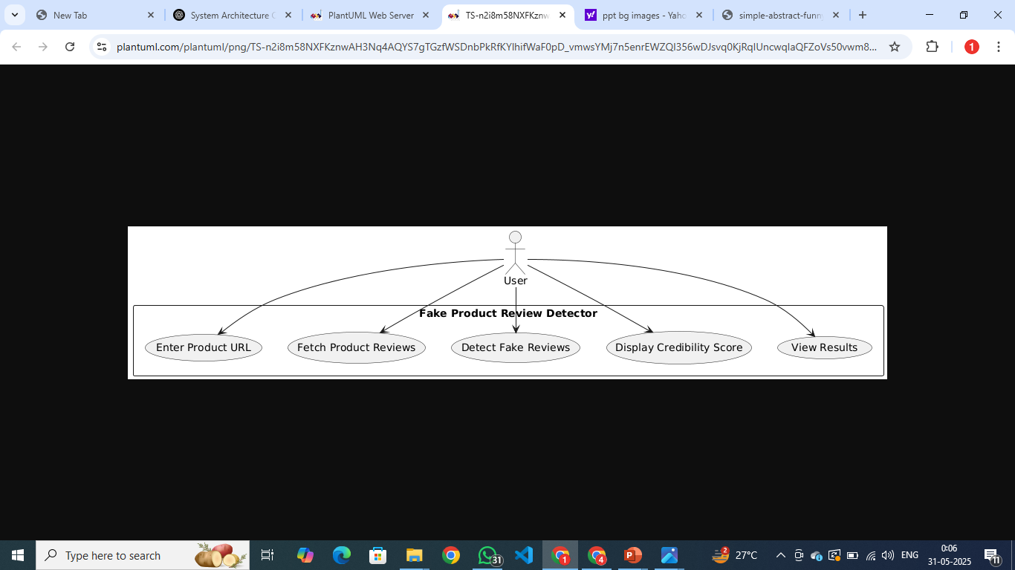
Use Case Diagram

Slide 12
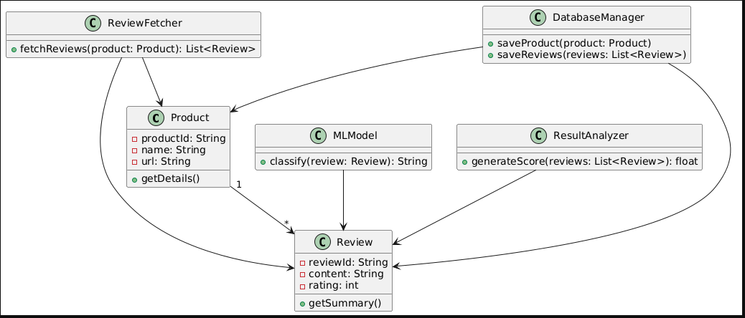
Class Diagram

Slide 13
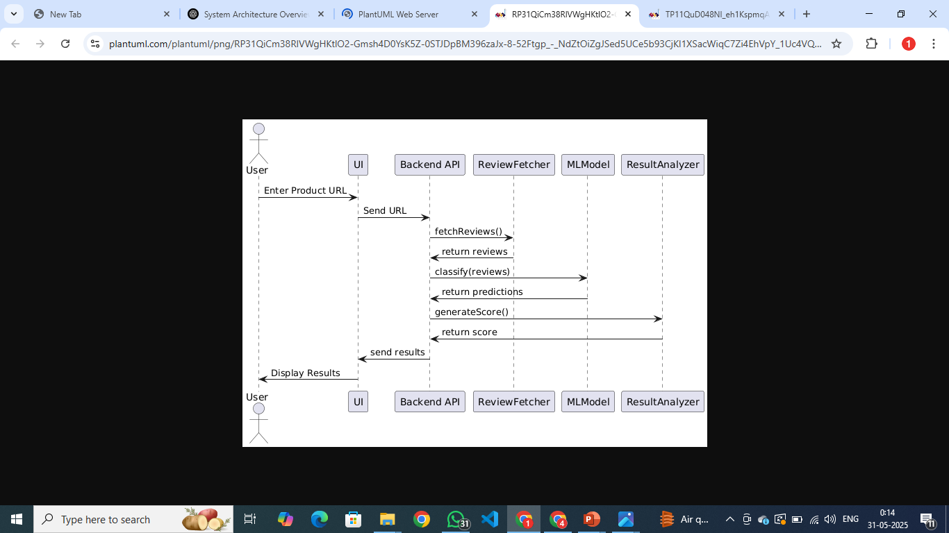
Sequence Diagram

Slide 14
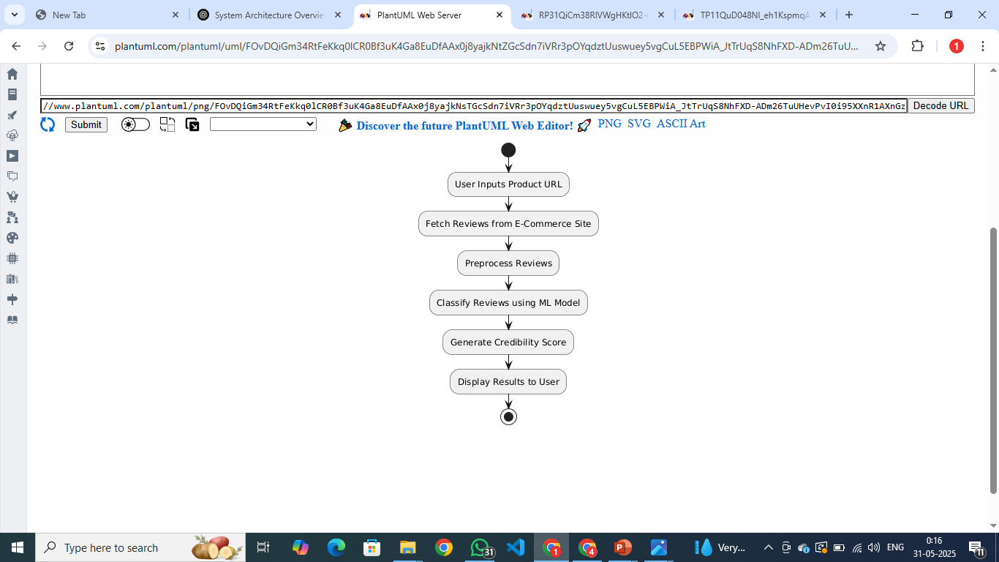
Activity Diagram

Slide 15
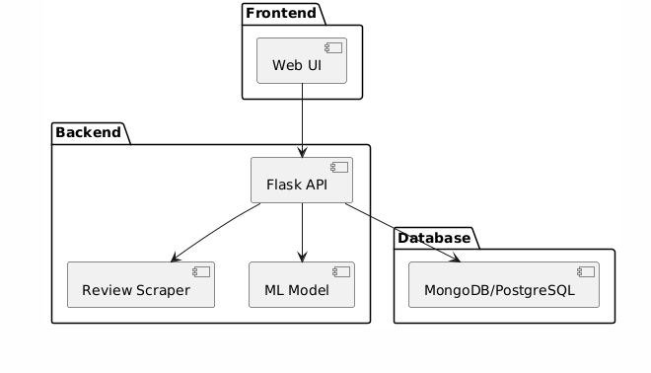
Component Diagram

Slide 16
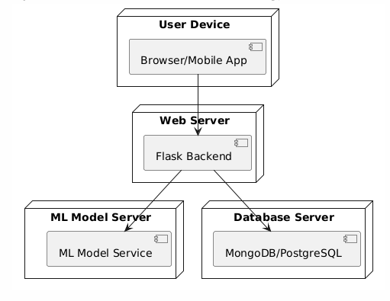
Deployment Diagram

Slide 17
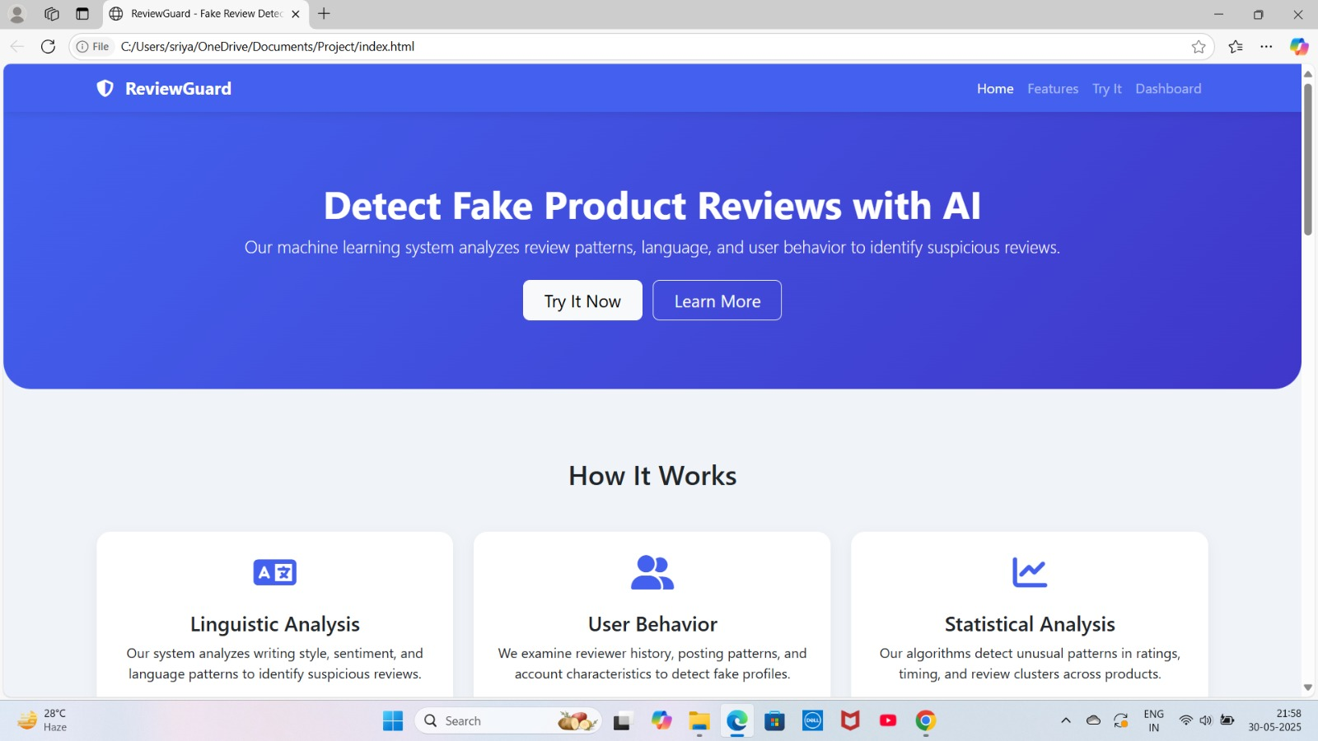
Outputs

Slide 18
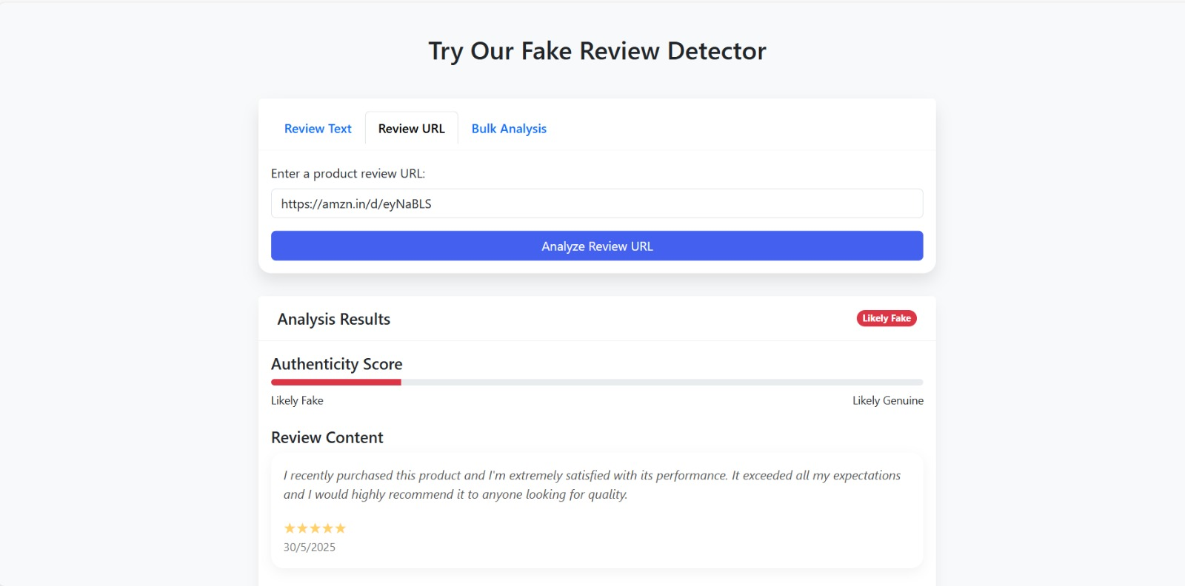

Slide 19
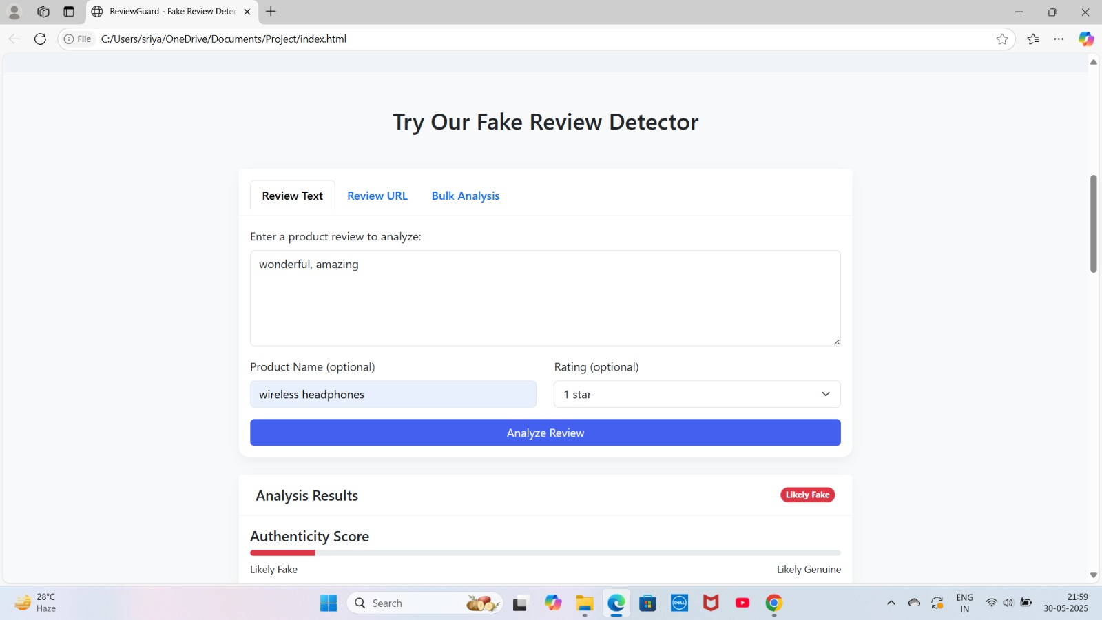

Slide 20
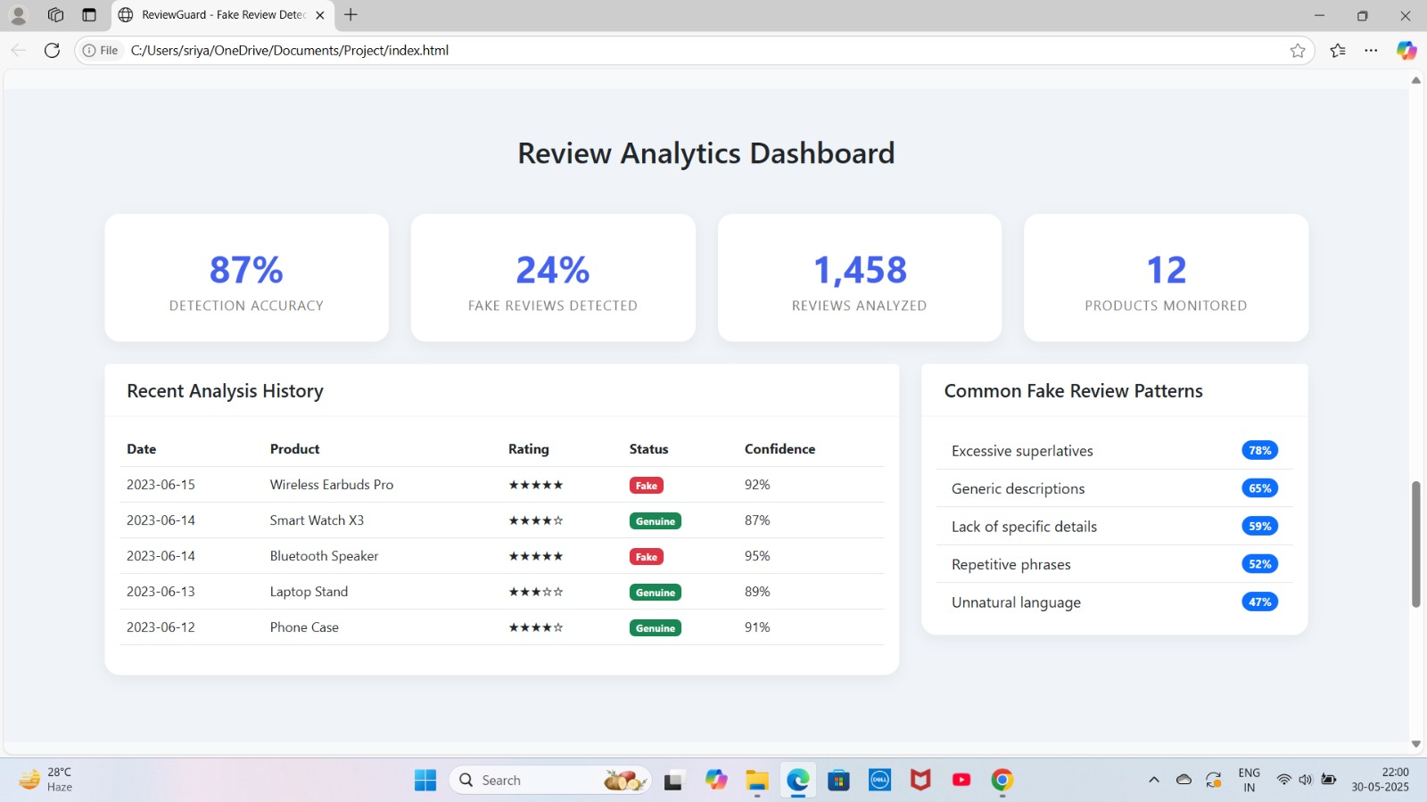

Slide 21
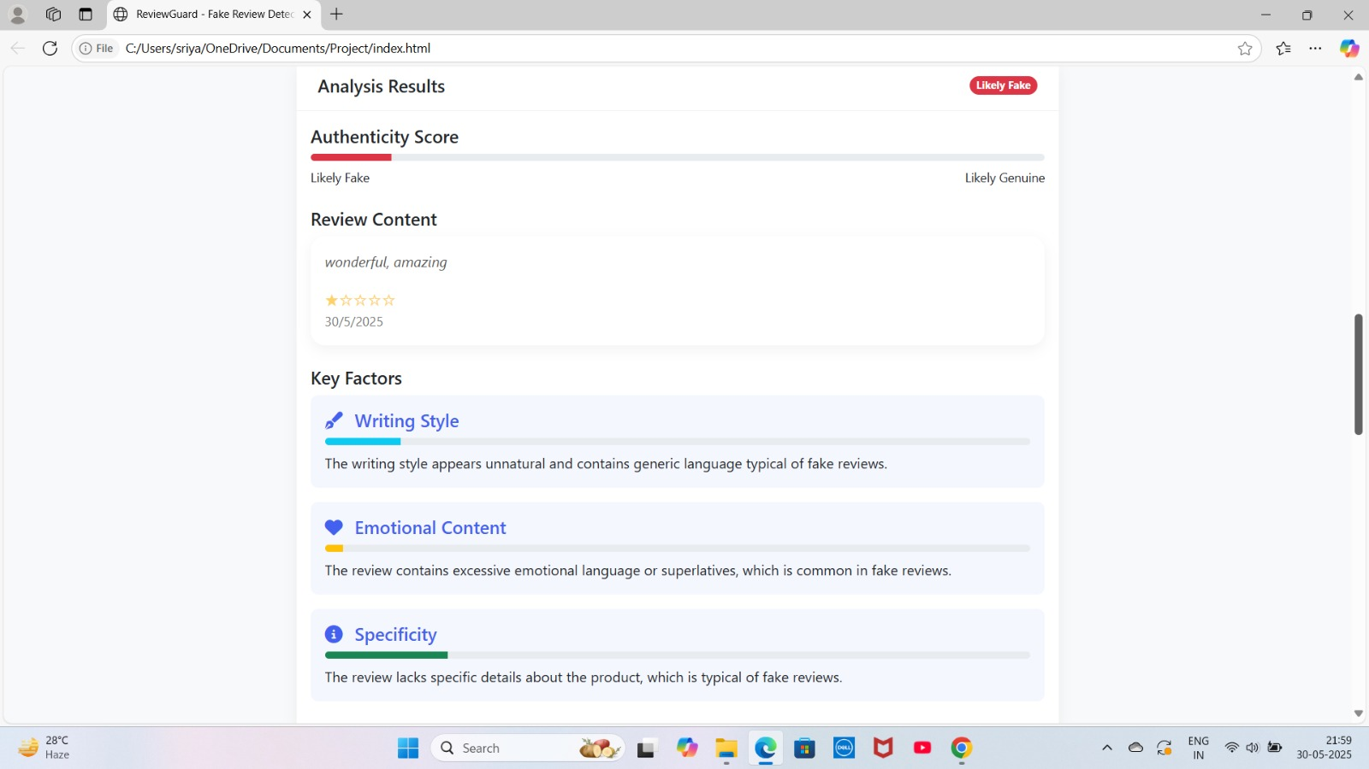

Slide 22
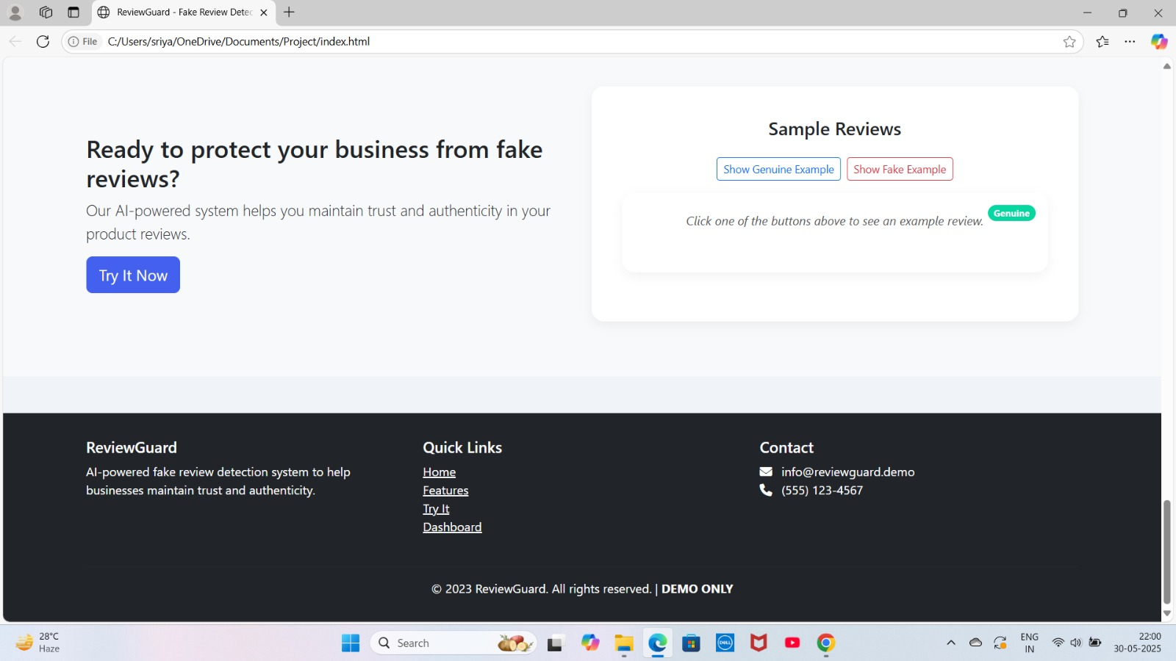

Slide 23
Conclusion
Fake reviews severely affect trust in online platforms.
Our system offers a reliable, automated solution using Machine Learning.
It effectively classifies reviews as Genuine or Fake and provides a Credibility Score for transparency.
Designed with a modular architecture, it supports easy integration with e-commerce platforms.
Provides a strong base for future improvements like:
Real-time detection
Integration with product recommendations
💡 Final Thought:
"Building trust in e-commerce begins with identifying truth in reviews."

Slide 24
Future Enhancements
🔍 Planned Upgrades
Multi-Language Support → Detect fake reviews in regional and international languages.
Real-Time Review Analysis → Classify reviews immediately after submission.
Review Source Verification → Validate user identities to detect bot-generated reviews.
Product Recommendation Engine → Suggest similar products with higher credibility scores.
Browser Extension / Mobile App Integration → Provide instant review credibility on popular e-commerce sites.
🤖 Advanced ML/DL Integration
Leverage Transformer-based models (e.g., BERT) for deeper context understanding.
Use Graph Neural Networks for user-review-product relationship analysis.

Slide 25
References
Research Papers & Articles
Mukherjee, A., Liu, B., & Glance, N. (2012). Spotting Fake Reviewer Groups in Consumer Reviews.
Ott, M., et al. (2011). Finding Deceptive Opinion Spam by Any Stretch of the Imagination.
Machine Learning & NLP
Scikit-learn Documentation – https://scikit-learn.org
NLTK Documentation – https://www.nltk.org/
TensorFlow – https://www.tensorflow.org/
Web Development
Flask Framework – https://flask.palletsprojects.com/
Bootstrap – https://getbootstrap.com/
Data Sources
Kaggle Review Datasets – https://www.kaggle.com
Amazon Product Review Dataset

