Slide 1
Reportgeneratordemo
Portfolio Overview

Slide 2
Outline of topics
Objectives
Portfolio trends
1
Objectives
2
Objective trends per capability

Slide 3
Progress towards objectives between January 2026 and March 2026
Objectives - Progress
Percentage of portfolio
⬤ Complete ⬤ Increased ⬤ Decreased ⬤ Incomplete

Slide 4
Progress towards objectives over time
Objectives - Progress
Percentage of portfolio (%)
⬤ Objectives completed

Slide 5
Progress towards objectives per capability between January 2026 and March 2026
Objectives - Progress
Percentage of portfolio
⬤ Complete ⬤ Increased ⬤ Decreased ⬤ Incomplete

Slide 6
Progress towards objectives: Maintainability
Objectives – Maintainability
Percentage of portfolio (%)
⬤ Objectives completed

Slide 7
Progress towards objectives: Architecture
Objectives – Architecture
Percentage of portfolio (%)
⬤ Objectives completed

Slide 8
Progress towards objectives: Open Source Health
Objectives – Open Source Health
Percentage of portfolio (%)
⬤ Objectives completed

Slide 9
Progress towards objectives: Security
Objectives – Security
Percentage of portfolio (%)
⬤ Objectives completed

Slide 10
Progress towards objectives between January 2026 and March 2026
Objectives – Status
Percentage of portfolio
⬤ Objective met ⬤ Improved ⬤ Unchanged ⬤ Worsened ⬤ Unknown

Slide 11
Progress towards objectives per team between January 2026 and March 2026
Objectives – Team
Percentage of team’s systems
⬤ Objective met ⬤ Improved ⬤ Unchanged ⬤ Worsened ⬤ Unknown

Slide 12
Progress towards objectives per capability between January 2026 and March 2026
Objectives – Capability
Percentage of portfolio
⬤ Objective met ⬤ Improved ⬤ Unchanged ⬤ Worsened ⬤ Unknown

Slide 13
Progress towards objectives over time
Objectives – Overall
Percentage of portfolio
⬤ Objective met ⬤ Improved ⬤ Unchanged ⬤ Worsened ⬤ Unknown

Slide 14
Progress towards objectives: Security
Objectives – Security
Percentage of portfolio
⬤ Objective met ⬤ Improved ⬤ Unchanged ⬤ Worsened ⬤ Unknown

Slide 15
Progress towards objectives: Open Source Health
Objectives – Open-Source Health
Percentage of portfolio
⬤ Objective met ⬤ Improved ⬤ Unchanged ⬤ Worsened ⬤ Unknown

Slide 16
Progress towards objectives: Maintainability
Objectives – Maintainability
Percentage of portfolio
⬤ Objective met ⬤ Improved ⬤ Unchanged ⬤ Worsened ⬤ Unknown

Slide 17
Progress towards objectives: Architecture
Objectives – Architecture
Percentage of portfolio
⬤ Objective met ⬤ Improved ⬤ Unchanged ⬤ Worsened ⬤ Unknown

Slide 18
Index
Objectives
Portfolio trends
1
Maintainability
2
Open Source Health
3
Security

Slide 19
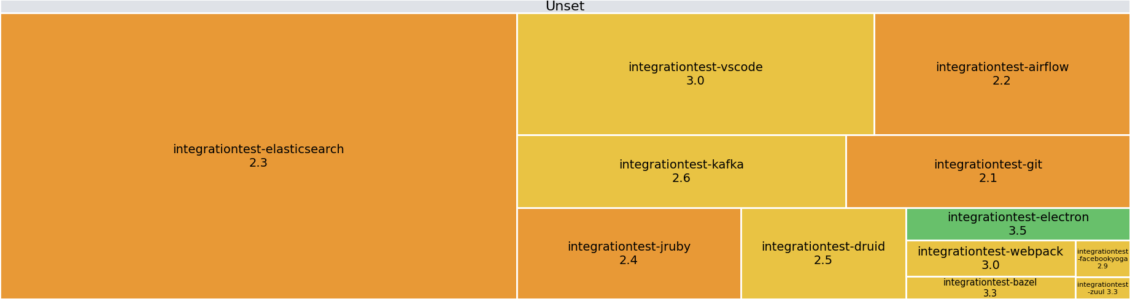
About 7 (58%) systems score market average on maintainability
Portfolio trends – Maintainability
The average maintainability rating for the portfolio is 2.5 ★.
8% of systems score above market average (≥3.5★).
58% of systems score market average (3★).
33% of systems score below market average (≤2.5★).
1 star
2 stars
3 stars
4 stars
5 stars
Systems grouped by Team

Slide 20
Maintainability Grouped by Lifecycle
Portfolio trends – Maintainability
@@
1 star
2 stars
3 stars
4 stars
5 stars
Systems grouped by Lifecycle

Slide 21
Maintainability Grouped by Deployment Type
Portfolio trends – Maintainability
@@
1 star
2 stars
3 stars
4 stars
5 stars
Systems grouped by Deployment Type

Slide 22
Maintainability Grouped by Business Criticality
Portfolio trends – Maintainability
@@
1 star
2 stars
3 stars
4 stars
5 stars
Systems grouped by Business Criticality

Slide 23
About 7 (58%) systems score market average on maintainability
Portfolio trends – Maintainability
maintainability benchmark
★★★★★
★★★★
★★★
★★
★
Maintainability
System in SIG benchmark
System rebuild volume in person years

Slide 24
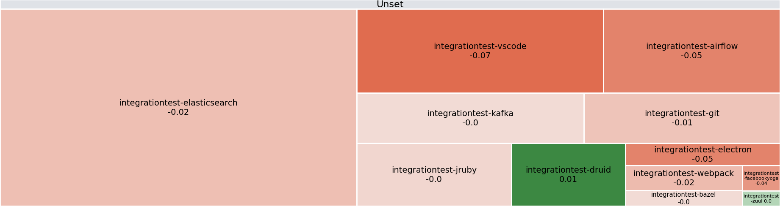
The portfolio's maintainability has decreased (with -0.7 to 2.5) during the measured period
Portfolio trends – Maintainability – Change
8% of systems has seen an increase in maintainability. 8% of systems has remained stable. 83% of systems has seen a decrease in maintainability.
The largest increase in maintainability rating was experienced by integrationtest-druid (0.0 stars). The largest decrease in maintainability rating was experienced by integrationtest-vscode (0.0 stars).
-★
+★
Systems grouped by Team

Slide 25
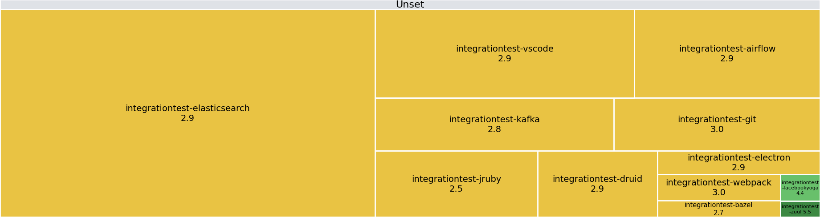
Maintainability ratings of newly written code between 11 January 2026 and 8 March 2026
Portfolio trends – Maintainability – Delta Quality
The highest maintainability rating for new code was achieved by integrationtest-zuul (5.5 stars). The lowest maintainability rating for new code was in integrationtest-jruby (2.5 stars).
1 star
2 stars
3 stars
4 stars
5 stars
Systems grouped by Team

Slide 26
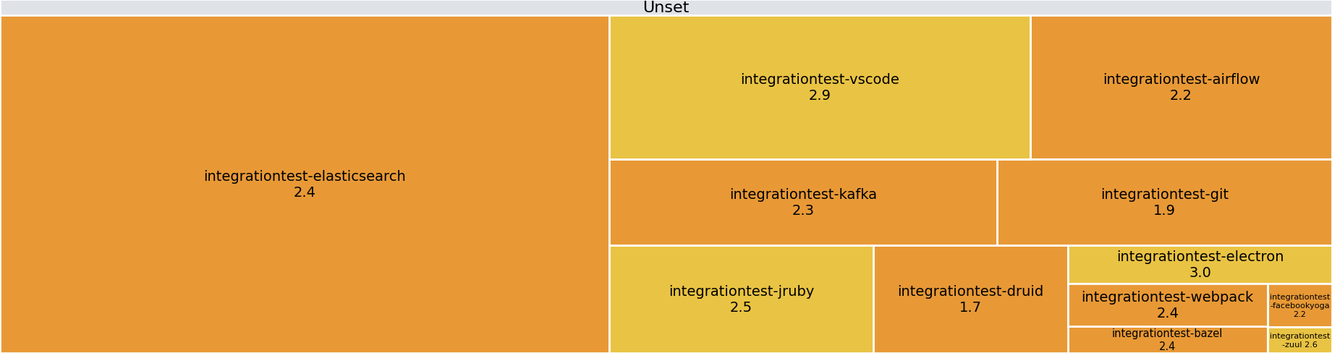
Maintainability ratings of changed code between 11 January 2026 and 8 March 2026
Portfolio trends – Maintainability – Delta Quality
@@
1 star
2 stars
3 stars
4 stars
5 stars
Systems grouped by Team

Slide 27
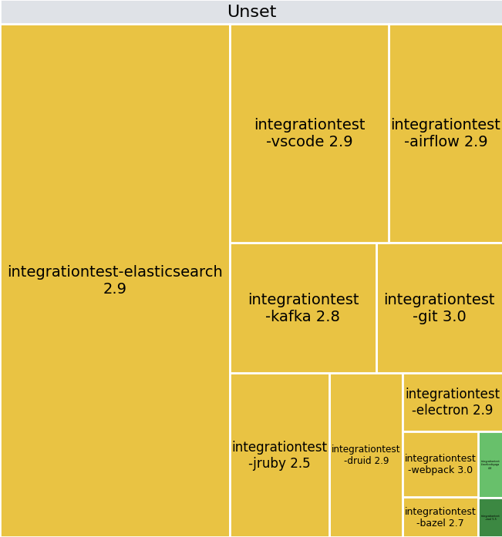
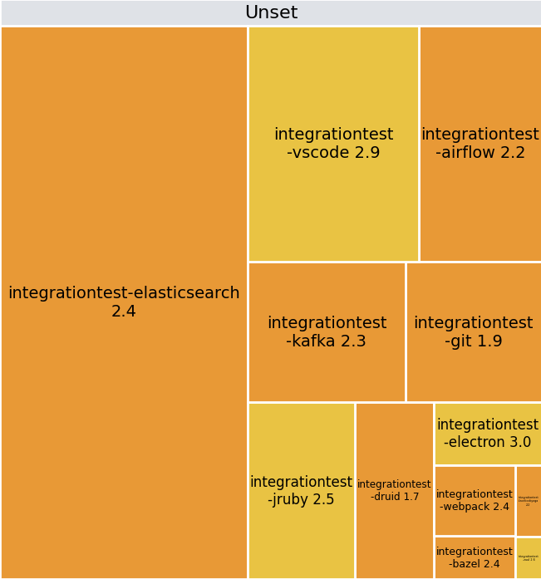
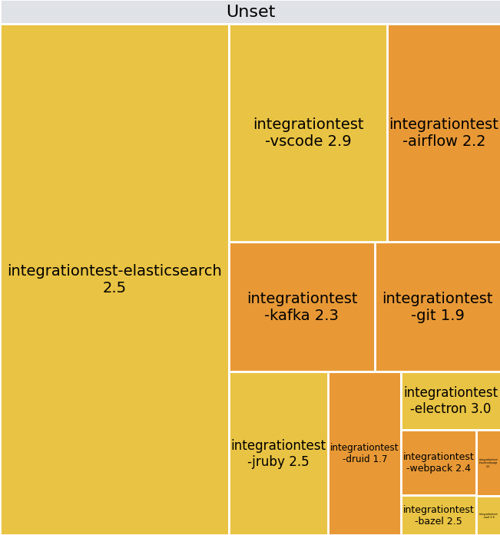
Maintainability delta quality ratings of the portfolio between 11 January 2026 and 8 March 2026
Portfolio trends – Maintainability – Delta Quality
New code
Changed code
New and changed code
1 star
2 stars
3 stars
4 stars
5 stars
Systems grouped by Team

Slide 28
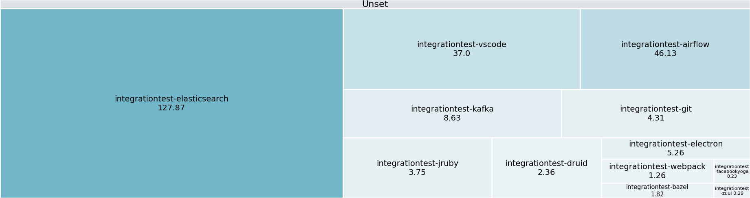
Change in volume (effort) of the portfolio between 11 January 2026 and 8 March 2026
Portfolio trends – Volume Change
The portfolio has seen an overall increase in volume of 19.9 person years.
The system integrationtest-elasticsearch has seen the biggest change with an increase of 10.7 person years.
-PY
+PY
Systems grouped by Team

Slide 29
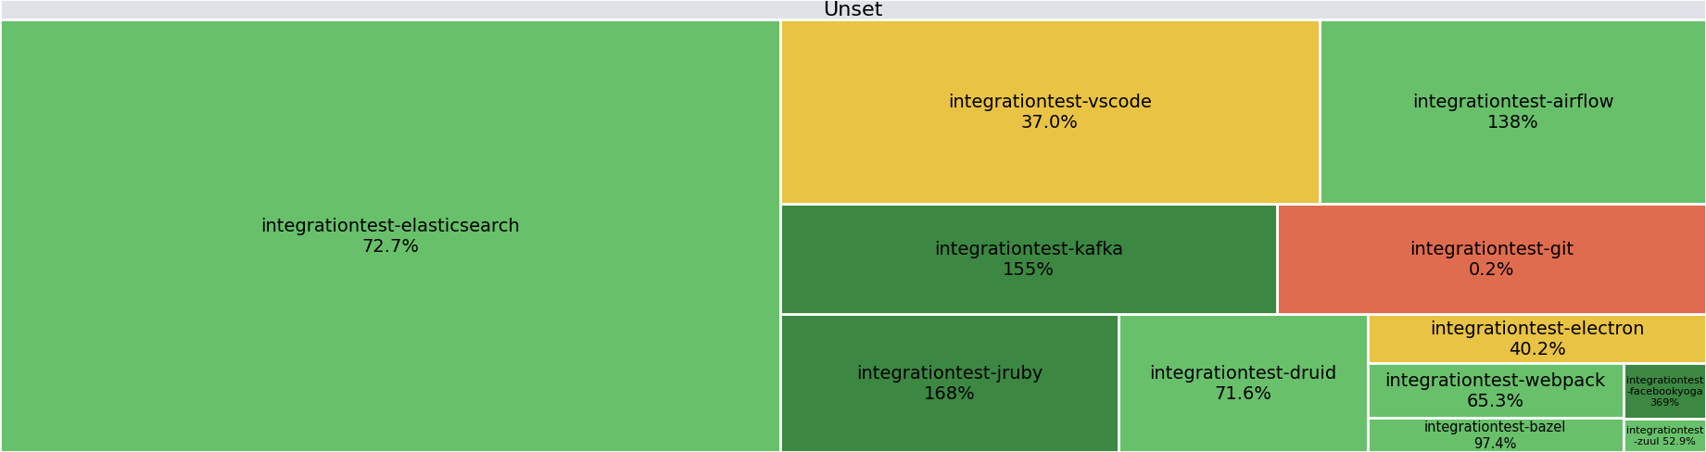
Test-to-production code ratios of the portfolio between 11 January 2026 and 8 March 2026
Portfolio trends – Test-to-production code ratio
25% systems have a test code ratio of < 50%.
42% of systems have a test code ratio between 50% and 100%.
33% of systems have a test code ratio ≥ 100%
≤ 1%
1% - 15%
15% - 50%
50% - 150%
> 150%
Systems grouped by Team

Slide 30
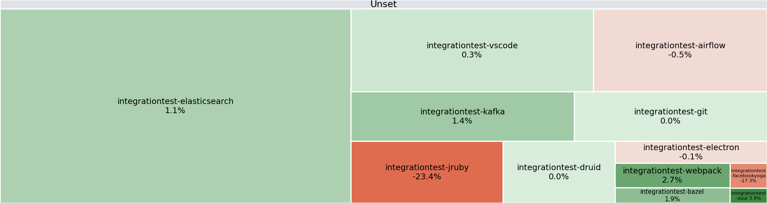
Change in test-to-production code ratios of the portfolio between 11 January 2026 and 8 March 2026
Portfolio trends – Test-to-production code ratio – Change
Overall, there has been a decrease in test code ratio for the portfolio (-2.3%).
42% of systems have seen an increase in test code ratio while 17% of systems have seen a decrease.
The largest increase in test code ratio was experienced by integrationtest-zuul (+3.9%). The largest decrease in test code ratio was experienced by integrationtest-jruby (-23.4%).
-%
+%
Systems grouped by Team

Slide 31
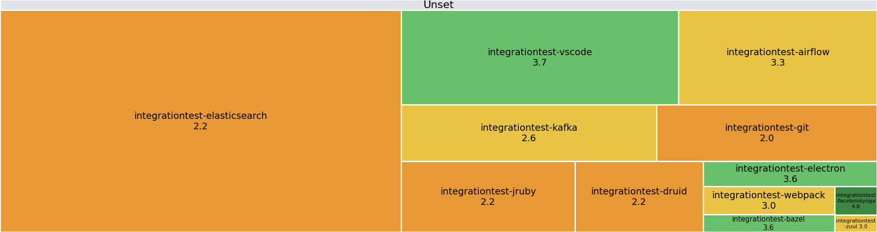
Architecture ratings of the portfolio between 11 January 2026 and 8 March 2026
Portfolio trends – Architecture
The average Architecture Quality rating for the portfolio is 2.6 ★.
33% of systems score above market average for Architecture Quality (≥3.5★).
33% of systems score market average for Architecture Quality (3★).
33% of systems score below market average for Architecture Quality (≤2.5★).
1 star
2 stars
3 stars
4 stars
5 stars
Systems grouped by Team

Slide 32
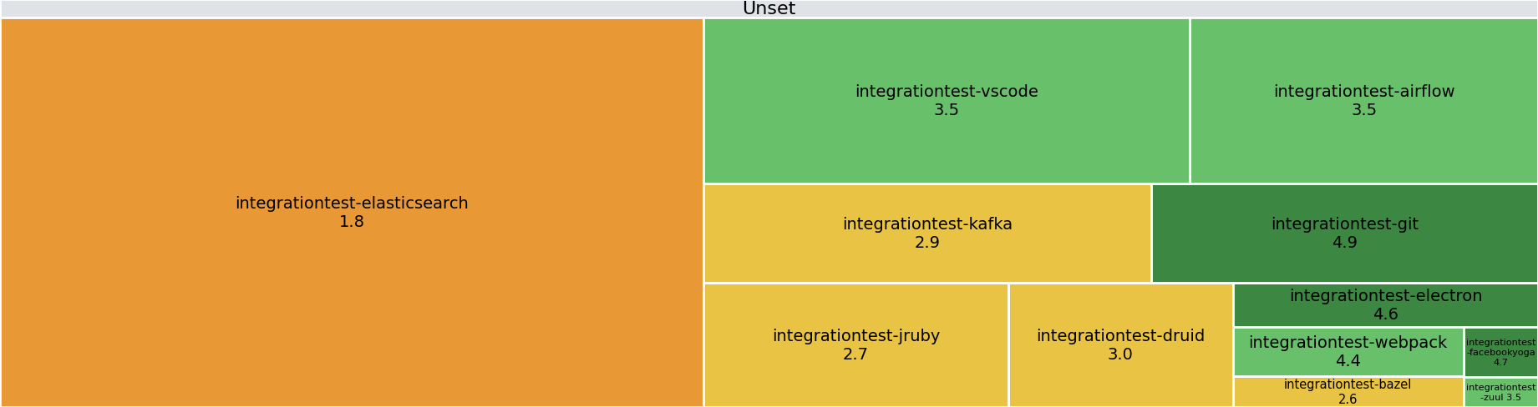
Open-source health ratings of the portfolio between 11 January 2026 and 8 March 2026
Portfolio trends – Open-Source Health
The average Open Source Health rating for the portfolio is 2.7 ★.
58% of systems score above market average for Open Source Health (≥3.5★).
33% of systems score market average for Open Source Health (3★).
8% of systems score below market average for Open Source Health (≤2.5★).
1 star
2 stars
3 stars
4 stars
5 stars
Systems grouped by Team

Slide 33
Overall Open Source Health Library Risks Overview
Key findings – Open Source and IP
3% of dependencies (40 in total) used in the system contain one or more known vulnerabilities.
1% of dependencies (5 in total) uses a potentially restrictive open-source license (e.g. GPL/AGPL).
12% of dependencies (190 in total) used in the system have not been updated for over 2 years.
6% of dependencies (93 in total) does not use a package manager but is placed in the codebase directly.
1529
174
91
251
158
855

Slide 34
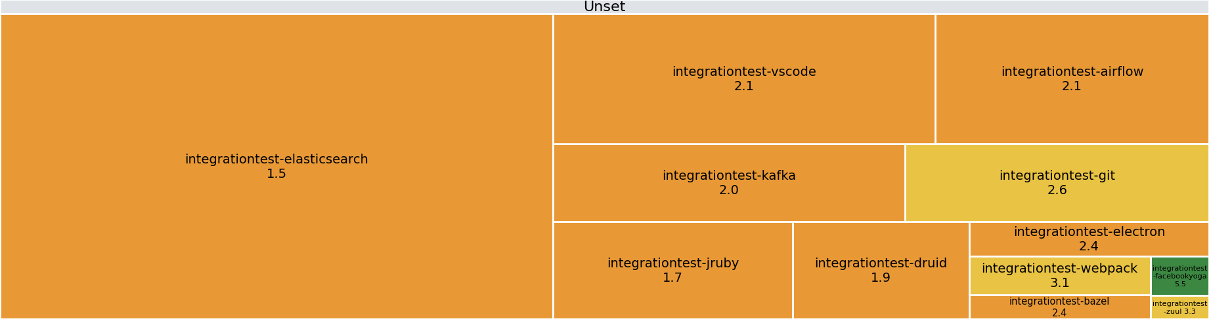
Security ratings of the portfolio between 11 January 2026 and 8 March 2026
Portfolio trends – Security
The average Security rating for the portfolio is 1.8 ★.
8% of systems score above market average for Security (≥3.5★).
25% of systems score market average for Security (3★).
67% of systems score below market average for Security(≤2.5★).
1 star
2 stars
3 stars
4 stars
5 stars
Systems grouped by Team

Slide 35
Critical findings trends of the last 12 months (ending at 8 March 2026)
Portfolio trends – Security – Findings trend
Since 2025-04-01, 0 critical security findings have been resolved while 356 new critical findings were discovered. Overall, there has been an increase in critical security findings of 356.
Of the resolved critical findings, most were resolved in at most 7 days (0 findings). 0 findings were resolved within the recommended 7 days while 0 were resolved after 30 days or more.
Critical

Slide 36
Security resolution times of the portfolio of the last 12 months (ending at 8 March 2026)
Portfolio trends – Security – Resolution times
Since 2025-04-01, 26 high security findings have been resolved while 2054 new high findings were discovered. Overall, there has been an increase in high security findings of 2028.
Of the resolved high findings, most were resolved in between 14 and 30 days (11 findings). 8 findings were resolved within the recommended 14 days while 0 were resolved after 180 days or more.
13 medium security findings have been resolved while 1237 new medium findings were discovered. Overall, there has been an increase in medium security findings of 1224.
Of the resolved medium findings, most were resolved in at most 30 days (2 findings). 2 findings were resolved within the recommended 30 days while 0 were resolved after 270 days or more.
High
Medium

Slide 37
Security findings of the portfolio of the last 12 months (ending at 8 March 2026)
Portfolio trends – Security – Findings trend
Security findings
Critical
High
Medium

Slide 38
Security findings of the portfolio of the last 12 months (ending at 8 March 2026)
Portfolio trends – Security – Findings trend
Security findings
Critical
High
Medium

