Slide 1
Grocery Shopping Optimization Using Dynamic Programming
MSML606 Extra Credit Project 2
Simran Kharbanda (UID: 122283671)
Shashank Ashoka (UID: 122241329)

Slide 2
Problem statement
Grocery shopping can be confusing when trying to eat healthy and stay within a budget.
Shoppers may want enough protein, fiber, vitamins, or minerals, but comparing many products is difficult.
People often buy items that do not fully meet their nutrition goals.
There is a tradeoff between cost and nutrition.
The goal is to choose the best combination of grocery items without going over the budget.
This problem can be solved using the 0/1 Knapsack Dynamic Programming algorithm, where each item is either selected or not selected.

Slide 3
Dataset overview
We are using the Open Food Facts dataset.
The dataset contains information from product labels, such as ingredients, allergens, nutrition facts, brands, and product categories.
It includes over 4 million food products from 150 countries.
It has more than 150 columns, which gives detailed information about each food product.
We use the Open Food Facts dataset, a large open-source food product database with over 4 million products from 150 countries. It contains product names, brands, ingredients, allergens, categories, and detailed nutrition values per 100g. For our project, we focus on key nutrition columns such as protein, fiber, sugar, salt, fat, carbohydrates, and energy. After cleaning the data and removing missing values, we use it to calculate a nutrition score for each item and apply the 0/1 Knapsack algorithm to select the best grocery items within a budget.

Slide 4
Algorithm
The code first loads and cleans the grocery dataset.
Each grocery item gets a random price between $2 and $12
Each item also gets a nutrition score using protein, fiber, sugar, and salt.
The user enters a budget.
The knapsack() function uses that budget to build a dynamic programming table.
For every item, the code decides whether to:
take the item, or
skip the item
It keeps the option that gives the higher nutrition score.
After the table is filled, the code traces backward to find the selected items.
The final result is the grocery list with the best nutrition score that stays within the budget.

Slide 5
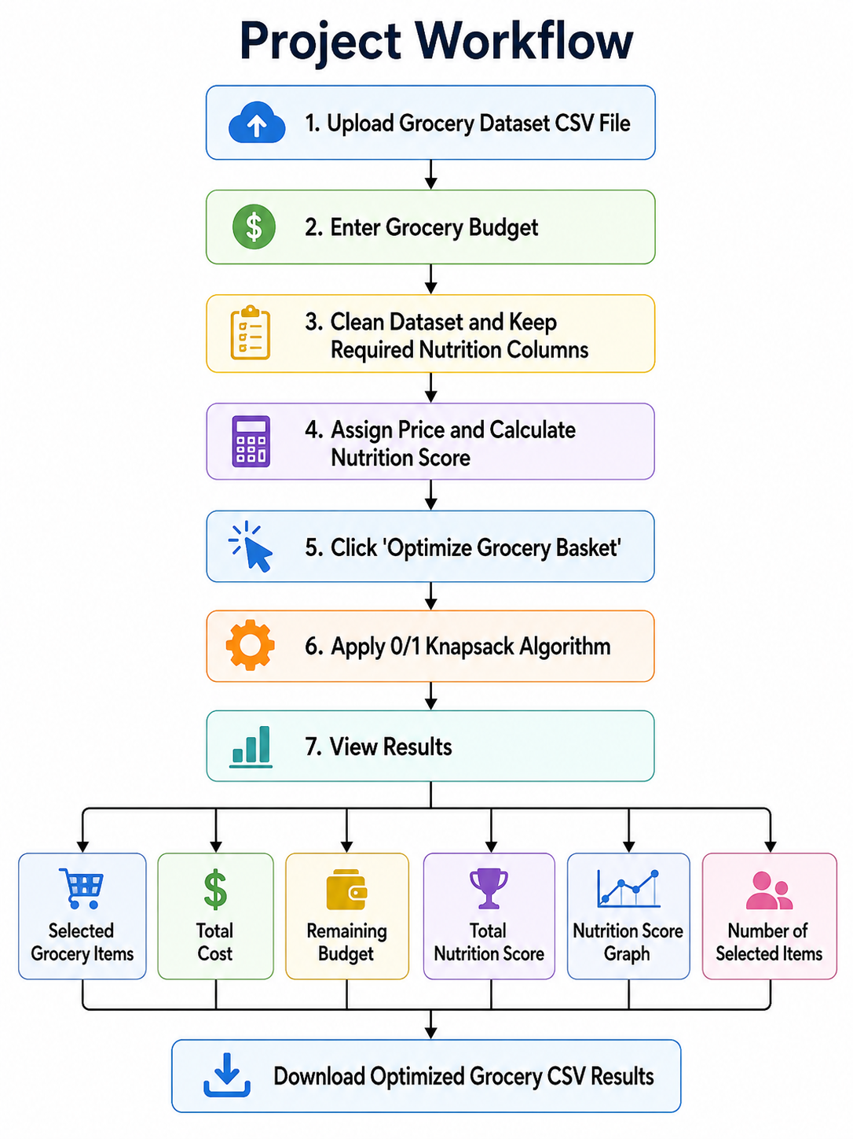
Project workflow

Slide 6
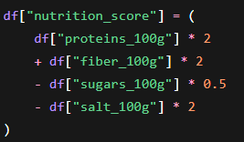
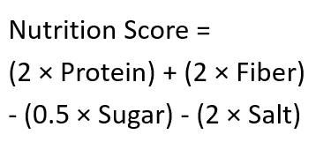
Nutrition Score Formula
In our project, this formula gives each grocery item a value. Items with more protein and fiber get a higher score, while items with more sugar and salt get a lower score.
How Knapsack Is Applied
Each grocery item has two important parts:
Price = cost of selecting the item
Nutrition score = value/benefit of selecting the item
The user’s budget becomes the knapsack limit.
The algorithm checks whether to take or skip each item.
It chooses the combination of grocery items with the highest total nutrition score while keeping the total price within the budget.

Slide 7
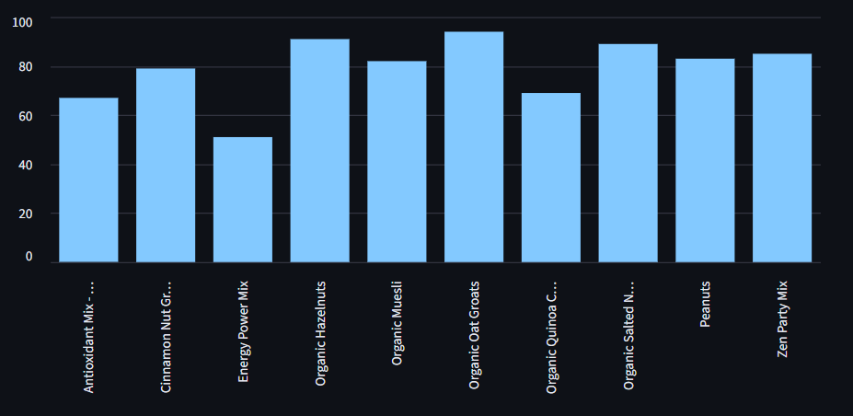
Results
The app successfully selects the best grocery items within the user’s budget.
The selected items have the highest possible total nutrition score based on the formula.
The output shows the selected grocery items, including their price and nutrition score.
The output shows the selected grocery items, including their price and nutrition score.
It also shows the total cost, remaining budget, and best nutrition score
A bar graph displays the nutrition scores of the selected items.

Slide 8
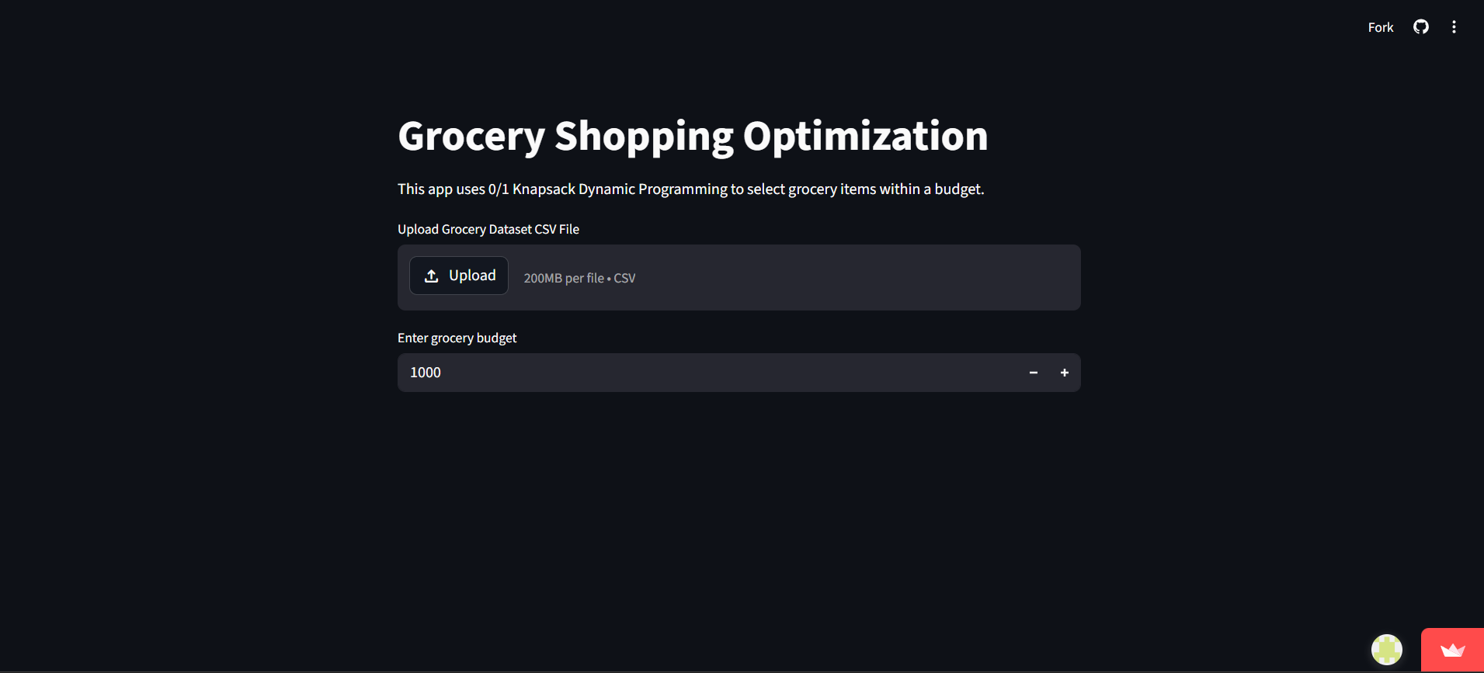
Web application
The user uploads a grocery CSV file that contains product names, brands, and nutrition columns such as protein, fiber, sugar, salt, fat, carbohydrates, and energy per 100g.
The user enters a grocery budget, such as $30 or $50, which tells the app the maximum amount they want to spend.
After clicking “Optimize Grocery Basket,” the app shows the selected grocery items, total cost, remaining budget, total nutrition score, and number of items selected.
The app also displays a bar graph comparing the nutrition scores of the selected items which helps the user shop better by choosing a balanced set of healthier grocery items while staying within their budget.

Slide 9
Conclusion
This project showed how the 0/1 Knapsack algorithm can be applied to a real-world problem that people face in everyday life: choosing groceries within a budget. We learned that dynamic programming is not only a theoretical concept, but a practical method for making better decisions when there are limited resources. By treating grocery prices as the constraint and nutrition scores as the value, we used the algorithm to find the best possible grocery basket. Overall, this project helped us understand how algorithms can support smarter, healthier, and more budget-friendly shopping decisions.

