Slide 1
Lecture 10:
Formal Models and Design Spaces for Interaction Techniques
Brad Myers
05-440/05-640: Interaction Techniques
Spring, 2016

Slide 2
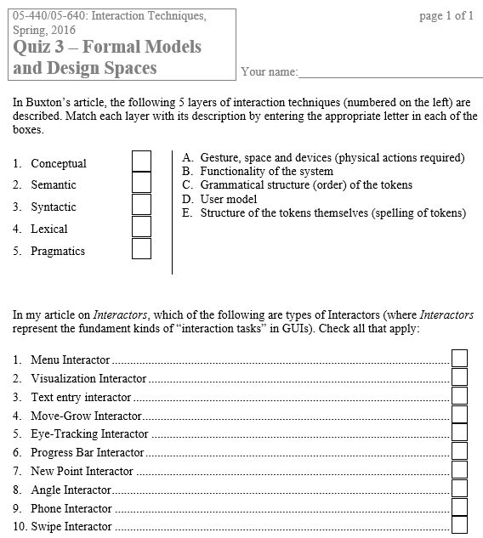
Quiz 3

Slide 3
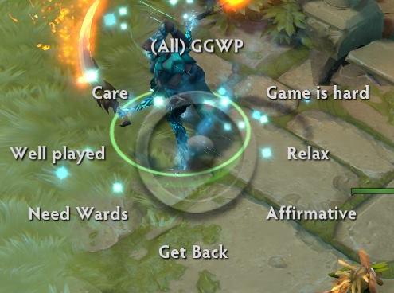
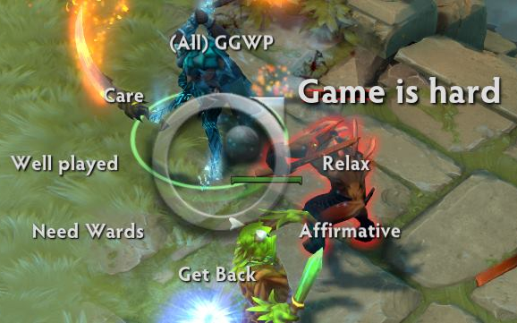
Homework 2 due today
Start on Homework 3
Interesting menu from Eileen Jiang
  “This menu is a scrolling selection menu (similar to a pie menu) used in the collaborative online video game Dota 2 and emphasizes speed and communication.”

Slide 4
More Menus
Diana Sun

Slide 5
Why Models?
Help understand the space of possible interaction techniques
  May identify opportunities for new ones
Provide a precise description of how interaction techniques work
  May identify missing parts of design
Help evaluate performance and other aspects of interaction techniques
  E.g., Keystroke Model and GOMS

Slide 6

Transition Diagrams
Set of states and set of arcs
States represent modes of the interaction
Arcs go from state to state based on an event
Mouse button
released
Do action
Mouse over
Start
hover
selected
Mouse button
pressed
Mouse away
Mouse
away
Mouse
over
Pressed but
outside
Mouse button
released

Slide 7
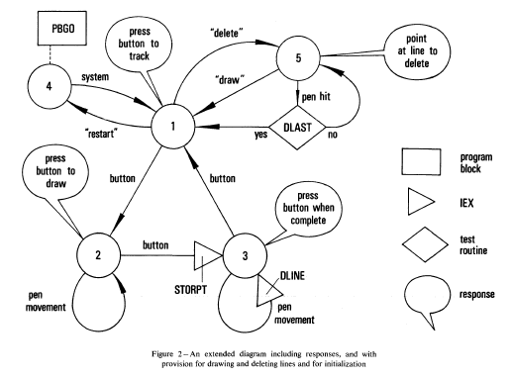
Transition Diagrams, cont
Probably the earliest model of user interfaces
  William Newman's "Reaction Handler" in 1968 http://doi.acm.org/10.1145/1468075.1468083

Slide 8
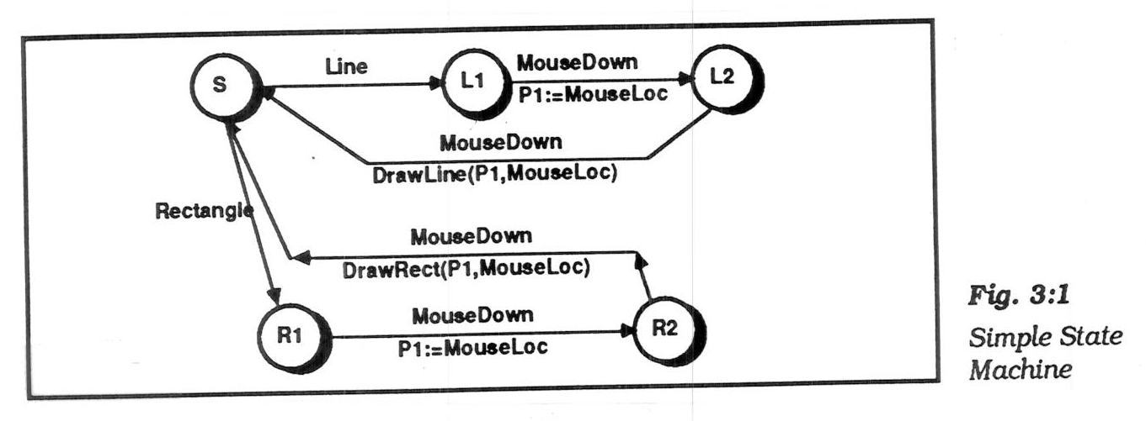
Transition Diagrams, cont.
Simplest form, arcs are user input events.
  arcs can be extended by listing feedback (output) and semantic actions on the arcs
  actions usually written in a conventional language (e.g. Java)
  picture, Olsen text, p. 37 (Fig 3:1)
  Olsen Jr., D.R., User Interface Management Systems: Models and Algorithms. 1992, San Mateo, CA: Morgan Kaufmann.

Slide 9
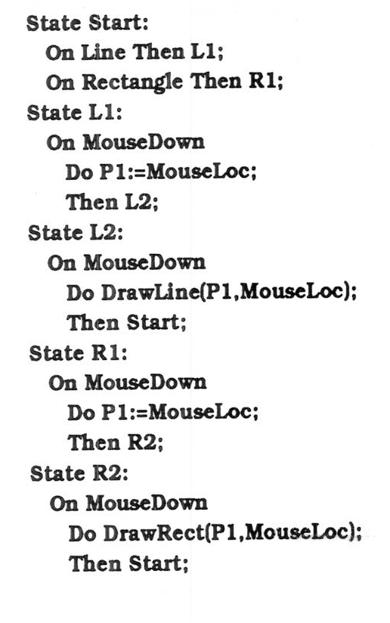
Transition Diagrams, cont.
Often, represented textually:
  picture, Olsen p. 38

Slide 10
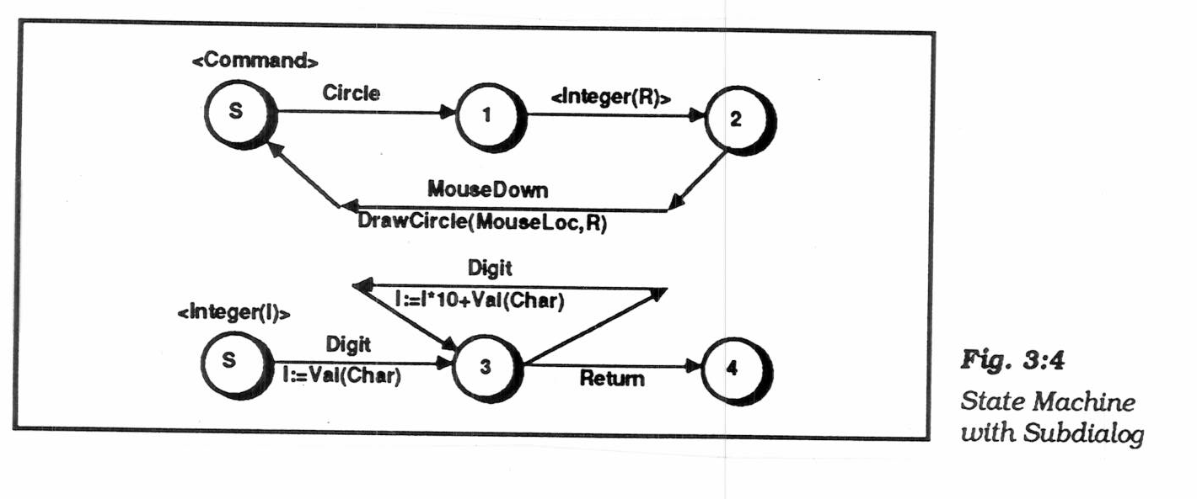
Transition Diagrams, cont.
Sub-diagrams
  To help modularize and simplify large networks
  if call themselves, then "recursive transition network"
    Picture Olsen, p. 41 (Fig 3:4)
  Problem: when to enter and leave the sub-dialog:
    don't want to use up a token

Slide 11
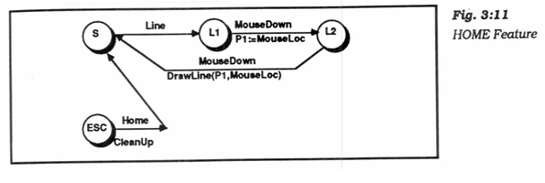
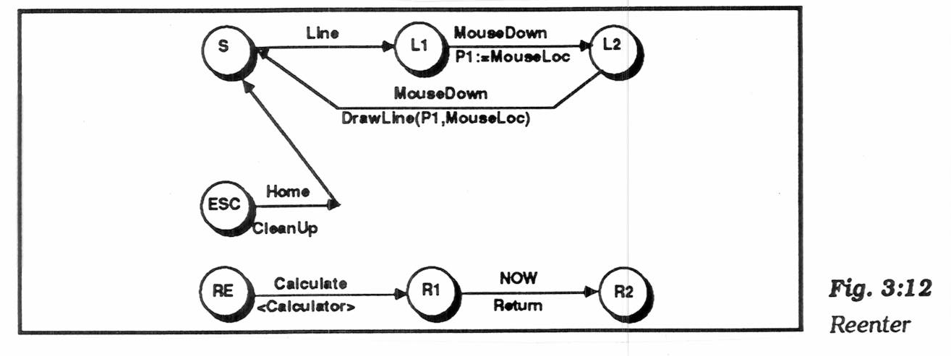
Transition Diagrams, cont.
"Pervasive states" to handle help, abort, undo, etc.
  "Escape" transitions to abort (permanently leave) a dialog
    picture, Olsen p. 53 (Fig 3:11)
  "Re-enter" sub-dialogs for temporary excursions that return to same place. E.g., help, use calculator, etc.
    picture, Olsen p. 55 (Fig 3:12)
  Transitions are taken if no specific arcs from node

Slide 12
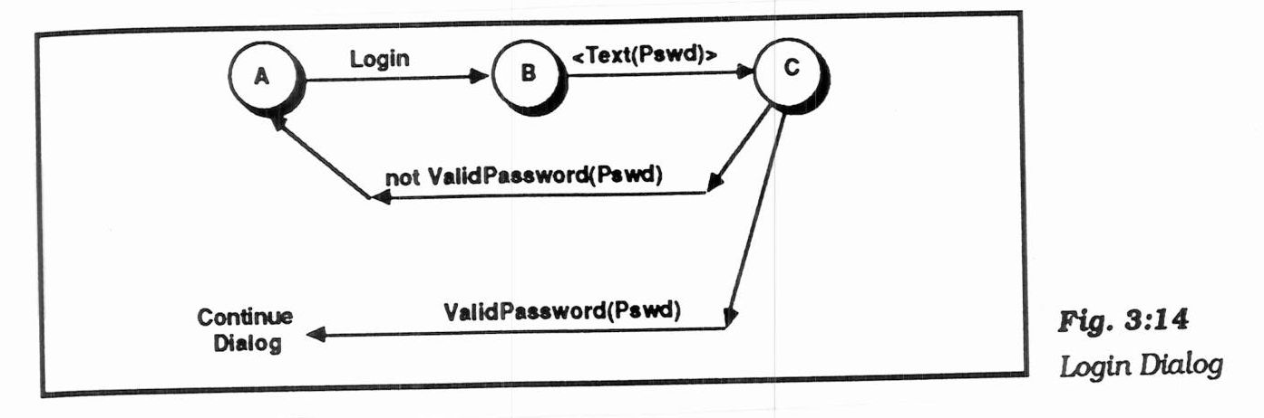
Transition Diagrams, cont.
"Augmented transition networks"
  local variables
  function on arcs can determine transitions
  "guards" determine whether transition is legal
  "conditional transitions" calculate where to go
    picture, Olsen p. 57 (Fig 3:14)
  upgrades the power to context-free-grammar

Slide 13
Transition Diagrams, evaluation
Good
  Make explicit the interpretation of all events in each state
  Emphasize the temporal sequence of user and system actions
  Natural and easily understood if small
    easy to teach, learn, and read
  Appropriate for some parts of GUIs: widget behaviors, dialog box transitions, etc.
  May be appropriate to model transitions around web sites

Slide 14
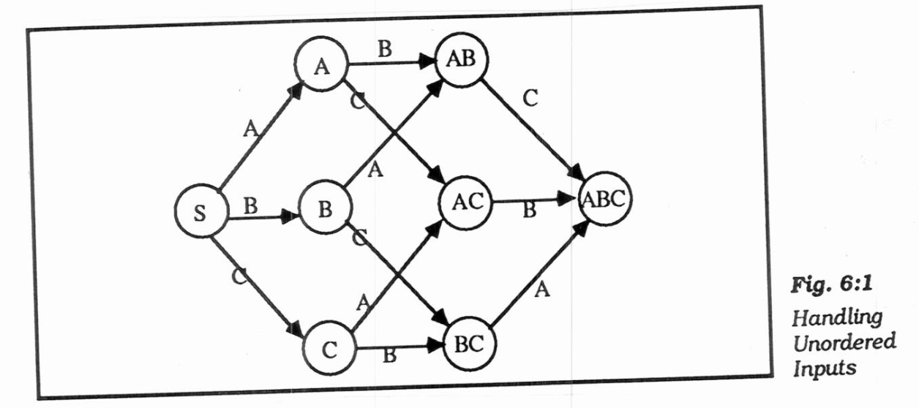
Transition Diagrams, evaluation
Bad
  Does not scale:
  150 commands with
  3 or 4 states each
    explosion of lines and
    states for normal interfaces: "maze of wires"
  unordered inputs
    picture, Olsen p. 91 (Fig 6:1)
  Doesn't handle GUI mode-free style well
  What to do with un-specified input? crash, ignore input
  Doesn't address output

Slide 15
Foley & Wallace, 1974
James D. Foley, Victor L. Wallace and Peggy Chan. “The Human Factors of Computer Graphics Interaction Techniques,” IEEE Computer Graphics and Applications. Nov, 1984. 4(11). pp. 13-48. http://ieeexplore.ieee.org/xpl/articleDetails.jsp?tp=&arnumber=6429355
“Virtual devices”
  Pick – identify user-defined objects
  Button – identify system-defined objects (menus)
  Locator – identify location and/or orientation in drawing space
  Valuator – indicate a single real number value
Also talked about: Lexical, Syntactic, and Semantic levels
  Lexical & syntactic are the level of interaction techniques

Slide 16
Pragmatic Lexical Syntactic Semantic Conceptual
William Buxton, "Lexical and Pragmatic Considerations of Input Structures," Computer Graphics, January, 1983, (17)1, pp. 31-37. http://dl.acm.org/citation.cfm?id=988586 or local html.
Derived from compiler theory and language work.
Added 2 more levels to the ones in Foley & Wallace
Pragmatic
  How the physical input devices work
  required "gestures" to make the input.
  Ergonomics
  skilled performance: "muscle memory"
  press down and hold, vs. click-click

Slide 17
Pragmatic Lexical Syntactic Semantic Conceptual, cont.
Lexical (as subdivided by Buxton)
  Spelling and composition of tokens
    “add” vs. “append” vs. “^a” vs.
  Where items are placed on the display
  “Key-stroke” level analysis
  For input, is the design of the interaction techniques:
    how mouse and keyboard combined into menu, button, string, pick, etc.
  Performed by reflex, requires response in about 50 msec. – [Foley, 74]

Slide 18
Pragmatic Lexical Syntactic Semantic Conceptual, cont.
Syntactic
  Sequence of inputs and outputs.
  For input, the sequence may be represented as a grammar:
    rules for combining tokens into a legal sentence
  For output, includes spatial and temporal factors
  Example: prefix vs. postfix
  “Sentence level” – response of 0.5 → 2 sec [Foley’74]

Slide 19
Conceptual-Semantic-Syntactic-Lexical-Pragmatic, cont.
Semantic
  Functionality of the system; what can be expressed
  What information is needed for each operation on object
  What errors can occur
  Application level – typically not interaction techniques
  Semantic vs. UI is key issue in UI tools
    but "semantic" is different than meaning in compilers
  "Semantic Feedback“
    Depends on meaning of items
    Example: only appropriate items highlight during drag

Slide 20
Pragmatic Lexical Syntactic Semantic Conceptual, cont.
Conceptual
  Extra level, added by Foley & Van Dam:
    James D. Foley, Richard L. Phillips, John F. Hughes, Andries van Dam, and Steven K. Feiner. 1994. Introduction to Computer Graphics. Addison-Wesley Longman Publishing Co., Inc., Boston, MA, USA. (1st edition)
  Key application concepts that must be understood by user
  User model
    Objects and classes of objects
    Relationships among them
    Operations on them
      Example: text editor
        objects = characters, files, paragraphs
        relationships = files contain paragraphs contain chars
        operations = insert, delete, etc.

Slide 21
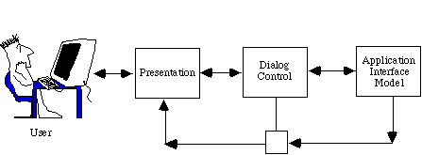
Seeheim Model
Resulted from the 1st UI software tools workshop which took place in Seeheim, Germany. Nov 1-3, 1983.
Logical model of a UIMS
  UIMS = User Interface Management System (old name for user interface software)
  All UI software must support these components, but are they separated? How interface?
Note that input and output are entirely separate

Slide 22
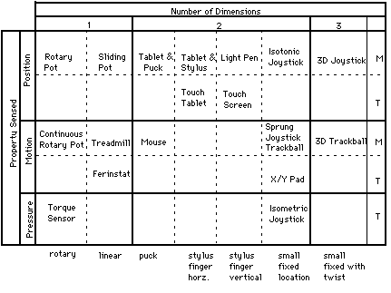
Buxton’s classification [1983]
Continuous manual input devices
  M = indirect
  T = touch
  directly

Slide 23
Card, Mackinlay, Robertson model
Stuart K. Card, Jock D. Mackinlay, and George G. Robertson. 1990. The design space of input devices. In Proceedings of the SIGCHI Conference on Human Factors in Computing Systems (CHI '90), ACM, New York, NY, USA, 117-124. http://doi.acm.org/10.1145/97243.97263
Extends Buxton’s model beyond just continuous devices
“Basically, an input device is a transducer from the physical properties of the world into logical values of an application.”
Input device is a six-tuple: (M, In, S, R, Out, W)
  M is a manipulation operator (slide, rotary, force, distance)
  In is the input domain,
  S is the current state of the device,
  R is a resolution function that maps from the input domain set to the output domain set,
  Out is the output domain set, and
  W is a general purpose set of device properties that describe additional aspects of how a device works (perhaps using production systems).
Composition operators – how inputs connected (x and y of mouse, buttons, output of one to input of another)

Slide 24
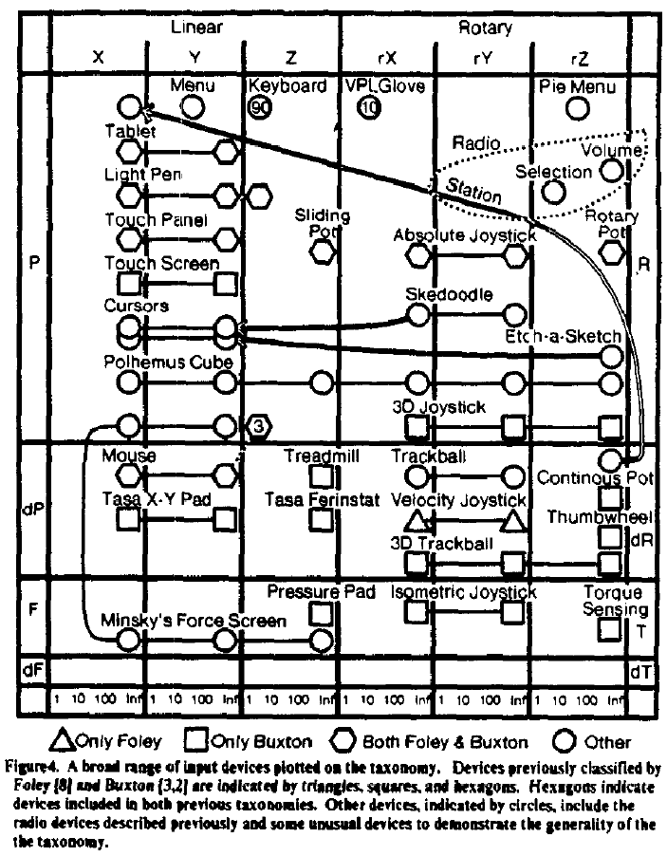
Card, Mackinlay,
Robertson Model, cont.

Slide 25
Model-View-Controller
Glenn Krasner and Stephen T. Pope, "A Cookbook for Using the Model-View-Controller User Interface Paradigm in Smalltalk-80", Journal of Object-Oriented Programming (JOOP). August-September, 1988. vol. 1, no. 3. pp. 26-49. pdf scan at UCI
Invented in Smalltalk, about 1980
Idea: separate out presentation (View), user input handling (Controller) and "semantics" (Model) which does the work
Fairly straightforward in principal, hard to carry through
Never adequately explained (one article, hard to find)
Goals
  program a new model, and then re-use existing views and controllers
  multiple, different kinds of views on same model

Slide 26
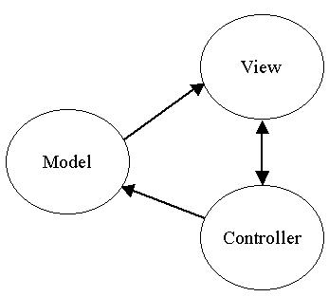
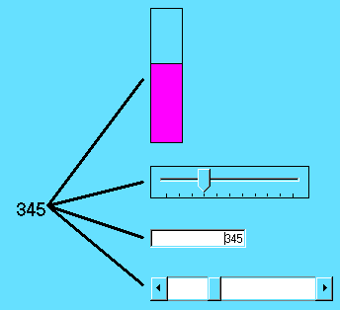
MVC

Slide 27
MVC
Model
  Simple as an integer for a counter; string for an editor
  Complex as a molecular simulator
Views
  Everything graphical
  Layout, subviews, composites
  Can be multiple per model
Controller
  Schedule interactions with other VCs
  A menu is a controller
  Usually 1-to-1 with Views

Slide 28
Interactors [Myers, 1990]
Brad A. Myers. 1990. A new model for handling input. ACM Trans. Inf. Syst. 8, 3 (July 1990), pp. 289-320. http://doi.acm.org/10.1145/98188.98204 or local pdf.
Idea: provide reusable behavior objects that would encapsulate all parameterizations needed
  Create all widgets and other interactions using just these behavior objects
  Independent of the graphics
  Parameterized by which event causes it to start/stop/abort, objects affected, call-back when finished, feedback type, etc.
  First successful implementation of the “C” part of MVC
Kinds (as revised in Amulet)
  Choice-lnteractor – choose one or more of a set
  Move-Grow-Interactor – move or grow existing objects, with gridding, minimum size, flip-if-change size, etc.
  New-Point-Interactor – enter 1 or 2 or n new points
  Angle-Interactor - rotation
  Text-Interactor – text editing
  Gesture-Interactor – traces that can be recognized

Slide 29
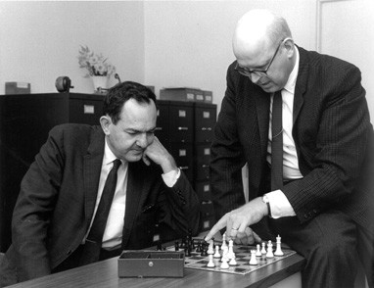
Human Performance Modeling
Source: CMU

Slide 30
User Modeling
Even if we can’t perfectly simulate the human brain, we can approximate it with theories that match what we observe,
and model how it behaves. If we do it well, then the models will match experiments.

Slide 31
Human Performance Modeling
John, B. E. (2003) "Information processing and skilled behavior." Chapter 4 In J. M. Carroll, (Ed.), Toward a multidisciplinary science of human computer interaction. Morgan Kaufman. pp. 55-101.
Goal: Compute measures of human performance without needing to do user tests
Use a “model” of how people work, that has been validated to be reasonably accurate, given certain assumptions
Works well for low-level, expert tasks
  “How long will it take to enter this sequence of commands?”
  Errors (both novice and skilled)
Research on higher-level, problem solving tasks
  Visual search, figure out how to do things, etc.

Slide 32
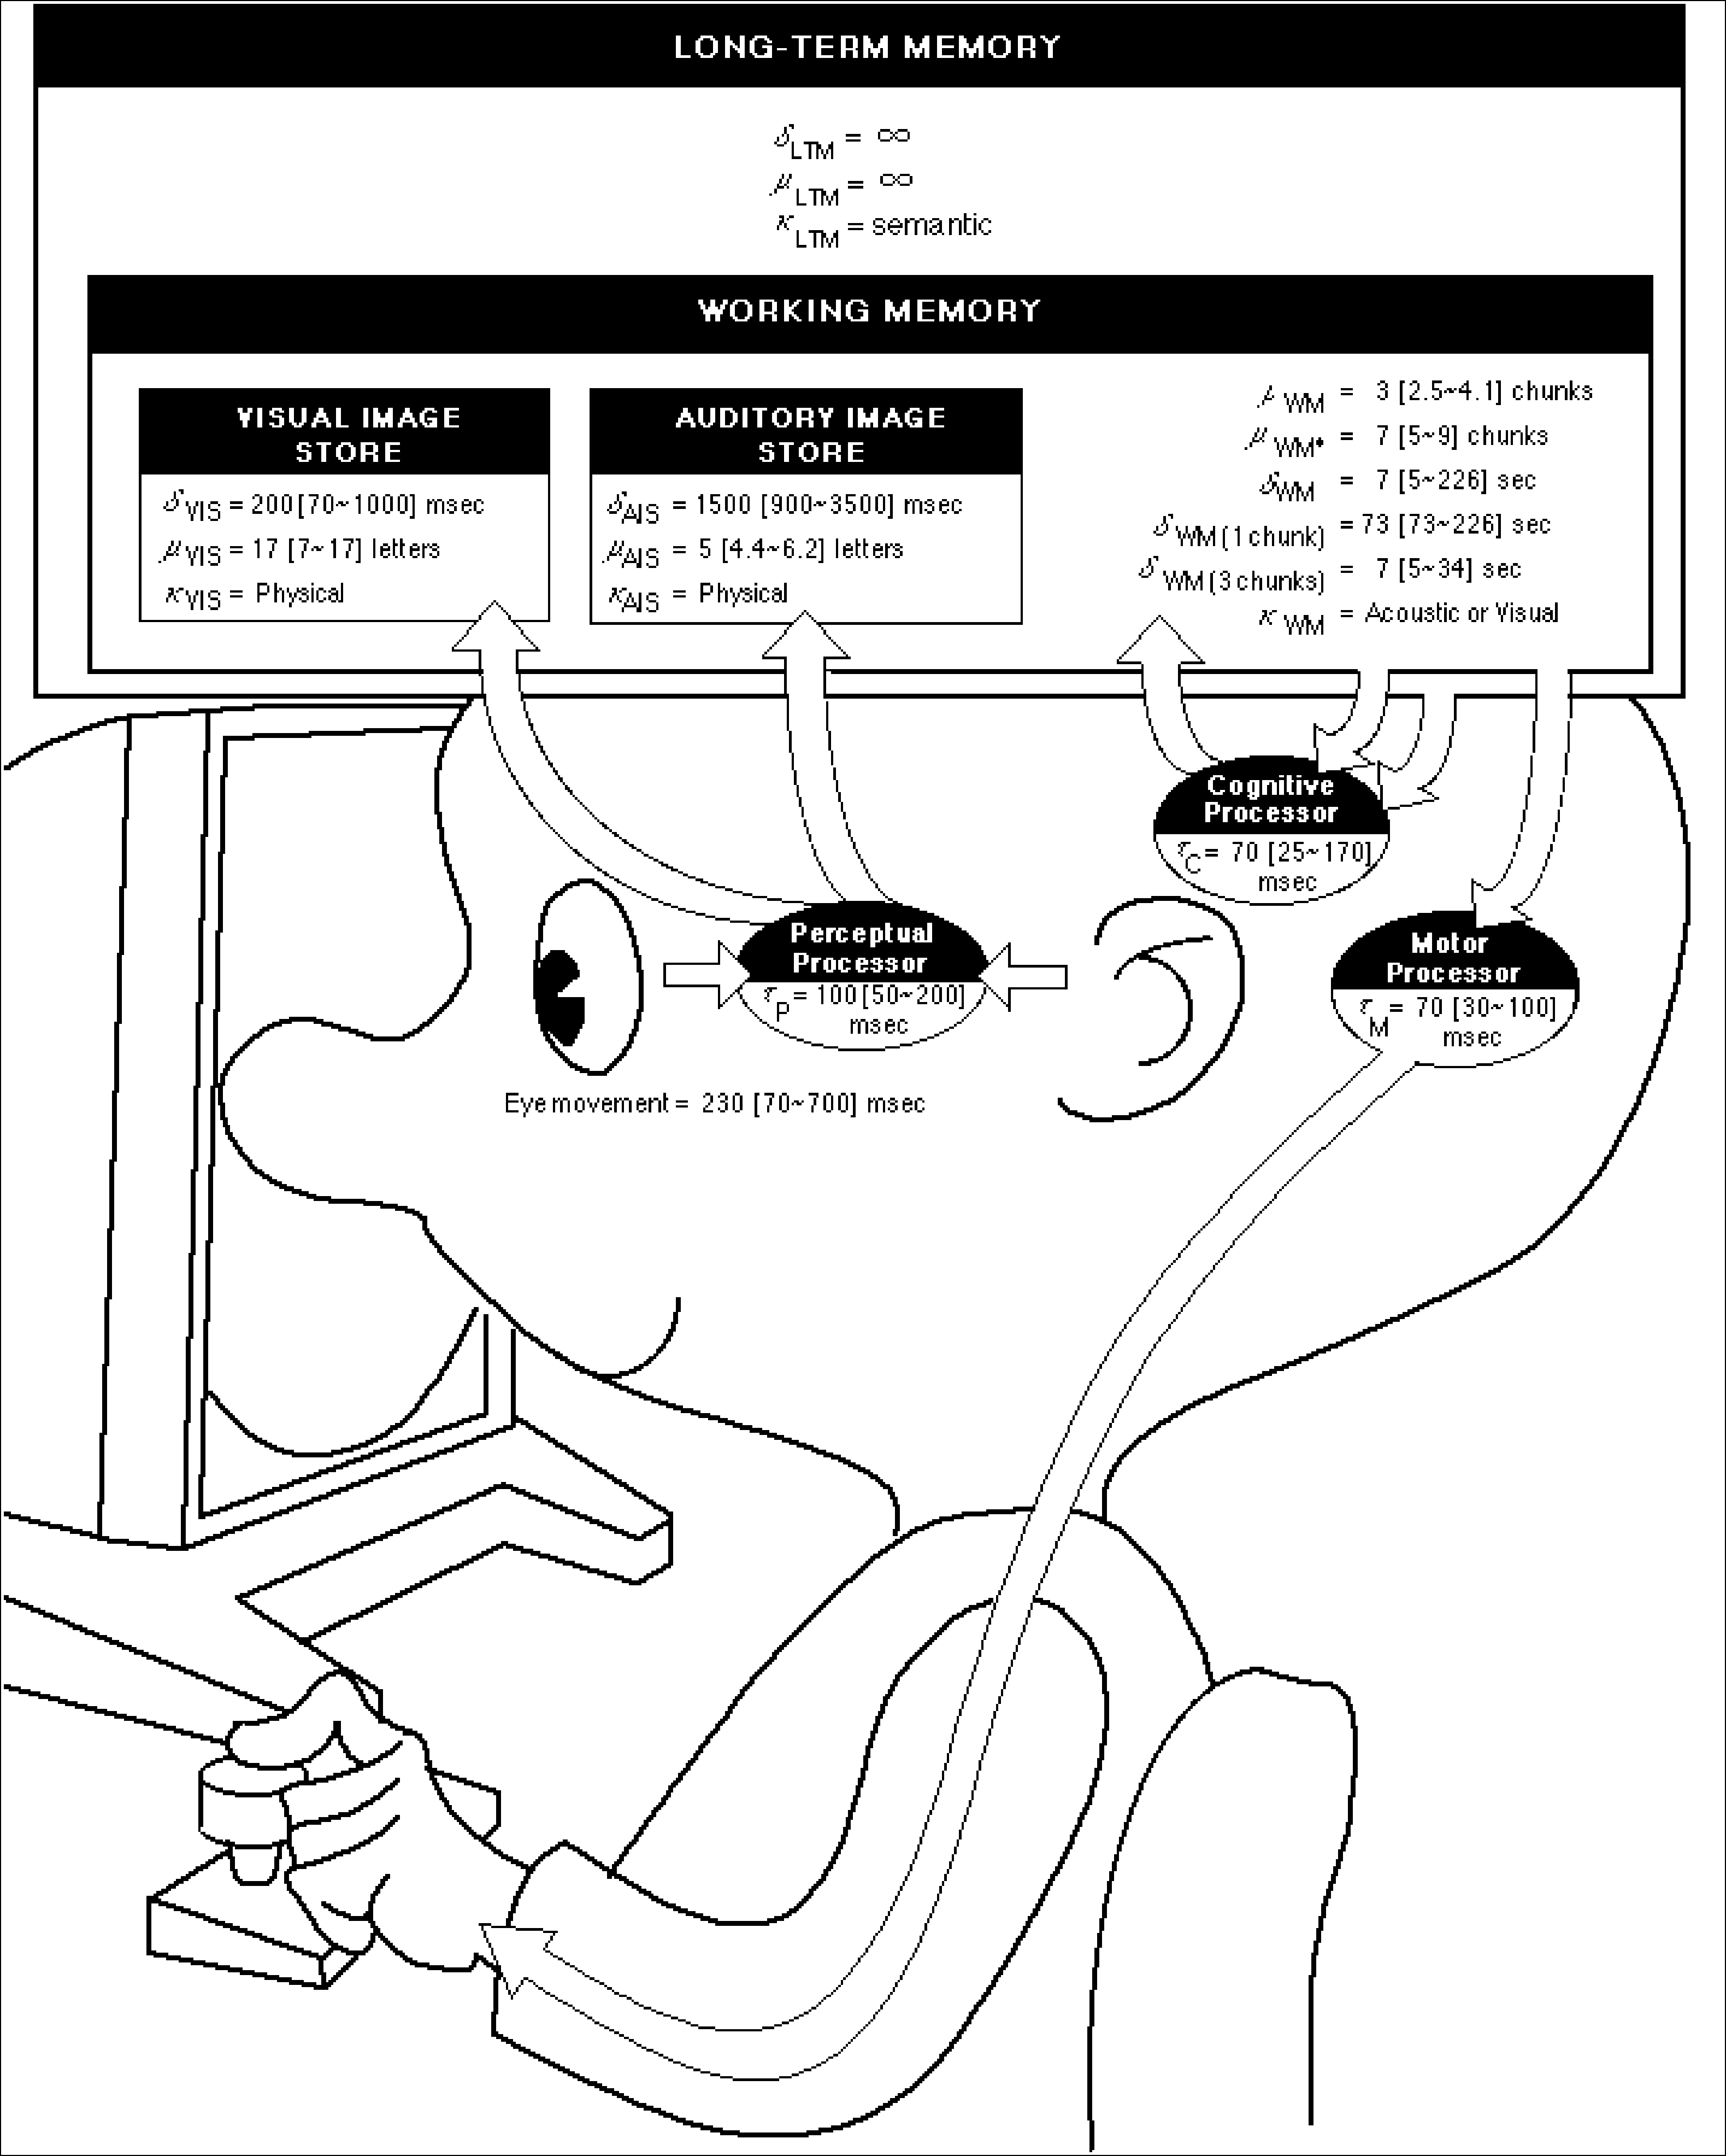
Wouldn’t it be great…
Reference: Stuart K. Card, Thomas P. Moran and Allen Newell. The Psychology of Human-Computer Interaction. Hillsdale, NJ, Lawrence Erlbaum Associates. 1983.
Just point Mr. Bubblehead (the Model Human Processor) at a system, automatically generate performance measures, in context, AND see what’s inside its “mind” and “heart”?
Better yet, point Mr. Bubblehead at design ideas (systems that haven’t been built yet)
Fast, cheap, easy to interpret
Quantitative measures to help persuade

Slide 33
Time
Constants

Slide 34
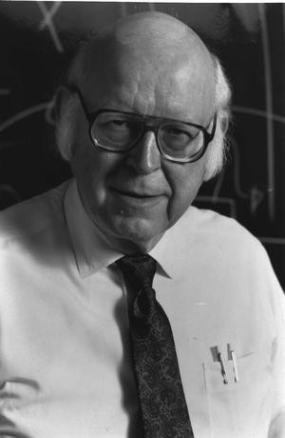
The simplest model: the Keystroke-Level Model (KLM)
Very, very low level
Task-centered
Provides timing data
Find places to optimize
Potential error cases
Source: nap.edu

Slide 35
Keystroke Level Model
Make an ordered list of actions
  Keys you press
  Clicking the mouse
  Scrolling, moving the mouse
  User physical movements
  User consideration, judgment, or thinking
  System responses (does the user have to wait?)
Assign and add up execution times for all the items in the list

Slide 36
Keystroke-Level Model
Stuart K. Card, Thomas P. Moran, and Allen Newell. 1980. The keystroke-level model for user performance time with interactive systems. Commun. ACM 23, 7 (July 1980), pp. 396-410. http://dl.acm.org/citation.cfm?id=358895
  Pre-defined level of detail:
  K (keystroke), P (point with mouse), H (home between devices), M (mental operator), R (system response time)
  Procedure for constructing a sequence of operators that perform a task
  Heuristics for placing mental operators
Input:
  A suite of benchmark tasks that are important to your design or evaluation
  A specification of the proposed system
Output:
  A prediction of the time it would take a skilled user to perform the benchmark tasks on the proposed system
  Accurate to within about 20% of observed performance
Appropriate for skilled performance, without problem solving

Slide 37
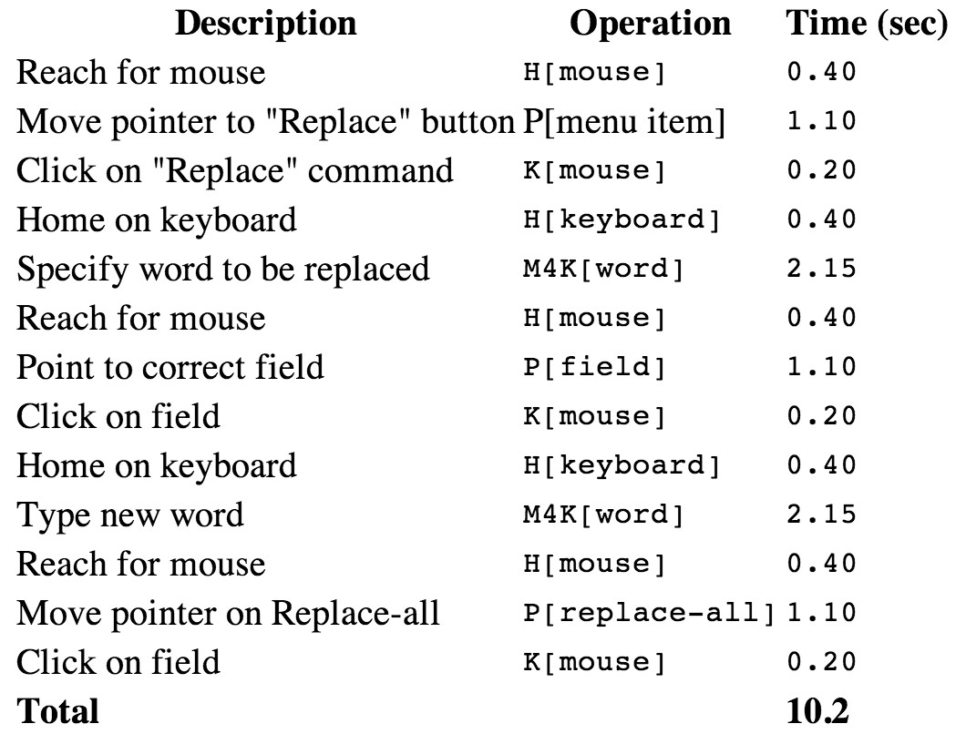
Keystroke Level Model
Source: Hochstein

Slide 38
Keystroke Level Models
Different kinds of users?
More than timing data?
Complex tasks?
Incorporating subtasks?

Slide 39
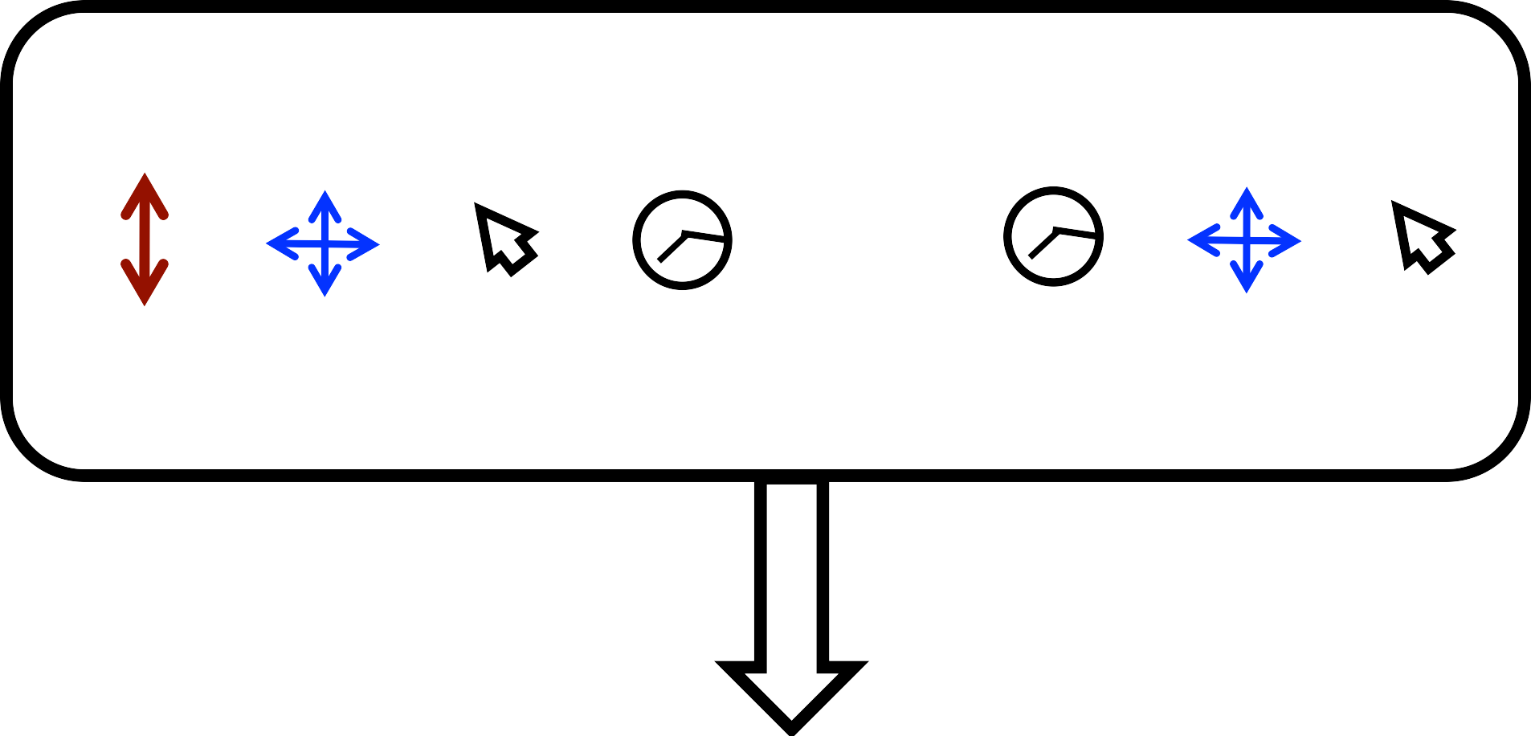
MOUSE MOVE
MOUSE MOVE
SCROLL
CLICK
DELAY
TYPING
DELAY
CLICK
ABC
120px
300px, 20px
Field1
1.1s
‘Hello’
0.9s
100px, 220px
Submit
Check it out: Rzeszotarski & Kittur, 2012

Slide 40
GOMS
High level
More detailed than KLM
Describe your tasks, (users), and interface elements
Generate measurements

Slide 41
GOMS models
Stuart K. Card , Allen Newell , Thomas P. Moran, The Psychology of Human-Computer Interaction, L. Erlbaum Associates Inc., Hillsdale, NJ, 1983
Goals, Operators, Methods, and Selection rules (GOMS)
  Also originally from Card, Moran, and Newell
  Significant advances by Bonnie John in HCII and others
Multiple strategies (“methods”) possible to do an operation (to reach a “goal”) (e.g., delete a character)
  Each strategy uses a variety of “operators”
  “Selection rules” to pick which method
    E.g., use backspace when previous character, use arrow keys when a few characters away, but use mouse when far away
Write these in a special language (e.g., ACT-R, SOAR) and system predicts how long tasks will take.

Slide 42
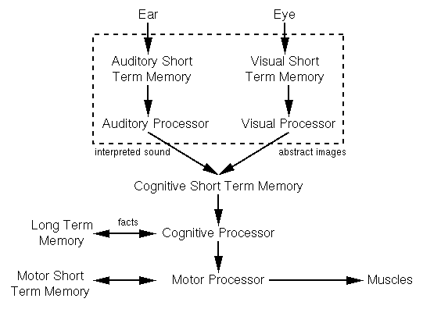
GOMS
Source: Blustein

Slide 43
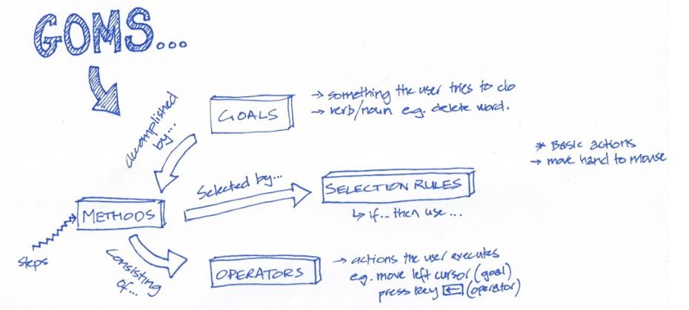
Source: beheconomics.blogspot

Slide 44
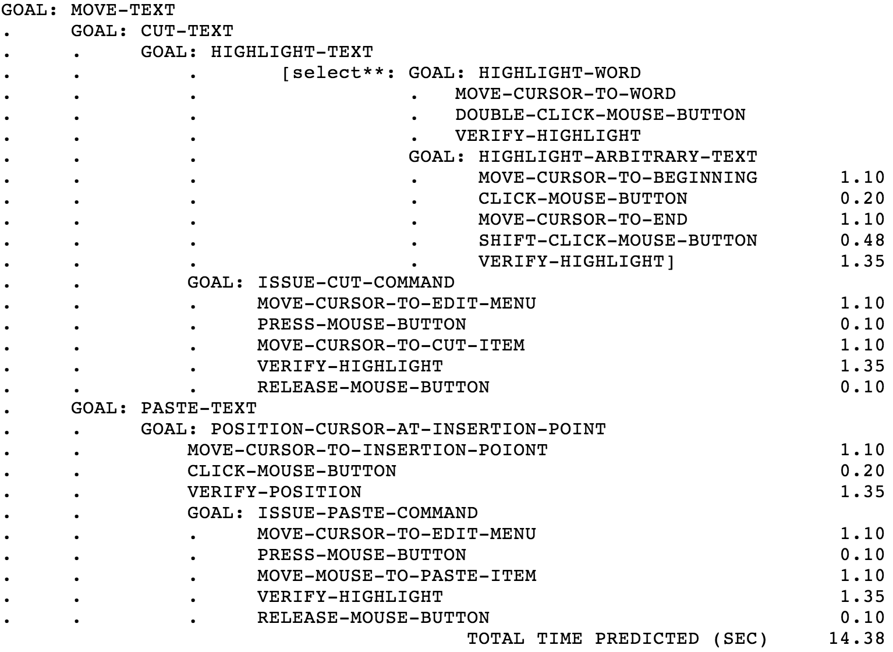
Source: Hochstein

Slide 45
GOMS
vs User Studies
  Sometimes faster, sometimes slower
  More detailed feedback
Requires a goal
  What about browsing?
Doesn’t evaluate design, human factors, social, or organizational impact

Slide 46

CogTool
Bonnie John’s tool to help
with Cognitive Modeling
http://cogtool.hcii.cs.cmu.edu/
Mock-up an interface in a storyboard
  States & transitions between those states
Use interactive widgets on a blank canvas
  Useful as a prototyping tool
Outputs performance predictions

Slide 47
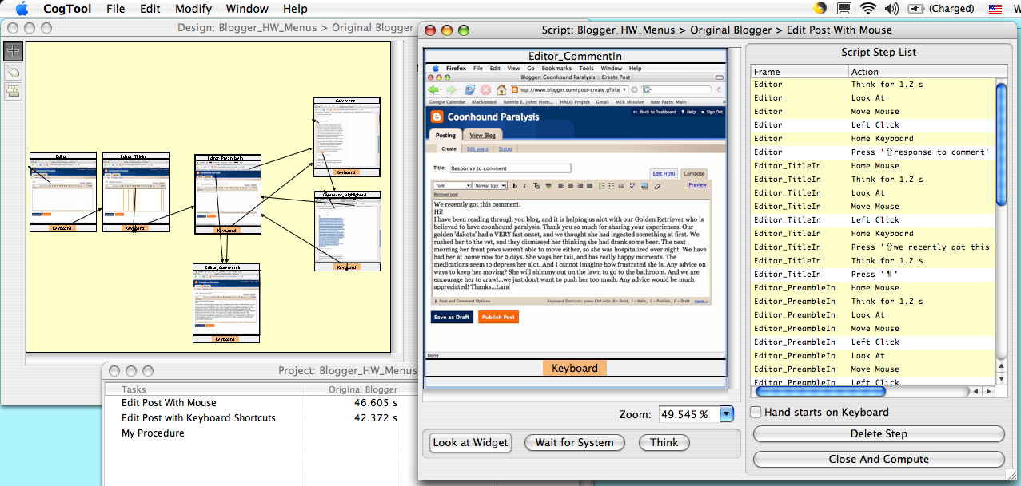
CogTool produces predictions through demonstrating tasks on a storyboard
1. Mock-up design in a storyboard
3. Predictions appear in a spreadsheet
2. Demonstrate the tasks

Slide 48
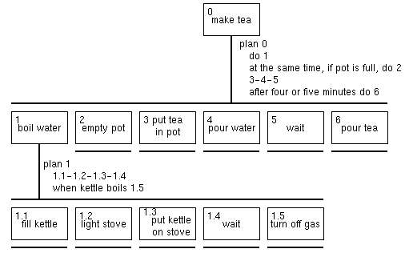
Other Task Models
Hierarchical Task analysis
Source: Blustein

