Slide 1
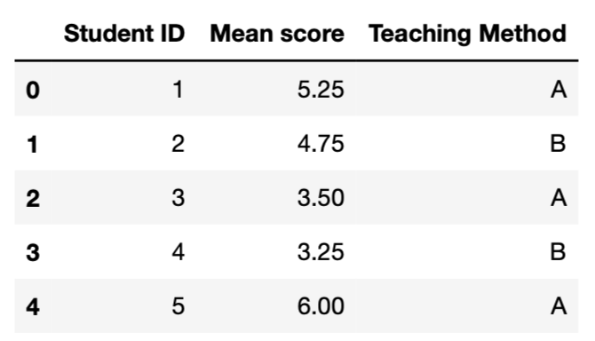
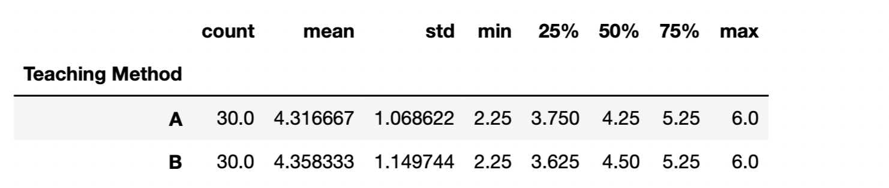
Slide 2
Raw Data
Descriptive statistics
Checking normality distribution

Slide 2
Slide 3
The p_value of 0.88 means that both sample are likely to come from a population with the same mean and that the 2 teaching methods produce similar results on average

