Slide 1
Deciphering C-section Rate Disparities: Analyzing Swiss Hospital Traits for Insights
CAS ADS Module 3 Group Project
Gaëlle Marti, Simon Rime, Lenja Flütsch
09.10.2023

Slide 2
Outline
Aim
Data
Models to find predictive features
Logistic regression
Decision Trees (Regression & Classfication)
K-Means Clustering (do we see differences in means of c-section rates in clusters created with all the features?)
Creation of new Dataset with only predictive features
Rerunning the Clustering with the new dataset
Conclusion/Discussion

Slide 3
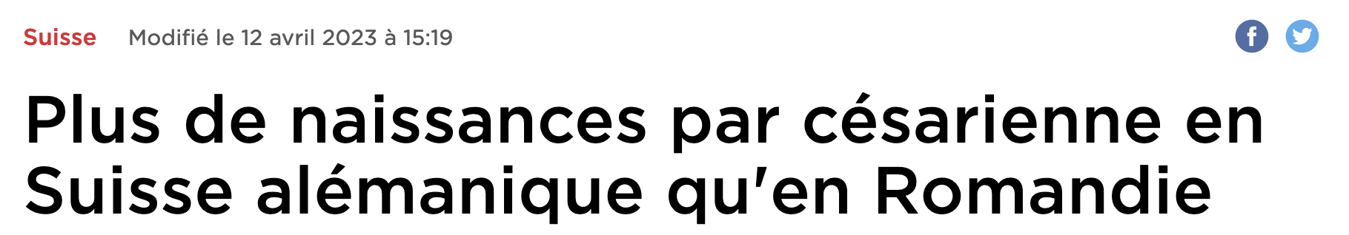
Source: RTS, l'Observatoire de la santé (Obsan)

Slide 4
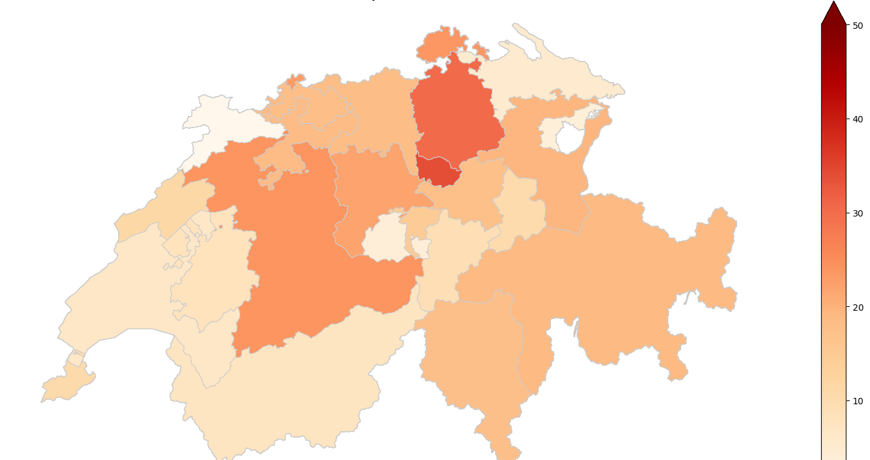
C-Section rates across Switzerland
Map 1: Inpatient C-Section rates per canton in 2021
Canton | C-Section Rate
Zug | 41.5
Zürich | 39.1
Bern | 36.2
Schaffhausen | 36.0
Basel-Stadt | 35.7
Lucerne | 35.2
Valais | 34.4
Sankt Gallen | 34.0
Graubünden | 33.6
Solothurn | 33.5
Aargau | 33.3
Basel-Landschaft | 33.2
Schwyz | 32.9
Nidwalden | 31.3
Ticino | 31.2
Neuchâtel | 29.6
Genève | 29.3
Glaurs | 29.0
Uri | 28.4
Fribourg | 27.8
Vaud | 27.1
Thurgau | 26.3
Obwalden | 25.6
Appenzell Ausserrhoden | 25.5
Jura | 23.6

Slide 5
Aim:
We aim to analyze hospital traits, such as infrastructural characteristics and staff, as potential explanatory variables for the stark differences in C-section rates observed across Swiss hospitals. Our project is centered around determining patterns in hospital characteristics that can account for the variations in C-section rates among different healthcare institutions.

Slide 6
Short Overview of the Dataset: - Types of Data - Sources

Slide 7
Data cleaning and preprocessing

Slide 8
Logistic Regression: Procedure and predictive features

Slide 9
Decision Trees: Procedure and predictive features

Slide 10
Random Forest: Procedure and predictive features

Slide 11
Boosted Decision Tree: Procedure and predictive features

Slide 12
Clustering with the entire dataset: Do we see Mean differences for C-section rates between the clusters?

Slide 13
Taking all the results together: Which features do we have and do certain features appear with different methods?

Slide 14
Creating a new dataset with only the predictive features

Slide 15
Rerunning the Clustering: Do we now see differences in C-Section rate means between the Clusters?

Slide 16
Conclusion/Discussion

Slide 17
Thank you for your attention!

