Slide 1

H0 = There are no systematic differences in width.
H1 = There is a significant difference between both widths.
Assumption: We can reject H0 with a confidence level of 95%.

Slide 2
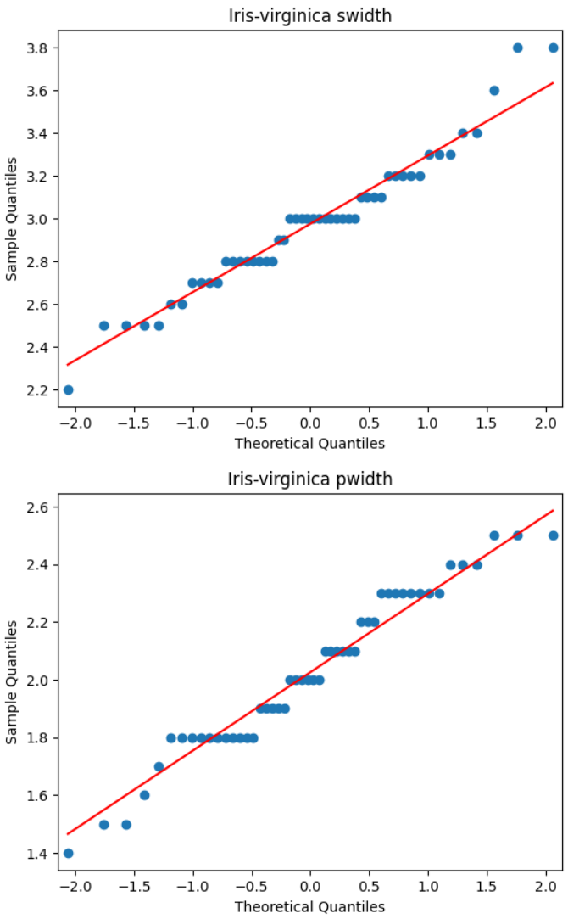
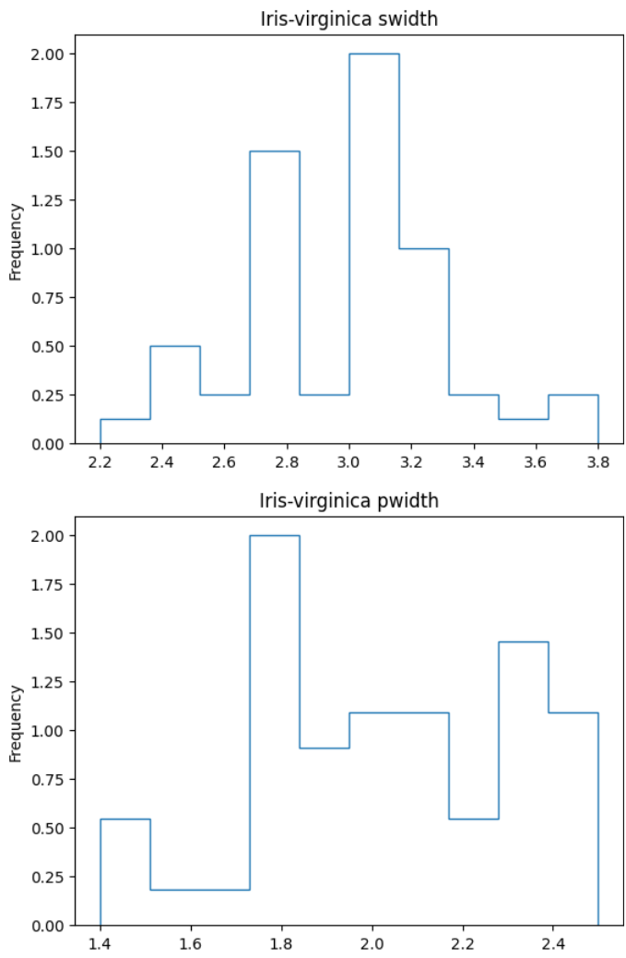

Slide 3

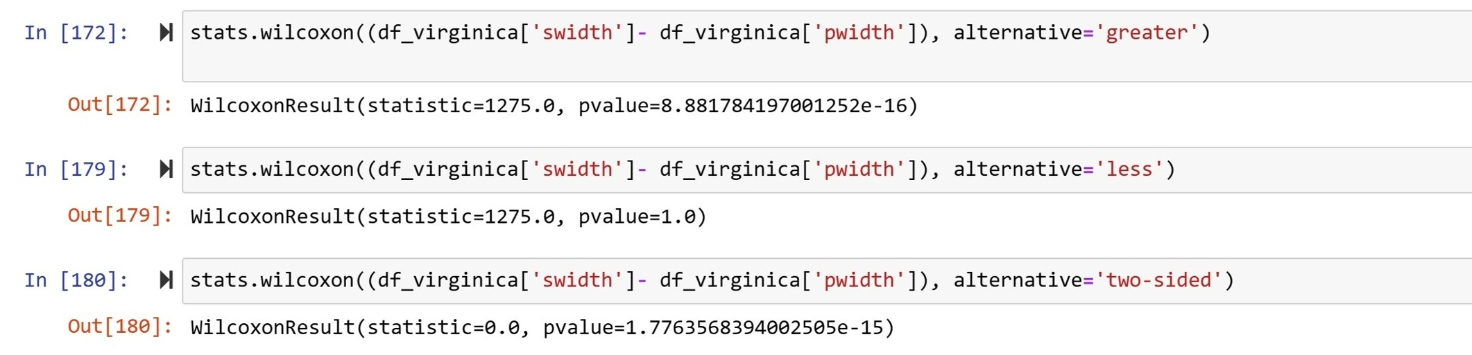
WilcoxonSigned-ranktest

