Slide 1
Wine Quality Dataset
Can one actually tell good quality wine from bad quality wine?

Slide 2
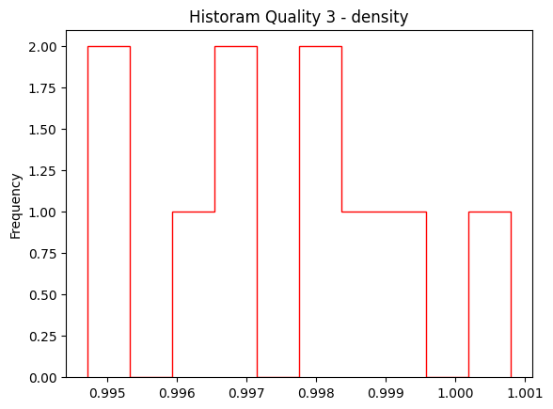
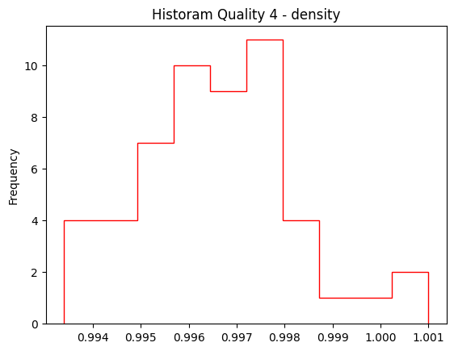
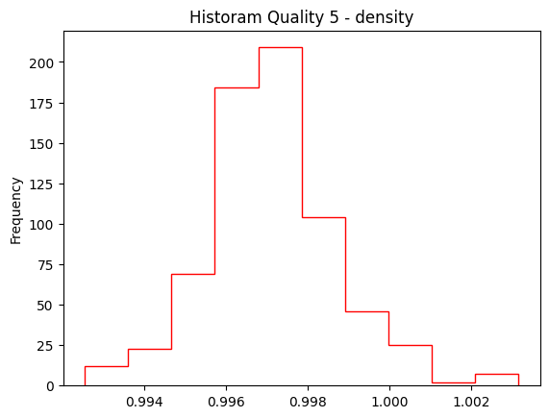
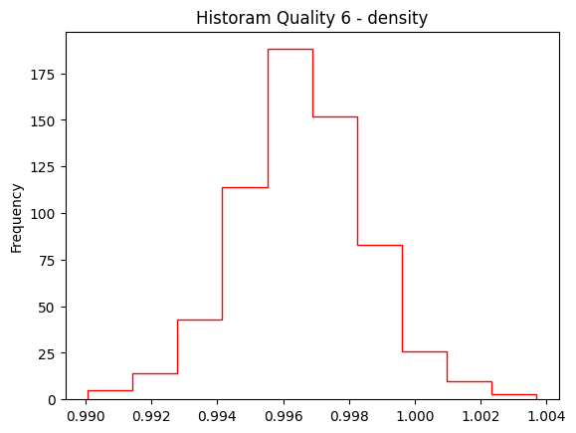
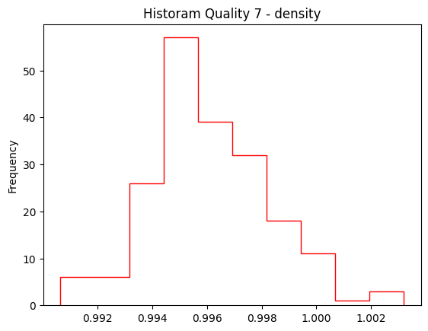
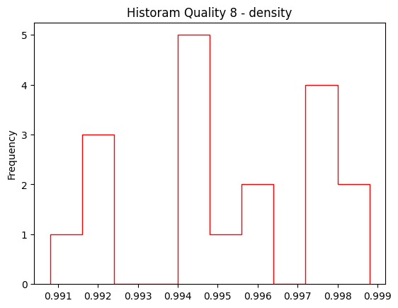
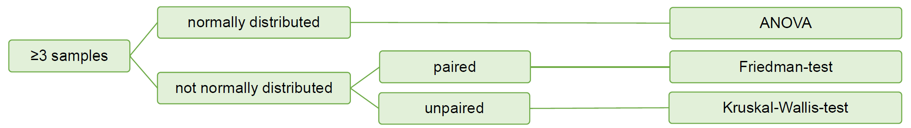
Wine Quality Dataset (1,599 Observations)
Dataset Features:
fixed acidity | volatile acidity | citric acid | residual sugar | chlorides | free sulfur dioxide | total sulfur dioxide | density | pH | Sulphates | alcohol | quality

Slide 3
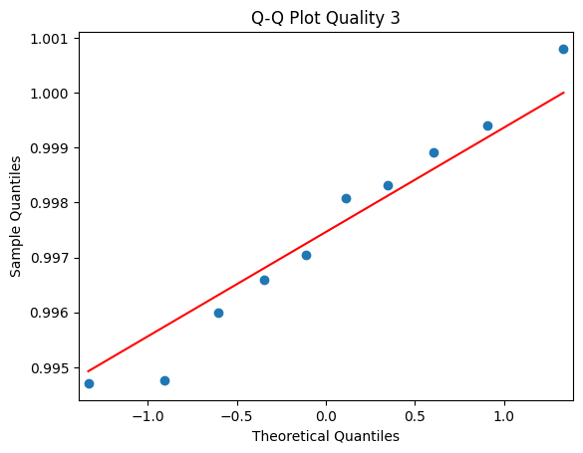
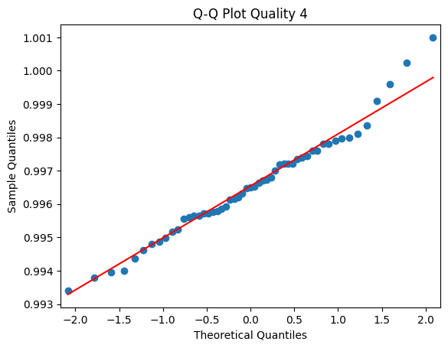
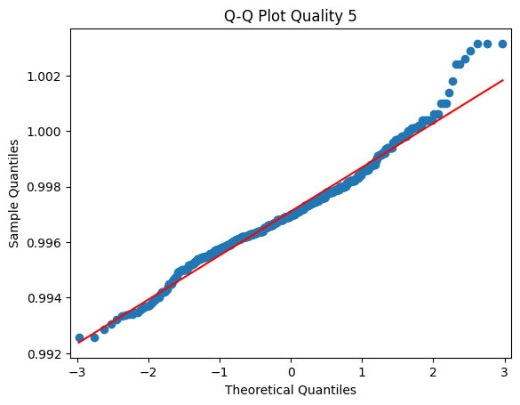
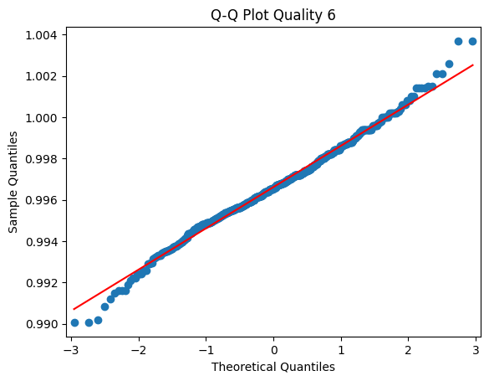
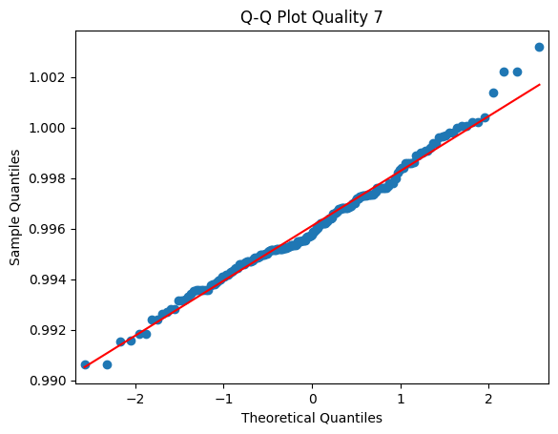
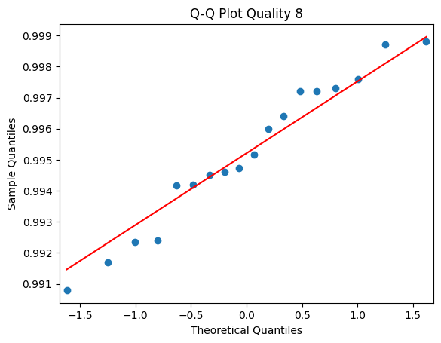
QQ-Plots of Wine Density for the Different Wine Categories
Wine density follows a normal distribution for all wine categories!

Slide 4
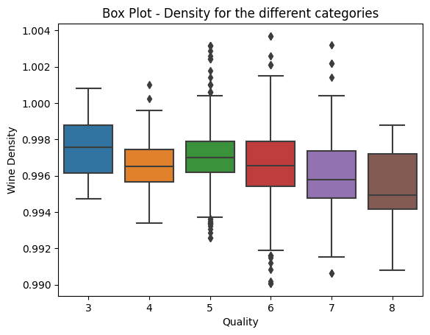
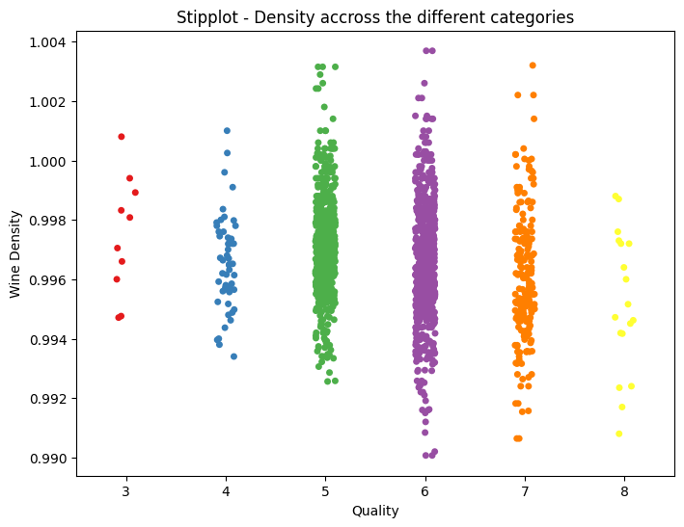
Anova Test
P value for out Anova Test:
Stats.f_oneway( Density_Quality_3, Density_Quality_4, Density_Quality_5, Density_Quality_6, Density_Quality_7, Density_Quality_8)
P Value = 8.12e-13
Interpretation: Wine Density differs for at least one wine category.

Slide 5
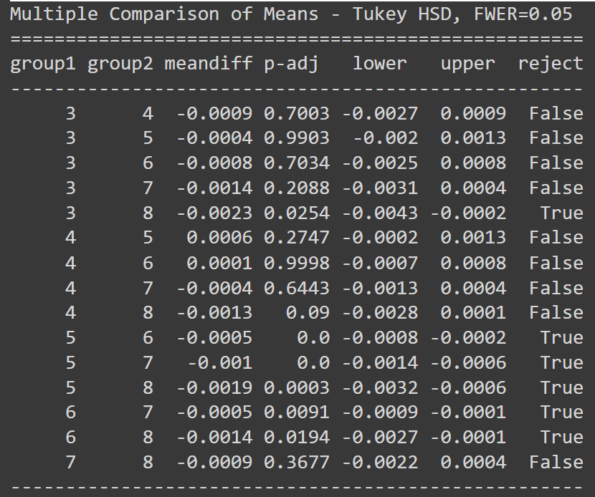
Test for Pairwise Comparison
For the reject = True P value is lower then 0.05 then Null Hypothesis can be rejected.
Meaning there are significant differences in the Density mean between wine categories.

