Slide 1


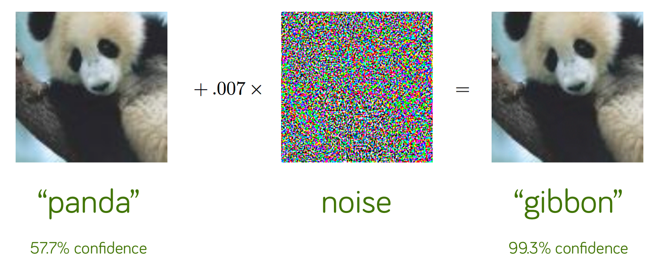
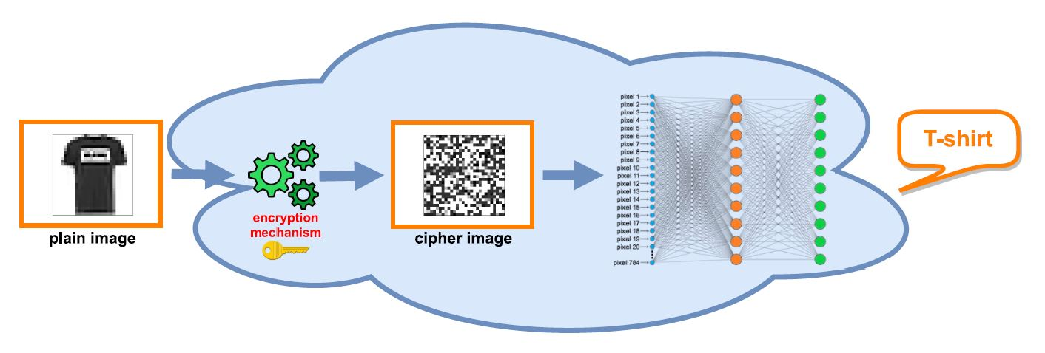
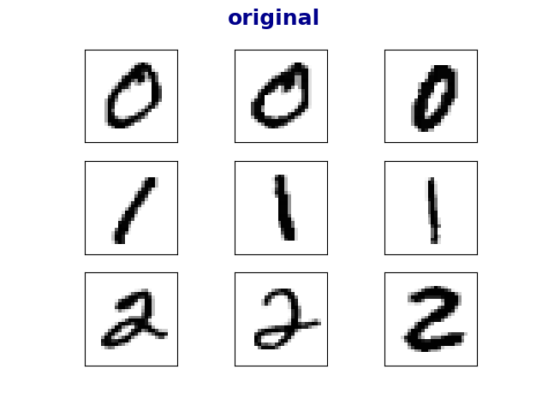
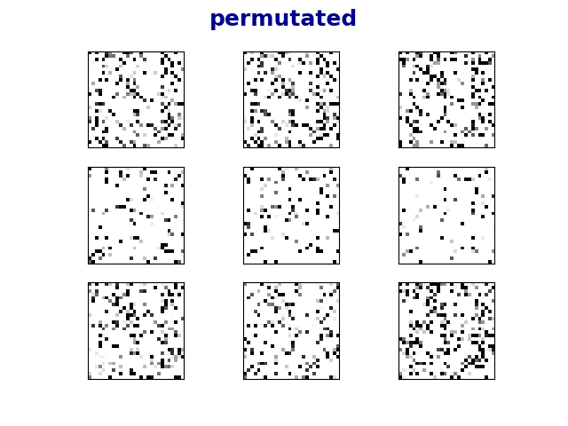
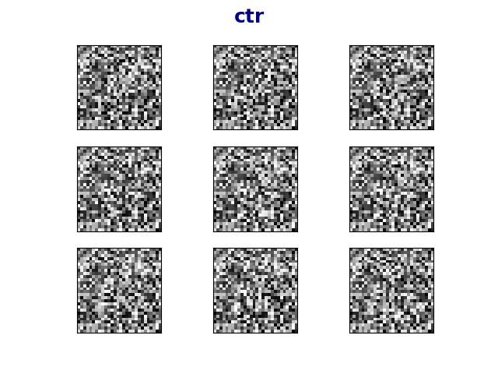
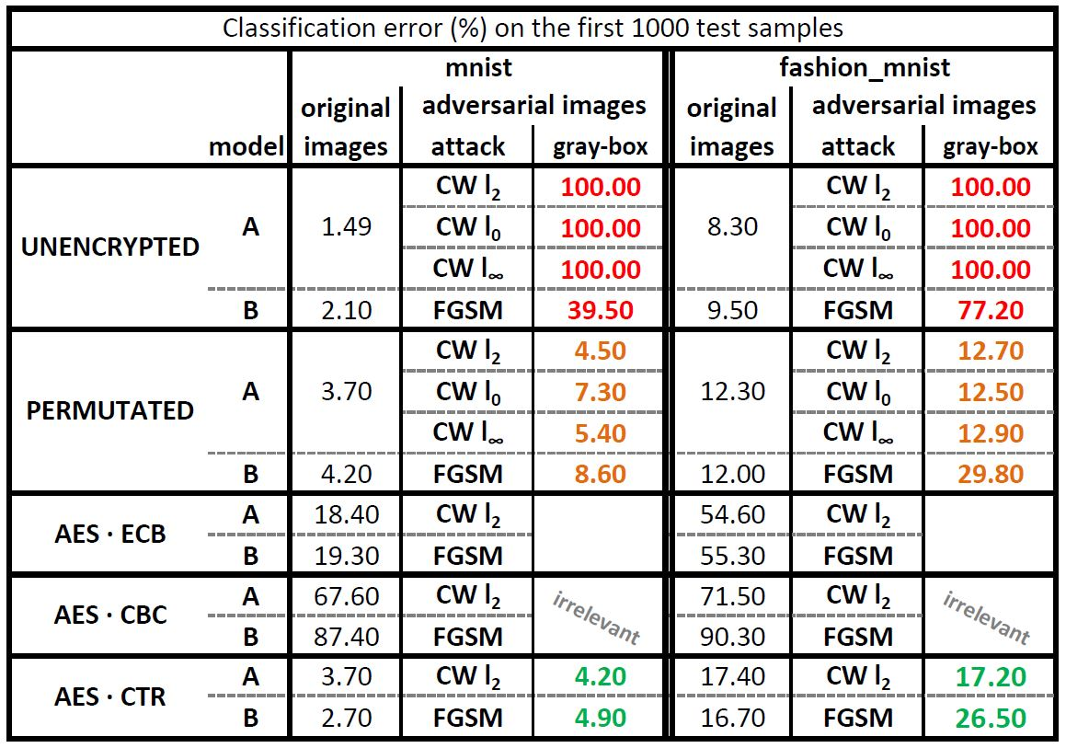
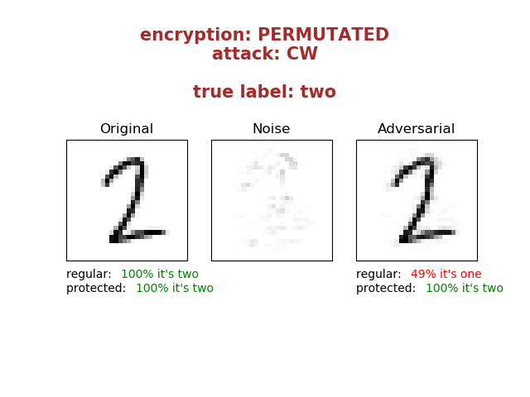
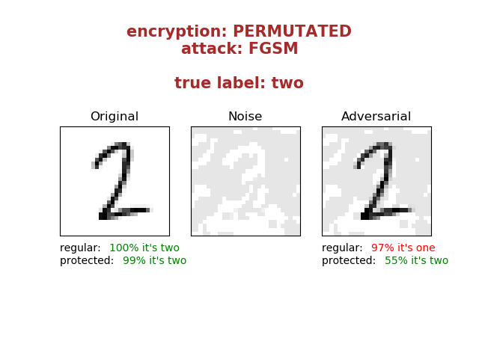




בס"ד
DEFENCE AGAINST
ADVERSARIAL EXAMPLES
­­­­­­­­­___________________
Yishay Asher • Steve Gutfreund
Instructor: Hanan Rosemarin
Problem Description
Building high accuracy DNN models which are sufficiently resistant to adversarial attacks
Background
An adversarial example is an instance with small, intentional feature perturbations that cause a machine learning model to make a false prediction.
(See figure 1)
Goal
Find a way to train ‘secured’ models such that this sort of attacks should not affect them.
Figure 1: example of an adversarial example
Set-Up
Results
We worked on mnist and fashion-mnist.
We’ve set neural networks known to be able to learn these datasets very well.
There’s a tradeoff between accuracy on the original images and the accuracy on the adversarial images.
permutation: although the error rate on the originals increased by a little bit (1% on mnist and 4% on fashion-mnist), the error rate on the adversarial decreased significantly
AES-CTR: on mnist it performs better than permutation but yet on fashion mnist the error rate on the adversarials is slightly higher
See figure 5 for the detailed results.
Securing Models
Figure 2: architecture of the secure models
We followed the approach presented in the article ‘Bridging machine learning and cryptography in defence against adversarial attacks’:
training models on encrypted images, see figure 2.
Encryption techniques:
Permutation on the pixels, as done in the article
AES in ECB, CBC and CTR modes of operation
original
permutated
ctr
Cutting loose ends
Figure 3: Sample of the encrypted images (permutated and aes-ctr). Interesting to see how for the human eyes it’s impossible to distinguish between various classes but a DNN model classifies quite well, see figure 5 for accuracies
Before performing an attack, we eliminated the models that did not learn well.
As can be seen in figure 3, learning is not so intuitive.
For this reason, AES in ECB and CBC mode were irrelevant to continue with.
Attacking
Figure 5: table containing all the results
Attacking the sufficiently accurate models with the following attacks:
Carlini & Wagner, CW
https://github.com/carlini/nn_robust_attacks
Fast Gradient Sign Method, FGSM
https://github.com/tensorflow/cleverhans
We focused on the ‘gray-box’ scenario, i.e. the attacker knows the architecture of the model but has no access to the private key.
See figure 4 for a visualization.
Future Work
improve accuracy on AES-ECB model (we got error rate of 19% on mnist and 55% on fashion-mnist)
we contacted Nicholas Carlini (the ‘C’ in CW attack) and he believes we still might defeat these defenses
try some other datasets; i.e. cifar-10, its images are 3 layered (rgb) and might be more difficult to learn encrypted images
Figure 4: visualization of a CW and FGSM attack

Slide 2
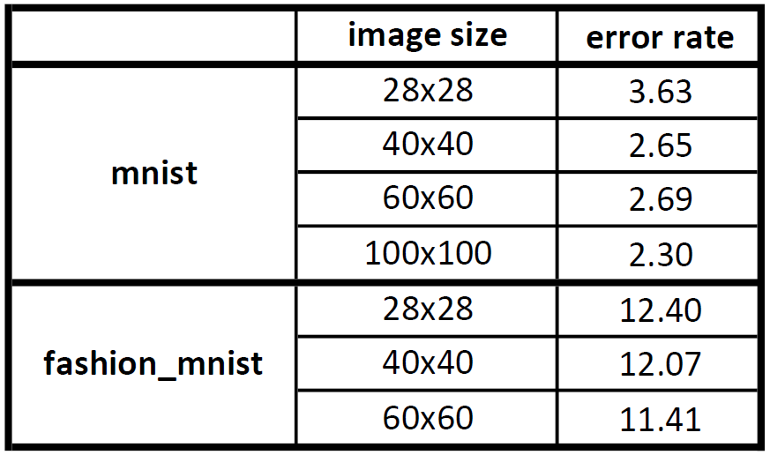
בס"ד
DEFENCE AGAINST
ADVERSARIAL EXAMPLES
­­­­­­­­­___________________
Yishay Asher • Steve Gutfreund
Instructor: Hanan Rosemarin
Problem Description
Building high accuracy DNN models which are sufficiently resistant to adversarial attacks
Background
An adversarial example is an instance with small, intentional feature perturbations that cause a machine learning model to make a false prediction.
(See figure 1)
Goal
Find a way to train ‘secured’ models such that this sort of attacks should not affect them.
Figure 1: example of an adversarial example
Set-Up
Securing Models
Cutting loose ends
Attacking
Mnist and fashion-mnist
Using well-known neural nets for these datasets
Our approach: training models on encrypted images, see figure 2.
Encryption techniques:
Permutation on the pixels, as done in the article
AES in ECB, CBC and CTR modes of operation
We eliminated the models that did not learn well.
As can be seen in figure 3, learning is not so intuitive.
For this reason, ECB and CBC mode were irrelevant to continue with.
Attacking the sufficiently accurate models with the following attacks:
Carlini & Wagner, CW
Fast Gradient Sign Method, FGSM
We focused on the ‘gray-box’ scenario, i.e. the attacker knows the architecture of the model but has no access to the private key.
See figure 4 for a visualization.
original
permutated
ctr
Figure 2: architecture of the secure models
Figure 3: Sample of the encrypted images (permutated and aes-ctr). Interesting to see how for the human eyes it’s impossible to distinguish between various classes but a DNN model classifies quite well, see figure 5 for accuracies
Results
There’s a tradeoff between accuracy on the original images and the accuracy on the adversarial images.
permutation: although the error rate on the originals increased by a little bit (1% on mnist and 4% on fashion-mnist), the error rate on the adversarial decreased significantly
AES-CTR: on mnist it performs better than permutation but yet on fashion mnist the error rate on the adversarials is slightly higher
See table 1 for the detailed results.
Figure 4: visualization of a CW and FGSM attack
Future Work
improve accuracy on AES-ECB model (as can be seen in the table, the model managed to learn)
we contacted Nicholas Carlini (the ‘C’ in CW attack) and he believes we still might defeat these defenses
try some other datasets; i.e. cifar-10, its images are 3 layered (rgb) and might be more difficult to learn encrypted images
Table 1: table containing all the results
Efficiency of Permutation
In order to check the efficiency of training models on permutated data, we trained models on images with greater dimensions.
See table 2 for the results.
Table 2: results for training permutated data, various image dimensions

