Slide 1


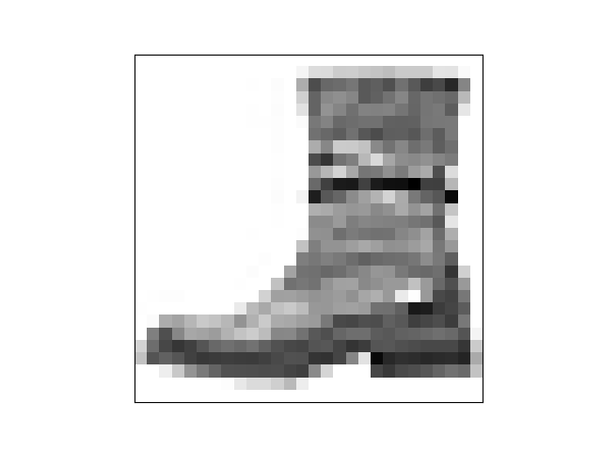
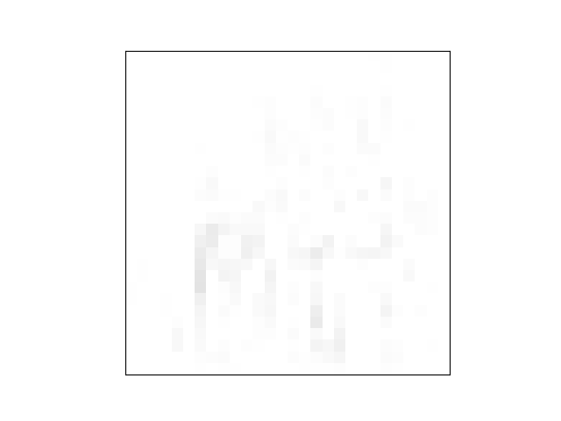


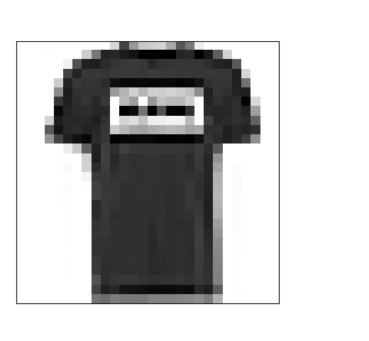

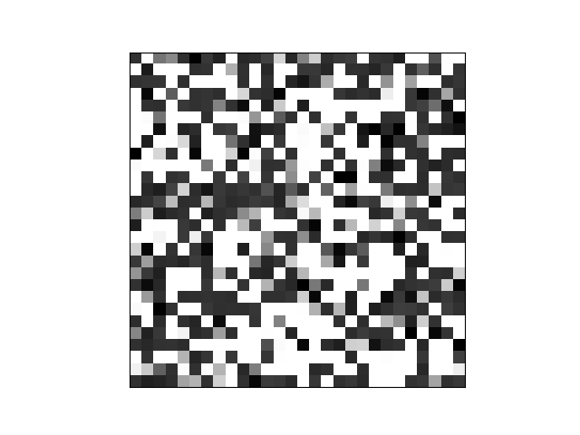
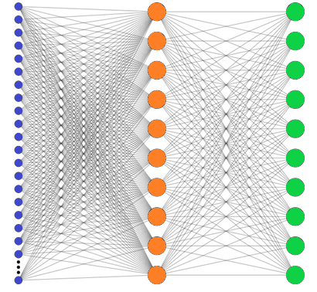

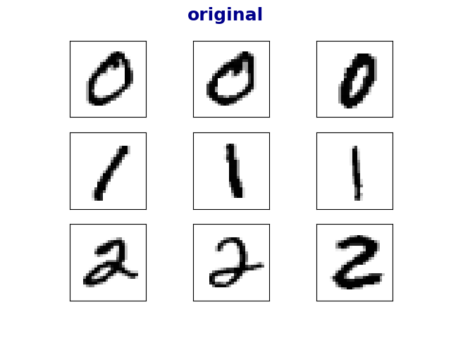
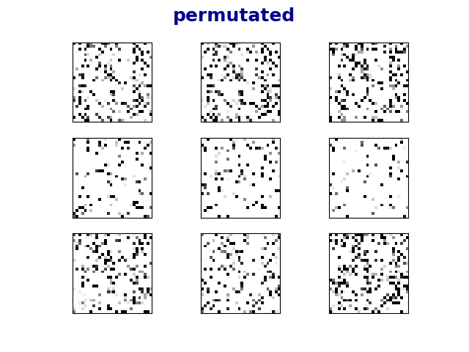
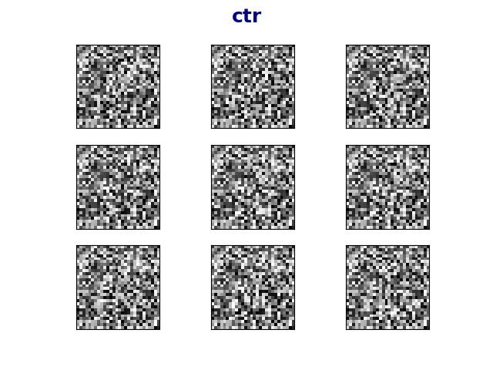
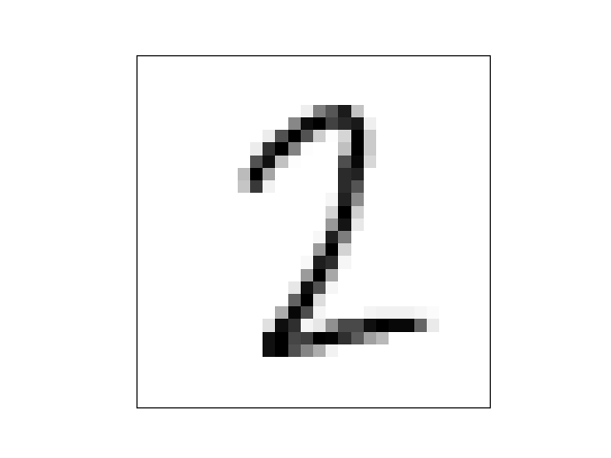
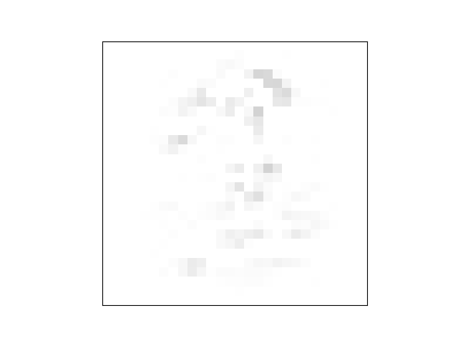
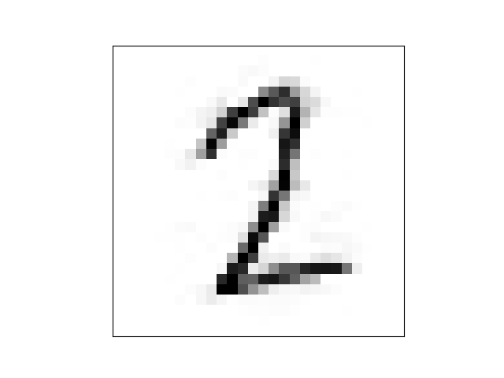




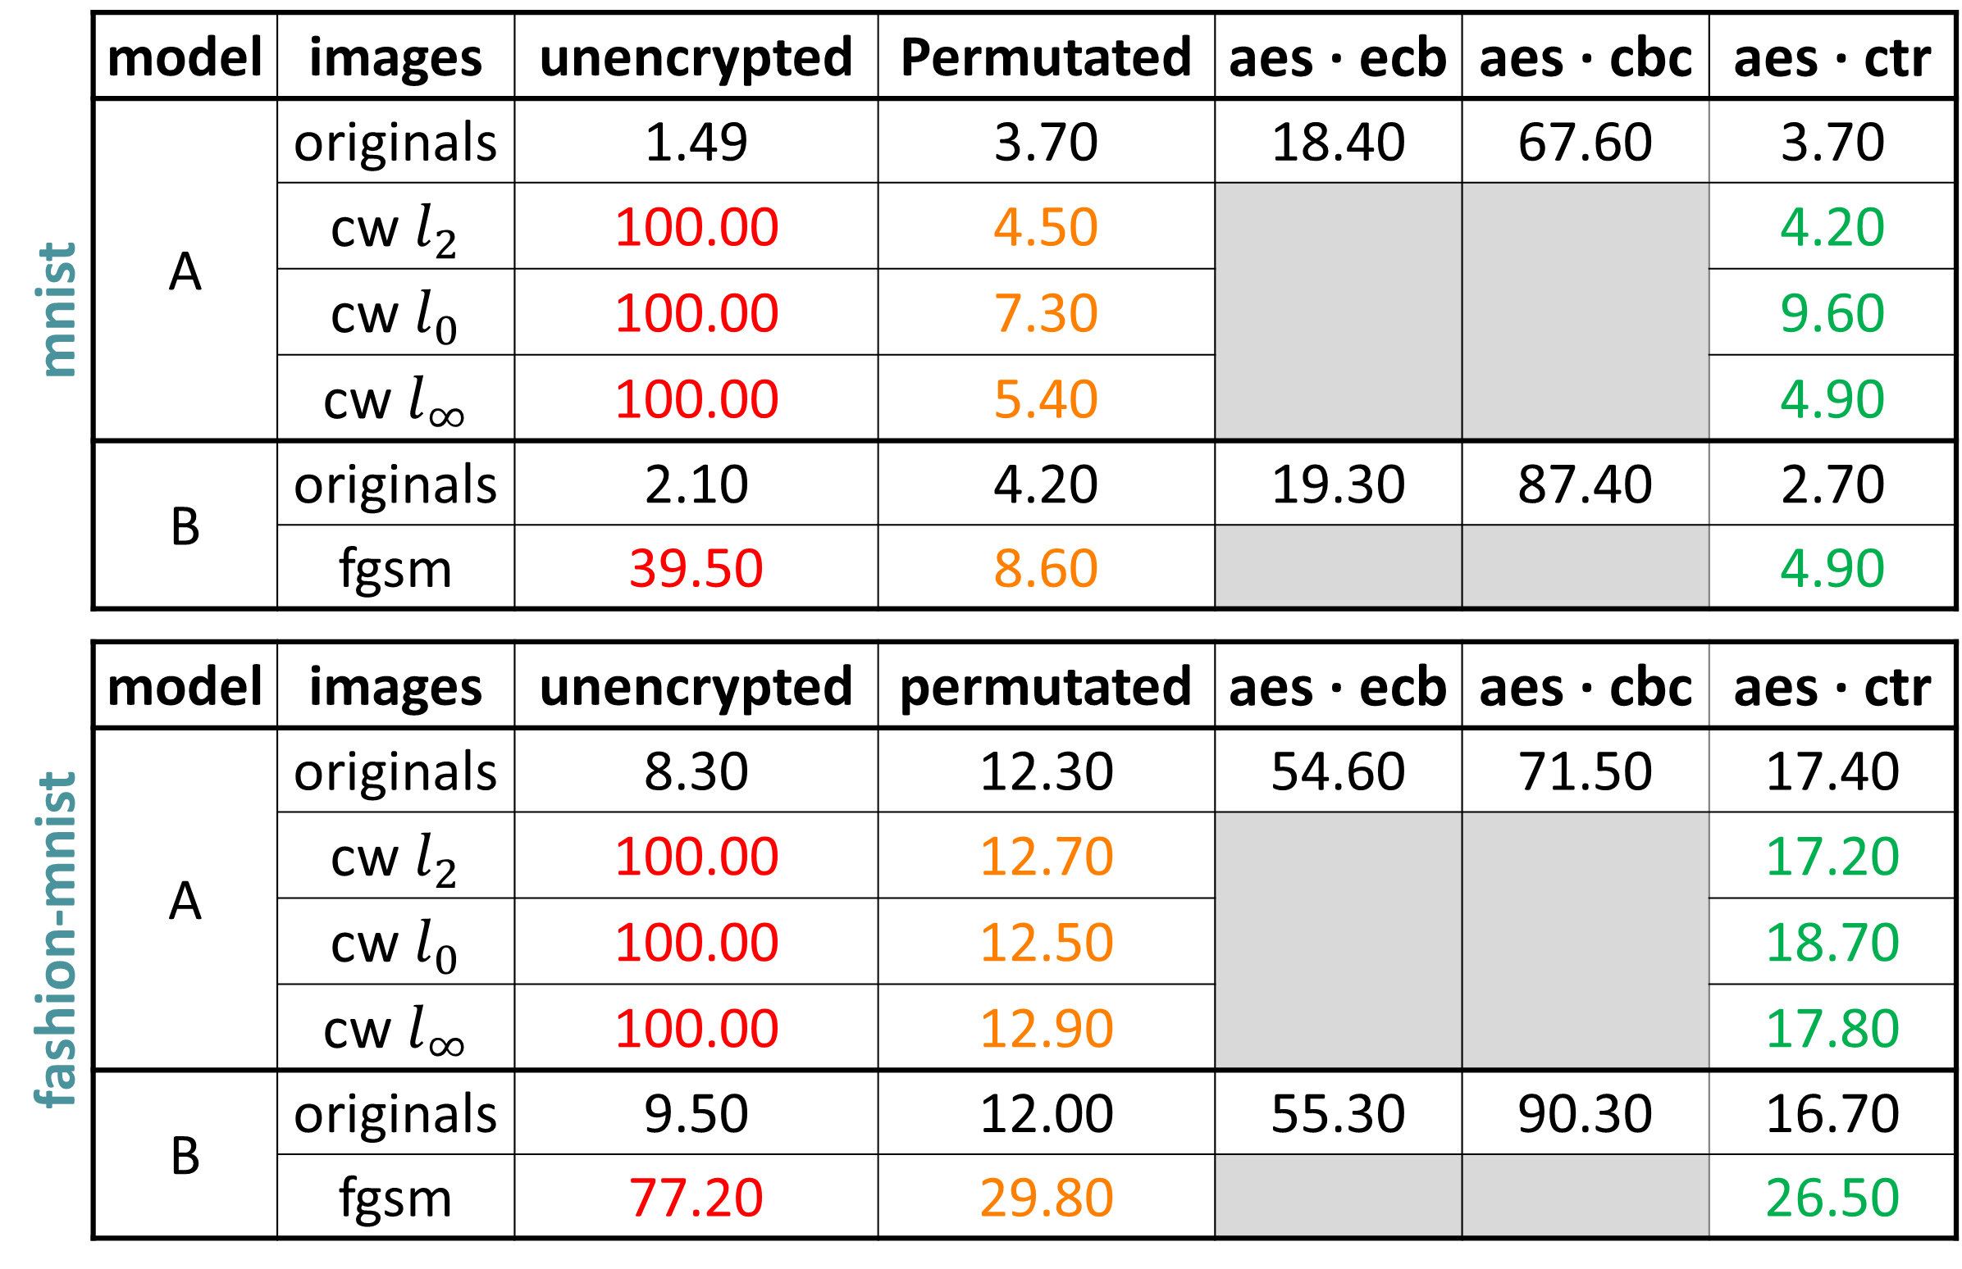
בס"ד
DEFENSE AGAINST
ADVERSARIAL EXAMPLES
­­­­­­­­­___________________
Yishay Asher • Steve Gutfreund
Supervisor: Hanan Rosemarin
Problem Description
START
Building high accuracy DNN models which are sufficiently resistant to adversarial attacks
Background and Goal
0
An adversarial example is an instance with small, intentional feature perturbations that causes a machine learning model to make a false prediction.
The goal is to find a way to train ‘secured’ models such that this sort of attacks should not affect them.
Project based on the article Bridging machine learning and cryptography in defense against adversarial attacks
1
Set-Up
Mnist and Fashion-Mnist datasets
Using well-known neural nets
Training ‘unsecured’ models
2
original
noise
adversarial
Securing Models
Approach: training models on encrypted images.
Encryption techniques:
Permutation
AES in ECB, CBC and CTR modes
+
=
100% it’s “ankle boot”
52% it’s “sandal”
example of an adversarial image
T-shirt
3
Cutting Loose Ends
Eliminated the models that did not learn well. Learning encrypted images is not very intuitive, as can seen below.
original
permutated
ctr
architecture for securing models
Attacking
4
Attacks:
Carlini & Wagner, CW
Fast Gradient Sign Method, FGSM
‘gray-box’ scenario, i.e. the attacker knows the architecture of the model but has no access to the private key.
sample of the encrypted images.
5
original
noise
adversarial
Results
+
=
There’s a slight tradeoff between accuracy on the original images and the accuracy on the adversarials, but overall, accuracies are good
mnist | model | images | unencrypted | Permutated | aes ∙ ecb | aes ∙ cbc | aes ∙ ctr
 | A | originals | 1.49 | 3.70 | 18.40 | 67.60 | 3.70
 |  | cw $l_{2}$ | 100.00 | 4.50 |  |  | 4.20
 |  | cw $l_{0}$ | 100.00 | 7.30 |  |  | 9.60
 |  | cw $l_{∞}$ | 100.00 | 5.40 |  |  | 4.90
 | B | originals | 2.10 | 4.20 | 19.30 | 87.40 | 2.70
 |  | fgsm | 39.50 | 8.60 |  |  | 4.90
fashion-mnist | model | images | unencrypted | permutated | aes ∙ ecb | aes ∙ cbc | aes ∙ ctr
 | A | originals | 8.30 | 12.30 | 54.60 | 71.50 | 17.40
 |  | cw $l_{2}$ | 100.00 | 12.70 |  |  | 17.20
 |  | cw $l_{0}$ | 100.00 | 12.50 |  |  | 18.70
 |  | cw $l_{∞}$ | 100.00 | 12.90 |  |  | 17.80
 | B | originals | 9.50 | 12.00 | 55.30 | 90.30 | 16.70
 |  | fgsm | 77.20 | 29.80 |  |  | 26.50
insecure: 100% it’s “two”
secure: 100% it’s “two”
insecure: 49% it’s “one”
secure: 100% it’s “two”
visualization of a CW attack secured by permutation
6
Success with Permutation , Coincidence?
To verify the learning ability of a permutation model does not result from high density in small images, we trained models on padded images.
 | image size | error rate
mnist | 28x28 | 3.70
 | 40x40 | 3.40
 | 60x60 | 3.30
fashion mnist | 28x28 | 12.30
 | 40x40 | 14.40
 | 60x60 | 10.80
classification error (%) on the first 1000 test samples
results for training permutated data, various image dimensions
FINISH
Future Work
 | Improve accuracy on AES-ECB model |  | Nicholas Carlini (‘C’ in CW) believes that CW might still defeat these defenses |  | Test on more complicated datasets; i.e. Cifar-10

