Slide 1


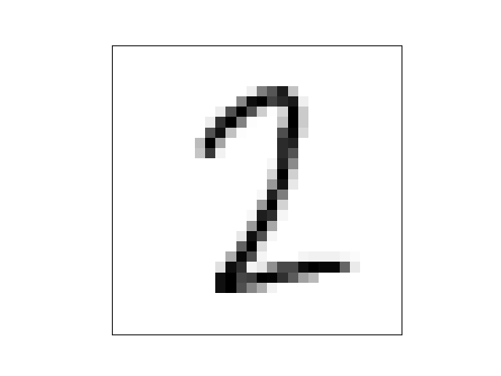
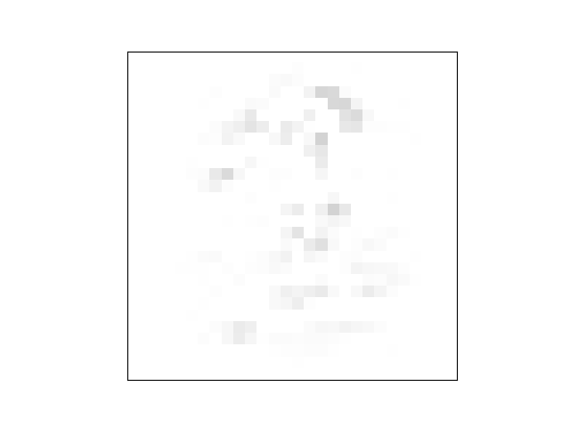
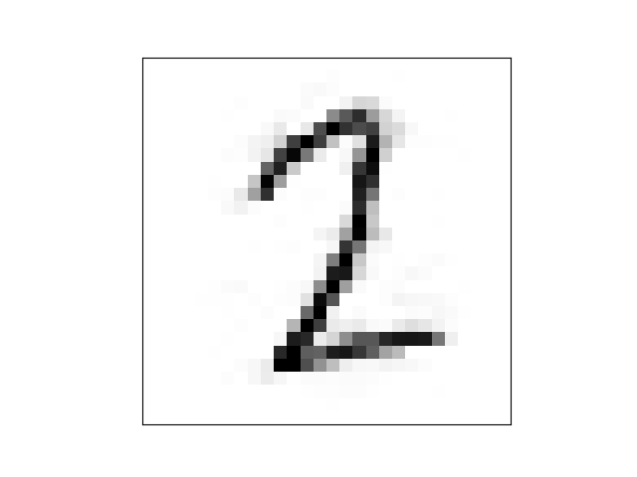
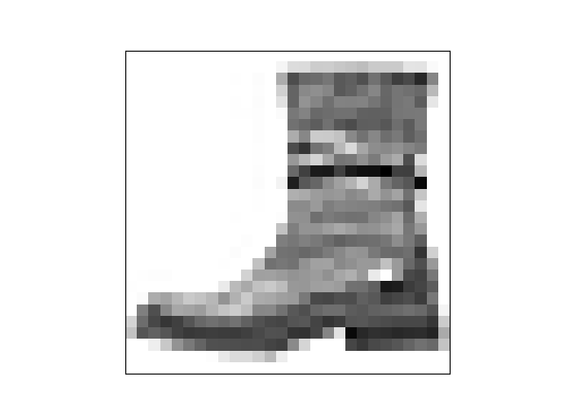
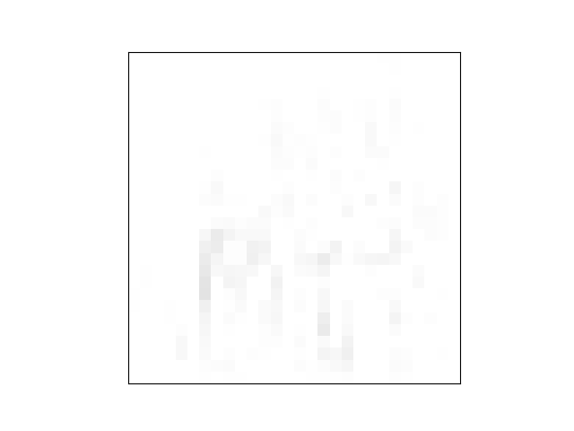


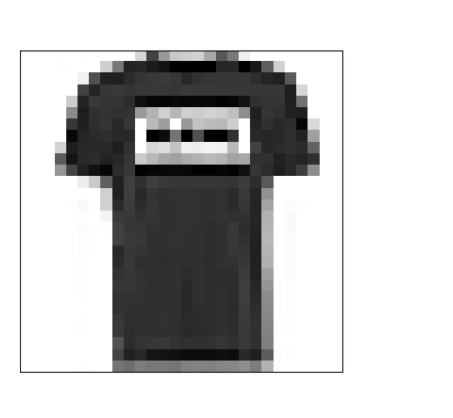

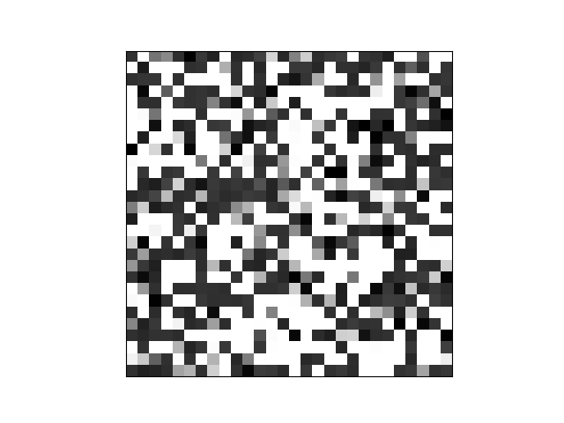
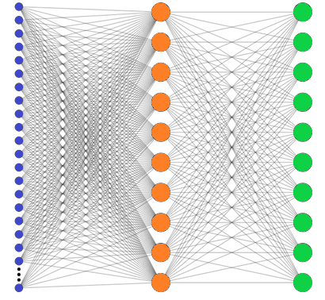

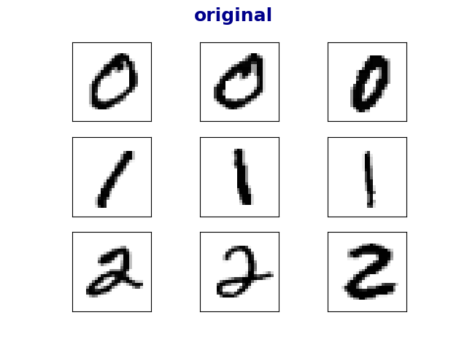
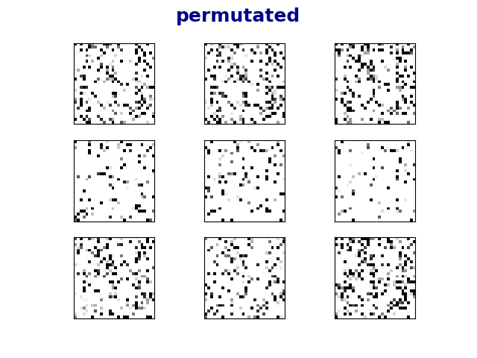
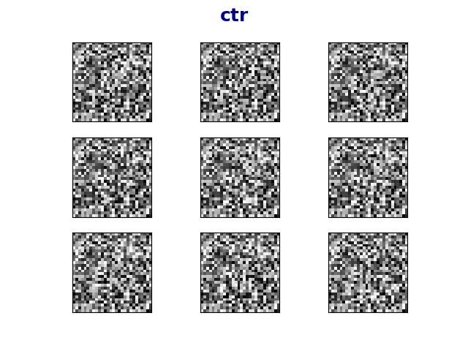




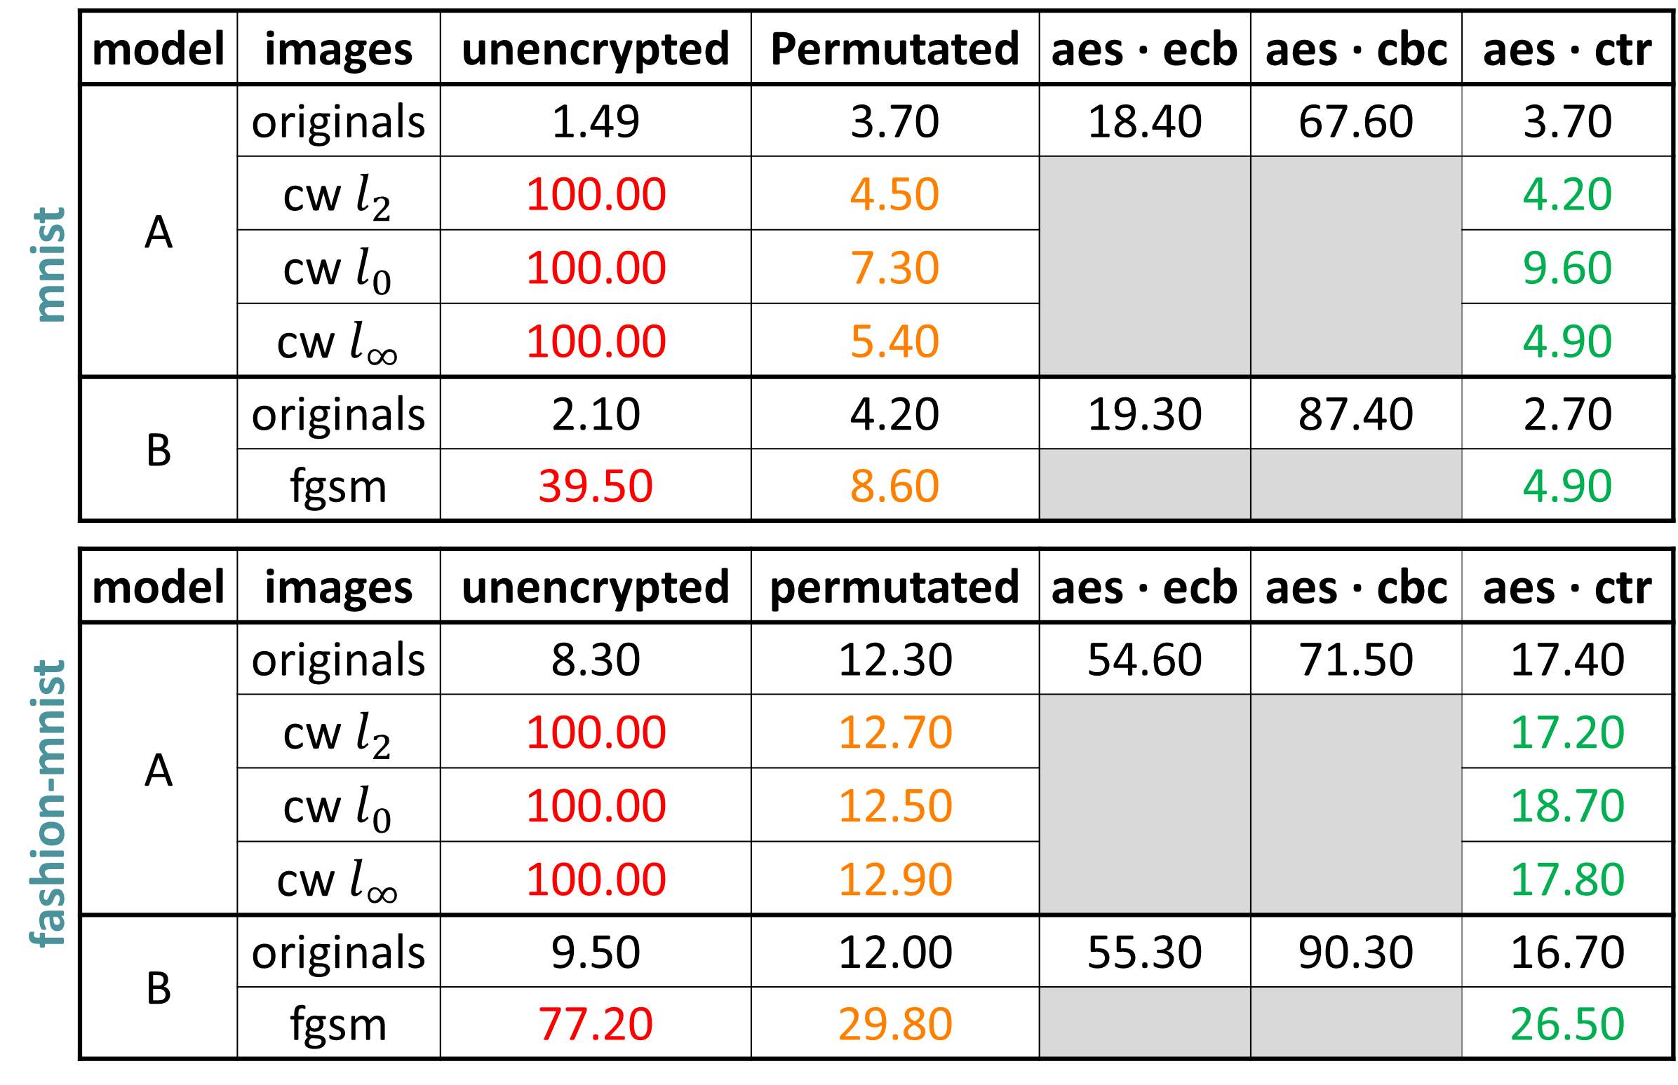
בס"ד
DEFENSE AGAINST
ADVERSARIAL EXAMPLES
­­­­­­­­­___________________
Yishay Asher • Steve Gutfreund
Supervisor: Hanan Rosemarin
Problem Description
Building high accuracy DNN models which are sufficiently resistant to adversarial attacks
Background and Goal
0
Attacking
4
An adversarial example is an instance with small, intentional feature perturbations that causes a machine learning model to make a false prediction.
The goal is to find a way to train ‘secured’ models such that this sort of attacks should not affect them.
Project based on the article Bridging machine learning and cryptography in defense against adversarial attacks
Attacks:
Carlini & Wagner, CW
Fast Gradient Sign Method, FGSM
‘gray-box’ scenario, i.e. the attacker knows the architecture of the model but has no access to the private key.
original
noise
adversarial
original
noise
adversarial
+
=
+
=
insecure: 100% it’s “two”
secure: 100% it’s “two”
insecure: 49% it’s “one”
secure: 100% it’s “two”
100% it’s “ankle boot”
52% it’s “sandal”
visualization of a CW attack secured by permutation
example of an adversarial image
Results
5
Set-Up
There’s a slight tradeoff between accuracy on the original images and the accuracy on the adversarials, but overall, accuracies are good
1
Mnist and Fashion-Mnist datasets
Using well-known neural nets
Training ‘unsecured’ models
mnist | model | images | unencrypted | Permutated | aes ∙ ecb | aes ∙ cbc | aes ∙ ctr
 | A | originals | 1.49 | 3.70 | 18.40 | 67.60 | 3.70
 |  | cw $l_{2}$ | 100.00 | 4.50 |  |  | 4.20
 |  | cw $l_{0}$ | 100.00 | 7.30 |  |  | 9.60
 |  | cw $l_{∞}$ | 100.00 | 5.40 |  |  | 4.90
 | B | originals | 2.10 | 4.20 | 19.30 | 87.40 | 2.70
 |  | fgsm | 39.50 | 8.60 |  |  | 4.90
fashion-mnist | model | images | unencrypted | permutated | aes ∙ ecb | aes ∙ cbc | aes ∙ ctr
 | A | originals | 8.30 | 12.30 | 54.60 | 71.50 | 17.40
 |  | cw $l_{2}$ | 100.00 | 12.70 |  |  | 17.20
 |  | cw $l_{0}$ | 100.00 | 12.50 |  |  | 18.70
 |  | cw $l_{∞}$ | 100.00 | 12.90 |  |  | 17.80
 | B | originals | 9.50 | 12.00 | 55.30 | 90.30 | 16.70
 |  | fgsm | 77.20 | 29.80 |  |  | 26.50
Securing Models
2
Approach: training models on encrypted images.
Encryption techniques:
Permutation
AES in ECB, CBC and CTR modes
T-shirt
architecture for securing models
classification error (%) on the first 1000 test samples
Cutting Loose Ends
3
Success with Permutation , Coincidence?
Eliminated the models that did not learn well. Learning encrypted images is not very intuitive, as can seen below.
6
To verify the learning ability of a permutation model does not result from high density in small images, we trained models on padded images.
original
permutated
ctr
 | image size | error rate
mnist | 28x28 | 3.70
 | 40x40 | 3.40
 | 60x60 | 3.30
fashion mnist | 28x28 | 12.30
 | 40x40 | 14.40
 | 60x60 | 10.80
sample of the encrypted images.
results for training permutated data, various image dimensions
Future Work
 | Improve accuracy on AES-ECB model |  | Nicholas Carlini (‘C’ in CW) believes that CW might still defeat these defenses |  | Test on more complicated datasets; i.e. Cifar-10

