Slide 1


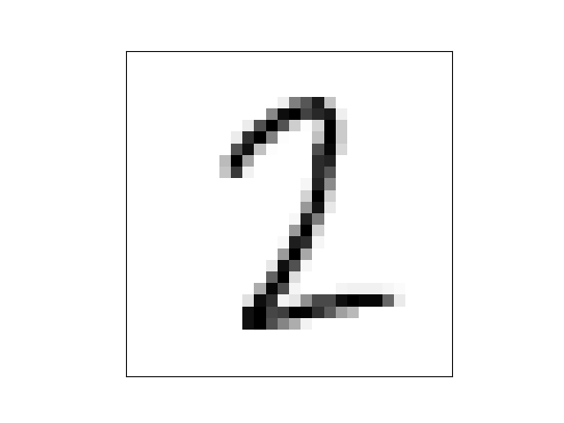
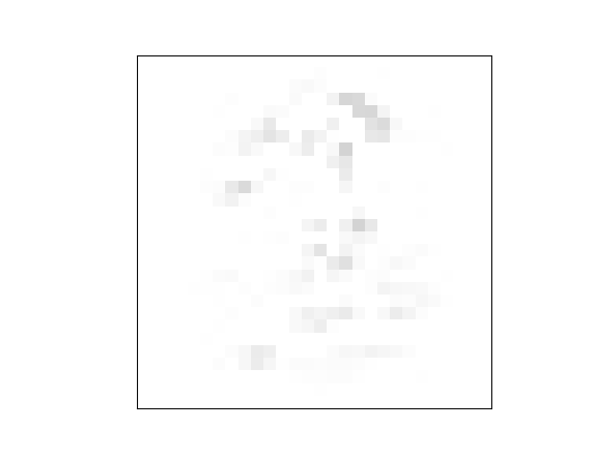
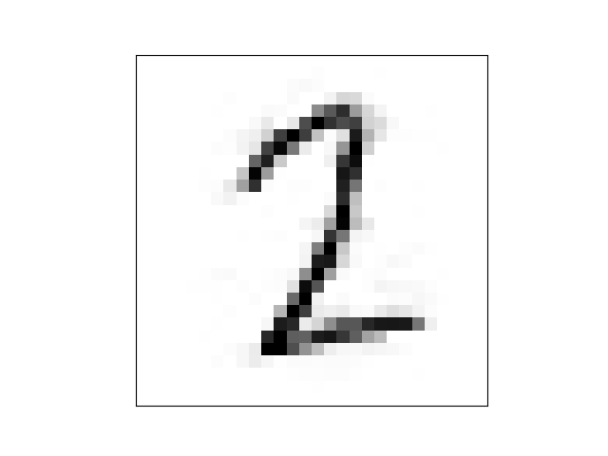
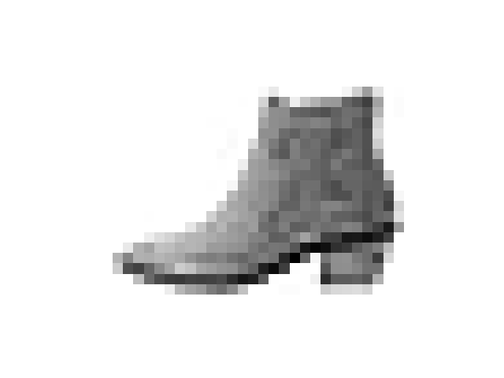



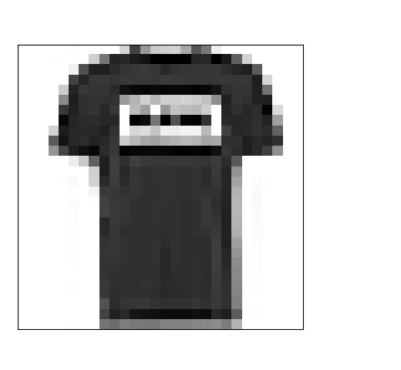
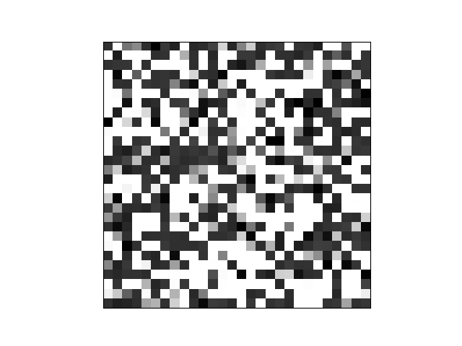
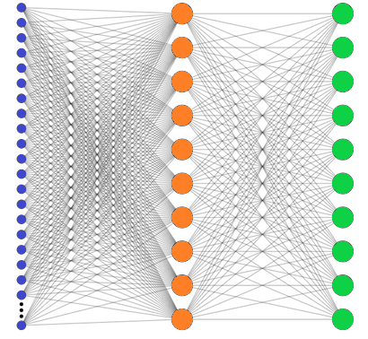


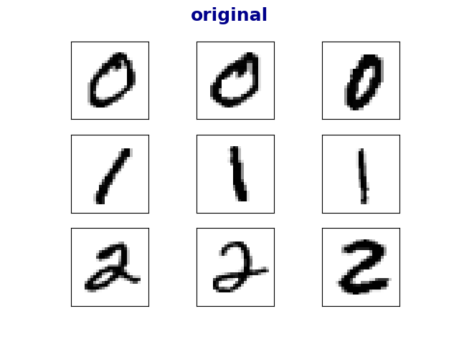
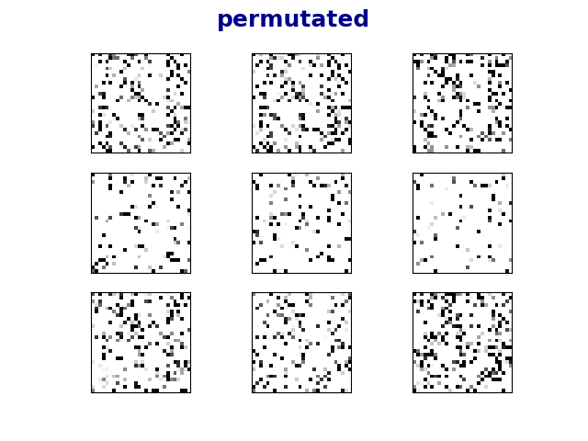
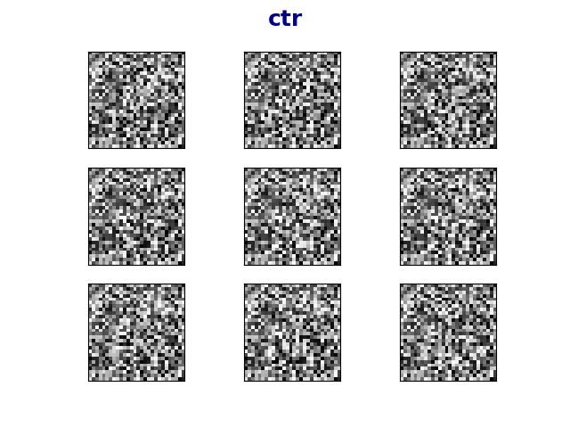




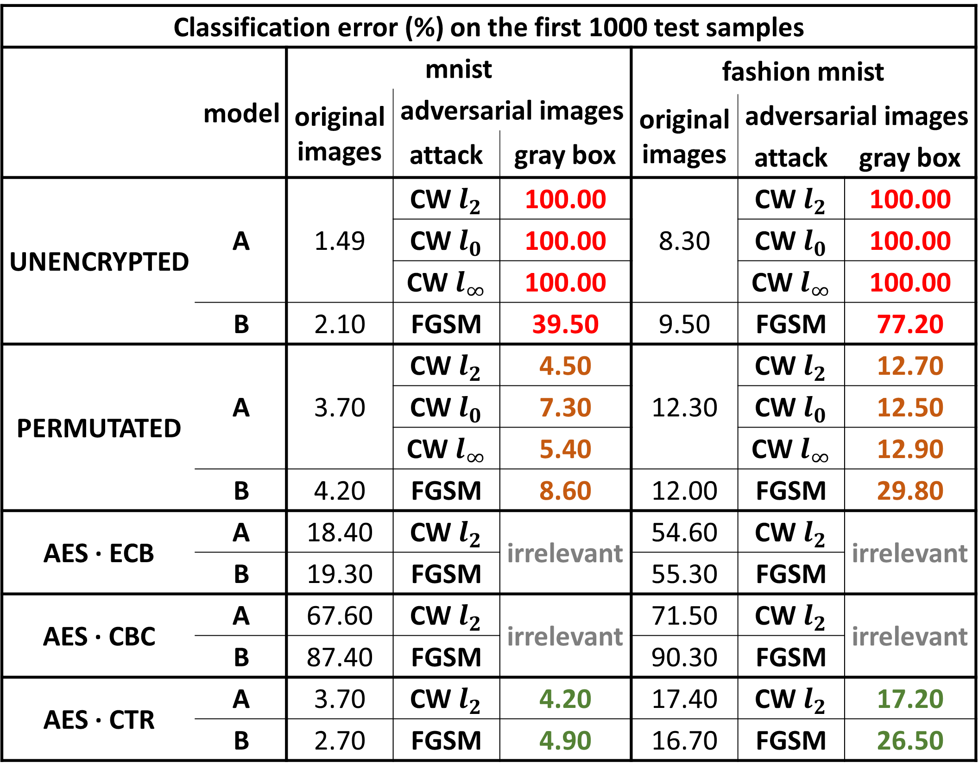
בס"ד
DEFENCE AGAINST
ADVERSARIAL EXAMPLES
­­­­­­­­­___________________
Yishay Asher • Steve Gutfreund
Instructor: Hanan Rosemarin
Problem Description
Building high accuracy DNN models which are sufficiently resistant to adversarial attacks
Background and Goal
Attacking
An adversarial example is an instance with small, intentional feature perturbations that cause a machine learning model to make a false prediction.
The goal is to Find a way to train ‘secured’ models such that this sort of attacks should not affect them.
Project based on the article Bridging machine learning and cryptography in defence against adversarial attacks
Attacks:
Carlini & Wagner, CW
Fast Gradient Sign Method, FGSM
‘gray-box’ scenario, i.e. the attacker knows the architecture of the model but has no access to the private key.
original
noise
adversarial
original
noise
adversarial
+
=
+
=
insecure: 100% it’s two
secure: 100% it’s two
insecure: 49% it’s one
secure: 100% it’s two
100% it’s “ankle boot”
50% it’s "sandal”
Figure 4: visualization of a CW attack secured by permutation
Figure 1: example of an adversarial image
Results
Set-Up
There’s a slight tradeoff between accuracy on the original images and the accuracy on the adversarial images, but overall, accuracies are good
Mnist and Fashion-Mnist datasets
Using well-known neural nets
Classification error (%) on the first 1000 test samples
 | model | mnist |  |  | fashion mnist
 |  | original images | adversarial images
 |  |  |  |  | original images | adversarial images
 |  |  | attack | gray box
 |  |  |  |  |  | attack | gray box
UNENCRYPTED | A | 1.49 | CW $l_{2}$ | 100.00 | 8.30 | CW $l_{2}$ | 100.00
 |  |  | CW $l_{0}$ | 100.00 |  | CW $l_{0}$ | 100.00
 |  |  | CW $l_{∞}$ | 100.00 |  | CW $l_{∞}$ | 100.00
 | B | 2.10 | FGSM | 39.50 | 9.50 | FGSM | 77.20
PERMUTATED | A | 3.70 | CW $l_{2}$ | 4.50 | 12.30 | CW $l_{2}$ | 12.70
 |  |  | CW $l_{0}$ | 7.30 |  | CW $l_{0}$ | 12.50
 |  |  | CW $l_{∞}$ | 5.40 |  | CW $l_{∞}$ | 12.90
 | B | 4.20 | FGSM | 8.60 | 12.00 | FGSM | 29.80
AES ∙ ECB | A | 18.40 | CW $l_{2}$ | irrelevant | 54.60 | CW $l_{2}$ | irrelevant
 | B | 19.30 | FGSM |  | 55.30 | FGSM
AES ∙ CBC | A | 67.60 | CW $l_{2}$ | irrelevant | 71.50 | CW $l_{2}$ | irrelevant
 | B | 87.40 | FGSM |  | 90.30 | FGSM
AES ∙ CTR | A | 3.70 | CW $l_{2}$ | 4.20 | 17.40 | CW $l_{2}$ | 17.20
 | B | 2.70 | FGSM | 4.90 | 16.70 | FGSM | 26.50
Securing Models
Approach: training models on encrypted images.
Encryption techniques:
Permutation
AES in ECB, CBC and CTR modes
T-shirt
Figure 2: architecture for securing models
Cutting Loose Ends
Table 1: table containing all the results
Eliminated the models that did not learn well. Learning encrypted images is not very intuitive, as can be seen in figure 3.
Success with Permutation , Coincidence?
To verify that the learning ability of a permutation model does not result from high density in small images, we trained models on padded images. Padding done with white pixels. See table 2 for results.
original
permutated
ctr
 | image size | error rate
mnist | 28x28 | 3.70
 | 40x40 | 3.40
 | 60x60 | 3.30
fashion mnist | 28x28 | 12.30
 | 40x40 | 14.40
 | 60x60 | 10.80
Figure 3: Sample of the encrypted images. Interesting to see how for the human eye it’s not easy to distinguish between various classes but a DNN model classifies quite well, as can be seen in table 1
Table 2: results for training permutated data, various image dimensions
Future Work
Improve accuracy on AES-ECB model
Nicholas Carlini (the ‘C’ in CW attack) believes we still might defeat these defenses. (we contacted him)
Test on more complicated datasets; i.e. Cifar-10

