Slide 1
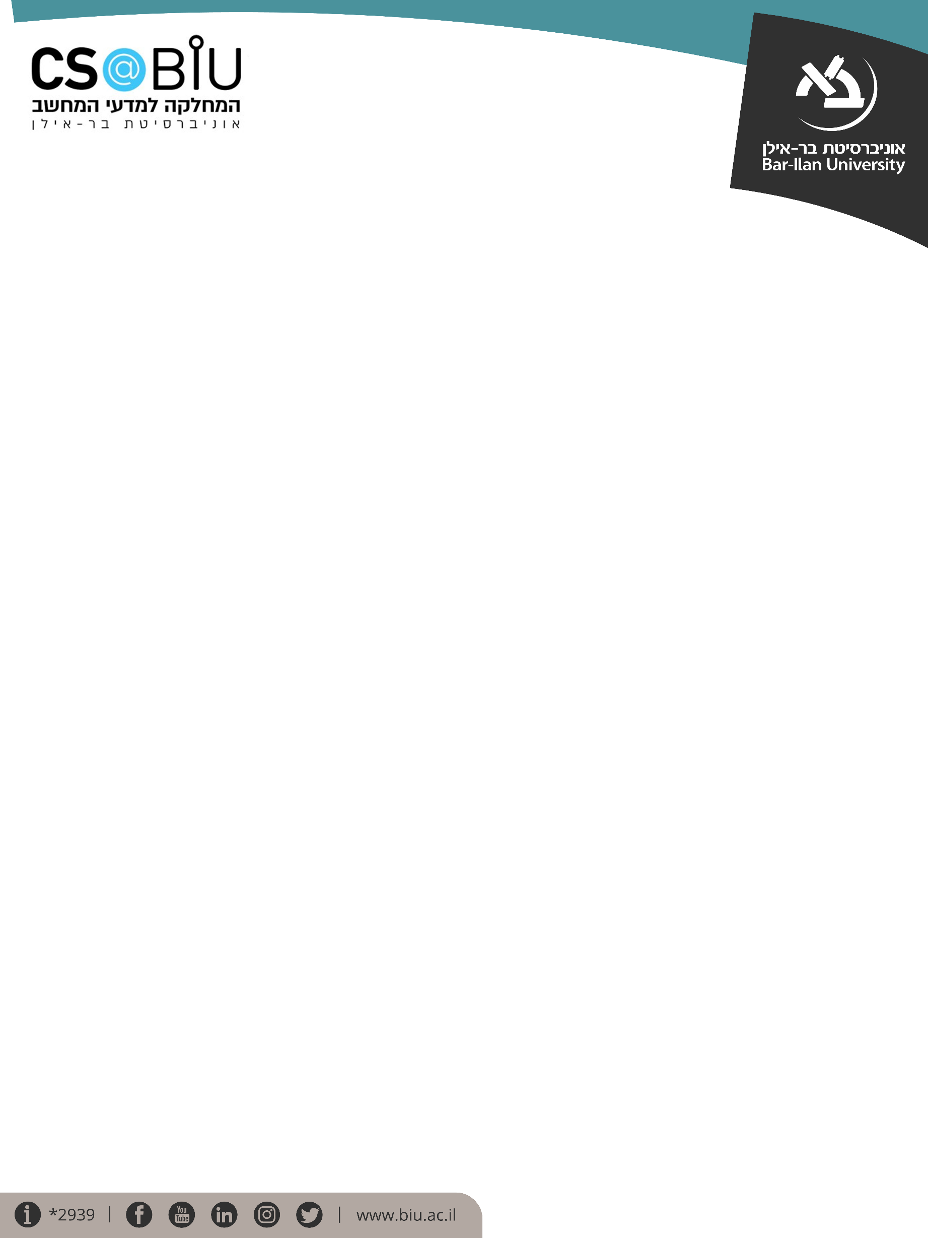

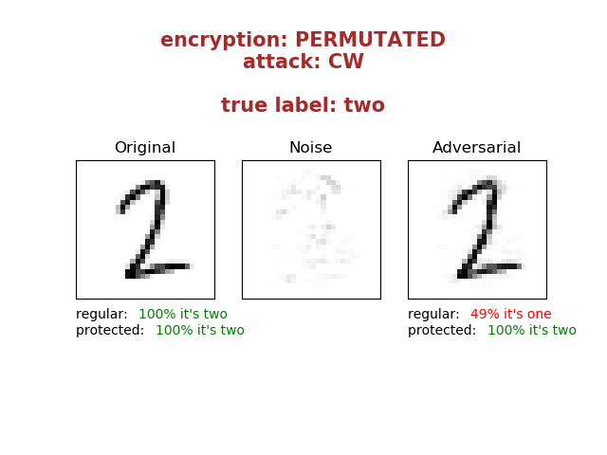
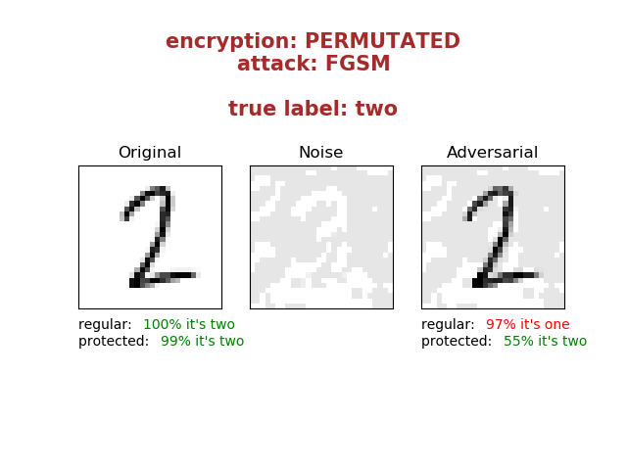
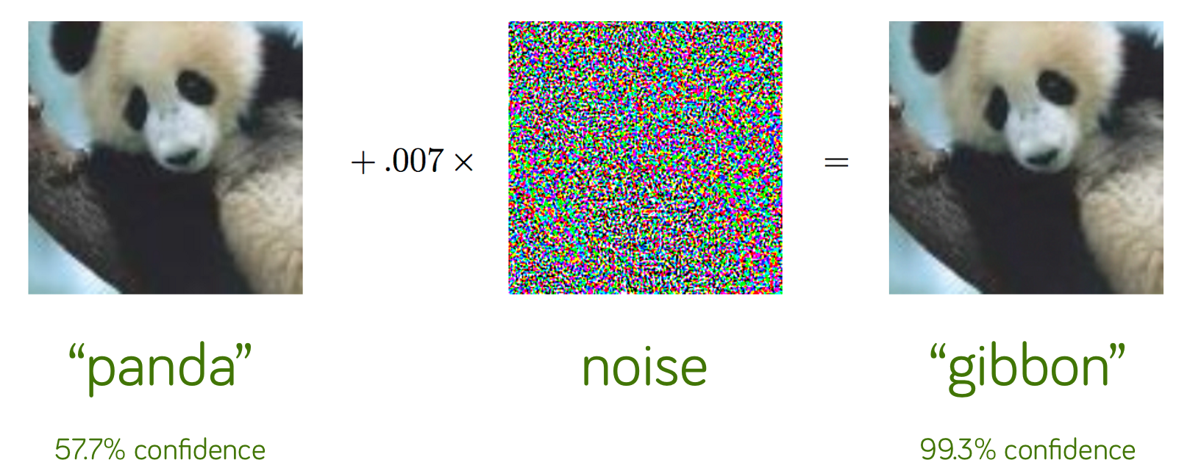

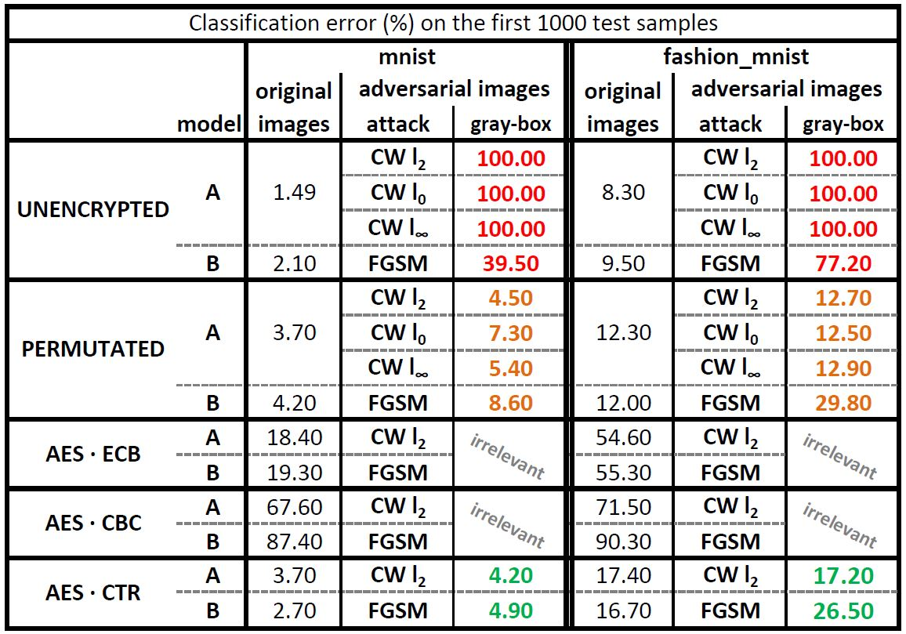
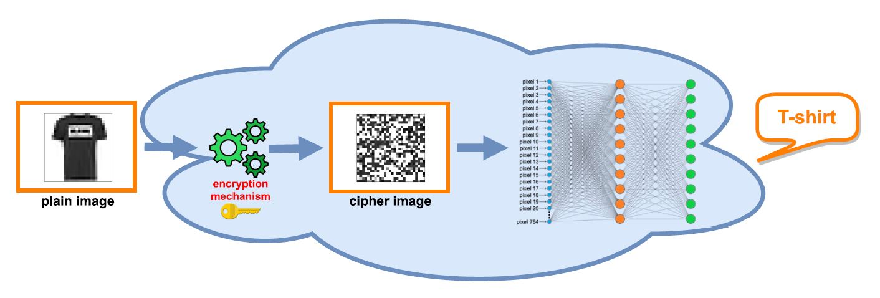
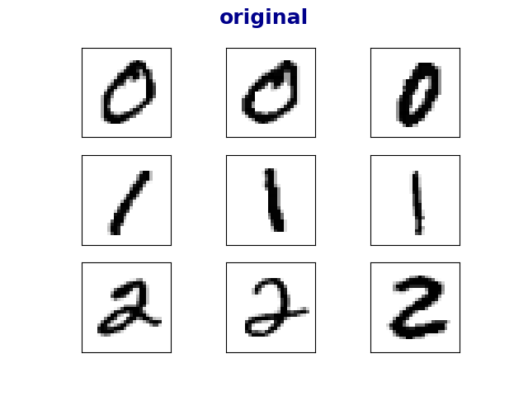
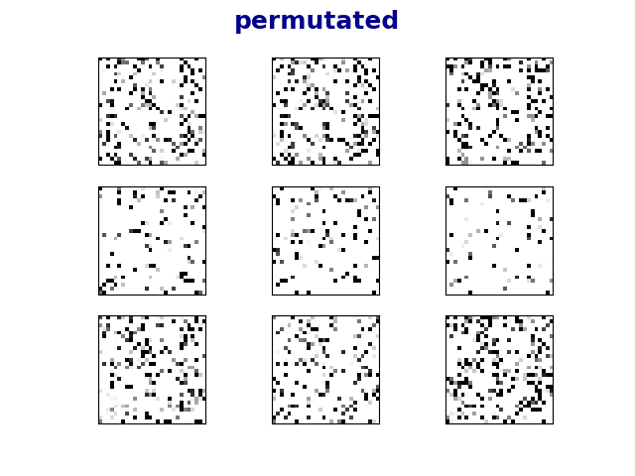
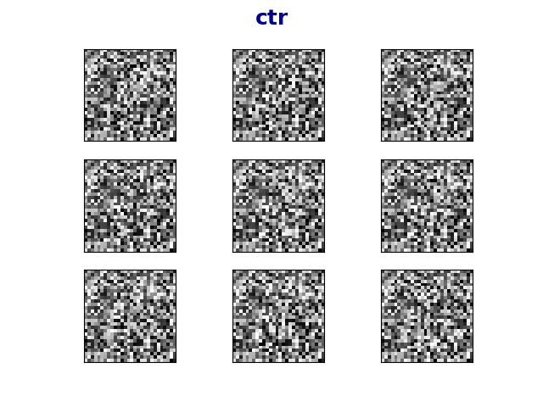
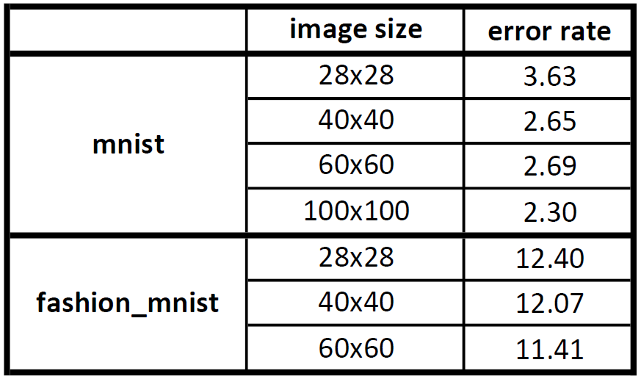




בס"ד
DEFENCE AGAINST
ADVERSARIAL EXAMPLES
­­­­­­­­­___________________
Yishay Asher • Steve Gutfreund
Instructor: Hanan Rosemarin
Problem Description
Building high accuracy DNN models which are sufficiently resistant to adversarial attacks
Background and Goal
Attacking
An adversarial example is an instance with small, intentional feature perturbations that cause a machine learning model to make a false prediction.
The goal is to Find a way to train ‘secured’ models such that this sort of attacks should not affect them.
Project based on the article Bridging machine learning and cryptography in defence against adversarial attacks
Attacks:
Carlini & Wagner, CW
Fast Gradient Sign Method, FGSM
‘gray-box’ scenario, i.e. the attacker knows the architecture of the model but has no access to the private key.
Figure 1: example of an adversarial example
Figure 4: visualization of a CW and FGSM attack
Set-Up
Results
Mnist and fashion-mnist
Using well-known neural nets
There’s a slight tradeoff between accuracy on the original images and the accuracy on the adversarial images, but overall, accuracies are good.
See table 1 for the detailed results.
Securing Models
Approach: training models on encrypted images
Encryption techniques:
Permutation
AES in ECB, CBC and CTR modes
Figure 2: architecture for securing models
Cutting loose ends
Table 1: table containing all the results
Eliminated the models that did not learn well. Learning encrypted images is not very intuitive, as can be seen in figure 3.
Efficiency of Permutation
original
permutated
ctr
In order to check the efficiency of training models on permutated data, we trained models on images with greater dimensions. See table 2 for results.
Figure 3: Sample of the encrypted images. Interesting to see how for the human eye it’s impossible to distinguish between various classes but a DNN model classifies quite well, as in table 1
Table 2: results for training permutated data, various image dimensions
Future Work
improve accuracy on AES-ECB model
Nicholas Carlini (the ‘C’ in CW attack) believes we still might defeat these defenses, (we contacted him)
Test on more complicated datasets; i.e. cifar-10

