Slide 1
Bridge Circuits

Slide 2
Introduction
Many sensors, such as strain gauges and resistance-temperature-detector, convert a physical quantity such as strain or temperature, into small changes in resistance.
In order to be suitable for electronic measurement systems, resistance changes should be converted into voltage changes.
This can be done using voltage divider or bridge circuits.

Slide 3
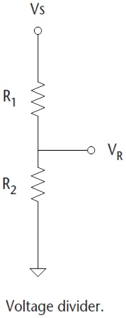
Voltage Divider

Slide 4
Voltage Divider
Note the following issues:
The variation of V_{R} with either R₁ or R₂ is nonlinear.
The effective output impedance of the divider is R1 // R2 (ideally, the output impedance should be zero!).
The current flows to both R₁ and R₂. The power rating of both resistors should be considered

Slide 5
Example
The resistive elements in a strain gauge are each 5kΩ. If R₂ is the fixed element and R₁ is the element measuring strain, what is the change in R₁ that produce 0.01V change in output voltage. Assume a supply of 10V.
Answer:
With no strain, R₁ = R₂. Hence, V_{R} = 5V. The question is then what is value of R1 that produces 5.01 V or 4.99V.
As expected, we can realize that the relation between change in resistance ΔR and the corresponding change in output voltage, ΔV, is nonlinear.

Slide 6
Problem 3
If Vs = 12 V, R₁ = 1 K and R₂ = 4 K, find
V_{D}
Zo
P_{R1} and P_{R2}
If R₂ doubles, does V_{D} double too?

Slide 7
Problem 3
If Vs = 12 V, R₁ = 1 K and R₂ = 4 K, find
V_{D} = 9.6 V
Zo = 800 Ω
P_{R1} and P_{R2}
P_{R1} = 5.76 mW
P_{R2} = 23.04 mW
If R₂ doubles, does V_{D} double too?
No

Slide 8
DC Bridge Circuits
Bridge circuits provide a commonly used method of detection of very small changes in resistance about a nominal value.
Bridge circuits are used very commonly as a variable conversion element in measurement systems and produce an output in the form of a voltage level that changes as the measured physical quantity changes.
They are of immense importance in measurement system technology because so many transducers measuring physical quantities have an output that is expressed as a change in resistance,

Slide 9
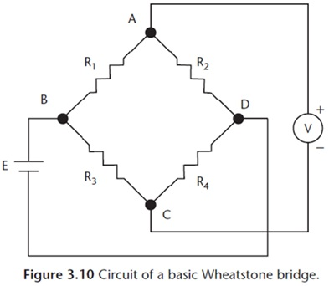
Wheatstone Bridge
The simplest and most common bridge network is the DC Wheatstone bridge which consists of four resistors connected in the form of a diamond with the supply and measuring instruments connected across the bridge.

Slide 10
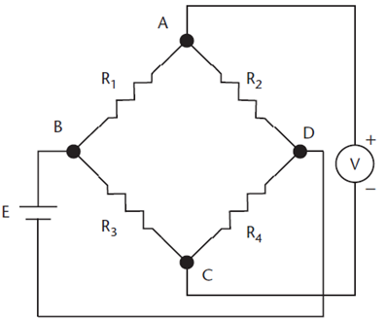
Balancing the bridge
When the voltage at A and C are equal, the voltmeter reads zero and the bridge is said to be balanced.
This can happen, for example, if all resistors are equal. In this case, the voltages at A and C will be equal (E/2), and the voltmeter reads zero.
To deduce the general condition for balance we can write:
The voltage at C referenced to D,
The voltage at A referenced to D,

Slide 11
Balancing the bridge
Hence, the voltage between A and C,
Therefore, to balance the bridge, i.e. to make V_{AC} = 0, the following condition must be achieved:
Note that the voltmeter should have a high resistance, so that it does not load the bridge circuit.

Slide 12
Null vs. Deflection-type Bridge Circuits
Bridge circuits, similar to many measuring instruments, have both null and deflection types.
The null-type is more accurate and so is used in calibration purposes.
On the other hand, deflection-type is more suitable for measuring systems.

Slide 13
Null-type | Deflection-type
R4 is an unknown resistor. R1 and R3 are two equal value resistors.
R2 is a variable resistor. It is varied until the measured voltage V_{AC} = 0. At this point, the value of R4 is obtained. | R2 is a fixed resistor equal to the nominal value of R4. As R4 changes, the voltage V_{AC} varies. However, the relationship between these changes is non-linear.

Slide 14
Example
A pressure transducer, designed to measure pressures in the range 0–10 bar, consists of a diaphragm with a strain gauge cemented to it to detect diaphragm deﬂections. The strain gauge has a nominal resistance of 120Ω and forms one arm of a Wheatstone bridge circuit, with the other three arms each having a resistance of 120Ω. The bridge output is measured by an instrument whose input impedance can be assumed inﬁnite.
(a) If, in order to limit heating effects, the maximum allowable gauge current is 30 mA, calculate the maximum allowable bridge supply voltage.
(b) If the sensitivity of the strain gauge is 338 mΩ/bar and the maximum bridge supply voltage is used, calculate the bridge output voltage when measuring a pressure of 10 bar.

Slide 15
Solution
(a) The resistors in the bridge circuit have the following values:
R₁ = R₂ = R₃ = 120Ω
And the nominal value of the sensor resistance R₄ = 120Ω.
Deﬁning I to be the current ﬂowing in path BCD of the bridge, we can write:
E = (R₃ + R₄) x I
As the maximum allowable value for I is 0.03A, then:
E = 0.03(120 + 120) = 7.2 V
Thus, the maximum allowable bridge supply voltage is 7.2V.

Slide 16
Solution
(b) For an applied pressure of 10 bar, the resistance change is 3.38 Ω, i.e. R₄ is then equal to 123.38 Ω.
The bridge output voltage is found as
Thus, with supply voltage of 7.2V, the output voltage is -50 mV when a pressure of 10 bar is measured.

Slide 17
Example 2
The depicted Wheatstone bridge nulls with R₁ = 1200 Ω, R₂ = 920 Ω, and R₃ = 600 Ω. Find the value of R₄.

Slide 18
Solution
R₁R₄ = R₃R₂
R₄ = (R₃R₂)/R₁ = (600 * 920)/1200 = 460 Ω

Slide 19
Bridge linearity
Now, let us study the linearity of the bridge circuit. The bridge output is given by:
It is clear that the relationship between V_{AC} and R4 is nonlinear.
However, let us assume that R4 changes to R4+ΔR4 where ΔR4 << R4. This results in output
Then, ΔV_{AC}
Based on the assumption that δR4 << R4, then
Linear relation!

Slide 20
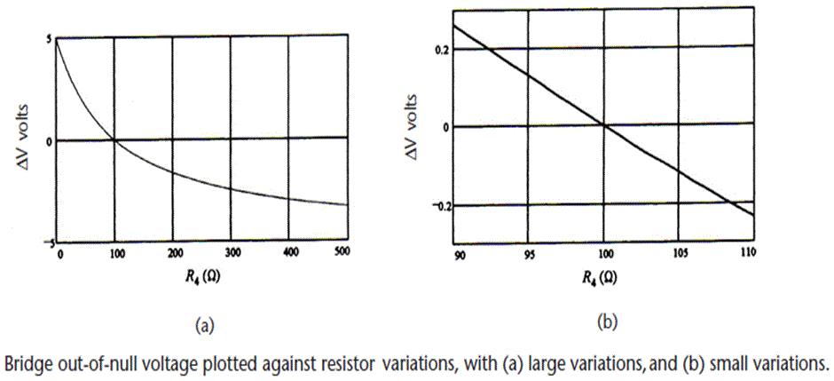
Bridge linearity
We conclude that ΔV_{AC} is approximately linear with ΔR4 if ΔR4 does not vary too much around the null condition ΔV = 0.
However, for large ΔR, the relationship is nonlinear. Hence, ΔV should not be used to indicate linear out-of-balance unless a correction is applied.

Slide 21
Temperature compensation
Resistive sensors such as strain gauges are temperature sensitive. It is important to minimize temperature effects on the measurement of strain and other physical quantities.

Slide 22
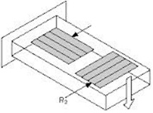
Temperature compensation
For this purpose, the sensors are often configured with two elements that can be used in a bridge circuit. For instance, in a bridge circuit, if R1 and R2 are the same type of sensing element. Then, resistance of each element will change by an equal percentage with temperature, so that the bridge will remain balanced when the temperature changes. If R1 is now used to sense a variable, the voltmeter will only sense the change in R1 due to the change in the variable, not the change due to temperature.

Slide 23
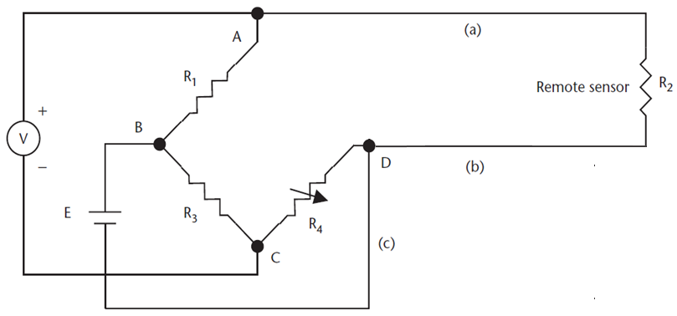
Lead Compensation
In many applications, the sensing resistor (R2) may be remote from a centrally located bridge as shown. The resistance temperature detector (RTD) is an example of such a device.
In this case, the resistance of the two long leads (a) and (b) is added to R2. Adjusting the bridge resistor (R4) can zero out this additional resistance.
However, any change in lead resistance due to temperature will appear as a sensor value change. To correct this error, three-lead compensation is used.

Slide 24
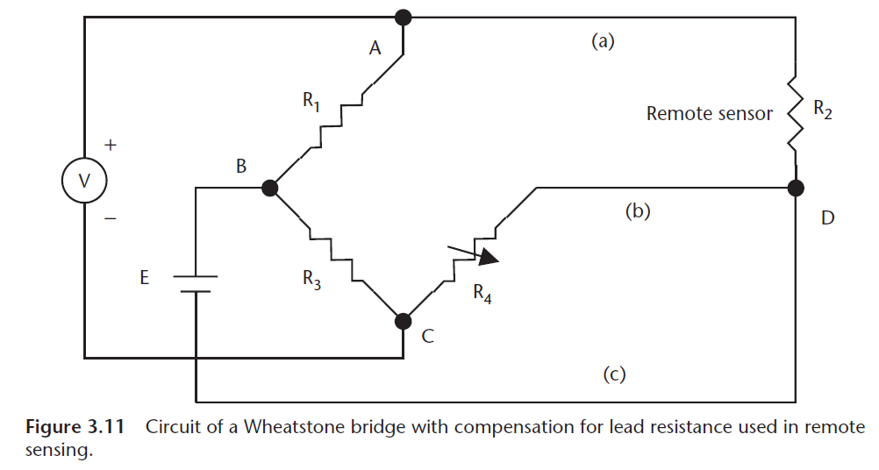
Three-lead (wire) compensation
In this method, three long wires {(a),(b),(c)} are connected to the sensor where a separate power lead (c) is used to supply R2. By this way point D in the bridge is moved remotely.

Slide 25
Three-lead (wire) compensation
Now, the resistance of lead (b) is part of resistor R4 and the resistance of lead (a) is part of remote resistor R2.
Since both leads have the same length with the same resistance and in the same environment, any changes in the resistance of the leads (due to temperatue) will cancel, keeping the bridge balanced.

Slide 26
AC Bridge Circuits
The basic concept of dc bridges can be extended to ac bridges.
In this case, the bridge supply is ac voltage, and hence ac meters are used and the resistive elements are replaced with impedances.
Now, measurement of resistance, capacitance, inductance, or a combination of them can be achieved.
This type of setup can be used to measure small changes in capacitance as required in, e.g., the capacitive pressure sensor.
Measurements of inductance, capacitance, storage factor, loss factor etc. may be made conveniently and accurately by employing a.c. bridge networks.

Slide 27
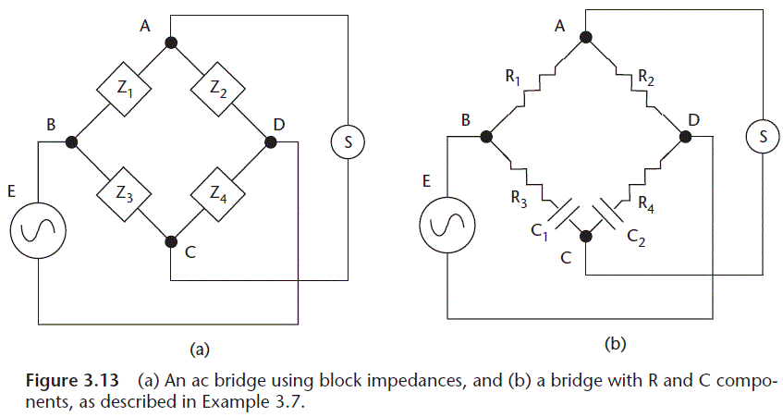
AC Bridge Circuits

Slide 28
The voltage V_{AC} is given by:
Where E is the ac supply voltage.
When the bridge is balanced, V_{AC} = 0, and:
Or
Because the real and imaginary parts must be independently equal

Slide 29
Example
If the previous ac bridge circuit is balanced, with R₁ = 15 kΩ, R₂ = 27 kΩ, R₃ = 18 kΩ, and C₁ = 220 pF, what are the values of R₄ and C₂?
R₄ = 27 × 18/15 = 32.4 kΩ
Additionally,
C₂ = 220 × 15/27 = 122 pF

Slide 30
Example 2
An a.c bridge circuit working at 1000 Hz is shown in Fig. below. Arm ab is a 0.2 μF pure capacitance ; arm be is a 500Ω pure resistance ; arm cd contains an unknown impedance and arm da has a 300Ω resistance in parallel with a 0.1 μF capacitor. Find the R and c or L constants of arm cd considering it as a series circuit

