Slide 1
CSE4421/5324: Introduction to Robotics
From:Thrun, Burgard and Fox, Probabilistic Robotics, The MIT Press, 2006, CSEB 1012J, burton@cse.yorku.ca

Slide 2
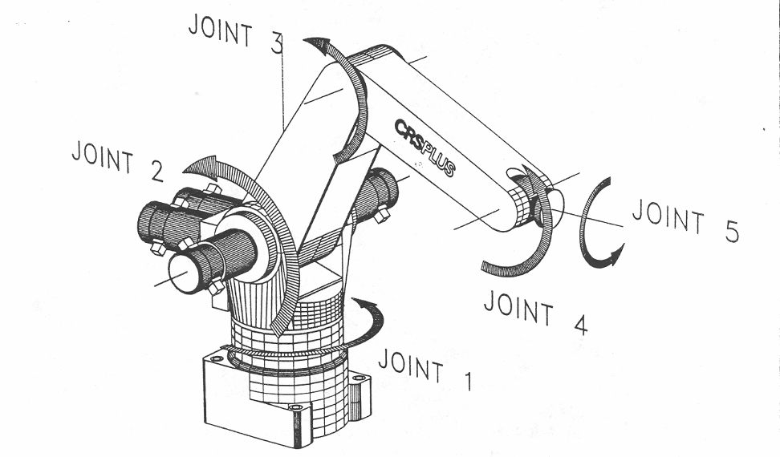
A150 Robotic Arm
link 3
link 2

Slide 3
Kinematics
the study of motion that ignores the forces that cause the motion
“geometry of motion”
interested in position, velocity, acceleration, etc. of the various links of the manipulator
e.g., where is the gripper relative to the base of the manipulator? what direction is it pointing in?
described using rigid transformations of the links

Slide 4
Kinematics
forward kinematics:
given the link lengths and joint angles compute the position and orientation of the gripper relative to the base
for a serial manipulator there is only one solution
inverse kinematics:
given the position (and possibly the orientation) of the gripper and the dimensions of the links, what are the joint variables?
for a serial manipulator there is often more than one mathematical solution

Slide 5
Wheeled Mobile Robots
robot can have one or more wheels that can provide
steering (directional control)
power (exert a force against the ground)
an ideal wheel is
perfectly round (perimeter 2πr)
moves in the direction perpendicular to its axis

Slide 6
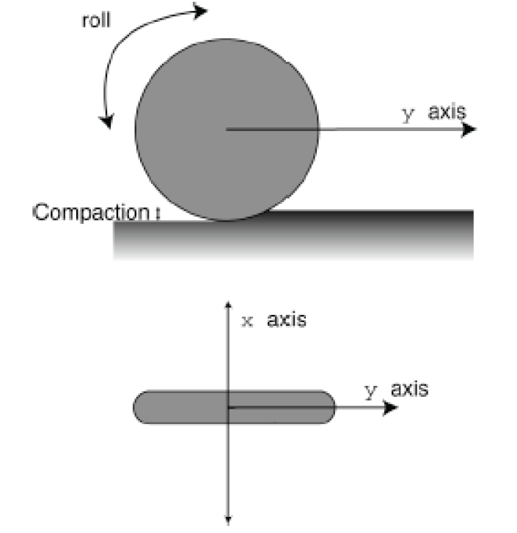
Wheel

Slide 7
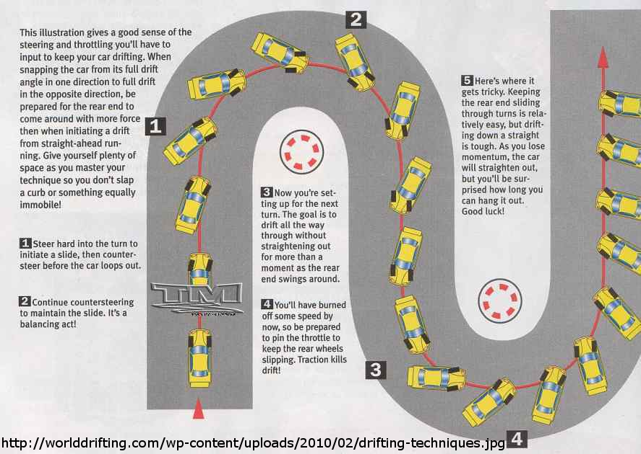
Deviations from Ideal

Slide 8
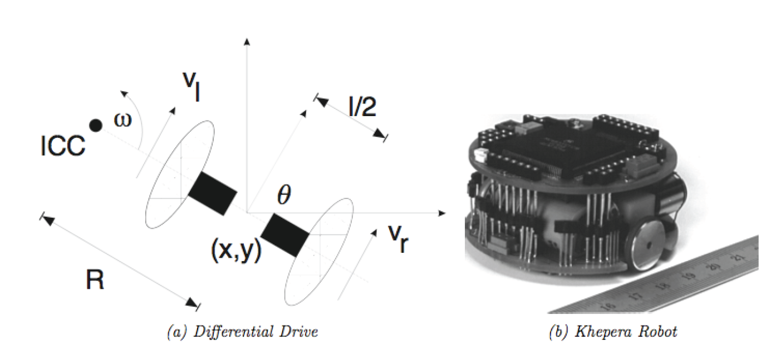
Differential Drive
two independently driven wheels mounted on a common axis

Slide 9
Forward Kinematics
for a robot starting with pose [0 0 0]^{T} moving with velocity V(t) in a direction θ(t) :

Slide 10
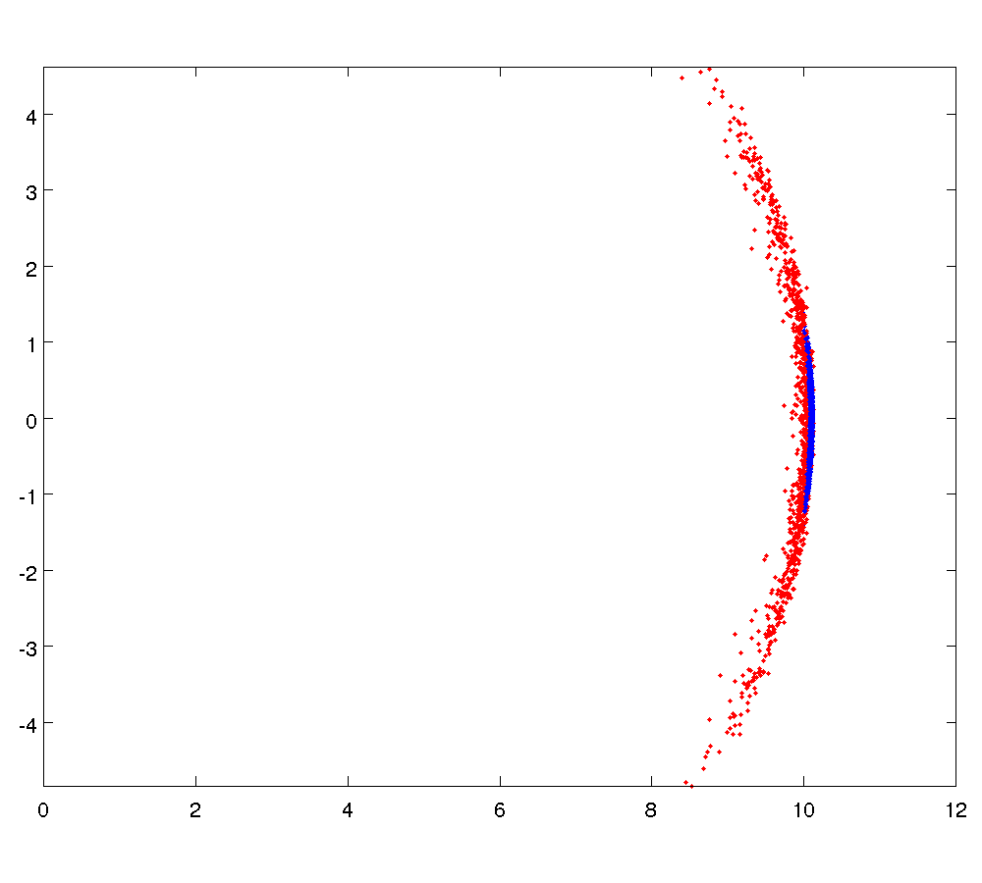
Sensitivity to Wheel Velocity
σ = 0.05
σ = 0.01

Slide 11
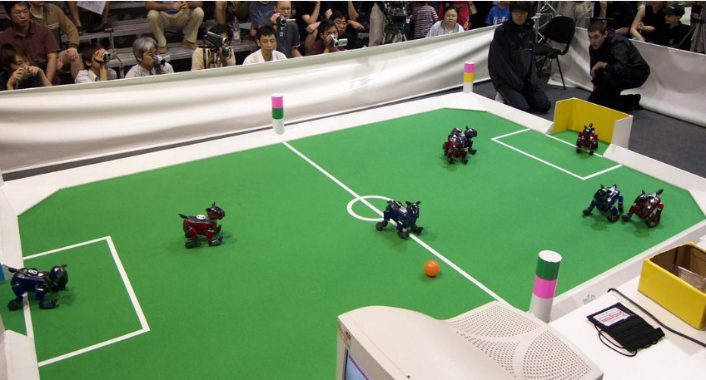
Localization using Landmarks: RoboSoccer

Slide 12
Maps
 |  |  |  |  |  |  |  |  |  |  |  |  |  |  | *
*
goal
start

Slide 13
Path Finding
goal
start

Slide 14
Localization
goal
start

Slide 15
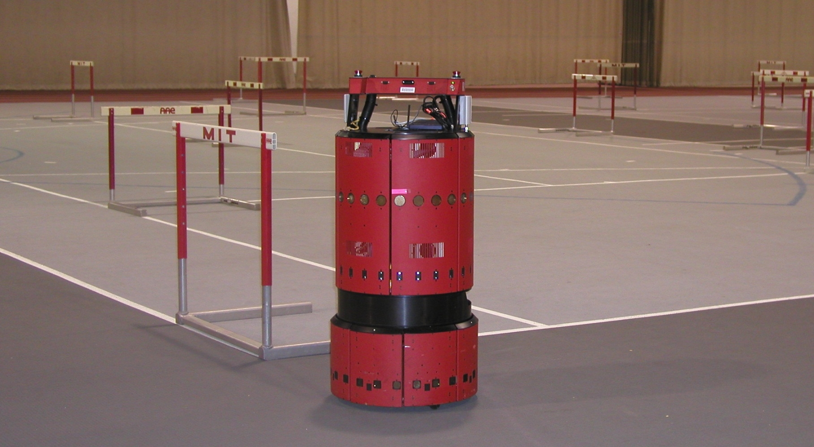
EKF SLAM Application
www.probabilistic-robotics.org
[MIT B21, courtesy by John Leonard]

Slide 16
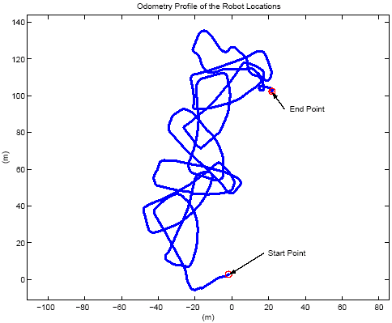
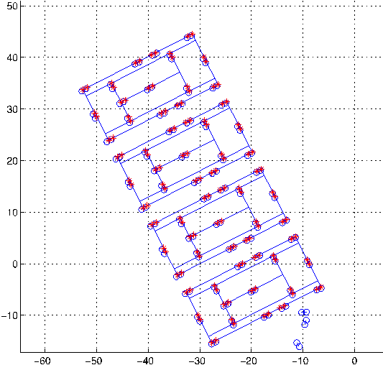
EKF SLAM Application
raw odometry
estimated trajectory
www.probabilistic-robotics.org
[courtesy by John Leonard]

Slide 17
Introduction to manipulator kinematics

Slide 18
Robotic Manipulators
a robotic manipulator is a kinematic chain
i.e. an assembly of pairs of rigid bodies that can move respect to one another via a mechanical constraint
the rigid bodies are called links
the mechanical constraints are called joints

Slide 19
A150 Robotic Arm
link 3
link 2

Slide 20
Joints
most manipulator joints are one of two types
revolute (or rotary)
like a hinge
allows relative rotation about a fixed axis between two links
axis of rotation is the z axis by convention
prismatic (or linear)
like a piston
allows relative translation along a fixed axis between two links
axis of translation is the z axis by convention
our convention: joint i connects link i – 1 to link i
when joint i is actuated, link i moves

Slide 21
Joint Variables
revolute and prismatic joints are one degree of freedom (DOF) joints; thus, they can be described using a single numeric value called a joint variable
q_{i} : joint variable for joint i
revolute
q_{i} = θ_{i} : angle of rotation of link i relative to link i – 1
prismatic
q_{i} = d_{i} : displacement of link i relative to link i – 1

Slide 22
Revolute Joint Variable
revolute
q_{i} = θ_{i} : angle of rotation of link i relative to link i – 1
link i
θ_{i}
link i – 1

Slide 23
Prismatic Joint Variable
prismatic
q_{i} = d_{i} : displacement of link i relative to link i – 1
link i – 1
link i
d_{i}

Slide 24
Common Manipulator Arrangments
most industrial manipulators have six or fewer joints
the first three joints are the arm
the remaining joints are the wrist
it is common to describe such manipulators using the joints of the arm
R: revolute joint
P: prismatic joint

Slide 25
Articulated Manipulator
RRR (first three joints are all revolute)
joint axes
z₀ : waist
z₁ : shoulder (perpendicular to z₀)
z₂ : elbow (parallel to z₁)
z₀
z₁
z₂
θ₂
θ₃
shoulder
forearm
elbow
θ₁
waist

Slide 26
Spherical Manipulator
RRP
Stanford arm
http://infolab.stanford.edu/pub/voy/museum/pictures/display/robots/IMG_2404ArmFrontPeekingOut.JPG
z₀
z₁
d₃
θ₂
shoulder
z₂
θ₁
waist

Slide 27
SCARA Manipulator
RRP
Selective Compliant Articulated Robot for Assembly
http://www.robots.epson.com/products/g-series.htm
z₁
z₂
z₀
θ₂
d₃
θ₁

Slide 28
Forward Kinematics
given the joint variables and dimensions of the links what is the position and orientation of the end effector?
a₂
θ₂
a₁
θ₁

Slide 29
Forward Kinematics
choose the base coordinate frame of the robot
we want (x, y) to be expressed in this frame
(x, y) ?
a₂
θ₂
y₀
a₁
θ₁
x₀

Slide 30
Forward Kinematics
notice that link 1 moves in a circle centered on the base frame origin
(x, y) ?
a₂
θ₂
y₀
a₁
θ₁
( a₁ cos θ₁ , a₁ sin θ₁ )
x₀

Slide 31
Forward Kinematics
choose a coordinate frame with origin located on joint 2 with the same orientation as the base frame
(x, y) ?
y₁
a₂
θ₂
y₀
θ₁
a₁
x₁
θ₁
( a₁ cos θ₁ , a₁ sin θ₁ )
x₀

Slide 32
Forward Kinematics
notice that link 2 moves in a circle centered on frame 1
(x, y) ?
y₁
a₂
( a₂ cos (θ₁ + θ₂),
a₂ sin (θ₁ + θ₂) )
θ₂
y₀
θ₁
a₁
x₁
θ₁
( a₁ cos θ₁ , a₁ sin θ₁ )
x₀

Slide 33
Forward Kinematics
because the base frame and frame 1 have the same orientation, we can sum the coordinates to find the position of the end effector in the base frame
(a₁ cos θ₁ + a₂ cos (θ₁ + θ₂),
a₁ sin θ₁ + a₂ sin (θ₁ + θ₂) )
y₁
a₂
( a₂ cos (θ₁ + θ₂),
a₂ sin (θ₁ + θ₂) )
θ₂
y₀
θ₁
a₁
x₁
θ₁
( a₁ cos θ₁ , a₁ sin θ₁ )
x₀

Slide 34
Forward Kinematics
we also want the orientation of frame 2 with respect to the base frame
x₂ and y₂ expressed in terms of x₀ and y₀
y₂
x₂
a₂
θ₂
y₀
θ₁
a₁
θ₁
x₀

Slide 35
Forward Kinematics
without proof I claim:
x₂ = (cos (θ₁ + θ₂),
sin (θ₁ + θ₂) )
y₂
x₂
y₂ = (-sin (θ₁ + θ₂),
cos (θ₁ + θ₂) )
a₂
θ₂
y₀
θ₁
a₁
θ₁
x₀

Slide 36
Inverse Kinematics
given the position (and possibly the orientation) of the end effector, and the dimensions of the links, what are the joint variables?
y₂
x₂
(x, y)
a₂
θ₂ ?
y₀
a₁
θ₁ ?
x₀

Slide 37
Inverse Kinematics
harder than forward kinematics because there is often more than one possible solution
(x, y)
a₂
y₀
a₁
x₀

Slide 38
Inverse Kinematics
law of cosines
(x, y)
a₂
b
θ₂ ?
y₀
a₁
x₀

Slide 39
Inverse Kinematics
and we have the trigonometric identity
therefore,
We could take the inverse cosine, but this gives only one of the two solutions.

Slide 40
Inverse Kinematics
Instead, use the two trigonometric identities:
to obtain
which yields both solutions for θ₂ . In many programming languages you would use the
four quadrant inverse tangent function atan2
c2 = (x*x + y*y – a1*a1 – a2*a2) / (2*a1*a2);
s2 = sqrt(1 – c2*c2);
theta21 = atan2(s2, c2);
theta22 = atan2(-s2, c2);

Slide 41
Inverse Kinematics
Exercise for the student: show that

