Slide 1

SIGNAL PROCESSING
ANALOG SIGNAL PROCESSING
DIGITAL SIGNAL PROCESSING

Slide 2
Signal processing
Signal processing is concerned with improving the quality of the reading or signal at the output of a measurement system, and one particular aim is to attenuate any noise in the measurement signal that has not been eliminated by careful design of the measurement system
Analog signal processing
Digital signal processing

Slide 3
Signal processing
Filters
Passive
Active
Signal amplification
Signal attenuation
Differential amplification
Signal linearization
Bias (zero drift) removal
Analog Signal Processing
Signal Integration
Voltage follower (pre-amplifier)
Voltage comparator
Phase-sensitive detector
Lock-in amplifier
Signal addition
Signal multiplication

Slide 4
Signal processing
Digital signal processing
Signal Integration
Sample and hold circuit
Analog-to-digital (A/D) conversion
Digital-to-analog (D/A) conversion
Digital filtering
Autocorrelation
Other digital signal processing operations

Slide 5
Filters
Background; Filtering is commonly used to reject noise outside of
predefined frequency range
. Filters may be classified as either digital or analog.
. Digital filters are implemented using a digital compute or special purpose digital hardware.
. Analog filters may be classified as either passive or
active and are usually implemented with R, L, and C
components and operational amplifiers.

Slide 6
Filters
Background:
. An active filter is one that, along with R, L, and C
components, also contains an energy source, such as that derived from an operational amplifier.
. A passive filter is one that contains only R, L, and
C components. It is not necessary that all three be
present. L is often omitted (on purpose) from
passive filter design because of the size and cost
of inductors – and they also carry along an R that
must be included in the design.

Slide 7
Analogue signal Filters
Low-pass filter (passes low frequencies and blocks high frequencies
High-pass filter (passes high frequencies and blocks low frequencies)
Band-pass filter (blocks below a low limit and above a high limit passing all frequencies between them)
Band-reject (Notch) filter (block or reject a particular range of frequencies)

Slide 8
Passive Analog Filters
Background:
Four types of filters - “Ideal”
lowpass
highpass
bandpass
bandstop

Slide 9
Passive Analog Filters
Background:
Realistic Filters:
lowpass
highpass
bandpass
bandstop

Slide 10
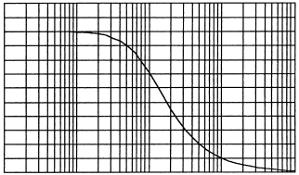
Low-pass RC Filter
fc = 1/(2πRC)
C in μF to pF range
1KΩ ≤ R ≤ 1 MΩ
Use standard values for R
Capacitors have a tolerance as high as ± 20%
|Vout/Vin|
f/fc

Slide 11
Low-Pass Rc Filter
Problem 1
A Low Pass Filter circuit consisting of a resistor of 4k7Ω in series with a capacitor of 47nF is connected across a 10v sinusoidal supply. Calculate the output voltage ( V_{OUT} ) at a frequency of 100Hz and again at frequency of 10,000Hz or 10kHz.

Slide 12




SOLUTION
Voltage Output at a Frequency of 100Hz.
Voltage Output at a Frequency of 10,000Hz (10kHz).

Slide 13
Problem 2
Attenuation is the process of decreasing the input amplitude for example, to get it to fit within the optimal range of the device digitizer.
A low-pass RC filter has fc = 2.5 kHz. Find the attenuation of a 2-kHz signal.

Slide 14
Problem 1 - Solution
A low-pass RC filter has fc = 2.5 kHz. Find the attenuation of a 2-kHz signal.
Solution:
The attenuation is found from:
So the attenuation is 1 – 0.781 = 0.219

Slide 15
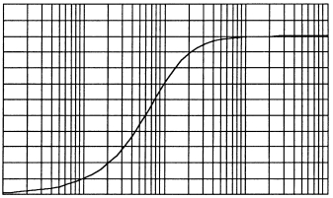
High-pass RC Filter
fc = 1/(2πRC)
C in μF to pF range
1KΩ ≤ R ≤ 1 MΩ
Use standard values for R
Capacitors have a tolerance as high as ± 20%
|Vout/Vin|
f/fc

Slide 16
Band-pass RC Filter
f_{H} =
f_{L} =
0.707
|Vout/Vin|
0
f
fL
fH

Slide 17
Signal Amplification
Signal amplification is carried out when the typical signal output level of a measurement transducer is considered to be too low.
Amplification by analogue means is carried out by an operational amplifier.
This is normally required to have a high input impedance so that its loading effect on the transducer output signal is minimized.

Slide 18

Operational Amplifier (OP-AMP)
The operational amplifier is an electronic device that has two input terminals and one output terminal, the two inputs being known as the inverting input and non-inverting input respectively.
The raw (unprocessed) signal Vi is connected to the inverting input through a resistor R1 and the non-inverting input is connected to ground. A feedback path is provided from the output terminal through a resistor R2 to the inverting input terminal.
Assuming ideal operational amplifier characteristics, the processed signal V0 at the output terminal is then related to the voltage Vi at the input terminal by the expression:
This ratio between R1 and R2 in the amplifier configuration is often known as the amplifier gain or closed-loop gain.

Slide 19
Summing Amplifier
Common modification of inverting amplifier which adds two or more applied voltages.

Slide 20
Noninverting Amplifier
A_{v} = 1 + R₂/R₁
Z_{in} ≥ 10 MΩ
Z_{out} ≤ 1Ω
Gain can be found by summing currents at point S.

Slide 21
Instrumentation amplifier
For some applications requiring the amplification of very low level signals, a special type of amplifier known as an instrumentation amplifier is used.
This consists of a circuit containing three standard operational amplifiers, as shown in Figure
The advantage of the instrumentation amplifier compared with a standard operational amplifier is that its differential input impedance is much higher.

Slide 22
Differential Amplification
The figure Shows a common amplifier configuration that is used to amplify the small difference that may exist between two voltage signals V1 and V2.
The output voltage Vout is given by:
A differential amplifier is also very useful for removing common mode noise voltages.

Slide 23
Integrator
Output varies as an integral of input with a scale factor of -1/RC.

Slide 24
Signal conditioning
refers to operations performed on signals to convert them to a form suitable for interfacing with other elements in the process-control loop.
Output is still an analog representation of the variable.
Every application, including digital processing, requires some type of analog conditioning before analog-to-digital conversion is made.

Slide 25
Principles of Analog Signal Conditioning
A sensor measures a variable by converting information about that variable into a dependent signal of either electrical or pneumatic nature.
Signal conditioning is referred by the term transfer function.
A transfer function is a mathematical representation of the relation between the input and output of a system.
Ex: A voltage amplifier has a transfer function of some constant that, when multiplied by the input voltage, gives the output voltage

Slide 26
Signal conditioning
Now, let us discuss the following signal conditioning categories:
Signal-range and offset changes
i.e. amplification and zero adjustment
Signal Linearization
Conversions
e.g. current to voltage and voltage to current

Slide 27
Signal-Level and Bias Changes
A common type of signal conditioning involves adjusting the level (magnitude) and bias (zero value) of some voltage representing a process variable.
Ex: A sensor output voltage may vary from 0.3 to 0.8 V as a process variable changes from 20ºC to 80ºC
However, the circuitry requires a voltage that varies from 0 to 5 V for the same variation from 20ºC to 80ºC

Slide 28
Signal-range and offset (bias)
Example
Design a circuit to achieve the following voltage conversion
Signal conditioning circuit
0.2 V – 0.7 V
0 V – 5 V

Slide 29
Answer
It is clear that we need to subtract 0.2V, then multiply the signal by 10.
Zero shift
Amplification
0.2 V – 0.7 V
0 V – 0.5 V
0 V – 5 V
This looks like a differential amplifier with a gain of 10 and a fixed input of 0.2 volts to the inverting side. The following circuit shows how this could be done using an instrumentation amplifier.

Slide 30
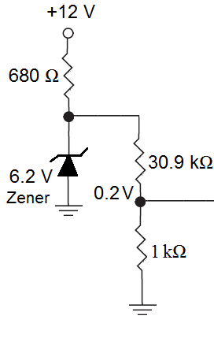
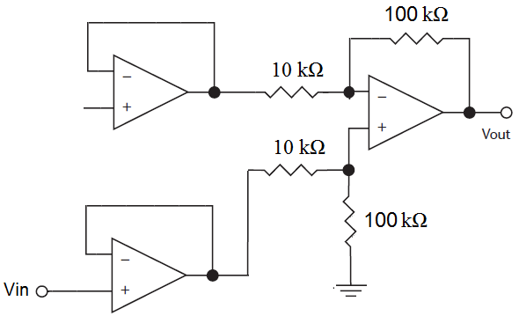
Note that a voltage divider is used to provide the 0.2V offset. The zener diode is used to keep the bias voltage constant against changes of the supply.

Slide 31
Example 2-20 (Johnson, page 89)
A sensor output a range of 20 to 250 mV as a variable varies over its range. Develop signal conditioning so that this become 0 to 5 V. The circuit must have very high input impedance.
Answer
Let us develop an linear equation for the output in terms of the input
V_{out} = aV_{in}+b
where a and b are to be found.

Slide 32
For the two conditions we have in this problem we can write
0 = a(0.020)+b
5 = a(0.250)+b
Solving these two equations gives a = 21.7 and b = -0.434.
Hence, the required equation is
V_{out} = 21.7V_{in}-0.434
This can also be written as
V_{out} = 21.7(V_{in}-0.02)
This looks like a differential amplifier with a gain of 21.7 and a fixed input of 0.02V to the inverting side. The following circuit shows how this could be done using an instrumentation amplifier.

Slide 33
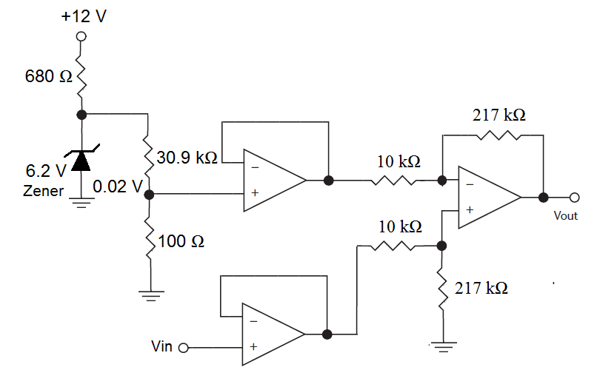

Slide 34
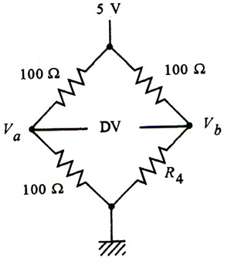
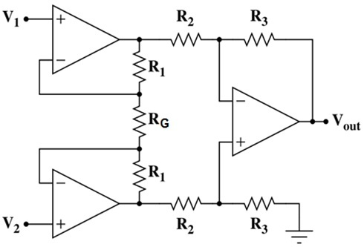
Example 2.21
A bridge circuit for which R4 varies from 100Ω to 102Ω is shown below. Show how the given instrumentation amplifier could be used to provide an output of 0 to 2.5V for that change of R4. Assume that, in the instrumentation amplifier circuit, R2 = R3 = 1 kΩ and R1 = 100 kΩ.

Slide 35
Answer
Clearly, the bridge is at null when R4=100 Ω.
When R4 = 102Ω the bridge offset voltage is found as
To get an output of 2.5V at 102Ω means that we need a differential gain of (2.5 V/24.75 mV) = 101.
For the instrumentation amplifier we have

Slide 36
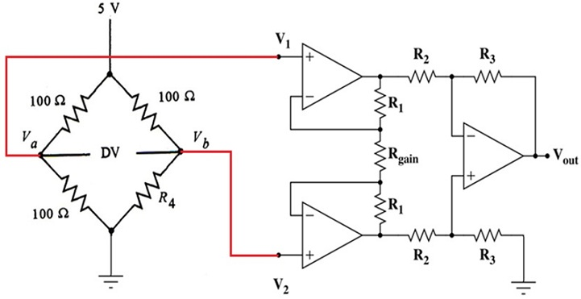

Slide 37
Linearization
linearization is the process of interpreting the signal from the sensor. It is necessary when sensors are not linearly aligned to the physical measurement.
Linearization circuits are difficult to design and usually operate only within narrow limits
The approach is to provide the nonlinear signal as input to a computer and perform the linearization using software.
With speed at which modern computers operate linearization can be done real-time.
b
c_{min}
c_{max}
b
Linearization
circuit
V
V
c_{min}
c_{max}

Slide 38
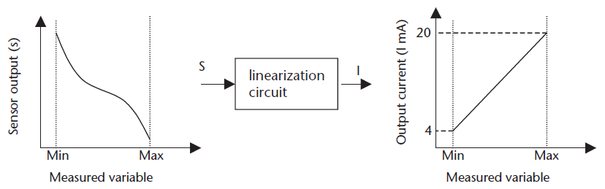
Linearization
Often, the characteristic of a sensor is nonlinear
Special circuits were devised to linearize signals
Modern approach is to use computer software for linearization.

Slide 39
Conversions
Often, signal conditioning is used to convert one type of electrical variation into another
Many sensors exhibit changes of resistance with changes in a dynamic variable
A circuit is then needed to convert this resistance change to a voltage or a current signal
This is accomplished by bridges

Slide 40
Conversion
In many situations it is required to convert one form of signal or physical value into another form such as
resistance to voltage
voltage-to-current
current-to-voltage
A typical standard in process control systems is to use current signals in the range 4 to 20 mA for transmission. This requires conversion from voltage to current at the sending end and a conversion from current to voltage at the receiving end.

Slide 41
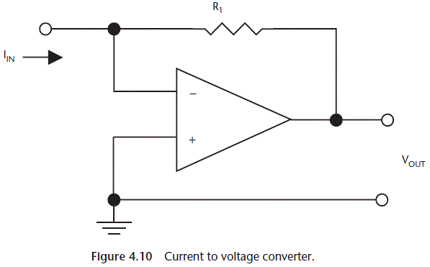
Current to voltage converter

Slide 42
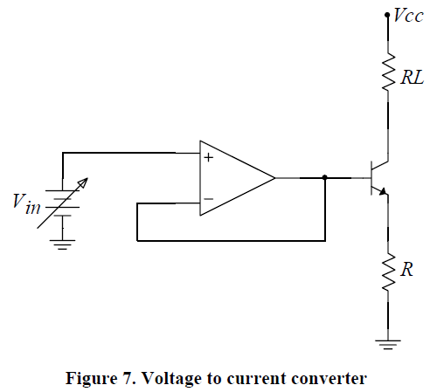
Voltage to current converter: an example
In the circuit shown, the op-amp is used as a voltage follower. Therefore, the op-amp output voltage is V_{in}.
The current through the load resistor, R_{L}, the transistor and R is consequently equal to V_{in}/R. No matter what value of the load resistor R_{L} is, the current through it will be function of V_{in} only.
The transistor is used at the output of the op-amp since the transistor is a high current gain stage (often a typical op-amp has a fairly small output current limit).

