Slide 1
LECTURE 6 (ENGINEERING ECONOMICS)
JAMES SHARKA JUANA (PhD)

Slide 2
Coverage
The time value of money
Simple and compound interest rates
Equivalence calculations with nominal and effective interest rates

Slide 3
Engineering Economic Analysis
Examines the money spent at various stages of implementing an engineering project.
Examines the revenues and benefits gained after project completion.
Therefore, engineering economic analysis focuses on costs, revenues, and benefits that occur over time.

Slide 4
Engineering Economic Decisions
A. Business Investment Decisions:
Which engineering projects are worthwhile?
Which engineering projects should have a higher priority?
How should the engineering project be designed?
B. Personal Investment Decisions:
How do I achieve my long-term financial goals?
How do I compare different ways to finance my purchases?
Which short- and long-term investment decisions should I make?

Slide 5
Common Types of Strategic Engineering Economic Decisions
Equipment or process selection
Equipment replacement decisions
New products and product expansion
Cost reduction
Improvement in service or quality

Slide 6
Time Value of Money
The value of money today is worth more or less in the future.
The value of money changes with time
Therefore, the money-time relationship should be understood by engineers/scientists for the purpose of planning and implementing engineering projects
For example replacing an old equipment now or in the future. Two options:
Save the money and buy a new equipment in the future
Buy the equipment now

Slide 7
Time Value of Money
Each of the two decisions has its related outcomes/implications
The price of the equipment may fall due to improvement in manufacturing technology.
The price of the equipment may increase due to increase in the cost of production.
The interest rate may fall/increase during the period, leading to a lower/higher future value of money.
Inflation may reduce the purchasing power of money ( real interest rate)
These and many more possible outcomes may lead to risk/uncertainties about the value of money with time

Slide 8
Time Value of Money
For money to be more valuable in the future the following should hold:
The rate of interest should be higher than the rate of inflation. The purchasing power of money increases with interest rate, but decreases with inflation.
Technological improvement may reduce the cost of production; hence, the selling prices may generally decrease and the purchasing power of money increases.
Therefore, in analysing the time value of money, there is the need to critically examine rate of interest at various points in time.

Slide 9
Time Value of Money
Suppose you win lottery today worth P20 000 000.00 and you are given two alternative ways of getting your payment.
You get the whole P10 000 000.00 today
You get P2 000 000.00 a year for ten years (P20 000 000.00)
Which payment method will you prefer?
Why do you prefer your selected method?

Slide 10
Interest Rate
Many types of transactions involve interest.
All these elements involve some common terminologies
Principal: The initial amount of money in a time-transaction, investment or debt (P). This is the present value (PV) or present worth (PW)
Interest rate per period; which measures the opportunity cost of money, or price of holding, investing or borrowing money (i). This impacts the value of money at different times.
Interest period which determines how frequently the interest is calculated (n) and (N) which shows the total number of interest periods)
Future Value; future sum of money at the end of the analysis period (FV or FW)
End of Period Payment/Receipt; which is a discrete payment or receipt at the end of some interest period (An)

Slide 11
Simple Interest
Is the interest that is computed only on the original sum, not on accrued interest.
Total interest earned is:
At the end of ‘n’ years the amount of money (F) is calculated as:

Slide 12
Simple Interest
To formalise Simple Interest calculations:

Slide 13
Example 1
Suppose that P50 000.00 is borrowed at a simple interest rate of 8% per year. The amount after two years is:

Slide 14
Simple Interest
Exercise
You have agreed to loan a friend P10000.00 for 5 years at a simple interest rate of 10% per year.
How much interest do you receive from the loan?
How much will your friend pay you at the end of the 5 years?

Slide 15
Compound Interest
In most daily financial transactions interest is computed on Compound Basis.
This implies that the interest in one period is added to the original amount and the new interest is now worked on the sum of the principal and the interest.

Slide 16
Compound Interest
See the computation of Compound interest

Slide 17
Example 2
Using example 1, i=8%, P=50000 and N=2. Try the class exercise using compound interest formula

Slide 18
Compound Interest
For a saving for any unwithdrawn amount, the interest is worked on the amount and interest of the previous period.
For a loan, the interest is worked on the unpaid amount and interest that was not paid.
Therefore, compound interest is thought of as interest on-top of interest.
The difference between the two methods is P58000-P58320 = P320
The P320 is interest on-top of interest

Slide 19
Excel Format
The solution arrived at in the previous example can be done in excel
Put the information in excel
In one column write the initial amount and beneath it the interest rate
In another column write the period starting from 1 to the end
Do the initial computation as shown in the next slide and scroll downwards until you get to the end period (see next slide)

Slide 20
Procedure
Calculations
A | B | C | D | E
Initial Amount | 50000 |  | 1 | =B$2*(1+B$3)^D2
Interest rate | 8% |  | 2 | =B$2*(1+B$3)^D3
Period | 6 |  | 3 | =B$2*(1+B$3)^D4
 |  |  | 4 | =B$2*(1+B$3)^D5
 |  |  | 5 | =B$2*(1+B$3)^D6
 |  |  | 6 | =B$2*(1+B$3)^D7
 | A | B | C | D | E
1
2 | Initial Amount | 50000 |  | 1 | 54000
3 | Interest rate | 8% |  | 2 | 58320
4 | Period | 6 |  | 3 | 62986
5 |  |  |  | 4 | 68024
6 |  |  |  | 5 | 73466
7 |  |  |  | 6 | 79344

Slide 21
Compound Interest
For any unwithdrawn of savings, the interest is worked on the amount and interest of the previous period.
For a loan, the interest is worked on the unpaid amount and interest that was not paid.
Therefore, compound interest is thought of as interest on-top of interest.
The difference between the two methods is P58000-P58320 = P320
The P320 is interest on-top of interest

Slide 22
Loan Repayment
Loan repayment schedules or plans differ with different institutions
Unpaid loan and interest are transferred to another period on which interest is worked
Loan and accumulated interest are paid at the end of the loan repayment period.
Constant periodic payments

Slide 23

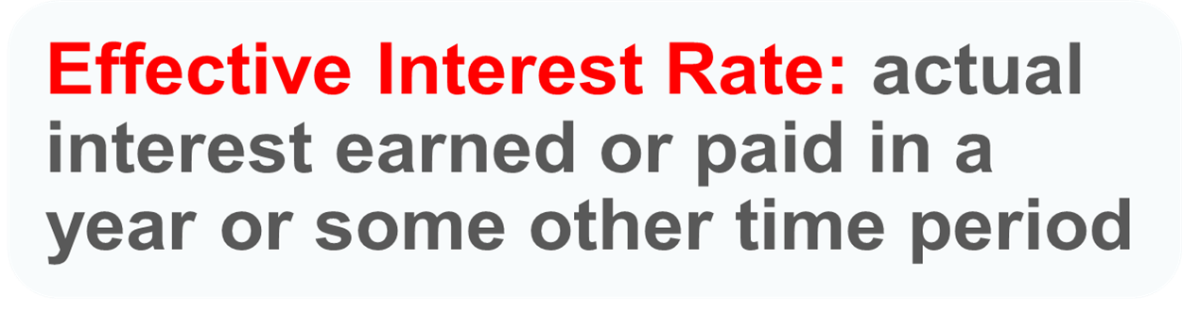
Single-payment compound interest on other than annual basis
Finding the future value using an alternative method:
The effective annual interest rate (yield)

Slide 24
Effective Annual Interest Rate (Yield)
Formula
r = nominal interest rate per year
i_{a} = effective annual interest rate
M = number of interest periods per year
A principal of P10,000 is invested at 12% interest for 5 years. Calculate the future value if the interest is compounded semi-annually.

Slide 25
Effective Annual Interest Rate (Yield)
A principal of P10,000 is invested at 12% interest for 5 years. Calculate the future value if the interest is compounded semi-annually.
Formula
r = nominal interest rate per year
i_{a} = effective annual interest rate
M = number of interest periods per year

Slide 26
F = P17908.48
Instead of F= P17623. 42. Difference of P285.06

Slide 27
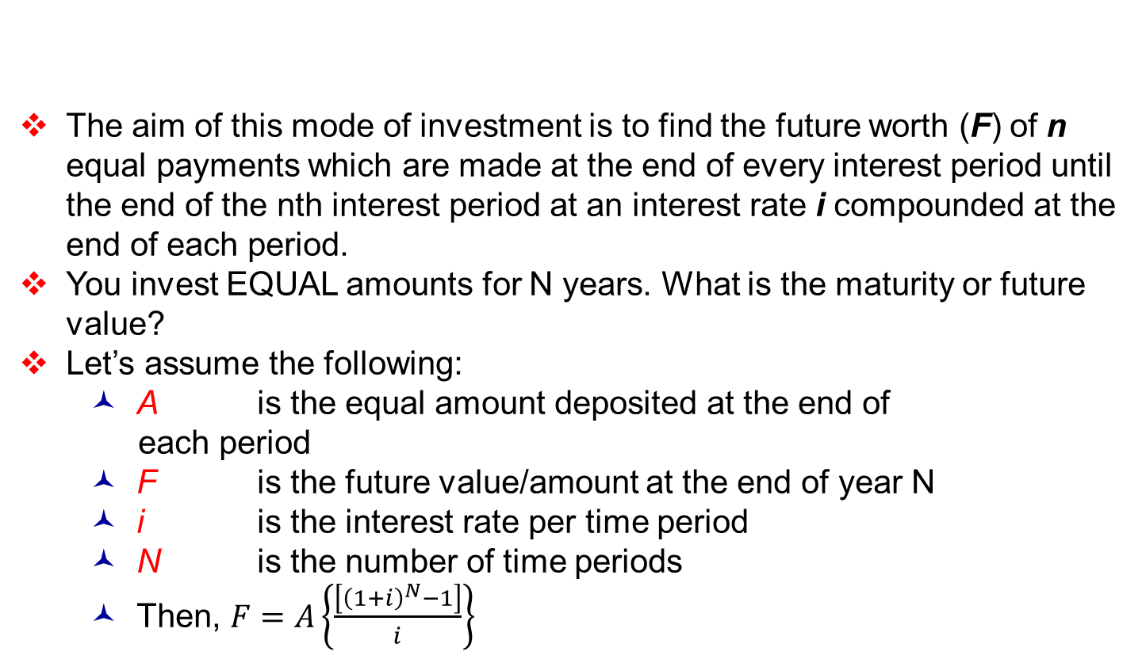
4. Equal-Payment Series Compound Amount
The aim of this mode of investment is to find the future worth (F) of n equal payments which are made at the end of every interest period until the end of the nth interest period at an interest rate i compounded at the end of each period.
You invest EQUAL amounts for N years. What is the maturity or future value?
Let’s assume the following:
A is the equal amount deposited at the end of each period
F is the future value/amount at the end of year N
i is the interest rate per time period
N is the number of time periods
Then, $F=A\left\{\frac{\left[{\left(1+i\right)}^{N}−1\right]}{i}\right\}$

Slide 28
4. Equal-Payment Series Compound Amount
Ex8: A person who is now 35 years old is planning for his retired life. He plans to invest an equal sum of P10,000 at the end of every year for the next 25 years starting at the end of next year. The bank offers a 20% interest rate compounded annually. Find the maturity value of his account when he is 60 years old.

Slide 29
4. Equal-Payment Series Compound Amount
Ex8: A person who is now 35 years old is planning for his retired life. He plans to invest an equal sum of P10,000 at the end of every year for the next 25 years starting at the end of next year. The bank offers a 20% interest rate compounded annually. Find the maturity value of his account when he is 60 years old.
= 10000 (1.20)²⁵ – 1 =10000(471.98)=P4,719,800
0.20
The future sum of the annual equal payments after 25 years is equal to P4,719,800.

Slide 30
5. Equal-Payment Series Sinking Fund
The aim of this mode of investment is to find the equivalent amount (A) that should be deposited at the end of every interest period for n periods to realize a future sum (F) at the end of the nth interest period at an interest rate i.
You want to buy or replace a fixed asset in the future, or save for retirement. What is the amount to be deposited/contributed every N period?
Let’s assume the following:
A is the equal amount deposited at the end of each period
F is the single future amount at the end of year N
i is the interest rate per time period
N is the number of time periods
Then

Slide 31
5. Equal-Payment Series Sinking Fund
Ex9: A company has to replace a present facility after 15 years at an outlay of P500,000. It plans to deposit an equal amount at the end of every year for the next 15 years at an interest rate of 18% compounded annually. Find the equivalent amount that must be deposited at the end of every year for the next 15 years.

Slide 32
5. Equal-Payment Series Sinking Fund
Ex9: A company has to replace a present facility after 15 years at an outlay of P500,000. It plans to deposit an equal amount at the end of every year for the next 15 years at an interest rate of 18% compounded annually. Find the equivalent amount that must be deposited at the end of every year for the next 15 years.
= 500000 [ 0.18 / (1.18)¹⁵ – 1]
= 500000 [0.0164] = P8,200
The annual equal amount which must be deposited for 15 years is P8,200

Slide 33
6. Equal-Payment Series Present Worth Amount
The aim of this mode of investment is to find the present worth (P) of an equal payment made at the end of every period for n periods at an interest rate of i compounded at the end of every period.
You want to withdraw/receive an amount at the end of each year for the next N years. How much should you invest NOW/ what single payment should be made NOW?
Let’s assume the following:
A is the annual equivalent payment
P is the present worth
i is the interest rate per time period
N is the number of time periods
Then
P = A (1 + i)^{N} – 1
i (1 + i)^{N}

Slide 34
6. Equal-Payment Series Present Worth Amount
Ex10: A company wants to set up reserve which will help the company to have an annual equivalent amount of $1,000,000 for the next 20 years towards its employees pension fund. The reserve is assumed to grow at the rate of 15% annually. Find the amount that must be paid now as the reserve amount.

Slide 35
6. Equal-Payment Series Present Worth Amount
Ex10: A company wants to set up reserve which will help the company to have an annual equivalent amount of $1,000,000 for the next 20 years towards its employees pension fund. The reserve is assumed to grow at the rate of 15% annually. Find the amount that must be paid now as the reserve amount.
= 1000000 (6.2593) = $6,259,331
The amount of reserve which must be set-up now is equal to $6,259,331.

Slide 36
Present Value of an Annuity
An annuity is an account earning a compound interest rate, from which periodic withdrawals are made.
Suppose
r = annual interest rate
m= number of compounding times per year
PV = Starting Balance
PMT = payment at the end of each compounding period
Account has a ‘0’ balance after ‘t’ years

Slide 37
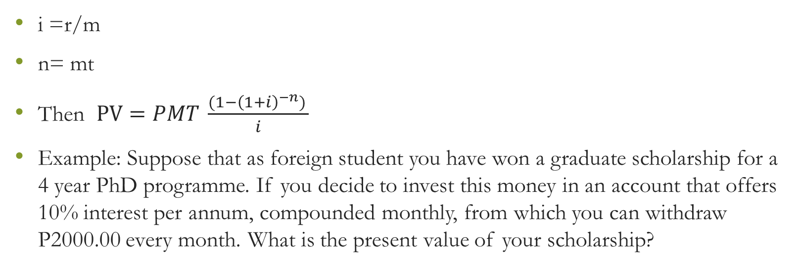
Present Value of an Annuity
i =r/m
n= mt
Then $PV=PMT \frac{(1−{\left(1+i\right)}^{−n}) }{i}$
Example: Suppose that as foreign student you have won a graduate scholarship for a 4 year PhD programme. If you decide to invest this money in an account that offers 10% interest per annum, compounded monthly, from which you can withdraw P2000.00 every month. What is the present value of your scholarship?

Slide 38
Present Value of an Annuity
PMT = 2000 mt = 4x 12 = 48
r = 10% r/m = 0.008333
m= 12
t= 4
PV = [1-(1+0.008333)^-48]/0.008333 = 2000x 39.42816 =P78856.32
The Present Value of P2000.00 received monthly for 4 years at an interest rate of 10% compounded monthly is P78856.32

Slide 39
7. Equal-Payment Series Capital Recovery Amount
The aim of this mode of investment is to find the annual equivalent amount (A) which is to be recovered at the end of every period for n periods for a loan (P) which is offered now at an interest rate of i compounded at the end of every period.
You take a loan for home improvement or to buy a fixed asset e.g. equipment, or a mortgage to buy a house or commercial property. Fixed monthly installments. What is the installment or recovery amount to be paid each period?
A is the annual equivalent payment; P is the present worth; i is the interest rate per time period; N is the number of time periods

Slide 40
7. Equal-Payment Series Capital Recovery Amount
Ex11: A bank gives a loan to a company to purchase an equipment worth P6259331.00 at an interest rate of 15% compounded annually. This amount must be repaid in 20 yearly equal installments. Find the installment amount that the company has to pay to the bank

Slide 41
7. Equal-Payment Series Capital Recovery Amount
Ex11: A bank gives a loan to a company to purchase an equipment worth P6259331.00 at an interest rate of 15% compounded annually. This amount must be repaid in 20 yearly equal installments. Find the installment amount that the company has to pay to the bank
= 6259331 (0.159761) = P1000000.00
The annual equivalent installment to be paid by the company to the bank is P1000000

Slide 42
Economic Equivalence
Economic equivalence exists between cash flows that have the same economic effect and could therefore be traded for one another.
Even though the amounts and timing of the cash flows may differ, the appropriate interest rate makes them equal.
If through an appropriate interest rate the Pula Value today is the same as the Pula Value after two years, not matter the difference in the timing and amount the two values are equivalent

Slide 43
Economic Equivalence
The lottery story:
Suppose the interest rate is 10% what will make the lottery winner be indifferent between P100000000.00 and an amount after 10 years?

Slide 44
Economic Equivalence
Suppose payment is three years earlier, are the two values still equivalent.
The solution is two-faceted:
What is F after 7 years at 10%?
Given the sum of (F = 259374246) after 10 years and at 10% (i) what is the equivalent sum after 7 years
If the two figures are the same there is economic equivalence.
F = 100000000 (1+0.1)^7 = P194871710 and P = 259374246/(1+0.1)^3 = 194871710

Slide 45
Economic Equivalence
For any future and present amount at a given interest rate there is an economic equivalence.
Therefore, the following are the variables to be considered
The size of payment/receipt
The timing of the payment/receipt
The interest rate in operation

Slide 46
Economic equivalence
Depends on interest rate; therefore change in the interest rate during the payment/receipt period challenges economic equivalence.
Suppose the interest rate was 8%.
After 10 years, F = 100000000(1+0.08)^10= P215 892 500.00 and receiving the amount three years earlier will be P171 382 427.00
If we want to have the same amount (P259 374 246.00) at a lower interest rate then P must be higher. At 8% interest rate P (for F = P259 382 412.00) should be P120 140 426.00 which more than P100 000 000.00.

