Slide 1
Errors in Measurement and its Analysis

Slide 2
No Measurement is Accurate!
Errors occur because of:
Parallax error (incorrectly sighting the measurement).
Calibration error (if the scale is not accurately drawn).
Zero error (if the device doesn’t have a zero or isn’t correctly set to zero).
Damage (if the device is damaged or faulty).
Limit of reading of the measurement device (the measurement can only be as accurate as the smallest unit of measurement of the device).

Slide 3
Definitions
Limit of Reading: is the smallest unit of measurement on the measuring instrument.
The Greatest Possible Error (also called the absolute error): is equal to half the limit of reading.
The Upper and Lower Limits: are the smallest and largest value between which a measurement can lie.

Slide 4
Types of Errors
Basically Three types of errors are studied:-
Gross Errors
Systematic Errors
Random Errors

Slide 5
Gross Errors
Gross Errors mainly covers the human mistakes in reading instruments and recording and calculating measurement results.
Example:- Due to oversight, The read of Temperature as 31.5 ̊ while the actual reading may be 21.5 .

Slide 6
Gross Errors may be of any amount and then their mathematical analysis is impossible. Then these are avoided by adopting two means:-
Great care is must in reading and recording the data.
Two , Three or even more reading should be taken for the quantity under measurement.

Slide 7
Systematic Errors
Systematic Errors classified into three categories :-
Instrumental Errors
Environmental Errors
Observational Errors

Slide 8
Instrumental Errors
These errors arises due to three main reasons.
Due to inherent shortcoming in the instrument.
Example:- If the spring used in permanent magnet instrument has become weak then instrument will always read high. Errors may caused because of friction , hysteresis , or even gear backlash.
Due to misuse of the instruments.
Due to Loading effects of instruments.

Slide 9
Environmental Errors
These errors are due to conditions external to the measuring Device including conditions in the are surrounding the instrument.
These may be effects of Temperature, Pressure, Humidity, Dust, Vibrations or of external magnetic or electrostatic fields.

Slide 10
Observational Errors
There are many sources of observational errors:-
-- Parallax, i.e. Apparent displacement when the line of vision is not normal to the scale.
-- Inaccurate estimate of average reading.
-- Wrong scale reading and wrong recording the data.
-- Incorrect conversion of units between consecutive reading.

Slide 11
Theoretical Errors
Theoretical errors are caused by simplification of the model system.
For example, a theory states that the temperature of the system surrounding will not change the readings taken when it does.
Then this factor will begin a source of error in measurement.

Slide 12
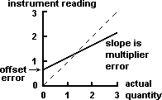
Here in Graph, Full Line shows the systematic Error in non Linear Instrument.
While Broken Line shows response of an ideal instrument without Error.

Slide 13






CAREFUL INSTRUMENT DESIGN
Reduction of systematic errors
CALIBRATION
B. Reduction of systematic errors
HIGH-GAIN FEEDBACK
METHOD OF OPPOSING INPUTS
INTELLIGENT
INSTRUMENTS
MANUAL CORRECTION OF OUTPUT READING
4/6/2022
LECTURE 04
15

Slide 14
ERROR IN MEASUREMENT
Measurement always introduce error
Error may be expressed either as absolute or percentage of error
Absolute error, e =
where – expected value
– measured value
% error =

Slide 15
ERROR IN MEASUREMENT
Relative accuracy,
% Accuracy, a = 100% - % error
=
Precision, P =
where - value of the n^{th} measurement
- average set of measurement

Slide 16
The precision of a measurement is a quantitative or numerical indication of the closeness with which a repeated set of measurement of the same variable agree with the average set of measurements.
Example 1.1
Given expected voltage value across a resistor is 80V.
The measurement is 79V. Calculate,
The absolute error
The % of error
The relative accuracy
The % of accuracy

Slide 17
Solution (Example 1.1)
Given that , expected value = 80V
measurement value = 79V
i. Absolute error, e = = 80V – 79V = 1V
ii. % error = = = 1.25%
iii. Relative accuracy, = 0.9875
iv. % accuracy, a = A x 100% = 0.9875 x 100%=98.75%

Slide 18
Example 1.2
From the value in table 1.1 calculate Table 1.1
the precision of 6th measurement?
Solution
the average of measurement value
the 6th reading
Precision =
No | X_{n}
1 | 98
2 | 101
3 | 102
4 | 97
5 | 101
6 | 100
7 | 103
8 | 98
9 | 106
10 | 99

Slide 19
LIMITING ERROR
The accuracy of measuring instrument is guaranteed within a certain percentage (%) of full scale reading
E.g manufacturer may specify the instrument to be accurate at ±2 % with full scale deflection
For reading less than full scale, the limiting error increases

Slide 20
LIMITING ERROR (cont)
Example 1.6
Given a 600 V voltmeter with accuracy ±2% full scale.
Calculate limiting error when the instrument is used to measure a voltage of 250V?
Solution
The magnitude of limiting error, 0.02 x 600 = 12V
Therefore, the limiting error for 250V = 12/250 x 100 = 4.8%

Slide 21
LIMITING ERROR (cont)
Example 1.7
Given for certain measurement, a limiting error for voltmeter at 70V is 2.143% and a limiting error for ammeter at 80mA is 2.813%. Determine the limiting error of the power.
Solution
The limiting error for the power = 2.143% + 2.813%
= 4.956%

Slide 22
Exercise
A voltmeter is accurate 98% of its full scale reading.
If the voltmeter reads 200V on 500V range, what is the absolute error?
What is the percentage error of the reading in (i).

Slide 23
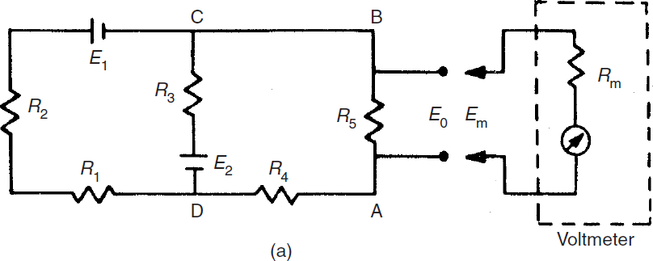
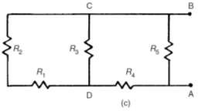
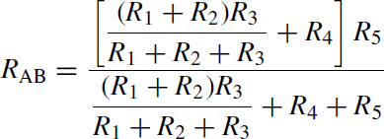
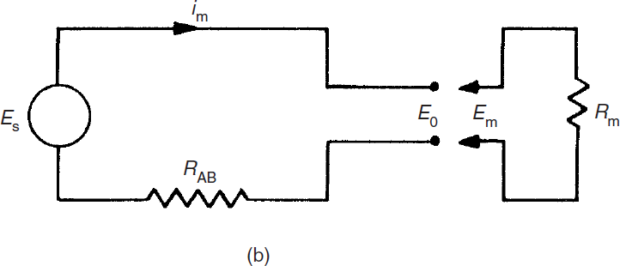
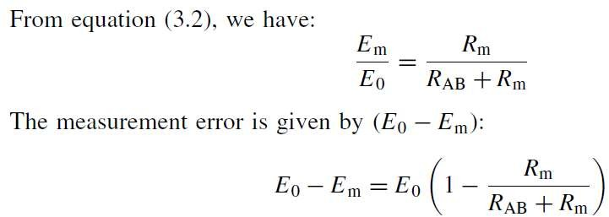
Errors in Electrical Circuits

Slide 24
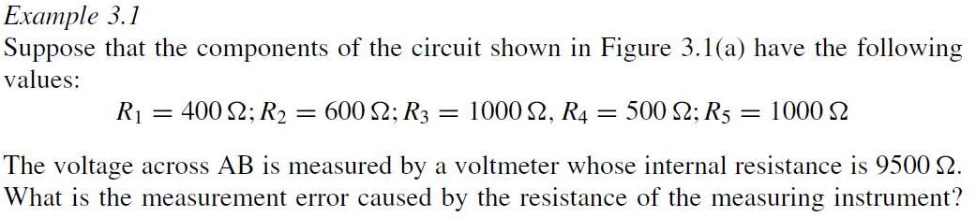

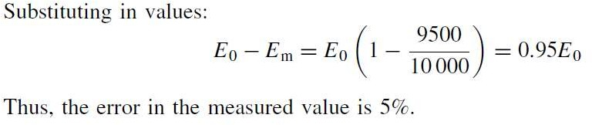
Example:

Slide 25
Random Errors
The quantity being measured is affected by many happenings in the universe. We are aware for
some of
the factors influencing the but about the rest we are
measurement,
unaware. The errors caused by happening or disturbances about which we are unaware are Random Errors. Its also known as residual Errors.

Slide 26
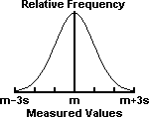
Example of Random Error
The Gaussian normal distribution. m = mean of measurements. s = standard deviation of measurements. 68% of the measurements lie in the interval m - s < x < m + s; 95% lie within m - 2s < x < m + 2s; and 99.7% lie within m - 3s < x < m + 3s.

Slide 27
Statistical Analysis of Data
The Experimental Data is obtained in Two Forms of the tests:-
Multi sample Test
Single Sample Test

Slide 28
1. Multi sample Test:- In this test, The Repeated measurement of a given quantity are done
using different test
conditions such as instruments,
employing different
and by employing
ways of measurement
different observers.
2. Single Sample Test :- A single measurement for succession of measurement done under identical conditions excepting for time is known as single sample Test.

Slide 29
Histogram
When The Number of multi sample observations are taken experimentally, There is a scatter of the data about some central value. One method presenting test results in the form of histogram. It is also called frequency distribution curve.

Slide 30
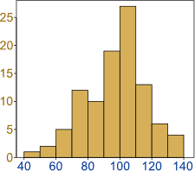
A Histogram is a graphical display of data using bars of different heights. It is similar to a Bar Chart, but a histogram groups numbers into ranges And you decide what ranges to use.

Slide 31
Arithmetic Mean
The best approximation that can be made of a number of readings of the same quantity is the arithmetic mean. It is also called Mean value. This mean is computed by summing all the values and dividing by the number of measurements.

Slide 32
Dispersion from the Mean
The property which denotes the extent to which the values are dispersed about the central value is termed as dispersion. It also known as spread or scatter. See Fig. 1.1, it shows two sets of data. In one case(curve 1) the values vary from x1 to x2 and in other curve 2 the values vary from x3 to x4. Though their central value is the same, clearly set of data represented by curve 1 has a smaller dispersion than that of the data represented by curve 2.

Slide 33
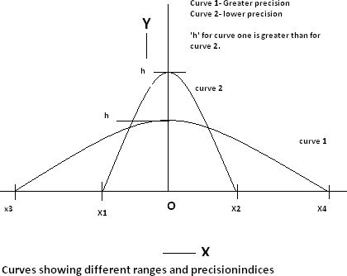

Slide 34
There are certain terms which must be defined as they form the basis defining the measure of dispersion of data:
Range
Deviation 3.Average deviation
Standard deviation
variance

Slide 35
Range And Deviation
The simplest possible measure of dispersion is the range which is the difference between greatest and least values of data. E.g. the range of curve 1 is (X2-X1) and that of the curve 2 is (X4-X3).
Deviation:- Deviation is departure of the observed reading from the arithmetic mean of the group of readings.

Slide 36
Average And Standard Deviation
Average deviation is defined as the sum of the absolute values of deviations divided by the number of readings. The absolute value of deviation is the value without respect to its sign.
Standard deviation is defined as the square root of the sum of the individual derivations squared, divided by the number of readings. It is the important term in analysis of random numbers.

Slide 37
Variance
The variance is the mean square deviation which is same as Standard deviation except that square root is not extracted.

Slide 38


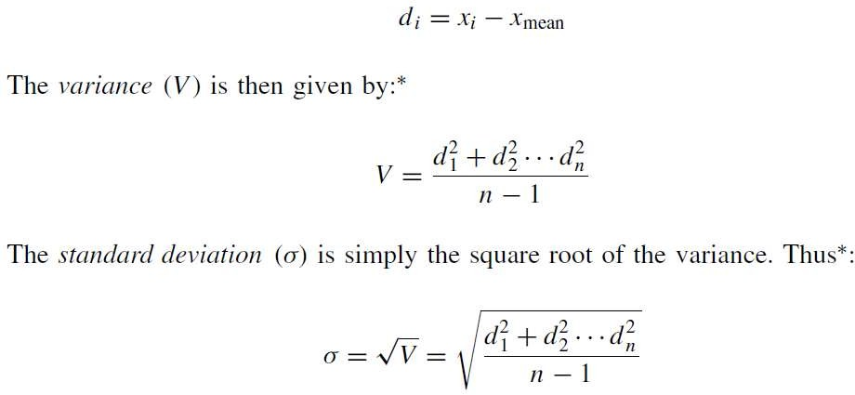
D.1: Statistical analysis of measurements subject to random errors
Mean and median
values
Standard deviation and
variance

Slide 39
Calibration
Calibration is the activity of checking, by comparison with a standard, the accuracy of a measuring instrument of any type. It may also include adjustment of the instrument to bring it into alignment with the standard.

Slide 40
Why should We Calibrate?
Calibration is required for:
Testing a new instrument
Testing an instrument after it has been repaired or modified
Periodic testing of instruments
Testing after the specific usage has elapsed
Prior to and/or after a critical measurement

