Slide 1
Data Structures and Algorithms
Mr. Jwaone Gaboitaolelwe

Slide 2
Hashing and Hash tables
Notes:
2

Slide 3
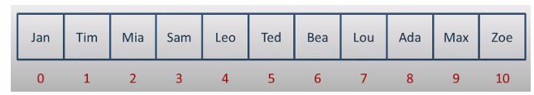
Hash tables
What are Hash Tables?
A hash table is a data structure that stores key-value pairs and allows you to access data in constant time, on average.“
What is hashing?
Hashing is a way to transform a key (e.g., "Ada") into an address in a data structure where it can be directly accessed. This avoids the need to scan every element sequentially.
Notes:
3

Slide 4
Examples of Real-Life Use Cases
We encounter hashing and hash tables almost everywhere.
Examples include:
Dictionary lookup
DNS Resolution
Databases
Cryptography
Phone books
Notes:
4

Slide 5
Hash Functions
What is a Hash Function?
A function used to transform a given key into an index that is within the bounds of the underlying array or table.
Ideal properties of a hash function:
Fast to compute
Distribute keys uniformly across the table
No occurrence of collisions.
Notes:
5

Slide 6
Example of Hash Function
Numeric Example:
If the key is 45 and we have a table size of 7, the hash function could be 45 % 7 = 3. This means that 45 is mapped to index 3.
If the key is 14 and we have a table size of 21?
Notes:
6

Slide 7
Example of Hash Function
Alphanumeric Example:
Step 1:
Find the ASCII values of each character: J = 77, i = 105, a = 97.
Step 2:
Sum the ASCII values: 77 + 105 + 97 = 279.
Step 3:
Use the modulo operator to find the index: 279 % 11 =4.
Step 4:
Store “Mia" at index 4 in the hash table of collisions.
Notes:
7

Slide 8
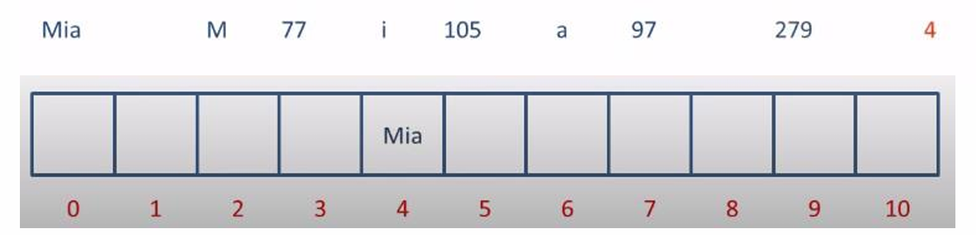
Example of Hash Function
Notes:
8

Slide 9
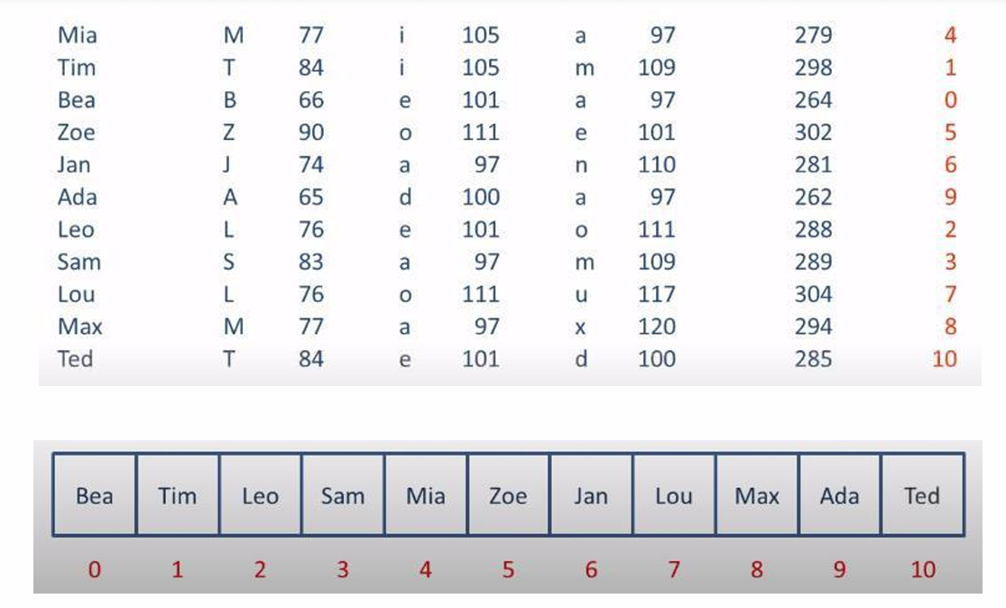
Example of Hash Function
Notes:
9

Slide 10
Example of Hash Function
Notes:
10

Slide 11
Common Hash Functions in Practice
There are several hash functions that have been developed over time.
Examples include:
DJB2,
MD5
SHA family hashes.
Notes:
11

Slide 12
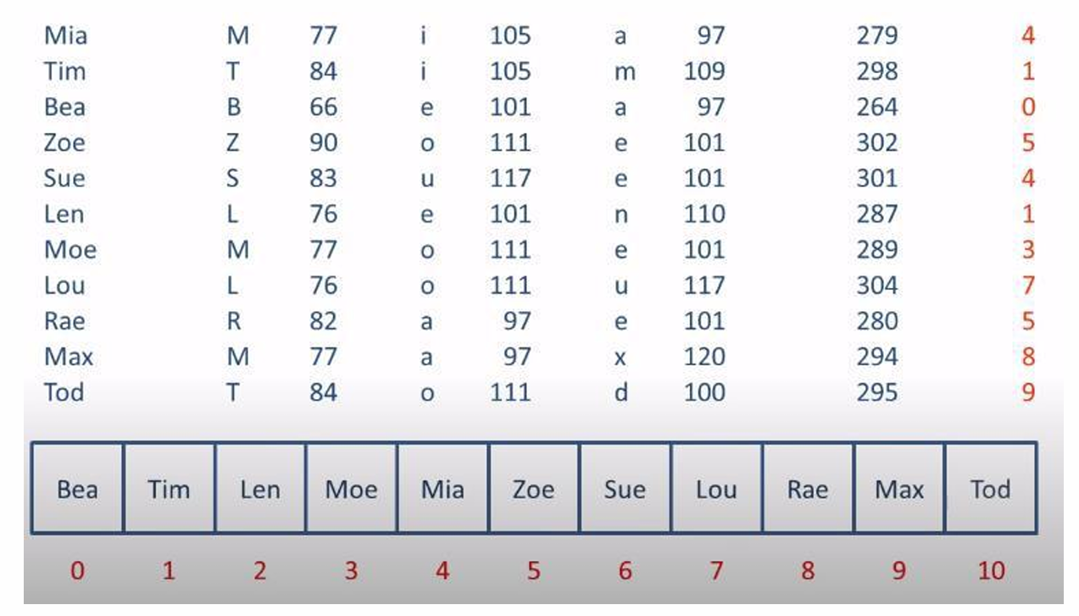
Collisions
What are Collisions?
When a hash function maps two different keys to the same index in the hash table
Notes:
12

Slide 13
Collisions
Collision Resolution Techniques?
Open addressing: A collision resolution technique that involves finding an empty slot within the hash table by following a defined sequence when a collision occurs.
Chaining: A collision resolution technique that uses data structures to store elements that collide at the same index.
Notes:
13

Slide 14
Examples of open addressing techniques
1. Linear Probing: When a collision occurs, move to the next slot in sequence until an empty slot is found.
2. Quadratic Probing: When a collision occurs, the next slot is determined by adding a quadratic function of the probe number to the original index. This means that instead of moving to the next slot linearly, you move in larger steps (e.g., 1^2, 2^2, 3^2, etc.).
3. Double Hashing: When a collision occurs, a secondary hash function is used to determine the step size for probing. Instead of just adding a fixed or growing step, double hashing makes the step size dynamic.
Notes:
14

Slide 15
Examples of Chaining techniques
1. Linked Lists: Each bucket in the hash table points to a linked list where all the colliding elements are stored.
2. Dynamic Arrays: Each bucket points to a dynamic array.
3. Balanced Trees (e.g., Red-Black Trees): Each bucket can use a balanced tree to store the elements.
4. Hash Table at Each Bucket (Double Hashing): Each bucket contains another smaller hash table.
5. Skip Lists: Each bucket can use a skip list instead of a linked list.
Notes:
15

Slide 16
Ways of avoiding collisions
1. Bigger Tables: To avoid collisions, make the hash tables bigger
2. Load Factor: The ratio of the number of elements to the size of the table. Keeping the load factor low (typically < 0.7) can reduce collisions.
3. Rehashing: A technique to expand the hash table size and reassign elements when the load factor becomes too high.
Notes:
16

Slide 17
Practical Example Section: Using Python

