Slide 1
Position Analysis

Slide 2
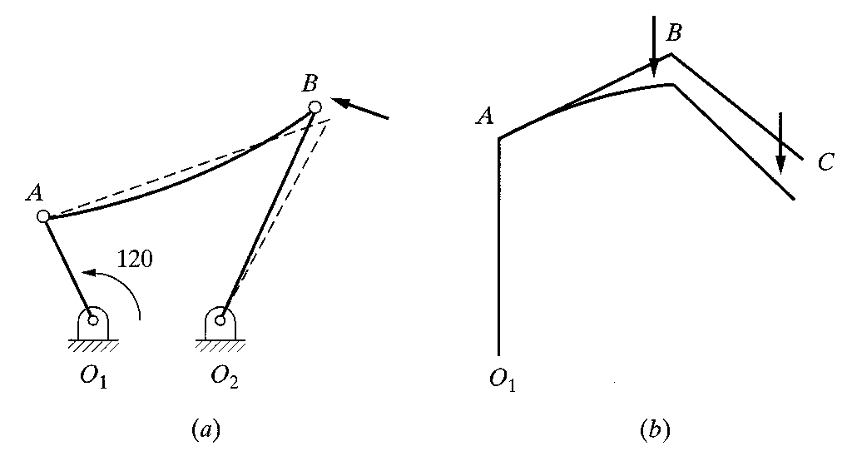
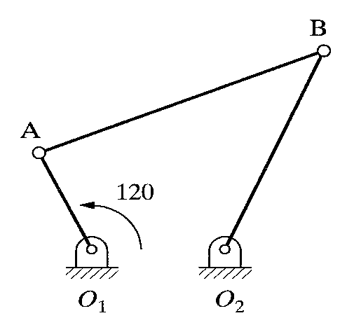
2.2 ROBOTS AS MECHANISM
♦Multiple type robot have multiple DOF.
(3 Dimensional, open loop, chain mechanisms)
Fig. 2.1 A one-degree-of-freedom closed-loop
four-bar mechanism
Fig. 2.2 (a) Closed-loop versus (b) open-loop mechanism

Slide 3
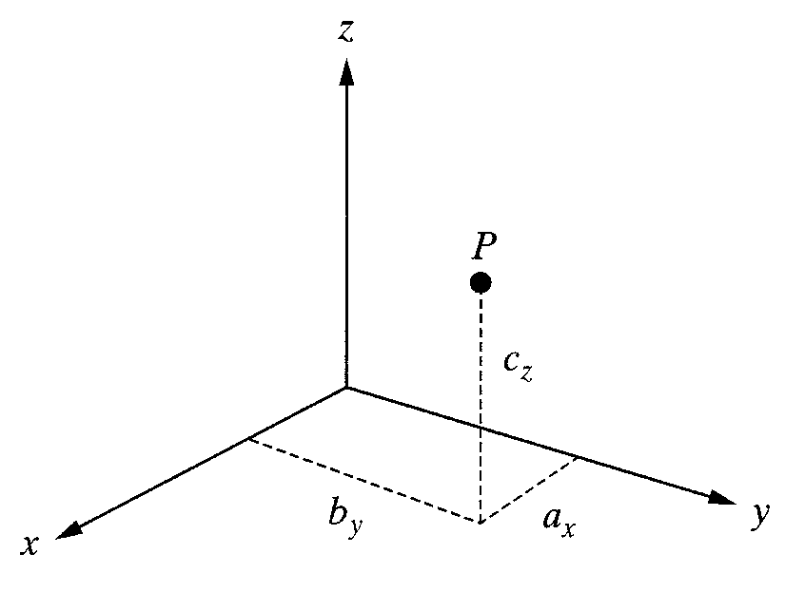
2.3 MATRIX REPRESENTATION
2.3.1 Representation of a Point in Space
♦A point P in space :
3 coordinates relative to a reference frame
Fig. 2.3 Representation of a point in space

Slide 4
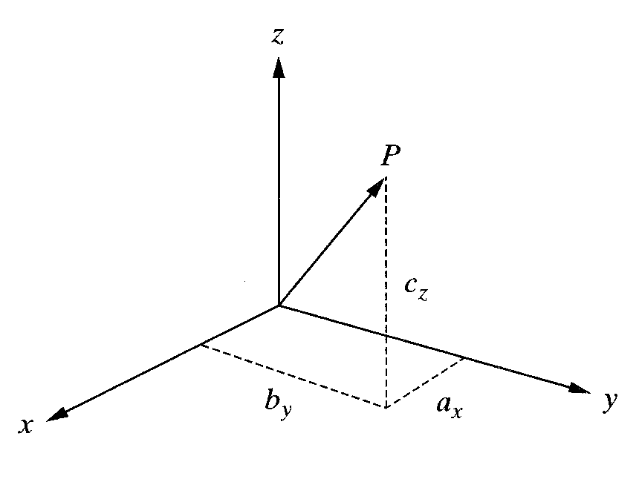
2.3 MATRIX REPRESENTATION
2.3.2 Representation of a Vector in Space
♦A Vector P in space :
3 coordinates of its tail and of its head
Fig. 2.4 Representation of a vector in space

Slide 5
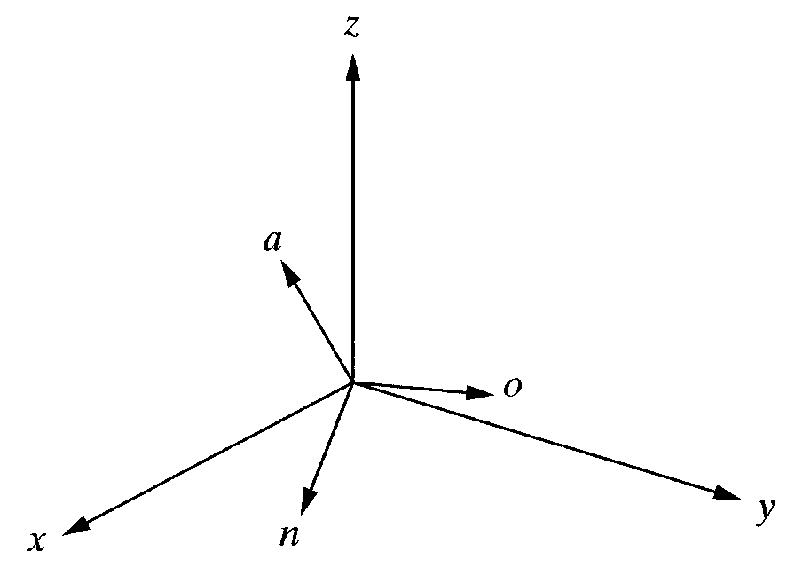
2.3 MATRIX REPRESENTATION
2.3.3 Representation of a Frame at the Origin of a Fixed-Reference Frame
♦Each Unit Vector is mutually perpendicular. :
normal, orientation, approach vector
Fig. 2.5 Representation of a frame at the origin of the reference frame

Slide 6
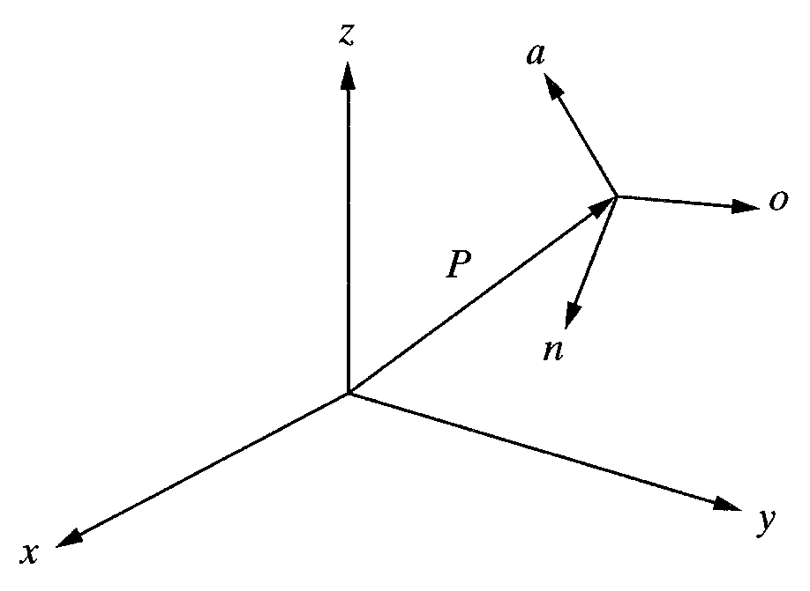
2.3 MATRIX REPRESENTATION
2.3.4 Representation of a Frame in a Fixed Reference Frame
♦Each Unit Vector is mutually perpendicular. :
normal, orientation, approach vector
Fig. 2.6 Representation of a frame in a frame

Slide 7
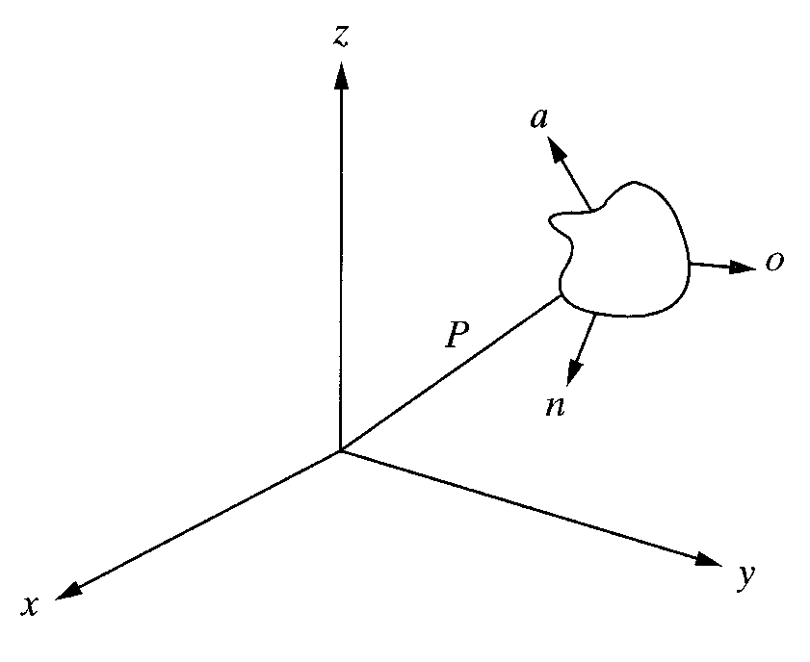
2.3 MATRIX REPRESENTATION
2.3.5 Representation of a Rigid Body
♦An object can be represented in space by attaching a frame
to it and representing the frame in space.
Fig. 2.8 Representation of an object in space

Slide 8
2.4 HOMOGENEOUS TRANSFORMATION MATRICES
♦A transformation matrices must be in square form.
It is much easier to calculate the inverse of square matrices.
To multiply two matrices, their dimensions must match.

Slide 9
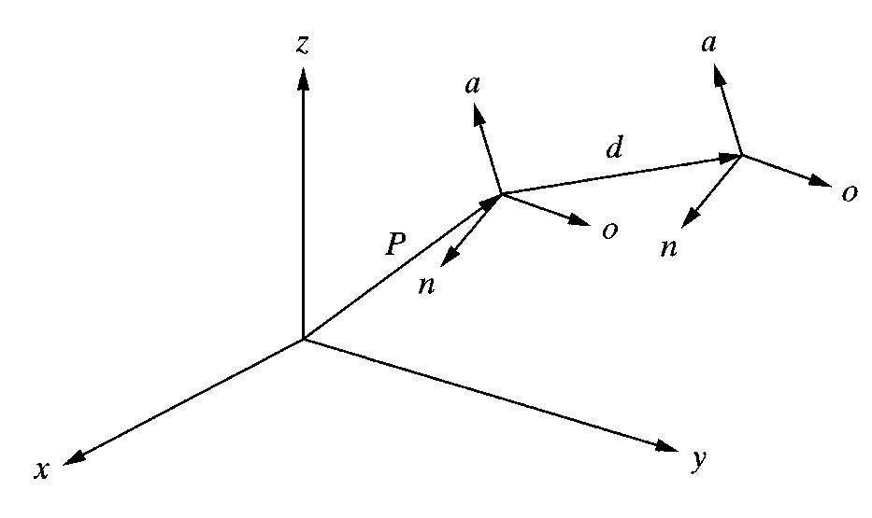
2.5 REPRESENTATION OF TRANSFORMATINS
2.5.1 Representation of a Pure Translation
♦A transformation is defined as making a movement in space.
A pure translation.
A pure rotation about an axis.
A combination of translation or rotations.
Fig. 2.9 Representation of an pure translation in space

Slide 10
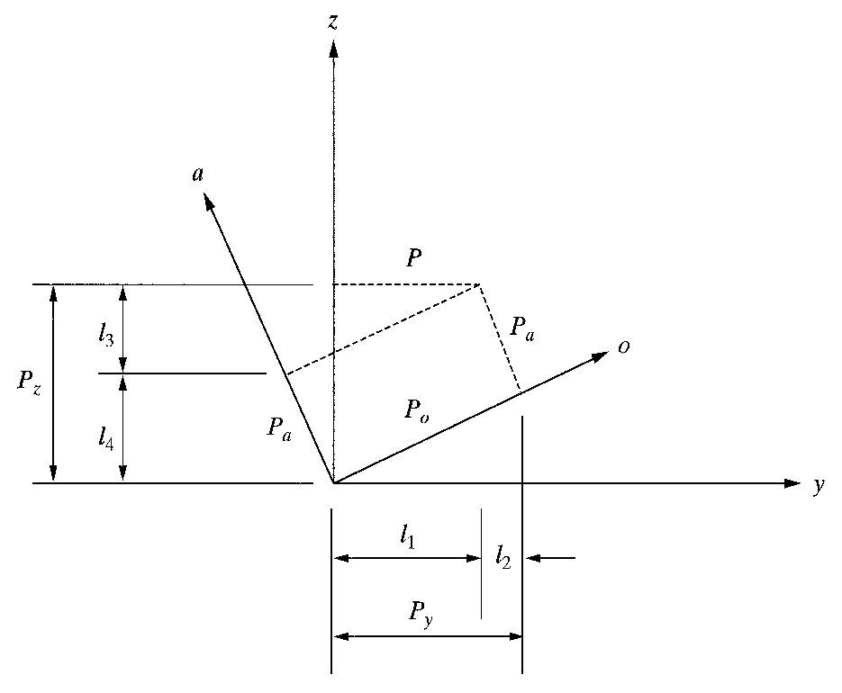
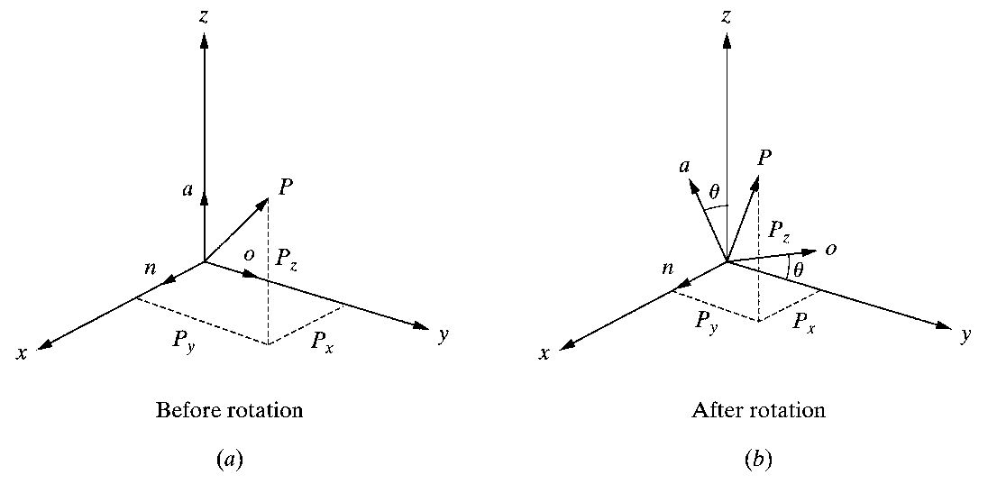
2.5 REPRESENTATION OF TRANSFORMATINS
2.5.2 Representation of a Pure Rotation about an Axis
♦Assumption : The frame is at the origin of the reference frame and parallel to it.
Fig. 2.10 Coordinates of a point in a rotating
frame before and after rotation.
Fig. 2.11 Coordinates of a point relative to the reference
frame and rotating frame as viewed from the x-axis.

Slide 11
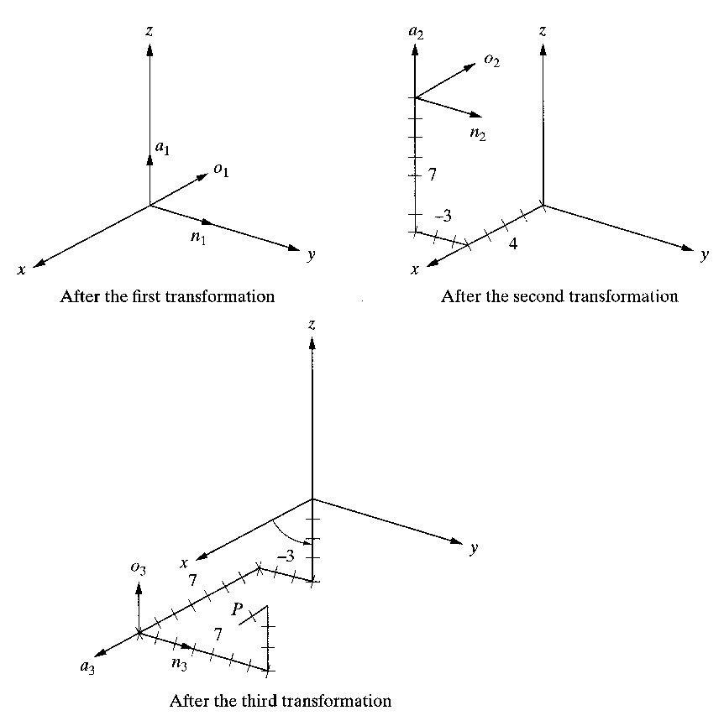
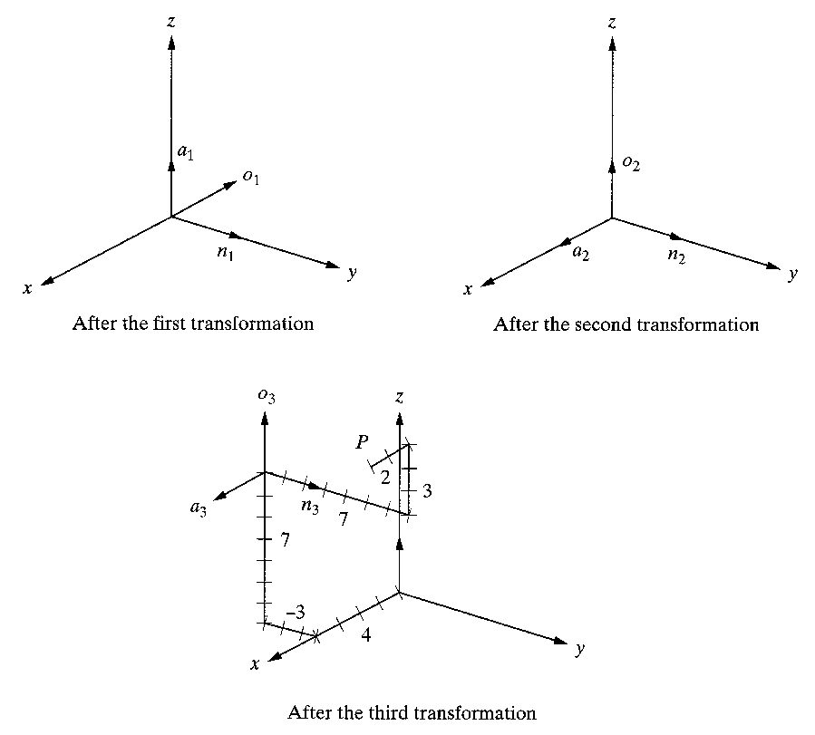
2.5 REPRESENTATION OF TRANSFORMATINS
2.5.3 Representation of Combined Transformations
♦A number of successive translations and rotations….
Fig. 2.13 Effects of three successive transformations
Fig. 2.14 Changing the order of transformations will
change the final result

Slide 12
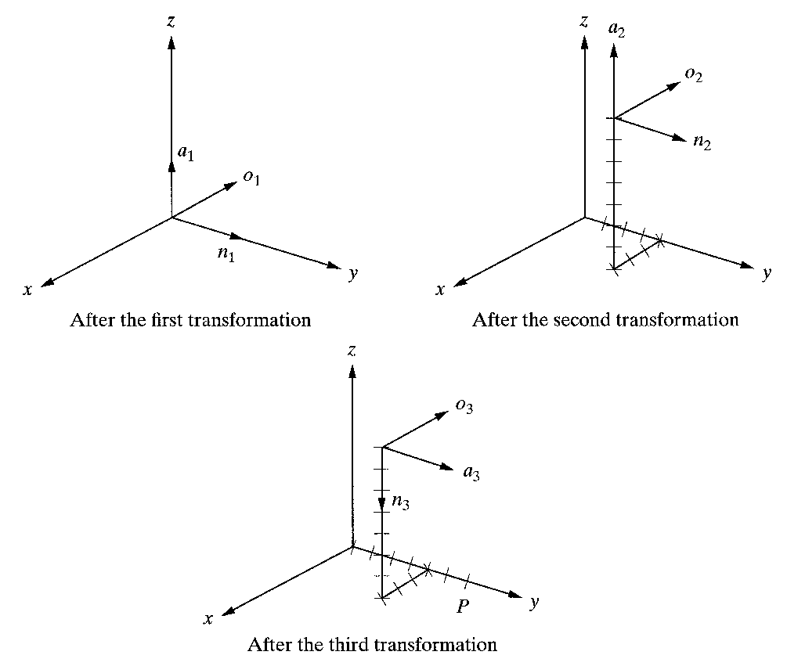
2.5 REPRESENTATION OF TRANSFORMATINS
2.5.5 Transformations Relative to the Rotating Frame
♦Example 2.8
Fig. 2.15 Transformations relative to the current frames.

Slide 13
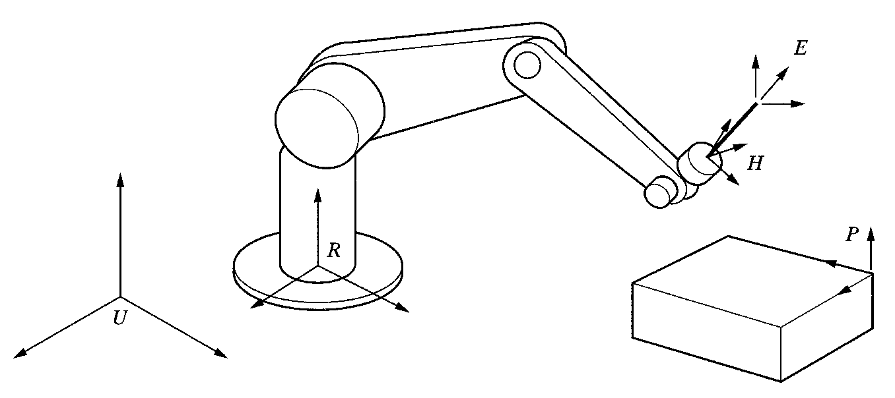
2.6 INVERSE OF TRANSFORMATION MATIRICES
♦Inverse of a matrix calculation steps :
• Calculate the determinant of the matrix.
• Transpose the matrix.
• Replace each element of the transposed matrix by its own minor(adjoint matrix).
• Divide the converted matrix by the determinant.
Fig. 2.16 The Universe, robot, hand, part, and end effecter frames.

Slide 14
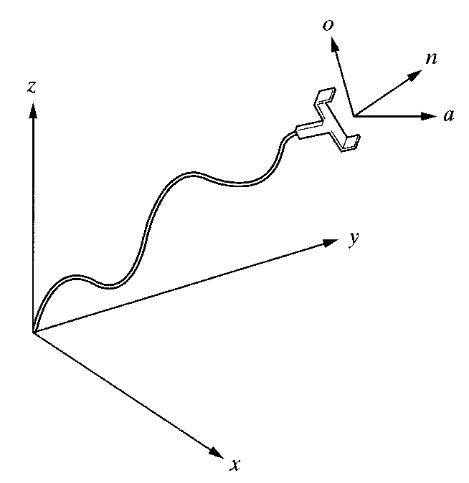
2.7 FORWARD AND INVERSE KINEMATICS OF ROBOTS
♦Forward Kinematics Analysis:
• Calculating the position and orientation of the hand of the robot.
• If all robot joint variables are known, one can calculate where the robot is
at any instant.
• Recall Chapter 1.
Fig. 2.17 The hand frame of the robot relative to the reference frame.

