Slide 1
COMP 302 Algorithms and Data Structures

Slide 2
Evaluation
Your grade G is calculated according to the formula:
where F, M, and P are your marks on your final, mid-term, and projects, respectively

Slide 3
Evaluation
The Course is assessed as follows:
Continuous Assessment | Final Examination
Assignment 10% | Theory examination 60%
Theory Test one 15%
Theory Test two 15%

Slide 4
Evaluation
A student who misses either examination must provide:
A Verification of Illness form indicating a severe illness, or
Other formal documentation, as appropriate
With proper documentation:
Missing the mid-term examination sets E = F in the formula
Missing the final examination results in the opportunity to write with the next offering of the course
Without proper documentation:
Missing the mid-term examination results in 0
Missing the final examination results in 0
There will be no re-weighting of the mid-term examination under any circumstances

Slide 5
In this course, we will look at:
Algorithms for solving problems efficiently
Data structures for efficiently storing, accessing, and modifying data
We will see that all data structures have trade-offs
There is no ultimate data structure...
The choice depends on our requirements

Slide 6
COMP 302 Algorithms and Data Structures
Consider accessing the k^{th} entry in an array or linked list
In an array, we can access it using an index array[k]
We must step through the first k – 1 nodes in a linked list
Consider searching for an entry in a sorted array or linked list
In a sorted array, we use a fast binary search
Very fast
We must step through all entries less than the entry we’re looking for
Slow

Slide 7
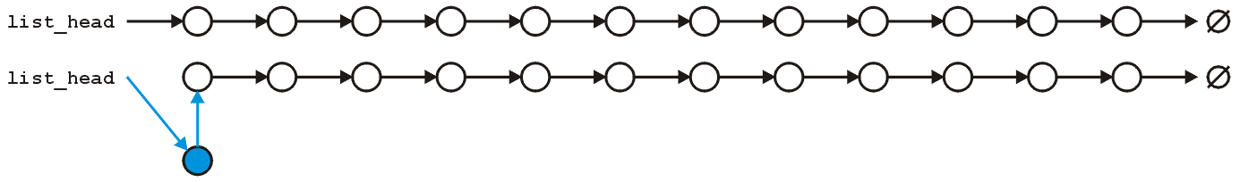
COMP 302 Algorithms and Data Structures
However, consider inserting a new entry to the start of an array or a linked list
An array requires that you copy all the elements in the array over
Slow for large arrays
A linked list allows you to make the insertion very quickly
Very fast regardless of size

Slide 8
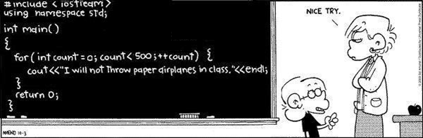
C++
You will be using the C++ programming language in this course
Modified for C++ from http://www.foxtrot.com/

Slide 9
C++
This course does not teach C++ programming
You will use C++ to demonstrate your knowledge in this course
An on-line tutorial is available on the course web site
It assumes minimal knowledge of programming

Slide 10
Projects
For each of the five projects, you will be required to implement one or more of the data structures taught in class
We provide an environment in which we test your projects
The times the projects are due is fixed:
Projects are due Tuesday at 22:00 (10:00 pm) on Learn
The drop-box will be kept open until midnight for late submissions
Maximum grade for late submissions is 70

Slide 11
Projects
We provide a interpreter which you can use to test your software
We will use the same interpreter to test your software
Your output must perfectly match our output
Comparisons are done using text comparisons
Any debugging printouts will cause your project to fail a test

Slide 12
Algorithm
An algorithm is a set of instructions to be followed to solve a problem.
There can be more than one solution (more than one algorithm) to solve a given problem.
An algorithm can be implemented using different programming languages on different platforms.
An algorithm must be correct. It should correctly solve the problem.
e.g. For sorting, this means even if (1) the input is already sorted, or (2) it contains repeated elements.
Once we have a correct algorithm for a problem, we have to determine the efficiency of that algorithm.
12

Slide 13
Algorithmic Performance
There are two aspects of algorithmic performance:
Time
Instructions take time.
How fast does the algorithm perform?
What affects its runtime?
Space
Data structures take space
What kind of data structures can be used?
How does choice of data structure affect the runtime?
We will focus on time:
How to estimate the time required for an algorithm
How to reduce the time required
13

Slide 14
Analysis of Algorithms
Analysis of Algorithms is the area that provides tools to analyze the efficiency of different methods of solutions.
How do we compare the time efficiency of two algorithms that solve the same problem?
Naïve Approach: implement these algorithms in a programming language (C++), and run them to compare their time requirements. Comparing the programs (instead of algorithms) has difficulties.
How are the algorithms coded?
Comparing running times means comparing the implementations.
We should not compare implementations, because they are sensitive to programming style that may cloud the issue of which algorithm is inherently more efficient.
What computer should we use?
We should compare the efficiency of the algorithms independently of a particular computer.
What data should the program use?
Any analysis must be independent of specific data.
14

Slide 15
Analysis of Algorithms
When we analyze algorithms, we should employ mathematical techniques that analyze algorithms independently of specific implementations, computers, or data.
To analyze algorithms:
First, we start to count the number of significant operations in a particular solution to assess its efficiency.
Then, we will express the efficiency of algorithms using growth functions.
15

Slide 16
General Rules for Estimation
Loops: The running time of a loop is at most the running time of the statements inside of that loop times the number of iterations.
Nested Loops: Running time of a nested loop containing a statement in the inner most loop is the running time of statement multiplied by the product of the sized of all loops.
Consecutive Statements: Just add the running times of those consecutive statements.
If/Else: Never more than the running time of the test plus the larger of running times of S1 and S2.
16

Slide 17
The Execution Time of Algorithms
Each operation in an algorithm (or a program) has a cost.
➔ Each operation takes a certain of time.
count = count + 1; ➔ take a certain amount of time, but it is constant
A sequence of operations:
count = count + 1; Cost: c₁
sum = sum + count; Cost: c₂
➔ Total Cost = c₁ + c₂
17

Slide 18
The Execution Time of Algorithms (cont.)
Example: Simple If-Statement
Cost Times
if (n < 0) c1 1
absval = -n c2 1
else
absval = n; c3 1
Total Cost <= c1 + max(c2,c3)
18

Slide 19
The Execution Time of Algorithms (cont.)
Example: Simple Loop
Cost Times
i = 1; c1
sum = 0; c2
while (i <= n) { c3
i = i + 1; c4
sum = sum + i; c5
}
Total Cost =
➔ The time required for this algorithm is proportional to ?
19

Slide 20
The Execution Time of Algorithms (cont.)
Example: Simple Loop
Cost Times
i = 1; c1 1
sum = 0; c2 1
while (i <= n) { c3 n+1
i = i + 1; c4 n
sum = sum + i; c5 n
}
Total Cost = c1 + c2 + (n+1)*c3 + n*c4 + n*c5
➔ The time required for this algorithm is proportional to n
20

Slide 21
The Execution Time of Algorithms (cont.)
Example: Nested Loop
Cost Times
i=1; c1
sum = 0; c2
while (i <= n) { c3
j=1; c4
while (j <= n) { c5
sum = sum + i; c6
j = j + 1; c7
}
i = i + 1; c8
}
Total Cost =
➔ The time required for this algorithm is proportional to
21

Slide 22
The Execution Time of Algorithms (cont.)
Example: Nested Loop
Cost Times
i=1; c1 1
sum = 0; c2 1
while (i <= n) { c3 n+1
j=1; c4 n
while (j <= n) { c5 n*(n+1)
sum = sum + i; c6 n*n
j = j + 1; c7 n*n
}
i = i + 1; c8 n
}
Total Cost = c1 + c2 + (n+1)*c3 + n*c4 + n*(n+1)*c5+n*n*c6+n*n*c7+n*c8
➔ The time required for this algorithm is proportional to n²
22

Slide 23
General Rules for Estimation
Loops: The running time of a loop is at most the running time of the statements inside of that loop times the number of iterations.
Nested Loops: Running time of a nested loop containing a statement in the inner most loop is the running time of statement multiplied by the product of the sized of all loops.
Consecutive Statements: Just add the running times of those consecutive statements.
If/Else: Never more than the running time of the test plus the larger of running times of S1 and S2.
23

Slide 24
Algorithm Growth Rates
We measure an algorithm’s time requirement as a function of the problem size.
Problem size depends on the application: e.g. number of elements in a list for a sorting algorithm, the number users for a social network search.
So, for instance, we say that (if the problem size is n)
Algorithm A requires 5*n² time units to solve a problem of size n.
Algorithm B requires 7*n time units to solve a problem of size n.
The most important thing to learn is how quickly the algorithm’s time requirement grows as a function of the problem size.
Algorithm A requires time proportional to n².
Algorithm B requires time proportional to n.
An algorithm’s proportional time requirement is known as growth rate.
We can compare the efficiency of two algorithms by comparing their growth rates.
24

Slide 25
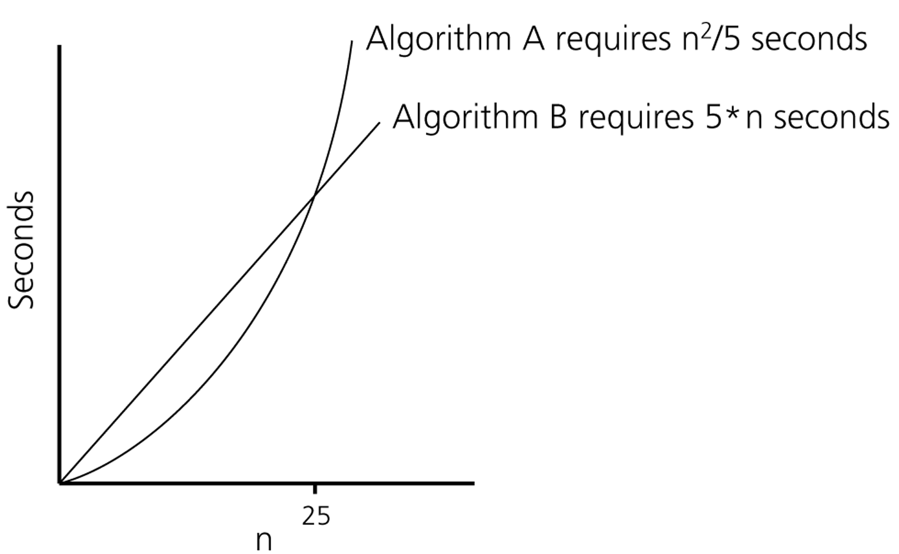
Algorithm Growth Rates (cont.)
Time requirements as a function
of the problem size n
25

Slide 26
Common Growth Rates
Function | Growth Rate Name
c | Constant
log N | Logarithmic
log² N | Log-squared
N | Linear
N log N | Log-linear
N² | Quadratic
N³ | Cubic
2^{N} | Exponential

Slide 27
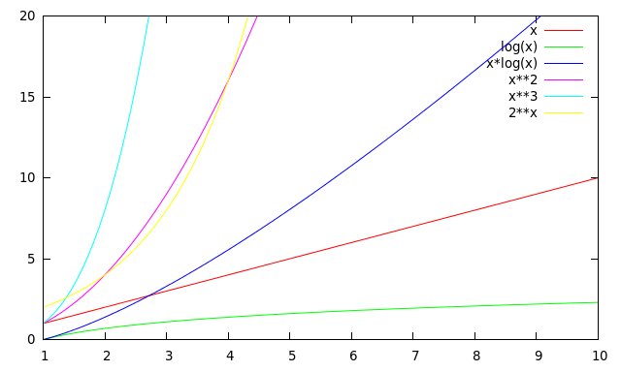
Running Times for Small Inputs
Running time
Input size (x = n)
27

Slide 28
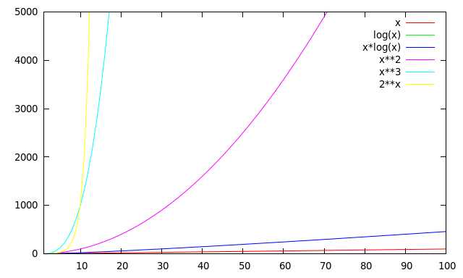
Running Times for Large Inputs
Running time
Input size (x = n)
28

Slide 29
Order-of-Magnitude Analysis and Big O Notation
If Algorithm A requires time proportional to g(n), Algorithm A is said to be order g(n), and it is denoted as O(g(n)).
The function g(n) is called the algorithm’s growth-rate function.
Since the capital O is used in the notation, this notation is called the Big O notation.
If Algorithm A requires time proportional to n², it is O(n²).
If Algorithm A requires time proportional to n, it is O(n).
29

Slide 30
Definition of the Order of an Algorithm
Definition:
Algorithm A is order g(n) – denoted as O(g(n)) –
if constants k and n₀ exist such that A requires
no more than k*g(n) time units to solve a problem
of size n ≥ n₀. ➔ f(n) ≤ k*g(n) for all n ≥ n₀
The requirement of n ≥ n₀ in the definition of O(f(n)) formalizes the notion of sufficiently large problems.
In general, many values of k and n can satisfy this definition.
30

Slide 31
Order of an Algorithm
If an algorithm requires f(n) = n²–3*n+10 seconds to solve a problem size n. If constants k and n₀ exist such that
k*n² > n²–3*n+10 for all n ≥ n₀ .
the algorithm is order n² (In fact, k is 3 and n₀ is 2)
3*n² > n²–3*n+10 for all n ≥ 2 .
Thus, the algorithm requires no more than k*n² time units for n ≥ n₀ ,
So it is O(n²)
31

Slide 32
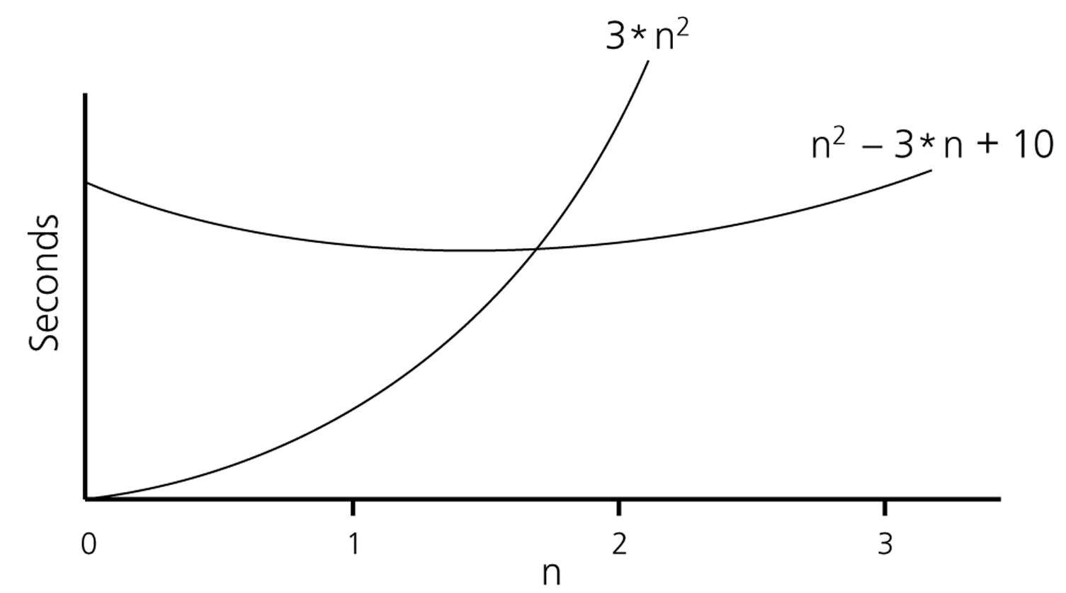
Order of an Algorithm (cont.)
32

Slide 33
Order of an Algorithm
Show 2^{x} + 17 is O(2^{x})
2^{x} + 17 ≤ 2^{x} + 2^{x} = 2*2^{x} for x > 5
Hence k = 2 and n₀ = 5
33

Slide 34
Order of an Algorithm
Show 2^{x} + 17 is O(3^{x})
2^{x} + 17 ≤ k3^{x}
Easy to see that rhs grows faster than lhs over time → k=1
However when x is small 17 will still dominate → skip over some smaller values of x by using n₀ = 2
Hence k = 1 and n₀ = 2
34

Slide 35
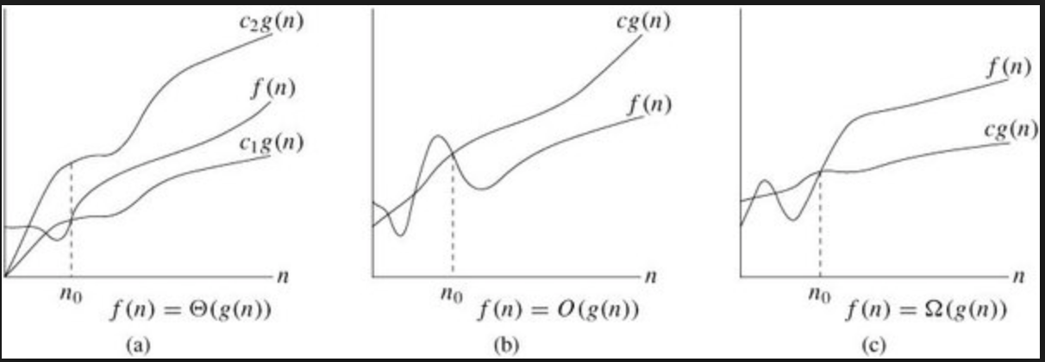
Definition of the Order of an Algorithm
Definition:
Algorithm A is omega g(n) – denoted as Ω(g(n)) –
if constants k and n₀ exist such that A requires
more than k*g(n) time units to solve a problem
of size n ≥ n₀. ➔ f(n) ≥ k*g(n) for all n ≥ n₀
35

Slide 36
Definition of the Order of an Algorithm
Definition:
Algorithm A is theta g(n) – denoted as 𝚹(g(n)) –
if constants k₁, k₂ and n₀ exist such that
k₁*g(n) ≤ f(n) ≤ k₂*g(n) for all n ≥ n₀
(Drop the equalities and you get small o and small omega (ω) notations, respectively, e.g., f(n) is o(g(n)) if f(n)<kg(n))
36

Slide 37
Order of an Algorithm
Show f(n) = 7n² + 1 is 𝚹(n²)
You need to show f(n) is O(n²) and f(n) is Ω(n²)
f(n) is O(n²) because 7n² + 1 ≤ 7n² + n² ∀n ≥ 1 ➔ k₁ = 8 n₀ = 1
f(n) is Ω (n²) because 7n² + 1 ≥ 7n² ∀n ≥ 0 ➔ k₂ = 7 n₀ = 0
Pick the largest n₀ to satisfy both conditions naturally ➔ k₁ = 8, k₂ = 7, n₀ = 1
37

Slide 38
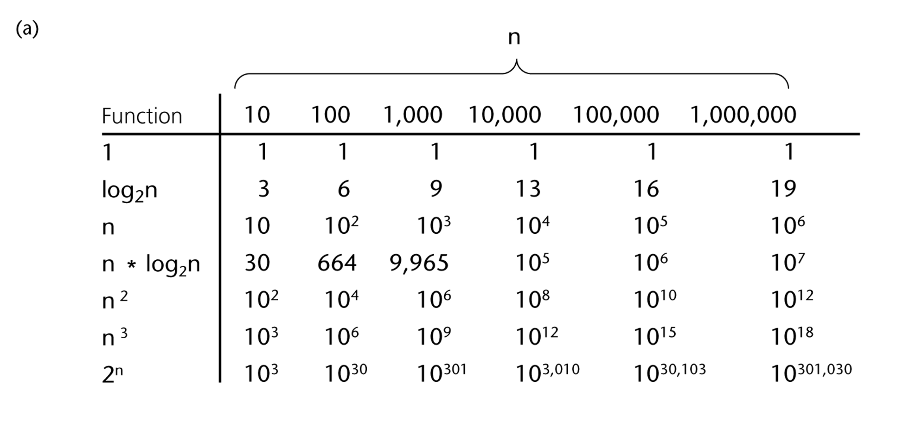
A Comparison of Growth-Rate Functions
38

Slide 39
Growth-Rate Functions
O(1) Time requirement is constant, and it is independent of the problem’s size.
O(log₂n) Time requirement for a logarithmic algorithm increases increases slowly
as the problem size increases.
O(n) Time requirement for a linear algorithm increases directly with the size
of the problem.
O(n*log₂n) Time requirement for a n*log₂n algorithm increases more rapidly than
a linear algorithm.
O(n²) Time requirement for a quadratic algorithm increases rapidly with the
size of the problem.
O(n³) Time requirement for a cubic algorithm increases more rapidly with the
size of the problem than the time requirement for a quadratic algorithm.
O(2^{n}) As the size of the problem increases, the time requirement for an
exponential algorithm increases too rapidly to be practical.
39

Slide 40
Growth-Rate Functions
If an algorithm takes 1 second to run with the problem size 8, what is the time requirement (approximately) for that algorithm with the problem size 16?
If its order is:
O(1) ➔ T(n) = 1 second
O(log₂n) ➔ T(n) = (1*log₂16) / log₂8 = 4/3 seconds
O(n) ➔ T(n) = (1*16) / 8 = 2 seconds
O(n*log₂n) ➔ T(n) = (1*16*log₂16) / 8*log₂8 = 8/3 seconds
O(n²) ➔ T(n) = (1*16²) / 8² = 4 seconds
O(n³) ➔ T(n) = (1*16³) / 8³ = 8 seconds
O(2^{n}) ➔ T(n) = (1*2¹⁶) / 2⁸ = 2⁸ seconds = 256 seconds
40

Slide 41
Properties of Growth-Rate Functions
We can ignore low-order terms in an algorithm’s growth-rate function.
If an algorithm is O(n³+4n²+3n), it is also O(n³).
We only use the higher-order term as algorithm’s growth-rate function.
We can ignore a multiplicative constant in the higher-order term of an algorithm’s growth-rate function.
If an algorithm is O(5n³), it is also O(n³).
O(f(n)) + O(g(n)) = O(f(n)+g(n))
We can combine growth-rate functions.
If an algorithm is O(n³) + O(4n), it is also O(n³ +4n²) ➔ So, it is O(n³).
Similar rules hold for multiplication.
41

Slide 42
Growth-Rate Functions – Example1
Cost Times
i = 1; c1 1
sum = 0; c2 1
while (i <= n) { c3 n+1
i = i + 1; c4 n
sum = sum + i; c5 n
}
T(n) = c1 + c2 + (n+1)*c3 + n*c4 + n*c5
= (c3+c4+c5)*n + (c1+c2+c3)
= a*n + b
➔ So, the growth-rate function for this algorithm is O(n)
42

Slide 43
Growth-Rate Functions – Example3
for (i=1; i<=n; i++)
for (j=1; j<=i; j++)
for (k=1; k<=j; k++)
x=x+1;
T(n) =
➔ So, the growth-rate function for this algorithm is O(n³)
43

Slide 44
Growth-Rate Functions – Example2
Cost Times
i=1; c1 1
sum = 0; c2 1
while (i <= n) { c3 n+1
j=1; c4 n
while (j <= n) { c5 n*(n+1)
sum = sum + i; c6 n*n
j = j + 1; c7 n*n
}
i = i +1; c8 n
}
T(n) = c1 + c2 + (n+1)*c3 + n*c4 + n*(n+1)*c5+n*n*c6+n*n*c7+n*c8
= (c5+c6+c7)*n² + (c3+c4+c5+c8)*n + (c1+c2+c3)
= a*n² + b*n + c
➔ So, the growth-rate function for this algorithm is O(n²)
44

Slide 45
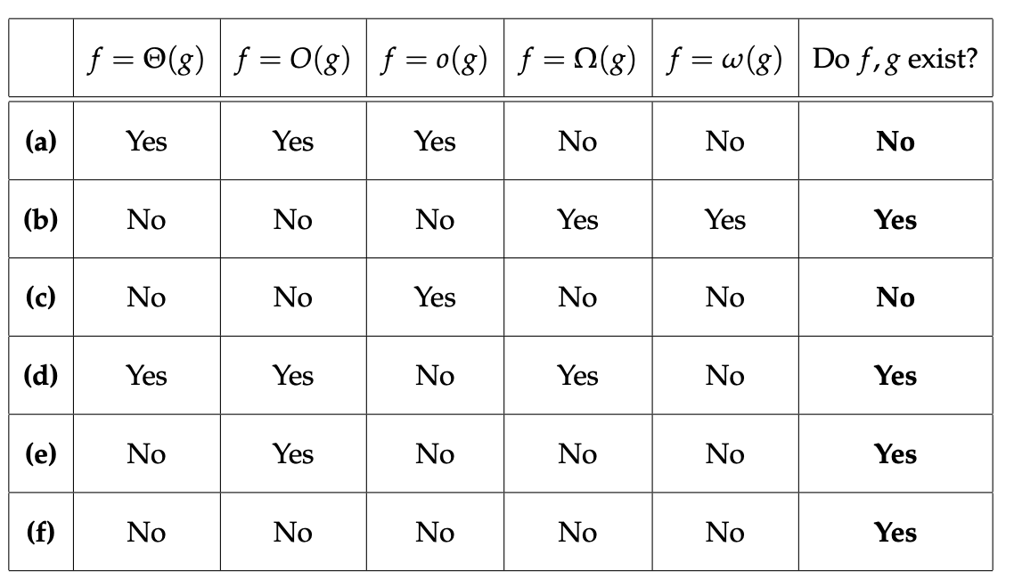
Growth-Rate Functions – Example3
Fill in the boxes below
45

Slide 46
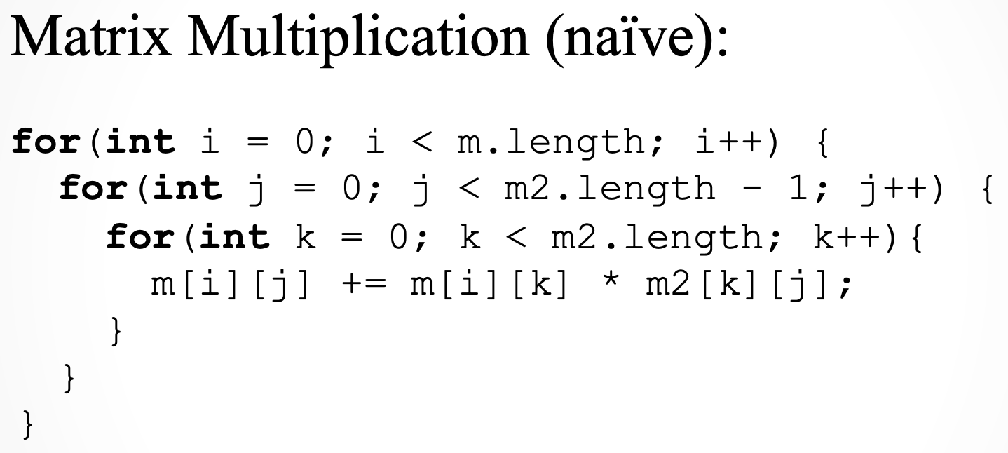

Growth-Rate Functions – Examples4-5
For nxn matrices, time complexity is: O(n³)
How about this one? O(logn)
46

Slide 47
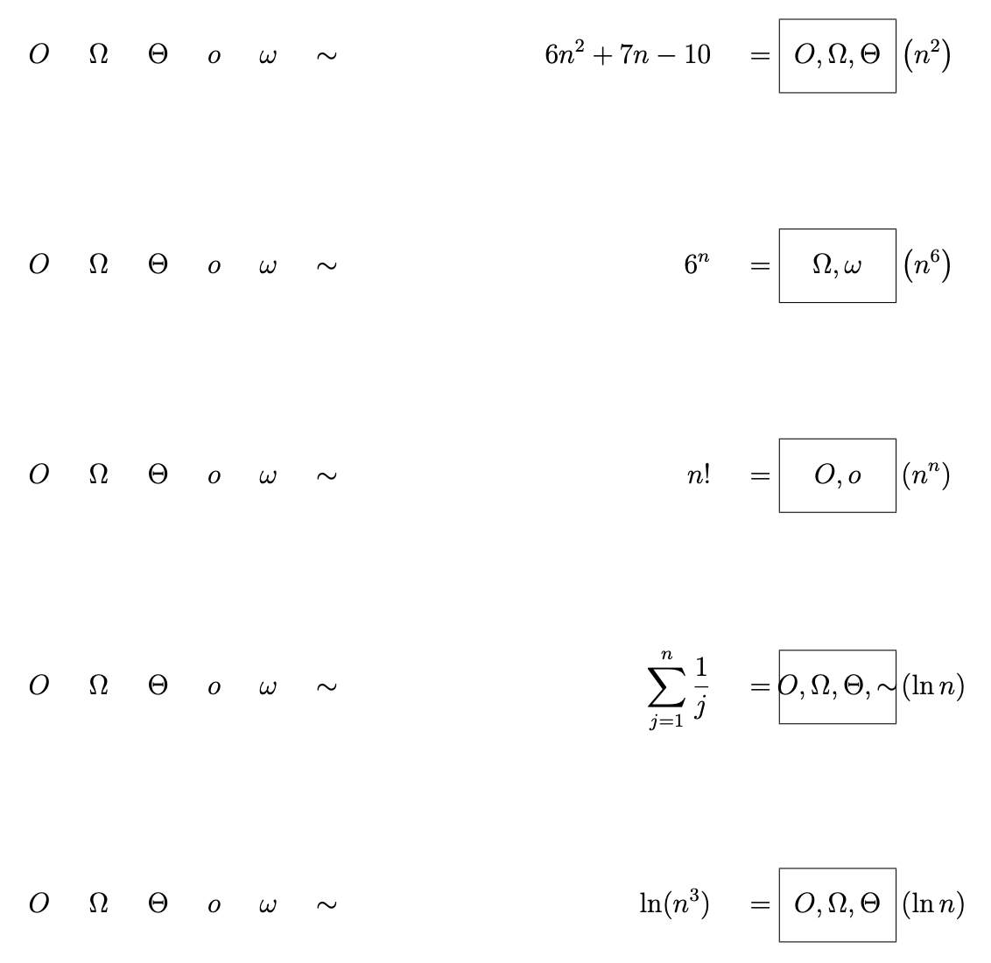
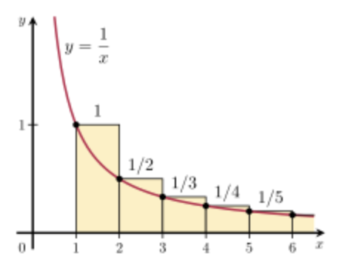
Growth-Rate Functions – Example6
Fill in the boxes below
47
Notes:
4th one: this sum gives the nth harmonic number, which is about as large as the natural logarithm of n. The reason is that the sum is approximated by the integral int_1^n 1/x dx, whose value is lnn (sum of yellow bars above gives ln6).

Slide 48
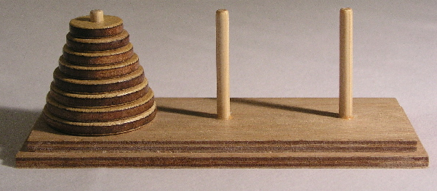
Growth-Rate Functions – Recursive Algorithms
void hanoi(int n, char source, char dest, char spare) { //Cost
if (n > 0) { //c1
hanoi(n-1, source, spare, dest); //c2
cout << "Move top disk from pole " << source //c3
<< " to pole " << dest << endl;
hanoi(n-1, spare, dest, source); //c4
}
}
The time-complexity function T(n) of a recursive algorithm is defined in terms of itself, and this is known as recurrence equation for T(n).
To find the growth-rate function for a recursive algorithm, we have to solve its recurrence relation.
48

Slide 49
Growth-Rate Functions – Hanoi Towers
What is the cost of hanoi(n,’A’,’B’,’C’)?
when n=0
T(0) = c1
when n>0
T(n) = c1 + c2 + T(n-1) + c3 + c4 + T(n-1)
= 2*T(n-1) + (c1+c2+c3+c4)
= 2*T(n-1) + c ⬅ recurrence equation for the growth-rate function of hanoi-towers algorithm
Now, we have to solve this recurrence equation to find the growth-rate function of hanoi-towers algorithm
49

Slide 50
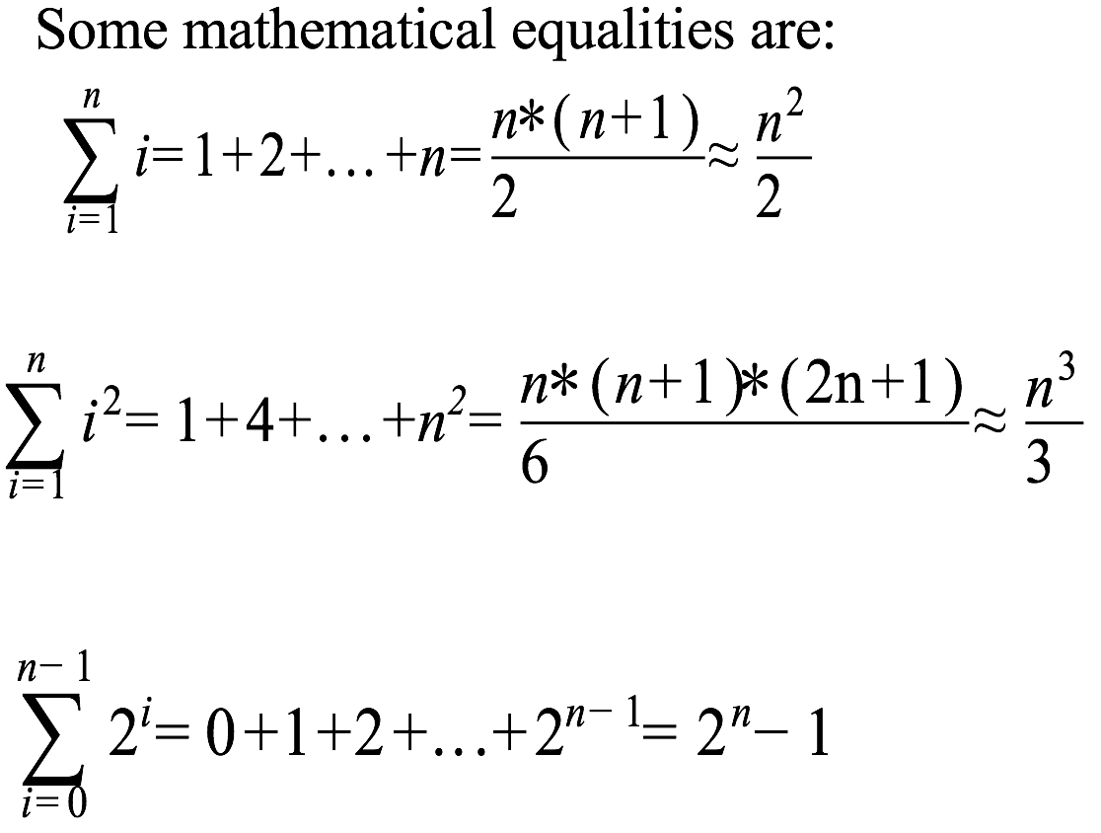
Growth-Rate Functions – Hanoi Towers (cont.)
There are many methods to solve recurrence equations, but we will use a simple method known as repeated substitutions.
T(n) = 2*T(n-1) + c
= 2 * (2*T(n-2)+c) + c
= 2 * (2* (2*T(n-3)+c) + c) + c
= 2³ * T(n-3) + (2²+2¹+2⁰)*c (assuming n>2)
when substitution repeated i-1th times
= 2^{i} * T(n-i) + (2^{i-1}+ ... +2¹+2⁰)*c
when i=n
= 2^{n} * T(0) + (2^{n-1}+ ... +2¹+2⁰)*c
= 2^{n} * c1 + ( )*c
= 2^{n} * c1 + ( 2^{n}-1 )*c = 2^{n}*(c1+c) – c ➔ So, the growth rate function is O(2^{n})
2a = 2 + 4 + 8 + .. + 2^{n-1} + 2^{n}
a = 1 + 2 + 4 + 8 + .. + 2^{n-1}
2a – a is your result 2^{n} - 1
50

Slide 51
More Recursive Algorithms
int fact(int n) {
if (n ==0)
return (1);
else
return (n * fact(n-1));
}
T(n) = T(n-1) + c
= (T(n-2) + c) + c
= (T(n-3) + c) + c + c
= (T(n-i) + i*c)
when i=n → T(0) + n*c ➔ T(n) = O(n)

Slide 52
Tracing the call fact (3)
N = 0 if (N==0) true return (1)
N = 1 if (N==0) false return (1*fact(0))
N = 2 if (N==0) false return (2*fact(1))
N = 3 if (N==0) false return (3*fact(2))
After 3rd call
N = 3 if (N==0) false return (3*fact(2))
After original call
N = 2 if (N==0) false return (2*fact(1))
N = 3 if (N==0) false return (3*fact(2))
After 1st call
N = 1 if (N==0) false return (1*fact(0))
N = 2 if (N==0) false return (2*fact(1))
N = 3 if (N==0) false return (3*fact(2))
After 2nd call

Slide 53
Tracing the call fact (3)
N = 1 if (N==0) false return (1* 1)
N = 2 if (N==0) false return (2*fact(1))
N = 3 if (N==0) false return (3*fact(2))
After return from 3rd call
N = 2 if (N==0) false return (2* 1)
N = 3 if (N==0) false return (3*fact(2))
After return from 2nd call
N = 3 if (N==0) false return (3* 2)
After return from 1st call
return 6

Slide 54
More Recursive Algorithms
bool isPalindrome (string s) { if (s.length() <= 1) return true; return (s[0]==s[s.length()-1]) && isPalindrome(s.substr(1,s.length()-2)); }
T(n) = T(n-2) + c
= (T(n-4) + c) + c
= (T(n-6) + c) + c + c
= (T(n-i) + i/2*c)
when i=n → T(0) + n/2*c ➔ T(n) = O(n)

Slide 55
More Recursive Algorithms
int fib(int n) { //1 1 2 3 5 8 13 21 34 ..
}

Slide 56
More Recursive Algorithms
int fib(int n) { //1 1 2 3 5 8 13 21 34 ..
if (n == 1) return 1; if (n == 2) return 1;
else
return fib(n-1) + fib(n-2);
}
T(n) = ?

Slide 57
More Recursive Algorithms
int fib(int n) { //1 1 2 3 5 8 13 21 34 ..
if (n == 1) return 1; if (n == 2) return 1;
else
return fib(n-1) + fib(n-2);
}
T(n) = T(n-1) + T(n-2) + c
= (T(n-2) + T(n-3) + c) + (T(n-3) + T(n-4) + c) + c
= gets nasty if we continue substituting; let’s be smarter.

Slide 58
More Recursive Algorithms
int fib(int n) { //1 1 2 3 5 8 13 21 34 ..
if (n == 1) return 1; if (n == 2) return 1;
else
return fib(n-1) + fib(n-2);
}
T(n) = T(n-1) + T(n-2) + c
T(n-1) + T(n-2) + c < T(n-1) + T(n-1) + c = O(2^{n}) as we showed in slide37.
This shows that it cannot exceed O(2^{n}), hence an upper bound.

Slide 59
More Recursive Algorithms
int fib(int n) { //1 1 2 3 5 8 13 21 34 ..
if (n == 1) return 1; if (n == 2) return 1;
else
return fib(n-1) + fib(n-2);
}
T(n) = T(n-1) + T(n-2) + c
T(n-1) + T(n-2) + c < T(n-1) + T(n-1) + c = O(2^{n}) as we showed in slide37.
This shows that it cannot exceed O(2^{n}), hence an upper bound.
let’s go for the lower bound; if it’s Ω(2^{n}), then T(n) is Θ(2^{n}).
T(n-1) + T(n-2) + c > T(n-2) + T(n-2) + c //cos T(n-1) > T(n-2) slightly.
T(n) = 2T(n-2) + c
= 2(2T(n-4) + c) + c = 4T(n-4) + 3c
= 2(2(2T(n-6) + c) + c) + c = 8T(n-6) + 7c
= = 16T(n-8) + 15c
= 2^{i}T(n-2i) + (2^{i}-1)
when i = n/2 ➔ 2^{n/2}T(0) + 2^{n/2}-1 = Ω(2^{n}) is the lower bound for T(n).

Slide 60
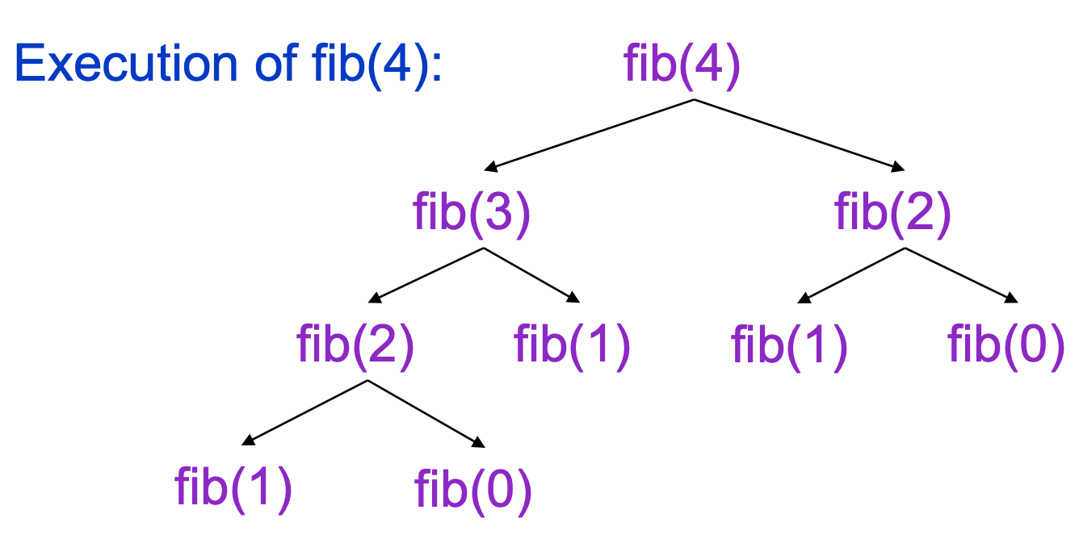
More Recursive Algorithms
int fib(int n) { //1 1 2 3 5 8 13 21 34 ..
if (n == 1) return 1; if (n == 2) return 1;
else
return fib(n-1) + fib(n-2);
}
Alternative method. Lots of re-computations.
Guess T(n) = O(2^{n}) ‘cos n → n-1+n-2=2n-3 doubling, seems to be exponential. You can also get this guess from the recursion tree.
Assume T(n-1) = O(2^{n-1}), induction hypothesis.
T(n) = T(n-1) + T(n-2) + O(1)
= O(2^{n-1}) + O(2^{n-2}) + O(1) = O(2^{n}).

Slide 61
More Recursive Algorithms
int fib(int n) { //1 1 2 3 5 8 13 21 34 ..
if (n == 1) return 1; if (n == 2) return 1;
else
return fib(n-1) + fib(n-2);
}
T(n) = O(2^{n}). Can you solve fib in O(n)?

Slide 62
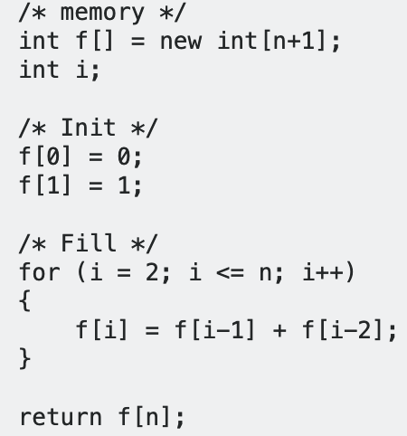
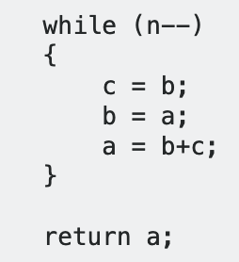
More Recursive Algorithms
int fibo(int n) { //1 1 2 3 5 8 13 21 34 ..
if (n == 1) return 1; if (n == 2) return 1;
else
return fibo(n-1) + fibo(n-2);
}
T(n) = O(2^{n}). Can you solve fib in O(n)? (Non-rec).
a=1, b = c = 0;
or
⬅ recomputations avoided!

Slide 63
More Recursive Algorithms
Count positive integers in an array recursively?
int countPos(int* A, int j) {
}

Slide 64
More Recursive Algorithms
Count positive integers in an array recursively?
int countPos(int* A, int j) { //1st call countPos(A, n-1)
if (j < 0) return 0;
if (A[j] > 0) return 1 + countPos(A, j-1);
else return 0 + countPos(A, j-1);
}
T(n) = T(n-1) + c ➔ T(n) = O(n) from slide 38.
Iterative version is also O(n).

Slide 65
What to Analyze
An algorithm can require different times to solve different problems of the same size.
Eg. Searching an item in a list of n elements using sequential search. ➔ Cost: 1,2,...,n
Worst-Case Analysis –The maximum amount of time that an algorithm require to solve a problem of size n.
This gives an upper bound for the time complexity of an algorithm.
Normally, we try to find worst-case behavior of an algorithm.
Best-Case Analysis –The minimum amount of time that an algorithm require to solve a problem of size n.
The best case behavior of an algorithm is NOT so useful.
Average-Case Analysis –The average amount of time that an algorithm require to solve a problem of size n.
Sometimes, it is difficult to find the average-case behavior of an algorithm.
We have to look at all possible data organizations of a given size n, and their distribution probabilities of these organizations.
Worst-case analysis is more common than average-case analysis.
65

Slide 66
Sequential Search
int sequentialSearch(const int a[], int item, int n){
for (int i = 0; i < n && a[i]!= item; i++);
if (i == n)
return –1;
return i;
}
Unsuccessful Search: ➔ O(n)
Successful Search:
Best-Case: item is in the first location of the array ➔O(1)
Worst-Case: item is in the last location of the array ➔O(n)
Average-Case: The number of key comparisons 1, 2, ..., n
➔ O(n)
66

Slide 67
Binary Search
We can do binary search if the array is sorted:
int binarySearch(int a[], int size, int x) {
int low =0;
int high = size –1;
int mid; // mid will be the index of
// target when it’s found.
while (low <= high) {
mid = (low + high)/2;
if (a[mid] < x)
low = mid + 1;
else if (a[mid] > x)
high = mid – 1;
else
return mid;
}
return –1;
}
67

Slide 68
Binary Search – Analysis
For an unsuccessful search:
The number of iterations in the loop is ⎣log₂n⎦ + 1
➔ O(log₂n)
For a successful search:
Best-Case: The number of iterations is 1. ➔ O(1)
Worst-Case: The number of iterations is ⎣log₂n⎦ +1 ➔ O(log₂n)
Average-Case: The avg. # of iterations < log₂n ➔ O(log₂n)
0 1 2 3 4 5 6 ← an array with size 7
3 2 3 1 3 2 3 ← # of iterations
The average # of iterations = 17/7 = 2.4285 < log₂7
For a proof of the general case see: http://raider.mountunion.edu/~cindricbb/sp06/340/avgbinsearch.html
68

Slide 69
How much better is O(log₂n)?
n O(log₂n)
16 4
64 6
256 8
1024 10
16,384 14
131,072 17
262,144 18
524,288 19
1,048,576 20
1,073,741,824 30
69

