Slide 1
Actuators
Dr Boyce Sigweni
from Sccemechanical.wordpress.com

Slide 2
ACTUATORS
Actuators are the devices which provide the actual motive force for the robot joints.
Actuators are the muscles of robots. If you imagine that the links and the joints are the skeleton of the robot, the actuators act as muscles, which moves or rotate the links to change the configuration of robots. The actuators must have enough power to accelerate and decelerate the links and to carry the loads, yet be light, economical, accurate, responsive, reliable and easy to maintain.
Actuators in robotic system basically consists of :
A power supply.
A power amplifier.
A servomotor.
A transmission system.

Slide 3
Actuator system
Pp : Primary source of power (Electric, Press.fluid, compress. Air)
Pc : Input control power usually electric .
Pa : Input power to motor Electric, Hydraulic, or Pneumatic.
Pm: Power output from motor.
Pu : mechanical power required
POWER
SUPPLIES
PP
POWER
AMPLIFIER
Pa
MOTOR
OR
SERVO MOTOR
Pm
TRANSMISSION
Pu
Pc
Pda
Pds
Pdt
Pds, Pdt , Pda : Powers lost in dissipation for the conversion performed by the Amplifier, Motor, Transmission

Slide 4
ISSUES/CHARACTERISTICS OF AN ACTUATOR
Load (e.g. torque to overcome own inertia)
Speed (fast enough but not too fast)
Accuracy (will it move to where you want?)
Resolution (can you specify exactly where?)
Repeatability (will it do this every time?)
Reliability (mean time between failures)
Power consumption (how to feed it)
Energy supply & its weight.

Slide 5
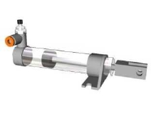
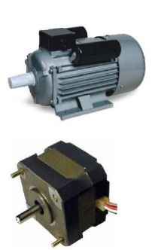
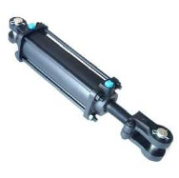
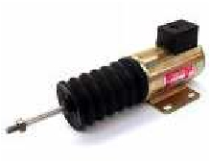
TYPES OF ACTUATORS
Based on the source of Input Power actuators are classified in to three groups :
Pneumatic Actuators.
These utilize pneumatic energy provided by the compressor and transforms it into mechanical energy by means of pistons or turbines.
Hydraulic Actuators.
These Transform the energy stored in reservoir into mechanical energy by means of suitable pumps.
Electric Actuators.
Electric actuators are simply electro-mechanical devices which allow movement through the use of an electrically controlled systems of gears

Slide 6
Pneumatic and Hydraulic Actuators
Both these actuators are powered by moving fluids.
In the first case, the fluid is compressed air and
In the second case, the fluid is pressurized oil.
Pneumatic systems typically operate at about 100lb/in2
Hydraulic systems at 1000 to 3000 lb/in2.
Both Hydraulic and Pneumatic actuators are classified as
linear Actuators (Cylinders).
Rotary Actuators (Motors).

Slide 7
Pneumatic and Hydraulic Actuators
linear Actuators

Slide 8
Pneumatic and Hydraulic Actuators
linear Actuators
The simplest power device could be used to actuate a linear joint by means of a moving piston.
There are two relationships of particular interest when discussing actuators:
The velocity of the actuator with respect to input power and
Force of the actuator with respect to the input power.

Slide 9
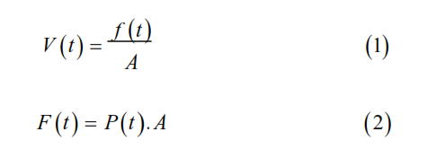
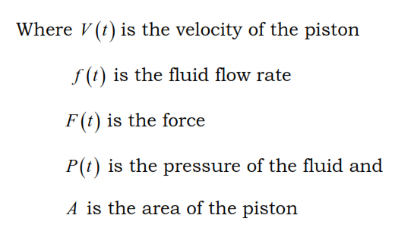
Pneumatic and Hydraulic Actuators
linear Actuators

Slide 10
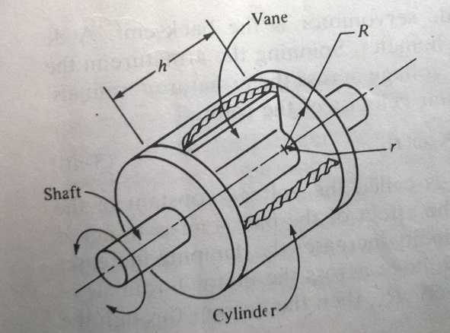
Pneumatic and Hydraulic Actuators
Sccemechanical.wordpress.com
Rotary Actuators

Slide 11
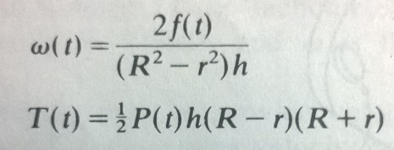
Pneumatic and Hydraulic Actuators
Rotary Actuators
There is a relationship of particular interest when discussing Rotary actuator:
The angular velocity, ω, and Torque, T.
R, outer radius of the vane., r, inner radius., h, thickness of the vane., ω, angular velocity., T, torque.

Slide 12
Advantages and limitations of Pneumatic actuators
ADVANTAGES
LIMITATIONS
It is cheapest form of all actuators. Components are readily available and compressed air normally is an readily available facility in factories.
Compressed air can be stored and conveyed easily over long distances.
They have few moving parts making them inherently reliable and reducing maintenance costs.
They have quick action and response time thus allowing for fast work cycles.
No mechanical transmission is usually required.
These systems are usually compact thus the control is simple e.g: mechanical stops are often used.
Since air is compressible, precise control of speed and position is not easily obtainable unless much more complex electro mechanical devices are incorporated in to system.
If mechanical stops are used resetting the system can be slow.
If moisture penetrates the units and ferrous metals have been used then damage to individual components may happen.

Slide 13
Advantages and limitations of Hydraulic actuators
ADVANTAGES
LIMITATIONS
High efficiency and high power to size ratio.
Complete and accurate control over speed position and direction of actuators are possible.
No mechanical linkage is required i.e., a direct drive is obtained with mechanical simplicity.
They generally have a greater load carrying capacity than electric and pneumatic actuators.
Self lubricating and non corrosive.
Hydraulic robots are more capable of with standing shock loads than electric robots.
Leakages can occur causing a loss in performance and general contamination of the work area. There is also a higher fire risk.
The power pack can be noisy typically about 70 decibel or louder if not protected by an acoustic muffler.
Changes in temp alter the viscosity of hydraulic fluid. Thus at low temperatures fluid viscosity will increase possibly causing sluggish movement of the robot.

Slide 14
Electric and Stepper Motors
There are a variety of types of motors used in robots. The most common types are Servomotors and Stepper motors.
Electric actuators are simply electro-mechanical devices which allow movement through the use of an electrically controlled systems of gear.

Slide 15
ELECTRIC MOTORS
Sccemechanical.wordpress.com
Electric motors usually have a small rating, ranging up to a few horsepower.
They are used in small appliances, battery operated vehicles, for medical purposes and in other medical equipment like x-ray machines.
Electric motors are also used in toys, and in automobiles as auxiliary motors for the purposes of seat adjustment, power windows, sunroof, mirror adjustment, blower motors, engine cooling fans.

Slide 16
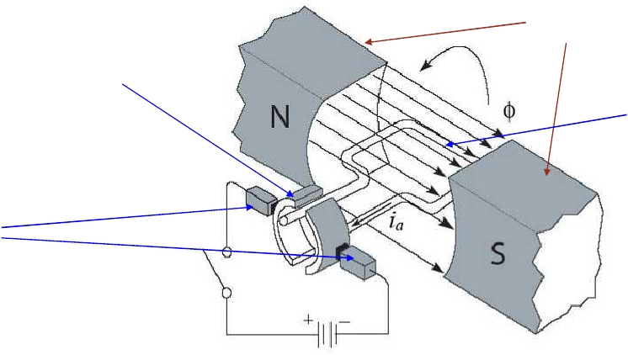
ROTATING
(COMMUTATOR)
STATOR
ARMATURE
Brushes

Slide 17
COMPONENTS OF DC ELECTRIC MOTOR
The principle components of an electric motor are: North and south magnetic poles to provide a strong magnetic field. Being made of bulky ferrous material they traditionally form the outer casing of the motor and collectively form the stator.
An armature, which is a cylindrical ferrous core rotating within the stator and carries a large number of windings made from one or more conductors.
A commutator, which rotates with the armature and consists of copper contacts attached to the end of the windings.
Brushes in fixed positions and in contact with the rotating commutator contacts. They carry direct current to the coils, resulting in the required motion.

Slide 18
ELECTRIC MOTORS
DC motors :In DC motors, the stator is a set of fixed permanent magnets, creating a fixed magnetic field, while the rotor carries a current. Through brushes and commutators, the direction of current is changed continuously, causing the rotor to rotate continuously.
AC motors : These are similar to DC motors except that the rotor is permanent magnet, the stator houses the windings, and all commutators and brushes are eliminated.
A Servomotor is a DC,AC, brushless, or even stepper motor with feedback that can be controlled to move at a desired speed (and consequently, torque), for a desired angle of rotation. To do this, a feedback device sends signals to the controller circuit of the servomotor reporting its angular position and velocity.

Slide 19
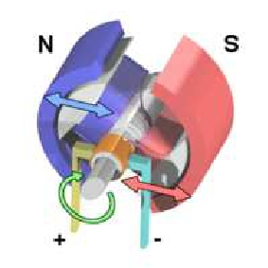
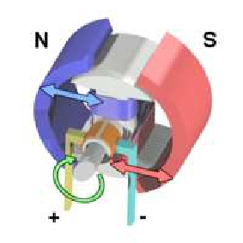
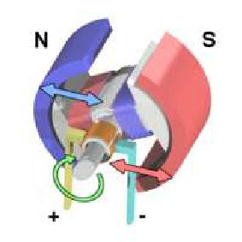
COMPONENTS OF DC ELECTRIC MOTOR
A simple DC electric motor: when the coil is powered, a magnetic field is generated around the armature. The left side of the armature is pushed away from the left magnet and drawn toward the right, causing rotation. The armature continues to rotate, When the armature becomes horizontally aligned, the commutator reverses the direction of current through the coil, reversing the magnetic field. The process then repeats.

Slide 20
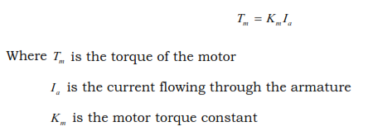
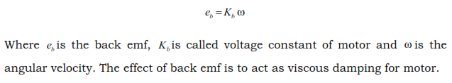


Slide 21
STEPPER MOTOR
When incremental rotary motion is required in a robot, it is possible to use stepper motors.
A stepper motor possesses the ability to move a specified number of revolutions or fraction of a revolution in order to achieve a fixed and consistent angular movement.
This is achieved by increasing the numbers of poles on both rotor and stator
Additionally, soft magnetic material with many teeth on the rotor and stator cheaply multiplies the number of poles(reluctance motor)

Slide 22
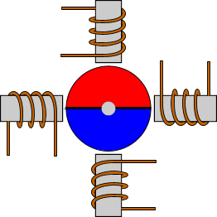
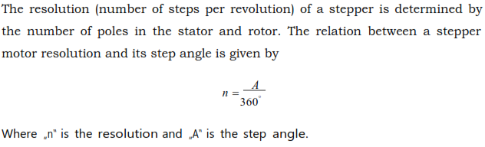
STEPPER MOTOR

Slide 23
ADVANTAGES & LIMITATIONS OF ELECTRIC ACTUATORS
ADVANTAGES
LIMITATIONS
Wide spread availability of power supply.
The basic dive element in an electric motor is usually lighter than that for fluid power.
High power conversion efficiency.
No pollution of working environment
The accuracy and repeatability of electric power driven robots are normally better than fluid power robots in relation to cost.
Easily maintained and repaired.
The drive system is well suited to electronic control.
Electric actuators often require some sort of mechanical transmission system this increases the unwanted movement, additional power and may complicate control.
Due to increased complexity of the transmission system additional cost is incurred for their procurement and maintenance.
Electric motors are not intrinsically safe. They cannot therefore be used in for example explosive atmospheres.

Slide 24
APPLICATIONS
Stepper motors can be a good choice whenever controlled movement is required.
They can be used to advantage in applications where you need to control rotation angle, speed, position
and synchronism. These include :
printers
plotters
medical equipment
fax machines
automotive and scientific equipment etc.

Slide 25
Comparison of actuating systems
Hydraulic
+ Good for large robots and heavy payload
+Highest Power/Weight Ratio
+Stiff system, High accuracy, better response
+No reduction gear needed
+Can work in wide range of speeds without difficulty
+Can be left in position without any damage
Electric
+ Good for all size of Robots
+Better control, good for high precision robots
+Higher Compliance that Hydraulics
+Reduction gears used reduce inertia on the motor
+does not leak, good for clean room
+Reliable, low maintenance
Pneumatic
+ Many components are usually off-the-shelf
+Reliable components.
+No leaks or sparks
+Inexpensive and simple
+Low pressure compared to hydraulics
+ Good for on-off applications and for pick and place

Slide 26
Comparison of actuating systems
Hydraulic
- May leak. Not fit for clean room application
-Requires pump, reservoir, motor, hoses etc.
-Can be expensive and noisy, requires maintenance.
-Viscosity of oil changes with temperature
-Very susceptible to dirt and other foreign material in oil
-Low compliance
-High torque, High pressure, large inertia on the actuator.
Electric
+Can be spark-free. Good for explosive environment.
-Low stiffness
-Needs reduction gears, increased backlash, cost, weight, etc.
-Motor needs braking device when not powered. Otherwise, the arm will fail.
-
-
-
Pneumatic
+Complaint systems.
-Noisy systems.
- Require air pressure, filter, etc.
-Difficult to control their linear position
-Deform under load constantly
-Very low stiffness. Inaccurate response.
-Lowest power to weight ratio

Slide 27
The Temperature Sensor
This circuit supports a poor man’s approach to ADC called delta sigma using the ADC VP object (page159)
You may need to play with the resistor and capacitor values to get useful output, but be careful not to over drive P8
+5v
P9 (pin 14)
1MΩ
1MΩ
LM34
P8 (pin 13)
1μF
Note: make sure you connect the voltages correctly to LM34 or you are going to have a short-lived room heater.

Slide 28
How The Circuits Works (1)
The output of the LM34
changes +10mV/°F
should be very close to 0mV at 0°F
Now the trick for doing ADC without an ADC chip
the SX controller of the Javelin is a CMOS device so its logic threshold voltage for a high value (i.e., when a zero becomes a one) is 2.5 volts
This means that if you apply a value less than 2.5 volts to an input line, the Javelin will assume it is a zero

Slide 29
How The Circuits Works (2)
Assume that the LM34 is putting out zero volts
applying a high voltage (5V) to P8 would generate a 2.5V drop across both resistors and the capacitor would be held at 2.5 volts above ground
applying a low to P8 would cause the charge on the capacitor to begin bleeding off and the voltage would drop below 2.5 volts
every 2.1 ms the ACD object reads the truth value of pin P9 (equal to the voltage across the capacitor)
since the duty cycle of the pulse is timed to allow some bleed off before the measurement is taken, if the LM34 is putting out zero volts, and all 255 samples would be zero

Slide 30
How The Circuits Works (3)
Now, assume that the LM34 is putting out 5 volts
applying a high voltage (5V) to P8 would generate no voltage drop across the resistors and the capacitor would be held at 5 volts above ground
applying a low to P8 would cause the charge on the capacitor to begin bleeding off but the voltage would never drop below 2.5 volts
thus, all 255 samples would be ones
At this point, it should be obvious that LM34 voltage outputs between 0 and 5 volts would generate values between 0-255

Slide 31
Issues With the Circuit
From the discussion, it should be fairly clear that a delta sigma ADC is both slow and fairly inaccurate
Further, the ADC has a resolution which is about ½ that of the temperature sensor so we are losing a great deal of information
Last, it does not help that the LM34D only generates a voltage range of 320-2120 mV losing more than half of the ADC’s range
Is there a way to fix any of these problems?

Slide 32
The Light Sensor
+5V
The good news is that this circuit supports a very common approach to measuring resistance called rcTime (page 55)
The bad news is that
CdS photoresistors are notoriously inaccurate
They have a memory which can last up for days
1μF
P4
(pin 9)
220Ω

Slide 33
How The Circuits Works (1)
The resistance of a typical CdS is inversely proportional to the amount of light falling on its surface
Built into the Javelin CPU object are all of the methods needed to support this circuit
First you call a CPU.writePen method to set the pin high, and thus, charge the capacitor
Then you call a CPU.delay method to ensure that it is fully charged
Finally, you call a CPU.rcTime method which track how long it takes for the capacitor to bleed below 2.5 volt

Slide 34
How The Circuits Works (2)
The time it takes for the capacitor to bleed down is directly proportional to the resistance of the photoresistor, and thus, to the amount of light falling on its surface
Once you characterize your photoresistor’s performance, the rcTime output can be used to keep track of how much light your sensor is seeing at any given time
This light can be from an ambient source or from one of your own actuators

