Slide 1

Velocity Propagation Between Robot Links

Slide 2
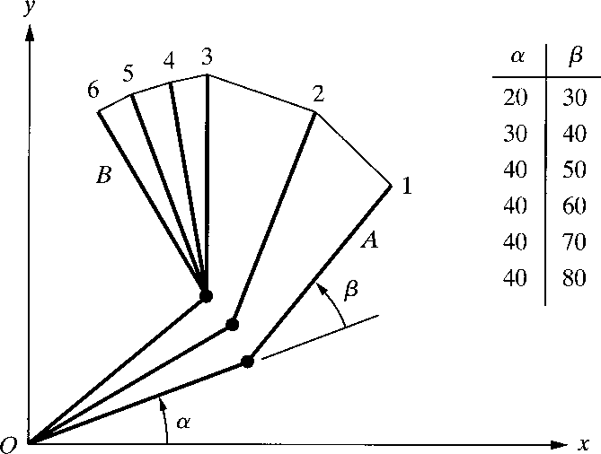
BASICS OF TRAJECTORY PLANNING
Let’s consider a simple 2 degree of freedom robot.
We desire to move the robot from Point A to Point B.
Let’s assume that both joints of the robot can move at the maximum rate of 10 degree/sec.
Move the robot from A to B, to run both joints at their maximum angular velocities.
After 2 [sec], the lower link will have finished its motion, while the upper link continues for another 3 [sec].
The path is irregular and the distances traveled by the robot’s end are not uniform.
Fig. 5.4 Joint-space nonnormalized movements of a robot with two degrees of freedom.

Slide 3
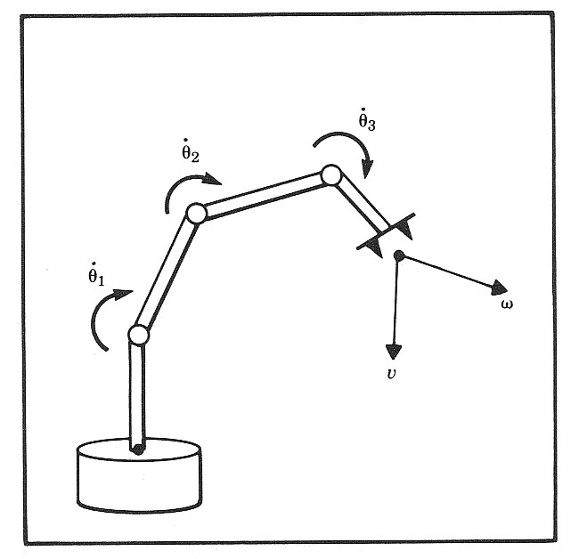
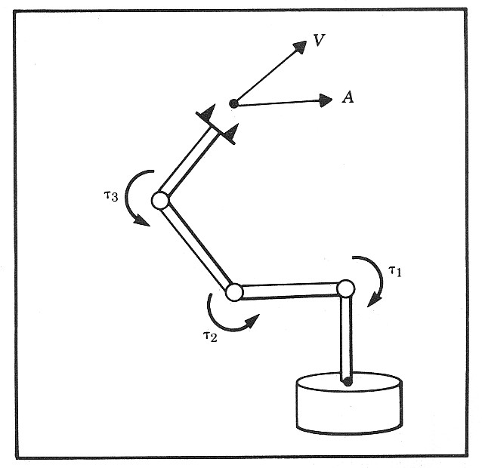
Jacobian Matrix - Introduction
In the field of robotics the Jacobian matrix describe the relationship between the joint
angle rates ( θ˙_{N} ) and the translation and
rotation velocities of the end effector ( This relationship is given by:
x˙ = J (θ )θ˙
x˙
).
In addition to the velocity relationship, we are also interested in developing a relationship between the robot joint torques ( τ ) and the
forces and moments ( F ) at the robot end effector (Static Conditions). This
relationship is given by:
F
τ = J (θ )^{T} F

Slide 4
Jacobian Matrix - Calculation Methods
Differentiation the Forward Kinematics Eqs.
Iterative Propagation
(Velocities or Forces / Torques)
Jacobian Matrix

Slide 5
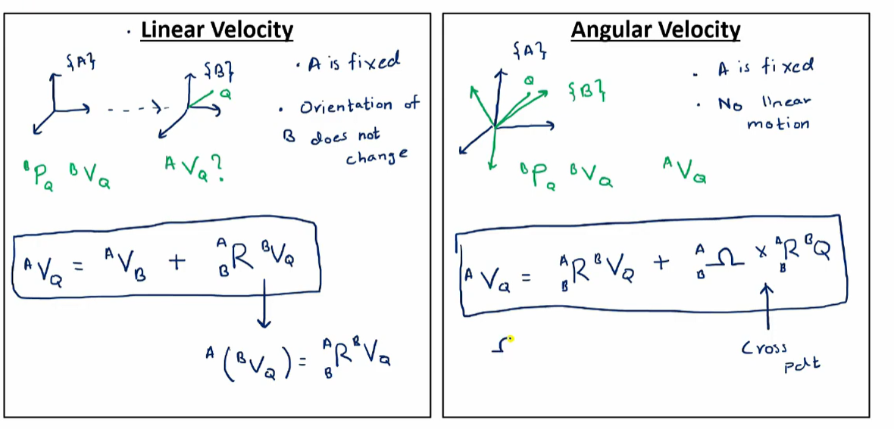
Introduction – Velocity Propagation

Slide 6
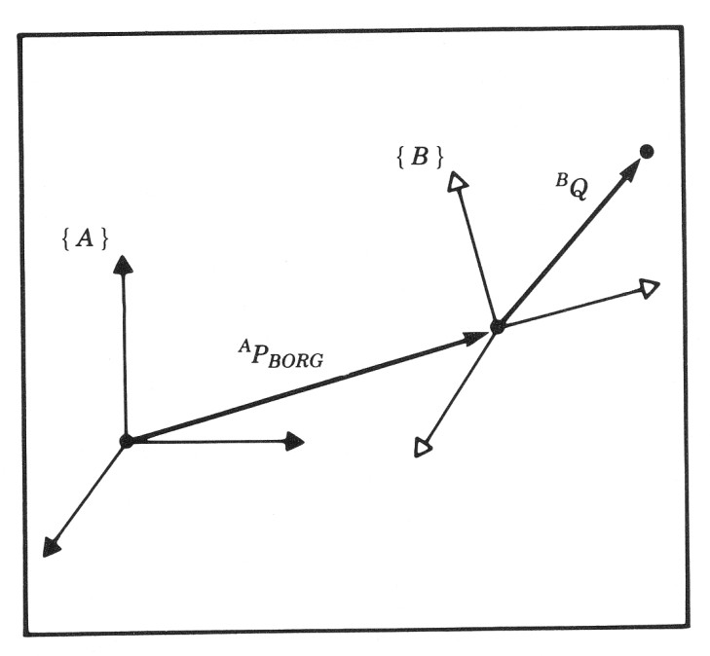
Summary – Changing Frame of Representation
Linear and Rotational Velocity
– Vector Form
A _{Ω}
B
A A
A B A
A B
B_{P}
V = V + R V + Ω × R P
Q
Q
BORG B
Q
B B Q
– Matrix Form
+ ^{A}R^{B}V + R ( R P )
^{A}V =^{A}V
A
˙
A B
Q
BORG B
Q B Ω B Q
Angular Velocity
Vector Form
Matrix Form
^{A} Ω =^{A}Ω + ^{A}R^{B} Ω C B B C
A_{R˙} A_{R}T
= ^{A}R˙ + ^{A}R ^{B}R˙
C Ω B Ω B C Ω B

Slide 7
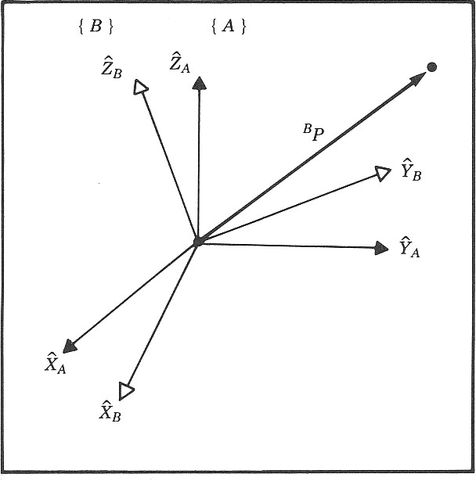
Frame - Velocity
As with any vector, a velocity vector may be described in terms of any frame, and this frame of reference is noted with a leading superscript.
A velocity vector computed in frame {B} and represented in frame {A} would be written
Represented
(Reference Frame)
Q
A_{d B}
A B
( V ) = P_{Q}
Q
dt
Computed (Measured)
A_{V}
= 0
BORG
^{A}R˙ = 0
B

Slide 8
Joint Variables
revolute and prismatic joints are one degree of freedom (DOF) joints; thus, they can be described using a single numeric value called a joint variable
q_{i} : joint variable for joint i
revolute
q_{i} = θ_{i} : angle of rotation of link i relative to link i – 1
prismatic
q_{i} = d_{i} : displacement of link i relative to link i – 1

Slide 9
Revolute Joint Variable
revolute
q_{i} = θ_{i} : angle of rotation of link i relative to link i – 1
link i
θ_{i}
link i – 1

Slide 10
Prismatic Joint Variable
prismatic
q_{i} = d_{i} : displacement of link i relative to link i – 1
link i – 1
link i
d_{i}

Slide 11
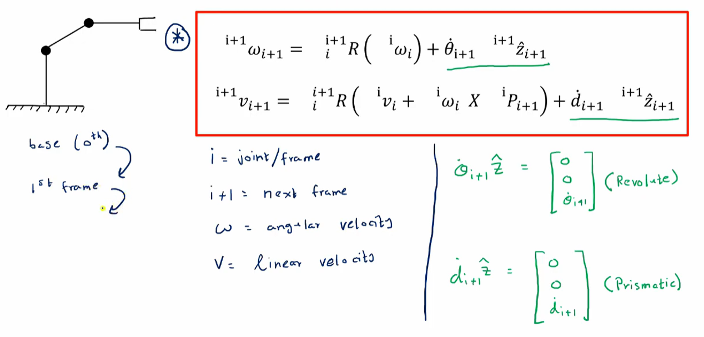
Velocity Propagation

Slide 12
Position Propagation
The homogeneous transform matrix provides a complete description of the linear and angular position relationship between adjacent links.
These descriptions may be combined together to describe the position of a link relative to the robot base frame {0}.
o_{T =}o_{T} 1_{T☹}i−1_{T}
i 1 2 i
A similar description of the linear and angular velocities between adjacent links as well as the base frame would also be useful.

Slide 13
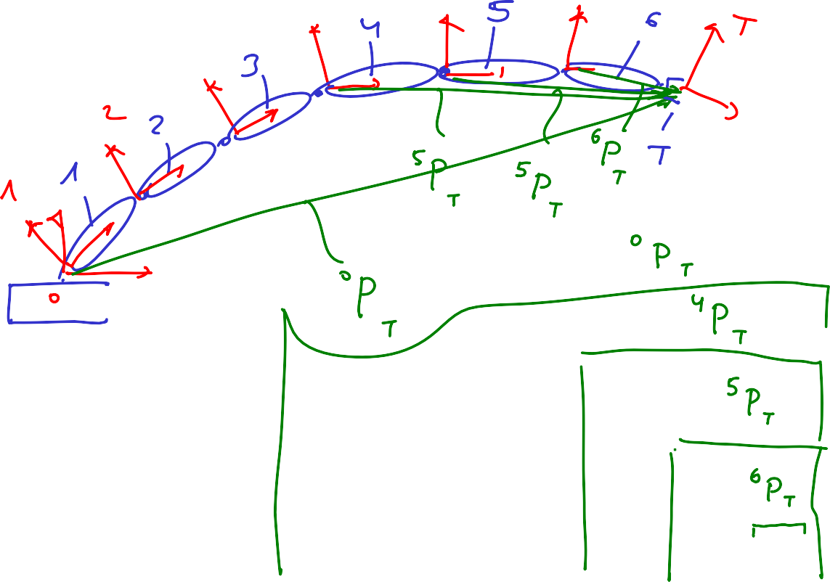
Position Propagation
0_{T}
=
0_{T} 1_{T} 2_{T} 3_{T} 4_{T} 5_{T} 6_{T}
T
1
2
3
4
5
6
T

Slide 14
Motion of the Link of a Robot
In considering the motion of a robot link we will always use link frame {0} as the reference frame (Computed AND Represented). However any frame can be used as the reference (represented) frame including the link’s own frame (i)
Where: v_{i}
ω_{i}
is the linear velocity of the origin of link frame (i) with respect to frame {0} (Computed AND Represented)
is the angular velocity of the origin of link frame (i) with respect to frame {0} (Computed AND Represented)
Expressing the velocity of a frame {i} (associated with link i ) relative to the robot base (frame {0}) using our previous notation is defined as follows:
v ≡ [ V ]= [ V ]
0
0 0
i i i
ω_{i} ≡ [ Ω ]= [ Ω ]
⁰ 0 0
i i

Slide 15
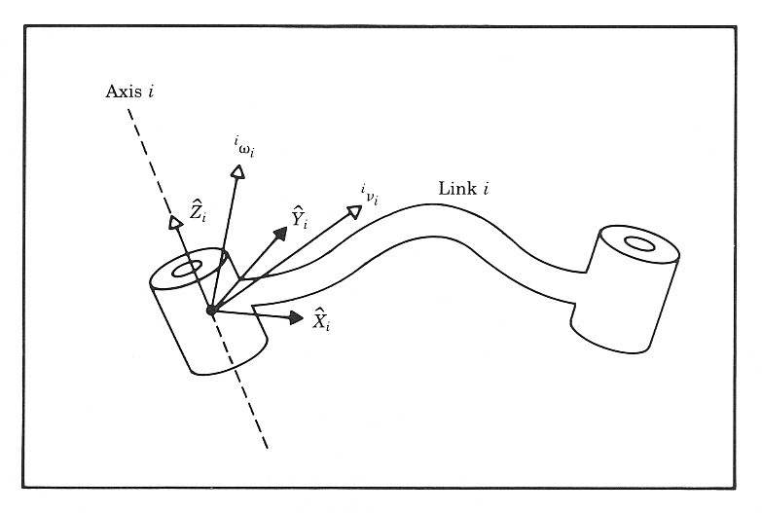
Velocities - Frame & Notation
The velocities differentiate (computed) relative to the base frame {0} are often represented relative to other frames {k}. The following notation is used for this conditions
v ≡ [ V ]= R [ V ]=
k
k
0 k 0
^{k}R ⋅ v
i i 0 i 0
i
ω ≡ [ Ω ]= R
[ Ω ]= R ⋅ω
k
k
0 k 0
k
0
i i
0
i
i

Slide 16
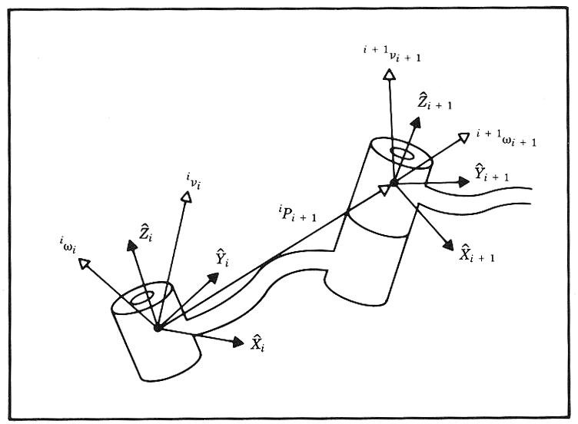
Velocity Propagation
Given: A manipulator - A chain of rigid bodies each one capable of moving relative to its neighbor
Problem: Calculate the linear and angular velocities of the link of a robot
Solution (Concept): Due to the robot structure (serial mechanism) we can compute the velocities of each link in order starting from the base.
The velocity of link i+1 will be that of link i , plus whatever new velocity components were added by joint i+1

Slide 17
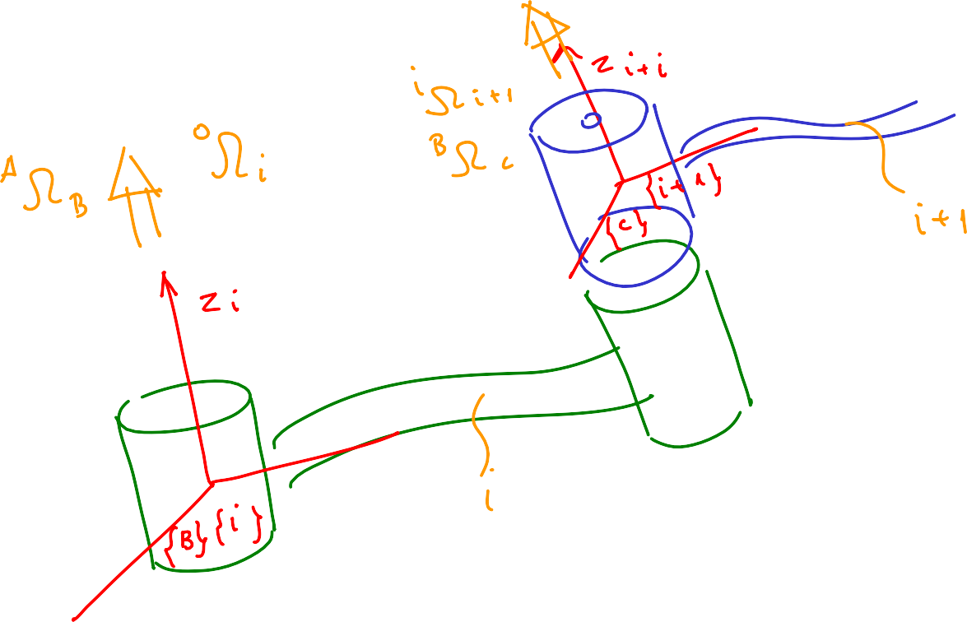

Velocity of Adjacent Links - Angular Velocity 0/5

Slide 18

Velocity of Adjacent Links - Angular Velocity 1/5
From the relationship developed previously
^{A} Ω =^{A}Ω + ^{A}R^{B} Ω C B B C
we can re-assign link names to calculate the velocity of any link i relative to the base frame {0}
A → 0
⎧
⎪
⎨
B → i
⎪⎩ C → i + 1
0 _{Ω}
=⁰ Ω +⁰R^{i} Ω
i i i+1
i+1
By pre-multiplying both sides of the equation by of reference for the base {0} to frame {i+1}
i+1_{R}
,we can convert the frame
0

Slide 19

Velocity of Adjacent Links - Angular Velocity 2/5
i+1_{R}0_{Ω}
₌i+1_{R}0_{Ω +}i+1_{R}0_{R}i _{Ω}
0
i+1 0 i 0 i i+1
Using the recently defined notation, we have
i+1_{ω}
= ω + R Ω
i+1 i+1 i
i+1
i i i+1
i+1_{ω}
- Angular velocity of frame {i+1} measured relative to the robot base, and
i+1
c
[ V ]
expressed in frame {i+1} - Recall the car example
w c
i+1_{ω}
= v
c c
Angular velocity of frame {i} measured relative to the robot base, and expressed in frame {i+1}
Angular velocity of frame {i+1} measured relative to frame {i} and expressed in frame {i+1}
i
i+1_{R}i _{Ω}
i
i+1

Slide 20



i+1_{ω}
Velocity of Adjacent Links - Angular Velocity 3/5
= ω
i+1
i+1 i
+ R Ω
i+1
i
i
i+1
Angular velocity of frame {i} measured relative to the robot base, expressed in frame {i+1}
i+1
ω = R ω
i+1 i
i i i

Slide 21
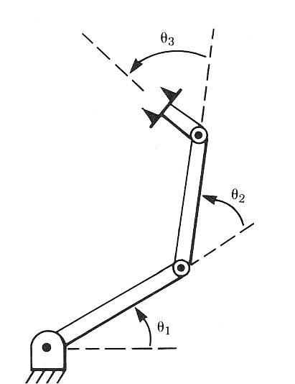
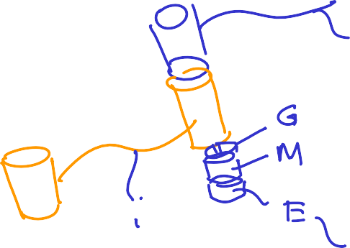
= ω + R Ω
Velocity of Adjacent Links - Angular Velocity 4/5
i+1
ω
i+1 i+1 i
i+1 i i i+1
Angular velocity of frame {i+1} measured (differentiate) in frame {i} and
represented (expressed) in frame {i+1}
Assuming that a joint has only 1 DOF. The joint configuration can be either revolute joint (angular velocity) or prismatic joint (Linear velocity).
Based on the frame attachment convention in which we assign the Z axis pointing along the i+1 joint axis such that the two are coincide (rotations of a link is preformed only along its Z- axis) we can rewrite this term as follows:
_{θ}˙
3
⎡ 0 ⎤
i+1
i
_{θ}˙
i+1_{R}i _{Ω =} ⎢ ₀ ⎥
2
i i+1
⎢ ⎥
⎢θ˙ ⎥
⎣ i+1 ⎦
_{θ}˙
1

Slide 22
Velocity of Adjacent Links - Angular Velocity 5/5
The result is a recursive equation that shows the angular velocity of one link in terms of the angular velocity of the previous link plus the relative motion of the two links.
⎡ 0 ⎤
i+1_{ω}
⎢ ⎥
= R ω + 0
i+1 i
i+1 i
i
⎢ ⎥
˙
⎢θ
⎣ i+1 ⎦
i+1_{ω}
Since the term
i+1
depends on all previous links through this recursion, the
angular velocity is said to propagate from the base to subsequent links.

Slide 23
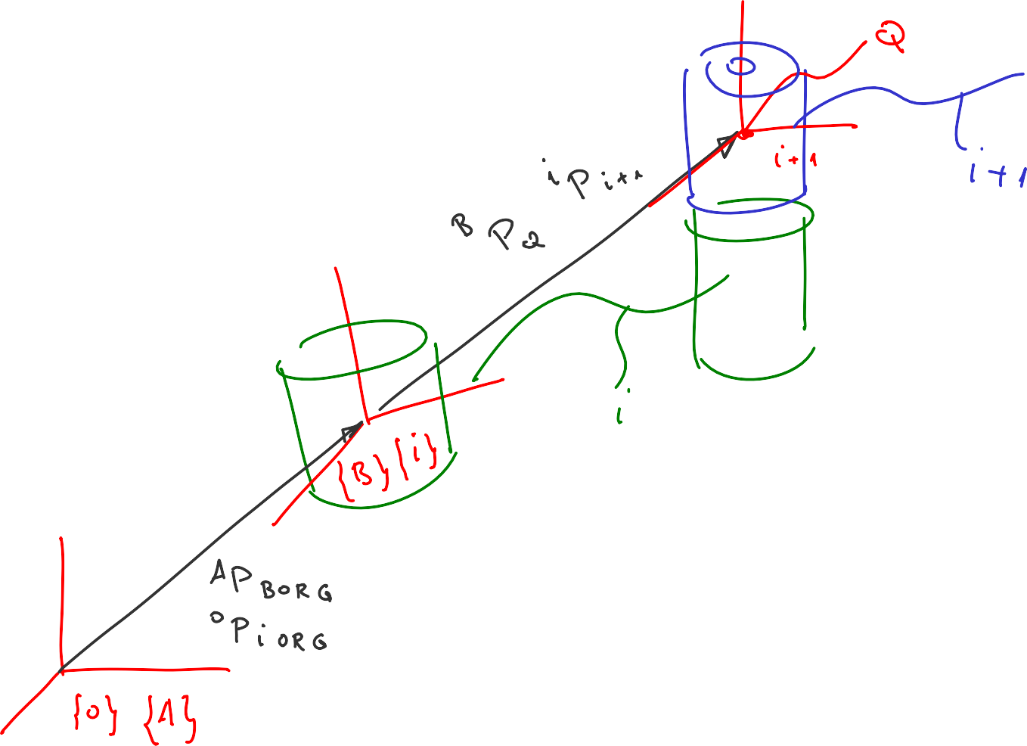
Velocity of Adjacent Links - Linear Velocity 0/6

Slide 24
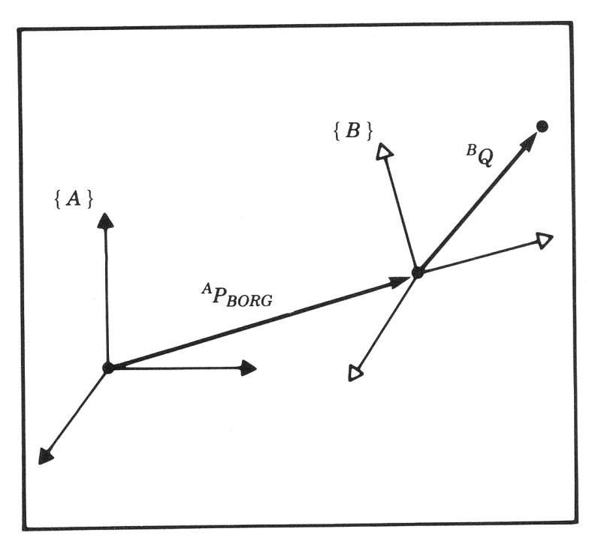
Velocity of Adjacent Links - Linear Velocity 1/6
Simultaneous Linear and Rotational Velocity
The derivative of a vector in a moving frame (linear and rotation velocities) as
seen from a stationary frame
Vector Form
B_{P}
A _{Ω}
Q
B
^{A}V =^{A}V
+ ^{A}R^{B}V +^{A}Ω × ^{A}R^{B}P
Q
BORG B Q B B Q
Matrix Form
A
˙
( R P )
^{A}V =^{A}V
+ ^{A}R^{B}V + R
A B
Q
BORG B
Q B Ω B
Q

Slide 25



Velocity of Adjacent Links - Linear Velocity 2/6
From the relationship developed previously (matrix form)
+ ^{A}R^{B}V + R ( R P )
^{A}V =^{A}V
A
˙
A B
Q
BORG B
Q B Ω B Q
we re-assign link frames for adjacent links (i and i +1) with the velocity computed relative to the robot base frame {0}
A → 0
⎧
⎪
⎨
B → i
⎪⎩ C → i + 1
0_{V}
=⁰R˙ ( R P )
0 i
0 0 i
+ V + R V
i+1 i Ω i i+1 i i i+1
By pre-multiplying both sides of the equation by frame of reference for the left side to frame {i+1}
i+1_{R}
,we can convert the
0

Slide 26
Velocity of Adjacent Links - Linear Velocity 3/6
i+1_{R}0_{V}
₌i+1_{R}0_{R˙} 0
( R P )
i
i+1 0
i+1 0 i
+ R V + R R V
0
i+1 0 i Ω i i+1
0
i 0 i
i+1
Which simplifies to
i+1_{R}0_{V}
₌i+1_{R}0_{R˙} 0
( R P )
i
i+1 0
i+1 i
+ R V + R V
0
i+1 0 i Ω i i+1
0
i i i+1
Factoring out ^{i+1}R from the left side of the first two terms
i
i+1_{R}0_{V}
= R( R R + R V )
0 0_{R}i_{P}
i+1 i
˙
i 0
i+1 i
+ R V
0
i+1 i 0 i Ω i
i+1 0 i
i
i+1

Slide 27
Velocity of Adjacent Links - Linear Velocity 4/6
i+1_{R}0_{V}
= R( R R + R V )+ R V
0 0_{R}i_{P}
i+1 i
˙
i 0
i+1 i
0 i+1 i 0 i Ω i i+1 0 i i i+1
i+1_{R}i_{V}
- Linear velocity of frame {i+1} measured relative to frame {i} and expressed in frame {i+1}
i
i+1
Assuming that a joint has only 1 DOF. The joint configuration can be either
revolute joint (angular velocity) or prismatic joint (Linear velocity).
Based on the frame attachment convention in which we assign the Z axis pointing along the i+1 joint axis such that the two are coincide (translation of a link is preformed only along its Z- axis) we can rewrite this term as follows:
⎡ 0 ⎤
i+1_{R}i_{V =} ⎢ ₀ ⎥
i i+1
⎢ ⎥
⎢d˙ ⎥
⎣ i+1 ⎦

Slide 28
= R( R R
Velocity of Adjacent Links - Linear Velocity 5/6
⎡ 0 ⎤
i+1_{R}0_{V}
0 0 _{R}i_{P}
i_{R}0_{V}
)+ ⎢ 0 ⎥
i+1 i
˙
+
0
i+1 i 0 i Ω i i+1 0
i
⎢ ⎥
⎢d˙ ⎥
⎣ i+1 ⎦
i _{R}0_{R˙}
i T i 0
i
ω = ω
⁰R= ^{i}R⁰R˙
R = R Ω = R
i
0 i Ω i 0 i Ω 0
0
i 0
i i
Multiply by Matrix
Definition
i+1_{R}0_{V =}i+1_{v}
0 i+1 i+1
^{i} R⁰V =^{i}v
0
i i
Definition
Definition

Slide 29
Velocity of Adjacent Links - Linear Velocity 6/6
The result is a recursive equation that shows the linear velocity of one link in terms of the previous link plus the relative motion of the two links.
⎡ 0 ⎤
= R( ω × P + v )+ 0
i+1_{v}
i+1 i i i
⎢ ⎥
⎢ ⎥
⎢ ⎦
i+1 i
i
i+1 i
˙
d
⎣ i+1
Since the term
i+1_{v}
depends on all previous links through this recursion, the
i+1
angular velocity is said to propagate from the base to subsequent links.

Slide 30


Velocity of Adjacent Links - Summary
Angular Velocity
0 - Prismatic Joint
⎡ 0 ⎤
i+1_{ω}
⎢ ⎥
= R ω + 0
i+1 i
i+1 i
i
⎢ ⎥
⎢θ˙ ⎥
⎣ i+1 ⎦
Linear Velocity
0 - Revolute Joint
⎡ 0 ⎤
i+1_{v}
= R( ω× P
+ v )+ 0
i+1 i i
i
⎢ ⎥
i+1 i
i+1 i
⎢ ⎥
⎢d˙ ⎥
⎣ i+1 ⎦

Slide 31
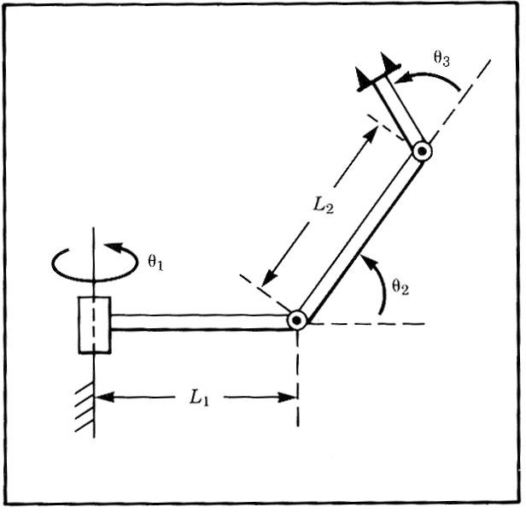
Angular and Linear Velocities - 3R Robot - Example
For the manipulator shown in the figure, compute the angular and linear velocity of the “tool” frame relative to the base frame expressed in the “tool” frame (that
is, calculate ⁴ω and
4 _{v}
).
4
4

Slide 32
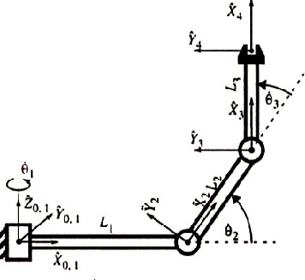
Angular and Linear Velocities - 3R Robot - Example
Frame attachment

Slide 33
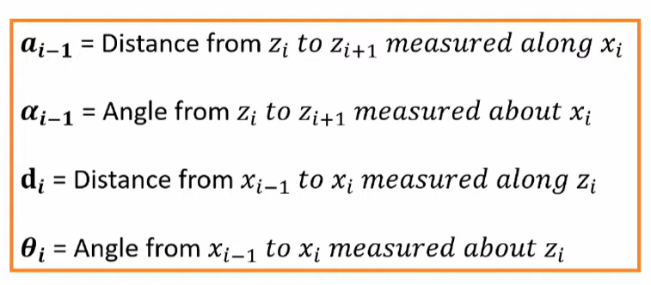
Angular and Linear Velocities - 3R Robot - Example
Denavit – Hartenberg (DH) Parameters
i | ^{α}i−1 | ªi−1 | d_{i} | θ_{i}
1 | 0 | 0 | 0 | θ₁
2 | 90 | L1 | 0 | θ ₂
3 | 0 | L2 | 0 | θ ₃
4 | 0 | L3 | 0 | 0

Slide 34
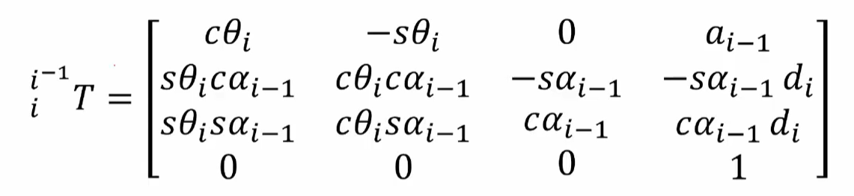
Angular and Linear Velocities - 3R Robot - Example
From the DH parameter table, we can specify the homogeneous transform matrix for each adjacent link pair:

Slide 35
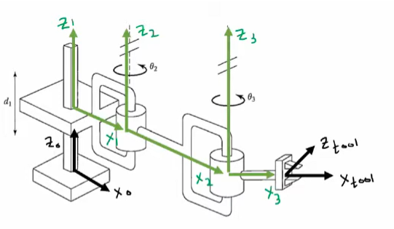
Creating Transformation Matrices From DH Tables

Slide 36
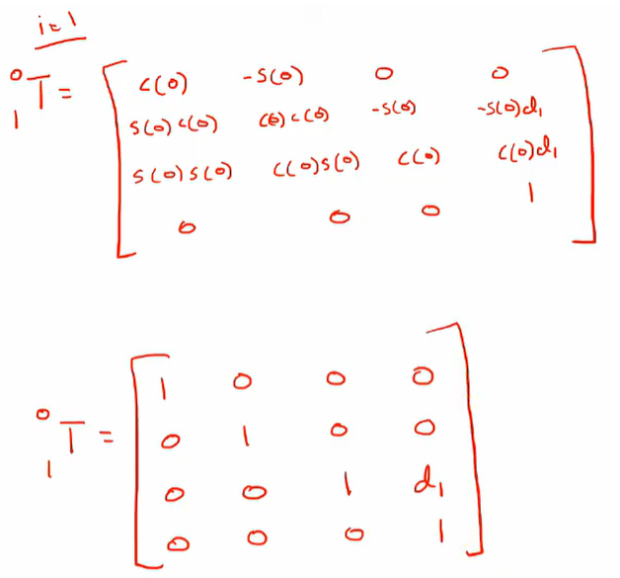

Creating Transformation Matrices From DH Tables

Slide 37
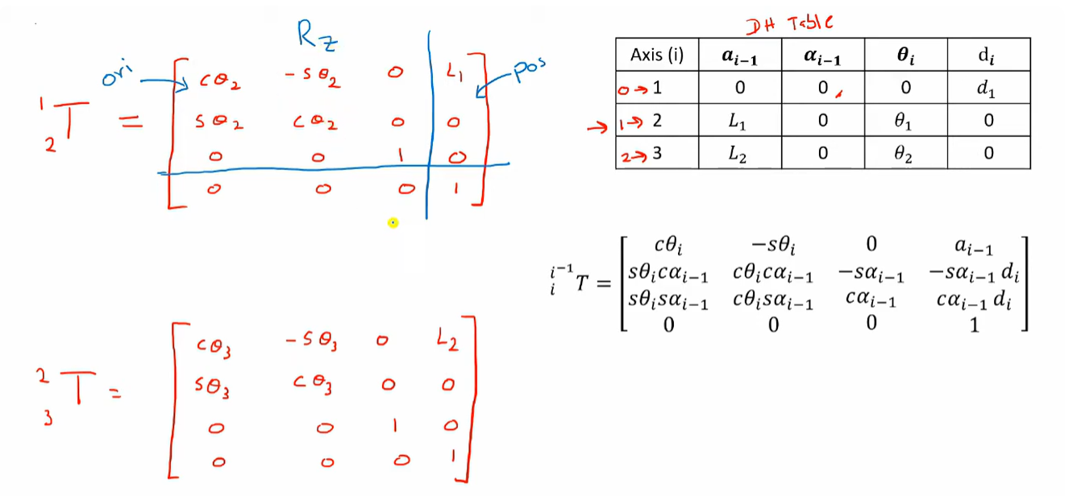
Creating Transformation Matrices From DH Tables

Slide 38
Angular and Linear Velocities - 3R Robot - Example
From the DH parameter table, we can specify the homogeneous transform matrix for each adjacent link pair:
⎡
cθ_{i} − sθ_{i}
0
ªi−1
⎤
⎢sθ cα cθ cα − sα − sα
_{d} ⎥
i−1
T =
⎢
i i−1 i i−1
i−1
i−1 i ⎥
i
⎢sθ sα
cθ sα cα
cα d ⎥
i i−1 i i−1
⎣ 0 0
⎡c1 − s1 0 0⎤
⎢s1 c1 0
0 1
⎣ 0 0 ⎦
⎡c3 − s3 0 L2⎤
⎢s3 c3 0
⎢ ⎥
⎢ 0 0 1 0 ⎥
0 0
i−1
i−1
⎢
0
⎥
1 ⎦
⎡c2 − s2 0 L1⎤
⎢ 0 − 1 ⎥
⎢s2 c2 0 0 ⎥
⎣ 0 0
⎡1 0 0 L3⎤
⎢ 1 0 ⎥
⎢0 0 1 0 ⎥
0 0
₀⎥
⎢ ₀
₀ ⎥
0
T =
⎢
⎢ 0
⎥
0⎥
1
T =
1
2
⎢ ₀
₁⎥
⎢ ₀
₁ ⎥
⎦
₀ ⎥
⎢₀
₀ ⎥
2
T =
3
T =
3
4
⎢ ₀
₁ ⎥
⎢₀
₁ ⎥
⎣
⎦
⎣
⎦

Slide 39
Angular and Linear Velocities - 3R Robot - Example
Compute the angular velocity of the end effector frame relative to the base frame expressed at the end effector frame.
⎡ 0 ⎤
i+1_{ω}
= R ω
⎢ ⎥
i+1 i
+ 0
i+1 i
i
⎢ ⎥
⎢θ˙ ⎥
⎣ i+1 ⎦
For i=0
⎡ c1 s1
¹ω = ¹R⁰ω + ⎢ 0 ⎥ = ⎢− s1 c1
0
⎡ 0 ⎤
0⎤⎡0⎤ ⎡ 0 ⎤ ⎡ 0 ⎤
₀⎥⎢₀⎥ ₊ ⎢ ₀ ⎥ ₌ ⎢ ₀ ⎥
1 0 0
⎢ ⎥ ⎢
⎥⎢ ⎥ ⎢ ⎥ ⎢ ⎥
⎢θ˙ ⎥ ⎢ 0
1⎥⎢0⎥ ⎢θ˙ ⎥ ⎢θ˙ ⎥
⎣ 1 ⎦ ⎣
⎦⎣ ⎦ ⎣ 1 ⎦ ⎣ 1 ⎦

Slide 40
⎡s2θ˙ ⎤
Angular and Linear Velocities - 3R Robot - Example
⎡ 0 ⎤
⎡ c2 0 s2⎤⎡ 0 ⎤
0
⎢ 0 −1
⎡ 0 ⎤
1 ⎥
⎢ ⎥
⎢
⎥⎢ ⎥ ⎢ ⎥
⎢
For i=1
²ω =²R¹ω + 0 = − s2
c2 0 + 0 = c2θ˙
1 ⎥
2 1 1
⎢ ⎥
⎢
⎥⎢ ⎥ ⎢ ⎥
⎢
⎢θ˙ ⎥
0 ⎥⎢θ˙ ⎥ ⎢θ˙ ⎥
⎢ _{θ}˙
⎥
⎣ 2 ⎦ ⎣
⎦⎣ 1 ⎦ ⎣ 2 ⎦
⎣ ⎦
2
⎡ 0 ⎤
⎡ c3 s3 0⎤⎡s2θ˙ ⎤
c3 0 c2
0
⎡ 0 ⎤
⎡ s23θ˙ ⎤
1 ⎥
1 ⎥
For i=2
³ω = ³R²ω + ⎢ 0 ⎥ = ⎢− s3
⎥
⎢
˙
⎢ ⎥
⎢
˙
θ + 0 = c23θ
3 2 2
⎢ ⎥ ⎢
⎥
⎢ ⎥
⎢ ⎥
⎢
⎥
1
⎢_{θ}˙
1
⎢θ˙ ⎥
⎢ 0
1⎥⎢ θ˙
⎥
⎢θ˙ ⎥
+ θ˙ ⎥
⎣ 3 ⎦ ⎣
⎦⎣ 2
⎦
⎣ 3 ⎦
⎣
2 3 ⎦
⎡0⎤
⎡1 0 0⎤⎡ s23θ˙ ⎤
1 0 c23
0 1⎥⎢θ˙ + θ˙ ⎥ ⎢0⎥
⎡ s23θ˙ ⎤
1 ⎥
⎡0⎤
1 ⎥
For i=3
⁴ω =⁴R³ω + ⎢0⎥ = ⎢0
⎥
⎢
˙
⎢ ⎥
⎢
˙
⎢
θ
⎥
+ 0 = c23θ
4 3 3
⎢ ⎥ ⎢
⎥
1
⎢ ⎥
⎢
1
⎥
⎢0⎥ ⎢0
⎢_{θ}˙
+ θ˙ ⎥
⎣ ⎦ ⎣
⎦⎣ 2 3 ⎦ ⎣ ⎦
⎣
2 3 ⎦
Note
³ω =⁴ω
3 4

Slide 41
Angular and Linear Velocities - 3R Robot - Example
Compute the linear velocity of the end effector frame relative to the base frame expressed at the end effector frame.
•
Note that the term involving the prismatic joint has been dropped from the equation (it is equal to zero).
0
⎡ 0 ⎤
i+1_{v}
= R( ω× P + v )+ 0
i+1 i i i
⎢ ⎥
i+1 i
i+1 i
⎢ ⎥
⎢d˙ ⎥
⎣ i+1 ⎦

Slide 42
Angular and Linear Velocities - 3R Robot - Example
For i=0
⎡ c1 s1
{ ω × P + v } ⎢ c1
⎢
⎢⎣ 0 0
0⎤⎧⎡0⎤ ⎡0⎤ ⎡0⎤⎫ ⎡0⎤
1
1 0
0 0
₀⎥⎪⎢₀⎥ × ⎢₀⎥ ₊ ⎢₀⎥⎪ ₌ ⎢₀⎥
v = R
= − s1
⎥⎨⎢ ⎥ ⎢ ⎥ ⎢ ⎥⎬ ⎢ ⎥
1 0
0 1 0
1⎥⎪⎢0⎥ ⎢0⎥
⎢0⎥⎪ ⎢0⎥
⎦⎩⎣ ⎦ ⎣ ⎦ ⎣ ⎦⎭ ⎣ ⎦
For i=1
⎡ c2 0 s2⎤⎧⎡ 0 ⎤ ⎡L1⎤
0
⎢ 0 −1
⎡0⎤⎫ ⎡
0
⎤
⎥
{ω × P + v }= − s2
2
2 1
1 1
⎢
_{c2}⎥⎪⎢ ₀ ⎥× ⎢ ₀ ⎥ ₊ ⎢₀⎥⎪ ₌ ⎢
v = R
⎢
⎥⎨⎢ ⎥ ⎢ ⎥ ⎢ ⎥⎬ ⎢
0
⎥
2 1
1 2 1
⎣
0 ⎥⎪⎢θ˙ ⎥ ⎢ 0 ⎥ ⎢0⎥⎪ ⎢− L θ˙ ⎥
⎦⎩⎣ 1 ⎦ ⎣ ⎦ ⎣ ⎦⎭ ⎣ 1 1 ⎦

Slide 43
Angular and Linear Velocities - 3R Robot - Example
For i=3
⎡ c3 s3 0⎤⎧⎡s2θ˙ ⎤
c30 0
⎡L2⎤
⎡
0
0
⎤⎫
⎥⎪⎢
1 ⎥
⎥⎪
³v = ³R{ ω × P + v }= − s3
⎢
⎢ ⎥ ⎢
2 2 2
0 ⎨ c2θ˙ × 0 +
⎬
3 2 2
3 2
⎢
⎥⎪⎢
1 ⎥
⎢ ⎥ ⎢
⎥⎪
⎢ 0
1⎥ ⎢ θ˙
⎥
⎢ 0 ⎥
⎢− L1θ˙ ⎥
⎣
⎦⎩⎣ 2
⎦
⎣ ⎦ ⎣ 1 ⎦⎭
⎡ c3 s3
= ⎢− s3 c3 0 ⎨
⎢ 0 0
0
⎤⎫
⎥⎪
⎡
⎢
L2s3θ˙
⎤
⎥
0⎤⎧⎡
⎥⎪⎢
2
⎢
⎥⎪⎢
L2θ˙
⎬ =
⎢
L2c3θ˙
⎥
1
⎥⎪
2
1⎥ ⎢− L2c2θ˙ − L1θ˙ ⎥
⎢(−L1− L2c2)θ˙ ⎥
⎣
⎦⎩⎣
1
1 ⎦⎭
⎣
1 ⎦

Slide 44
Angular and Linear Velocities - 3R Robot - Example
For i=4
⎡1 0 0⎤⎧⎡ s23θ˙ ⎤
1
0
⎡L3⎤
⎡
⎢
L2s3θ˙
⎤⎫
⎥⎪⎢
1 ⎥
2
⎥⎪
{ ω × P + v }= 0
⎢
⎢ ⎥
⁴ v = ⁴R
3 3 3
0 ⎨ c23θ˙ × 0 +
L2c3θ˙
⎬
4 3
3
4 3
⎢
⎥⎪⎢
1 ⎥
⎢ ⎥
⎢
2
⎥⎪
⎢0
1⎥ ⎢θ˙ + θ˙ ⎥
⎢ 0 ⎥
⎢(−L1− L2c2)θ˙ ⎥
⎣
⎦⎩⎣ 2
3 ⎦ ⎣ ⎦
⎣
1 ⎦⎭
⎡
L2s3θ˙
⎤
⎥
⎢
2
= (L2c3 + L3)θ˙ + L3θ˙
⎢ ⎥
2 3
⎢⎣(−L1− L2c2 − L3c23)θ˙ ⎥⎦
1

Slide 45
Angular and Linear Velocities - 3R Robot - Example
4
ω , v
Note that the linear and angular velocities (
4
) of the end effector where
4 4
differentiate (measured) in frame {0} however represented (expressed) in frame
{4}
C
[ V ]
In the car example: Observer sitting in the “Car”
Observer sitting in the “World”
W
C
W
[ V ]
W
C
v ≡ [ V ]= R [ V ]= ^{k}R ⋅ v
k
k
0 k 0
i i 0 i 0 i
ω ≡ [ Ω ]= R[ Ω ]=
k
k
0 k 0
^{k}R ⋅ω
0 i
i i 0 i
Solve for v₄ and ω₄ by multiply both side of the questions from the left by
4_{R}−1
0
⁴v = ⁴R ⋅ v
4 0 4
4
ω = R ⋅ω
4
4 0
4

Slide 46
Angular and Linear Velocities - 3R Robot - Example
Multiply both sides of the equation by the inverse transformation matrix, we finally get the linear and angular velocities expressed and measured in the stationary frame {0}
v =
4_{R}−1⋅4 _{v =}
⁴R^{T} ⋅⁴ v = ⁰R ⋅⁴ v
4 0
4
0
4 4 4
ω = R ⋅ ω
R ⋅ ω = R ⋅ ω
4 −1 4
=
4 T 4
0 4
4 0
4
0
4
4
4
⁰T =⁰T ¹T ²T ³T
4 1 2 3 4

Slide 47
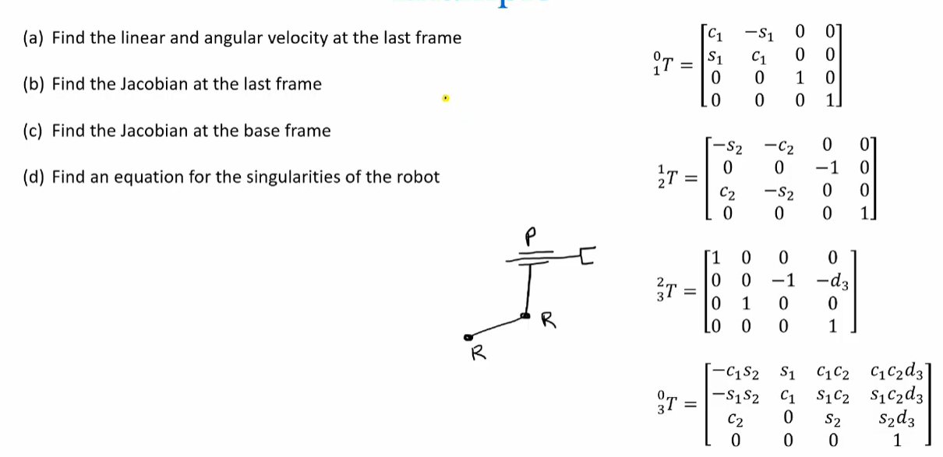
Worked Example

