Slide 1
Unit-1 Java Script

Slide 2
History of Java script
JavaScript was created in 10 days in may 1995 by Brendan Eich, then working at Netscape and now Mozilla.
The original name of JavaScript was mocha(name chosen by founder of Netscape)
In September 1995, name changed to LiveScript .
Again in December 1995, name changed to JavaScript.

Slide 3
Overview/Introduction Of JavaScript
Java script is high level, un-typed interpreted client-side scripting language.
Designed to add interactivity to HTML pages
Lightweight scripting programming language
Interpreted and embedded directly into HTML pages

Slide 4
Overview/Introduction Of JavaScript
JavaScript gives HTML designers a programming tool pages
JavaScript can put dynamic text into an HTML page
JavaScript can react to events
JavaScript can read and write HTML elements
JavaScript can be used to validate data
JavaScript can be used to create cookies

Slide 5
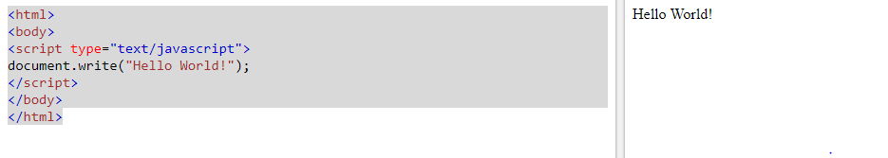

Slide 6
Where to Put the JavaScript
JavaScript executes immediately while the page loads into the browser.
This is not always what we want. Sometimes we want to execute a script when a page loads, or at a later event, such as when a user clicks a button.
When this is the case we put the script inside a function, head, body and both in head and body.

Slide 7
Primitives
JS has 5 primitives :
numbers: 2, 3.7, -7
string: “hello”, “123”
booleans: true , false
null: variables whose value are set to null
undefined: variables which are declared but not initialized

Slide 8
JavaScript Variables
hold values or expressions
Variable names are case sensitive
Variable names must begin with a letter or the underscore character
declare JavaScript variables with the var statement:
var name; (deceleration)
var age;
age = 23; (initialization)
var city= “Kathmandu”;( declaration and initialization)

Slide 9
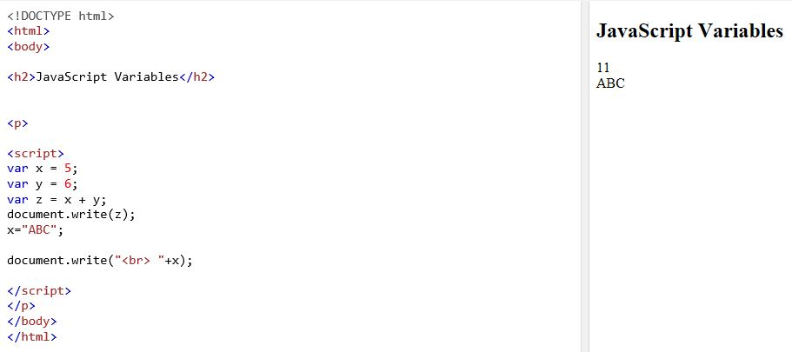
JavaScript Variables

Slide 10
Way to include java script in html
1. Internal:
JavaScript code must be inserted between
<script> and </script>tags.
2. External
An external JavaScript file must be saved by .js extension. It is recommended to embed all JavaScript files into a single file. It increases the speed of the webpage.
Syntax: <script src="URL">

Slide 11
Operators
operators are used to perform an operation
types of operator in JS are:
Arithmetic Operators
Assignment Operators
Comparison Operators
Logical/boolean Operators
String Operators

Slide 12
Control Statement
Branching statement
Looping statement

Slide 13
Branching statement
There are mainly four kinds of branching statements are available in JavaScript. These branching statements are as follows.
If Statement
If else Statement
Else if Statement
Switch Statement

Slide 14
If Statement:
We use the if statement when we want to run a piece of code only if a certain condition will be true. Please check out the syntax of the if statement.
Syntax:-
if(condition)
{
Statements;
}

Slide 15
Example of If statement:
<html>
<head><title></head>
<body>
<script>
var num=10;
if(num==10)
{
document.write("num is equal to 10");
}
</script>
</body>
</html>

Slide 16
If else Statement:
We use an if-else statement in case we want to run separate pieces of code for both conditions(true and false). In the if-else statement, in the case of the true condition if block will run, and in the case of false condition else block will run.
Syntax:-
if(condition) {
Statements;
}
else{
Statements;
}

Slide 17
If else example :
<html>
<head><title></title></head>
<body>
<script>
var num=5;
if(num%2==0)
{
document.write("num is even number");
}
Else
{
document.write("num is odd number");
}
</script>
<body>
</html>

Slide 18
Else if Statement:-
We use an else if statement in case we have multiple conditions and we want to run a piece of code from the block where the condition would be true. The construct is also known as a ladder. In this statement, if statement followed by n number of else if statements and at last an else statement comes after the required number of else if statements.

Slide 19
Example of else if statement:-
<html>
<head><title></title></head>
<body>
<script>
<script>
var marks=75;
if(marks>=80){
document.write("Grade A");
}
else if(marks>=60){
document.write("Grade B");
}
else if(marks>=40){
document.write("Grade C");
}
else{ document.write("Fail");
}
</script></body></html>

Slide 20
Switch Statement:
We use a switch statement in case we have multiple choices. In the case of the switch statement, it tasks an expression and matches this expression will all available cases in the statement. Please check out the following syntax of the switch statement
Syntax:
witch(expression) {
case 1:
//Statements
break;
case 2:
//Statements
break;
case n:
//Statements
break;
default:
//Statements
}

Slide 21
Example of switch case statement:-
<html>
<head><title></title></head>
<body>
<script>
var num=1;
var result;
switch(num)
{ case 1:
document.write("Red");
break;
case 2:
document.write("Green");
break;
case 3:
document.write("Blue");
break;
default:
document.write("Black");
}
</script>
</body></html>

Slide 22
Looping Statements:
for loop
while loop
do ….while loop
for each loop

Slide 23
For Loop: The JavaScript for loop iterates the elements for the fixed number of times. It should be used if number of iteration is known. The syntax of for loop is given below.
for (initialization; condition; increment)
{
//code to be executed
}
Let’s see the simple example of for loop in javascript.

Slide 24

<html>
<head><title></title>
</head>
<script>
for (i=1; i<=5; i++)
{
document.write(i + "<br/>")
}
</script>
</body>
</html>

Slide 25
While Loop :-The JavaScript while loop iterates the elements for the infinite number of times. It should be used if number of iteration is not known. The syntax of while loop is given below.
while (condition)
{
code to be executed
}
Let’s see the simple example of while loop in javascript.

Slide 26
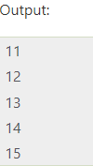
Example:-
<html>
<head><title></title>
</head>
<script>
var i=11;
while (i<=15)
{
document.write(i + "<br/>");
i++;
}
</script>
<body>
</html>

Slide 27
Do…while :-The JavaScript do while loop iterates the elements for the infinite number of times like while loop. But, code is executed at least once whether condition is true or false. The syntax of do while loop is given below.
do{
code to be executed
}while (condition);
Let’s see the simple example of do while loop in JavaScript.

Slide 28
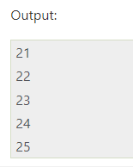
Example:
<html>
<head><title></title>
</head>
<script>
var i=21;
do{
document.write(i + "<br/>");
i++;
}while (i<=25);
</script></body>
</html>

Slide 29
Array in JavaScript
Array is a collection of similar elements and represented in a single variable name. Array index is always start form [0] and ends to [n-1] . There are 3 ways to construct array in JavaScript:-
By array literal
By creating instance of Array directly (using new keyword)
By using an Array constructor (using new keyword)

Slide 30
1.JavaScript by using array literal:-
The syntax of creating array using array literal is given below:-
var arrayname=[value1,value2.....valueN];
For example:
<script>
var i;
var emp=["Sonoo","Vimal","Ratan"];
for (i=0;i<emp.length;i++){
document.write(emp[i] + "<br/>");
}
</script>

Slide 31
2.JavaScript Array directly (new keyword)
Syntax is given below:
var arrayname=new Array();
Example:-
<script>
var i;
var emp = new Array();
emp[0] = "Arun";
emp[1] = "Varun";
emp[2] = "John";
for (i=0;i<emp.length;i++){
document.write(emp[i] + "<br>");
}
</script>

Slide 32
3. JavaScript array constructor (new keyword)
Here, we need to create instance of array by passing arguments in constructor so that we don't have to provide value explicitly.
The example of creating object by array constructor is given below.
<script>
var emp=new Array("Jai","Vijay","Smith");
for (i=0;i<emp.length;i++){
document.write(emp[i] + "<br>");
}
</script>

Slide 33
forEach () in JavaScript or forEach loop
Loops through a block of code for each element in an array.
The foreach loop works only on arrays, and is used to loop through each key/value pair in an array.
Syntax:
arrayname.forEach(callback(currentvalue){
//statements;
})

Slide 34
Example:
<script type="text/javascript">
const arry=['Javascript','PHP','.Net','DBMS','Python','java'];
arry.forEach(function(x)
{
document.write(x+"<br>");
})
</script>

Slide 35
Q.N: 1. WAP in JavaScript to input 10 student's obtained marks in a subject and display the total and average marks of them by using foreach loop.
Ans:-
<script type="text/javascript">
const arry=[50,67,45,43,21,34,34,54,32,43];
var total=0;
var average=0;
arry.forEach(function(x)
{
total=total+x;
})
average=total/arry.length;
document.write(total+"<br>"+average);
</script>

Slide 36
Array Methods in JavaScript
Array length Array toString() Array pop() Array push() Array shift() Array unshift() | Array join() Array delete() Array concat() Array flat() Array splice() Array slice()

Slide 37
Q.N.2. What is need for client side scripting? Write a JavaScript program which accepts user’s first and last name and print them in reverse order with space between them. (2080/2023)

Slide 38
JavaScript Function:-
A JavaScript function is a block of code designed to perform a particular task.
A JavaScript function is executed when "something" invokes it (calls it).
With functions we can reuse code
We can write code that can be used many times.
We can use the same code with different arguments, to produce different results.
Syntax:
function function_name(para1,para2,par3…….para N)
{
//block of code;
}
Call the function();

Slide 39
For Example:-
<!DOCTYPE html>
<html>
<head>
<meta charset="utf-8">
<meta name="viewport" content="width=device-width, initial-scale=1">
<title>function</title>
</head>
<body>
<script type="text/javascript">
function sum()
{
var a=parseInt(prompt("Enter a number"));
var b=parseInt(prompt("Enter a number"));
var c=parseInt(prompt("Enter a number"));
var pro=a*b*c;
document.write("the product is:"+pro+"<br>");
}
sum();
sum();
</script>
</body>
</html>

Slide 40
JavaScript Function with Parameter
Example:
<!DOCTYPE html>
<html>
<head>
<meta charset="utf-8">
<meta name="viewport" content="width=device-width, initial-scale=1">
<title>function</title>
</head>
<body>
<script type="text/javascript">
function sum(a,b,c)
{
var pro=a*b*c;
document.write("the product is:"+pro+"<br>");
}
sum(8,9,6);
sum(9,6,5);
</script>
</body>
</html>

Slide 41
Do the questions:
Q.N.1. WAP in JS to input four parameter value by passing arguments and display the average value of them three times with different passing arguments.
Q.N. 2. WAP in JS to ten numbers in a array and display the largest and smallest number among them by using function
Q.N.3.How can you defining and invoking the function in JavaScript.
Q.N.4.What is an Immediately Invoked Function JavaScript? Explain with suitable example.

Slide 42
// Function to find the largest number in an array
function findLargestNumber(numbers) {
var largest = numbers[0];
for (var i = 1; i < numbers.length; i++) {
if (numbers[i] > largest) {
largest = numbers[i];
}
}
return largest;
}
// Function to find the smallest number in an array
function findSmallestNumber(numbers) {
var smallest = numbers[0];
for (var i = 1; i < numbers.length; i++) {
if (numbers[i] < smallest) {
smallest = numbers[i];
}
}
return smallest;
}
// Array to store user input numbers
var numbers = [];
// Prompting the user to enter ten numbers
for (var i = 0; i < 10; i++) {
var num = parseFloat(prompt("Enter number " + (i + 1) + ":"));
numbers.push(num);
}
// Finding the largest and smallest numbers
var largestNumber = findLargestNumber(numbers);
var smallestNumber = findSmallestNumber(numbers);
// Displaying the largest and smallest numbers
console.log("The largest number is: " + largestNumber);
console.log("The smallest number is: " + smallestNumber);

Slide 43
Pop-up Boxes
Java script has three pop up boxes.
Alert box
Confirm box
Prompt box

Slide 44
Alert box
used if you want to make sure information comes through to the user
the user will have to click "OK" to proceed
Syntax :alert("sometext");

Slide 45
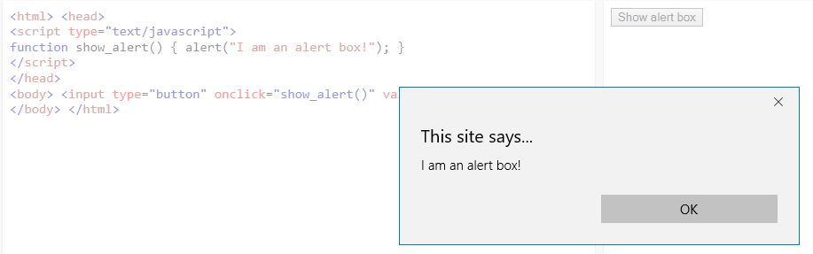

Slide 46
Confirmation Box
used if we want the user to verify or accept something
have to click either "OK" or "Cancel" to proceed
If the user clicks "OK", the box returns true
If the user clicks "Cancel", the box returns false
Syntax : confirm("sometext");

Slide 47
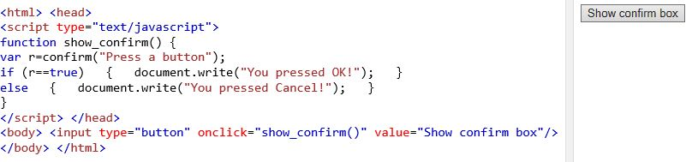

Slide 48
Prompt Box
used when you want user to input a value before entering a page
user will have to click either "OK" or "Cancel" to proceed after entering an input value
If the user clicks "OK" the box returns the input value
If the user clicks "Cancel" the box returns null
Syntax: prompt("sometext","defaultvalue");

Slide 49
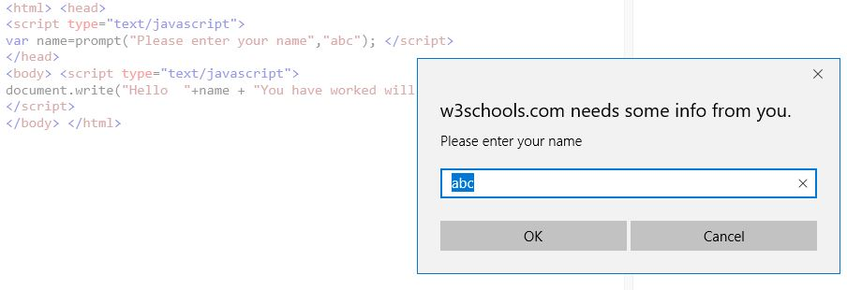

Slide 50
Events
An HTML event can be something the browser does, or something a user does.
Here are some examples of HTML events:
An HTML web page has finished loading
An HTML input field was changed
An HTML button was clicked
When user clicks mouse
When image has been loaded
When mouse moves over an element
When html form is submitted
When user stroke a key

Slide 51
Event
Event Handling:
Event handling is mechanism that controls the event and sometime we want to execute a java script when an event occurs such as when user clicks button
Events are normally used in combination with function and function cannot be executed before event occurs
Syntax:<element event attribute="some JavaScript">

Slide 52
Event attribute:
Onload: A page or image is finished loading
Onupload: The user exits the page
Onblur: An element loses focus
Onchange: The content of field change.
Onclick: Mouse click on object.
Ondbclick: Mouse double click on object
Onfocus: An element get focus.
Onselect: Text is selected
Onkeydown: A keyboard key is pressed.
Onkeypress: A keyboard key is pressed or held down.
Onmousemove: A mouse is moved
Onmouseout: A mouse is moved off an element
Onmouseover: A mouse is moved over an element.
Onmouseup: A mouse is released.

Slide 53
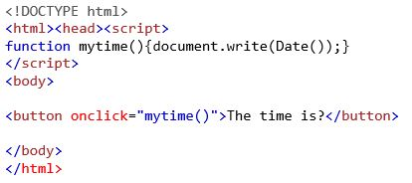
Output:

Slide 54
Java Script Object
Java script object is an entity having state and behavior (properties and method).
In java script, everything is an object.
Java script is template based not class base, here class cannot be created to get object, but direct create object.
An object is unordered collection of properties, each of which has a name and value
There are three ways to create an object
By object literal
By creating instance of object directly(using new keyword)
By using an object constructor.

Slide 55
JavaScript Object by object literal
Syntax: object={property1:value1,property2:value2.....propertyN:valueN}
Example:
<html>
<body>
<script>
student={roll:102,name:"Shyam ",address:"ktm"}
document.write(student.roll+" "+student.name+" "+student.address);
</script>
</body>
</html>

Slide 56
By creating instance of Object
Syntax: var objectname=new Object();
Example:
<html>
<body>
<script>
var emp=new Object();
emp.id=101;
emp.name=“Taveeta Lohani";
emp.salary=50000;
document.write(emp.id+" "+emp.name+" "+emp.salary);
</script>
</body>
</html>

Slide 57
By using an Object constructor
Here, user need to create function with arguments. Each argument value can be assigned in the current object by using this keyword.
Example:
<html>
<body>
<script>
function emp(id,name,salary){
this.id=id;
this.name=name;
this.salary=salary;
}
e=new emp(103,“Taveeta Lohani",30000);
document.write(e.id+" "+e.name+" "+e.salary);
</script>
</body>
</html>

Slide 58
Java script object
There are mainly six object used in java script.
1. Array
2. String
3. Math
4. Date
5. Number
6. Boolean

Slide 59
1. Arrays:
An array is ordered set of data element which can be accessed through single variable.
Java script array is an object that represents collection of variable of similar type.
There are several way to define arrays in JS
Var <arr_name> = [value 1, value 2,…..,value n];
Var <arr_name> = new Array();
Var <arr_name> = new Array(value 1, value 2,…..,value n);

Slide 60
JavaScript Array Methods:
Concat(): It returns a new array object that contains two or more merged arrays.
Find(): It returns the value of the first element in the given array that the specified condition.
Pop(): It removes and returns the last element of an array.
Push(): It adds one or more elements to the end of an array.
Reverse(): It reverses the elements of given array.
Sort(): It returns the element of the given array in a sorted order.
Slice():It returns a new array containing the copy of the part of the given array

Slide 61
Example:
<html>
<body>
<script>
var emp=[“Taveeta",“supriya",“Tekendra"];
for (i=0;i<emp.length;i++)
{
document.write(emp[i] + "<br/>");
}
</script>
</body>
</html>

Slide 62
2.String object
String is a set of character enclose in pair of double quotes.
Java script string is an object that represents a sequence of character.
Syntax:
Var <string name>=“string value”;
Var <string name>= new string(string value);
Property: length.

Slide 63
JavaScript String Methods:
charAt(): It provides the char value present at the specified index.
Concat(): It provides a combination of two or more strings.
Indexof():It provides the position of a char value present in the given string.
toLowerCase():It converts the given string into lowercase letter.
toUpperCase(): It converts the given string into uppercase letter.
Trim(): remove leading and tailing whitespace.
Slice(): returns substring.

Slide 64
Example:
<html>
<body>
<script>
var str = “TRIBHUVAN UNIVERSITY";
document.writeln(str.toLowerCase());
</script>
</body>
</html>

Slide 65
Math object:
Java script math object provides several constants and methods to perform mathematical operation.
Method:
Math.sqrt()
Math. Random()
Math.floor()
Math. Ceil()
Math.abs()
Math.min()
Math.max()
Math.sin()
Math.cos()
Math.tan()
Math.exp()

Slide 66
Date object:
Java script date object is used to obtain a date and time .
This date and time is based on computer local time
Use different date constructor to create data object.
Syntax:
Date()
Date(miliseconds)
Date(datestring)
Date(year, month,day,h,m,s,ms)

Slide 67
Methods:
getFullyear()
getMonth()
getDate()
getDay()
getHours()
getMinutes()
getSeconds()
getMiliseconds()

Slide 68
Example:
<html>
<body>
Current Time: <span id="txt"></span>
<script>
var today=new Date();
var h=today.getHours();
var m=today.getMinutes();
var s=today.getSeconds();
document.getElementById('txt').innerHTML=h+":"+m+":"+s;
</script>
</body>
</html>

Slide 69
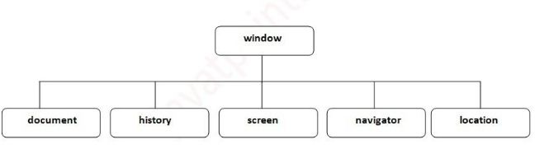
Browser object model
The browser object model is used to interact with browser.
The default object of browser is window.

Slide 70
Window object:
Window object represents a window in browser.
An object of window is created automatically by the user
Method: alert(),confirm(), prompt(), setTimeout(),open(),close()
History objects:
Java script history object represents an array of url’s visited by user.
By using this object we can load previous, forward or particular page.
Property: length
Method: forward(),back(),go()

Slide 71
Navigator object:
It is used for browser detection
It is used to get browser information such as appName, appCodeName, userAgent etc.
Property: appName, appVersion, appCodeName, Language, userAgent etc
Mtheod: javaEnabled()
Screen Object:
It hold information about browser screens
It can be used to display screen width, height, color depth pixel depth etc.
Property: width ,height, availwidth, availheight, colaorDepth etc.

Slide 72
Document Object model
The document object represents the whole html document .
The document object model (DOM) is a platform and language neutral interface that allows programs and scripts to dynamically access and update the content, structure and style of document.
HTML DOM is standard object model for HTML
The DOM says:
The entire document is document node
Every HTML element is an element node
Text in html elements are text nodes
Every html attribute is an attribute node
Comments are comment node.

Slide 73
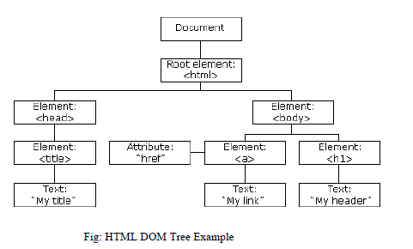

Slide 74
HTML DOM properties:
Some DOM properties are
X.innerHTML: The text value of x
X.innerText: Sets or returns the text content of X
X.nodeName: The name of x
X.nodeValue: The value of x
X.parentNode: The parent of node X
X.childNode: The child node of x.
X.attribute: The attribute of x

Slide 75
HTML DOM Methods:
Write(“string”): writes the given string on the document.
Writeln(“string”): writes the given string on the document with newline character at the end.
getElementById(): returns the element having the given id value.
getElementsByName():returns all the elements having the given name value.
getElementsByTagName():returns all the elements having the given tag name.
getElementsByClassName():returns all the elements having the given class name.

Slide 76
Example :getElementById():
<!DOCTYPE html>
<html>
<body>
<p id="demo">Click the button to change the text in this paragraph.</p>
<button onclick="myFunction()">Click Me</button>
<script>
function myFunction() {
document.getElementById("demo").innerHTML = "Hello World";
}
</script>
</body>
</html>

Slide 77
Validation
Validation is process of ensuring that form’s values are correct or not.
Form validation is process of checking that form has been filled in correctly before it is processed.
Some type of validation are:
Preventing blank values.
Ensuring the type of values
Ensuring the format and range of values
Ensuring that values fit together.

Slide 78
There are mainly two methods for validating form.
Client-side validation
Validation is done before the form is submitted
Can lead to better user experience but not secure
Faster and easier to do.
client-side validation usually done using JavaScript and VBScript.
Server-side validation:
Validation is done after the form is submitted
Server-side validation is more secure but often more tricky to code.
it also increases load of server computer, it is slower.
Server-side validation is done usually done using php, asp and jsp etc.

Slide 79
Some of Validation rules for field
Field | Validation Rules
Name | Should required letters and white-spaces
Email | Should required @ and .
Website | Should required a valid URL
Radio | Must be selectable at least once
Check Box | Must be checkable at least once
Drop Down menu | Must be selectable at least once

Slide 80
Form Validation - Checking for Non-Empty
Check to see if a given HTML input is empty or not.
Example:
<!DOCTYPE html>
<html>
<head>
<title>validation Example:</title>
<script type='text/javascript'>
function notEmpty()
{
var v= document.getElementById("elem").value;
if(v.length == 0)
{
alert("Field should not be empty:");
}
}
</script>
</head>
<body>
<form>
Required Field: <input type="text" id="elem"/>
<input type="button" onclick="notEmpty()" value="Check"/>
</form>
</body>
</html>

Slide 81
Form Validation - Checking for All Numbers
The quickest way to check if an input's string value is all numbers is to use a regular expression /^[0-9]+$/ that will only match if the string is all numbers and is at least one character long.
<!DOCTYPE html>
<html>
<head>
<title>validation Example:</title>
<script type='text/javascript'>
function validate()
{
var patt=/^[0-9]+$/;
var v= document.getElementById('elem').value;
if(v.match(patt))
alert("valid entry");
else
alert("Invalid entry");
}
</script>
</head>
<body><form>
Required Field: <input type="text" id="elem"/>
<input type="button" onclick="validate()" value="Check"/>
</form>
</body></html>

Slide 82
Form Validation - Checking for All Letters
regEX:/^[a-zA-Z]+$/
Example:
<!DOCTYPE html>
<html>
<head>
<title>validation Example:</title>
<script type='text/javascript'>
function validate()
{
var patt=/^[a-zA-Z]+$/;
var v= document.getElementById('elem').value;
if(v.match(patt))
alert("valid entry");
else
alert("Invalid entry");
}
</script>
</head>
<body><form>
Required Field: <input type="text" id="elem"/>
<input type="button" onclick="validate()" value="Check"/>
</form>
</body></html>

Slide 83
Form Validation - Restricting the Length
Example :
<!DOCTYPE html>
<html>
<head>
<title>validation Example:</title>
<script type='text/javascript'>
function validate()
{
var minlen=6;
var v= document.getElementById('elem').value;
if(v.length<minlen)
alert("User ID must have at least 6 Characters"); ;
else
alert("valid entry");
}
</script>
</head>
<body>
<form>
Required Field: <input type="text" id="elem"/>
<input type="button" onclick="validate()" value="Check"/>
</form>
</body>
</html>

Slide 84
Form Validation - Selection Made
Example:
<!DOCTYPE html>
<html>
<head>
<title>validation Example:</title>
<script type='text/javascript'>
function validate()
{
var si=document.getElementById('con').selectedIndex;
var v= document.getElementById('con').options[si].text;
if(v=="Please Choose")
alert("You must choose the country");
else
alert("Your Country is:"+v);
}
</script>
<form>
Select Country: <select id='con'>
<option>Please Choose</option> <option>Nepal</option>
<option>India</option> <option>China</option>
</select>
<input type='button' onclick='validate()' value='Check'/>
</form>
</body>
</html>

Slide 85
Validating radio buttons:
Example:
<!DOCTYPE html>
<html>
<head>
<title>validation Example:</title>
<script type='text/javascript'>
function validate()
{
var gender=document.getElementsByName("gen");
if(gender[0].checked==false && gender[1].checked==false)
{
alert("You must choose Gender");
}
else
{
if(gender[0].checked==true)
alert("Male");
else
alert("Female");
}}
</script>
<form>
Select Gender:
<input type=radio name='gen'>Male
<input type=radio name='gen'>Female
<input type='button' onclick='validate()' value='Check'/>
</form>
</body>
</html>

Slide 86
Email validation:
Every email is made up for 5 parts:
1. A combination of letters, numbers, periods, hyphens, plus signs, and/or underscores
2. The at symbol @
3. A combination of letters, numbers, hyphens, and/or periods
4. A period
5. The top level domain (com, net, org, us, gov, ...)
Valid Examples:
ram@ntc.net
ram+nepal@gmail.com
ram-nepal@patan.edu.np
Invalid Examples:
@deleted.net - no characters before the @
free!dom@bravehe.art - invalid character !
shoes@need_shining.com - underscores are not allowed in the domain name

Slide 87
Example(Regular Expression):
<!DOCTYPE html>
<html>
<head>
<title>validation Example:</title>
<script type="text/javascript">
function validate()
{
var patt=/^[\w\-\.\+]+\@[a-zA-Z0-9\.\-]+\.[a-zA-z0-9]{2,4}$/;
var v= document.getElementById("elem").value;
if(v.match(patt))
alert("valid Email");
else
alert("Invalid Email");
</script>
</head>
<body><form>
Email ID: <input type="text" id='elem'/>
<input type="button" onclick="validate()" value="Check"/>
</form>
</body>
</html>

Slide 88
Example (without regular expression)
<!DOCTYPE html>
<html>
<head>
<title>validation Example:</title>
<script type="text/javascript">
function validate()
{
var v= document.getElementById("elem").value
var atpos=v.indexof('@');
var dotpos=v.indexof('.');
if(atpos<1||dotpos>=v.length-2||dotpos<3)
alert("invalid Email");
else
alert("valid Email");
</script>
</head>
<body><form>
Email ID: <input type="text" id='elem'/>
<input type="button" onclick="validate()" value="Check"/>
</form>
</body>
</html>

Slide 89
Error Handling
The try statement lets you test a block of code for errors.
The catch statement lets you handle the error.
The throw statement lets you create custom errors.
The finally statement lets you execute code, after try and catch, regardless of the result.

Slide 90
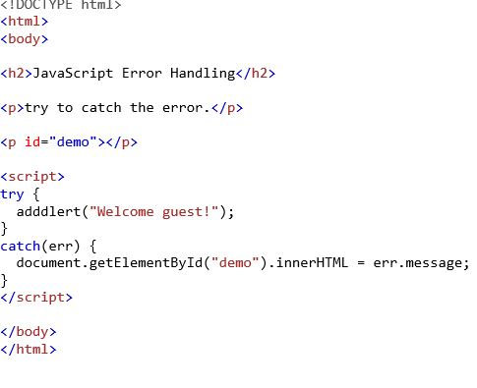
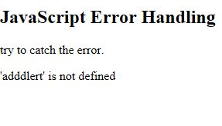

Slide 91
Cookies in JavaScript
Cookies are small piece of information stored in the browsers.
cookies were invented to solve the problem "how to remember information about the user":
When a user visits a web page, his/her name can be stored in a cookie.
Next time the user visits the page, the cookie "remembers" his/her name.

Slide 92
JavaScript can create, read, and delete cookies with the document.cookie property.
1)With JavaScript, a cookie can be created like this:-
document.cookie = "username=John Doe";
2) We an also add an expiry date (in UTC time). By default, the cookie is deleted when the browser is closed:-
document.cookie = "username=John Doe; expires=Thu, 18 Dec 2013 12:00:00 UTC";

Slide 93
3) Read a Cookie with JavaScript
With JavaScript, cookies can be read like this:
let x = document.cookie;
document.cookie will return all cookies in one string much like: cookie1=value; cookie2=value; cookie3=value;

