Slide 1


Introduction to Statistics
By Simanga Mchunu | 2026
https://introductiontostats.vercel.app/

Slide 2

Agenda
What is Statistics?
What is Data?
Types of Statistics
Descriptive Statistics Essentials
Inferential Statistics
Data Distributions
Probability
Case Study: Predicting Students Success

Slide 3
01 - Introduction to Statistics
Foundations for Data Science · 2026

Slide 4
What is Statistics?
Science of collecting, analyzing, interpreting, presenting, and organizing data.
Used in business, healthcare, sports, and machine learning.
It is making sense of numbers.
Making informed decisions in the presence of uncertainty and variation.
Organising and summarizing data to draw conclusions based on the information contained in the data.

Slide 5
What is Data?
Data is information collected through observation, measurement,or facts, used for reference, analysis, or research.
Data is information collected through observation, measurement, or facts, used for reference, analysis, or research.
It represents raw inputs that, when structured and interpreted, form the basis of knowledge and decision-making

Slide 6
Types of Statistics
“The numbers have no way of speaking for themselves. We speak for them. We imbue them with meaning". - Nate Silver, The Signal and the Noise
Descriptive Statistics:
Summarize data (mean, median, variance).
Inferential Statistics:
Draw conclusions (hypothesis testing, confidence intervals).

Slide 7
Descriptive Statistics Essentials
Mean: Average = μ = (1/n) ∑xᵢ)
Median: Middle value
Mode: Most frequent value
Variance: Spread = σ² = (1/n) ∑(xᵢ - μ)²
Standard Deviation = √Variance

Slide 8
Inferential Statistics Concepts
Sample vs. Population
Confidence Intervals
Hypothesis Testing: Null & Alternative Hypotheses, p-values
Population: Collection of objects about which information is sought.
Sample: Part of the population that is observed.
Spiegelhalter’s key idea: Even when you seem to have all the data, treat it as a sample from a metaphorical population , the imaginary space of all possible observations that could have arisen. This means every finding is an estimate, not a fact.
p-values warning: Spiegelhalter is emphatic that many studies claiming statistical significance are misleading. A p-value below 0.05 does not mean a result is true , it means the data would be unlikely if the null hypothesis were true. Small samples amplify this problem.
Source [1]: https://medium.com/analytics
vidhya/population sample parameter statistic biased
unbiased ead2021d93d7

Slide 9
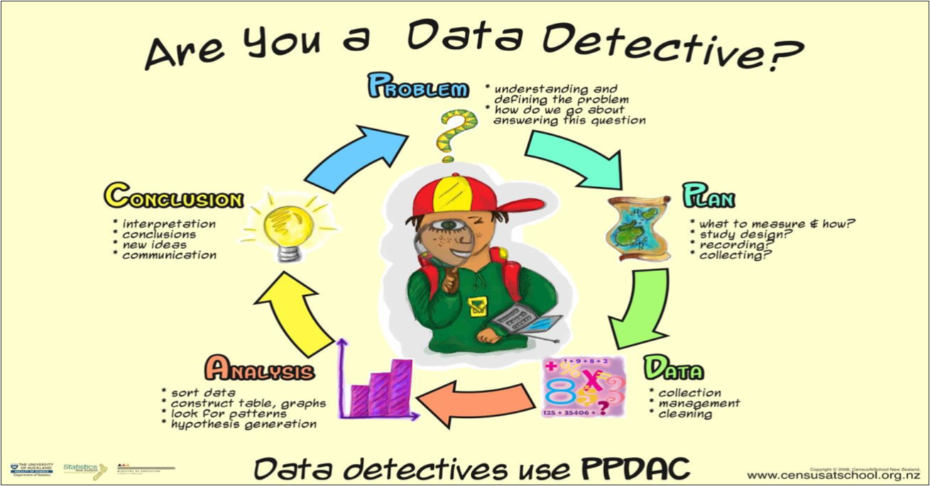

Data Distributions
Source [2]: https://www.lse.ac.uk/Events/2019/03/20190327t1830vHKT/Learning-from-Data

Slide 10
Shipman Murdered More Than 200 Patients, Inquiry Finds
The British former GP Harold Shipman murdered at least 215 of his patients, the first phase of the public inquiry into the serial killings concluded last week. There is a “real suspicion” that he claimed the lives of another 45 victims, according to the judge leading the inquiry.
High court judge Dame Janet Smith said Shipman may have been hoping to get caught when he altered the will of his last victim, Kathleen Grundy, 81. The “crude forgery” of the will “made detection inevitable,” she said, concluding: “It is hard to resist the inference that Shipman was driven by a need to draw attention to himself and his crimes.”
The inquiry examined a total of 888 cases in its 2000 page report, Death Disguised. Shipman was found not responsible for 604 deaths, and no conclusion was reached in a further 38 cases. The 215 people that the inquiry determined were killed by Shipman comprised 171 women and 44 men.
Source [3]: https://pmc.ncbi.nlm.nih.gov/articles/PMC1123718/

Slide 11
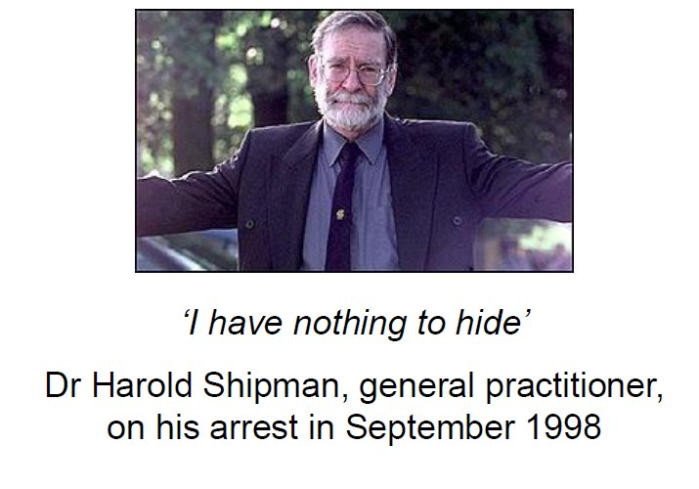
Looking at Data: The Shipman Case
What was the pattern of Harold Shipman’s murders?
Problem: can more detail tell us more about what Shipman did?
Plan: compare actual times at which his patients died with the times
of deaths recorded by other local GPs
Data: a huge exercise requiring examination of death certificates
Analysis: simple plotting of death times revealed a stark afternoon cluster
Conclusion: the pattern was statistically impossible by chance — but required domain context to interpret correctly
Critical lesson: The same test applied to all GPs surfaced a second outlier with an entirely innocent explanation (elderly rural patients). Without domain context, statistics produces dangerous conclusions. This is PPDAC — see next slide.
Source [4]: The art of Statistics by David Spiegelhalter’s book​

Slide 12
The PPDAC Cycle A Framework for Every Statistical Investigation
PPDAC is the named framework Spiegelhalter uses throughout The Art of Statistics. Every investigation follows fivestages in order.
P — Problem: State the question precisely before touching data. A vague question produces a useless answer.
P — Plan: Decide what to measure, from whom, and how. Sampling design matters enormously.
D — Data: Collect, inspect, and understand limitations. What is missing? How was it recorded?
A — Analysis: Apply statistical methods. Summaries, visualisations, models — always with uncertainty.
C — Conclusion: Return to the Problem. Translate findings into an honest answer. State what the data cannot tell you.
The Shipman case (previous slide) followed PPDAC exactly: the Problem drove every decision about which data to collect and how toanalyse it. Without that structure, the pattern would never have been found.
Warning: most students jump directly to Analysis. This is how wrong conclusions are reached.
Source [4]: The Art of Statistics by David Spiegelhalter

Slide 13
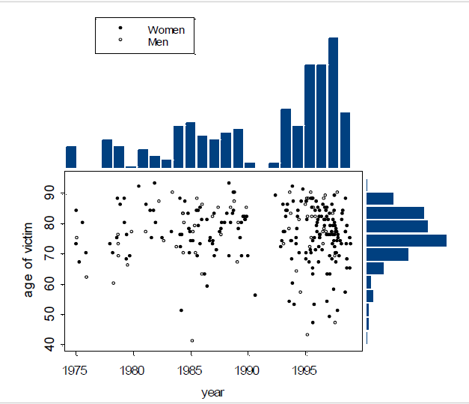
Looking at Data
Source: [4] https://www.lse.ac.uk/Events/2019/03/20190327t1830vHKT/Learning-from-Data

Slide 14
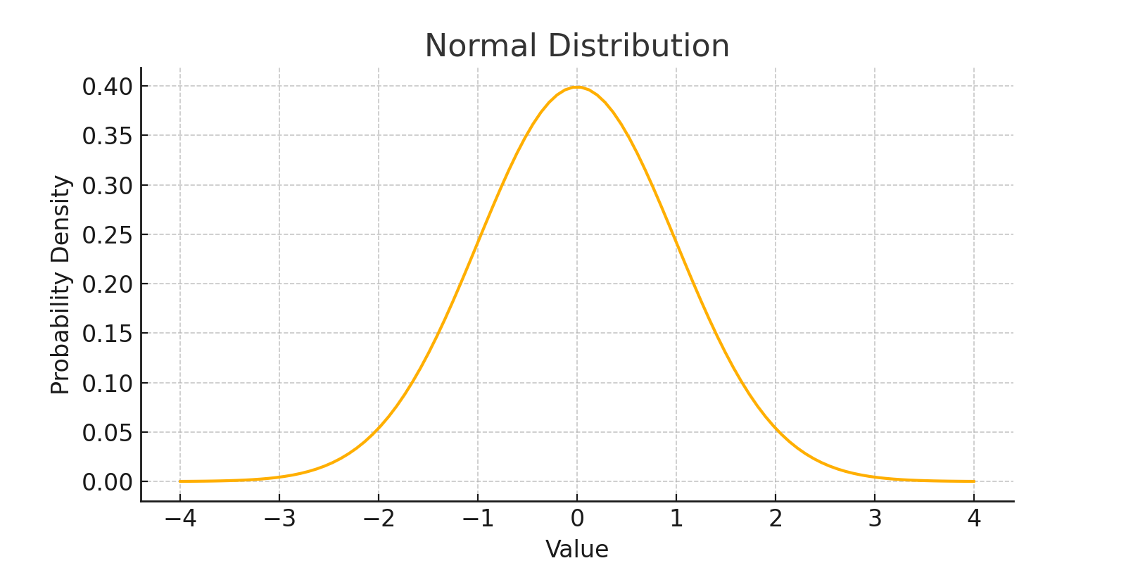
What is a Data Distribution?
Normal Distribution (Known as the Gaussian Distribution) is a probability distribution that appears as a "bell curve" when graphed. Also called the Bell Curve because of its shape.
Characteristics:
Symmetrical around the mean
Mean = Median = Mode
Most data falls near the center
Tails taper off equally on both sides
Defined mathematically by the Gaussian function

Slide 15
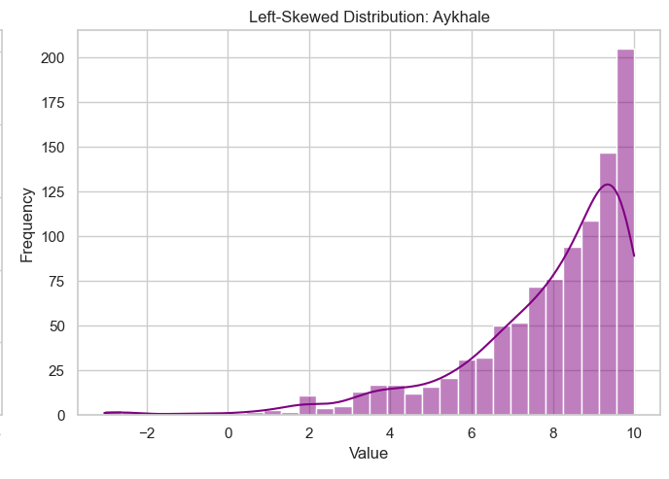
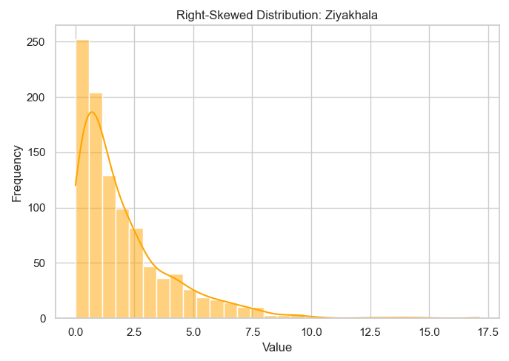
What is Skewed Distribution?
A skewed distribution occurs when the data is not evenly distributed around the mean. The values tend to lean more to one side, forming a tail on either the right or left.
Characteristics:
Asymmetrical shape
The mean, median, and mode are not equal
Two types of skewness:
Right-Skewed (Positive Skew): Tail on the right, Mean > Median > Mode
Left-Skewed (Negative Skew):
Tail on the left, Mean < Median < Mode
Affects statistical analysis and interpretation

Slide 16
Which Central Tendency Measure to Choose?
Measure | Best When | Avoid When
Mean | Data is evenly distributed (normal distribution). No outliers | Sensitive to outliers
Median | Data has outliers or skewed distribution | Less informative for symmetric, well-behaved data
Mode | Data is categorical or you need the most frequent value | Not very useful for continuous data or when no clear mode exists
In probability theory, the central limit theorem (CLT) states that, under appropriate conditions, the distribution of a normalized version of the sample mean converges to a standard normal distribution.

Slide 17
What Distribution Means in Data Science
Understanding if your data is normally distributed matters because:
Many algorithms assume it:
Linear regression
Logistic regression
Naive Bayes
T-tests and ANOVA
Standardized models:
Let you apply z-scores (how many std deviations from mean)
Make it easier to detect outliers

Slide 18
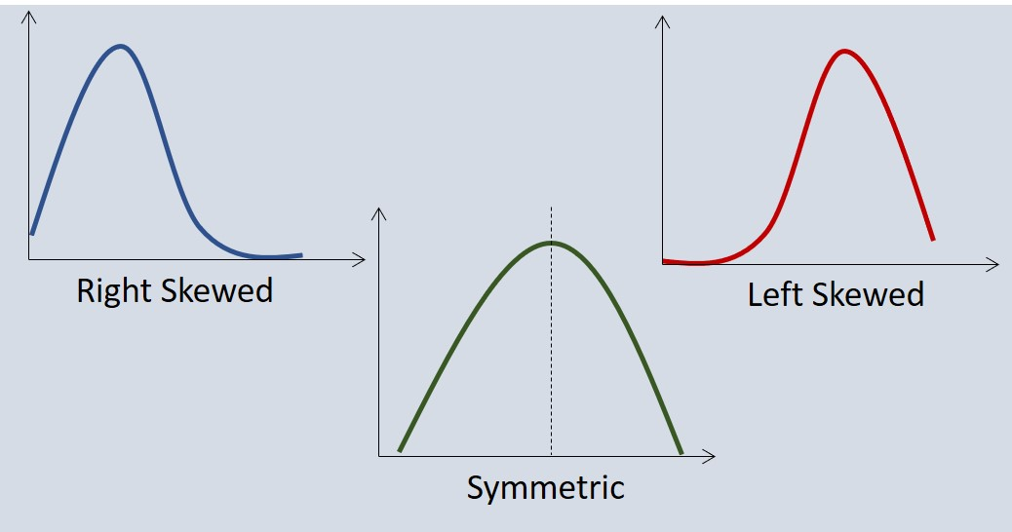
What Distribution Means in Data Science
Helps with:
Feature scaling
Probability estimates
Statistical inference
Real-World Example:
If you’re analyzing student test scores, a normal distribution means:
Most students score near the average
Fewer students score very high or very low
The grading curve might be centered on the class average

Slide 19
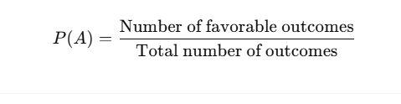
Probability: The Language of Uncertainty
Formula for an event A:
Why it matters in Data Science:
Handles uncertainty in predictions (e.g., spam detection, fraud detection)
Used in probabilistic models like Naive Bayes, Bayesian networks, Hidden Markov Models
Foundation of sampling, A/B testing, and predictive modeling

Slide 20

Probability Example
If 3 out of 5 emails are spam:

Slide 21
Conditional Probability: Knowing Changes the Odds
Formula:
P(A|B) = P(A ∩ B) / P(B)
Data Science Example:
What's the chance a user buys given they clicked?
Let A = Buy, B = Click
Crucial for recommendation systems and conversion analysis

Slide 22
Bayes' Theorem: Update Your Beliefs
Formula: P(A|B) = P(B|A) * P(A) / P(B)
Logic: Combine prior knowledge P(A) and observed data P(B∣A) to update belief
Core to Bayesian reasoning, probabilistic classifiers, and medical diagnostics

Slide 23
Bayesian Thinking: Updating Beliefs With Evidence
Bayes’ theorem is not just a formula. It encodes a way of thinking that Spiegelhalter considers foundational to all statistics.
The core idea : three steps:
1. Prior: Start with a belief. What do we think before seeing any data?
2. Likelihood: Collect evidence. How probable is this evidence if our belief is true?
3. Posterior: Update the belief. P(Hypothesis | Evidence) using Bayes’ rule.
Worked Example Shipman revisited:
Prior: a GP has a normal rate of patient deaths. Likelihood: Shipman’s death rate among afternoon patients is vastly higher than expected. Posterior: after updating on this evidence, the probability that his pattern is due to chance becomes vanishingly small.
This is why Bayesian thinking matters: we do not need to wait for a definitive test. We update our confidence continuously as evidence accumulates.
In data science: spam filters, medical diagnosis, fraud detection and recommendation engines all use Bayesian updating at their core.
Source [4]: The Art of Statistics : Chapter 8: Probability, the Language of Uncertainty

Slide 24
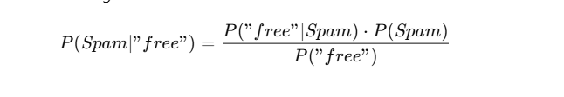
Data Science Use Case: Naive Bayes Classifier
Data Science Use Case – Naive Bayes Classifier:
Let’s classify if a message is spam or not spam:
A: Message is spam
B: Message contains the word "free“
Trained on labelled data to estimate all components.

Slide 25
Case Study: Predicting Student Success
Applying the PPDAC workflow end-to-end

Slide 26
Case Study:Predicting Student Success
Practical Case Study
Scenario: A university wants to identify students at risk of failing beforethe final exam.
Your dataset:
Student 1 — 5 hrs study, 60% attendance, 45 assignment, 48 exam
Student 2 — 8 hrs study, 75% attendance, 58 assignment, 60 exam
Student 3 — 10 hrs study, 80% attendance, 62 assignment, 67 exam
Student 4 — 12 hrs study, 85% attendance, 70 assignment, 74 exam
Student 5 — 15 hrs study, 90% attendance, 82 assignment, 85 exam
Student 6 — 18 hrs study, 95% attendance, 90 assignment, 92 exam
Variables: Study Hours | Attendance | Assignment Score | Exam Score

Slide 27
Steps 1 & 2: Understand the Problem and Explore the Data
Step 1: Understand the Problem
Before calculating anything - ask questions:
What does success mean in this context?
Which variables might influence performance?
What is missing from the data?
Statistical Thinking: The question comes before the data.
Step 2: Explore the Data
Calculate summary statistics:
Mean study hours — what is typical?
Mean attendance percentage
Mean assignment and exam scores
Discussion: Are there any unusual observations?

Slide 28
Step 3: Measure Variability (The Spread of the Data)
Why does variability matter?
Two datasets can have the same mean but be completely different.
For Study Hours and Final Exam Scores, calculate:
Range = Maximum value − Minimum value
Variance = Average squared distance from the mean
Standard Deviation = Square root of variance (typical distance from the mean)
Example — Study Hours:
Values: 5, 8, 10, 12, 15, 18
Mean = 11.33 | Range = 13
Standard Deviation ≈ 4.5 → Data is moderately spread
Key Insight: High variability = students are very different from each other.

Slide 29
Step 4: Visualise the Data (See Before You Model)
Histogram of Final Exam Scores:
Is the distribution symmetric or skewed?
Are scores clustered together or spread out?
Are any scores unusually low (potential at-risk students)?
Scatter Plot — Study Hours vs Final Exam Score:
Plot each student as a point: x = study hours, y = exam score
Look for a trend: do more study hours lead to higher scores?
Identify outliers: students who studied a lot but still scored low
Golden Rule of Data Science:
Always visualise before you model. A chart reveals what a formula cannot.
Visualisation reveals patterns, clusters, outliers, and errors.

Slide 30
Step 5: Investigate Relationships (Correlation)
Correlation tells us: do two variables move together?
Calculate correlation between:
Study Hours vs Exam Score
Attendance vs Exam Score
Assignment Score vs Exam Score
Interpreting the correlation value (r):
r close to +1 → Strong positive relationship
r close to 0 → Weak or no relationship
r close to −1 → Strong negative relationship
Warning - Correlation is NOT Causation:
Two variables can move together without one causing the other.
Always look for a logical reason behind the relationship.

Slide 31
Step 6: Build a Simple Statistical Model (No ML Needed)
Using the scatter plot, draw an estimated line of best fit.
Linear Relationship Formula:
Exam Score ≈ a + b × Study Hours
From our data — estimated values:
Intercept (a) ≈ 22 | Slope (b) ≈ 4
So: Exam Score ≈ 22 + 4 × Study Hours
What the slope means:
For every additional hour of study per week,
exam performance increases by approximately 4 marks.
This is regression — the foundation of predictive modelling.
We reached prediction using only statistics.

Slide 32
Steps 7 & 8: Make a Prediction and Quantify Uncertainty
Step 7: Use your model to make a prediction.
Scenario: A new student studies 13 hours per week.
Using our formula:
Predicted Exam Score = 22 + 4 × 13 = 74 marks
Step 8: Can we be certain about this prediction?
No. Statistics gives us estimates, not guarantees.
Reasons predictions can fail:
Motivation and stress levels are not in the data
Health, family circumstances, or external disruptions
Sample is small (only 6 students)
Key Principle: Always report your uncertainty alongside your prediction.

Slide 33
Step 9: Statistical Decision Making
Scenario: The university can only support 20 at-risk students.
How do you decide who needs help most?
Use evidence from multiple variables:
Low study hours (below 8 hrs per week)
Low attendance (below 70%)
Low assignment score (below 55)
Statistical Approach:
Rank students by predicted exam score
Identify those predicted to score below 50%
Investigate further: is the risk consistent across variables?
Important: Every recommendation must be backed by evidence.
Opinion without data is just guessing.

Slide 34
Step 10: Final Reflection — The Full Statistical Workflow
You have just completed the process used by:
Data Scientists • Public Health Researchers
Business Analysts • Economists • AI Engineers
The complete workflow:
Question → Data → Exploration → Visualisation
→ Correlation → Model → Prediction → Decision
What is remarkable:
We reached prediction and decision-making without using machine learning.
We used only statistical thinking.
The most important skill in data science is not knowing algorithms —
it is knowing how to ask the right question and reason from evidence.

Slide 35
Can 6 Students Represent a Population? The Critical Question
Spiegelhalter insists: before generalising any finding, ask; what population does this sample represent, and how well?
Our case study dataset: 6 students. University population: potentially thousands.
Five questions every analyst must answer:
1. Were these 6 students randomly selected? If not, the sample may be biased ; volunteers tend to be more motivated than average.
2. What is the target population? This university? All South African students? The answer changes whether findings generalise.
3. What cases did we not observe? Students who study 0 hours, students who fail despite high attendance ; our model has never seen these.
4. What variables are entirely absent? Socio economic background, part-time employment, access to resources, language of instruction.
5. Is our correlation real or a small-sample artefact? With n=6, extreme r values can appear by chance even when no population-level relationship exists.
Spiegelhalter’s metaphorical population: treat results as a sample from the imaginary space of all students who could have been in this situation. Our findings are always estimates, never certainties.
Source [4]: The Art of Statistics — Chapter 3: Why Are We Looking at Data Anyway? Populations and Measurement

Slide 36
Ethical Responsibility: What the Analyst Owes the Student
We labelled Student 1 “high risk.” This has real consequences for a real person. Statistics without ethics is dangerous.
Four obligations Spiegelhalter places on every analyst:
1. Report uncertainty alongside every estimate. “Student 1 may fail” is irresponsible. “Predicted score: 30.4, typical error ±3.2 marks, based on 6 students” is honest.
2. State what the data cannot support. Attendance and study hours are associated with performance in this sample ; we cannot claim causation, and we cannot claim this holds for the full student body.
3. Consider who is harmed by errors. A false positive (wrongly labelled at-risk) may stigmatise a student. A false negative (missed at-risk) may leave a struggling student without support.
4. Ensure decision-makers understand the limits. If an academic advisor acts on this analysis without understanding its uncertainty and sample size, the analyst shares responsibility for the outcome.
Spiegelhalter’s closing principle: Statistics produces honest estimates with uncertainty made visible ; so that humans can make better decisions. The moment an analyst forgets this, the numbers become dangerous.
Ask yourself: if this analysis was wrong, who would bear the cost? Could that person challenge the conclusion? Do they even know it was made about them?
Source [4]: The Art of Statistics — Ethical Communication of Statistical Findings

Slide 37
Key Takeaways: What Every Student Must Remember
Statistics is the foundation of all data science and AI.
Data is NOT reality ; it is only a representation
Samples represent populations ; never assume they are perfect
Variability matters as much as averages
Correlation is NOT causation ; always look for logical reasons
Every prediction has uncertainty ; always report your confidence
Evidence must drive every recommendation
When you encounter a data challenge:
Do NOT rush to machine learning.
First: Understand the problem.
Then: Explore, visualise, and reason statistically.
The best data scientists start with questions, not algorithms.

Slide 38
Quiz Time!
Where the mean, mode, and median are equal? Which graph distribution is:
A. Negative Skewed
B. Normal Distribution
C. Data Distribution
D. None of the Above
Answer: B. Normal Distribution
What is Statistics? ​
A. Information collected through observation, measurement ​
B. The state of the country. ​
C. Science of collecting, analyzing, interpreting, presenting, and organizing data ​
D. All of the above
Answer: C. Science of collecting, analyzing, interpreting, presenting, and organizing data​

Slide 39
Quiz Time!
What does a skewed distribution indicate?
A. Data has multiple peaks
B. Data tails off more on one side C. Data is symmetrical D. Data is uniformly distributed
Ans: Correct Answer: B
What does standard deviation measure in a dataset?​
A. The average value of the data​ B. The most frequent value​ C. The median of the data​
D. The spread or variability of the data around the mean​
Ans: Correct Answer: D

Slide 40
Any Questions?
Thank you for your attention

Slide 41
References
[1] – The Art of Statistics: How to learn from data by David Spiegelhalter
[2] – https://pub.towardsai.net/mastering-the-basics-how-decision-trees-simplify-complex-choices-7d2bd7dd35ba
[3] - Adhikari, A., DeNero , J. and Wagner, D., Computational and Inferential Thinking: The Foundations of Data Science , Second edition,
University of California, Berkeley. https://inferentialthinking.com/
[4] - Çetinkaya Rundel , M. and Hardin J. Introduction to Modern Statistics , First edition, OpenIntro https://openintro ims.netlify.app/

Slide 42

THANK YOU
https://introductiontostats.vercel.app/

