Slide 1


Finite State Machine-Based Factory Production Control
CMPE243-S02 Logic Circuit Design
Final Project
Project Supervisor: Dr. Fatih Genç
CMPE243-FTP2
Team Members
Zeynep Nisa Kaya (CMPE)
Şimal Ersuz (CMPE)
Zeynep Bayraktar (CMPE)

Slide 2

Project Goals
Designing a FSM (Finite State Machine) for Product-2.
D-type Flip-Flops are used for the sequence. (M1→M5→M3→M6→M7)
Verifying the design by implementing in MATLAB/Simulink.

Slide 3
Design & Implementation
Overview of the Basic Methodology
Model:
The system is modeled as a Mealy Finite State Machine (FSM).
Outputs depend on current state and input signals
Design:
States are defined according to the machine order of Product-2
State transitions are determined by the input DONE signals
States stored using binary system
D flip-flops used to store state information
Implementation:
Design implemented and checked in MATLAB/Simulink

Slide 4
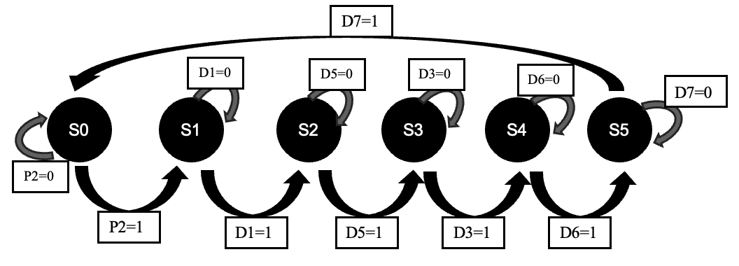
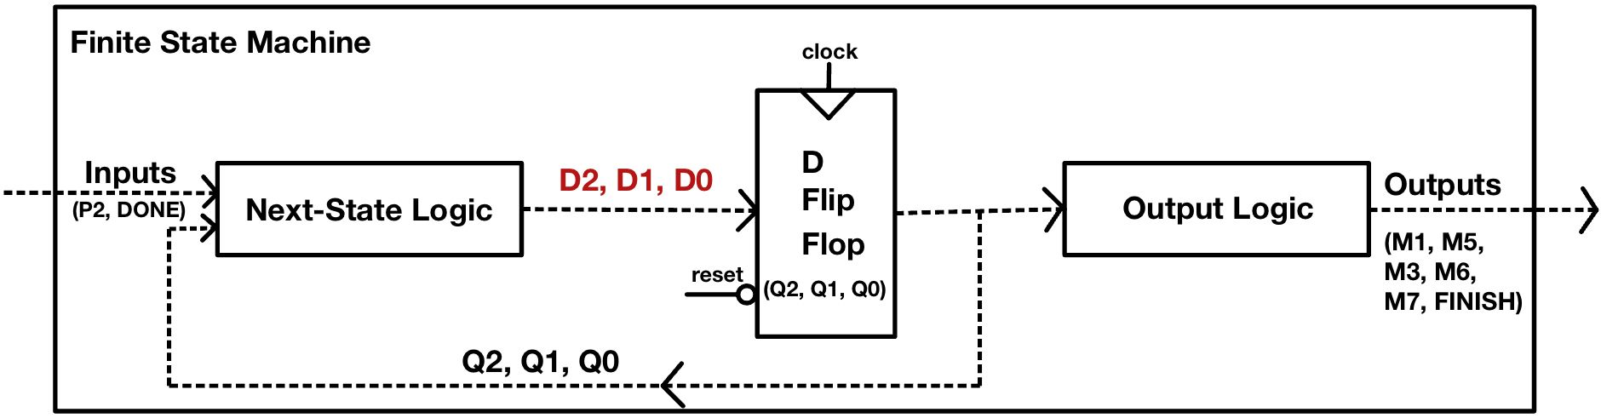
Design & Implementation
State diagram of the Mearly FSM for Product-2
FSM in Block Diagram

Slide 5
Key Points
Six-state Mealy FSM controls the production flow based on DONE signals.
The D₂, D₁ and D₀ next-state equations were minimized using Karnaugh Maps.
D flip-flops store the states, and outputs are generated using decoded state and input logic

Slide 6
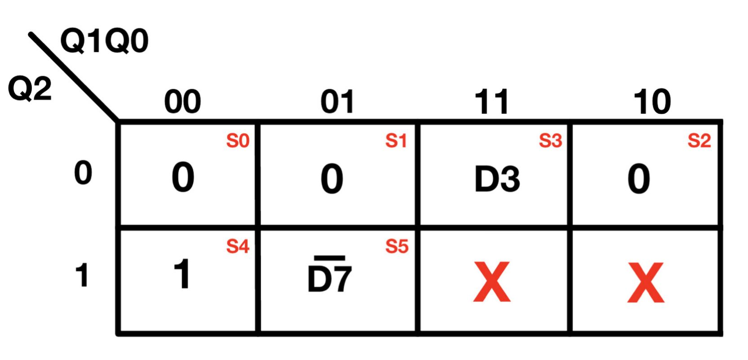
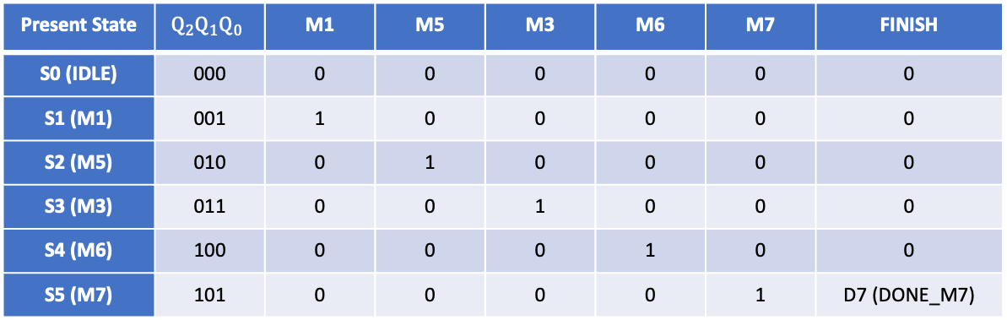
Key Points
Karnaugh Map for D2
Present State | $$Q_{2}Q_{1}Q_{0}$$ | M1 | M5 | M3 | M6 | M7 | FINISH
S0 (IDLE) | 000 | 0 | 0 | 0 | 0 | 0 | 0
S1 (M1) | 001 | 1 | 0 | 0 | 0 | 0 | 0
S2 (M5) | 010 | 0 | 1 | 0 | 0 | 0 | 0
S3 (M3) | 011 | 0 | 0 | 1 | 0 | 0 | 0
S4 (M6) | 100 | 0 | 0 | 0 | 1 | 0 | 0
S5 (M7) | 101 | 0 | 0 | 0 | 0 | 1 | D7 (DONE_M7)
Output Table of the FSM (FINISH=S5.D7)

Slide 7
Main Findings
For the FSM, the production and state transitions are correct.
Output signals are the expected states, showing that control logic is correct.
This unit-to-clock mapping may lead to timing disagreement, but preserves the correct functional behavior.

Slide 8
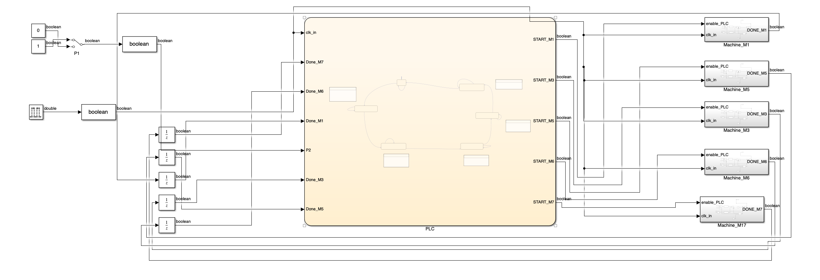
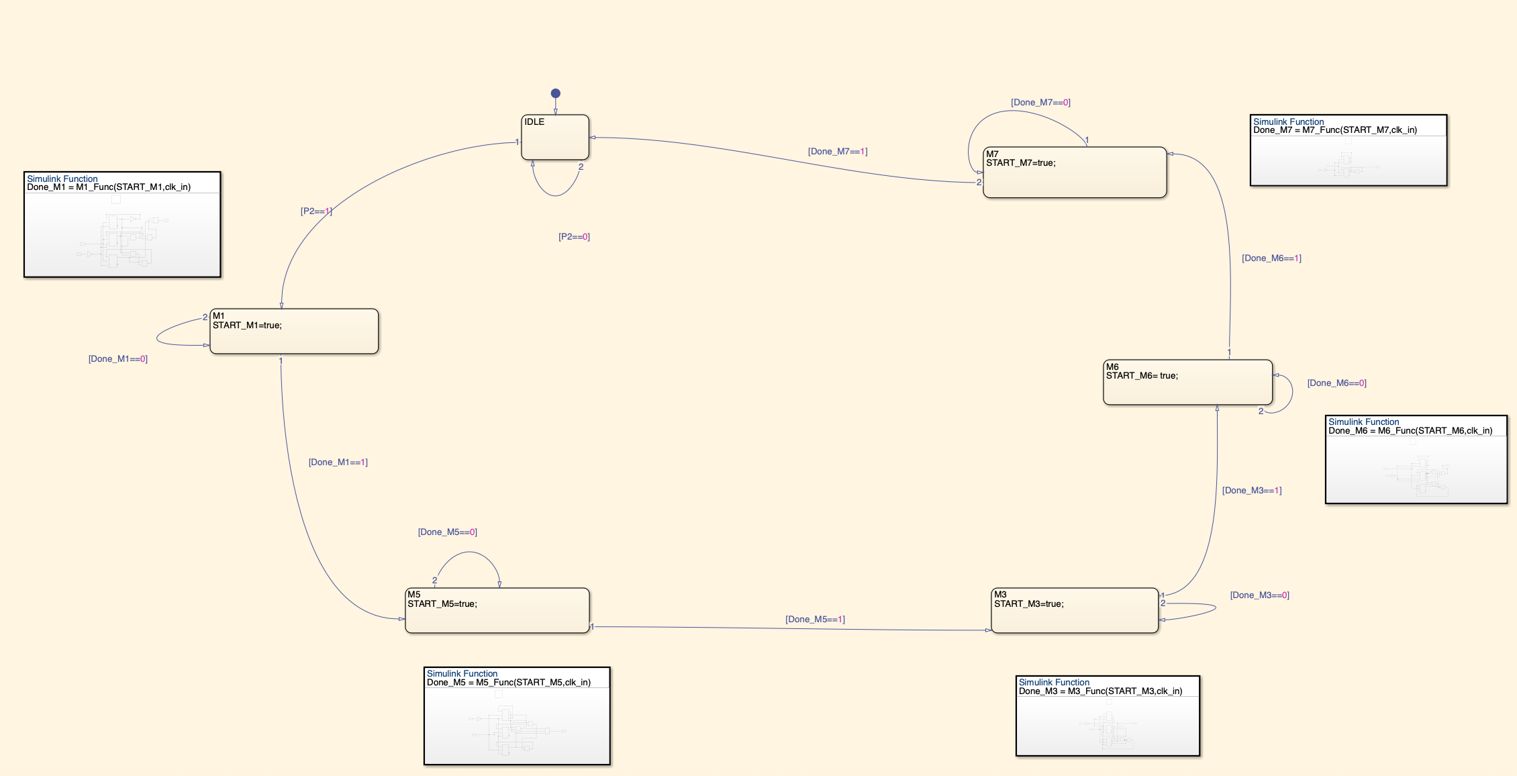
Main Findings
Overall Simulink system implementation
Stateflow FSM for sequential control

Slide 9
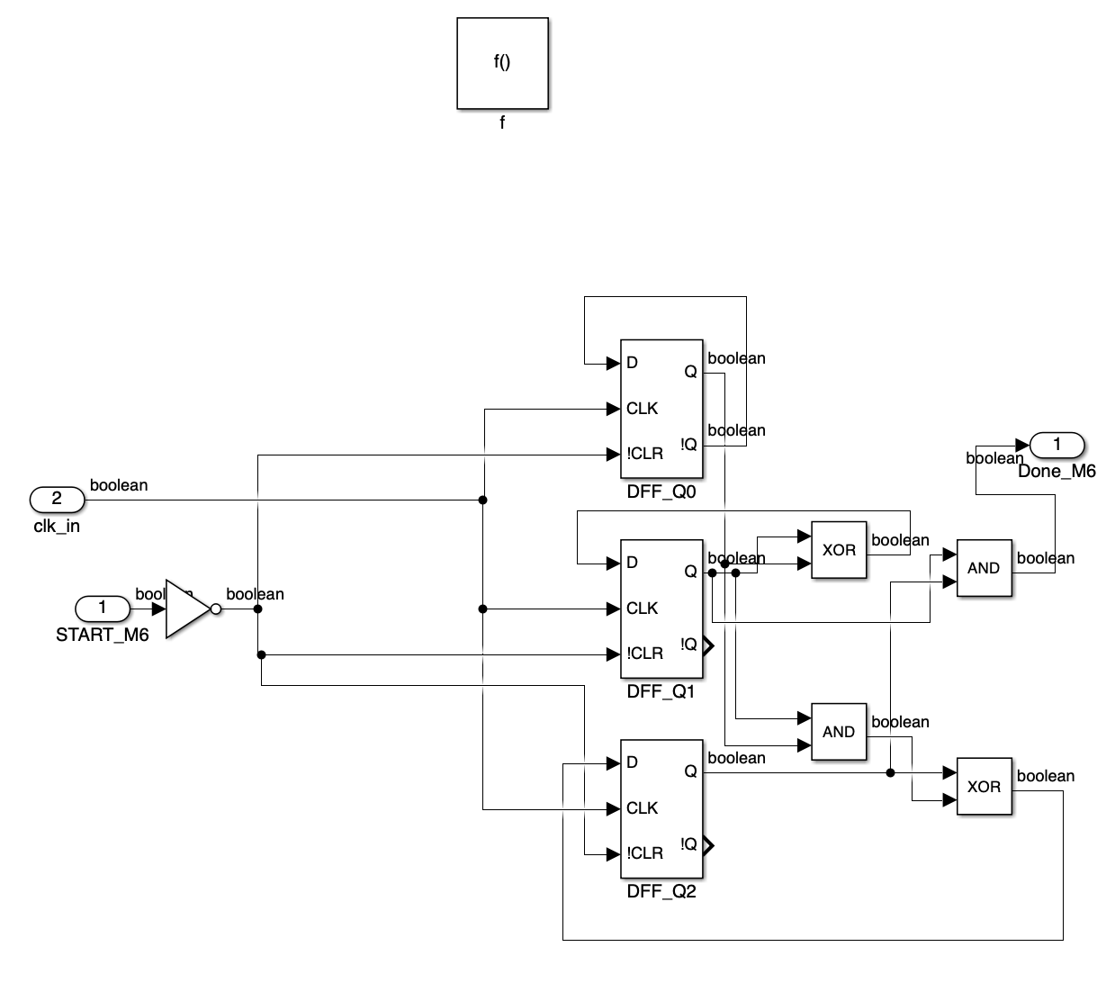
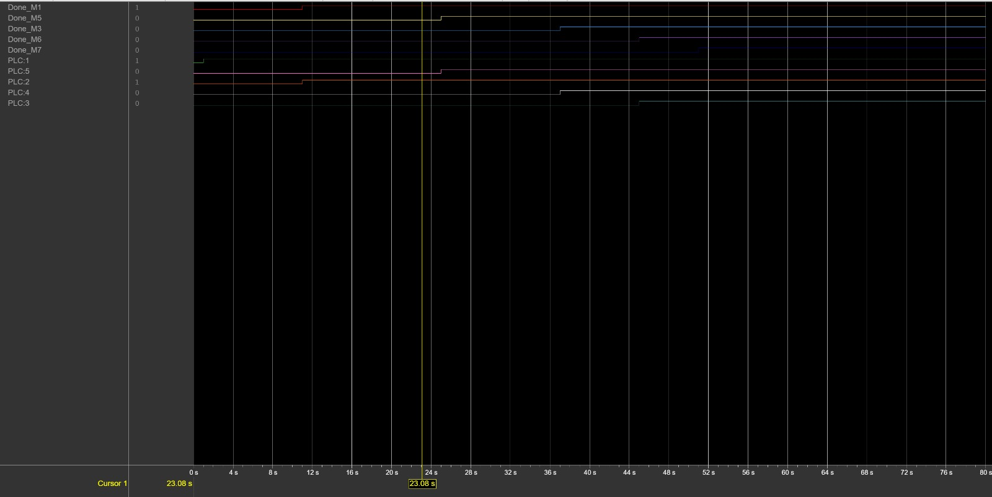
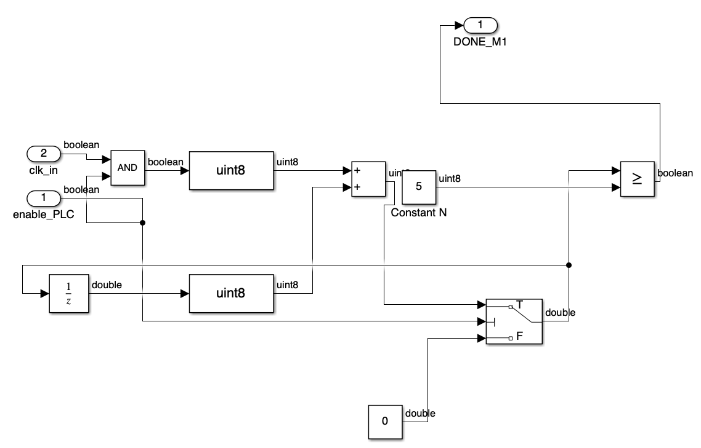
Main Findings
M6 function and state logic implementation
Logic Analyzer - FSM State Transitions
DONE_M1 machine control logic

Slide 10
Conclusion
A complete FSM-based production control system is modeled, verified and simulated in the Simulink environment.
The Mealy FSM structure and minimized logic enabled reliable state transitions.
Modular machine timers are convenient for extending to new products or stages in production.
This design provides a strong foundation for future extensions such as additional machines or performance optimization.

Slide 11
References
[1] Mano, M. Morris, and Michael D. Ciletti. Digital Design. 4th ed., Prentice Hall International, 2007.
[2] Vahid, Frank. Digital Design with RTL Design, VHDL & Verilog. 2nd ed., Wiley, 2011.
[3] Arsan, Taner, and Rifat Çölkesen. Lojik Devre Tasarımı. 4. baskı, Papatya Yayıncılık, 2007.

