Slide 1

a colourful journey through time
sometimes

Slide 2
hsl

Slide 3
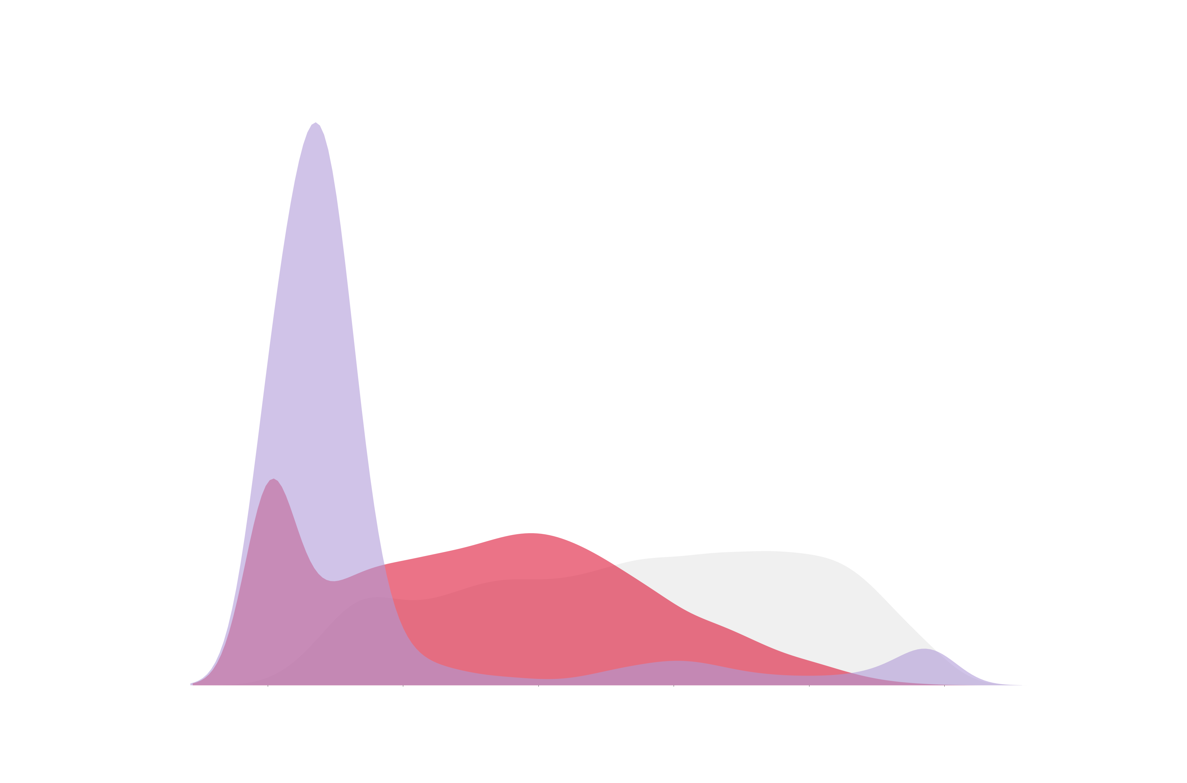
northern renaissance
hue
saturation
lightness
0
100

Slide 4
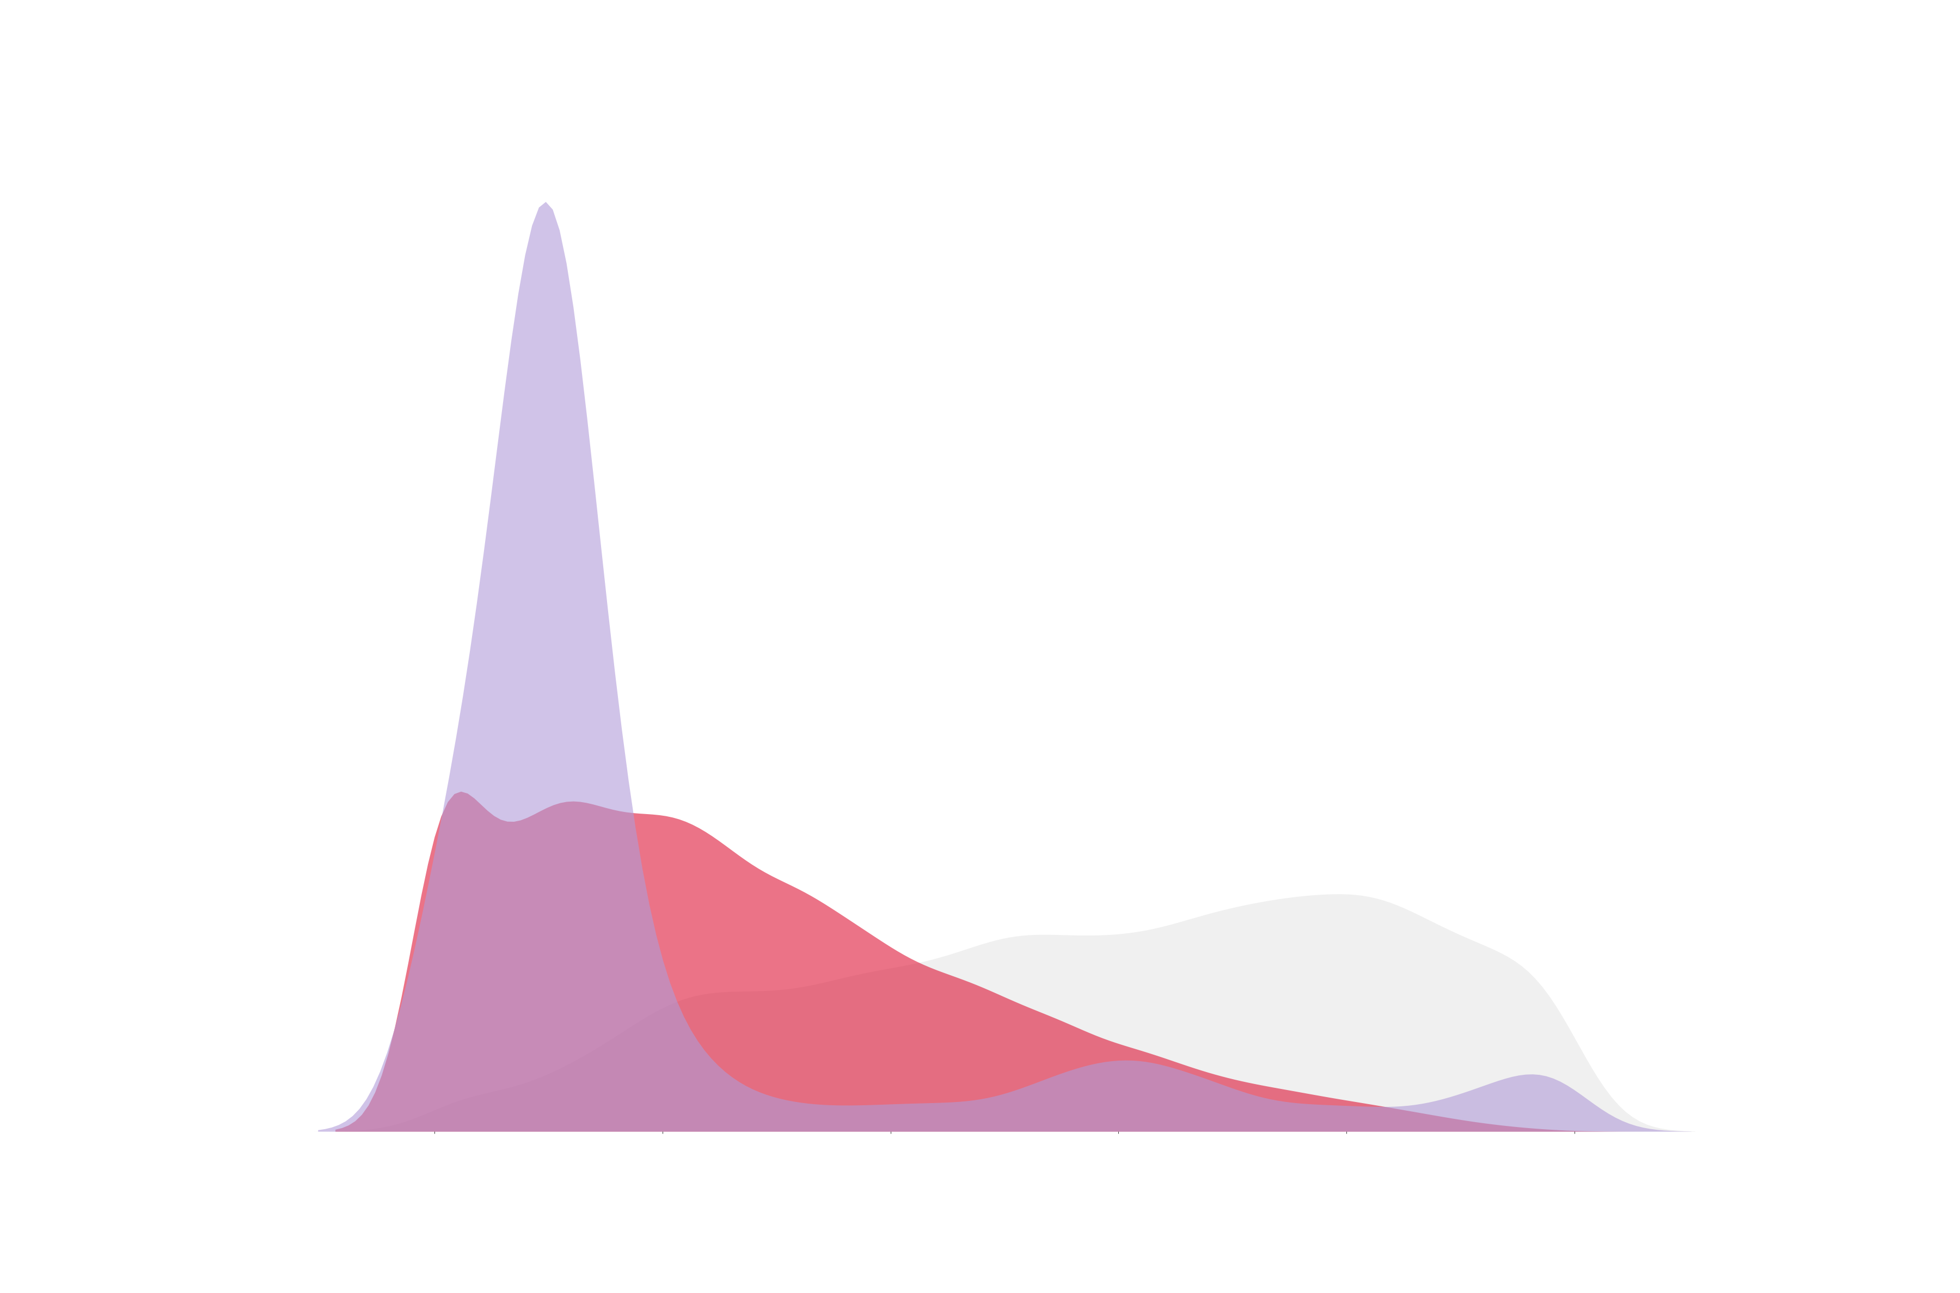
art nouveau
0
100

Slide 5
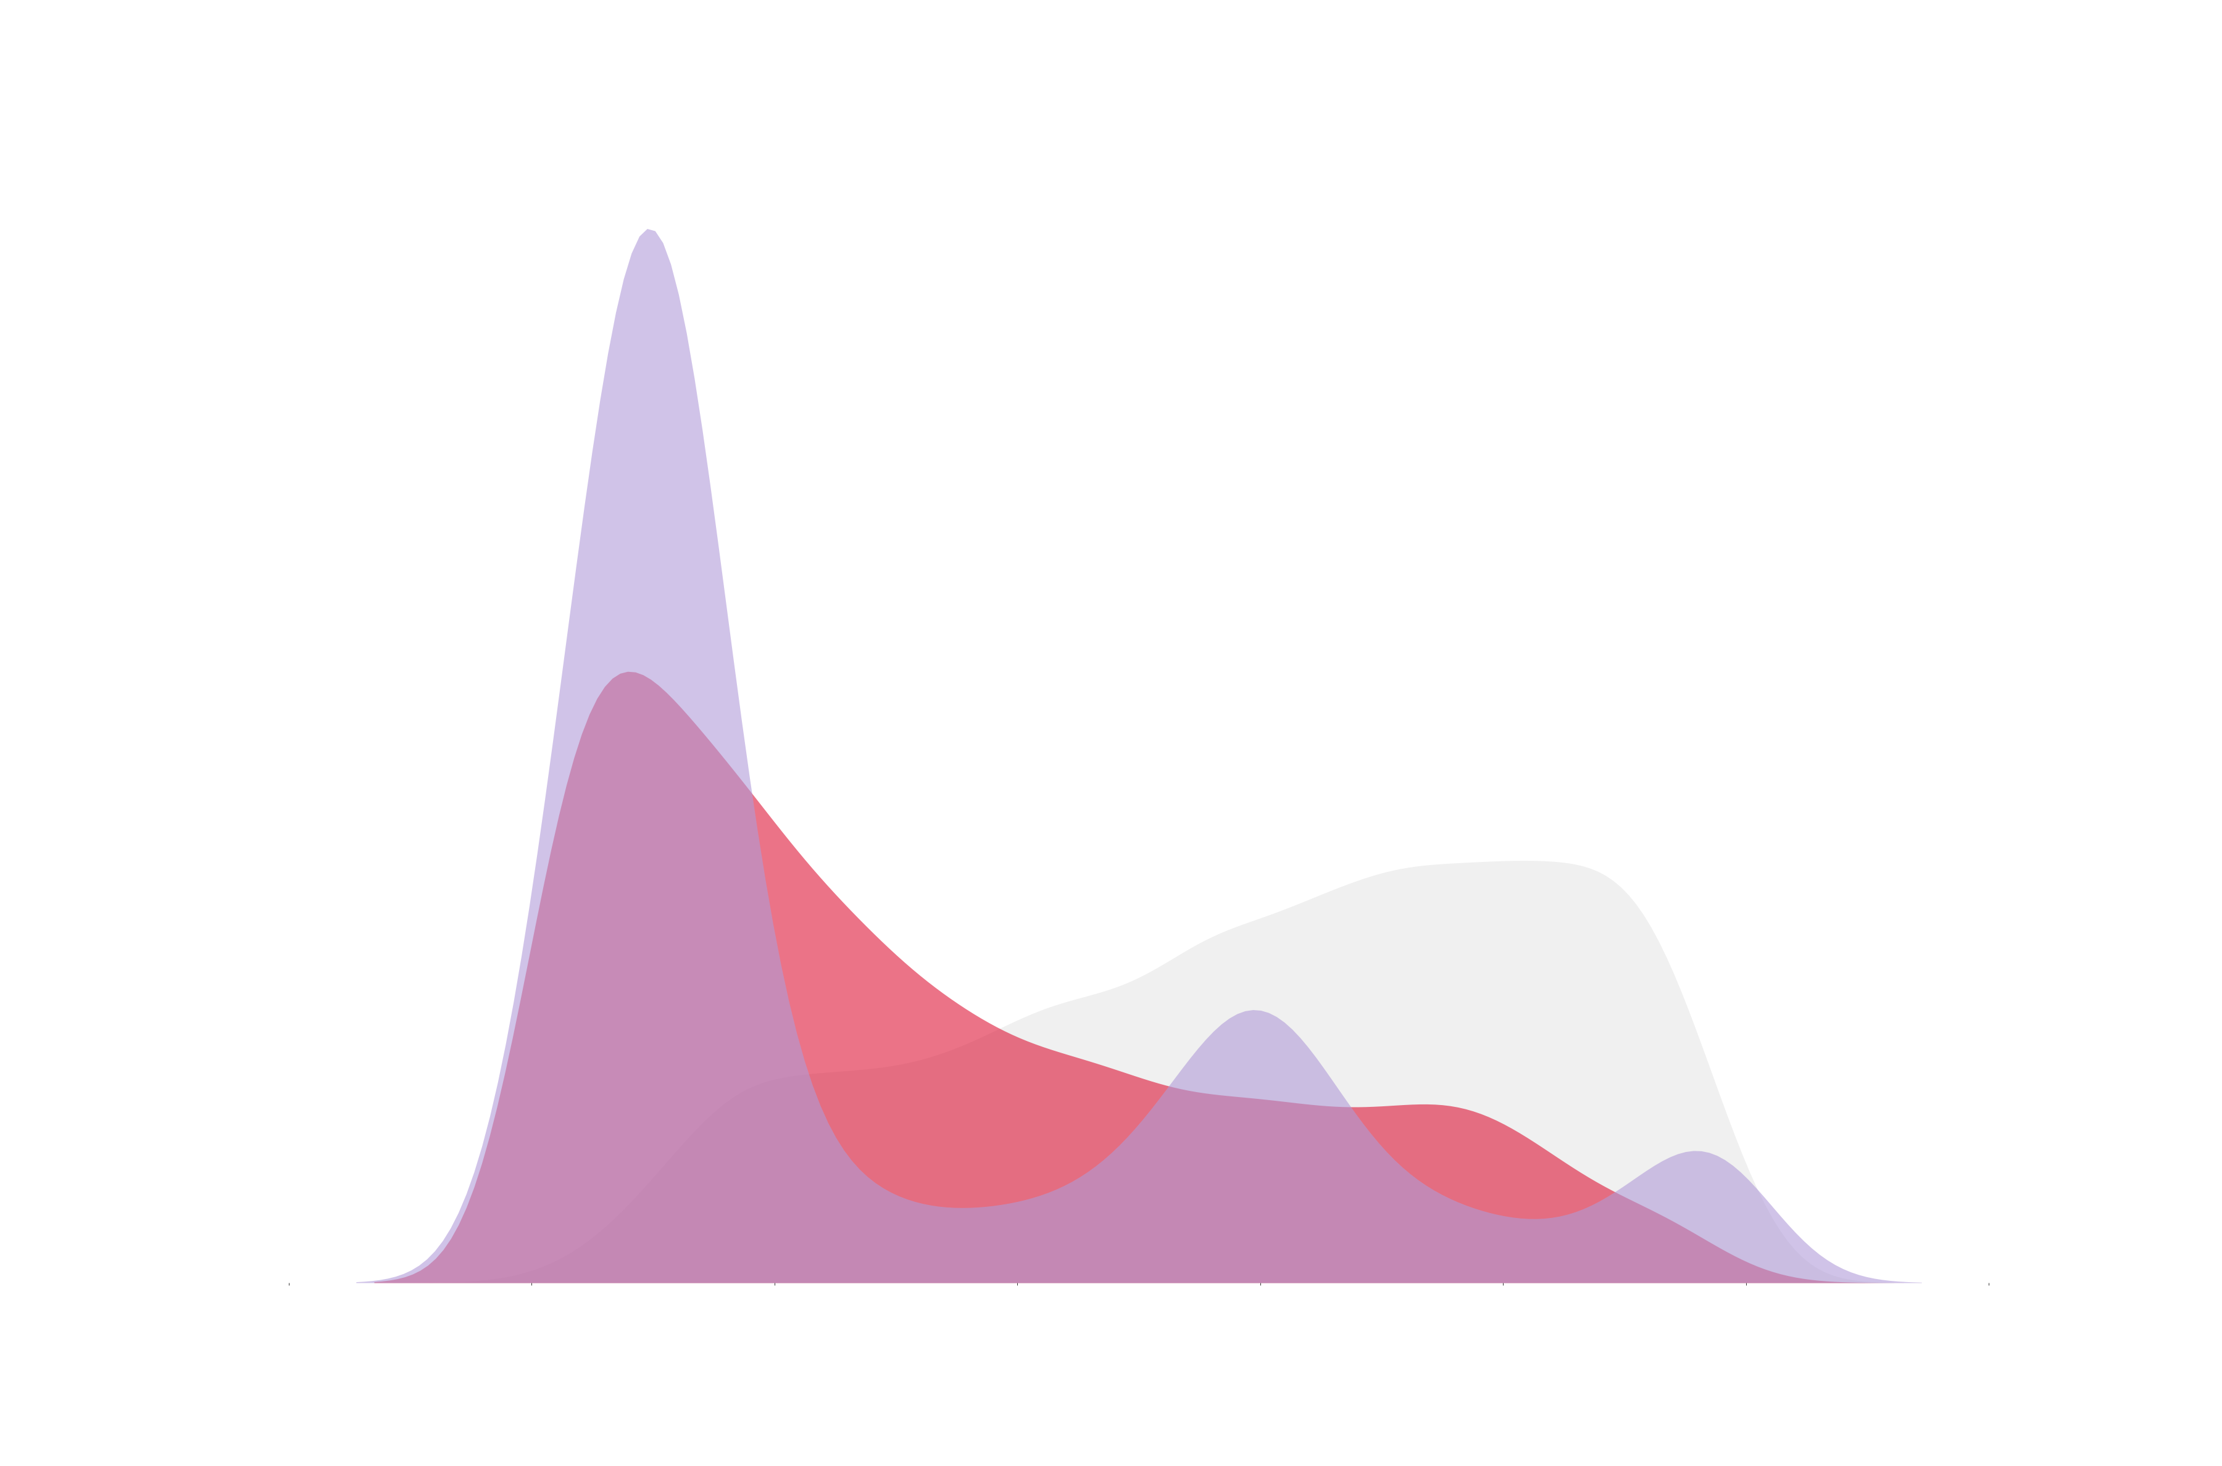
abstract expressionism
0
100

Slide 6
rgb

Slide 7
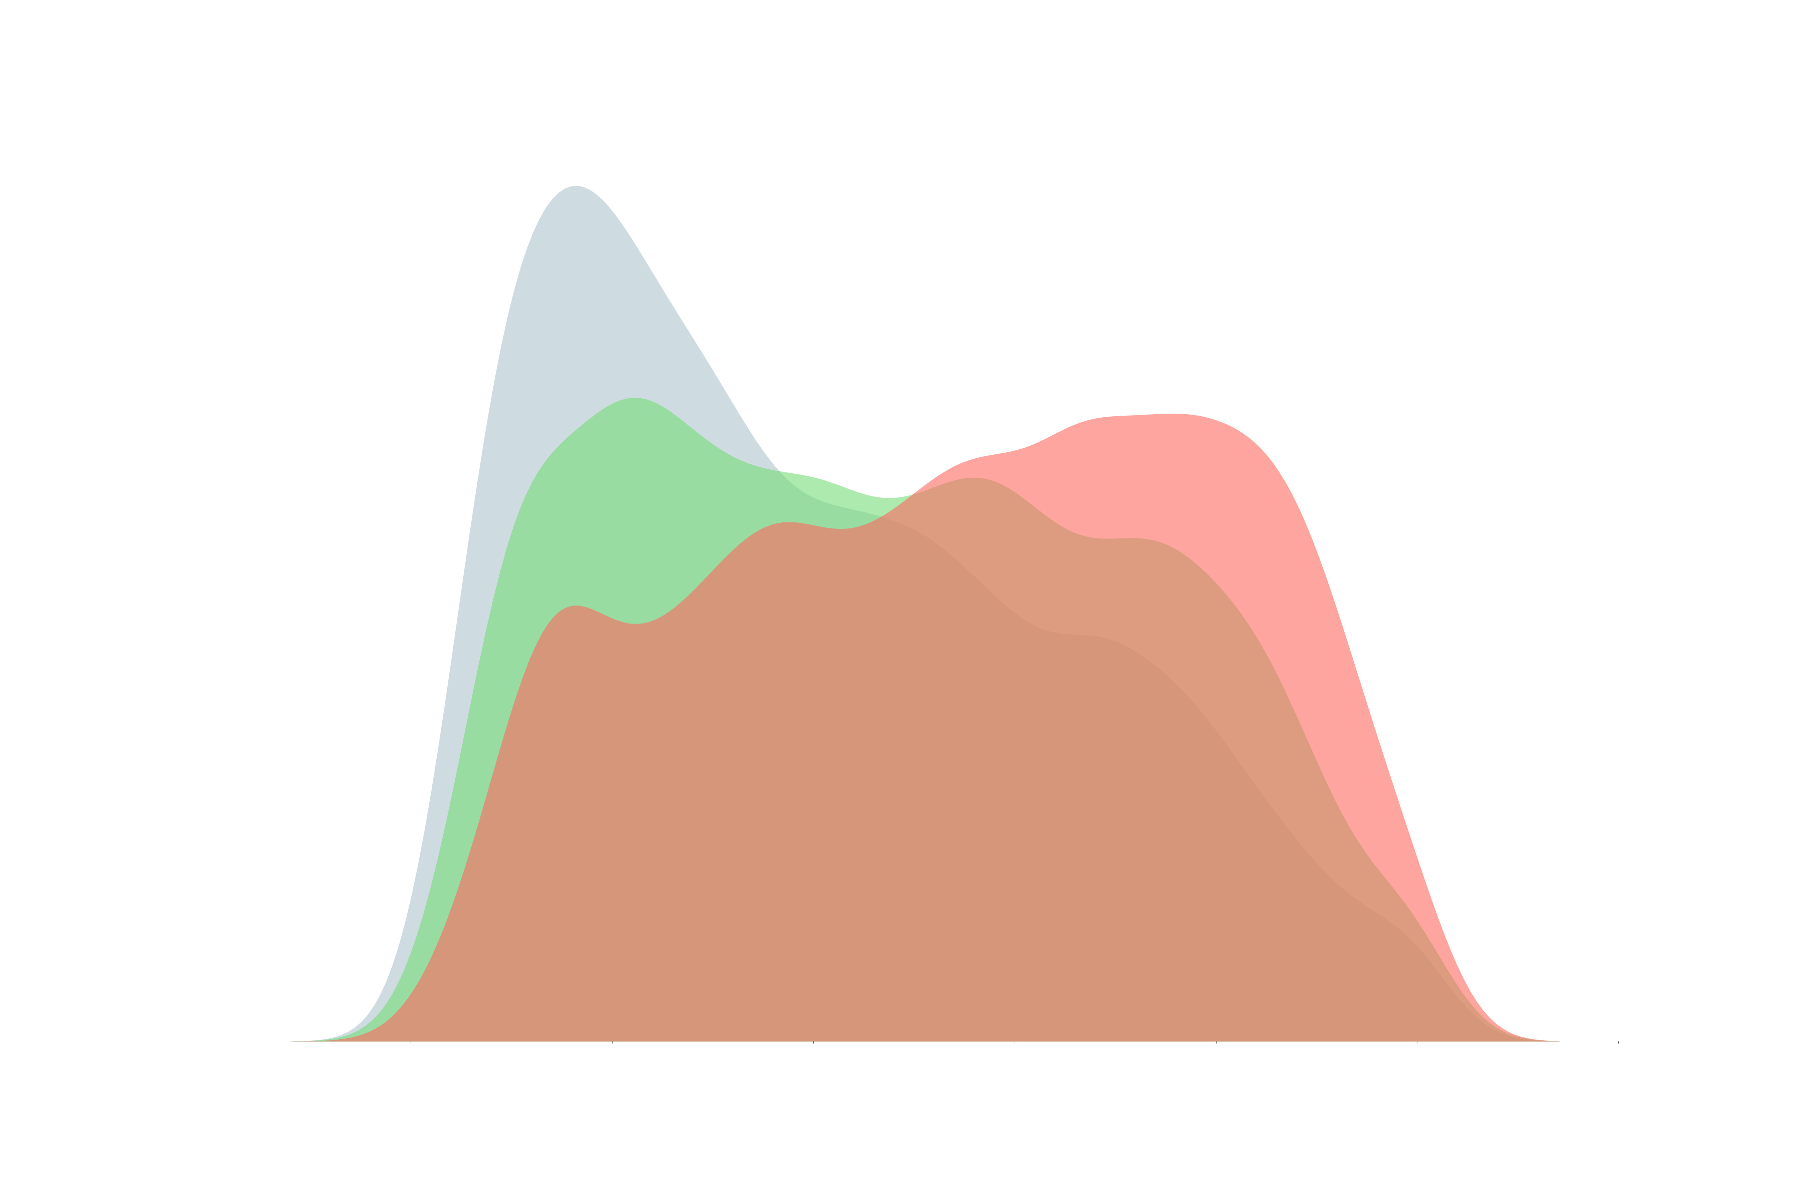
northern renaissance
blue
green
red
dull
vivid

Slide 8
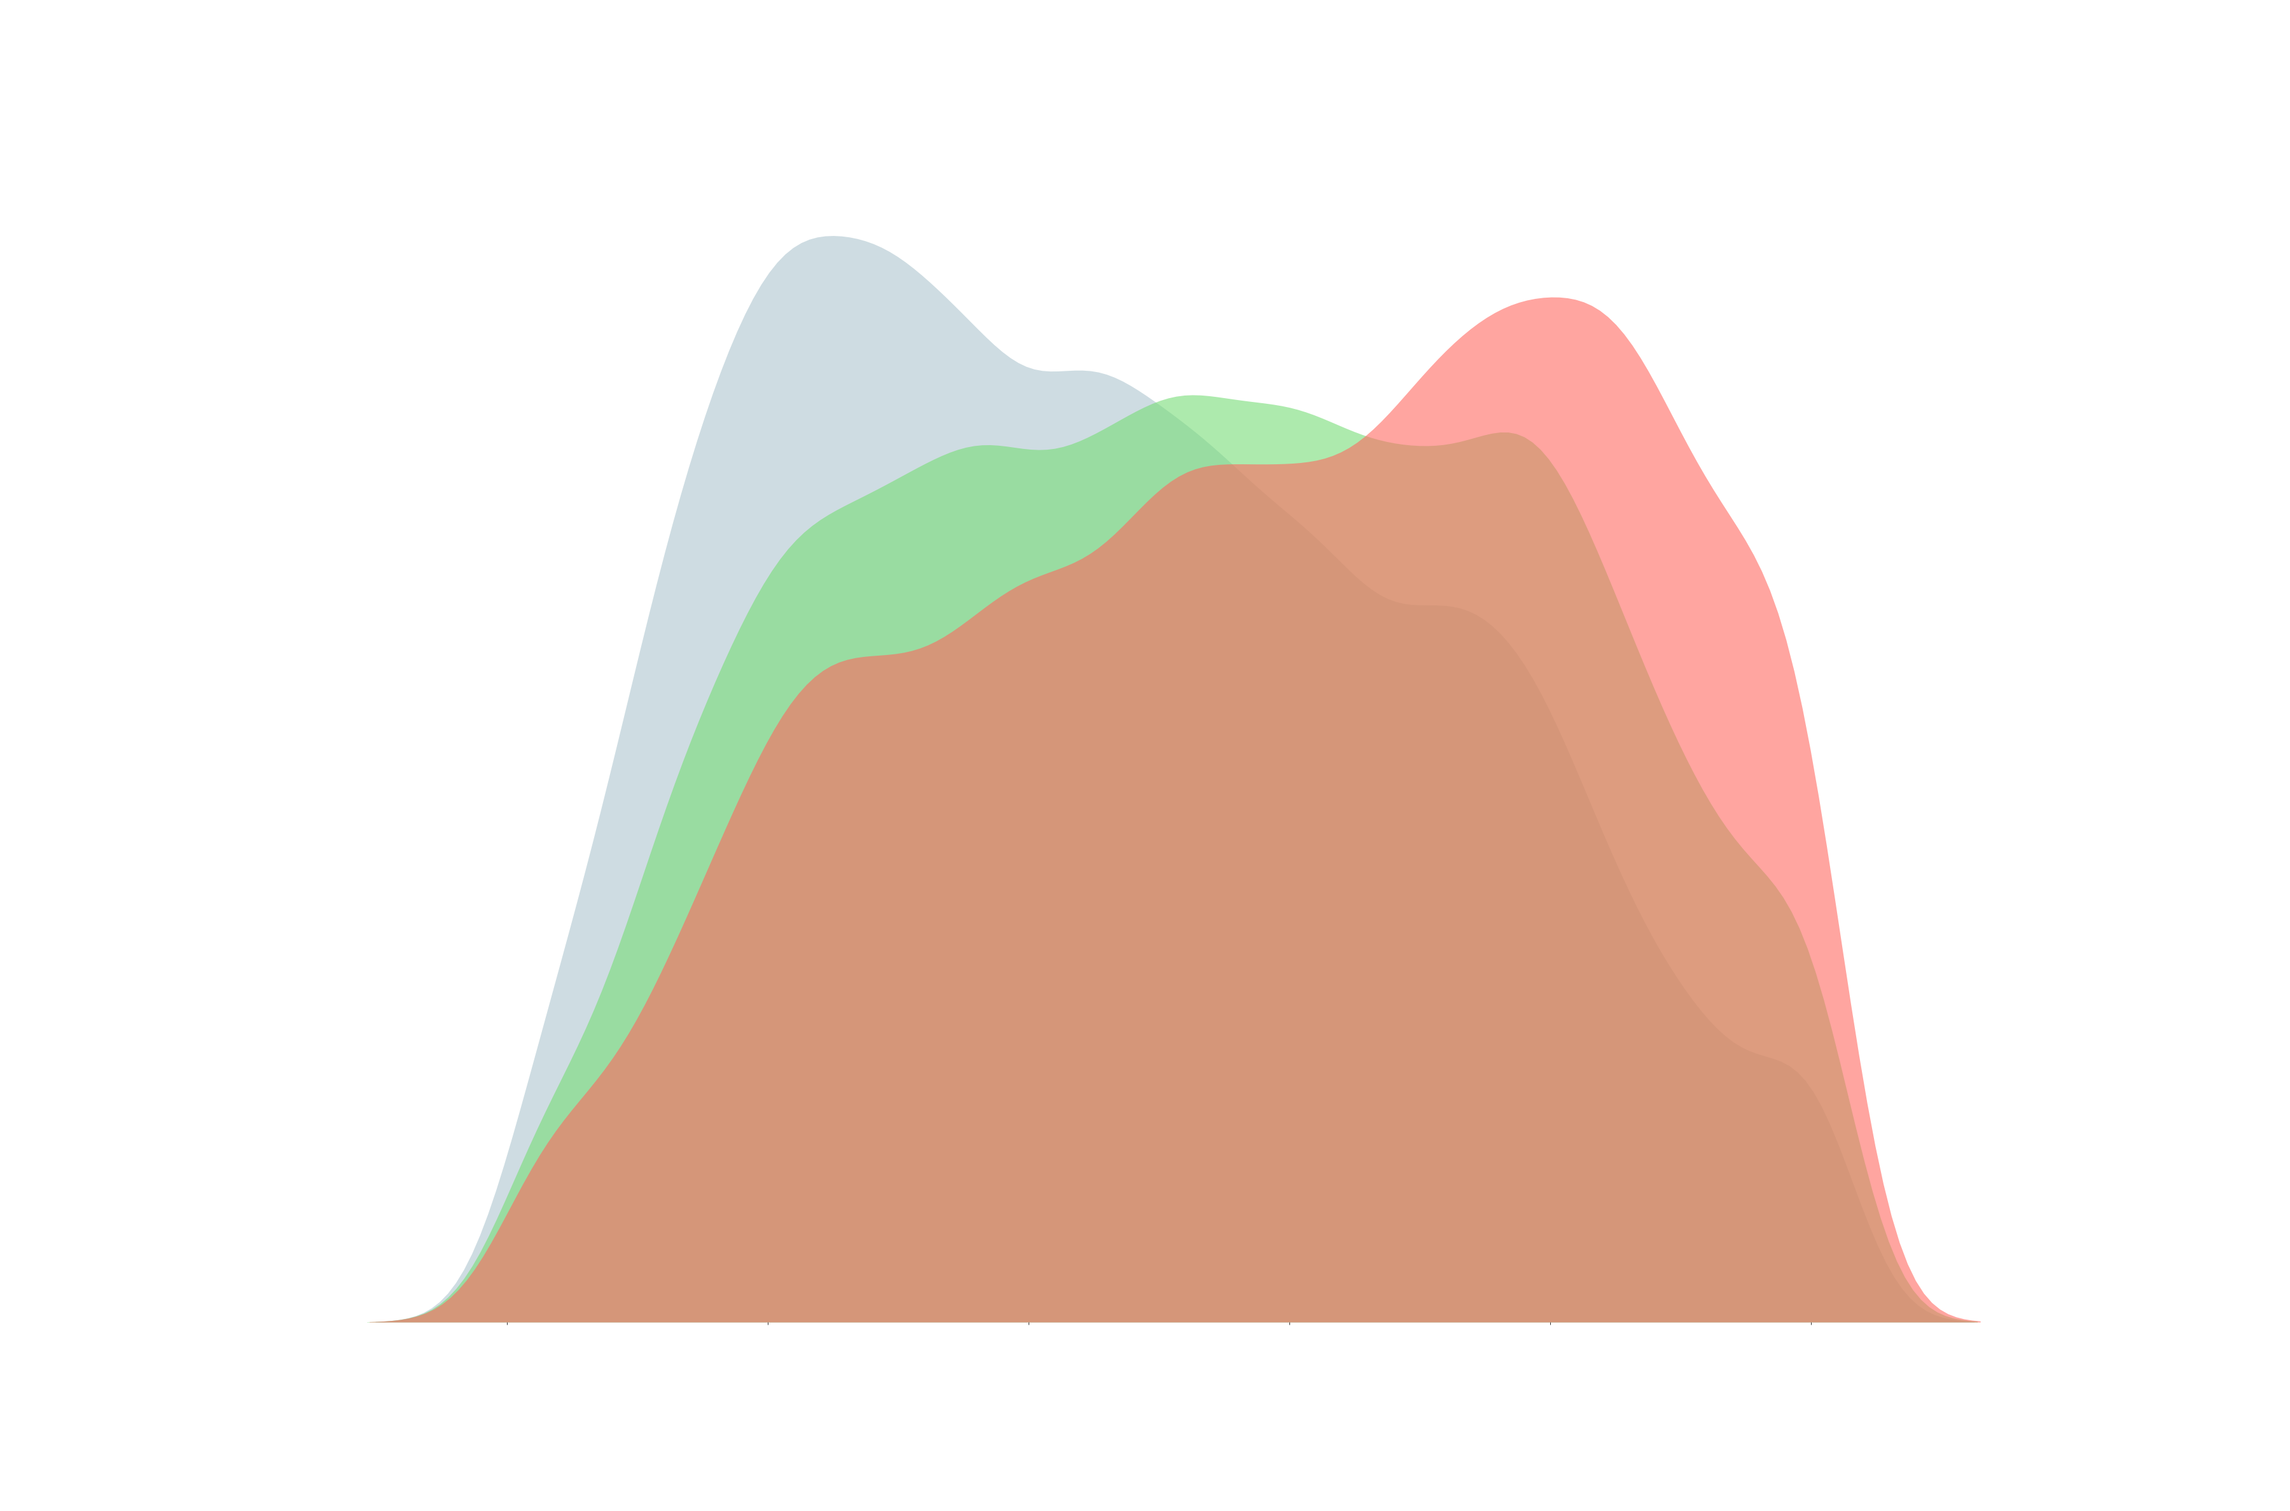
art nouveau
dull
vivid

Slide 9
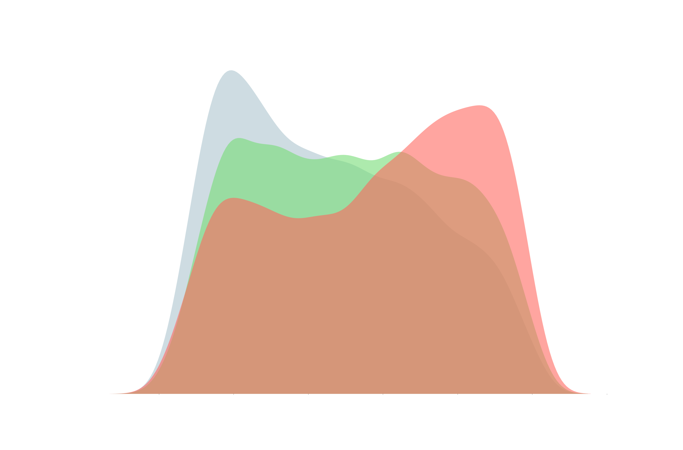
abstract expressionism
dull
vivid

Slide 10
colour in history

Slide 11
the dull red season
we went berserk
we like orange
with a ugly brown
wth?!
Abstract expressionism
realism
symbolism
barroque
post impressionism
cubism
surrealism
neoclassicism
impressionism
expressionism
rococo
Naïve art
northern renaissance
romantism
art nouveau

Slide 12
conclusion
if you have an art supplies store,
stock up on the reds.

Slide 13
predictive app

Slide 14
Scraping
Artists and movements
Kaggle
Image + dataset
the recipe
museum API paintings to
sugest
create unified dataset and validate images
create colour palettes for each image and cluster by pallete
modelling neural network to predict styles of paintings
Knn=40
RESnet50
Prediction based on
previously built model
and a calculated colour pallete
also previously clustered
App deployment

Slide 15
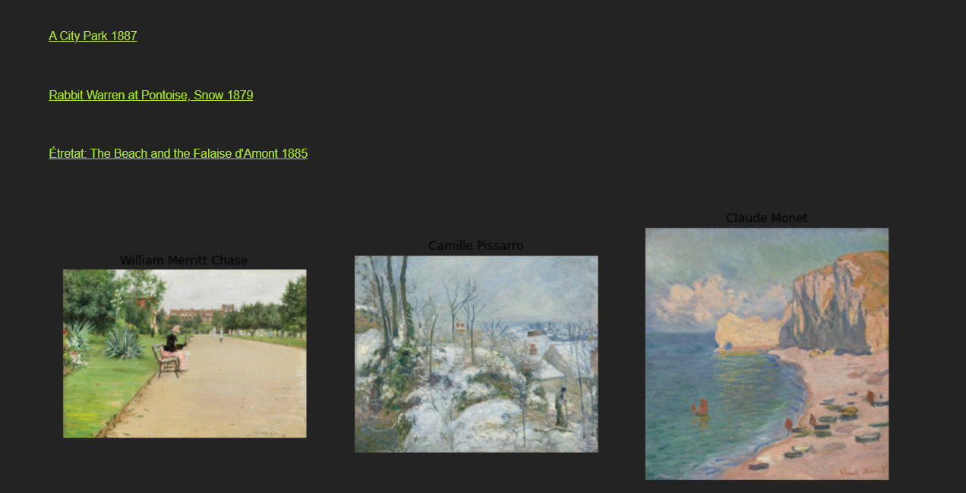
the result
it’s ugly!

Slide 16
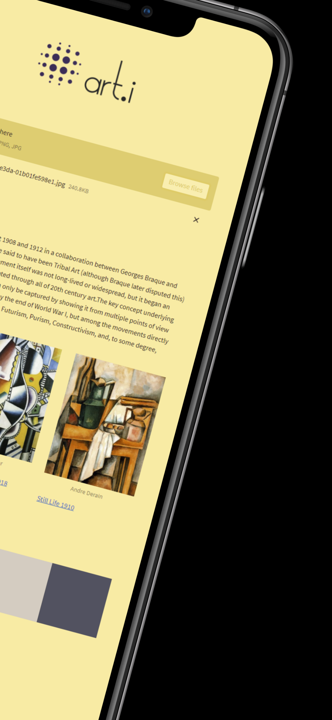

the real result

