Slide 1
Group 101: Software Engineering
Sprint 3

Slide 2
Teams Overall Thoughts

Slide 3
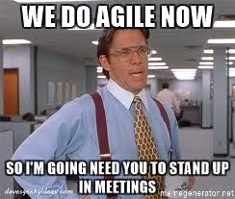
How Did the Sprint Go?
What Went Well
Communication (along with daily text standup)
Stayed on track within the sprint
More team programming!
Areas of Improvement
Documenting incrementally as we go through the sprint

Slide 4
Burndown Charts

Slide 5
Quick note about weights

Slide 6

Simardeep
21
Lead sprint planning, team meetings, follow ups, etc.
Reviewed MR's, resolved merge conflicts, kept the repo organized
Highlight of sprint:

Slide 7
Maneesh
20
Routed all paths using NINGX
Contributed by implementing individual php script
Highlight of sprint:

Slide 8
Sara
26
Designed a Figma design of the UI of the site, and later on implemented it.
Contributed by implementing individual php script
Highlight of sprint:
Being able to implement a figma design in full!

Slide 9
Emily
20
Contributed by implementing individual php script, user stories, and documentation
Highlight of sprint:

Slide 10
Fee Kim
20
Contributed by implementing individual php script, user stories, and documentation
Highlight of sprint:

Slide 11
DEMO

