Slide 1

Group 101: Software Engineering
Maneesh, Sara, Fee Kim, Simardeep, Emily
Sprint 4

Slide 2
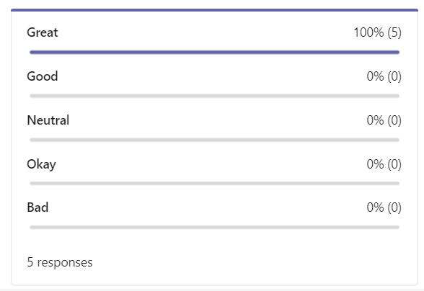

Team’s Overall Thoughts
Overall, feelings on the sprint are really positive!

Slide 3
How Did the Sprint Go?
What Went Well
Communication – great amount of team meetings for progress check-ups and written documentation between the team
Consistency – work was evenly distributed throughout the week, and dependent tasks were completed on time for the others to get started
Task Completion – everyone helped each other complete their tasks and with any unexpected issues that came up due to local envs
Areas of Improvement
More team programming – we like coding individually
More testing – we found bugs late in the sprint

Slide 4
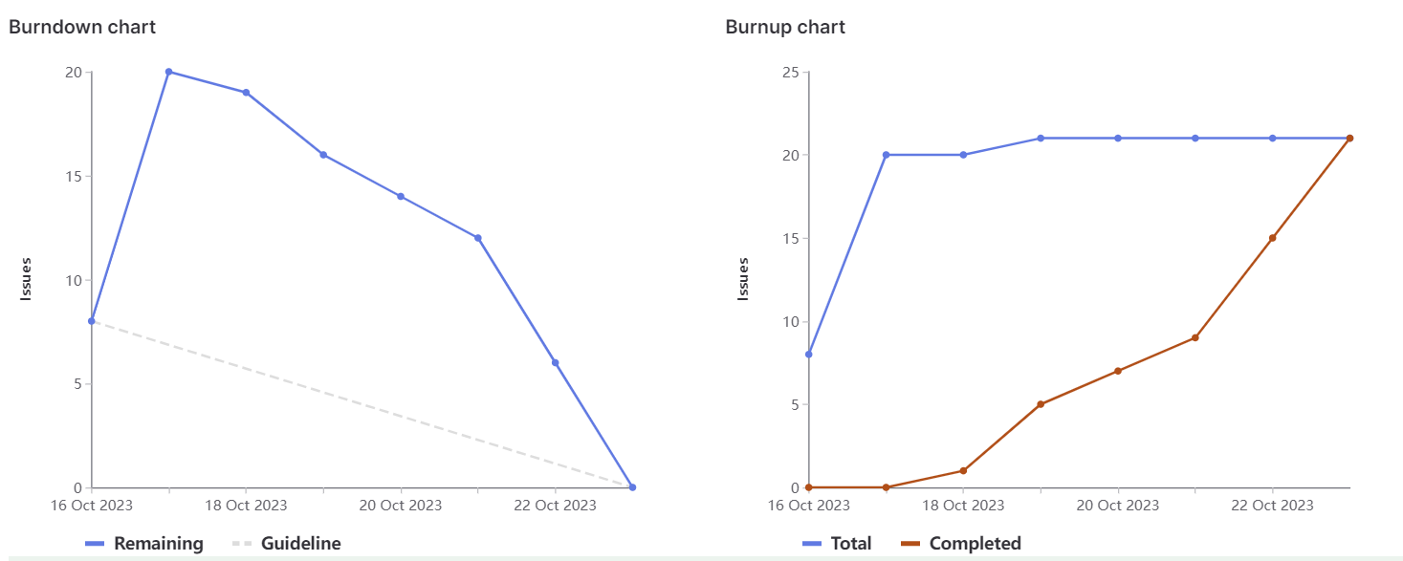
Burndown Charts

Slide 5

Individual Slides Commencing…

Slide 6
Emily → 23 weights
Team lead for the sprint – in charge of sprint planning, team meetings, overseeing issues, etc.
Re-organized repo, participated in documentation and end-user testing
Overall, a lot of management
Highlight of the sprint:
Being a team lead! Loved it

Slide 7
Sara → 26 weights
Took charge over the MySQL portion of the sprint – created both the design and the database
Ensured population and copying of the DB was fully functional
Wrote extensive documentation on set-up and usage
Highlight of the sprint:
Setting up the initial database and learning MySQL!

Slide 8
Maneesh → 30 weights
Did detailed documentation on local environment set-up for development
Established initial database connection PHP script
Worked on both GET and DELETE API calls via PHP
Highlight of the sprint:
Being able to learn about the MySQLi extension built into php and make functioning GET endpoints

Slide 9
Simardeep → 21 weights
Developed the POST API call scripts and tested them
Wrote documentation on how to use the queries in Postman
Participated in user stories, research, and test cases
Highlight of the sprint:
Learning about Restful API and implementing POST endpoint using PHP.

Slide 10
Fee Kim → 21 weights
Worked on establishing the PUT call query scripts
Documentation on how to use the provided URLs via Postman
Helped debug several issues that came up in sprint (and testing)
Highlight of the sprint:
Learning how Restful API works and how to get PUT endpoints working

Slide 11
Demo Time

