Slide 1

World Electricity Analysis
Team Members:
Supriyam Mishra
Simaran Raghuvansh
Jitendra Singh Rao
Meena Vadadoriya
1

Slide 2



Tasks and Objectives
Tasks
Comparison of access to electricity post 2000s in different countries
Find one interesting insight present in the data (across all the tables)
Present a way to compare every country’s performance with respect to world average
A chart to depict the increase in count of country with greater than 75% electricity access in rural areas across different year.
A chart to present the production of electricity across different sources (nuclear, oil, etc.) as a function of time
RAW DATA
Clean and Convert
Tabular Form
DASHB ARD

Slide 3

Understanding the data
JSON DATA
Area
Sources
Access of electricity across the world (countries) throughout different year
JSON Format
Originally taken from World Data Bank
RURAL
NUCLIER
URBAN
OIL
TOTAL
RENEWABLE

Slide 4
Access of Electricity in Different Regions
4

Slide 5
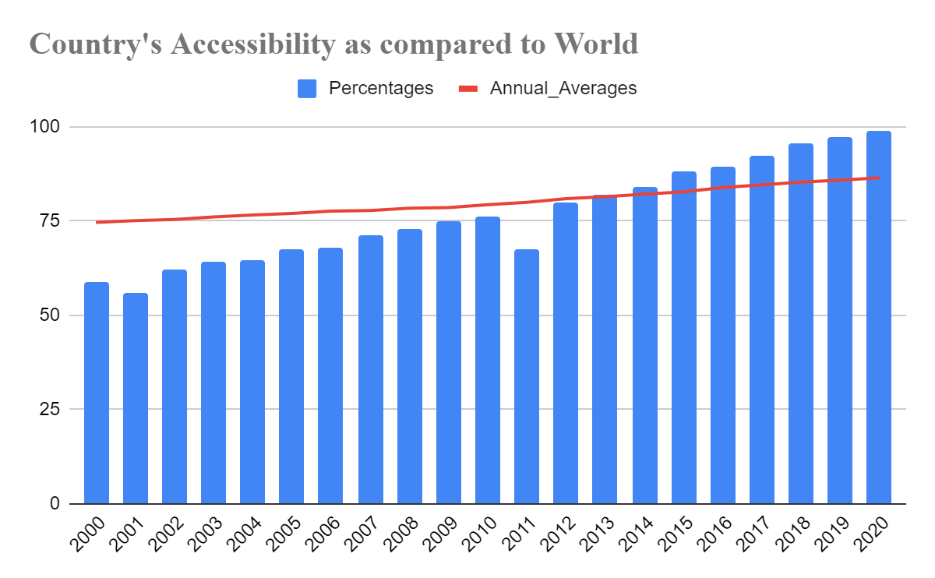

Slide 6
Count of countries (75%+ access)

Slide 7
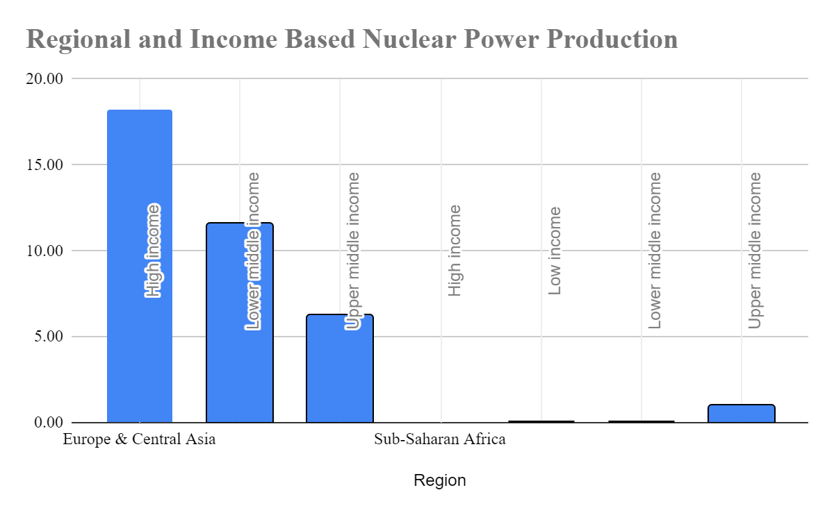
The evolution of nuclear power presence in different Regions and Income Groups shows that the evolution is majorly based in the West and powerful nations and countries with lower economic conditions are trying to catch-up. (The chart is showing comparison between Europe & Central Asia and Sub-Saharan Africa)

Slide 8
Electricity across different sources
The production of electricity across different sources (nuclear, oil, etc.) has changed in a considerably over the period of time, however the move towards the other sources is clearly evident, so as to have a Greener and Affordable Sources

Slide 9
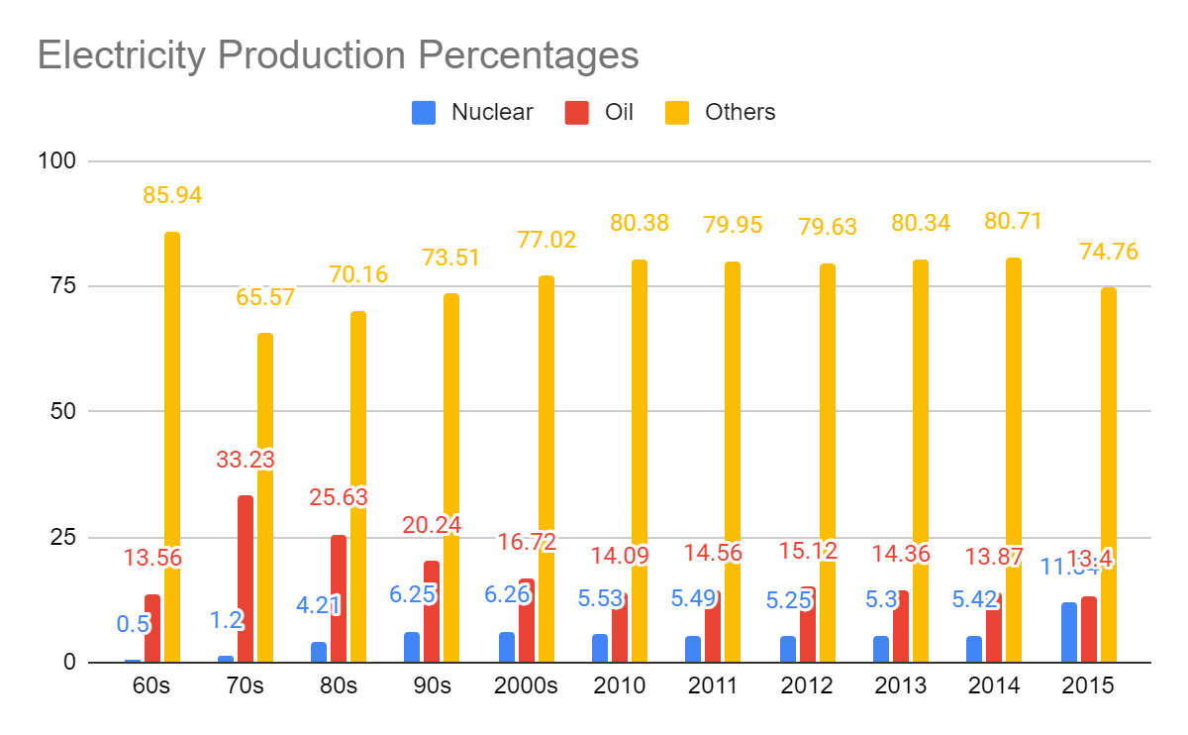
`Takeaway and Insights
The chart shows that there is a drastic rise in Nuclear Power production till 70s then it got stand still.

Slide 10
Why?
1971 Convention: Transportation of Nuclear Goods
In 1971 IMO, in association with the International Atomic Energy Agency (IAEA) and the European Nuclear Energy Agency of the Organization for Economic Co‑operation and Development (OECD), convened a Conference which adopted a Convention to regulate liability in respect of damage arising from the maritime carriage of nuclear substances.
The purpose of this Convention is to resolve difficulties and conflicts which arise from the simultaneous application to nuclear damage of certain maritime conventions dealing with shipowners' liability, as well as other conventions which place liability arising from nuclear incidents on the operators of the nuclear installations from which or to which the material in question was being transported.
The 1971 Convention provides that a person otherwise liable for damage caused in a nuclear incident shall be exonerated for liability if the operator of the nuclear installation is also liable for such damage by virtue of the Paris Convention of 29 July 1960 on Third Party Liability in the Field of Nuclear Energy; or the Vienna Convention of 21 May 1963 on Civil Liability for Nuclear Damage; or national law which is similar in the scope of protection given to the persons who suffer damage.
Source: IMO Website, Centre for International Law

Slide 11
Conclusion
North America And Europe have the highest average electrification in both rural and urban areas as they are among highly developed regions in the world.
Regions belonging to lower and lower middle income have comparatively lower electrification along with considerable difference of distribution between rural and urban areas.
There is gradual increase in number of developing countries accomplishing minimum 75% electrification over the last two decades.
Developed regions have increased their electricity production through nuclear sources whereas some developing regions have gradually started increasing their foothold in nuclear power generation while some regions have been unable to do so.
Transmission loss has been highest among the countries having poor economy, political instability , infrastructure issues and outdated technologies.
Countries having emphasis on tourism , geographical & demographic constraint have seen highest growth rate of electrification in the last two decades.
Higher income region have been in forefront of increasing renewable energy production along with nuclear sources whereas middle and lower middle countries are in gradual process.

Slide 12





Tools and Technology
Excel
Python
Pandas
Numpy
SQL

Slide 13
Challenges?
Handling the Data
Finding Interesting Insights
Timings

Slide 14
How did we overcome?
We learnt the YouTube, Sites and resources given by Masai.
Discussion with the team members.
Task division and regular team meeting.

Slide 15
Thank you

