Slide 1

Online Purchase Risk Prediction
Machine Learning Classification Project

Slide 2
The Problem
• Predict high-risk (default) vs low-risk orders
• Financial loss if high-risk orders are accepted
• Revenue loss if good customers are rejected

Slide 3
The Goal
• Build a classification model
• Focus on detecting high-risk orders
• Target: F1-score = 70% for high-risk class

Slide 4
Dataset Overview
• 30,000 orders, 44 features
• Highly imbalanced dataset
• Only ~5.8% high-risk cases

Slide 5
Key Challenge
• Severe class imbalance
• Weak feature correlations
• Difficult to separate classes

Slide 6
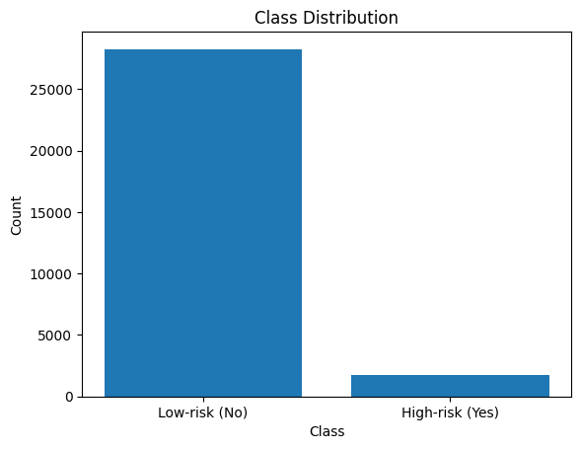
Dataset Insight: Class Imbalance
Dataset heavily skewed toward low-risk (~94%)

Slide 7
Approach Overview
• Logistic Regression model
• Data preprocessing + feature engineering
• Class imbalance handling
• Threshold tuning

Slide 8
Data Preprocessing
• Dropped irrelevant/high-missing columns
• Binary encoding (yes/no → 1/0)
• One-hot encoding for categorical data
• Median imputation for missing values

Slide 9
Feature Engineering
• Converted birthdate → age
• Created recency features
• Time converted to hour
• Added prior-order indicators

Slide 10
Key Decisions
• Used class_weight = 'balanced'
• Standardized features
• Stratified train-test split (80/20)
• Focused on F1-score (not accuracy)

Slide 11
Threshold Tuning
• Default threshold = 0.5
• Optimal threshold = 0.68
• Improved F1-score from 0.19 → 0.28

Slide 12
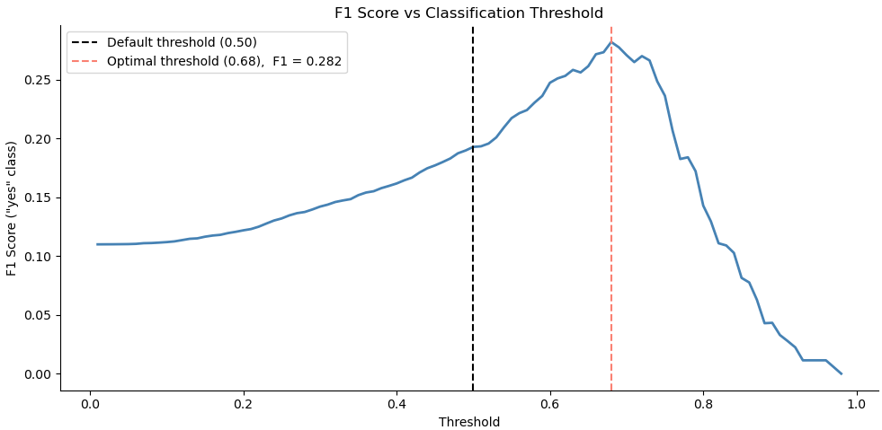
Key Insight: Threshold Optimization
Optimal threshold (~0.68) improves F1-score

Slide 13
Results (Key Metrics)
• F1-score (high-risk): 0.28
• Accuracy: 88% (misleading)
• AUC: 0.74 (moderate performance)

Slide 14
What Results Mean
• Model detects some high-risk orders
• Many false positives (low precision)
• Misses many true high-risk cases

Slide 15
Trade-offs
• Increasing F1 reduced recall
• More missed high-risk orders
• Business may prefer higher recall

Slide 16
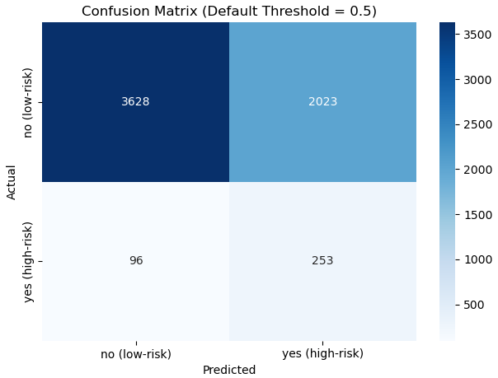
Model Outcomes: Confusion Matrix
Trade-off between detecting risk and false alarms

Slide 17
Why Target Was Not Met
• Weak predictive features
• Logistic regression is linear
• Severe class imbalance

Slide 18
Conclusion
• Model shows moderate performance
• F1 target (70%) not achieved
• More advanced models or features needed

