Slide 1
Size Distribution Analysis Over Geological Time

Slide 2
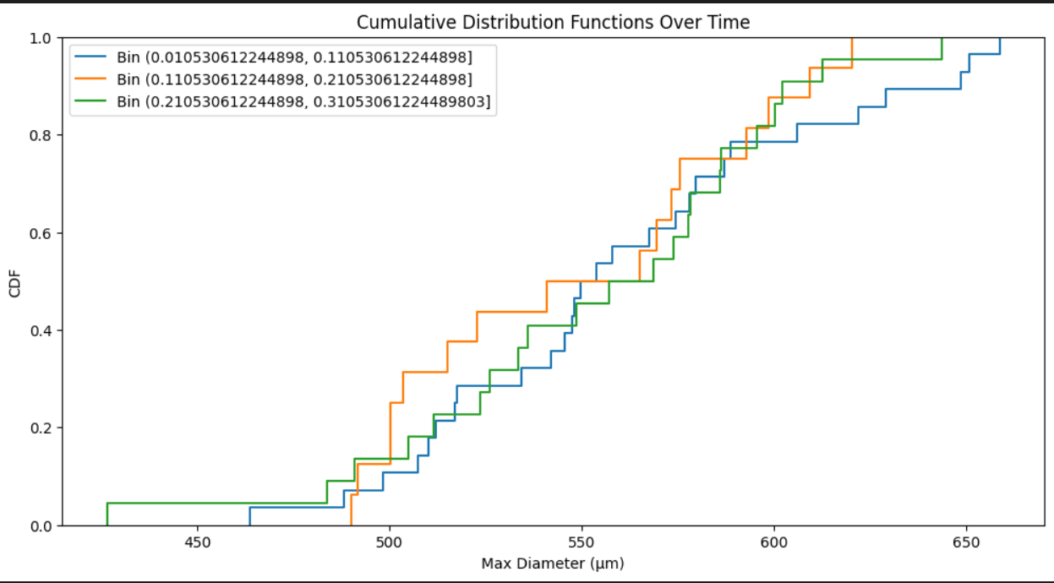

Slide 3
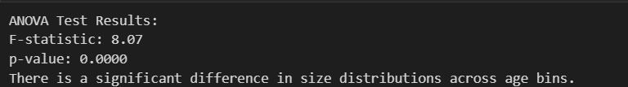
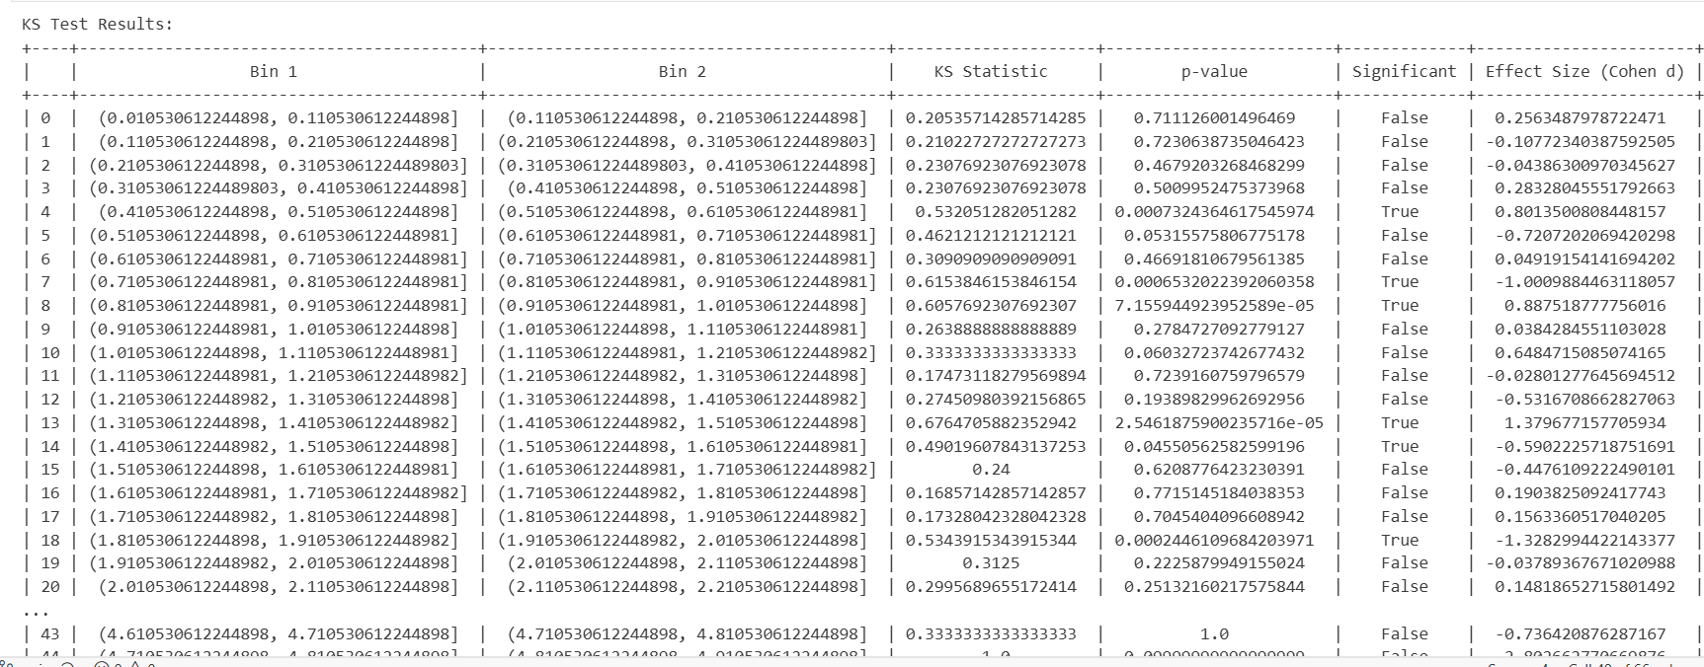
ANOVA Test Results:
KS Test Results:

Slide 4
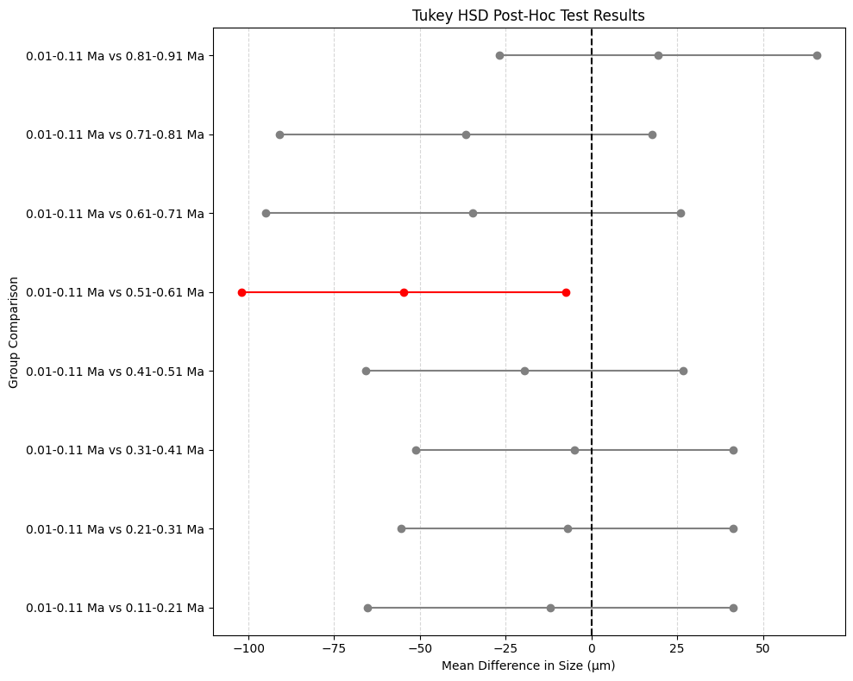
Tukey's HSD Post-Hoc Test Results:

