Slide 1
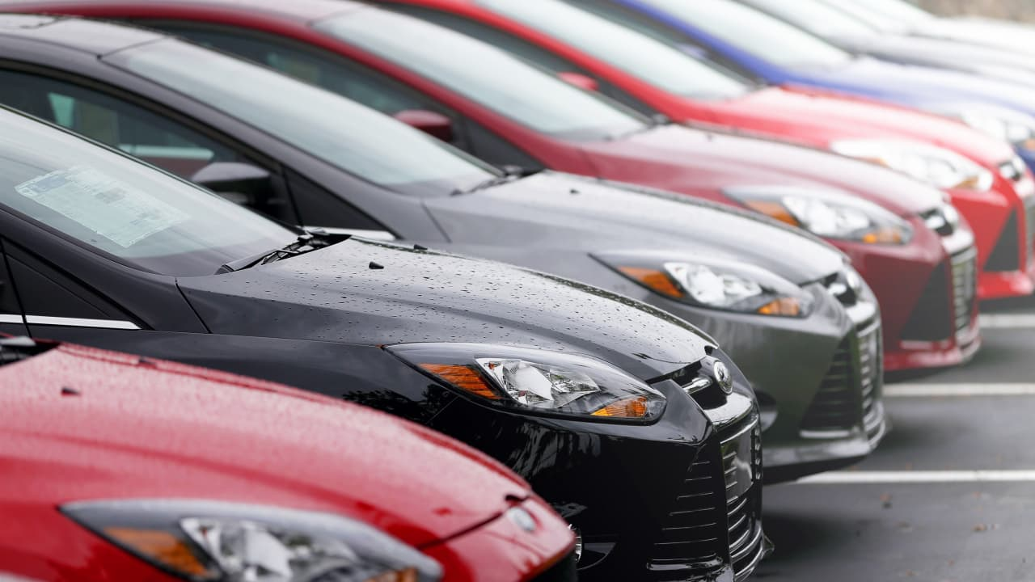
Predicting Used Car Selling Price Using Machine Learning
Video link: https://drive.google.com/file/d/1BgkhBNn9cRM9O4CyWliKWmrhAp6DF3_W/view?usp=drive_link
GitHub link: https://github.com/Simba-gwu/Machine_learning_project
Team members:
Simba Mpofu
Heng Jui Chu
Simbanegavi Simbarashe

Slide 2

Project Overview
Goal
Build a machine learning model that predicts the selling price of a used car from vehicle characteristics and listing information.
Inputs
Modeling
Output
Year
Mileage
Manufacturer
Model
Fuel / transmission
Condition
Feature prep
Encoding
Scaling
Model comparison
Hyperparameter tuning
Predicted
car price
Business relevance: helps buyers, sellers, and dealerships estimate fair prices.
Prediction target: selling price of used cars.
Approach: clean the data, engineer useful features, compare multiple regression models, and select the best performer.

Slide 3
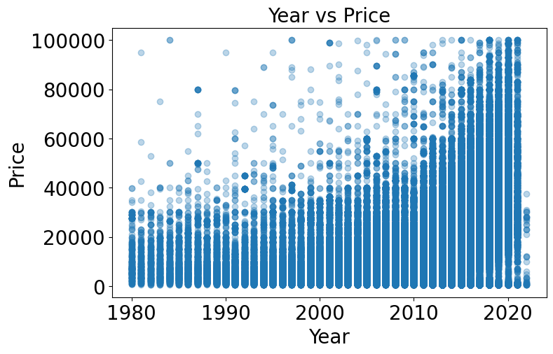
Dataset and Key Variables
Representative fields
Why this is a good ML problem
year
odometer
manufacturer
model
fuel
transmission
cylinders
condition
title_status
drive
Price is continuous, so regression models are appropriate.
The dataset combines numeric and categorical variables, making preprocessing important.
Vehicle age, mileage, and brand effects are expected to drive strong patterns.
The problem has clear real-world value and measurable performance metrics.
Target variable
Selling price

Slide 4
Data Preprocessing Pipeline
1. Clean
Remove obvious outliers and unwanted columns
Why preprocessing mattered
2. Split
Create train, validation, and test sets
Used-car listings are noisy and often contain missing or inconsistent values.
Categorical fields such as model and manufacturer must be encoded before model training.
Feature engineering improves the model’s ability to capture depreciation patterns.
A separate test set protects against overly optimistic results.
Identify uncommon categories and remove weak features
3. Reduce noise
4. Encode
Convert categorical variables into model-ready features
5.Feature Engineer
Create useful variables such as car_age
6. Scale
Standardize features where needed for training
Outcome: a cleaner and more informative feature matrix for model comparison

Slide 5
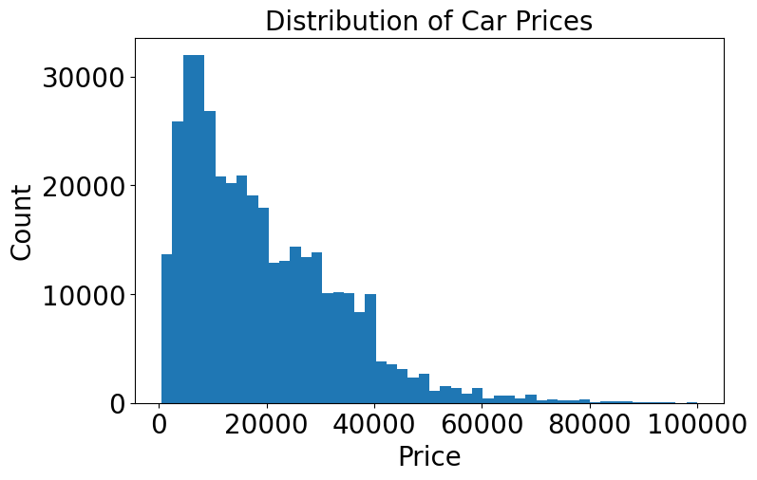
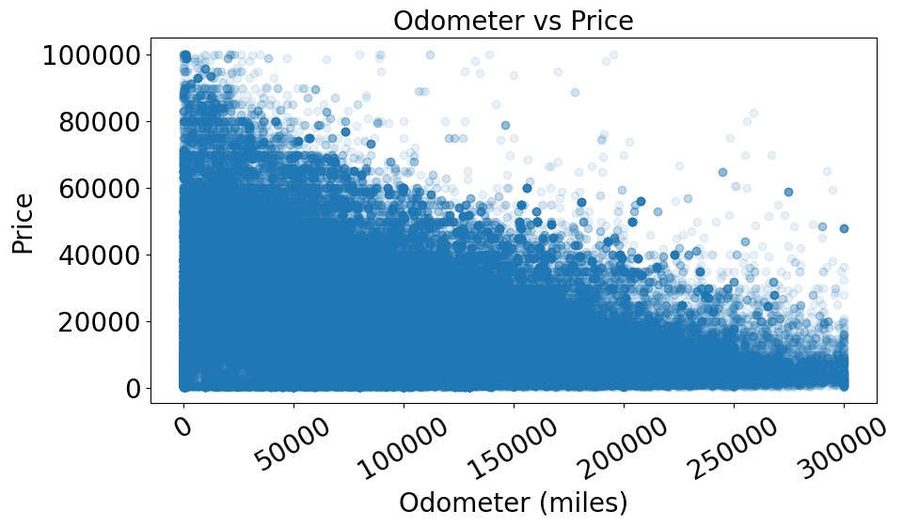
Exploratory Data Analysis
Price distribution is right-skewed: many cars are lower-priced, with fewer very expensive listings.
Year vs price shows that newer cars generally command higher prices.
Odometer vs price shows a negative relationship: higher mileage tends to reduce value.

Slide 6
Models and Tuning Strategy
Models compared
SGD Regressor
Linear Regression
Random Forest Regressor
XGBoost Regressor
Tuning examples
Random Forest: n_estimators, max_depth
XGBoost: n_estimators, max_depth, learning_rate
SGD: eta0, alpha
Lower RMSE is better. XGBoost ranked first and was selected as the final model.

Slide 7
Final Model Performance
MAE
RMSE
R²
2,908.92
4,999.56
0.88
Average absolute error in dollars
Penalizes larger prediction errors
Explains 88% of price variation
An R² of 0.88 means the model captures most of the variation in used-car prices.
MAE near $2.9k shows typical prediction error is moderate for a noisy marketplace dataset.
RMSE is higher than MAE, indicating some larger misses still occur on difficult examples.

Slide 8
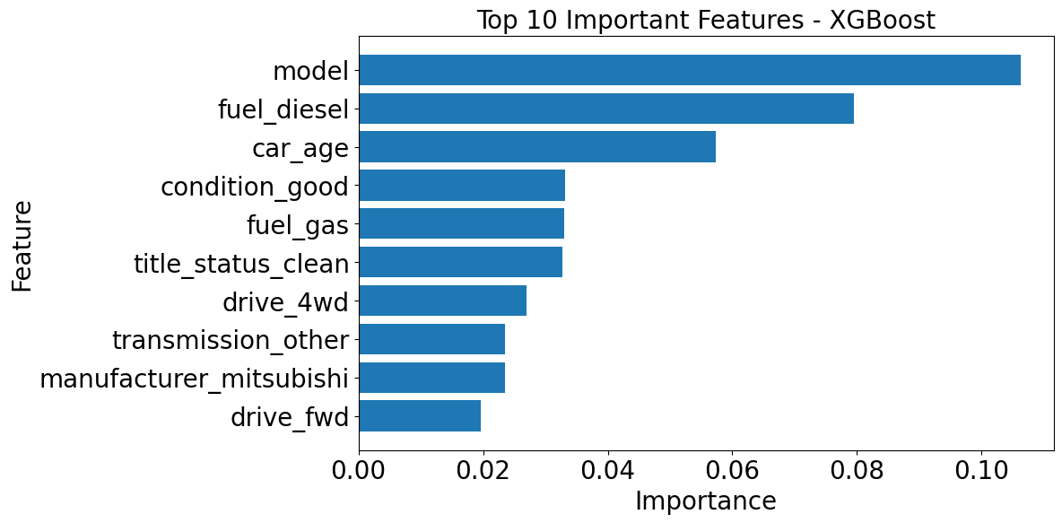
Most Important Features
Key takeaway
Model-specific features and manufacturer signals were highly influential.
Car age was a major predictor, matching real-world depreciation logic.
Condition, fuel type, and drive configuration also contributed to price differences.
Interpretation: both vehicle identity and usage-related features matter.

Slide 9

Conclusion and Presentation Handoff
Main conclusion
Suggested speaking split
The project successfully built a strong used-car price predictor.
XGBoost outperformed the other tested models after tuning.
The workflow demonstrates a full ML pipeline: preprocessing, EDA, modeling, evaluation, and interpretation.
Simbarashe ¹: background, objective, and dataset
Heng-Jui ² : preprocessing, EDA, and modeling choices
Mpofu ³: results, feature importance, conclusion.
All: Q&A
Final message to audience
Machine learning can estimate used-car prices effectively when the data is cleaned well and the right model is chosen.

Slide 10
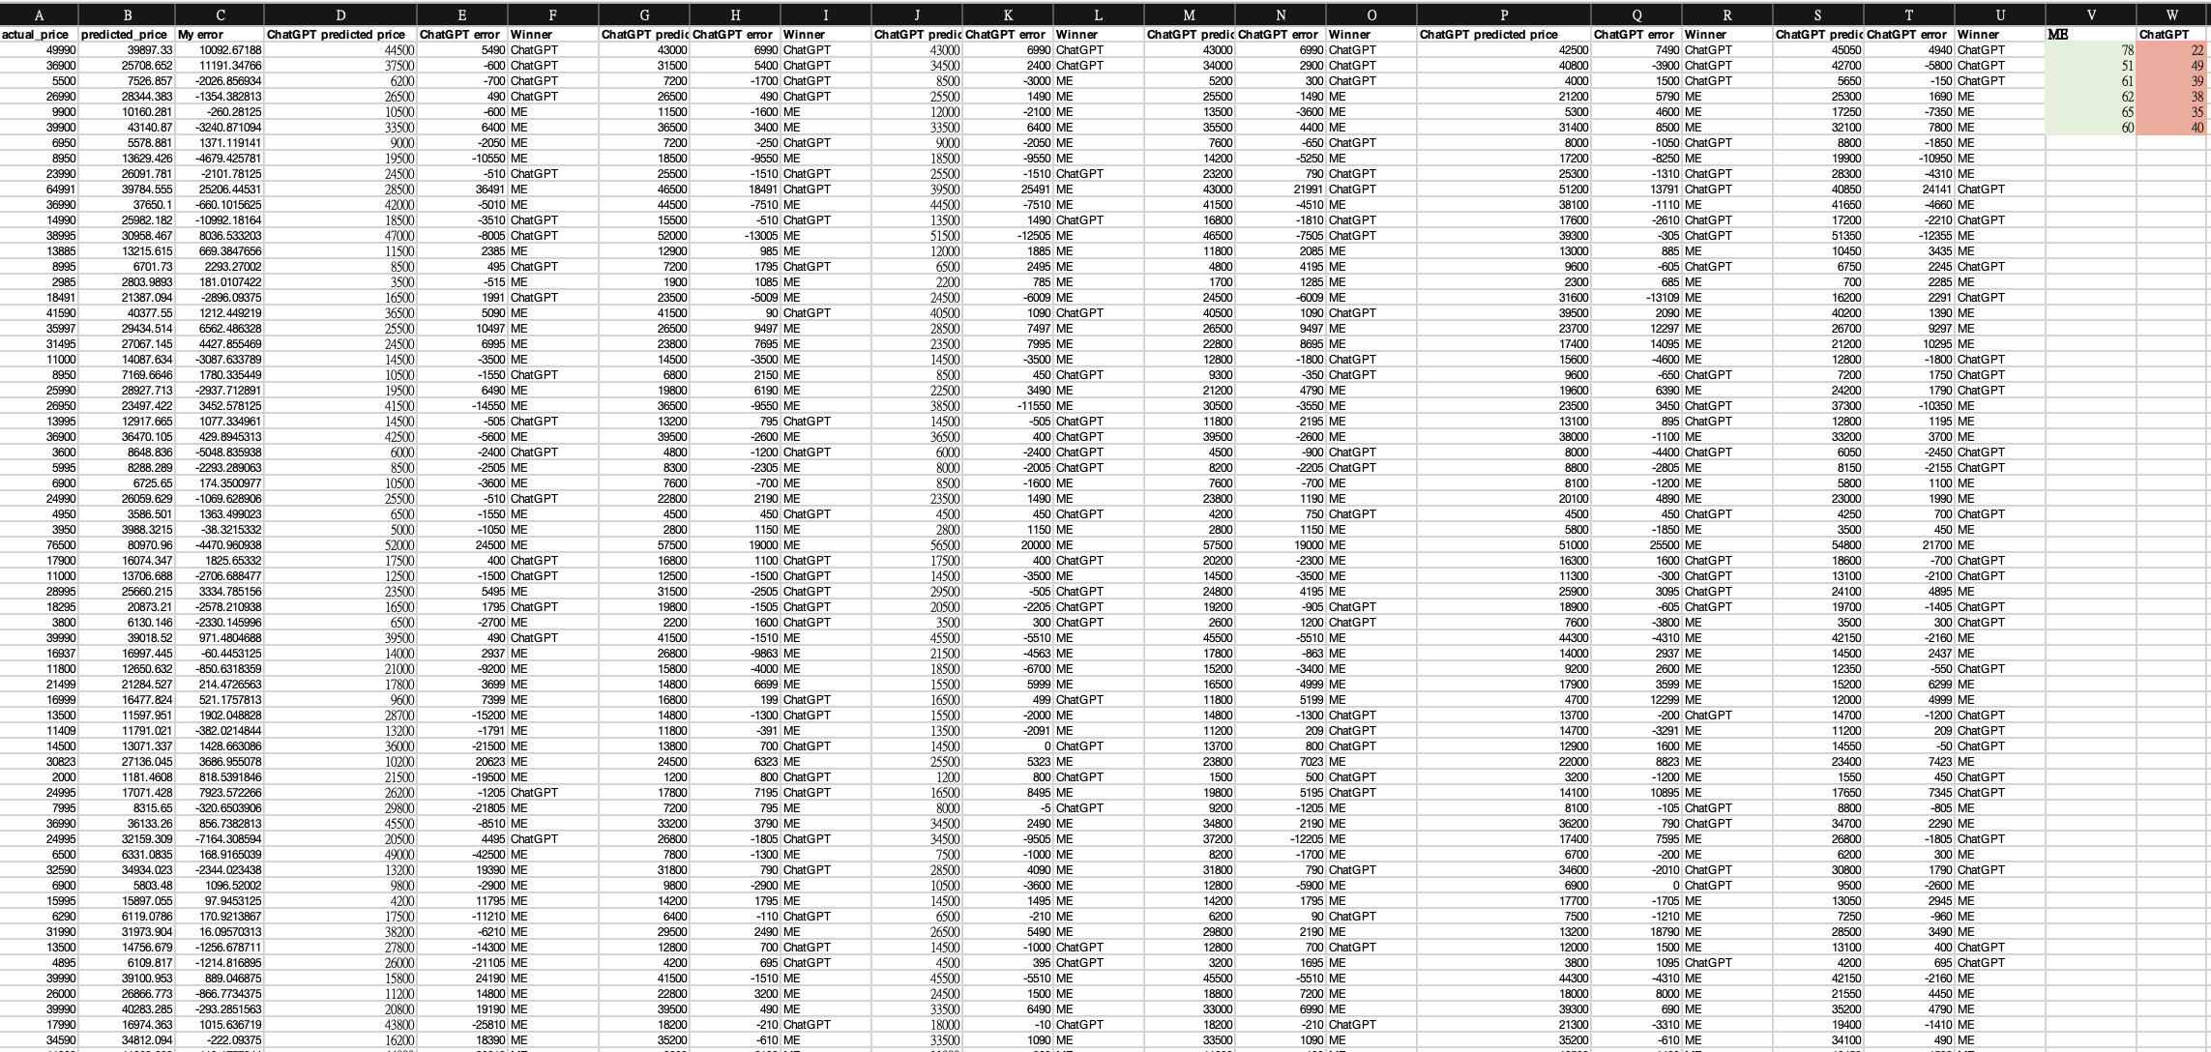
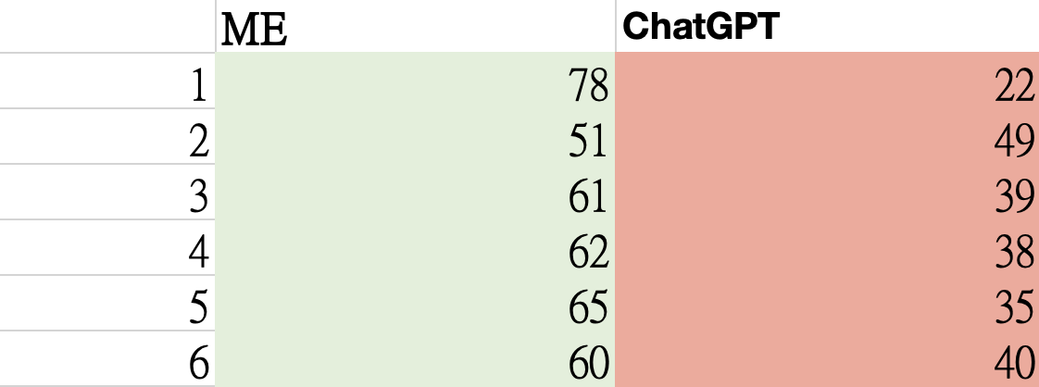
Compare with ChatGPT
Test data size: 100
Our project win: 6
ChatGPT win: 0

Slide 11
REFFERENCES
Reese, A. (n.d.). Craigslist cars and trucks data [Data set]. Kaggle. https://www.kaggle.com/datasets/austinreese/craigslist-carstrucks-data
Chen, T., & Guestrin, C. (2016). XGBoost: A scalable tree boosting system. Proceedings of the 22nd ACM SIGKDD International Conference on Knowledge Discovery and Data Mining. https://doi.org/10.1145/2939672.2939785
Breiman, L. (2001). Random forests. Machine Learning, 45(1), 5–32. https://doi.org/10.1023/A:1010933404324
Pedregosa, F., Varoquaux, G., Gramfort, A., Michel, V., Thirion, B., Grisel, O., Blondel, M., Prettenhofer, P., Weiss, R., Dubourg, V., Vanderplas, J., Passos, A., Cournapeau, D., Brucher, M., Perrot, M., & Duchesnay, E. (2011). Scikit-learn: Machine learning in Python. Journal of Machine Learning Research, 12, 2825–2830.

