Slide 1

Modelling Phase Results
Worth the Investment? Player Value and Injury Risk Project
Two Angles on Player Value and Injury Risk
September 17, 2026
Presented by Mahmoud
Notes:
Audio cue: play the kickoff whistle here. Insert it yourself with Insert > Audio, set it to Start Automatically, and hide the speaker icon during the show.

Slide 2








Where This Update Fits
This week I move from raw patterns into testing real questions with statistics behind them.
Kickoff and Planning
Data Retrieval and Wrangling
Raw Analysis
Modelling and Hypothesis Testing
Dashboards and Presentation
Final Capstone Presentation
DONE
DONE
DONE
THIS WEEK
UP NEXT
UPCOMING
Last week I confirmed the raw patterns. This week I put two of my stakeholder questions through real statistical tests.
Worth the Investment? Weekly Update
2 / 17

Slide 3


Two Angles, Two Answers
Each angle answers a question a different part of the club would ask. Headlines here, evidence later.
Angle 1
Angle 2
Recruitment and Scouting
Sporting Directors
"Does a player's injury history predict a value drop?"
"Does age predict a better value-to-risk tradeoff?"
Yes, but any injury counts, not just recent ones.
Risk yes; value growth only at 21-24.
Bonus: my own forecast is right 22.7% of the time against a 50% baseline, so it needs rebuilding.
Worth the Investment? Weekly Update
3 / 17

Slide 4


A Quick Note on the Statistics
Both tests are new this week. Here's what they do and why they fit this data.
Mann-Whitney U Test
Kruskal-Wallis Test
For Angle 1. Ranks every value instead of averaging, so a few extreme outliers cannot skew the result.
For Angle 2. Same rank-based idea, extended past two groups: five age buckets at once.
scipy.stats.mannwhitneyu · 2 groups
scipy.stats.kruskal · 5 groups
Both ask one thing: is the difference real, or could chance produce it? With samples this large, p under 0.0001 is easy to clear, so it shows a difference exists, not that it is big.
Worth the Investment? Weekly Update
4 / 17

Slide 5
Angle 1
Recruitment and Scouting
Does a player's injury history predict a value drop?
Worth the Investment? Weekly Update
5 / 17
Notes:
Audio cue: play the final whistle here, then open for questions. Insert it with Insert > Audio, Start Automatically, speaker icon hidden during the show.

Slide 6
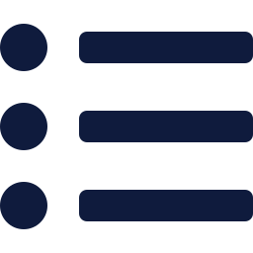
Does Recent Injury History Predict a Value Drop?
Angle 1, for Recruitment and Scouting: which rising-value targets carry hidden injury risk?
What I Compared
How I Grouped It
How I Tested It
For every valuation snapshot: did the player have a prior injury, how recent was it, and what happened to value?
Buckets by injury recency: under 90 days, 91-365, over 365, or none. Median value change in each.
Mann-Whitney U, recent-injury snapshots against all others. Value change is skewed, so ranks beat averages.
32,544 valuation snapshots, 107,951 injury events
4 recency buckets
scipy.stats.mannwhitneyu
Worth the Investment? Weekly Update
6 / 17

Slide 7
Any Injury History, Not Its Recency, Separates the Groups
Three injury-recency buckets against a no-injury baseline.
Median value change at the valuation snapshot, by prior injury recency
Mann-Whitney U, recent injury vs. all other snapshots: p < 0.0001
Timing barely matters: every injured bucket sits at 0.00%.
Any injury history at all is what separates the groups.
Excluding breakout debuts: +4.35%, and the pattern holds.
Why the flat 0.00%: many valuation snapshots simply repeat the last known value between updates. This does not yet confirm every injured player's value was frozen, that breakdown is still to come.
Worth the Investment? Weekly Update
7 / 17

Slide 8
Angle 2
Sporting Directors
Does age predict a better value-to-risk tradeoff?
Worth the Investment? Weekly Update
8 / 17
Notes:
Audio cue: play the final whistle here, then open for questions. Insert it with Insert > Audio, Start Automatically, speaker icon hidden during the show.

Slide 9
Does Age Predict a Better Value-Risk Tradeoff?
Angle 2, for Sporting Directors: are younger signings really the lower-risk, higher-upside bet?
What I Compared
What I Excluded
How I Tested It
For each player: median value growth paired with injury rate per 1,000 90s (a 90 is one full match played), grouped into five age bands.
Excluded 1,310 players with no playing time, plus 67 more players with fewer than 10 total 90s played. A rate needs a real denominator.
Kruskal-Wallis on growth and risk across the five buckets, the right test for more than two skewed groups.
582 players with both numbers
1,377 players excluded, disclosed
scipy.stats.kruskal
Worth the Investment? Weekly Update
9 / 17

Slide 10
Age Predicts Risk. It Doesn't Predict Value Growth.
Median value growth and median injury risk across four age buckets.
Median Value Growth (%)
Median Injury Risk (per 1,000 90s)
Growth concentrates in the 21-24 window: +7.14% median.
Risk more than doubles: 2.49 at 21-24 up to 5.95 at 33+.
Under-21 players are excluded from both charts (4 players). Risk is not strictly ordered: 25-28 (3.97) sits above 29-32 (3.22).
Kruskal-Wallis: value growth and risk rate both differ across age buckets, p < 0.0001 (large n, so p clears easily; effect sizes still to be reported)
The 0.00% brackets reflect valuations that did not change between snapshots, not a measured decline, that breakdown is still to come.
Worth the Investment? Weekly Update
10 / 17

Slide 11
Bonus: The Forecast Model Is Reliably Wrong
A third angle, validating the value forecast before leaning on it for anything.
22.7%
149.4% median error
The forecast misses by more than the true value itself.
91% predict rising
directional accuracy, against a 50% coin-flip baseline. Below chance means the model is wrong in a consistent direction, not just noisy.
80% of the actual holdout snapshots were falling.
The fix
Age and injury history become real input features before this model is trusted.
Worth the Investment? Weekly Update
11 / 17

Slide 12

What This Means So Far
Two independent angles, one shared direction.
History matters more than timing
Age is a risk signal, not a value rule
Any past injury, not just a recent one, goes with flatter value growth. Still to confirm: how much of that flatness is valuations that never moved.
Injury risk is higher for older players, though not strictly in order. Value growth follows no usable age rule on its own.
Together: a recruitment signal built on injury history and age as separate inputs, not on one feature.
Worth the Investment? Weekly Update
12 / 17

Slide 13

Being Honest About These Results
Real statistics, with real limits I am carrying forward.
Small Samples in Places
The Playing-Time Gap, Still Here
Under-21 holds only 4 players. The age-risk comparison drops to 582 players once real playing time is required.
1,310 of 1,959 players have no matching on-field record, the same coverage gap as last week.
4 players (Under 21); 582 of 1,959 usable overall
67% of players excluded from risk-rate calculations
Flat medians, not yet verified: every injured bucket sits at exactly 0.00%, which points to snapshots where the value never moved. I still need to report what share of snapshots change at all.
Worth the Investment? Weekly Update
13 / 17

Slide 14
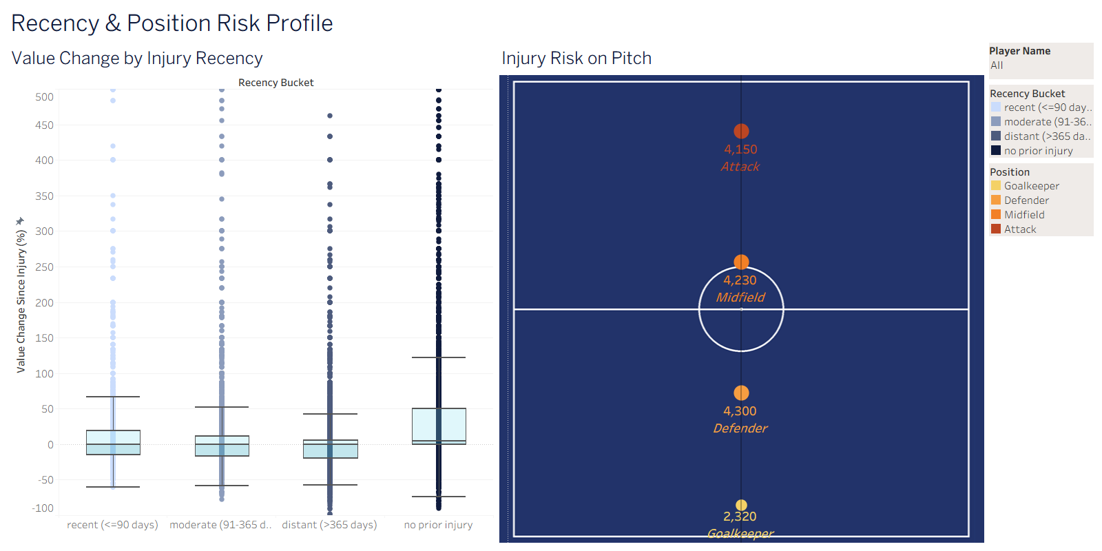

A First Look: Where This Goes Next
Production, output visualisations, and the story concept get their own session next week.
Production
Both angles move from notebooks into the live dbt pipeline behind the dashboards.
Output Visualisations
Interactive Tableau dashboards, like the one on the left, for every angle tested.
Story Concept
Live from the Tableau workbook, Recency & Position Risk Profile dashboard
The narrative arc that ties it together for the final capstone.
Full walkthrough at next week's meeting, September 24.
Worth the Investment? Weekly Update
14 / 17

Slide 15

Put both stakeholder questions through rank-based statistical tests
Modelling and Hypothesis Testing
100%
Found that any injury history, not its recency, tracks with flat value growth
Showed injury risk more than doubles from the 21-24 bracket to 33+
Complete
Stress-tested my own forecast and documented exactly where it fails
Flagged the flat-median and playing-time caveats in the open
Ready to carry both angles into the dashboards and the final story
Phase 4 of 6. Up next: dashboards and presentation.
Worth the Investment? Weekly Update
15 / 17

Slide 16

Next Update
Dashboards and Presentation
Bringing today's two angles into the Tableau dashboards and the final capstone deck
Thank You
Questions and feedback are welcome.
Worth the Investment? Weekly Update
16 / 17
Notes:
Audio cue: play the final whistle here, then open for questions. Insert it with Insert > Audio, Start Automatically, speaker icon hidden during the show.

Slide 17
The Code Behind Both Tests
Snippets from the two hypothesis-test notebooks.
HYPOTHESIS_INJURY_RECENCY_VS_VALUE.IPYNB · ANGLE 1
recent = merged.loc[merged.recency_bucket == "recent (<=90 days)", "value_change_pct"]
other = merged.loc[merged.recency_bucket != "recent (<=90 days)", "value_change_pct"]
u_stat, p_value = stats.mannwhitneyu(recent, other, alternative="less")
HYPOTHESIS_AGE_VS_VALUE_RISK_TRADEOFF.IPYNB · ANGLE 2
value_groups = [g["median_value_change_pct"] for _, g in combined.groupby("age_bucket")]
risk_groups = [g["risk_per_1000_90s"] for _, g in combined.groupby("age_bucket")]
h_val, p_val = stats.kruskal(*value_groups)
h_risk, p_risk = stats.kruskal(*risk_groups)
Worth the Investment? Weekly Update
17 / 17

