Slide 1
NORTHWIND
Sales Insights
A dbt analytics pipeline turning raw order data into trusted, ready to use sales performance metrics
Stakeholder Review • Data Analytics and AI Bootcamp Project • Presented by Mahmoud

Slide 2




What We Will Cover
The Business Problem
Why raw order data was hard to trust and reuse
The Pipeline We Built
Staging, prep, and mart layers in dbt
What the Data Shows
Revenue, order volume, and category performance
Quality and Next Steps
How we validated results and what comes next
Northwind Sales Insights
2

Slide 3


The Business Problem
Northwind Trading distributes food and beverage products worldwide. Their analytics team faced three recurring problems.
Messy Raw Data
Repeated Manual Joins
No Shared Definition
Inconsistent column names and data types across order, product, and category tables
Every analyst wrote the same long SQL joins to answer basic sales questions
Revenue and profit were calculated differently depending on who ran the report
Northwind Sales Insights
3

Slide 4



The Pipeline We Built
Three dbt layers turn raw Northwind tables into one trusted, query ready mart
→
→
Staging
Prep
Mart
4 models
1 model
1 model
Clean column names, cast dates and numbers, drop unused fields from orders, order details, products, and categories
Join staging tables and calculate revenue as unit price times quantity times one minus discount, plus order year and month
Aggregate revenue, order counts, and average order value by year, month, and category for reporting
Validated with automated data tests confirming no missing values in the final mart
Northwind Sales Insights
4

Slide 5
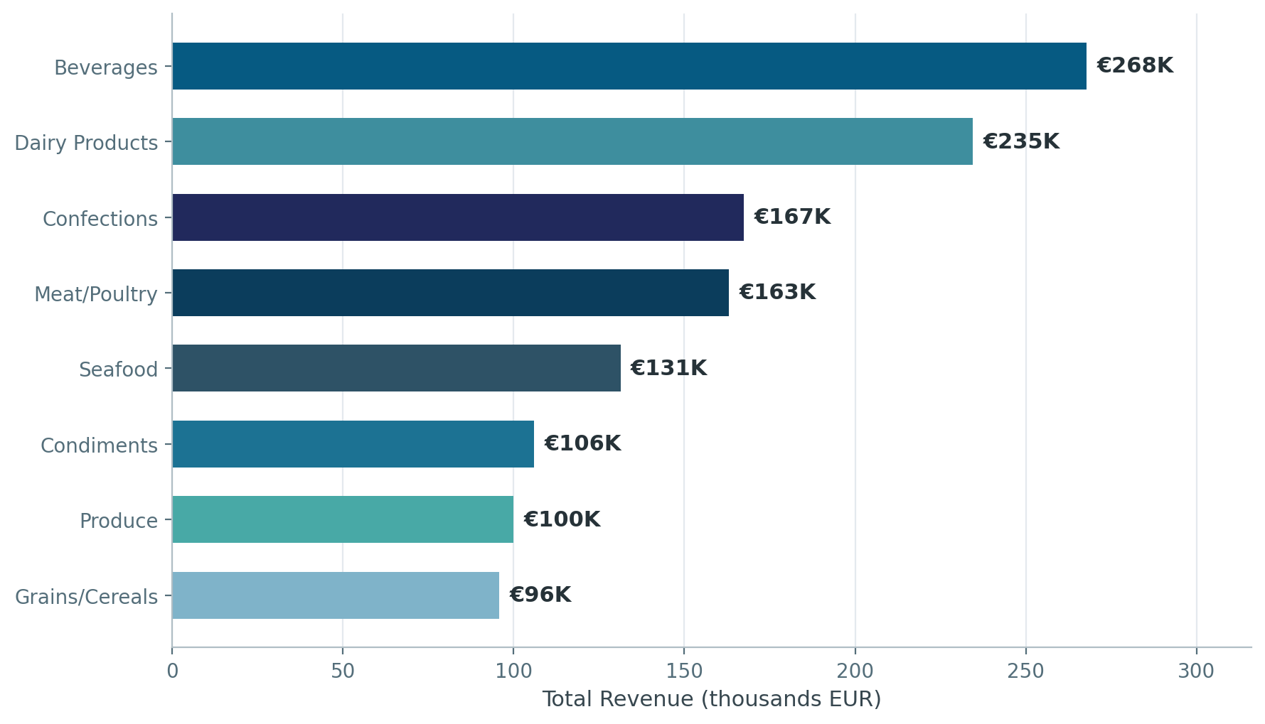
Revenue by Category
Total revenue across all periods, July 1996 through May 1998
WHAT THIS SHOWS
Each category ranked by total revenue earned across the full period, in thousands of euros
€1.27M
Total Revenue Analyzed
Beverages
Top category by revenue, €268K
Northwind Sales Insights
5

Slide 6
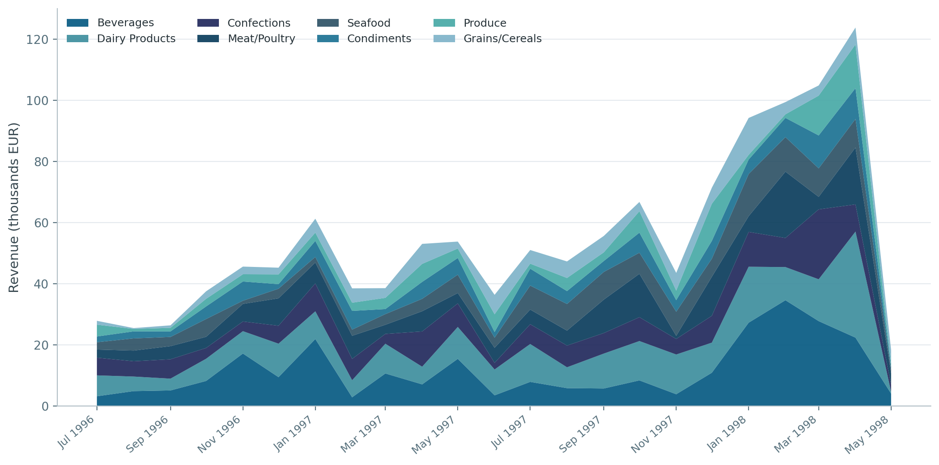
Monthly Revenue Trend
Combined category revenue by month, showing strong growth into early 1998
WHAT THIS SHOWS
Each colored band is one category; the total height at any point is that month’s combined revenue
Northwind Sales Insights
6

Slide 7
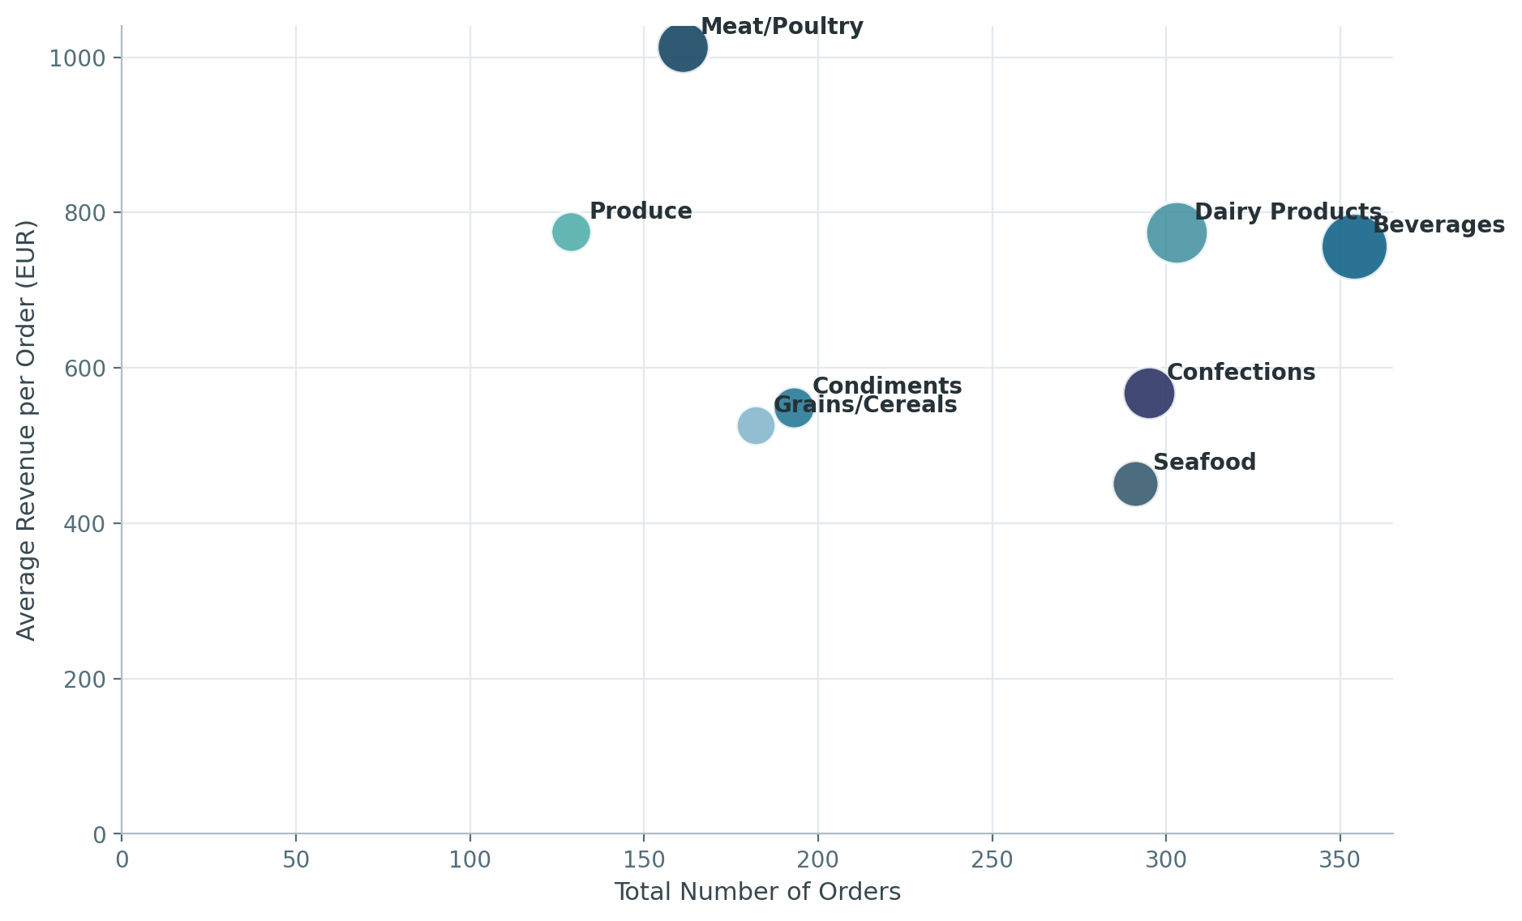
Order Volume vs Order Value
Bubble size reflects total category revenue; position shows the volume and value trade off
WHAT THIS SHOWS
Left to right is order count, bottom to top is average order value, bubble size is total revenue
Reading the Chart
Meat and Poultry: fewer orders but the highest average value per order
Beverages and Dairy Products:
the highest order counts, driving steady volume
Seafood:
high volume but the lowest average order value, a possible upsell opportunity
Northwind Sales Insights
7

Slide 8
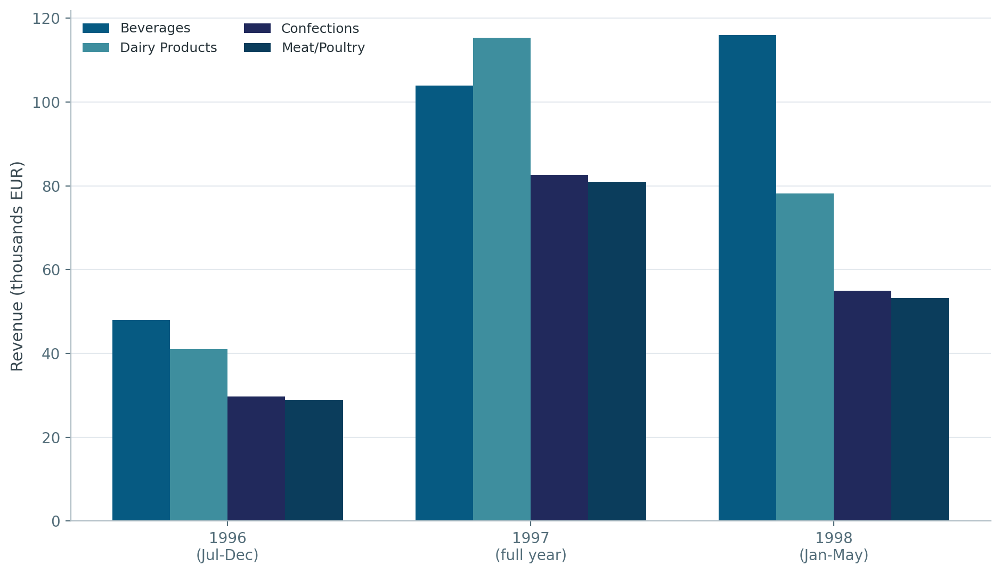
Year over Year, Top Categories
Comparing the four highest revenue categories across the three years of data
WHAT THIS SHOWS
Grouped bars let you compare the same category side by side across three consecutive years
Note on 1998
1996 and 1998 are partial years in this dataset. 1996 begins in July and 1998 ends in May, so full year totals are not directly comparable to 1997.
Northwind Sales Insights
8

Slide 9
Key Takeaways
Beverages and Dairy Products together account for close to forty percent of total revenue across the full period
1
Meat and Poultry commands the highest average order value, suggesting a smaller base of higher spending customers
2
Revenue climbed sharply into early 1998, with January through April outperforming the same months in prior years
3
Seafood combines high order volume with a comparatively low average order value, a candidate for bundling or upsell
4
Northwind Sales Insights
9

Slide 10

Reflections From the Project
In our own words, from the project README
"The sample solution didn't match the real database, so I had to actually check the columns myself, and that's when it really clicked what this job is.”
ON WORKING WITH REAL DATA
"Verifying the real schema before writing a single line of SQL is not optional, it is the actual first step of the job."
ON THE BIGGEST LEARNING MOMENT
"The cleaning happens once, the definition of revenue is calculated once, and every downstream user works from one trusted table."
ON WHY THE PIPELINE MATTERS
Northwind Sales Insights
10

Slide 11

Data Quality and Validation
Every mart column is covered by automated dbt tests to catch broken joins or missing data before it reaches a dashboard
order_year
order_month
category_name
not null, verified
not null, verified
not null, verified
total_revenue
total_orders
avg_revenue_per_order
not null, verified
not null, verified
not null, verified
All 6 automated tests passed on the current build
Northwind Sales Insights
11

Slide 12

Recommended Next Steps
Connect a BI Tool
Expand Test Coverage
Add Customer Dimension
Point a dashboard directly at the mart for self serve reporting
Add uniqueness and relationship tests across the staging layer
Bring in customer data to analyze revenue by region and account
Northwind Sales Insights
12

Slide 13
Thank You
Questions and discussion welcome
Northwind Sales Insights • dbt Analytics Pipeline

