Slide 1
Design Concepts To
Lower Deropements
On Surface Lifts
Group 7 - Lab 10
Jakob Roberts
Scott Andreen
Bogdan Fanea
Erik Bergen
Lance Hughes

Slide 2
Revised Problem Definition
Need:
The frequency of unretained deropements of surface lifts in BC is unacceptably high.
Goal:
Improve current surface lifts to increase the safety in regards to deropements involving snowboarders.
Constraints:
Cannot add more than 20% of the current weight to the movement system.
All new designs must be compatible with older systems and technology.
The interface system must be switched between skier and snowboarder, and vice versa within half of the time the T-bar takes to travel around the bull wheel.
The mechanism to switch the interface system must not be affected by ice and freezing temperatures.
The mechanism must be resistant against all elements that would cause corrosion or failure of the mechanical components.

Slide 3
Revised Problem Definition
Objectives:
Objectives for the deropement failsafe system:
Objective | Basis for Measurement | Units
Design implementation shouldn’t drastically slow down current operating speed | the speed of the system | m/s
Should be an inexpensive solution | cost to manufacture and implement new design | dollars
Should have a low implementation time | time it takes to put system in place | hours
Should be simple to use for the general public | amount of people that comprehend signage within 2 minutes | percent

Slide 4
Background Info
Researched:
Current T-bar design flaws in respect to snowboarders and any alternatives currently being employed on surface lifts
http://www.abc-of-snowboarding.com/pistelifts.asp.
Video footage of T-bars being used on youtube
How the horizontal force causes deropements from the design of the connection between the T-bar, the attachment cable, and the main lift cable.
BCSA standards and regulations
CSA Z98-14 Standards Manual
BCSA representatives claim minimal research has been done into reducing deropements caused by snowboarder
Special coatings for the materials for the new systems:
Ice Resistant Coating: http://www.ecologicalcoatings.com/icephobic.html

Slide 5
Key Findings
Reducing horizontal forces caused by boarders sitting awkwardly would reduce likelihood of deropements.
Videos proved the existing T-bar design to be flimsy, uncomfortable, and impractical for snowboarder use.
The Z98-14 manual provided a useful guideline on the constraints for our designs.
Something specifically addressed was part 4.6.2.2: “Critical components and their connections shall be designed, detailed, and fabricated to minimize stress concentrations.”.

Slide 6
Design 1 H-Bar
New type of T-bar model designed: {taken snowboarders into consideration}
Aim to reduce the deropements caused by snowboarders
This design concept has minimal research and investigation
Adaptable for:
2 skiers
2 snowboarders
1 skier & 1 snowboarder
Easy to understand concept through:
Signage
Knowledgeable chairlift operators providing assistance

Slide 7
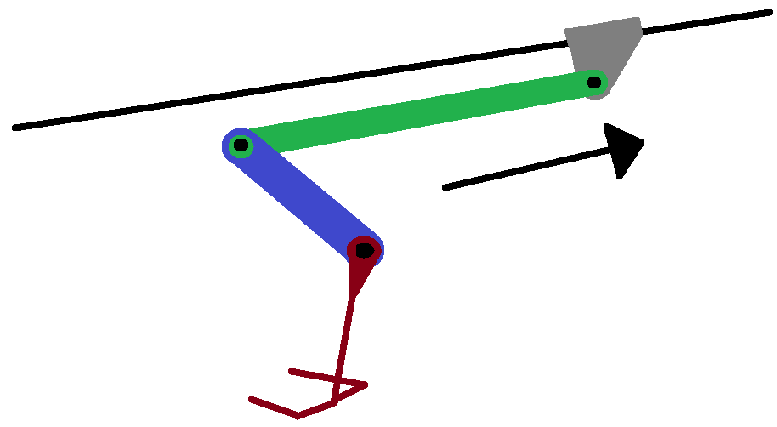
Design 2 Cable-Arm System
Replacement for the current retractable cable system. Horizontal movement of passengers taken into consideration.
Pros:
This arm system removes any possible horizontal movement by the passengers due to having a system of fixed and rigid beams
Cons:
Due to the lack of arm swing, there would not be much time to load passengers onto the bar
Huge weight increase to the overall system likely breaking one of the base constraints
The 3 springed bearings on the arm allow for both vertical and forward/backward movement. These axis of movement aid in account for variations in snowfall and rider embarkment/disembarkment.

Slide 8
Design 3 Ball & Socket
Ball and Socket mechanism installed at top of carrier cable system
Reduce overall sideways motion of grip, reducing horizontal force on lift cable system.
Minimal weight added to the overall system.
Problems Encountered & Possible Solutions:
Water accumulation and ice formation in socket
Possible Solutions:
Hydrophobic coating on metal and hole at bottom to allow water runoff to escape.
Rubber gasket covering top of ball & socket, preventing water from entering.

Slide 9
Conclusion
Of 3 designs, Design #1 H-Bar was decided to be the most feasible idea due to:
Ease of implementation
Cost effectiveness for usability
The next feasible concept is Design #3 Ball & Socket due to:
Apparent reduction in horizontal stresses on cable mechanism system
Does not add a lot of weight considering the benefits it provides
Unfortunately would require significant upkeep
Design #2 Cable-Arm System does not seem feasible:
It eliminates any horizontal force on the system caused by riders
But the problems are:
It allows minimal time for passenger loading and unloading
Too much weight will be added to the system

