Slide 1
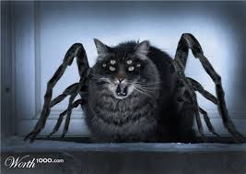
Rubbits
They comin 4 u
We gon’ neutralize us sum radiayshun
Jakob Roberts Jim Galloway
Takuma Pimlott Nick Glover

Slide 2
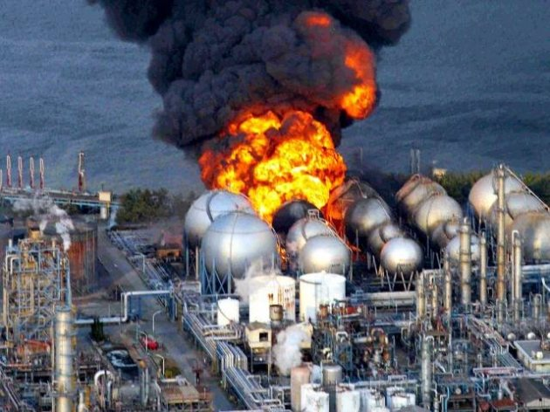
Project Background
Gotta help them pipplz that
can’t even nuclear
much explode
very boom
such fire
wow

Slide 3
Project Requirements
Overview, Objectives, changes

Slide 4
Robot Designs
Robot 1 look like dis:
Robot 2 rook rike dis:

Slide 5
SpockBot features
Wheel Normalization for straight movement
3 IR sensors
4wheels, 2 motors
long-arm pickup with potentiometer
IR threshold stepping for long distance sensing

Slide 6
SpockBot Pros/Cons
Pros
Cons

Slide 7
Design 2 features
4 wheels
3 IR sensors
4 motors
forklift mechanism arm
item pusher

Slide 8
Design 2 Pros/Cons

Slide 9
SpockBot Difficulties
hardware broke
wall reflectance on close start to beacon

Slide 10

Work Completed - Robot 2
Urrythang…
put my picture here

Slide 11
Work Remaining
Basically nothing. It’s April 1
Talk about…. something

Slide 12
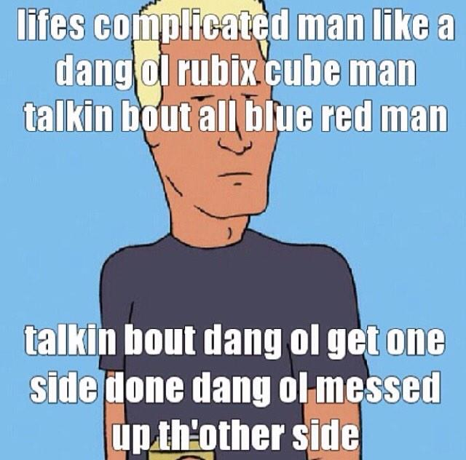
Problems
so
many
problems
oh
my
god

Slide 13
Possible Solutions
all dun since robot dun

Slide 14
Conclusion
something important
another important thing

Slide 15
[1] xx
[2] xx
[3] xx
[4] xx
References

