Slide 1
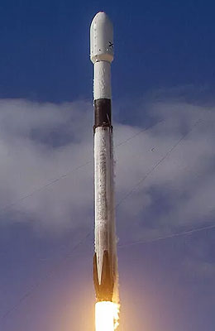






SPACE-Y INVESTIGATION INTO REUSABLE LAUNCH VEHICLES
Simbai Manyumwa
6 July 2024

Slide 2
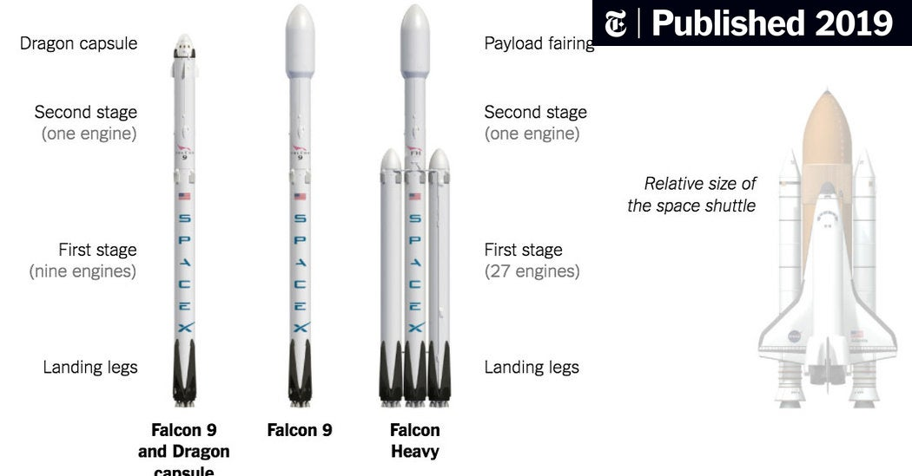


OUTLINE
Executive Summary
Introduction
Methodology
Results
Visualization – Charts
Dashboard
Discussion
Findings & Implications
Conclusion
Appendix

Slide 3
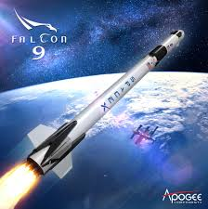
EXECUTIVE SUMMARY
We set out to find the feasibility of Space Y using a similar version of the Falcon 9 booster used by SpaceX, specifically to see if we could predict a successful re-landing of the SpaceY first stage.
We gathered data from SpaceX historical Falcon 9 launches including Payload Mass, Launch Site, Launch Outcomes and other factors around each launch.
With the gathered data we applied various machine learning models and were able to come up with one that K Nearest Neighbor was the most accurate model in predicting the outcome of launches.

Slide 4
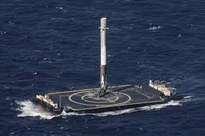
INTRODUCTION
The Falcon 9 designed and manufactured by SpaceX, following consultation Space Y tasked us with investigating what has made the Falcon 9 a success and how the success could be replicated for their own Booster Version.
The biggest competitive advantage the Falcon9 has is its re-usability and we investigate the factors surrounding this advantage.
We explore the results of the Falcon 9 Booster launches between 2010 and 2020, SpaceX were able to conduct a total of 90 launches over 3 sites within this period.

Slide 5
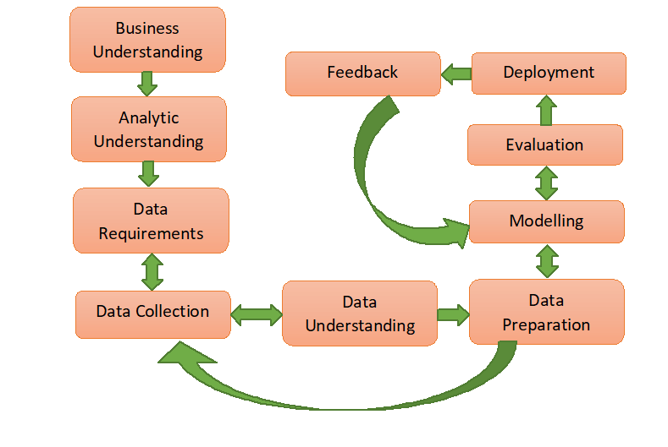
METHODOLOGY
Problem - investigate the factors surrounding the Falcon 9's success so we can see it they can be replicated. This meant looking int what factors contribute to the success of the Falcon 9 and what factors contribute to its failure to land.
Data requirements were the information around all the launches for the Falcon 9 available. This was done mostly from various web scrapes that provided the launch details of the Falcon 9.
Applying various comparisons we were able to see the relationships between the success and failure with other flight details.
We then standardized the data so we could apply different models and test what would best apply to this situation. We split the data into train and test data (80:20 split).
After applying four models we found the K Nearest Neighbour model to be the most accurate. This is the model we would like to put forward your evaluation.

Slide 6
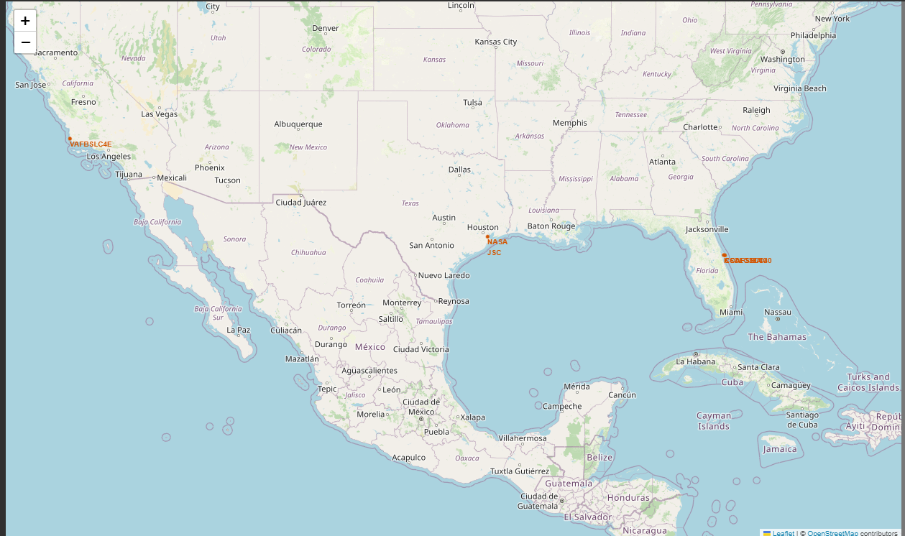
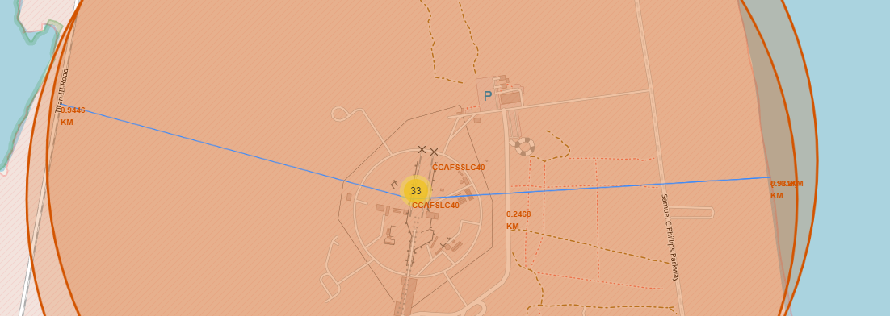
RESULTS-source- https://cf-courses-data.s3.us.cloud-object-storage.appdomain.cloud/IBM-DS0321EN-SkillsNetwork/labs/module_2/data/Spacex.csv
Our finding show that the Falcon 9 booster has had 90 launches from four locations:
VAFB SLC-4E - Vandenberg Space Force Base, Santa Maria
CCAFS LC-40 - Cape Canaveral Space Force Station, Cape Canaveral
CCAFS SLC-40 - Cape Canaveral Space Force Station, Cape Canaveral
KSC LC-39A - near Merrit Island National Wildlife Refuge
All launch sites are in close proximity to the coastline and have relatively close access to a major road or railway

Slide 7
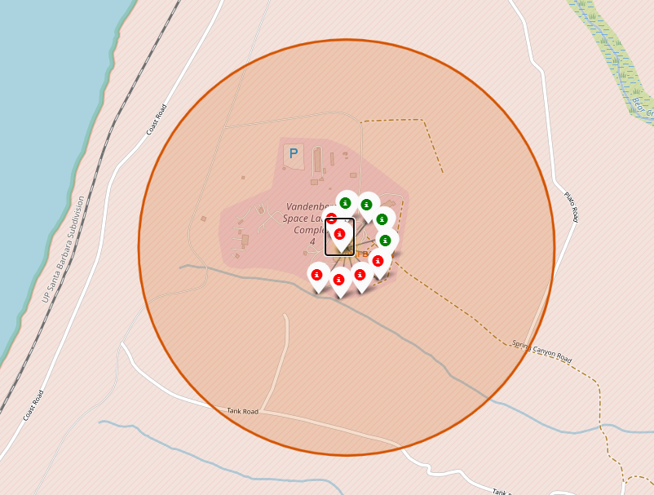
VAFB SLC-4E - Vandenberg Space Force Base, Santa Maria
In the period investigated there were 10 launches of the Falcon 9 -
4 resulted in a successful re-landing
6 were unsuccessful

Slide 8
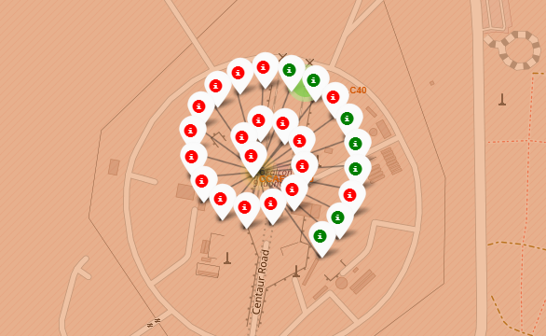
CCAFS LC-40 - Cape Canaveral Space Force Station, Cape Canaveral
26 launches have been from this location
19 failed landings
7 successful

Slide 9
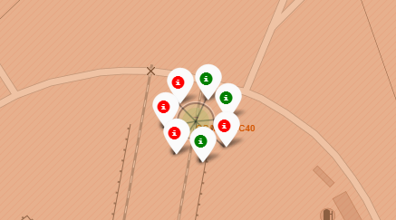
CCAFS SLC-40 - Cape Canaveral Space Force Station, Cape Canaveral
7 launches from this location
3 successful
7 failed

Slide 10
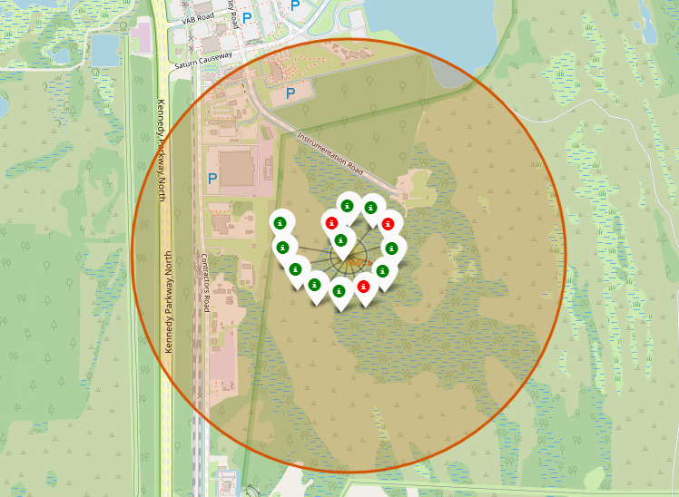
KSC LC-39A - near Merrit Island National Wildlife Refuge
X launches from this location
10 successful landings
3 failed

Slide 11
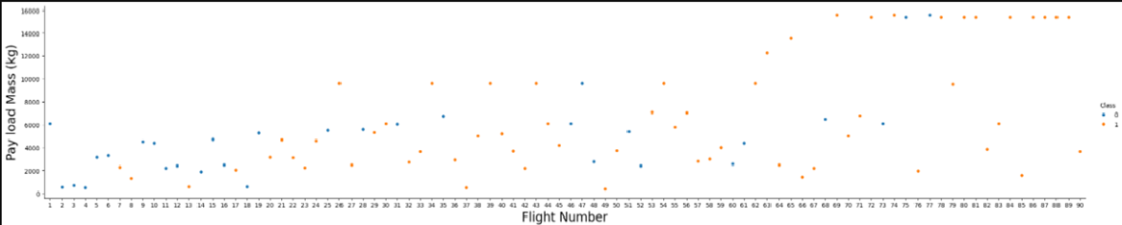
SCATTER PLOT COMPARING PAYLOAD MASS AND FLIGHT NUMBER(Class1=Success, Class 0=Failure)
In this plot we can see the successes(class 1) have increased with time also the launches with a heavier payload mass are generally more successful. This can be attributed to the fact that Space X have been cnstantly improving on their initial design.

Slide 12
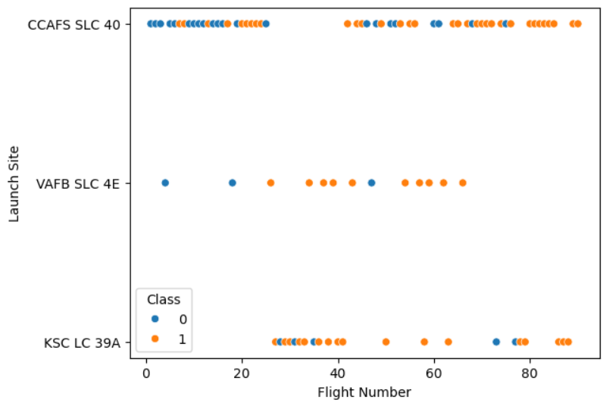
SCATTER PLOT COMPARING LAUNCHSITE AND FLIGHT NUMBER(Class1=Success, Class 0=Failure)
As highlighted previously the majority of launches are from CCAFS SLC 40. This plot also supports the previous statement that the success rate has been improving with time.

Slide 13
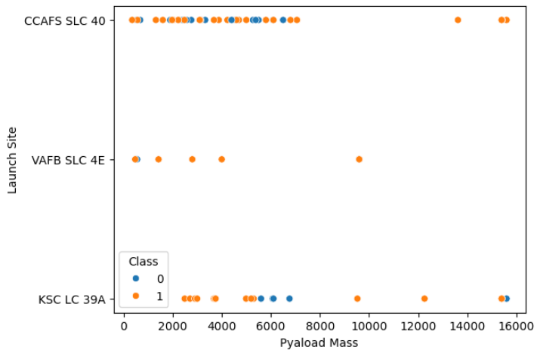
SCATTER PLOT COMPARING LAUNCHSITE AND PAYLOAD MASS(Class1=Success, Class 0=Failure)
The majority of launches are for a payload mass below 1000kg.
All launches over 10000kg from site CCAFS SLC 40 were successful
All launches with a payload mass greater that 1500kg from VAFB SLC 4E were successful
The failed ;aunches from site KSC LC 39A were when the payload mass was around 6000kg or greater than 15500kg

Slide 14
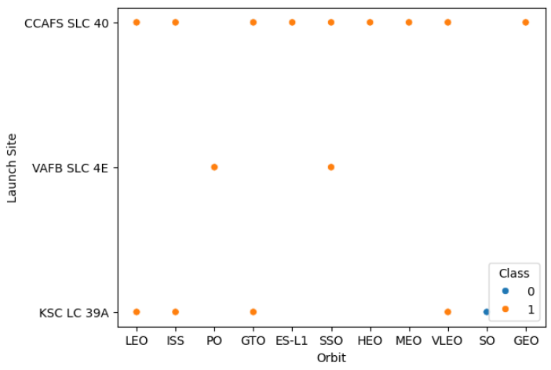
SCATTER PLOT COMPARING LAUNCHSITE AND ORBIT (Class1=Success, Class 0=Failure)
Site CCAFS SLC 40 can handle launches to any orbit. However the other 2 sites are less versatile.

Slide 15
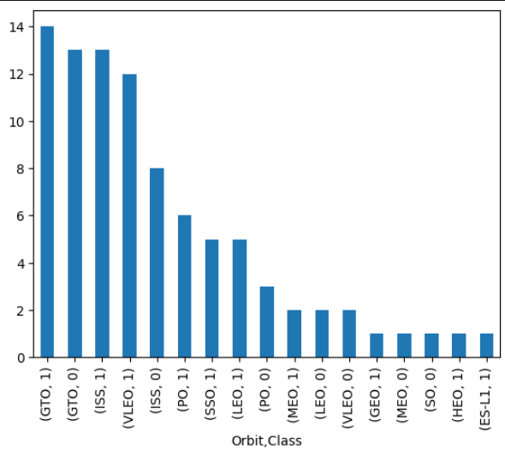
BAR PLOT SHOWING ORBIT SUCCESS RATE (Class1=Success, Class 0=Failure)
GTO orbit has the most successes 14 also the most fails 13 and is the most common orbit for launches.

Slide 16
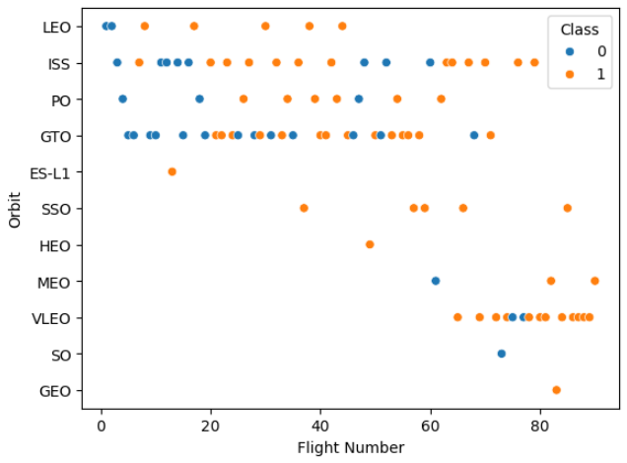
SCATTER PLOT COMPARING ORBIT AND FLIGHT NUMBER (Class1=Success, Class 0=Failure)
In recent launches the most common orbit attempted has been for VLEO and ISS orbits. Though the most common remains GTO.

Slide 17
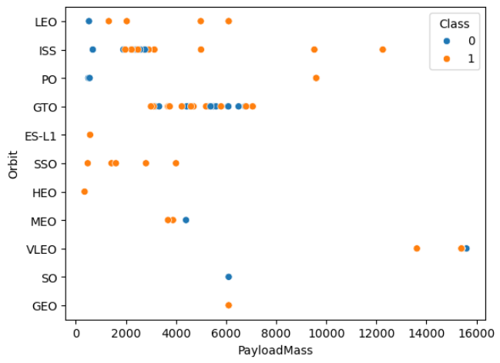
SCATTER PLOT COMPARING ORBIT AND PAYLOAD MASS (Class1=Success, Class 0=Failure)
In this plot we see that most launches have a payload mass between 2000-8000kg.
ISS orbit success is 100% over 3000kg
LEO orbit success rate is 100% over 1500kg
SSOorbit has a 100% success rate

Slide 18
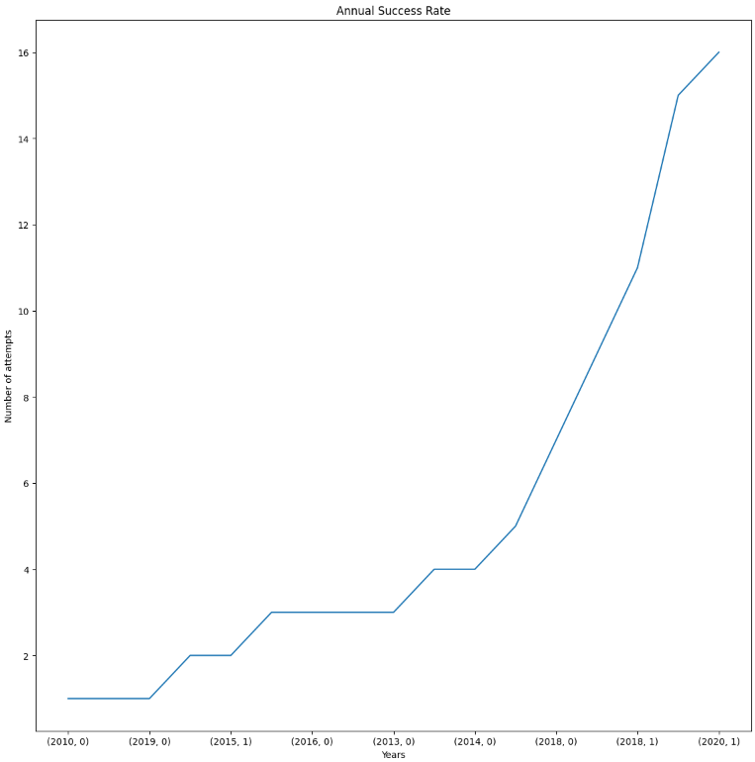
ANNUAL SUCCESS RATE
We can clearly see in this line graph that the launches have been far more successful as time has passed. The first spike is in 2013 reaching 16 successful launches in 202. This again supports the fact that the modifications to the booster have been very successful.

Slide 19
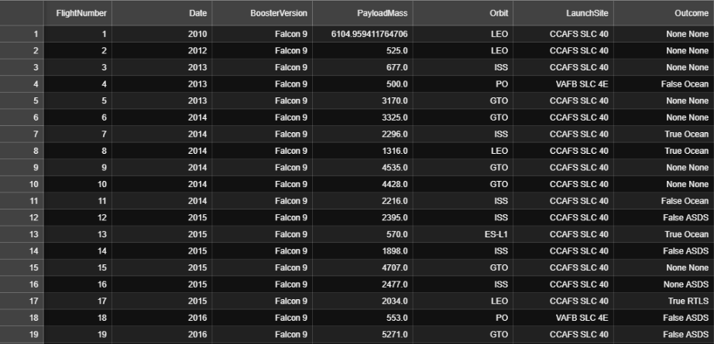
THE DATA
Next Year
Using a jupyter notebook we were able to scrape various sources and organise it into meaningful data. Links of the sorted data are below:
Space X data

Slide 20
THE DATA -SQLITE3
Next Year
using our jupyter notebook with SQLite3 we were able to extract further insights.

Slide 21
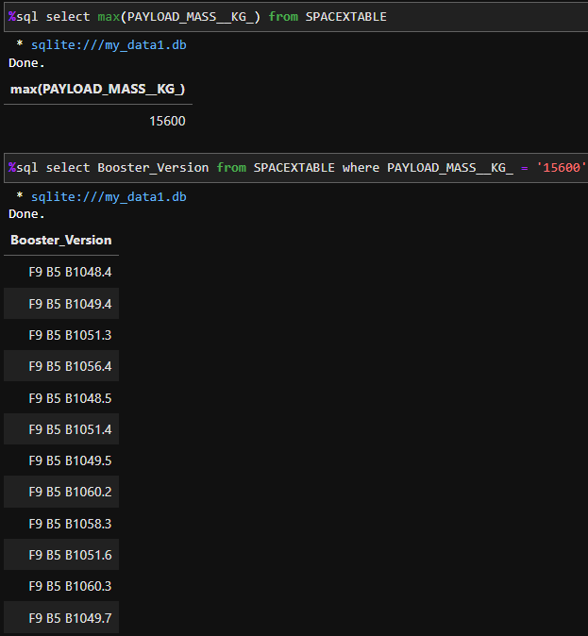
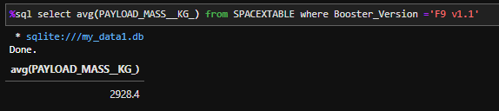
THE DATA -SQLITE3
Which Booster versions were able to handle the maximum payload(12 version could handle 15600kg).
Or what the average payload mass is for the F9 1v1 Booster- 2928.4kg

Slide 22
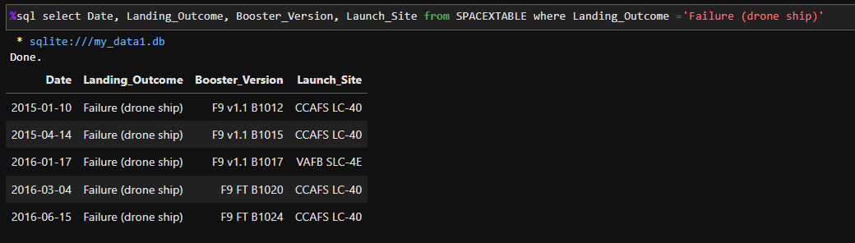
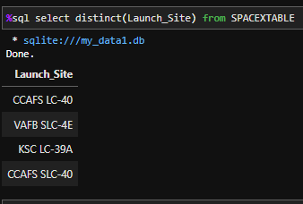
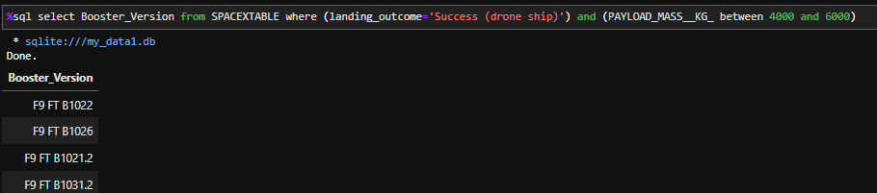
THE DATA -SQLITE3
Using a SQLite3 we were able to extract other data like;
The booster versions used for drone landings, with a certain payload mass
Along with the Booster versions that failed to land on a drone ship
The 4 launch sites studied

Slide 23
MACHINE LEARNING
As discussed earlier we applied 4 models to the data to try and see which would yield the most accurate results. We then split our data into train and test data (80 % to train the model and 20% to test it) and applied each model and drew up a confusion matrix.
The four models were:
A logistic Regression Model
Support Vector Machine Model
Decision Tree Classifier model
K Nearest Neighbour model

Slide 24
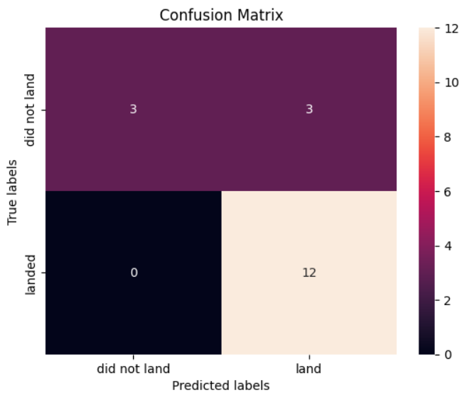
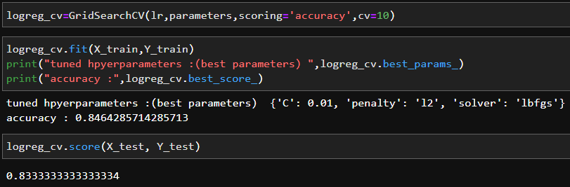
MACHINE LEARNING - LOGISTIC REGRESSION
Logistic regression estimates the probability of an event occurring, such as booster landing or booster not landing, based on a given data set of independent variables
we can see from the confusion matrix under this model
It correctly predicted that 3 would not land and that 12 would land
It incorrectly predicted that 3 would land
The main concern is the bottom left had no predictions at all.

Slide 25
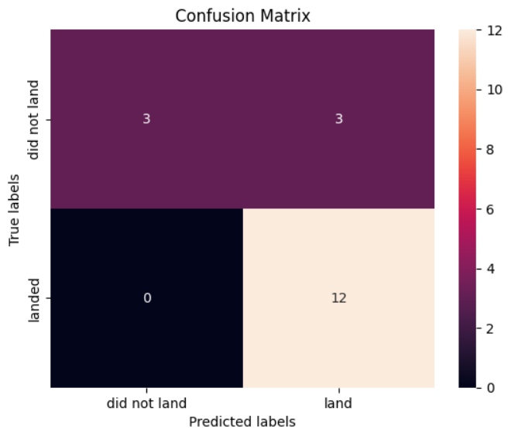
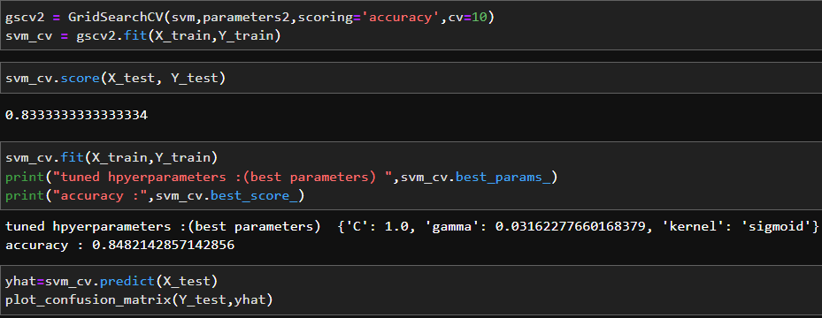
MACHINE LEARNING - SUPPORT VECTOR MACHINE
A support vector machine (SVM) is a supervised machine learning algorithm that classifies data by finding an optimal line or hyperplane that maximizes the distance between each class in an N-dimensional space.
We can see from the confusion matrix under this model
It correctly predicted that 3 would not land and that 12 would land
It incorrectly predicted that 3 would land
Again the main concern is the bottom left had no predictions at all.

Slide 26
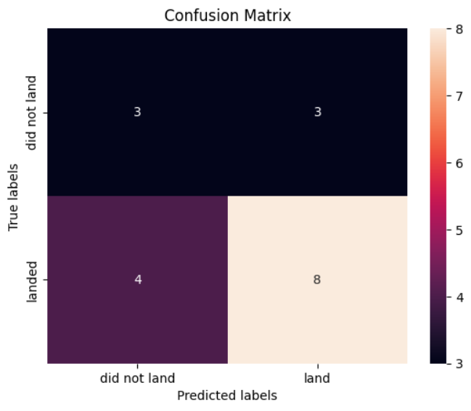
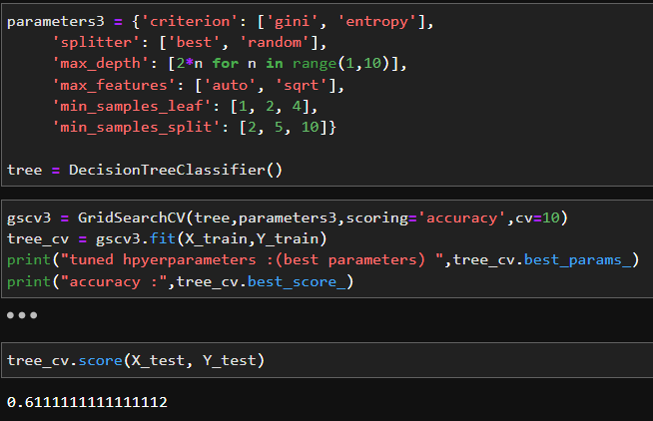
MACHINE LEARNING - DECISION TREE CLASSIFIER
Decision Tree is a Supervised Machine Learning Algorithm that uses a set of rules to make decisions, similarly to how humans make decisions
We can see from the confusion matrix under this model
It correctly predicted that 3 would not land and that 8 would land
It incorrectly predicted that 3 would land that 4 would not land

Slide 27
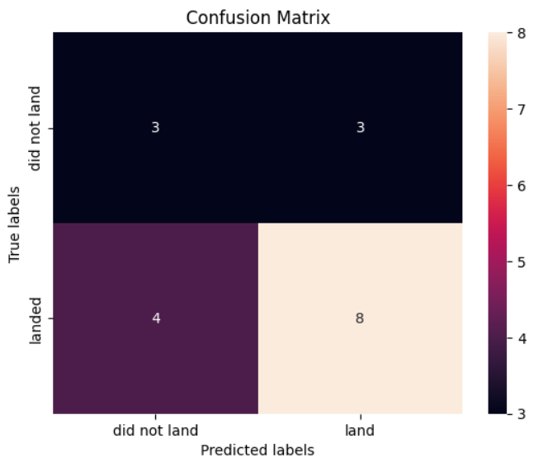
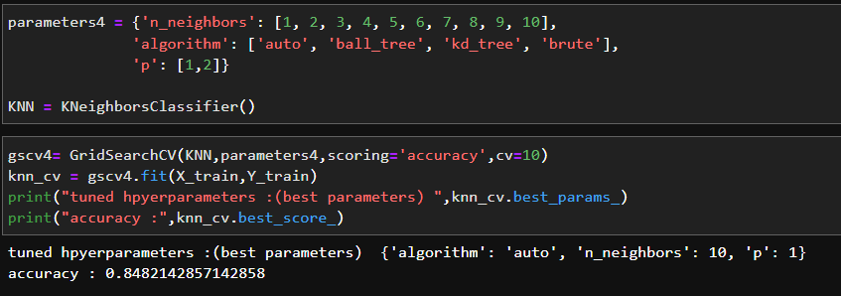
MACHINE LEARNING - K NEAREST NEIGHBOR
k-nearest neighbors (KNN) algorithm is a non-parametric, supervised learning classifier, which uses proximity to make classifications or predictions about the grouping of an individual data point
We can see from the confusion matrix under this model
It correctly predicted that 3 would not land and that 8 would land
It incorrectly predicted that 3 would land that 4 would not land

Slide 28
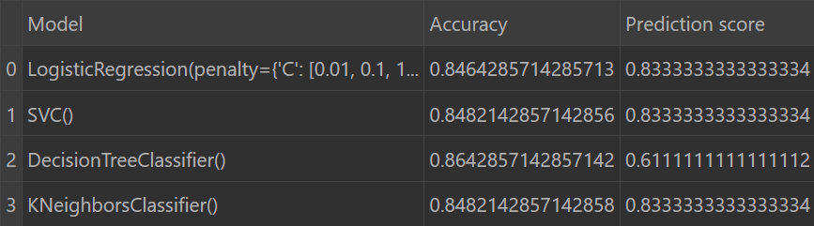
MACHINE LEARNING -
When we look at the accuraccy and prediction scores of the models we can confidently advise proceeding with the KNearest Neighbors Classifier to appl y to the unknown data.

Slide 29

DASHBOARD
<The GitHub link of the Cognos dashboard goes here.>

Slide 30
DASHBOARD TAB 1
Screenshot of dashboard tab 1 goes here

Slide 31
DASHBOARD TAB 2
Screenshot of dashboard tab 2 goes here

Slide 32
DASHBOARD TAB 3
Screenshot of dashboard tab 3 goes here

Slide 33

DISCUSSION
Data sources
Visualisations
Model selection
Additional data
Next steps

Slide 34
OVERALL FINDINGS & IMPLICATIONS
Findings
It is possible to predict whether a launch will be successful
SapceX's biggest client is NASA
The most common orbit is GTO but in recent time this has shifted to VLEO and ISS orbits
Implications
We need more data on the site locations and weather patterns related to the landings and launches
It is possible to enter this market

Slide 35

CONCLUSION
WE CAN PREDICT SUCCESS THOUGH MORE DATA WOULD ASSIST THE MODEL
WE NEED TO SECURE SITES IN CLOSE PROXIMITY TO THE EQUATOR, THE COASTLINE, WHERE THERE IS RAILWAY AND ROAD ACCESS WITHIN 1KM
Point 3
Point 4

Slide 36

APPENDIX
Falcon 9 - Wikipedia
MODELLING DATA SET 1
MODEELING DATA SET 2
DATASET 1
DATASET 2
DATASET 3
DATASET 4

