Slide 1
Go-Moku Game (Five-in-row)
Team 3: Java Program for the Go-Moku game ( five-in-row)
Team Members:
Simen Svedrup-Thygeson
Piran Caci
Woojin Kim

Slide 2
Why Go-Moku?
We find game-development interesting and motivating
Go-Moku is an appropriate game for command line execuction (since we weren‘t allowed to implement Graphical User Interface)
A popular game in Korea

Slide 3
Introduction
Abstract strategy board game
The board consists of 15 (horizontal lines) x 15 ( vertical lines)
Horizontal lines are marked with numbers, whereas vertical lines with capital letters
Two players: O(1st ) X(2nd); O is the player who starts the game
Every player takes turns to mark their own sign (O or X) in the board
The program doesn‘t provide a GUI, so it can be played only in through the command line

Slide 4
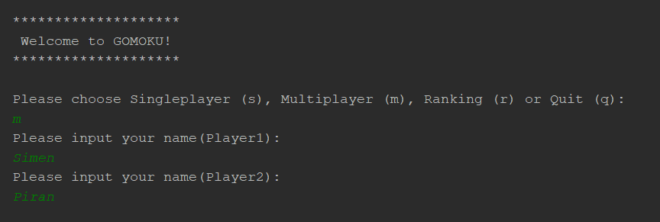
Program description
Terminal output:

Slide 5
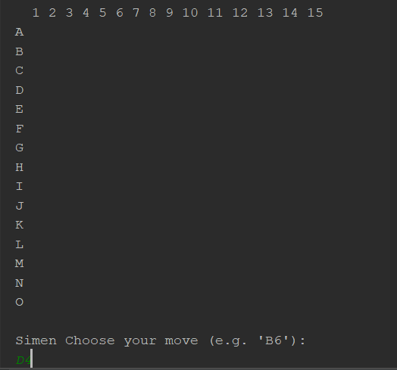
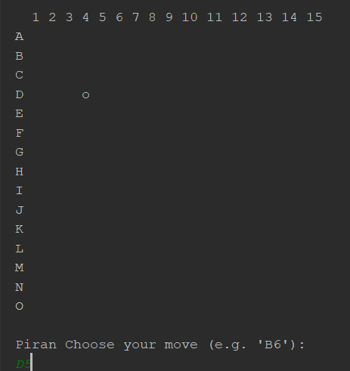
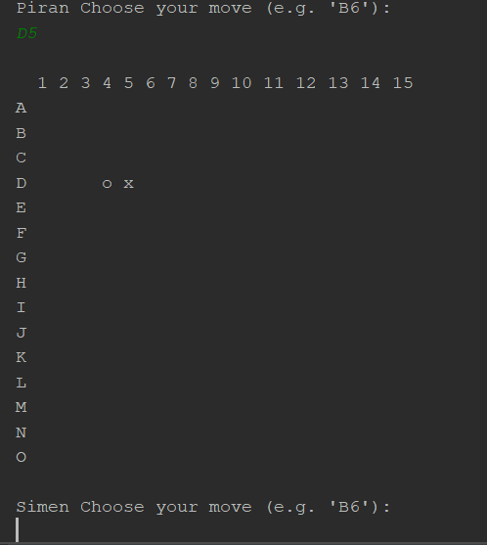

Slide 6
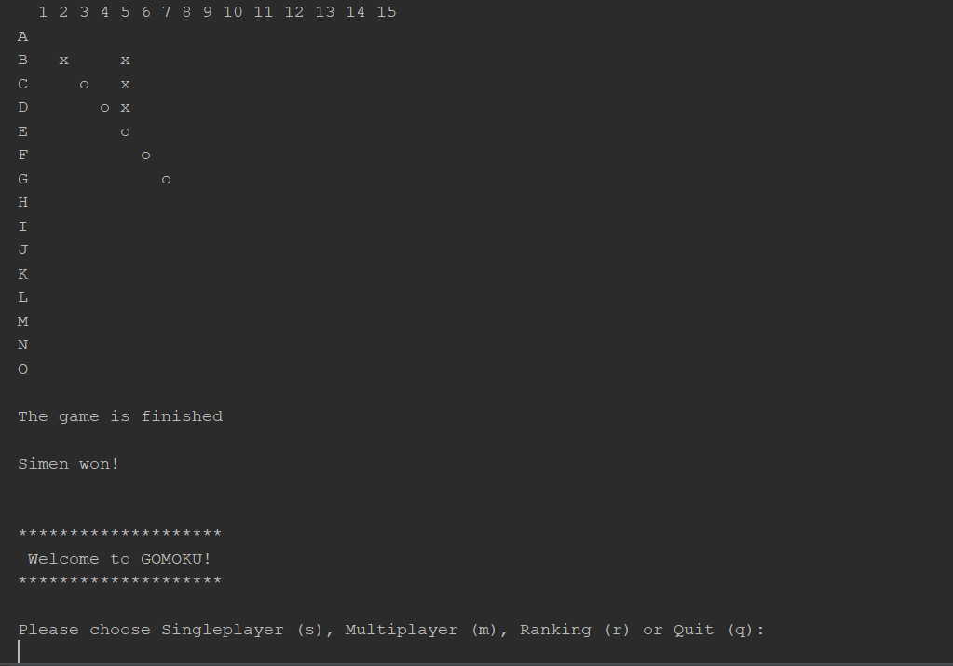

Slide 7
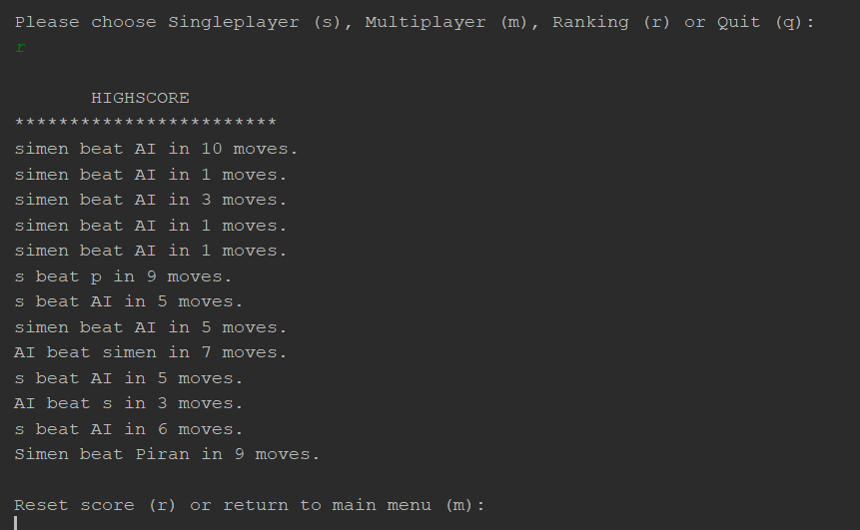

Slide 8
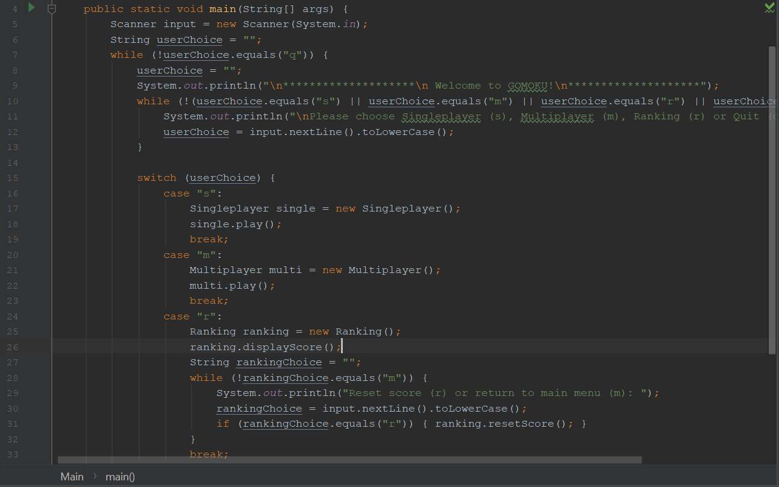
Main class
Contains the driving code
The main method runs through a infinite loop which presents the user with the main menu and the different alternatives.

Slide 9
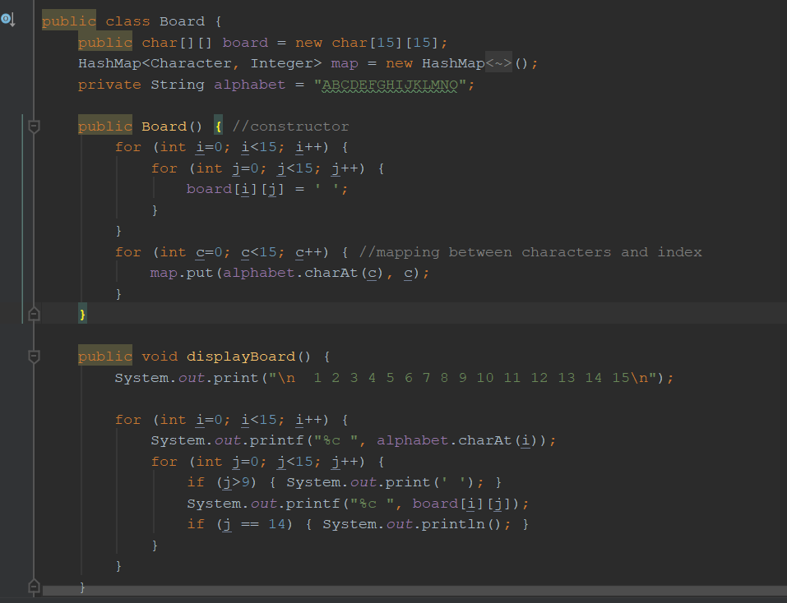
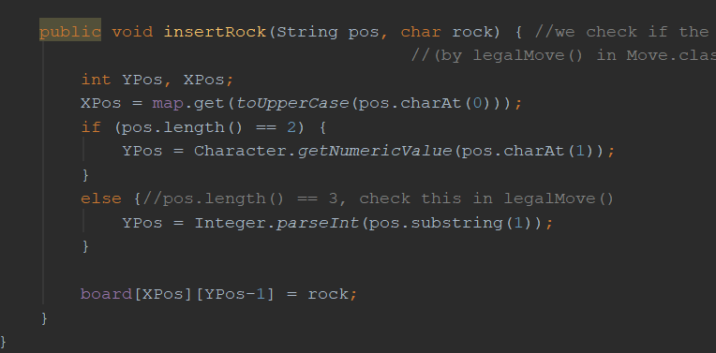
Board class
Constructs and displays the board
Inserts stones into the board

Slide 10
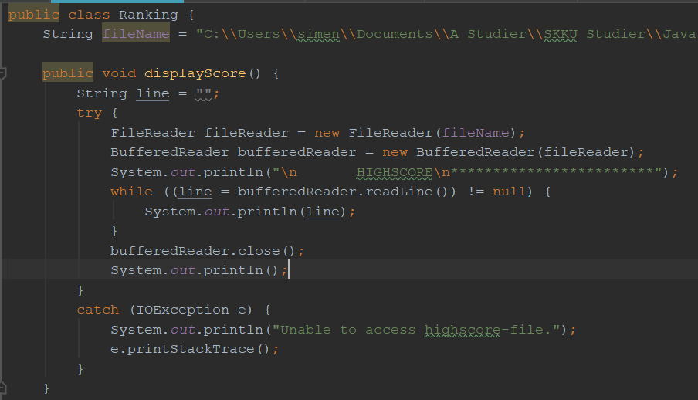
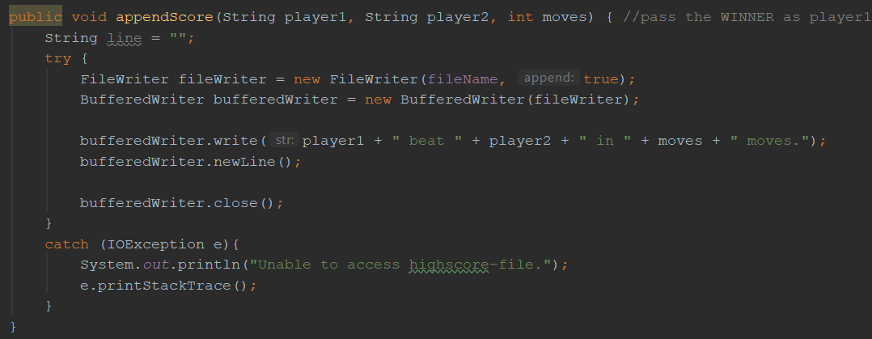
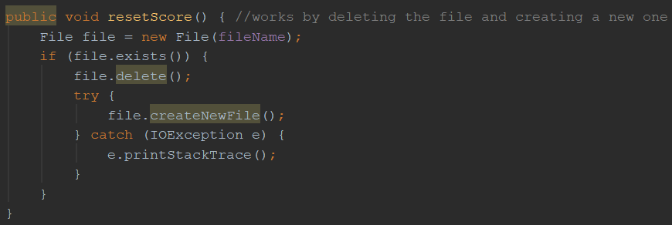
Ranking class
- Keeps track of the game results
in a non-volatile way

Slide 11
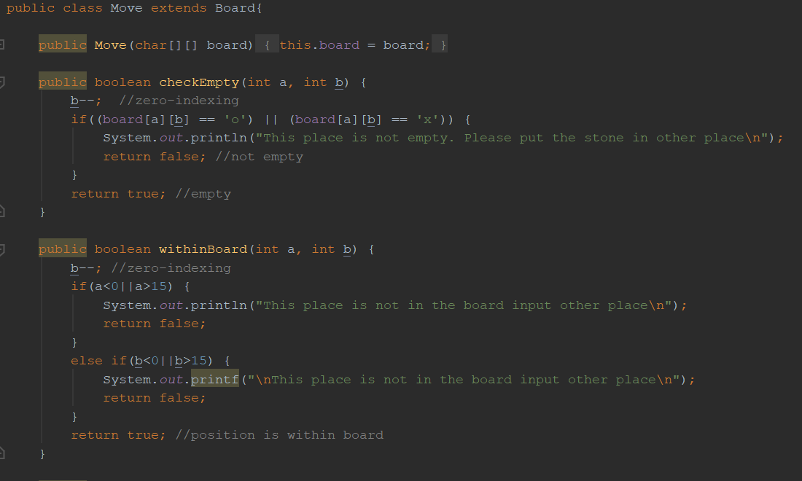
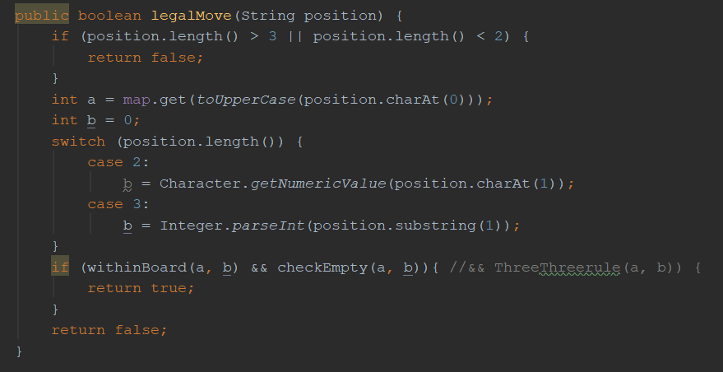
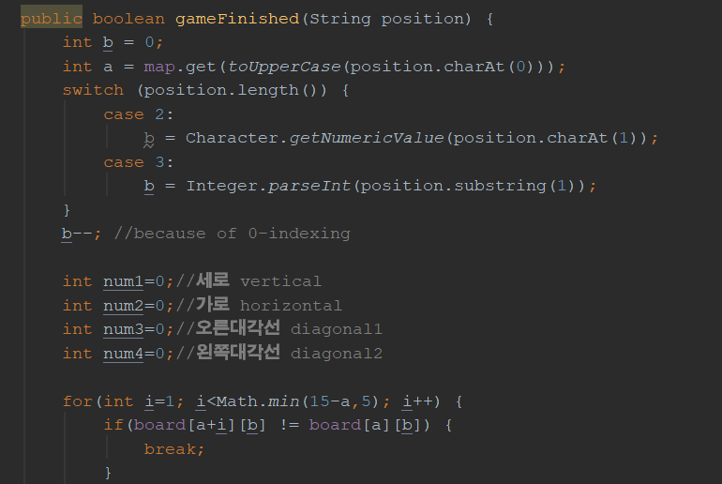
Move class
Checks whether a given move is legal and if it results in winning the game

Slide 12
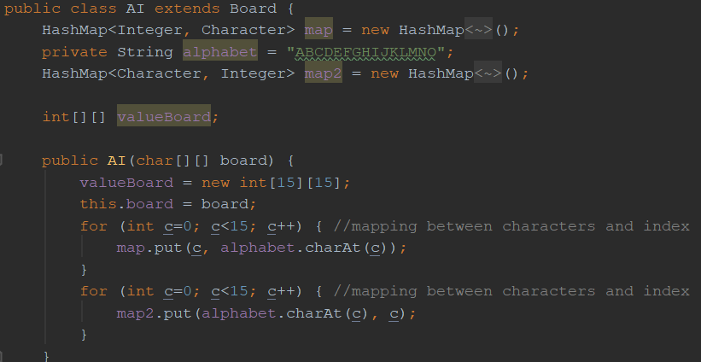
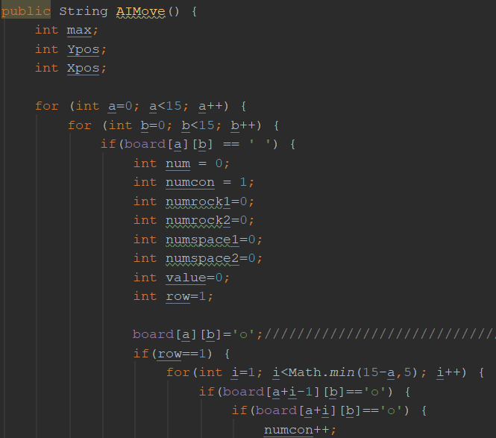
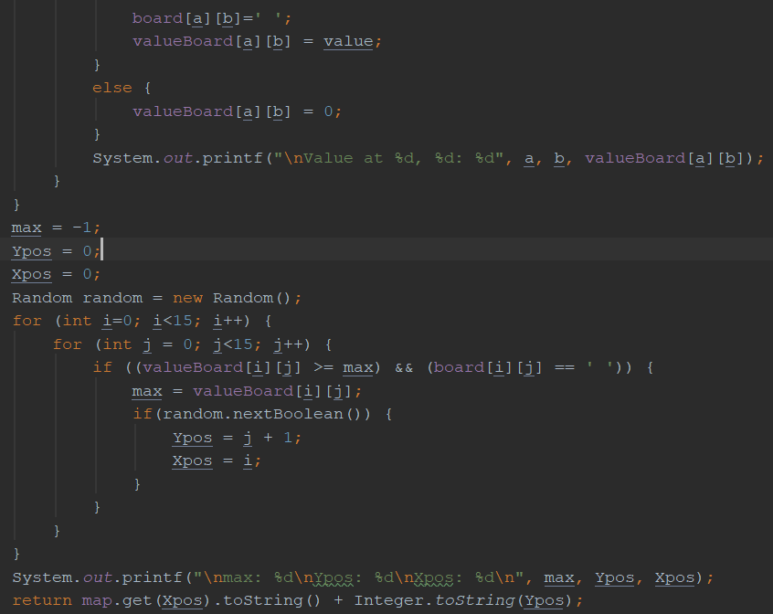
Ai class
(…)
Generates the opponent’s move for the singleplayer
Two HashMaps to simplify coordinate extraction and generation

Slide 13
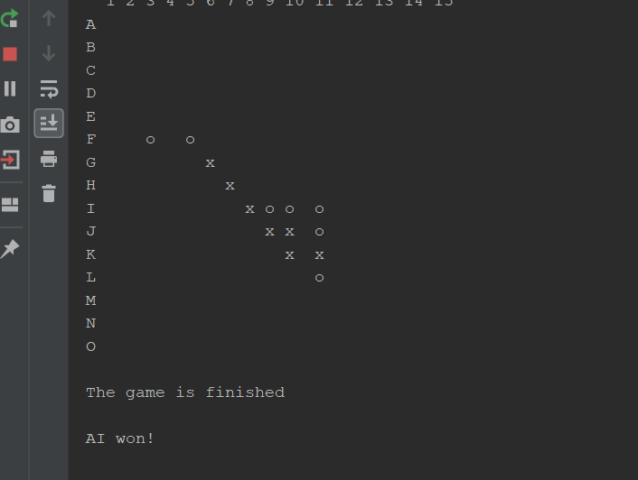

Slide 14
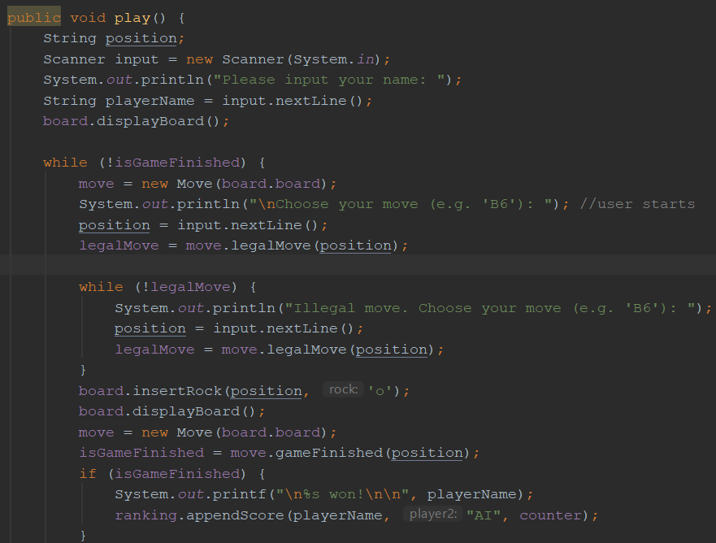
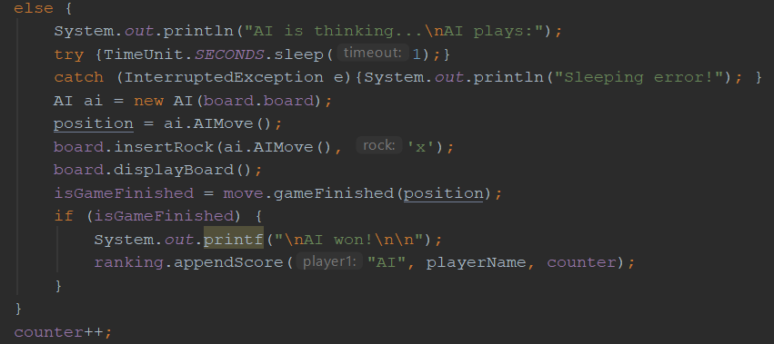
Singleplayer class
Implements the singleplayer functionality
using the AI-class

Slide 15
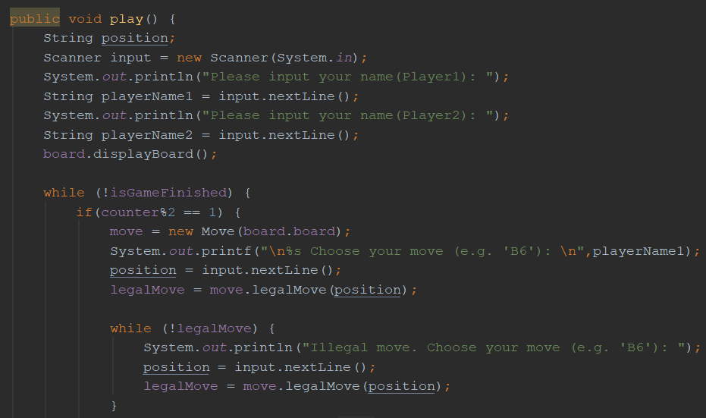
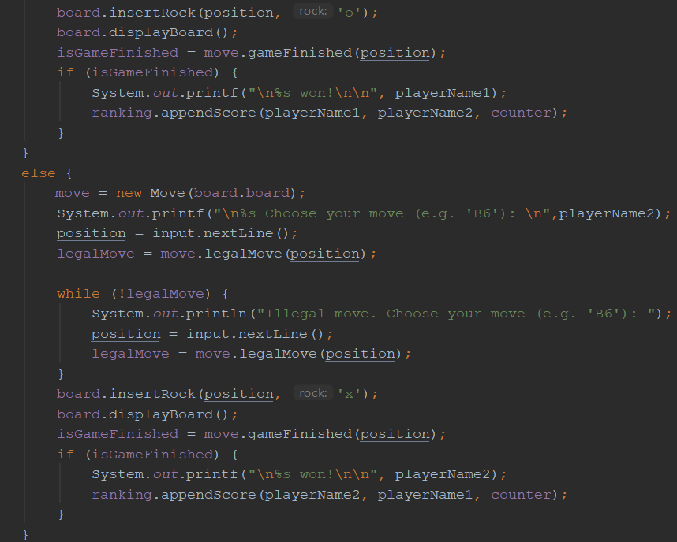
Multiplayer class
Implements the multiplayer functionality

Slide 16
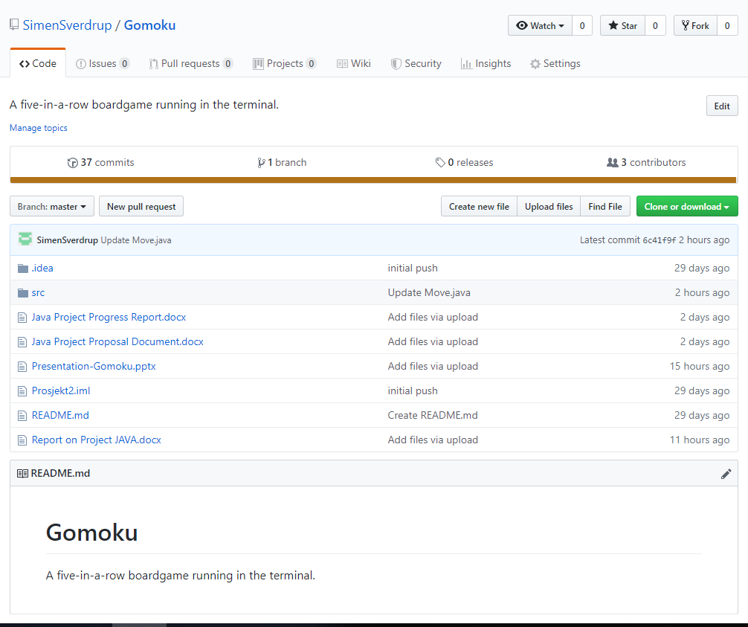
Development and external tools
We established a GitHub repository to handle version control and manage collaboration.
We also used KakaoTalk to discuss various aspects of the development and cooperation, when we weren’t able to meet in person.

Slide 17
Thank you
Questions?

