Slide 1
GPA1-B
Simeon Sipes
08/31/25

Slide 2
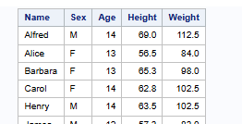

Slide 3
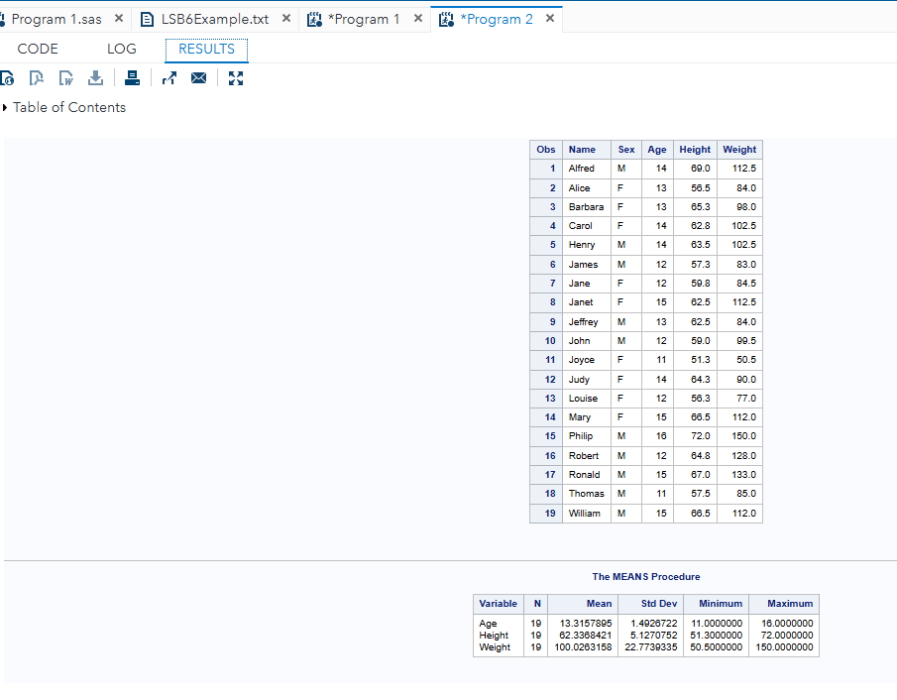

Slide 4


