Slide 1
🛡️
Enterprise Security Guardrail Auditor
API-first Infrastructure Security Scanner • Terraform • Risk Scoring • Dashboard
Technical Architecture Review & MVP Demo
Adedoyin Simeon Adeyemi • May 2026

Slide 2
Problem Statement
Infrastructure misconfigurations are the #1 cause of cloud security breaches
☁️
🔓
💾
👤
Public S3 Buckets
Open SSH Ports
Unencrypted Databases
Wildcard IAM Policies
Exposing sensitive data to the internet
Inviting brute-force attacks on servers
Violating compliance (HIPAA, SOC2, PCI-DSS)
Granting god-mode access across accounts
Teams need automated, continuous auditing of infrastructure-as-code before deployment.

Slide 3
Solution Overview
Enterprise Security Guardrail Auditor — an API-first infrastructure scanner
1
→
2
→
3
→
4
PARSE
EVALUATE
SCORE
VISUALIZE
Terraform configuration files
Against 15 security rules
Weighted risk 0–100 scale
Real-time dashboard
Upload a .tf file → Get instant security findings with remediation guidance

Slide 4
System Architecture
API-first, async, pluggable rule engine
Frontend — React 19 + TypeScript
Backend — FastAPI + SQLAlchemy Async
● Dashboard & Risk Visualization
● Scan Management
● Guardrail Configuration
● Tailwind CSS + Recharts
● Thin Controllers + Service Layer
● Scanner: Parser → Rules → Scoring
● Async throughout (aiosqlite)
● SQLite Database
REST API
◀─────▶
● API-first: Frontend is a pure REST consumer
● Pluggable rules: BaseRule subclasses
● Async throughout: FastAPI + SQLAlchemy async

Slide 5
Scanner Engine Design
Four-stage pipeline with pluggable rules
Stage | Component | Output
1. Parse | TerraformParser | list[ParsedResource]
2. Evaluate | RuleRegistry → BaseRule.evaluate() | list[Finding]
3. Score | calculate_risk_score() | float (0–100)
4. Aggregate | ScanEngine.scan() | ScanResult
Key Design Choices
● Frozen dataclasses for immutable scan results
● Registry pattern for O(1) rule lookup by resource type
● Dual scan paths (engine + legacy regex)
● Automatic deduplication of findings

Slide 6
Security Rules
15 rules covering critical AWS infrastructure patterns
Engine Rules (5)
Seed Guardrails (+10)
Rule | Severity | Catches
S3 Public Access | Critical | Public ACL on S3 buckets
Open SSH | Critical | Port 22 open to 0.0.0.0/0
Public Database | Critical | RDS publicly_accessible = true
Wildcard IAM | Critical | Action: "*" in policies
Disabled Encryption | High | storage_encrypted = false
● Default VPC detection
● CloudWatch logging
● EBS volume encryption
● RDS backup retention
● Security group egress
● S3 versioning
● IAM user policies
● MFA enforcement
● VPC flow logs
● KMS key rotation

Slide 7
Risk Scoring
Weighted severity model with 0–100 scale
Severity | Weight | Rationale
Critical | 10.0 | Immediate exploitation risk
High | 7.0 | Significant security gap
Medium | 4.0 | Best practice violation
Low | 1.0 | Minor improvement
Info | 0.5 | Advisory only
Formula
score = (weighted_sum / max_possible) × 100
Score Interpretation
0
25
60
100
Clean
Low Risk
High Risk
Critical

Slide 8
Frontend Dashboard
React 19 + TypeScript + Tailwind CSS + Recharts
📊
📋
📤
🔍
⚙️
Dashboard
Scan List
New Scan
Scan Detail
Guardrails
Stats cards, severity bar chart, recent scans overview
Paginated table with status & file type filters
Upload .tf file or paste content directly
Findings by severity, risk score badge
Security rule management interface
React 19 • TypeScript • Tailwind CSS 3 • Recharts • React Query • React Router 7

Slide 9
Tech Stack
Modern async Python + React with full DevOps pipeline
Layer | Technology | Purpose
API Framework | FastAPI | Async REST API with OpenAPI docs
ORM | SQLAlchemy 2.x Async | Async database operations
Database | SQLite + aiosqlite | Zero-config persistence
Validation | Pydantic v2 | Request/response schemas
Frontend | React 19 + TypeScript | Type-safe UI components
Styling | Tailwind CSS 3 | Utility-first responsive design
Charts | Recharts | Severity distribution visualization
Server State | @tanstack/react-query | Cache, sync, background refresh
Testing | pytest + Vitest + RTL | Backend + frontend coverage
CI/CD | GitHub Actions | 5-job automated pipeline
Containers | Docker + Compose | Multi-stage production builds

Slide 10
Testing & Quality Assurance
Automated testing, linting, and security audit pipeline
Backend Tests
Coverage
Frontend Tests
Lint Violations
Security Findings
97
94.65%
24
0
26 / 10 fixed
Testing Approach
Quality Gates
● Async integration tests with httpx.AsyncClient
● In-memory SQLite for test isolation
● React Testing Library for behavior testing
● Pre-commit hooks prevent regressions
● ruff — linting (E, F, W, I, N, UP, S, B)
● black — code formatting
● mypy — static type checking
● tsc — TypeScript type checking

Slide 11
DevOps & Deployment
Production-ready containerized deployment
GitHub Actions CI — 5 Jobs
✓ backend-lint
✓ backend-test
✓ frontend-lint
✓ frontend-test
✓ docker-build
Docker
Developer Tools
● Multi-stage builds (small images)
● Non-root container users
● Healthcheck endpoints
● docker-compose one-command deploy
● Makefile with 12 shortcuts
● Pre-commit hooks (ruff, black, mypy)
● Secret detection in commits
● .env.example for easy setup
$ docker compose up --build -d # Full stack in 60 seconds $ make test # Run all tests $ make lint # Run all linters

Slide 12
MVP Tradeoffs & Limitations
Pragmatic decisions for rapid delivery
Limitation | Rationale | Future Fix
No authentication | MVP scope — scanner logic first | JWT / OAuth2
SQLite only | Zero-config, adequate for demo | PostgreSQL option
Regex-based parser | No binary deps, pure Python | HCL2 library
Sync scanning | Simple flow for single files | Background tasks
AWS rules only | Most common cloud provider | Azure / GCP rules
No CloudFormation | Terraform-first approach | YAML / JSON parser

Slide 13
Future Roadmap
Planned enhancements beyond MVP
Near-term
Long-term
● API key authentication
● CloudFormation YAML/JSON parsing
● Azure and GCP rule packs
● Export results as PDF/CSV
● Error boundary in React frontend
● JWT/OAuth2 with RBAC
● Async scan processing
● Multi-file / zip upload
● Scan trend comparison charts
● Webhook notifications
● PostgreSQL migration option
● Custom guardrail creation via UI

Slide 14
Demo Flow
Live walkthrough of the scanning workflow
1
→
2
→
3
→
4
→
5
Start Stack
Open Dashboard
Upload .tf File
View Findings
Check Score
docker compose up --build -d
http://localhost:3000 View stats & charts
New Scan → Upload vulnerable-infra.tf
Scan Detail → Findings grouped by severity
Risk score badge 0–100 weighted
📁 Sample files: samples/vulnerable-infra.tf (11 vulns) • samples/multi-service-vulnerable.tf (9 vulns)

Slide 15
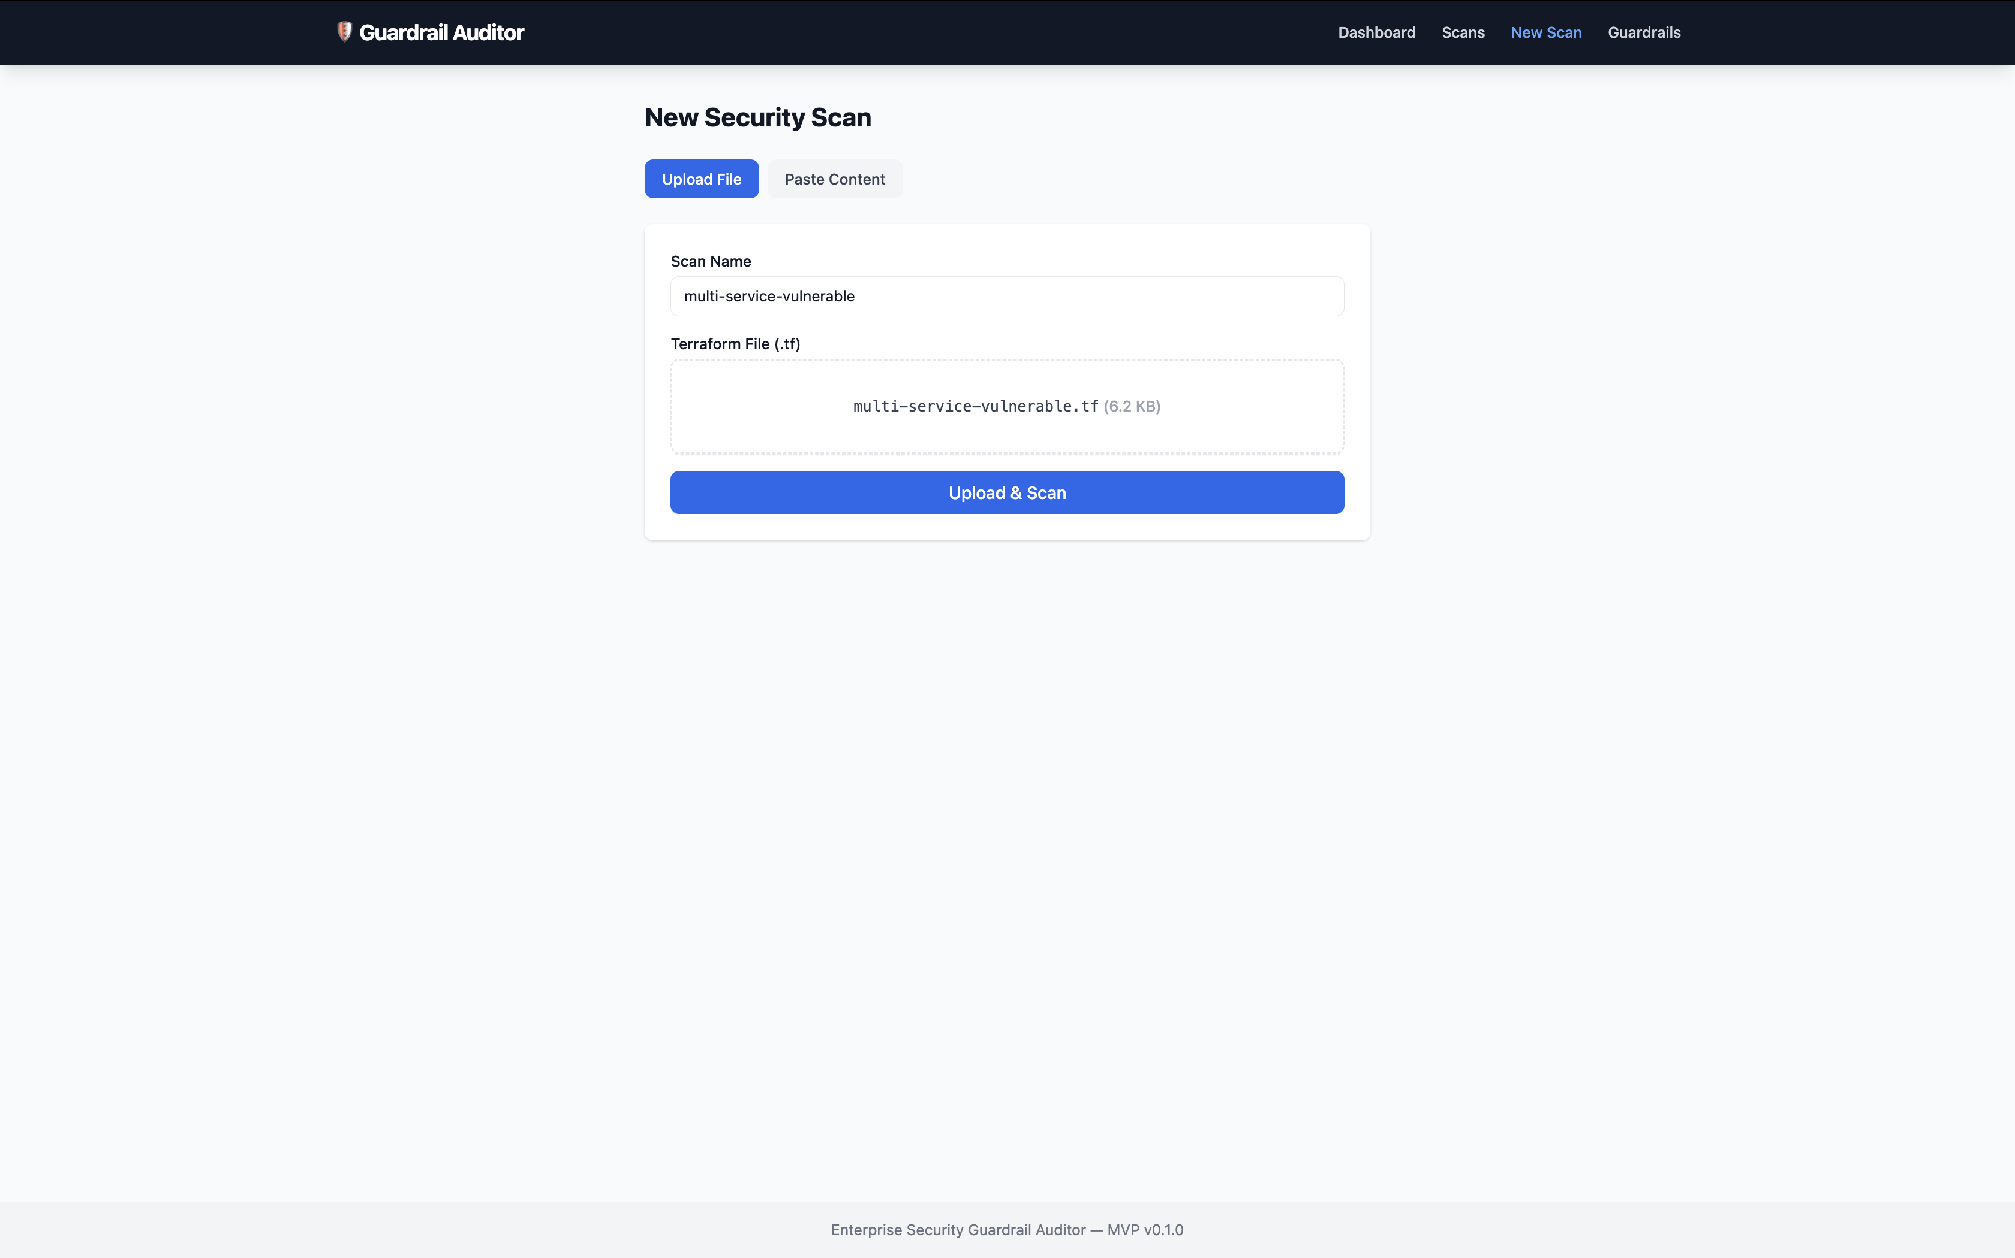
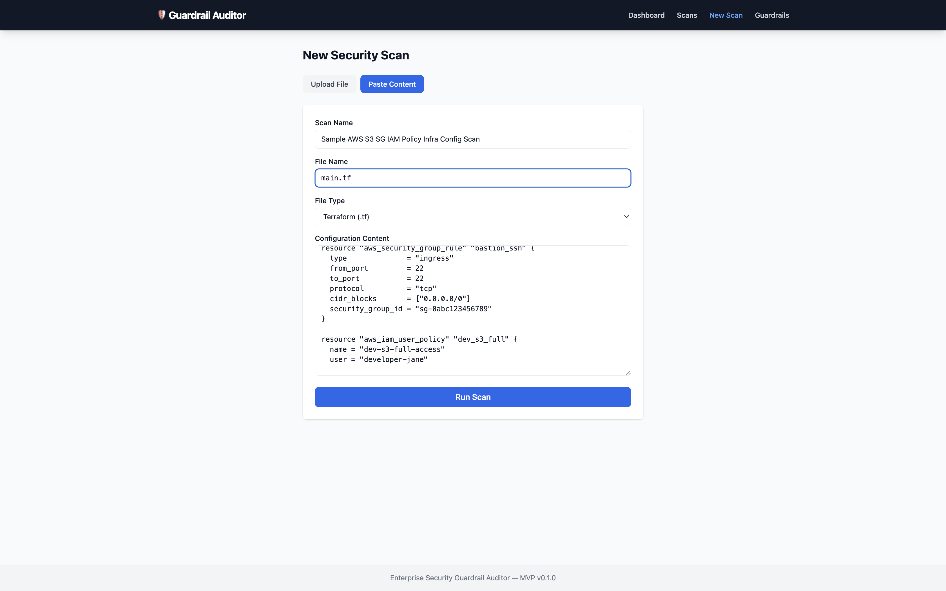
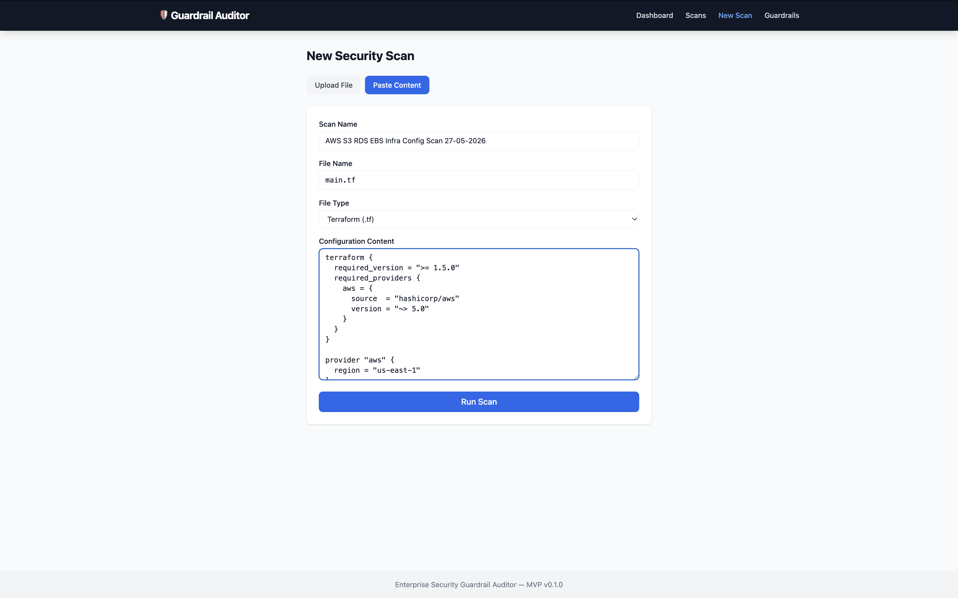
MVP App Screenshots — New Scan Forms
File upload and direct content entry modes
File Upload
Direct Entry (S3/SG/IAM)
Direct Input (S3/RDS/EBS)

Slide 16
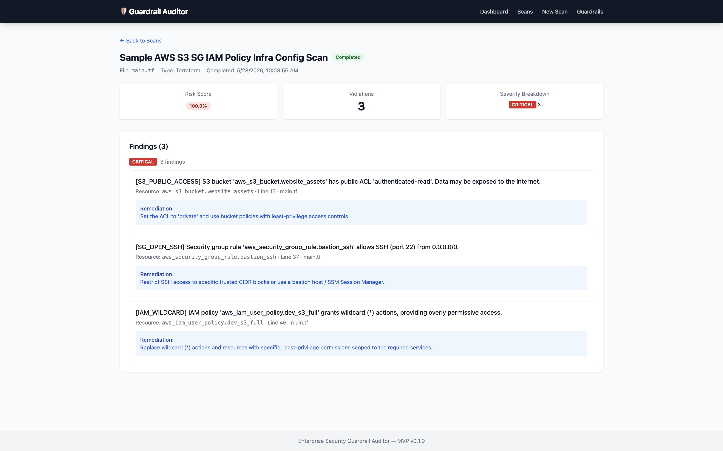
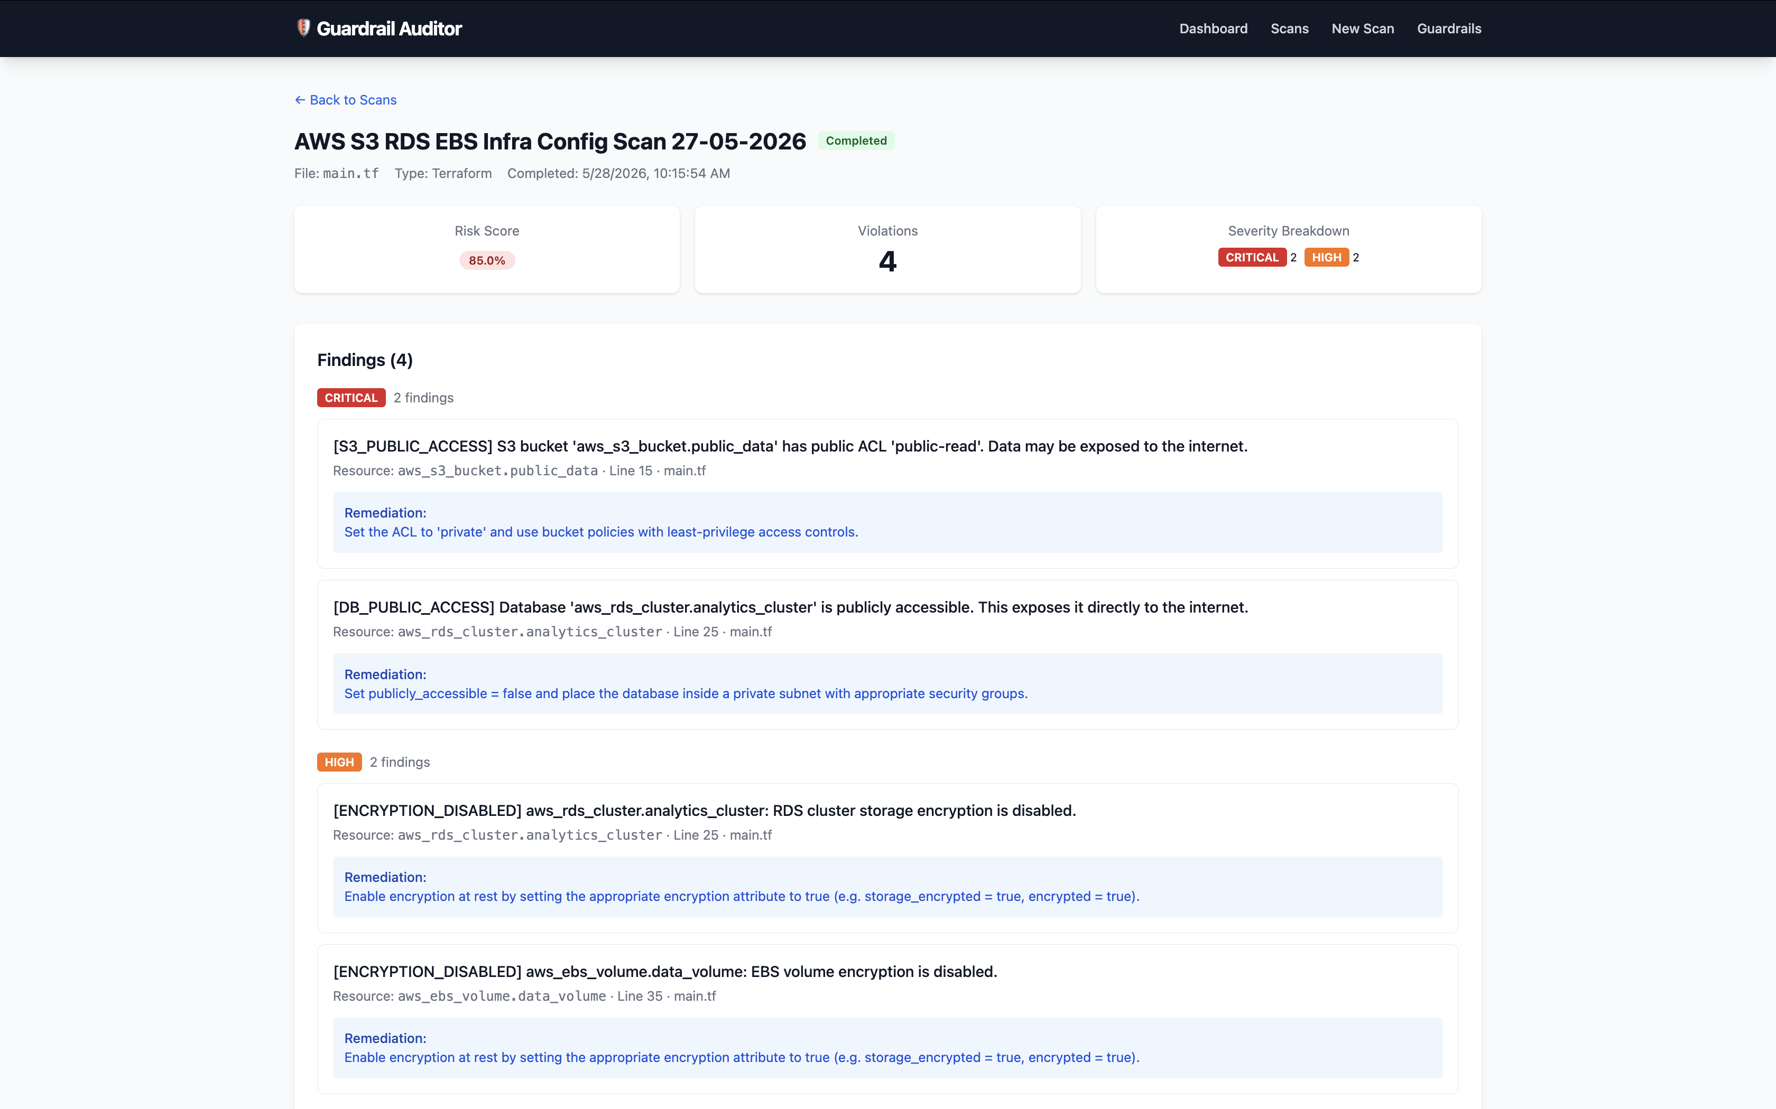
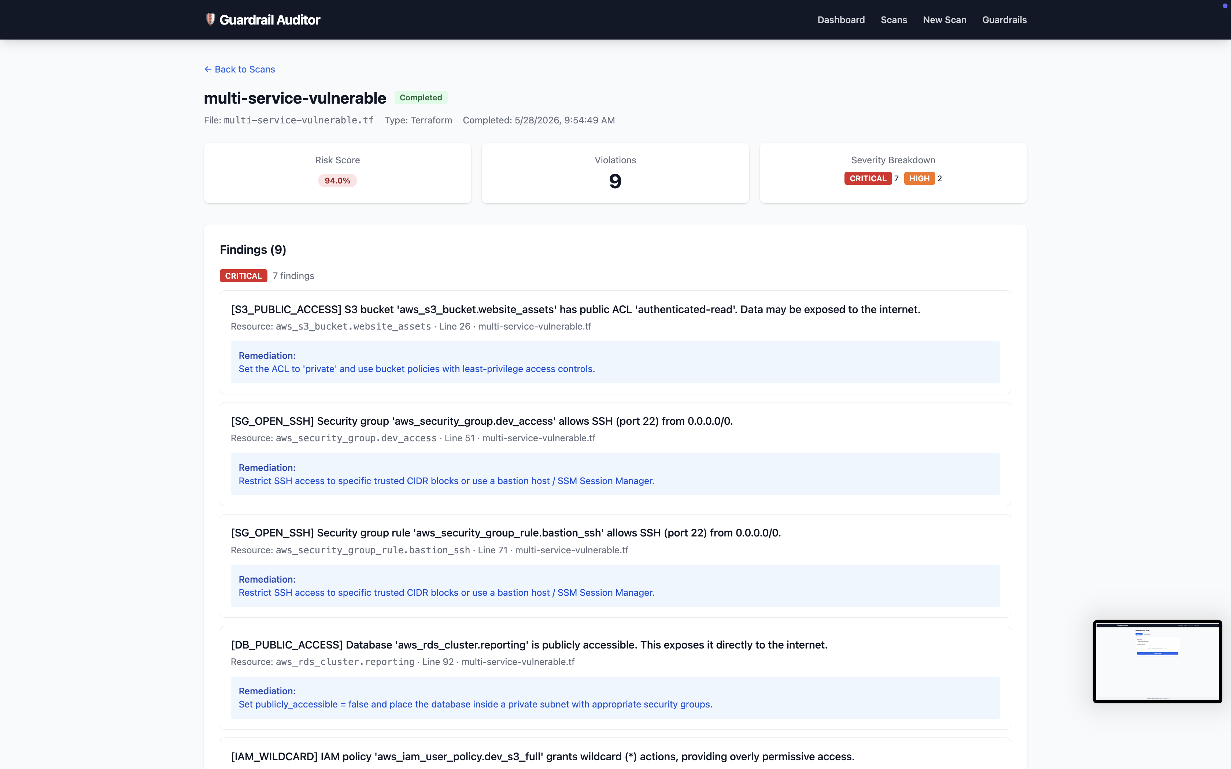
MVP App Screenshots — Scan Results
Security findings with severity grouping and risk scores
Direct Entry (S3/SG/IAM)
Direct Input (S3/RDS/EBS)
Uploaded Multi-Service

Slide 17
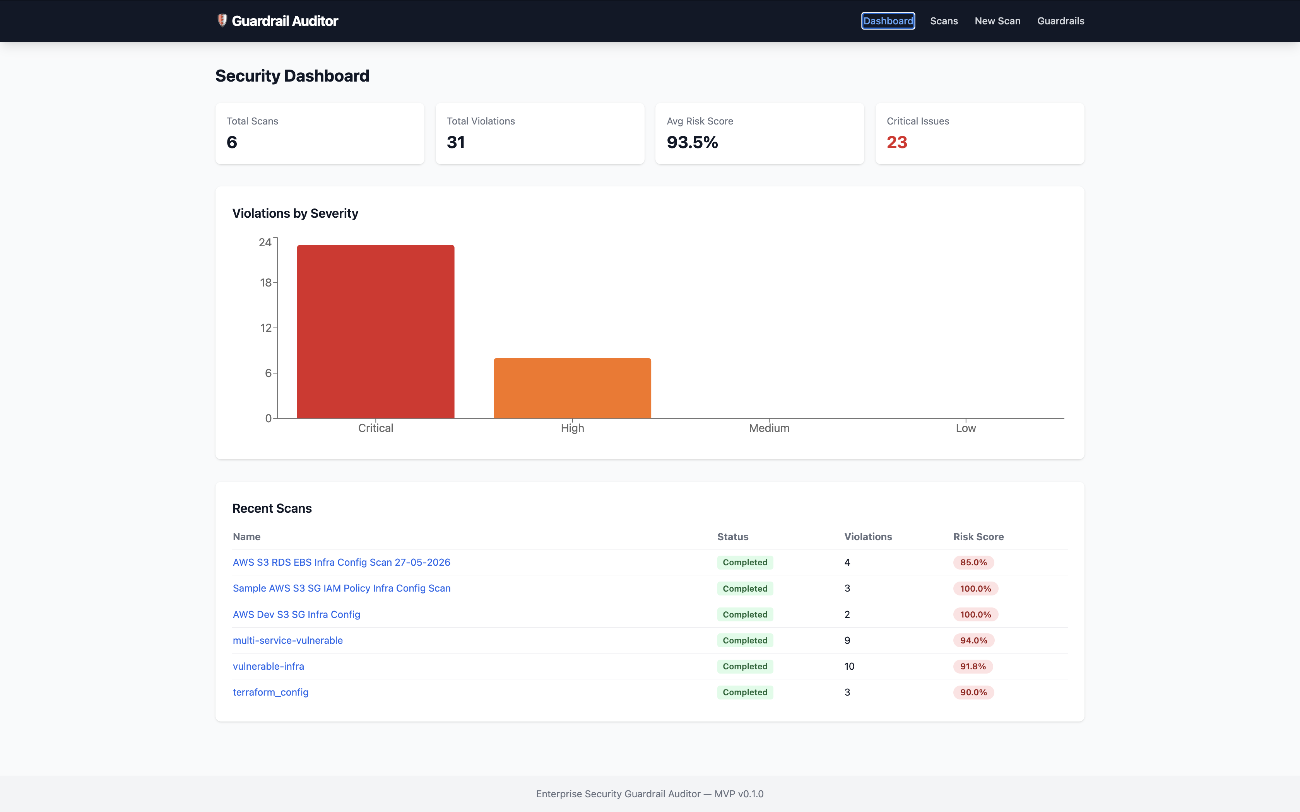
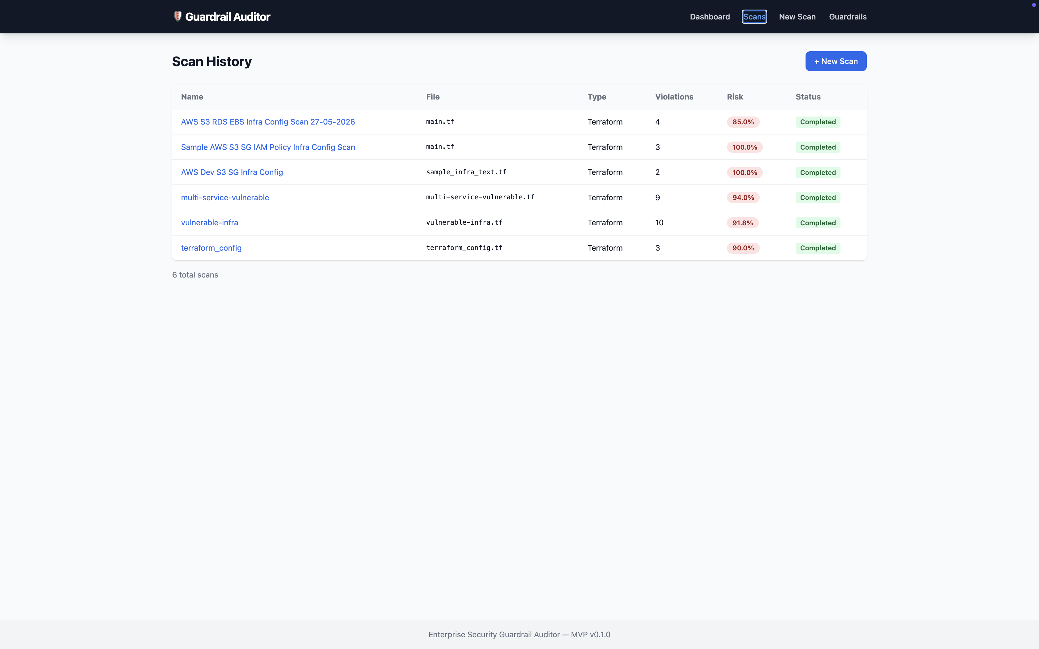
MVP App Screenshots — Dashboard & Scan History
Live application captures from the running MVP
Dashboard
Scan History

Slide 18
Enterprise Security Guardrail Auditor
✅ Automated IaC security scanning — 15 rules
✅ Weighted risk scoring — 0 to 100
✅ Visual dashboard with severity charts
✅ RESTful API with OpenAPI documentation
✅ 94.65% test coverage, zero lint violations
✅ Production-ready Docker deployment
✅ Extensible rule system for future growth
github.com/SimeonDee/Enterprise-Security-Guardrail-Auditor

Slide 19
Thank You
Questions & Discussion
Adedoyin Simeon Adeyemi
github.com/SimeonDee/Enterprise-Security-Guardrail-Auditor

