Slide 1
Finovate
Visual Feature Guide & Architecture Walkthrough
Version 1.0.0 · 2026-10-11 · Synthetic demo screenshots

Slide 2
Agenda
Product purpose & honest boundaries
Architecture & data flow
Authentication & onboarding
Feature visual walkthroughs
Savings plan & simulated investing logic
API, integrations, deployment
Testing, coverage, known gaps

Slide 3
What Finovate is
Personal finance tracker + planner (Django 6.1)
Real: transactions, budgets, goals, CSV import, plan math
Simulated: investing, round-up sweeps, demo AI orders
Identity: Auth0 and/or Supabase Auth (no local password site login when IdPs expected)
Data: SQLite locally or Postgres (Supabase)
Notes:
Emphasize simulated investing disclaimers in every demo.

Slide 4
Architecture at a glance
Thin views → services/plan_engine/pipeline → ORM
Decimal money helpers shared in core.services
Per-user ownership on every query
Vercel WSGI entry; migrate-on-boot; optional seed
External: Auth0, Supabase, Twelve Data, Spectrum webhook

Slide 5
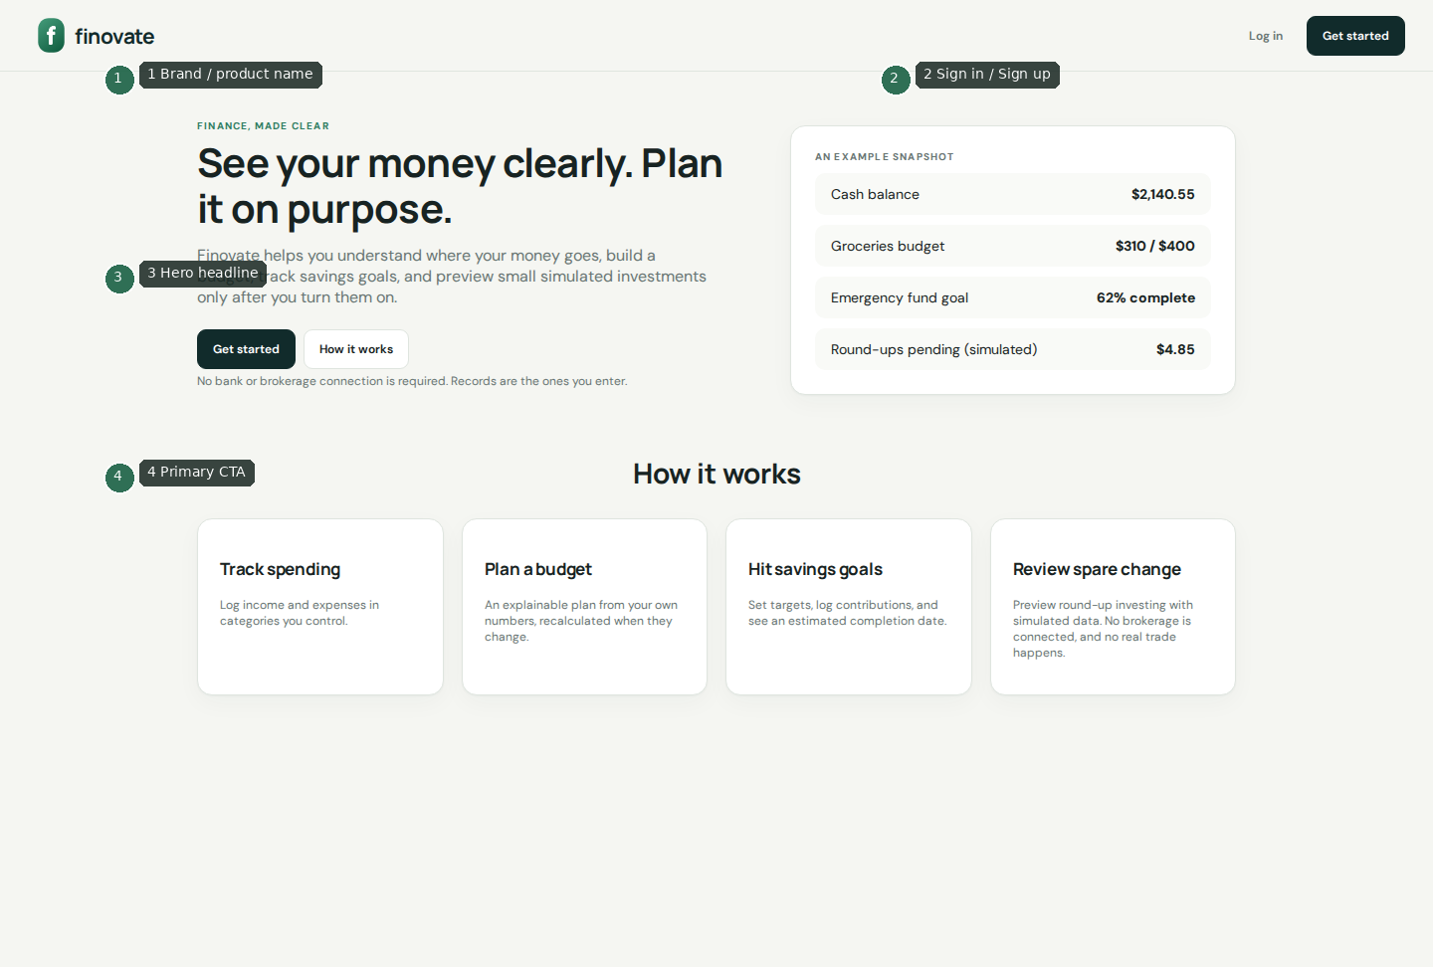
Landing page

Slide 6
Landing — callouts
1 Brand / product name as hero signal
2 Sign in / Sign up entry points
3 Value proposition headline
4 Primary CTA into registration
Public route: /

Slide 7
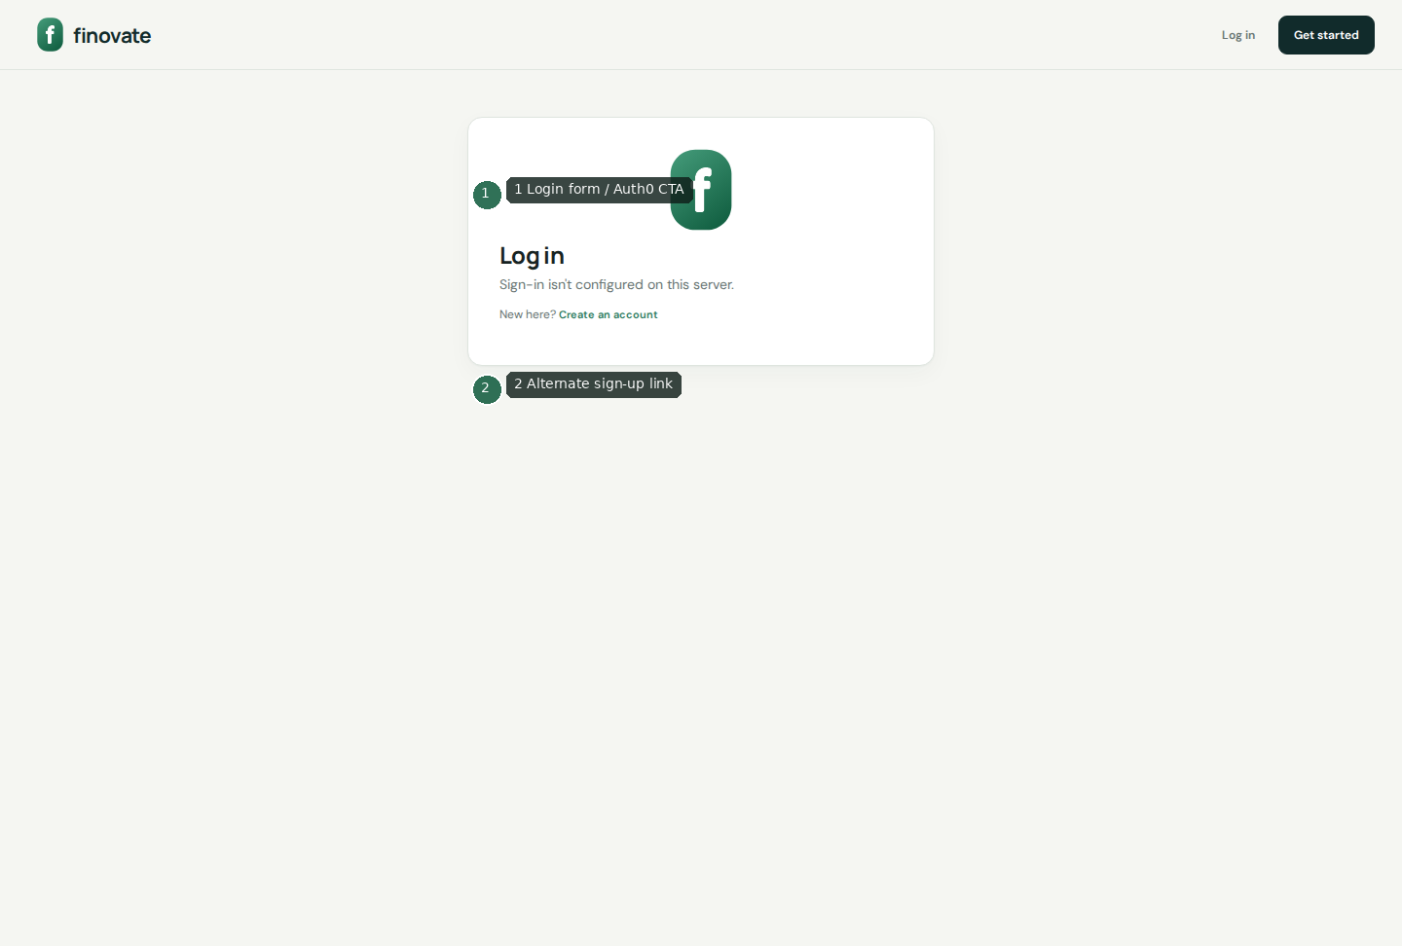
Login

Slide 8
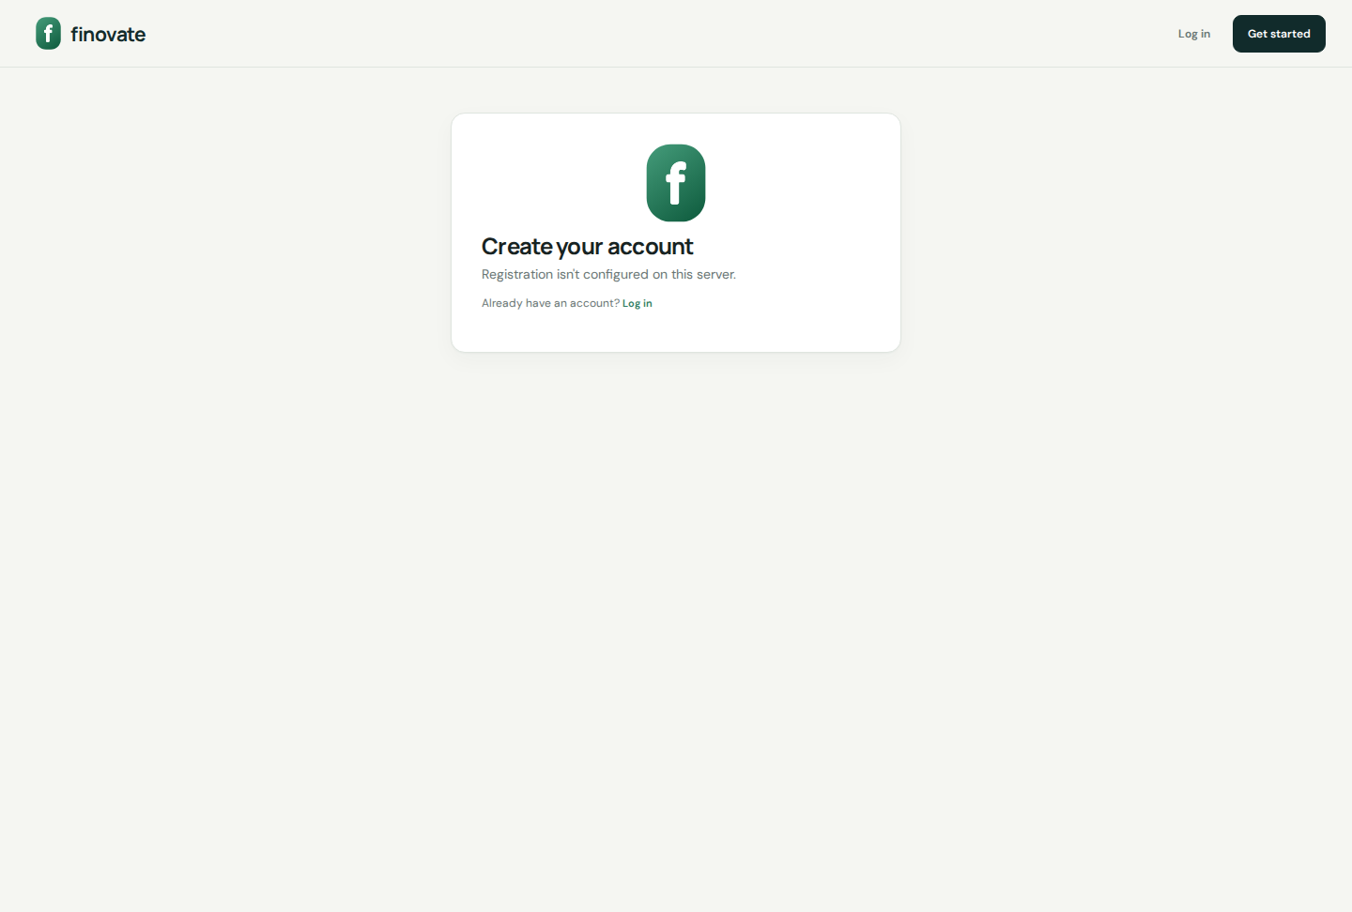
Sign up

Slide 9
Auth lifecycle
Signup/login via Auth0 Universal Login or Supabase email
Profile keyed by auth0_sub or supabase_uid (never email merge for Auth0)
Verify gate → onboarding → preferences → dashboard
Rate limits protect signup/login/resend
GET /api/me/ accepts Auth0 Bearer access tokens

Slide 10
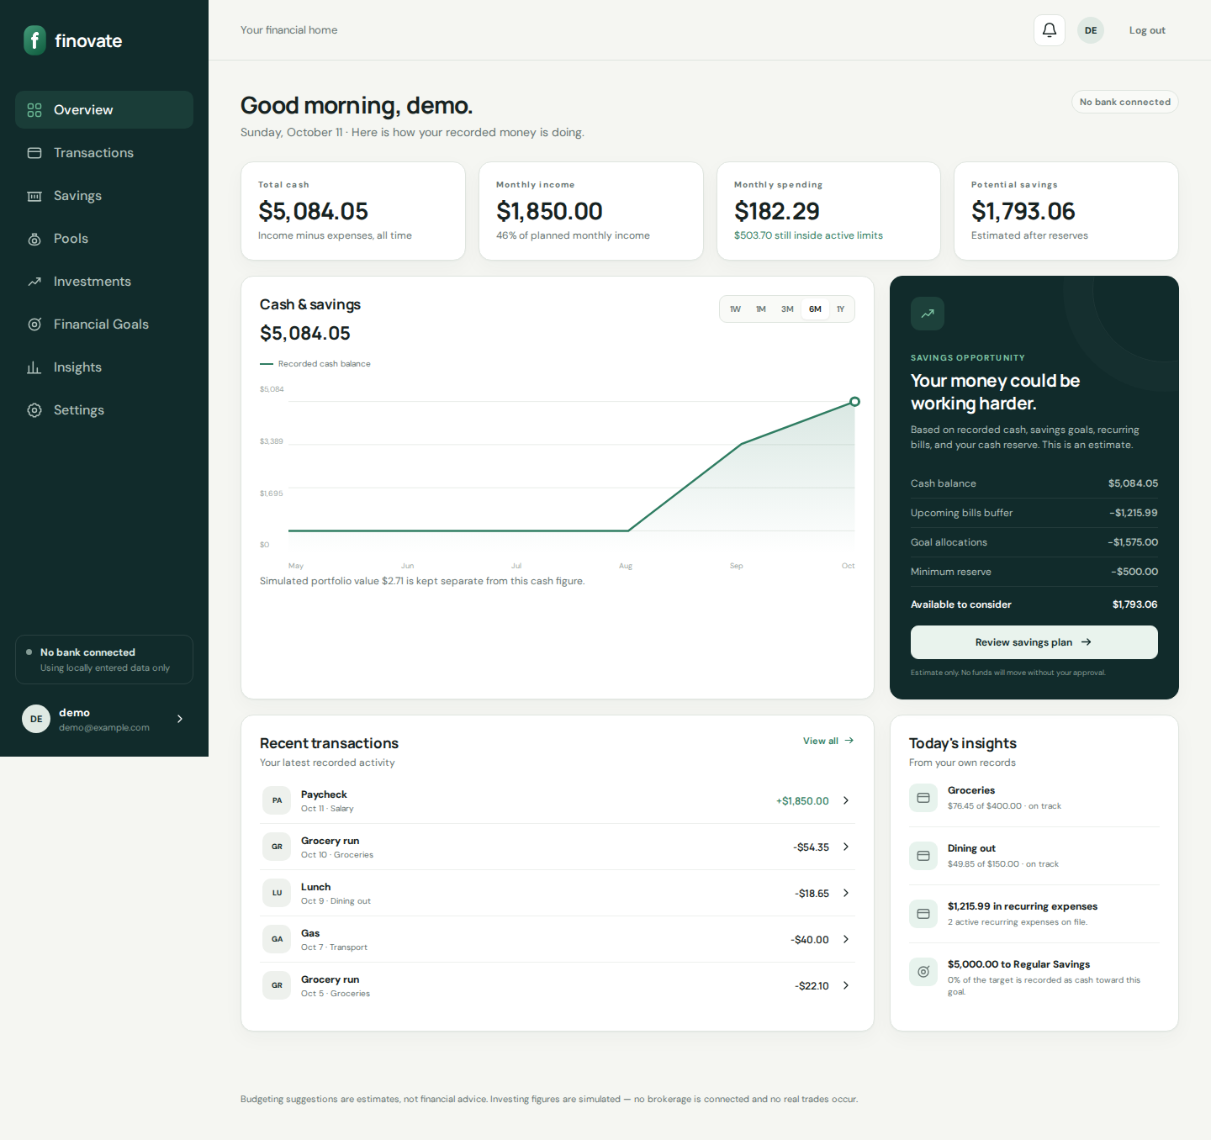
Onboarding

Slide 11
Onboarding paths
Import CSV bank statement (real commit after preview)
Connect bank — coming soon placeholder
Manual setup estimates → budget plan summary
Preferences set onboarding_completed

Slide 12
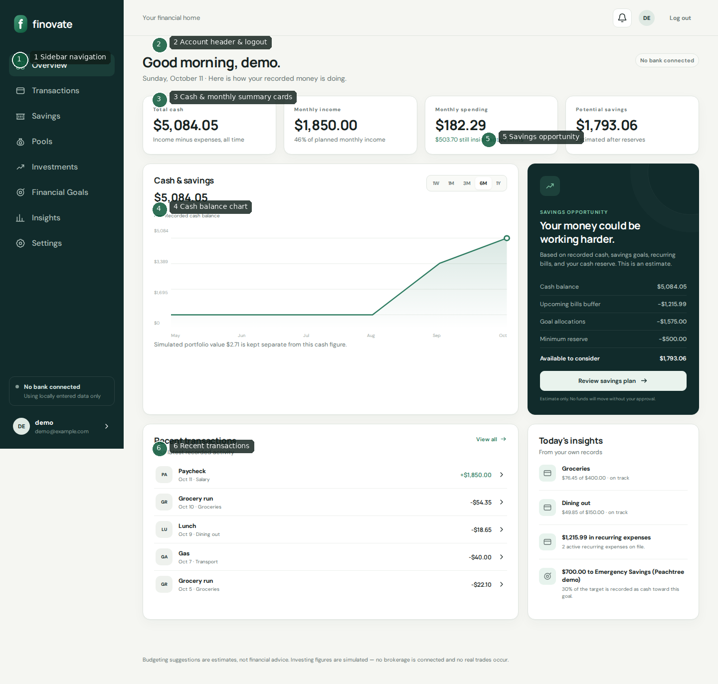
Dashboard overview

Slide 13
Dashboard elements
1 Sidebar navigation across product areas
2 Account header, notifications affordance, logout
3 Cash & monthly summary cards
4 Cash balance chart (range controls)
5 Savings opportunity / plan CTA
6 Recent transactions

Slide 14
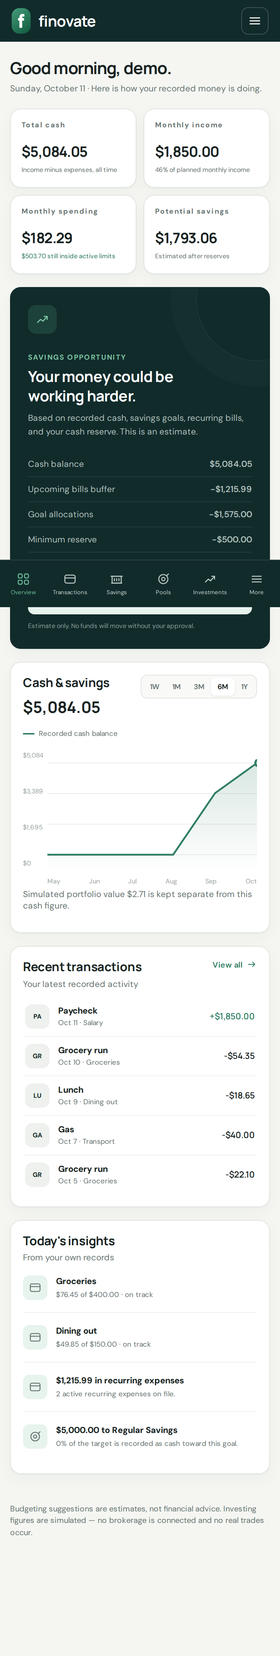
Dashboard (mobile)

Slide 15
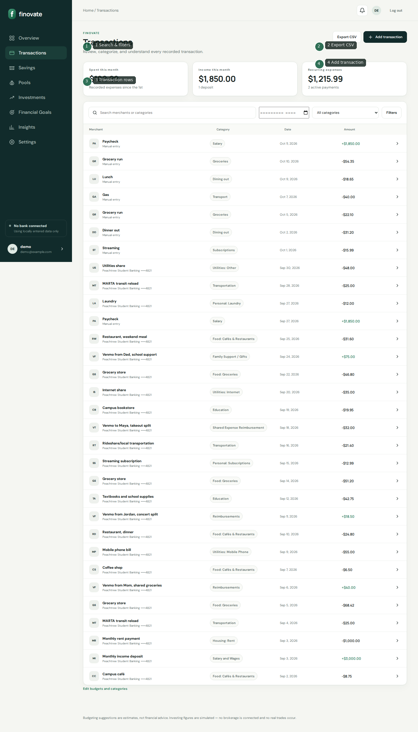
Transactions

Slide 16
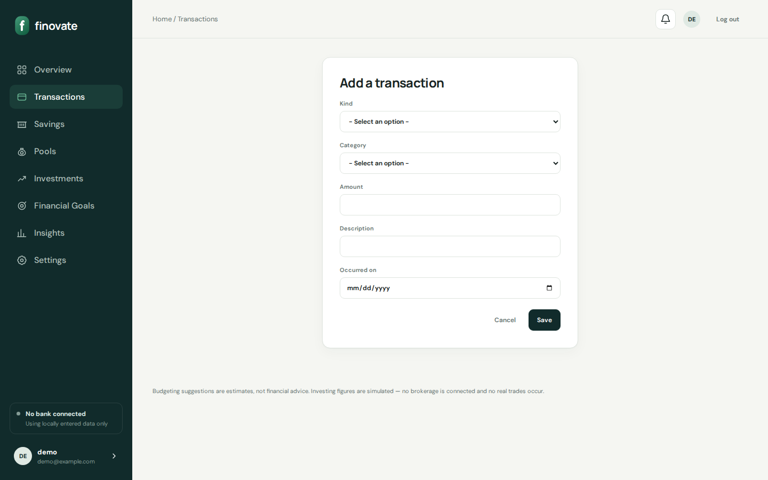
Add transaction

Slide 17
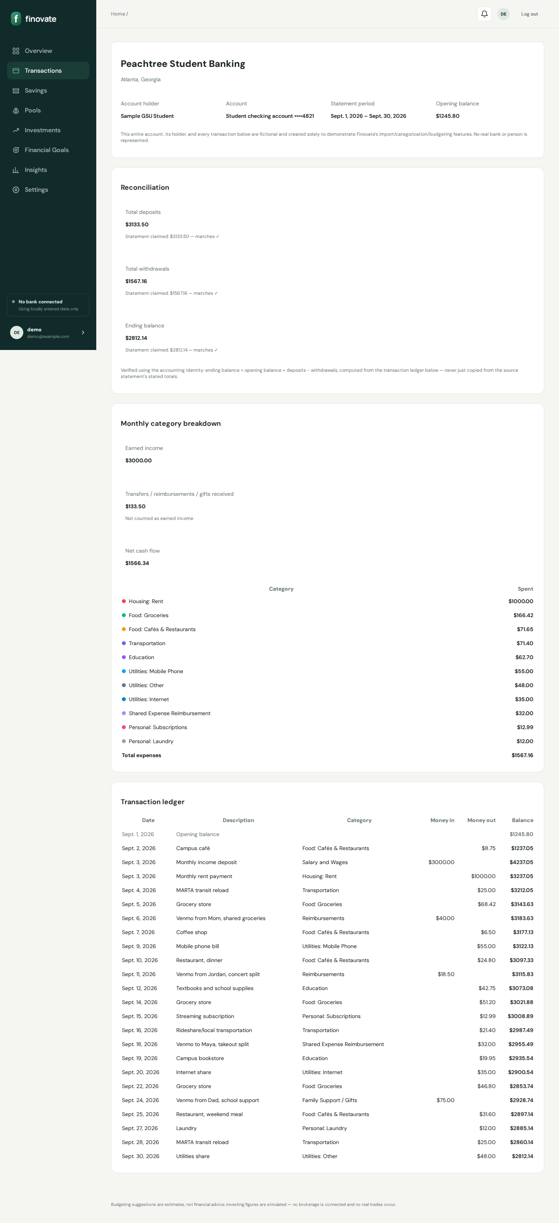
Statement detail

Slide 18
Transactions — logic
CRUD under /budgets/transactions/
CSV export endpoint
Positive amount + kind; Decimal quantization
Idempotent imports via external_id
Statements reconcile computed vs stated balances

Slide 19
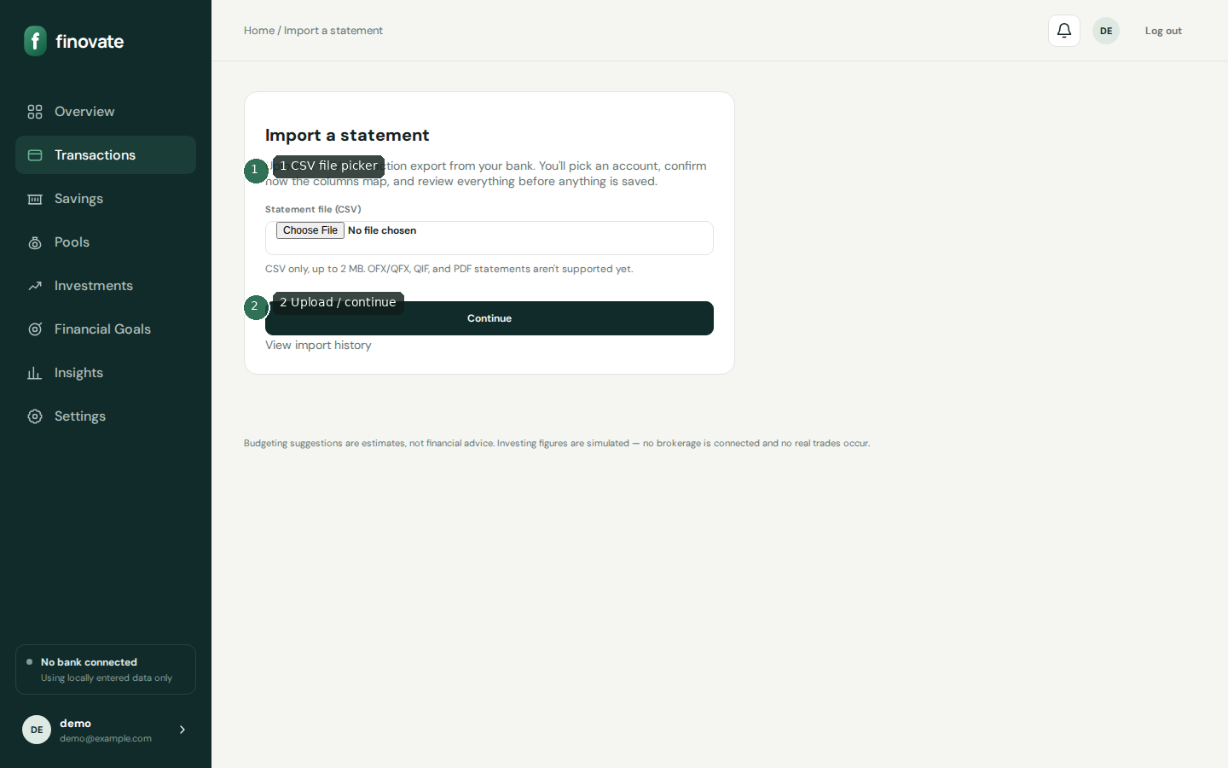
CSV import upload

Slide 20
Import wizard
Upload (≤2MB CSV) → choose/create account → preview → commit
ImportBatch stores raw file + mapping + counters
Duplicates skipped; unreadable → manual setup path
History/retry/delete at /imports/

Slide 21
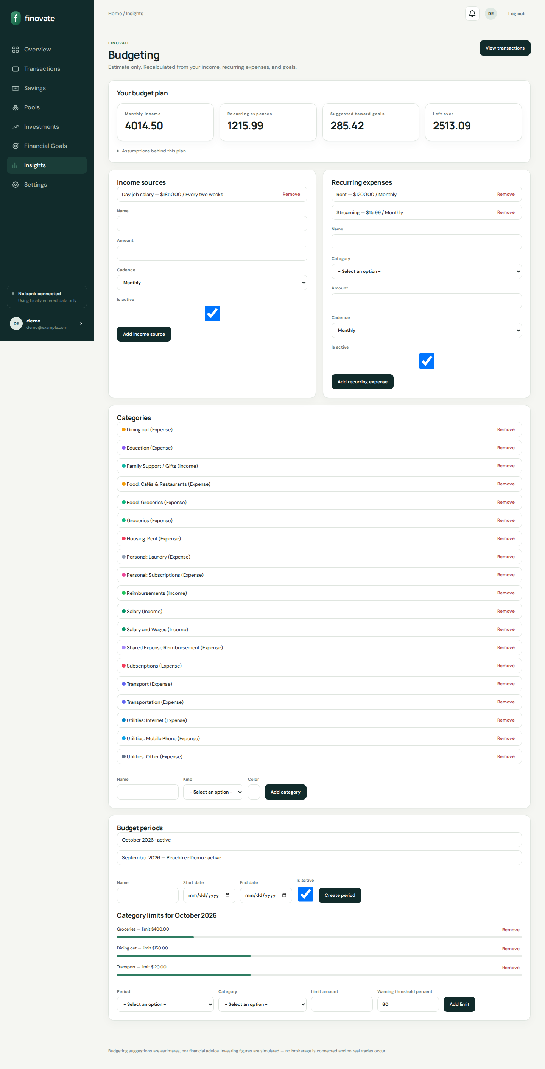
Budgets

Slide 22
Budget math
Progress spent is live-summed from transactions (never stored)
Warning when percent_used ≥ threshold and < 100; over at ≥ 100
Plan cadence factors: weekly×4.33, biweekly×2.17
Suggested savings heuristic uses remaining goals ÷ 12

Slide 23
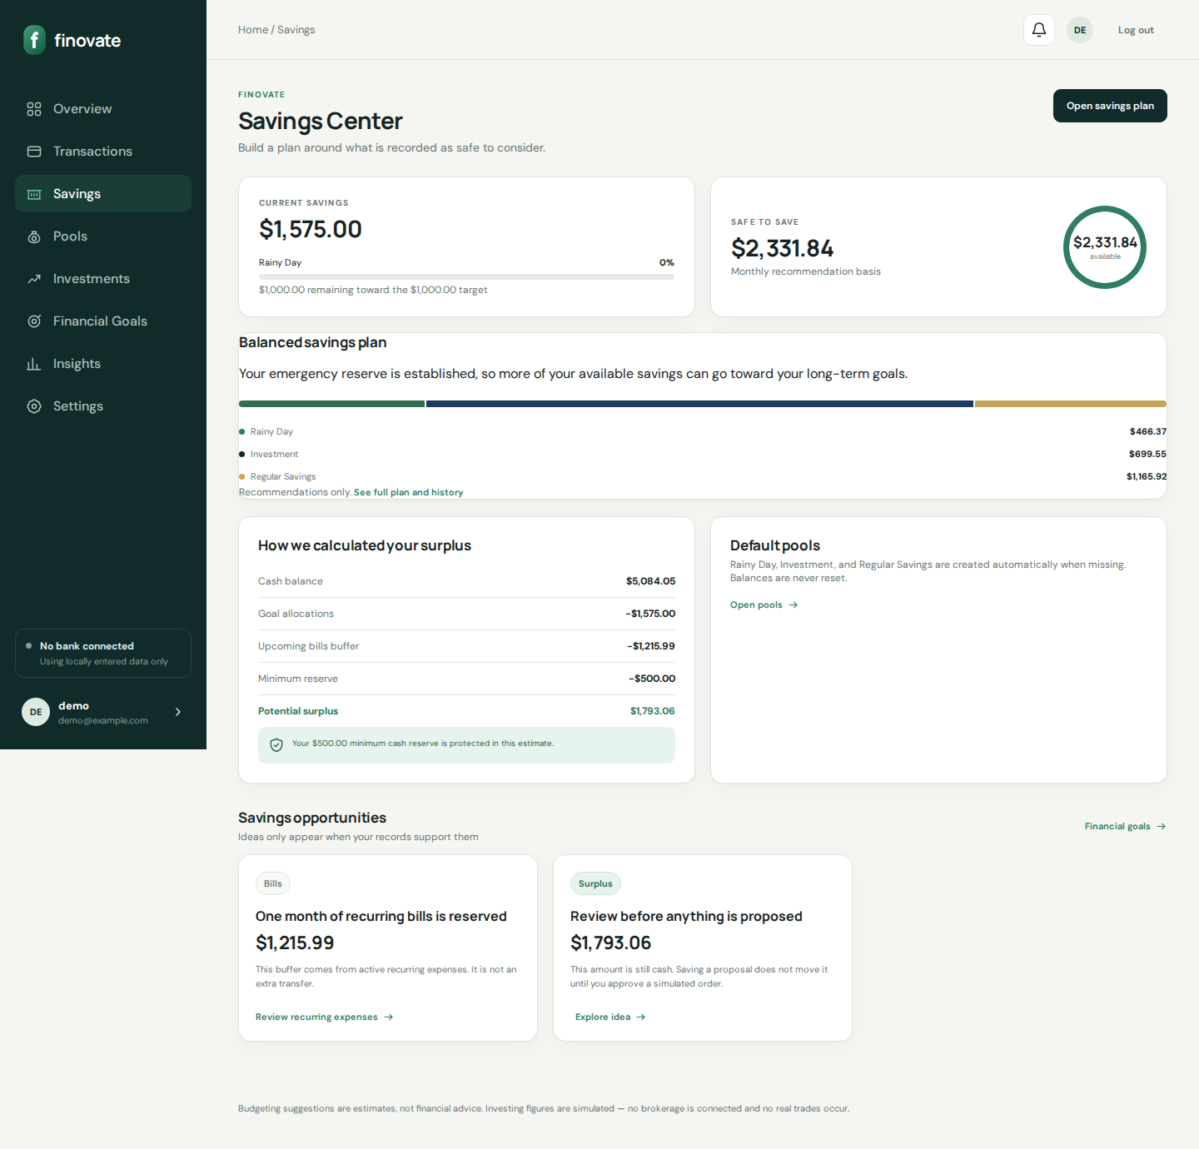
Savings home

Slide 24
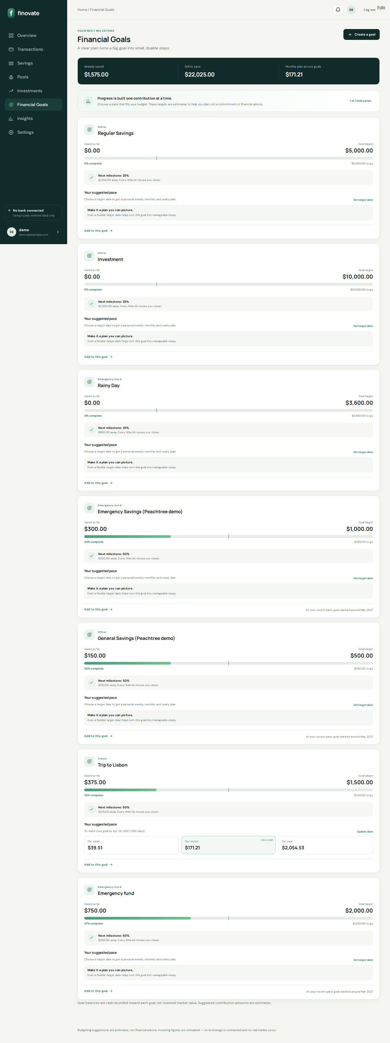
Financial goals

Slide 25
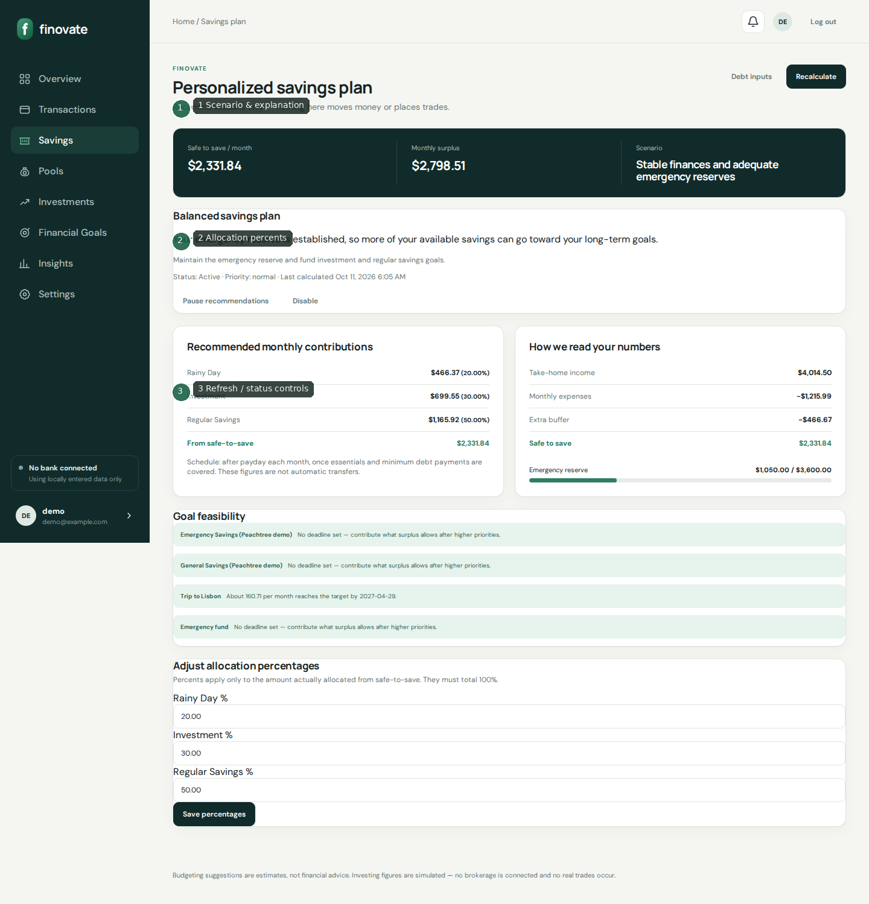
Savings plan

Slide 26
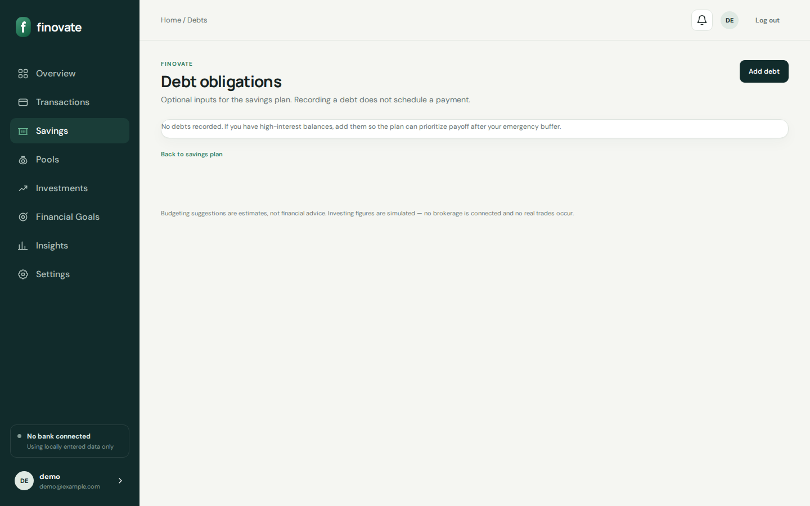
Debts (plan inputs)

Slide 27
Savings plan engine
Recommendation only — never transfers funds
Safe-to-save = max(0, surplus − buffer)
Scenarios: stabilization → build reserve → debt focus → stable → strong
Default pools: Rainy Day, Investment, Regular Savings
Revisions stored when material changes occur

Slide 28
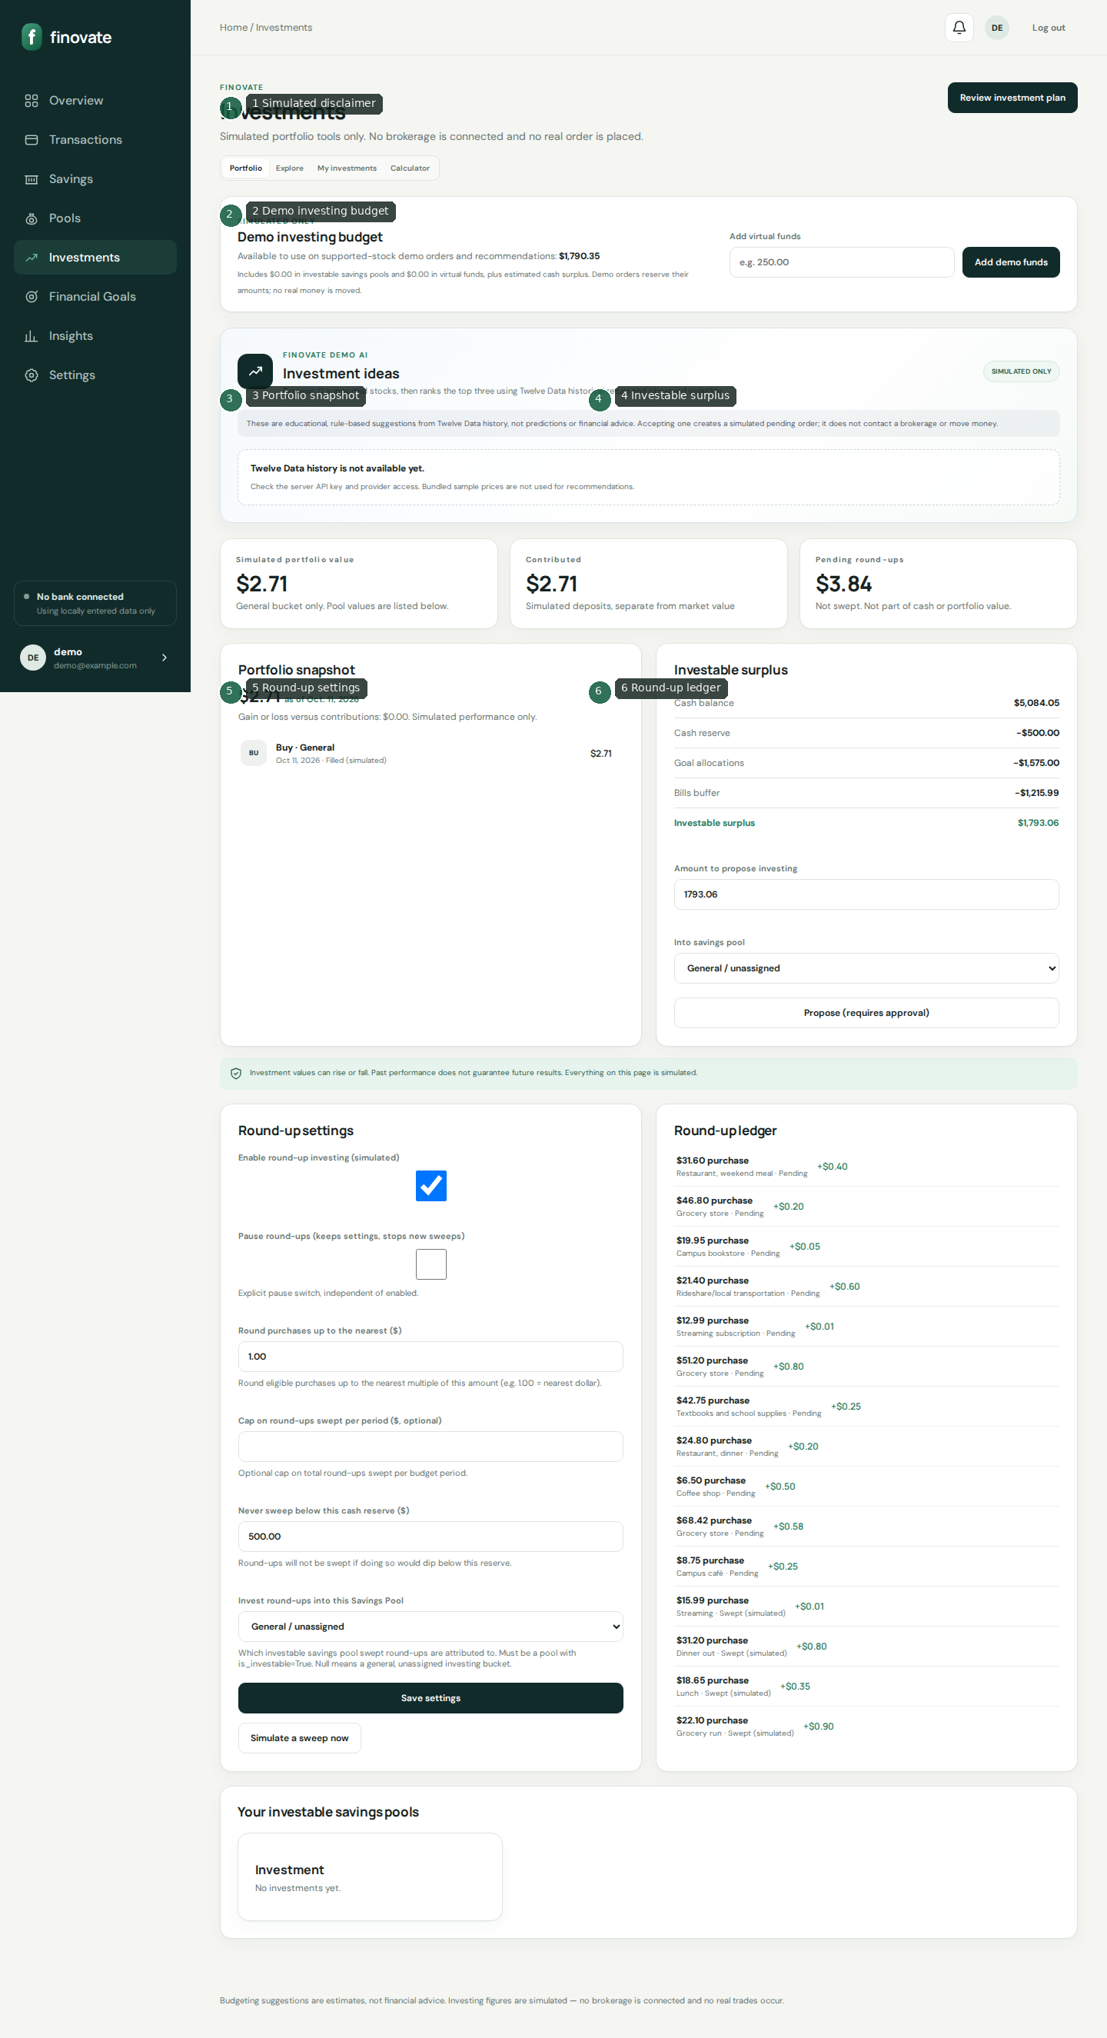
Investing (simulated)

Slide 29
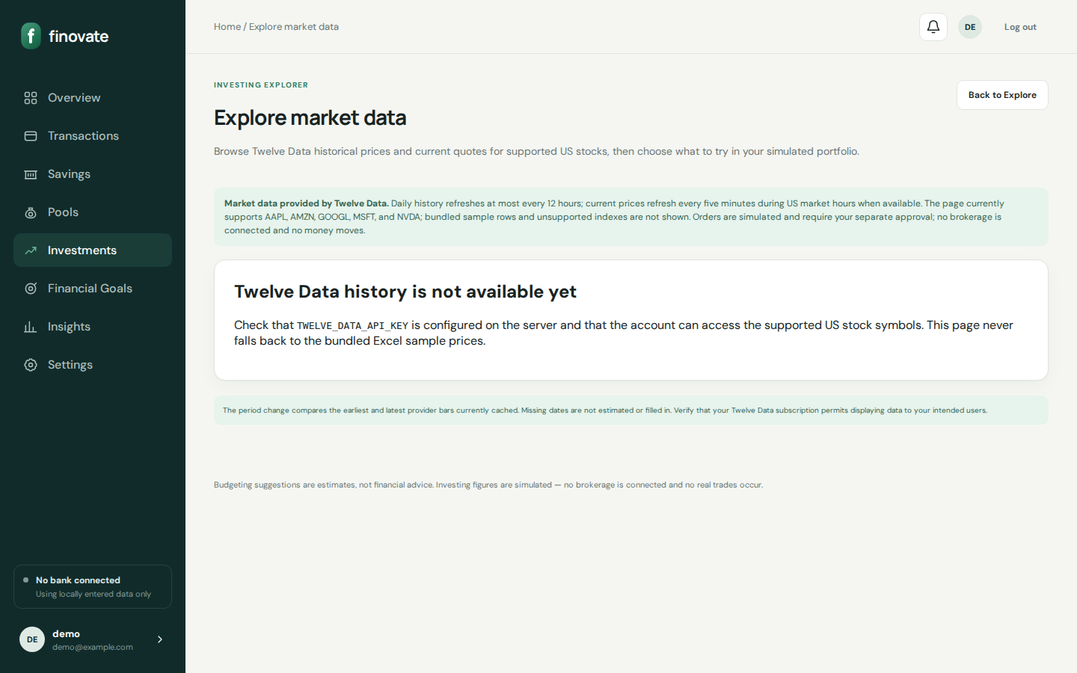
Market data explore

Slide 30
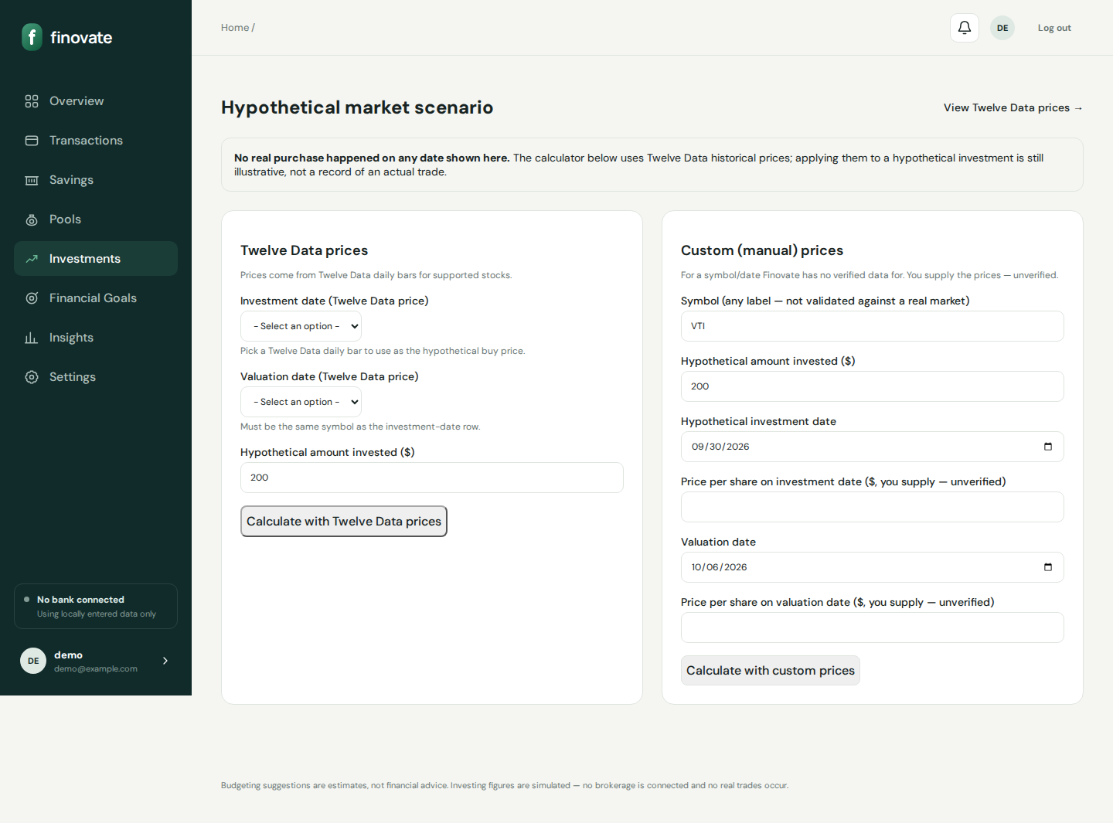
Historical demo

Slide 31
Investing rules
No brokerage connected — UI disclaimers required
Round-up: $4.35 with $1 increment → $0.65
Sweep enforces pause, contribution cap, cash reserve
Surplus propose → approve/reject SimulatedOrder
Demo AI is rule-based; Twelve Data optional

Slide 32
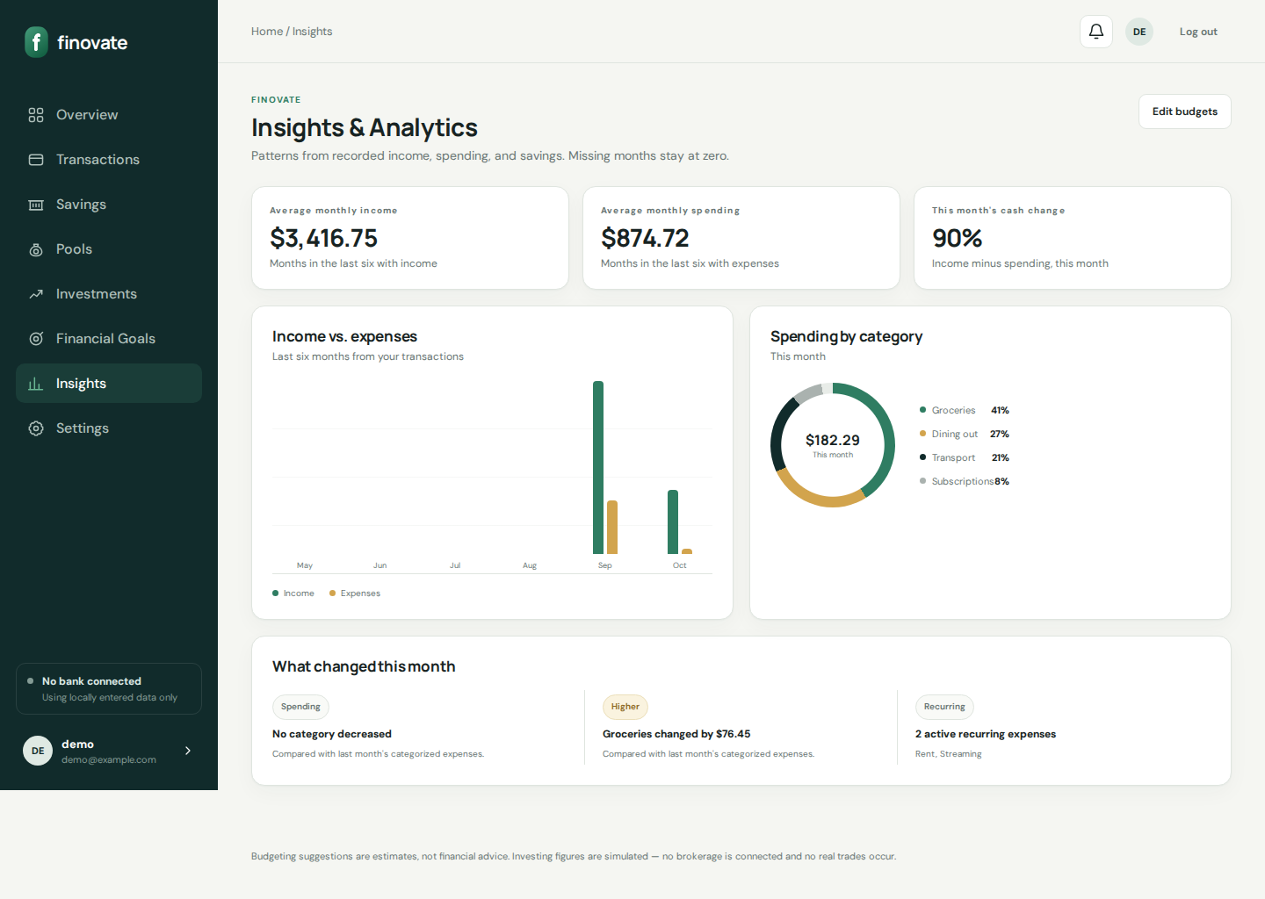
Insights

Slide 33
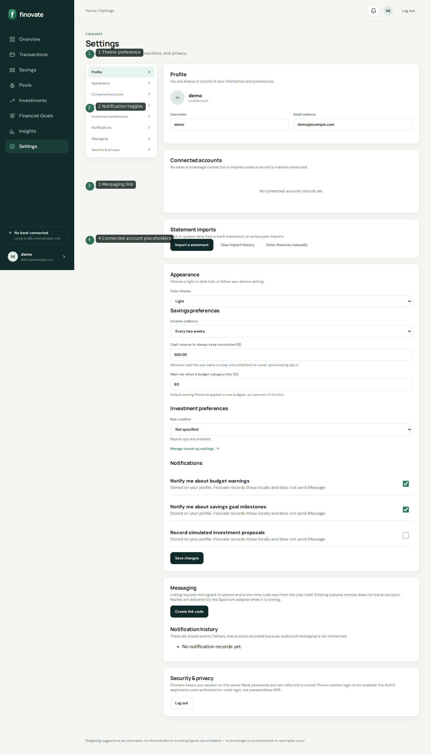
Settings

Slide 34
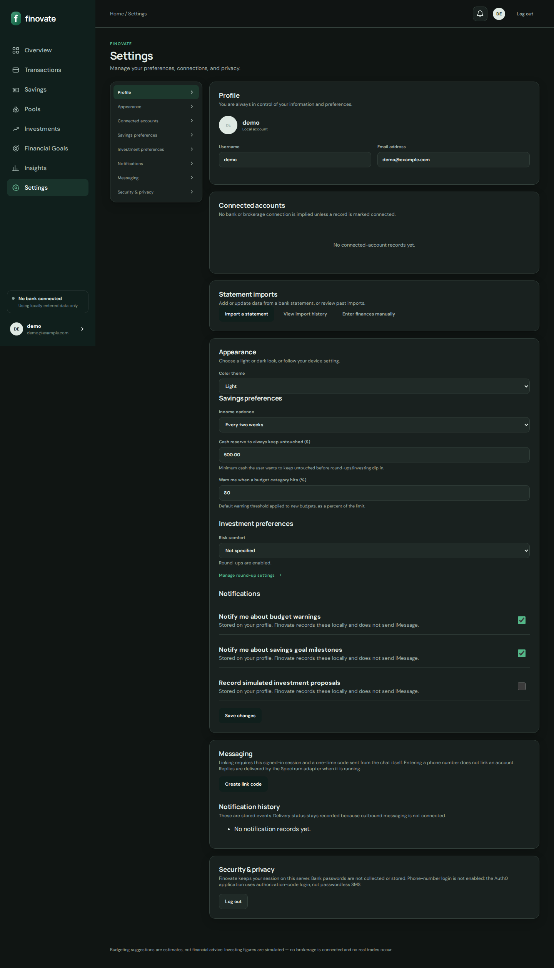
Dark theme

Slide 35
Interface behaviors
Themes: light / dark / system via data-theme
Mobile nav toggle; desktop sidebar
Live quote polling JS (~5 minutes)
Review modal is client-only (does not persist plan)
Notifications recorded, not emailed/pushed

Slide 36
API surface
GET /api/me/ — Auth0 Bearer token → identity + txn count
POST /assistant/photon-webhook/ — signed Spectrum inbound
GET /investing/live-quotes/ — session JSON holdings quotes
GET /investing/market-data/live-quotes/ — session market quotes
All other mutations: CSRF-protected HTML form posts

Slide 37
Integrations
Auth0 — primary OIDC identity
Supabase Auth — optional email/password
Postgres via DATABASE_URL / SUPABASE_DB_URL
Twelve Data — optional live market data
Photon Spectrum — inbound messaging only from Django’s POV
Bank/Brokerage API keys — placeholders (unused)

Slide 38
Security controls
IdP authentication; passwords not stored in Finovate
User-scoped ORM filters on every data path
CSRF on forms; session auth for pages
IP rate limits on signup/login/resend
Webhook HMAC / shared secret verification
Env-based secrets; never commit real values

Slide 39
Deployment & operations
Vercel Django framework entry: finovate/wsgi.py
maxDuration 60s; migrate on boot when VERCEL set
Prefer Postgres — /tmp SQLite is ephemeral
Configure APP_BASE_URL + Auth0 callbacks
python manage.py test for regression suite

Slide 40
Troubleshooting highlights
Login/signup inert → missing Auth0/Supabase env
Callback failures → APP_BASE_URL mismatch
Verify loop → confirm email in Auth0, then refresh
Import errors → size/format; use manual setup
Twelve Data warnings → key or free-tier credits
“Trades” not in brokerage → expected (simulated)

Slide 41
Documentation deliverables
Markdown portal under /docs (navigable README)
Word: docs/deliverables/Finovate-Complete-Documentation.docx
PowerPoint: docs/deliverables/Finovate-Visual-Feature-Guide.pptx
Screenshots: docs/assets/screenshots/{raw,annotated,mobile}
Coverage matrix + audit report included

Slide 42
Known gaps / defects reported
Root README test count / Tailwind mentions outdated vs code
Notifications toggles without delivery channel
Spectrum Bun sidecar currently echo-only
Bank connect coming soon; brokerage simulated
No transaction pagination yet
Optional follow-up: validation-error & import-preview shots

Slide 43
Thank you
See /docs for the full reference. Investing is simulated — no real trades.

