Slide 1
SONA · ANALYSIS FIGURES
Why the complex mask trades
fidelity for perceptual quality
Four visual analyses on the 824-clip VoiceBank-DEMAND test set
Spectrograms
Reconstruction error
Phase corrections
Metric correlation

Slide 2
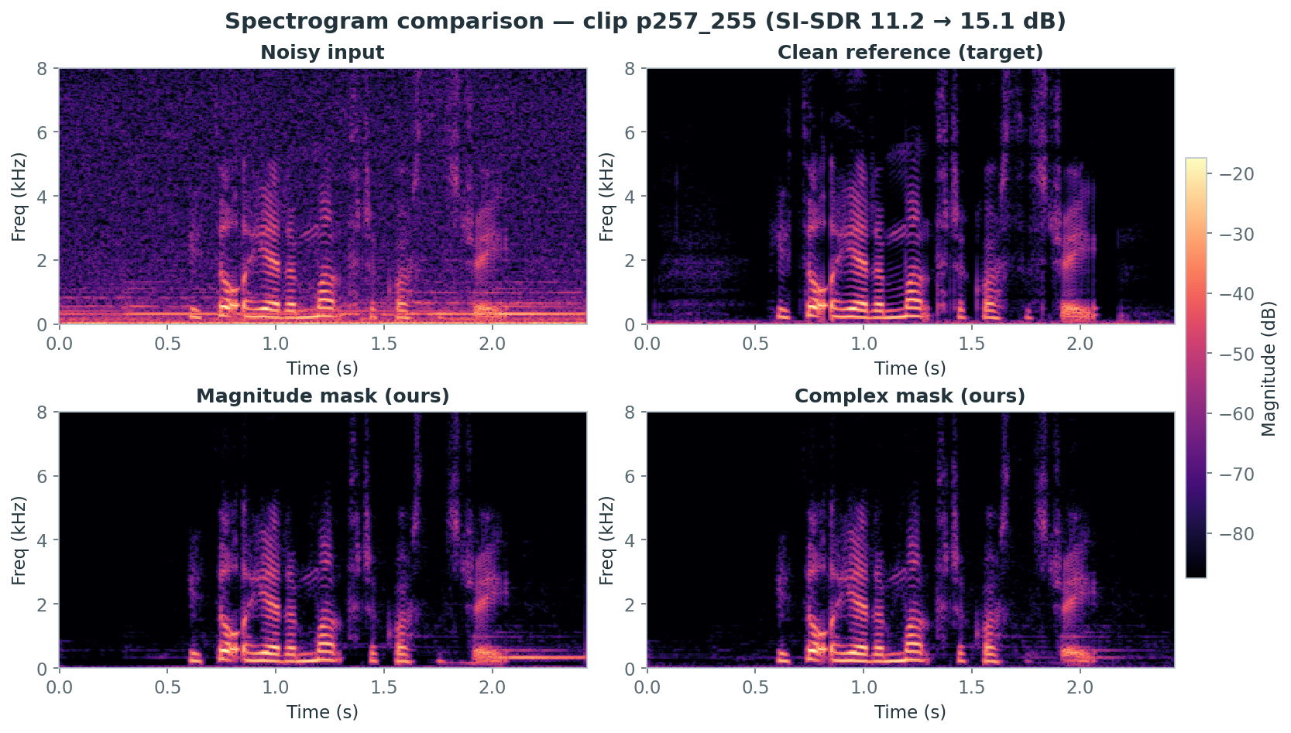
1 · SPECTROGRAMS
Both masks denoise cleanly; harmonics are preserved
Broadband noise (top-left) is removed while the harmonic speech structure of the clean target is recovered — the enhancement itself works well. The magnitude and complex outputs look nearly identical to the eye.
→
SONA · Complex Ratio Masking — Analysis Figures
2

Slide 3
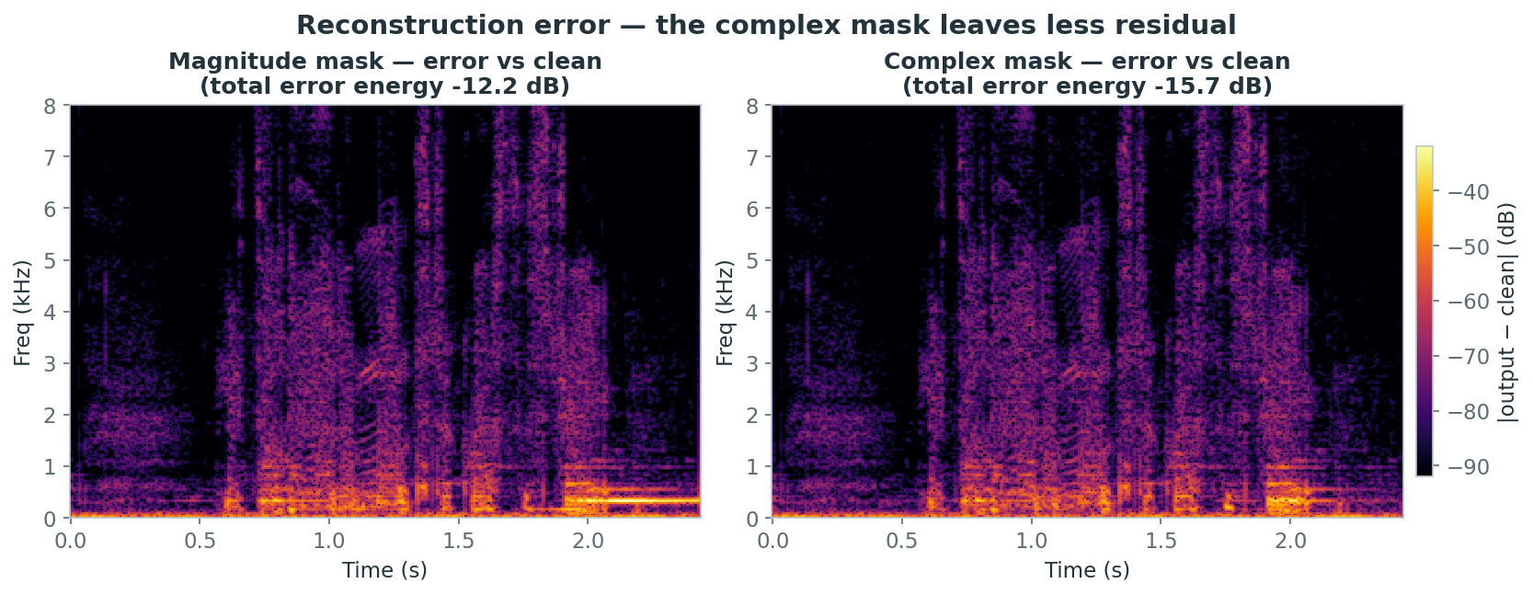
2 · RECONSTRUCTION ERROR
The complex mask leaves less residual
|output − clean| in the T-F plane. Total error energy drops from −12.2 dB (magnitude) to −15.7 dB (complex): a real fidelity gain, concentrated in low-frequency voiced regions — consistent with the +0.31 dB SI-SDR result.
→
SONA · Complex Ratio Masking — Analysis Figures
3

Slide 4
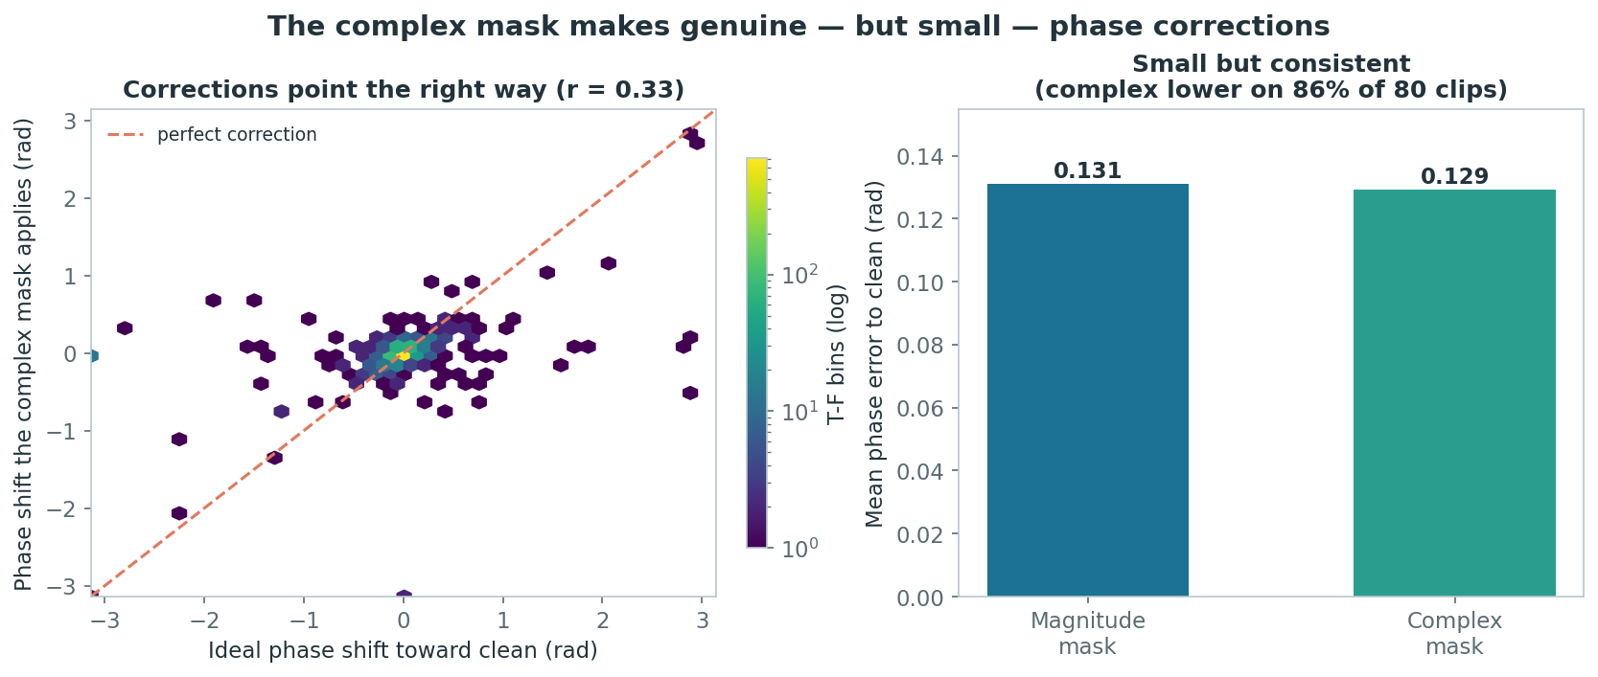
3 · PHASE MECHANISM
The gain comes from genuine — but small — phase corrections
The complex mask's phase shifts point toward the ideal (positive correlation), and reduce phase error on 86% of clips — but the magnitude of the correction is tiny. Small phase gains explain a small SI-SDR gain.
→
SONA · Complex Ratio Masking — Analysis Figures
4

Slide 5
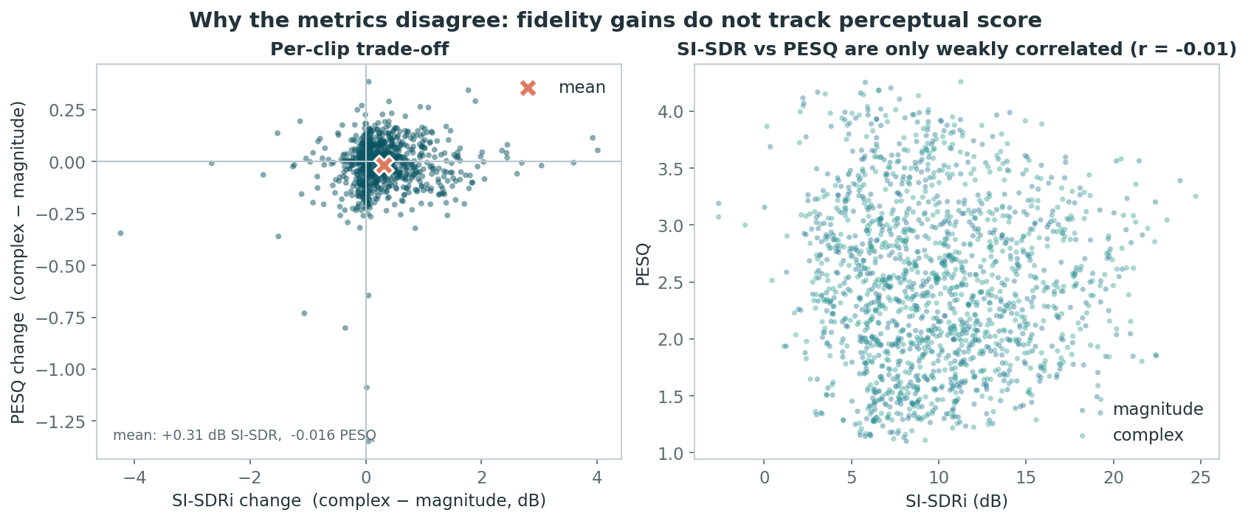
4 · METRIC CORRELATION
Fidelity gains do not track perceptual score
Left: per-clip, most clips gain SI-SDR while PESQ scatters around zero. Right: across 824 clips SI-SDR and PESQ are essentially uncorrelated (r = −0.01). This is why an SI-SDR win need not be a PESQ win.
→
SONA · Complex Ratio Masking — Analysis Figures
5

Slide 6
WHAT THE FIGURES SHOW
A coherent, honest mechanism
Denoising works
Complex reduces error
1
2
Clear noise removal, harmonics intact (Fig. 1).
−15.7 vs −12.2 dB residual energy (Fig. 2).
Via small phase fixes
Metrics decouple
3
4
Directionally correct, but tiny (Fig. 3).
SI-SDR vs PESQ, r = −0.01 (Fig. 4).
Takeaway: the complex mask is a real but modest fidelity improvement whose benefit is invisible to PESQ — a measurable fidelity–perceptual trade-off, shown four ways.

