Slide 1
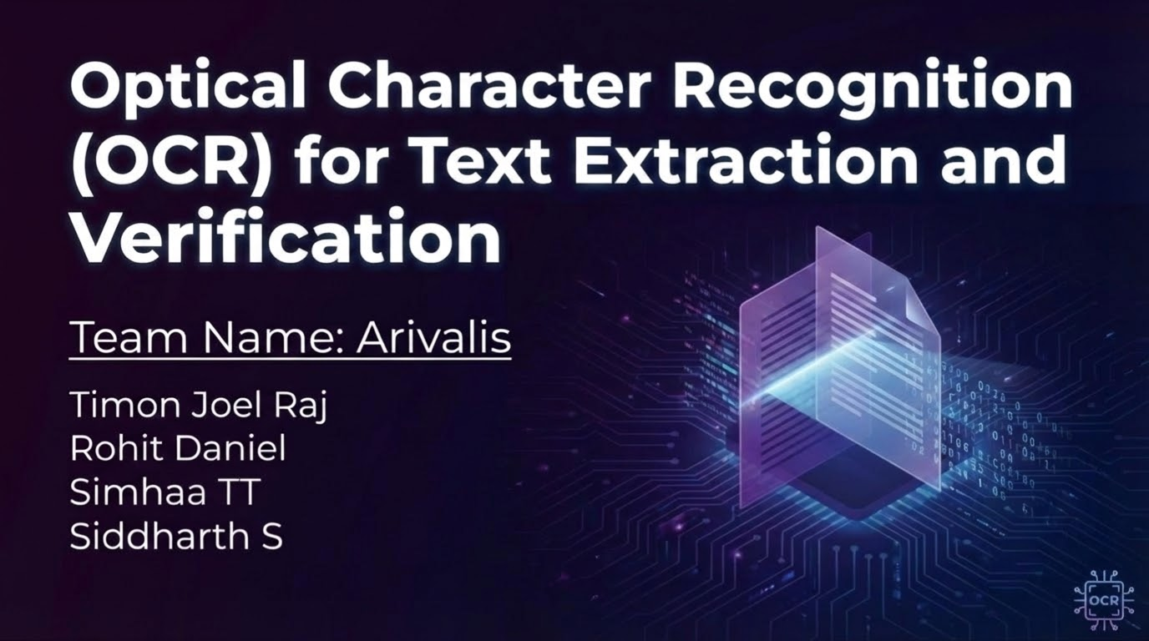

Slide 2
Problem Statement
Manual extraction & verification of text from scanned documents is time-consuming, error-prone, and inefficient.
The challenge is to build an OCR-driven solution that:
Automatically extracts fields from scanned documents
Auto-populates digital forms
Verifies accuracy by comparing extracted values with user input
Supports multiple document types

Slide 3
Our Solution
We built an end-to-end solution that leverages OCR to automate data capture and validation.
Extract: The Extraction API accepts a scanned document (image or PDF) and uses OCR to precisely extract text fields
Edit: Users can review and correct low-confidence extracted fields before verification
Verify: The Verification API compares user-submitted form data with the extracted text, ensuring data integrity and highlighting mismatches with confidence scores

Slide 4
Technical architecture and approach
Our solution uses a robust, open-source, local-first technology stack.
Architecture: Two-API FastAPI (Python) backend:
API 1: /extract-text for OCR processing.
API 2: /verify for data validation.
OCR Engine: PaddleOCR, supporting printed, handwritten, and multiple languages.
Verification Logic: Fuzzy string matching (RapidFuzz) compares OCR output with user data and computes confidence scores.
Frontend: Lightweight HTML/CSS/JavaScript interface interacts with backend APIs.
Deployment: Entire system runs locally without cloud dependence.

Slide 5
OCR Pipeline
1. Image Preprocessing
Resize for optimal OCR input.
Denoise to remove artifacts
Thresholding for clean text separation
Deskew to fix tilted scans
2. OCR Engine
PaddleOCR for high-accuracy English text extraction
3. Field Extraction
Name
Date of Birth
Gender
Address
Phone Number
Email

Slide 6
The Extraction API
Endpoint: POST /api/v1/ocr/extract-text
Functionality:
Accepts a scanned PDF or image file
Uses PaddleOCR to extract text and identify relevant fields
Supports English (Latin-based language)
Tested with provided sample documents (ID cards, forms)

Slide 7
The Verification API
Endpoint: POST /api/v1/verification/verify
Functionality:
  Accepts form-filled data (JSON) and the original scanned document
  Compares submitted data against OCR-extracted values
  Returns a confidence score and match status for each field
  Highlights mismatches for quick correction
Good-to-Have: Supports partial data mapping and verifies available fields even if some are missing

Slide 8
Bonus Task : MOSIP Integration
Goal: Automate document intake into MOSIP pre-registration with minimal manual effort..
Main Endpoint: POST /api/v1/mosip/integrate
Upload a PDF/JPG/PNG and optional user data for verification.
Returns pre_registration_id and next steps.
How It Works:
OCR (PaddleOCR) extracts text from the document.
Text is normalized and mapped to key fields (name, DOB, address, etc.).
Optionally verifies against user-provided data for consistency and confidence.
Submits structured data to MOSIP pre-registration and uploads the document.
Provides status link and follow-up guidance.

Slide 9
Features
Can take in printed/handwritten documents in pdf/png/jpg formats
Ocr extracted text can be edited before verification
Confidence score must >= 80% to get registered in MOSIP
Verification review can be downloaded in json format
MOSIP registration status can be checked using the pre registration ID

Slide 10
Results
Successfully delivered two mandatory APIs for extraction and verification.
Implemented "Good-to-Have" features: handwritten text recognition, a working UI, and partial data mapping.
Achieved a high degree of accuracy in both text extraction and verification across diverse test documents.
Bonus: Integrated a simulated MOSIP flow, proving the solution's readiness for real-world, large-scale identity systems.

Slide 11
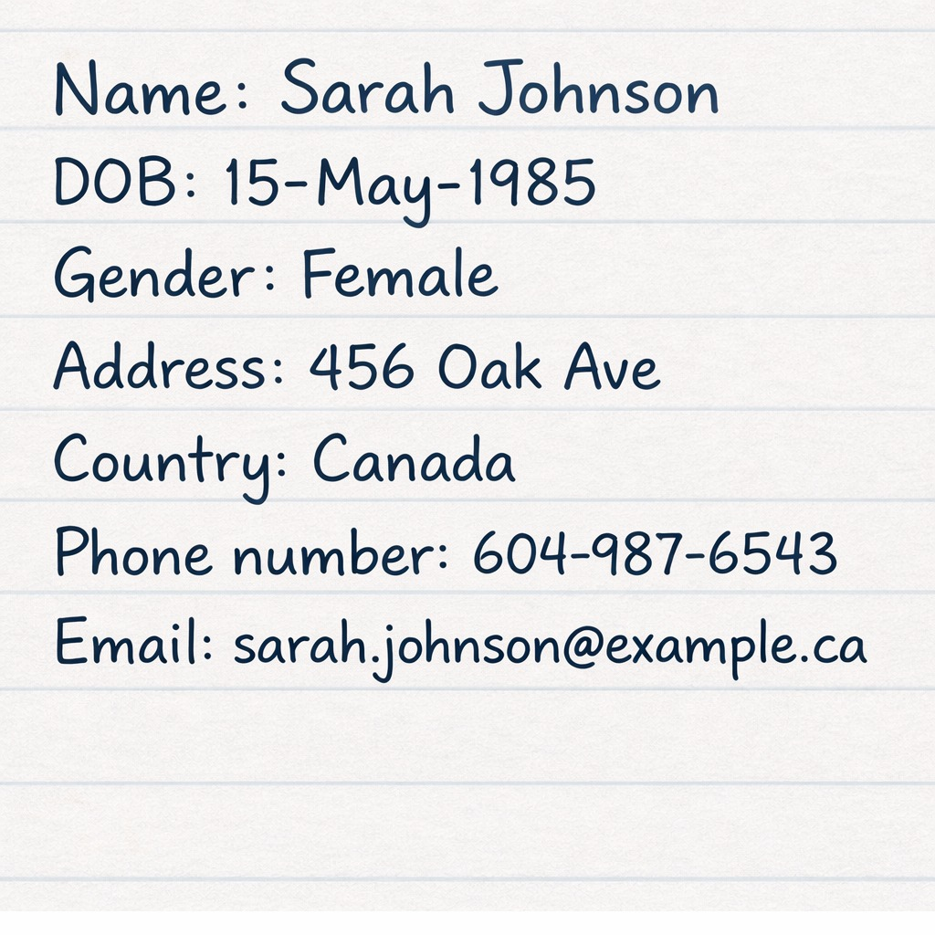
Sample Results

Slide 12
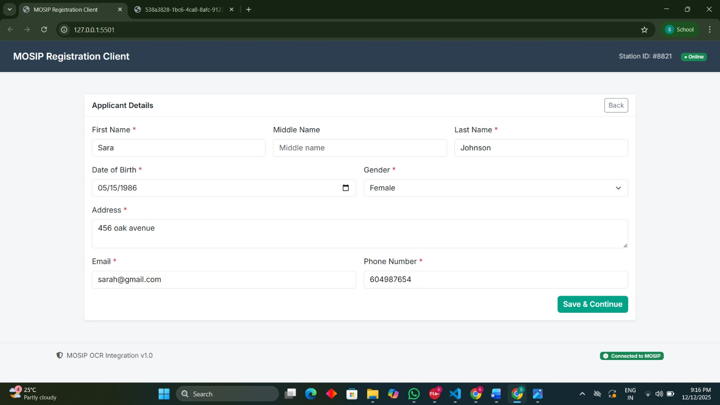
Sample Results

Slide 13
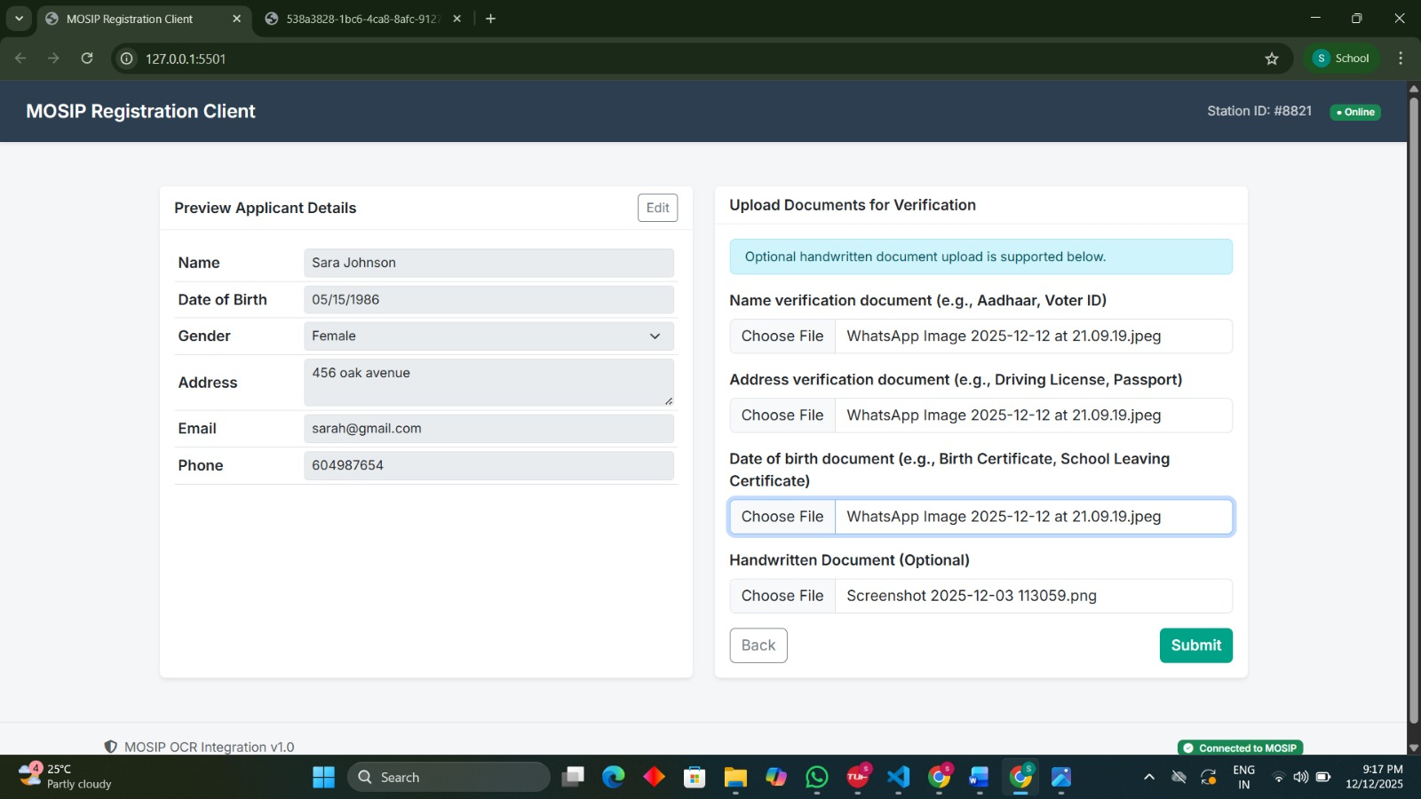
Sample Results

Slide 14
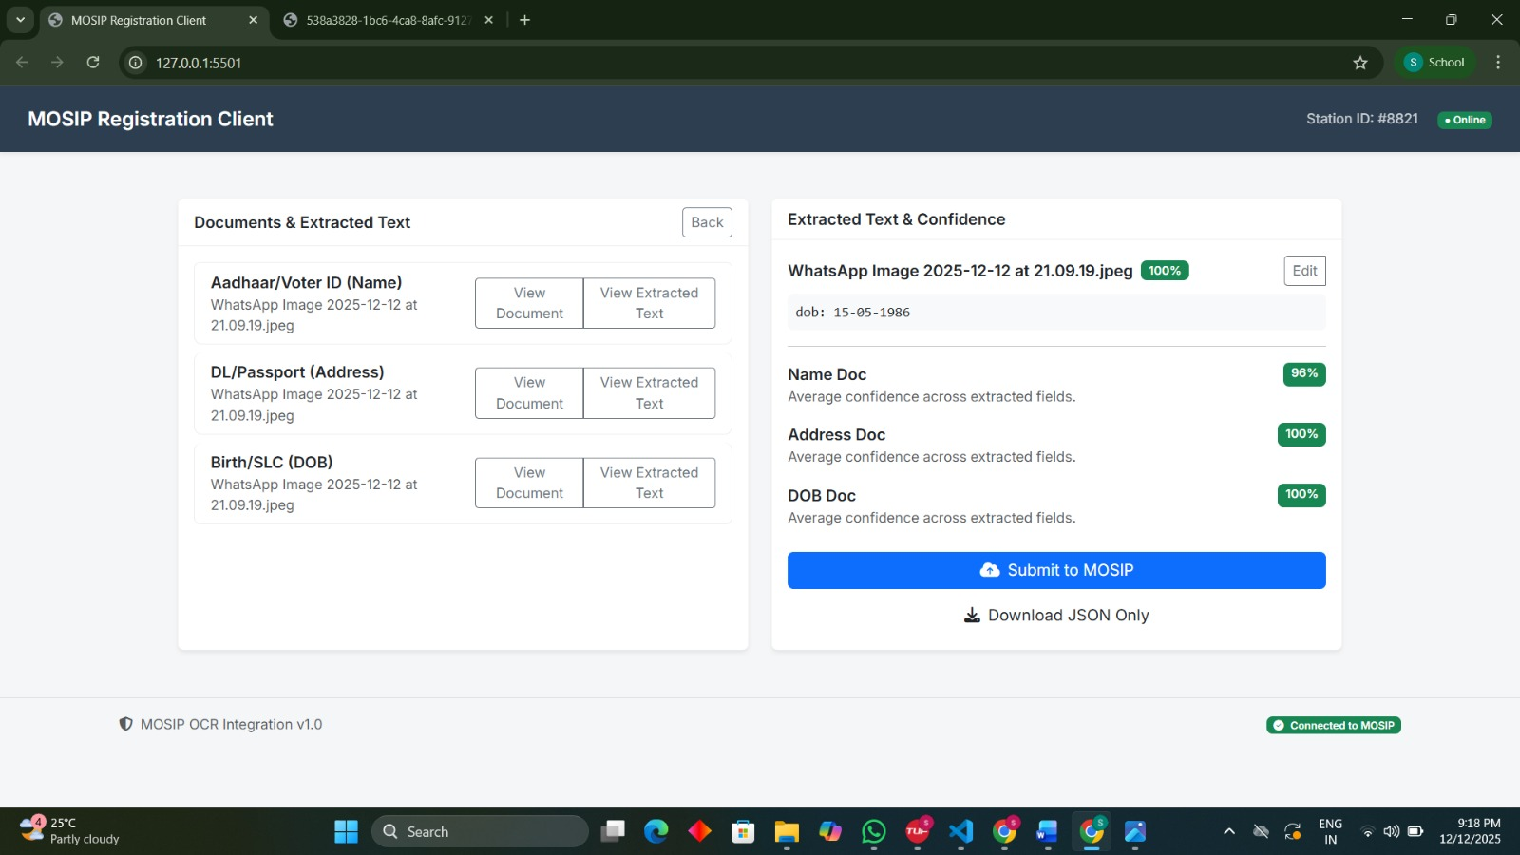
Sample Results

Slide 15
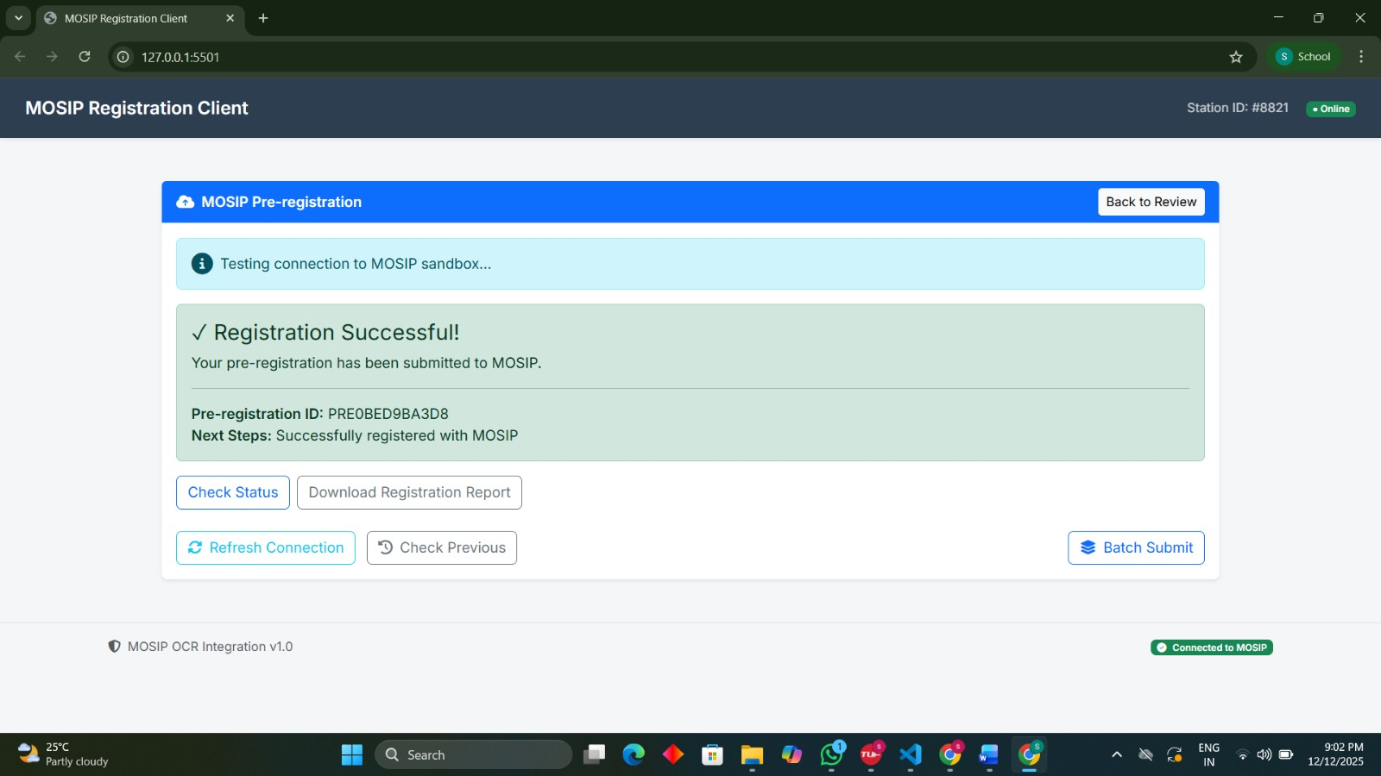
Sample Results

Slide 16
Potential Impact
Enhance Efficiency: Dramatically reduce manual data entry and processing times.
Increase Reliability: Minimize human error and ensure high data integrity.
Streamline Workflows: Accelerate onboarding, application processing, and compliance checks for any organization.

Slide 17
Future Work
Integrate with live MOSIP modules: Transition from simulation to full integration with Pre-registration and Registration Client
Add advanced document quality checks: Blur detection and lighting analysis for real-time scan feedback
Expand document support: Multi-page processing and real-time OCR confidence zones on document preview
Broaden language support: Add more non-Latin languages

Slide 18
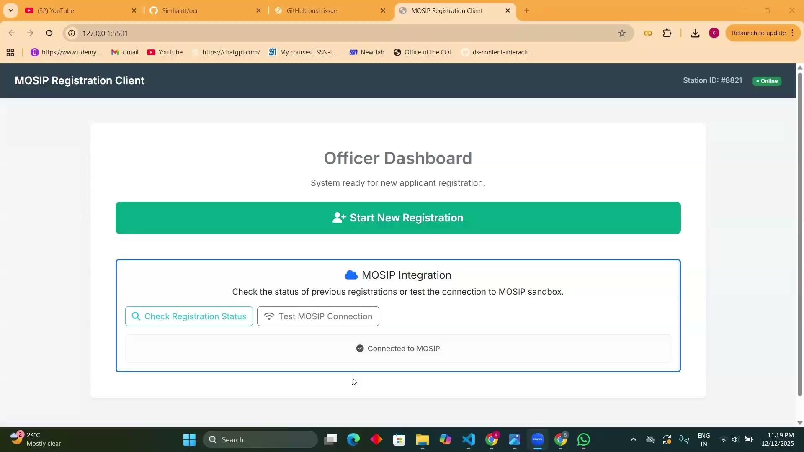
Project resources
Github : https://github.com/Simhaatt/ocr.git
Video:

