Slide 1

UNDERSTANDING MICROSOFT AZURE

Slide 2

AGENDA
INTRODUCTION
WHAT IS AZURE?
AZURE ARCHITECTURE OVERVIEW
AZURE SERVICES
AZURE VS OTHER CLOUD PROVIDERS
SECURITY AND COMPLIANCE
REAL-WORLD APPLICATIONS
CONCLUSION

Slide 3
INTRODUCTION​
Microsoft Azure is a cloud computing platform and service created by Microsoft.
It provides a wide range of cloud services, including compute, analytics, storage, and networking.
Users can develop and scale applications or run existing ones in the public cloud.

Slide 4
WHAT IS AZURE?
Azure offers IaaS, PaaS, and SaaS solutions.
Supports multiple programming languages, tools, and frameworks.
Used across industries like finance, healthcare, retail, and government.

Slide 5
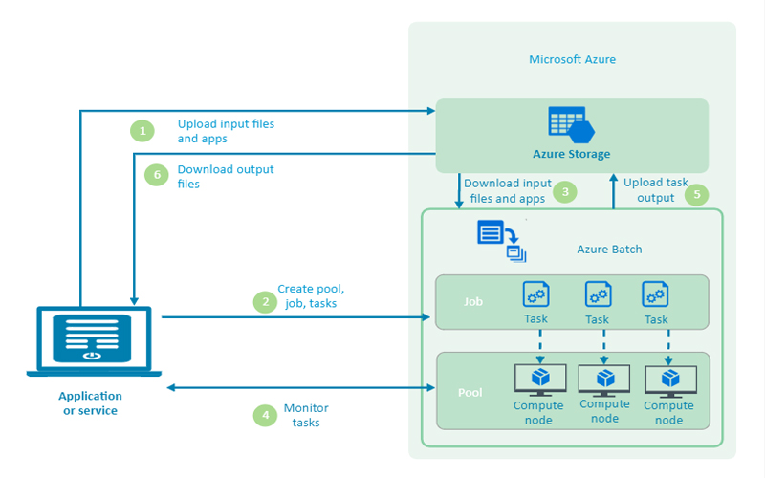
AZURE ARCHITECTURE-OVERVIEW

Slide 6
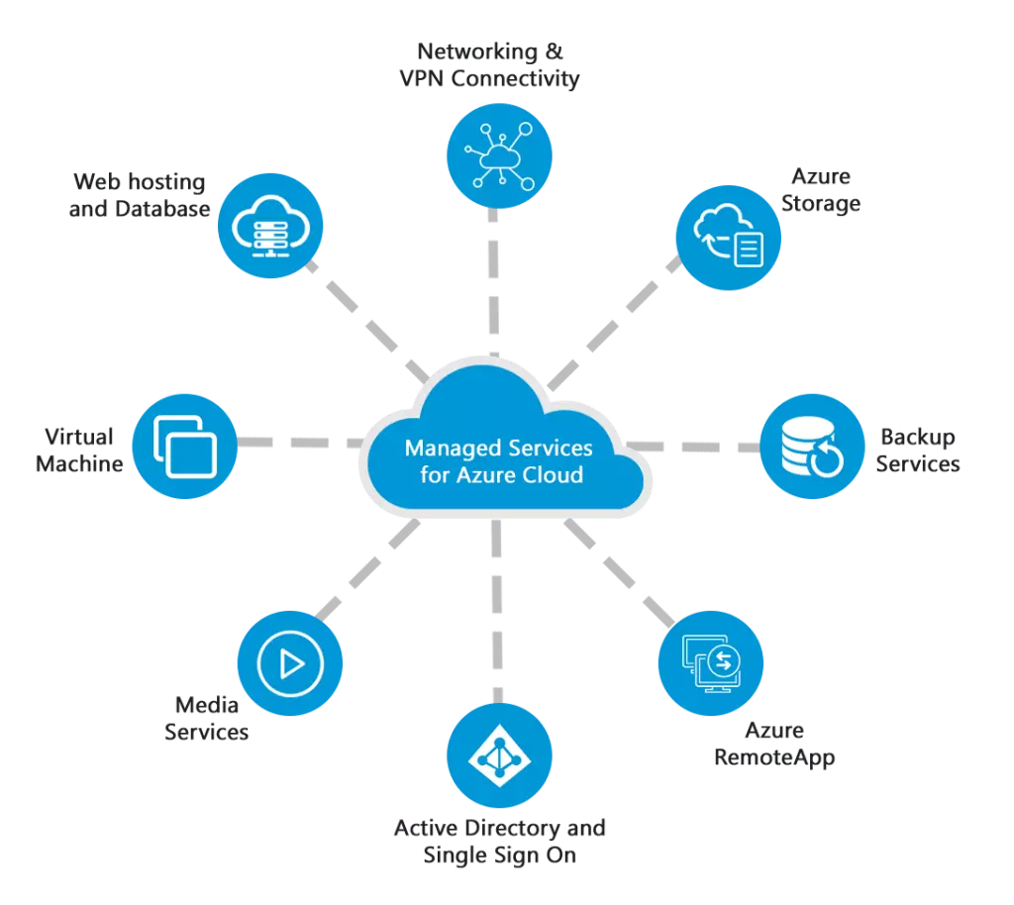
AZURE SERVICES

Slide 7
FEATURE | MICROSOFT AZURE | AWS | GOOGLE CLOUD
Compute | VMs, AKS, App Services | EC2, ECS, Lambda | Compute Engine, GKE
Storage | Blob, Disk, File Storage | S3, EBS, Glacier | Cloud Storage, Persistent Disks
Networking | Virtual Network, Load Balancer | VPC, ELB, CloudFront | VPC, Cloud Load Balancing
Databases | Azure SQL, Cosmos DB | RDS, DynamoDB | Cloud SQL, Fire store
AI/ML | Azure AI, ML Studio | SageMaker, Recognition | AI Platform, Auto ML
Pricing | Pay-as-you-go, Reserved Instances | Same | Sustained Use Discounts
AZURE vs OTHER CLOUD SERVICES

Slide 8
SECURITY COMPLIANCE
Azure offers tools like azure security center and azure active directory.
Complies with standards like GDPR, ISO 27001, HIPAA.
Provides encryption, threat detection, and identity management.

Slide 9

REAL WORLD APPLICATIONS
Hosting websites and enterprise apps
Data storage and backup
AI model development
IOT device management
Hybrid cloud solutions

Slide 10
CONCLUSION
Azure is a powerful, flexible cloud platform.
Offers a wide range of services for various business needs.
Its scalability, security, and global presence make it a top choice.

