Slide 1
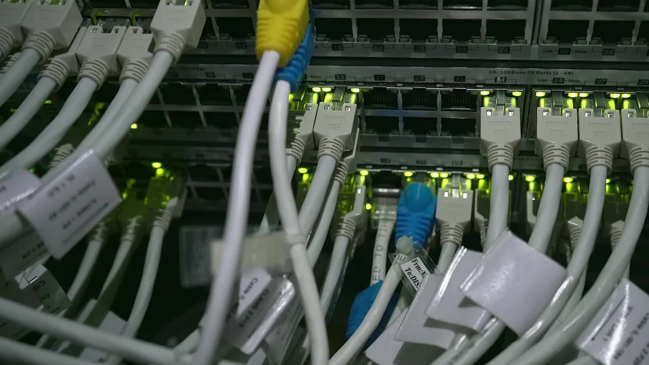
ARP
UNDERSTANDING ETHERNET ADDRESS RESOURCE PROTOCOL

Slide 2

AGENDA
INTRODUCTION
WHAT IS ETHERNET, NETWORK?
WHAT IS ARP?
TYPES OF ARP
WHY IS ARP NEEDED?
HOW ARP WORKS?
ARP PACKET
ARP CACHE
ARP SPOOFING & HOW TO PREVENT IT?
USE- CASES OF ARP
CONCLUSION

Slide 3
INTRODUCTION
Ethernet is a widely used LAN technology that enables devices to communicate over a physical medium using MAC addresses.
It operates at Layer 2 (Data Link Layer) of the OSI model.
ARP (Address Resolution Protocol) is used to map IP addresses to MAC addresses within a local network.
It works between Layer 2 (MAC) and Layer 3 (IP) of the OSI model.

Slide 4
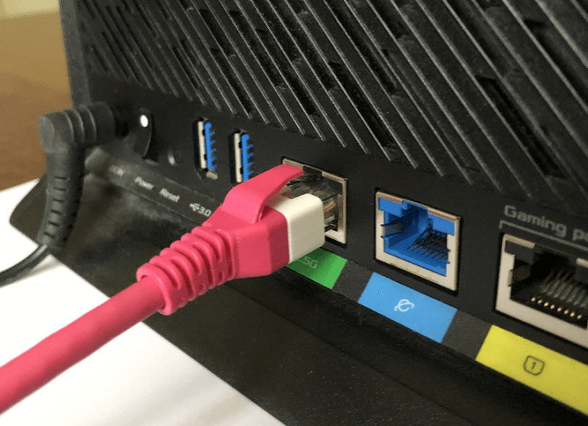
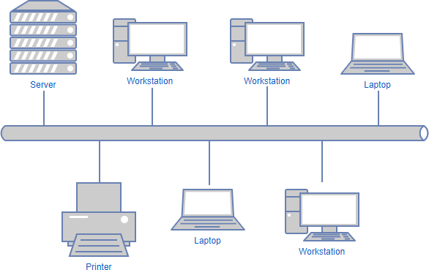
ETHERNET
It is a traditional technology for connecting devices in a LAN or WAN.
It enables devices to communicate with each other.
Communicate via a protocol, which is a set of rules.
NETWORK
It is a group of devices to share data
LAN : small area, e.g., Office, Home
WAN : large area, e.g., Internet

Slide 5

ARP stands for Address Resolution Protocol.
It is used to find the MAC address of a device associated with an IP address.
Essential for communication within a local network.
WHAT IS ARP?

Slide 6
TYPES OF ARP
Proxy ARP: In a n/w it can answer ARP queries of another IP Addresses
01
Gratuitous ARP: It checks the IP Address.
02
Inverse ARP: It checks the IP Address of its own Computer Server.
03
Reverse ARP (RARP): Used to know the IP Address of our devices through MAC Address
04

Slide 7
WHY IS ARP NEEDED?
IP addresses are used for routing packets across networks.
MAC addresses are used for communication within the same network.
ARP bridges the gap between IP addresses and MAC addresses.

Slide 8
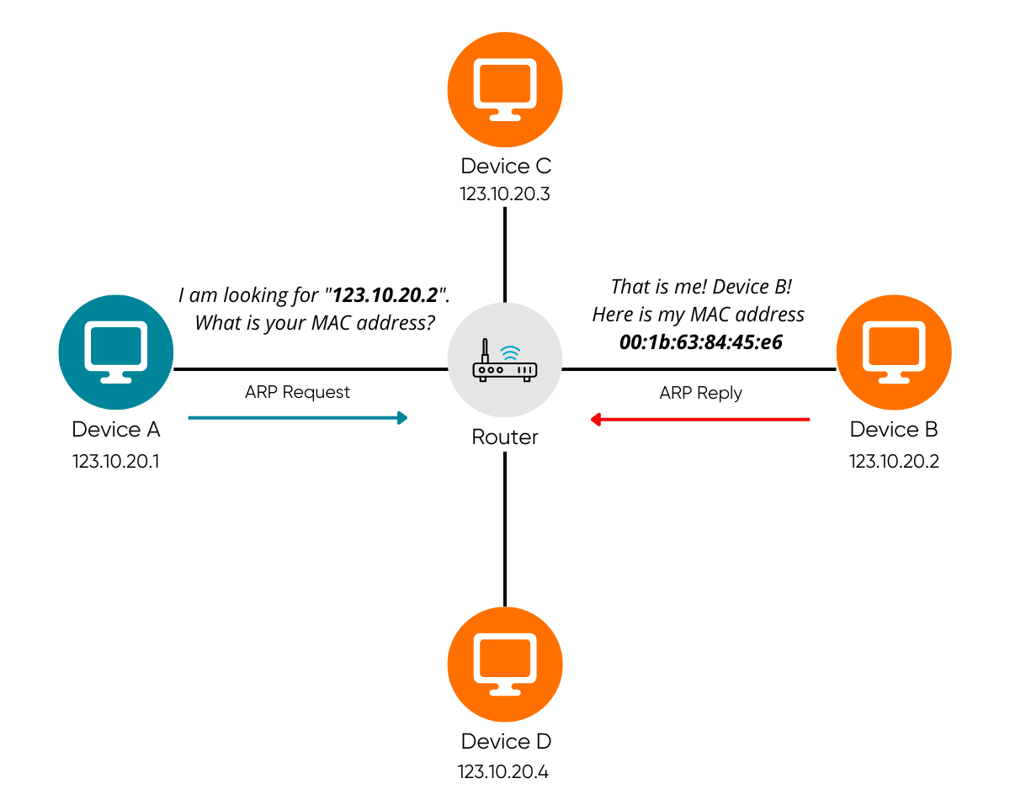
HOW ARP WORKS?
ARP Request: The sender broadcasts an ARP request packet to all devices on the local network.
ARP Reply: The device with the matching IP address responds with an ARP reply packet containing its MAC address.
Caching: The sender caches the MAC address for future use.

Slide 9
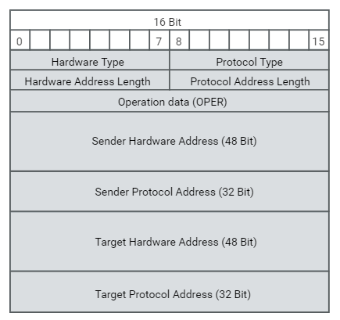
ARP PACKET
Hardware Type: 0X0001(Ethernet)
Protocol Type:0X0800(IPV4)
Hardware size (6): length of MAC address
Protocol size (4): length of IP Address
OPCode:1(ARP Request), 2(ARP Reply)
Sender MAC : AA:AA:AA:AA:AA:AA
Sender IP: 192.168.1.2
Target MAC: 00:00:00:00:00:00
Target IP: 192.168.1.10

Slide 10
ARP CACHE
It is also known as ARP table.
It is a temporary memory that keeps a list of IP Addresses & their corresponding MAC Addresses
USES
Speeds up communication.
Reduces network traffic.

Slide 11
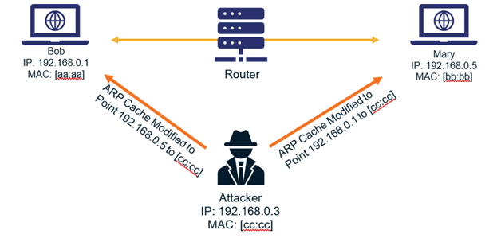
ARP SPOOFING
It is also known as ARP Poisoning.
It is a type of cyber-attack.
The goal of Attacker to intercept, modify, or steal data by pretending to be another device over the network.
TO PREVENTING SPOOFING:
Static ARP Entries.
Use HTTPs.
Use ARP monitoring tool.

Slide 12

BENEFITS OF ARP
Efficient Communication: Ensures devices can communicate within a local network
Dynamic Mapping: Automatically maps IP addresses to MAC addresses
Reduced Configuration: Minimizes manual network configuration

Slide 13
ARP is essential for mapping IP addresses to MAC addresses.
It facilitates communication within local networks.
Understanding ARP helps in network management and security.
CONCLUSION

