Slide 1
UNDERSTANDING ICMP & HTTPS
A Comprehensive Overview of Network Protocols

Slide 2
AGENDA
Introduction to Network Protocol
What is ICMP?
Working of ICMP
What is HTTPS?
Working of HTTPS
Differences between HTTP & HTTPS
Conclusion

Slide 3
Introduction to Network Protocols
Network protocols define rules and conventions for communication between devices.
ICMP (Internet Control Message Protocol) and HTTPS (Hyper Text Transfer Protocol Secure) are essential for maintaining and securing networks.
ICMP is used for diagnostics, while HTTPS ensures secure communication over the web.

Slide 4

WHAT IS ICMP?
ICMP is a network layer protocol used to send error messages and operational information.
It is primarily used for network troubleshooting and diagnostics.
ICMP is commonly used by tools like ping and traceroute to test connectivity and find network issues.

Slide 5
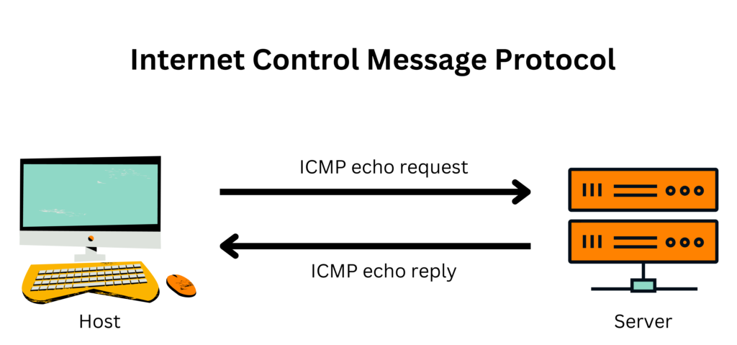
HOW ICMP WORKS
ICMP is connectionless – no handshake like TCP.
Works directly with IP, not with TCP/UDP.
Datagram structure includes IP header + ICMP header + payload.
Used for diagnostics like ping and traceroute.
Compared with TCP to show the difference in communication style

Slide 6
WHAT IS HTTPS?
HTTPS stands for Hyper Text Transfer Protocol Secure.
It is an encrypted version of HTTP, providing secure communication over the web.
HTTPS uses SSL/TLS protocols to encrypt data, ensuring privacy and security.
Commonly used for online transactions, secure browsing, and protecting user data.

Slide 7
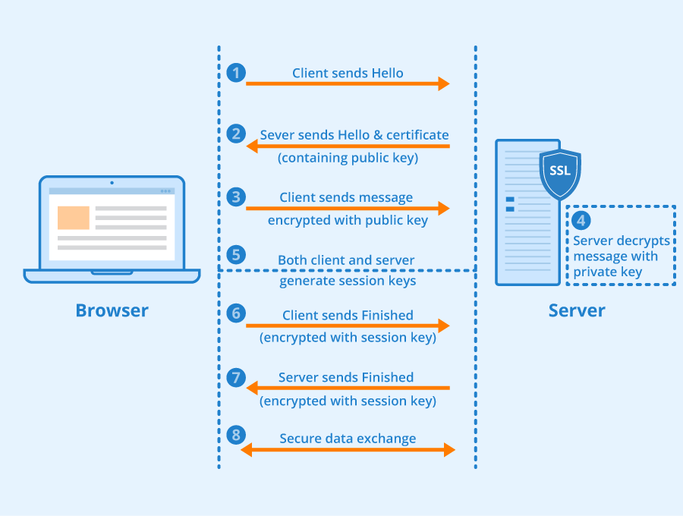
HOW HTTPS WORKS

Slide 8
KEY DIFFERENCES BETWEEN HTTP AND HTTPS
HTTP | HTTPS
HTTP stands for Hyper Text Transfer Protocol. | HTTPS stands for Hyper Text Transfer Protocol Secure.
URL begins with “http://”. | URL starts with “https://”.
HTTP Works at the Application Layer | HTTPS works at Transport Layer.
HTTP speed is faster than HTTPS. | HTTPS speed is slower than HTTP.

Slide 9
CONCLUSION
ICMP is essential for monitoring and troubleshooting network issues.
HTTPS ensures secure and private communication over the internet.
Understanding these protocols is key for maintaining a safe and reliable network environment.

