Slide 1

LDAP
Understanding LDAP (Lightweight Directory Access Protocol)

Slide 2

AGENDA
Introduction
What is LDAP?
How LDAP Works
LDAP Structure
Benefits of LDAP
LDAP vs Database
Real-world Applications
Conclusion

Slide 3
INTRODUCTION
LDAP is a crucial protocol for accessing and maintaining distributed directory information services.
This presentation covers LDAP’s purpose, how it works, its structure, benefits, and real-world uses.

Slide 4
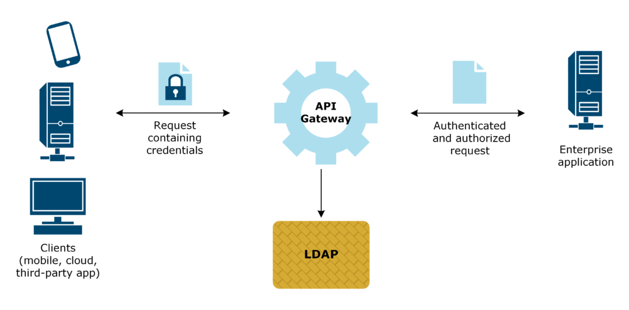
WHAT IS LDAP?
LDAP is a crucial protocol for accessing and maintaining distributed directory information services.
This presentation covers LDAP’s purpose, how it works, its structure, benefits, and real-world uses.

Slide 5
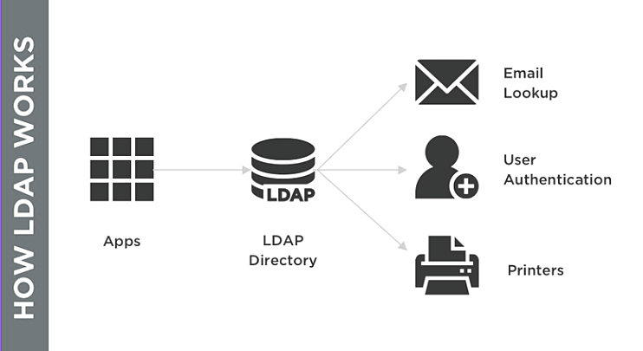
HOW LDAP WORKS?

Slide 6
BENEFITS OF LDAP
LDAP uses a tree-like structure.
The top level is the root.
Below the root are branches (e.g., organizational units).
Leaf nodes represent individual entries like users or devices.

Slide 7
Feature | LDAP | Database
Full Form | Lightweight Directory Access Protocol | Database Management System
Purpose | Directory services | Data storage and retrieval
Structure | Hierarchical tree | Relational tables
Query Language | LDAP Search Filters | SQL
Use Case | Authentication, directory services | Transactional data, complex queries
LDAP vs DATABASE

Slide 8
CONCLUSION
LDAP is essential for managing directory-based information.
It offers centralized, scalable, and flexible solutions.
Widely used in enterprise IT environments.

